Slide 1
Project Activities for MSD
Mayling Wong-Squires
AD Operations Friday 9am Meeting
26 July 2024

Slide 2
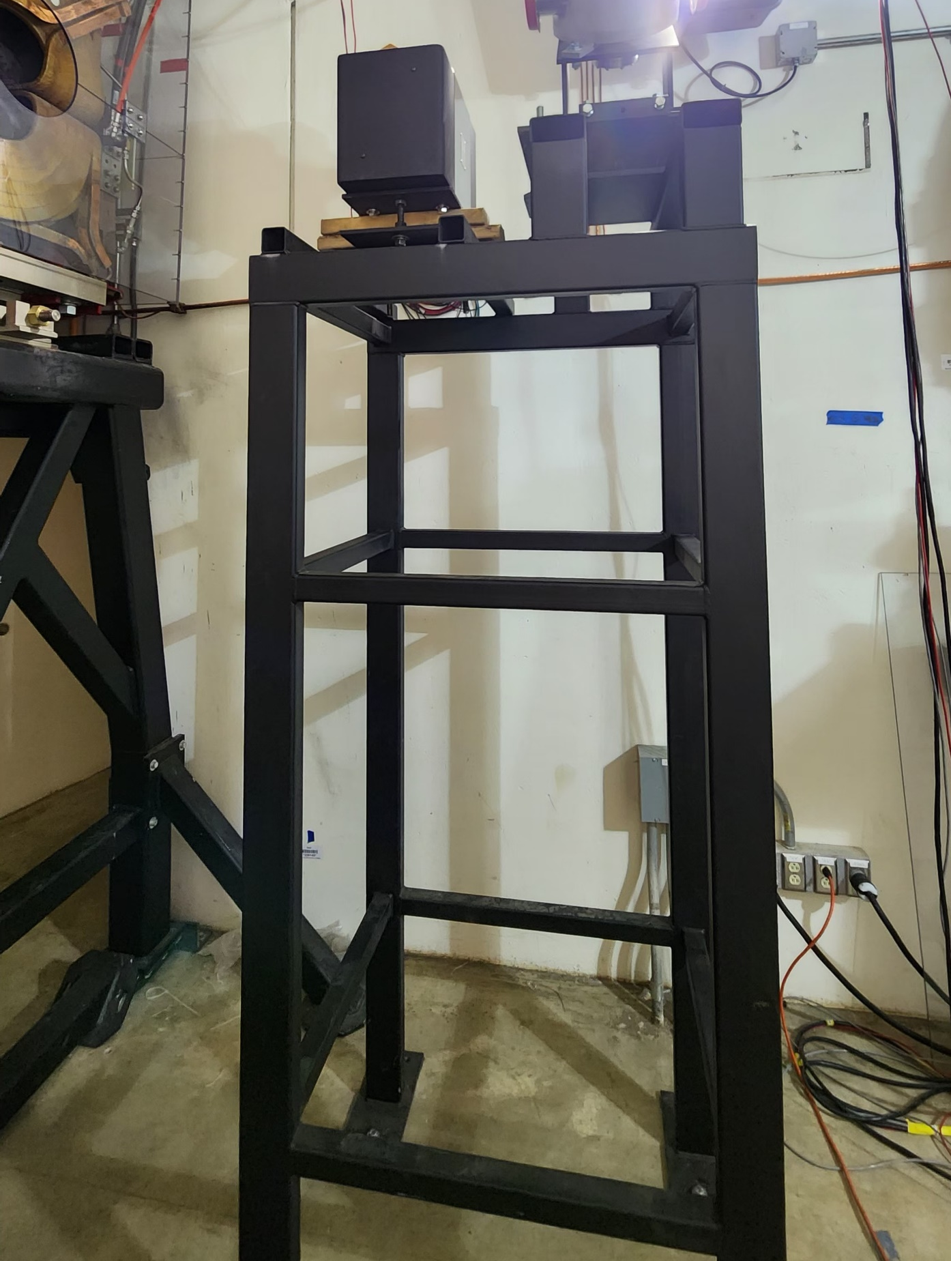
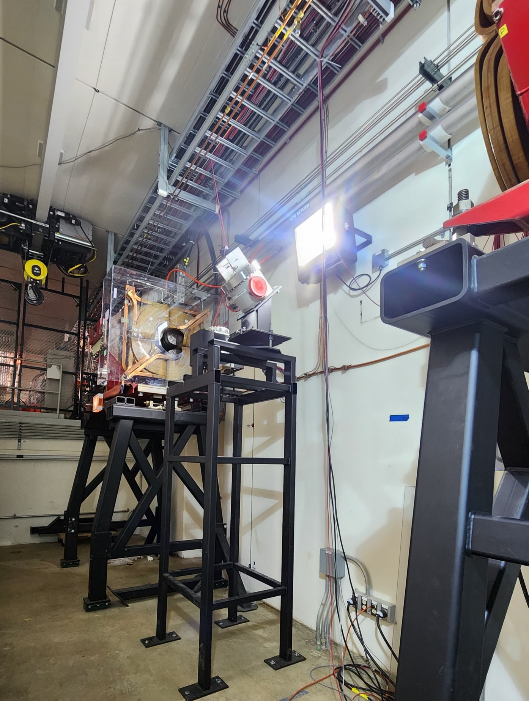
Mu2e Beamline Chris Ader, Jason Morin, Pat Minton, Dirk Hurd, Dan Vrbos, Jason Kubinski, Greg Bulat
Current Status
Stand in Final Focus area (see photos to the right) has been put in place with ion pump and multi-wire on it. Await termination and installation of power cables on magnets.
All magnets but one has been modified. The one magnet that still needs the hardened tubing is not installed will not slow us down from installing the beam line for final focus.
Coming up
Planning and procurement package for the installation of the entrance and exit collimators is still in progress. We are also still waiting for the metrology data from the physicist for the beam-line.
Department resources needed
Engineering (collimator installation planning and oversight)
Technician (assembly, testing of septa cart) and planning of collimator installation. One cart has been tested and used. The 2nd cart has all the parts and will be load tested next week if nothing more pressing comes up.
Fabrication Procurement (septa cart modifications) We have the parts on hand and will test cart next week.

Slide 3
PIP-II Vacuum Systems Lucy Nobrega, Sherese Humphrey, Alex Chen, Rich Andrews, Eric Pirtle
Working on
Procurement of Warm Front End and Superconducting Linac vacuum equipment
Writing travelers and finalizing handoff documentation
Final design for Beam Transfer Line and Beam Absorber line
Detail BTL/BAL Vacuum CAD model and magnets interspaces configurations with input from stakeholders: MagPS, BI, BTL/BAL Installation
Vacuum chamber design for dipole magnets (quantity 40) in coordination with MagPS
Final design of interfaces with Beam Instrumentation devices, Booster vacuum, Beam Absorber Line
Validation of equipment selection with vacuum pressure and structural simulations
Addressing review recommendation: review of vacuum analysis (K Duel)
Finalizing designs of laserwire UHV chamber, commissioning cart, wide aperture BPM’s (D Krokosz)
Finalizing design of laserwire optics and adjustment stages (T Price)
Department resources needed
Engineering: instrumentation design design
Vacuum technician for acceptance testing and vacuum cart assembly (starting October)
Fabrication Procurement: BTL dipole & septum chambers
Design/Drafting: BTL design & integration (E Pirtle)

Slide 4
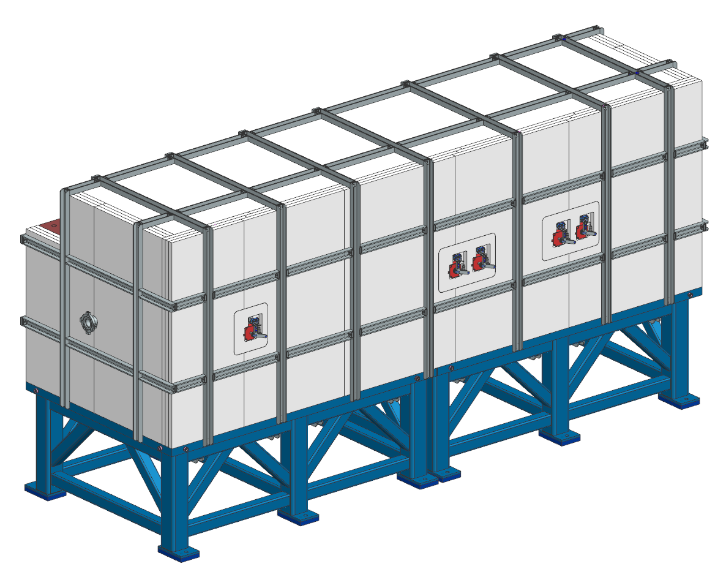
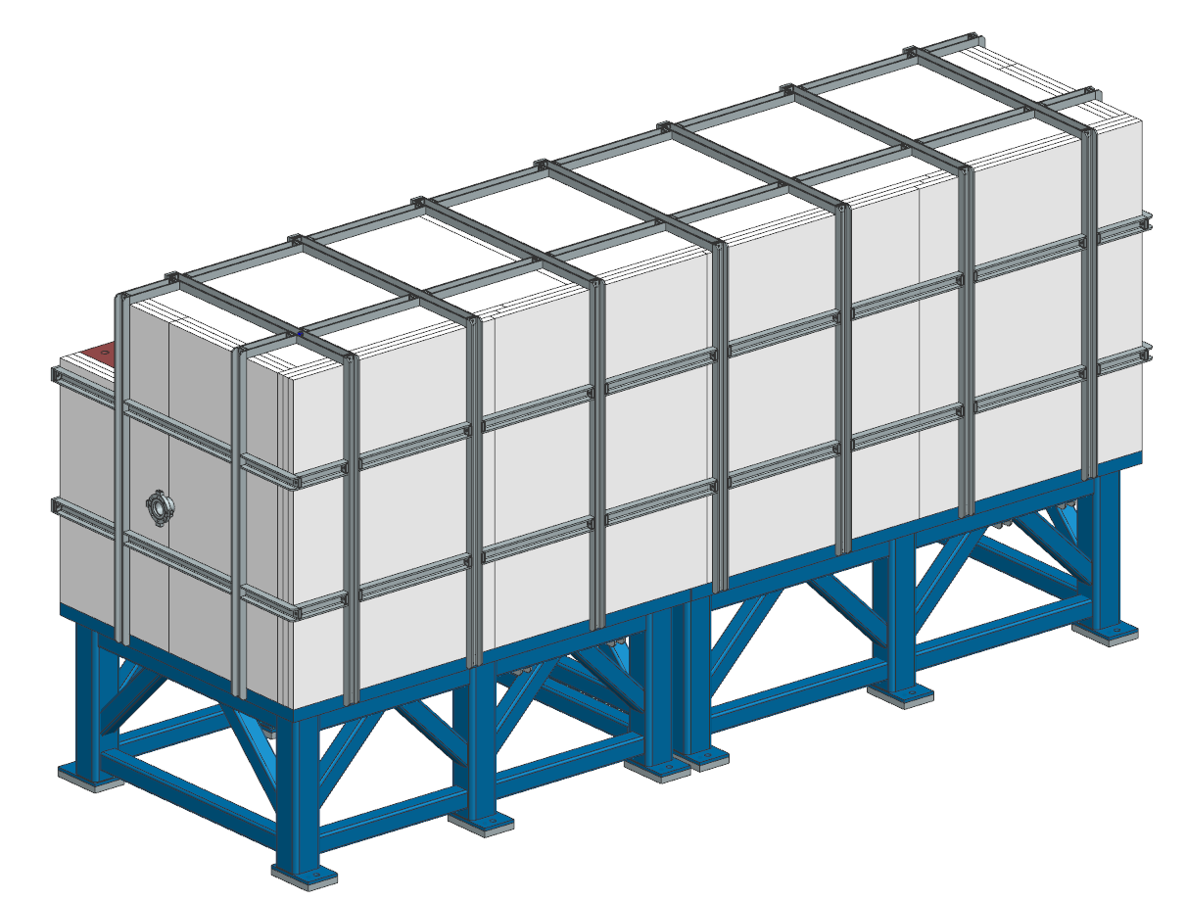
PIP-II BTL Collimators
MSD personnel involved
Bob Donahue – engineering
PRR deliverables are complete
Engineering note approved and released
All drawings released
Currently working on PRR procurement spreadsheet
Schedule PRR this month
Initiate procurements/fabrications after PRR complete
Horizontal collimator
Vertical collimator

Slide 5
LBNF Primary Vacuum and Magnet Installation Kevin Duel, Ty Funk, Jason Morin, Parth Gandhi, Peggy Jones, Kathrine Laureto, Dirk Hurd, Scott Oplt
Primary Vacuum
Beamline vacuum drawings continue to be released
Remaining work is finalizing installation drawings
Kicker ceramic beam tube TiN coating
Waiting for 12” long tube samples from vendor
Kicker magnet top level assembly drawing work continues
Finalizing relocation of MI components the LBNF beamline interferes with at MI-10
Magnet Installation
Quad installation procedure writing in process
Corrector magnet installation fixture drawings being finalized
Primary Beam Enclosure dipole stand design completion activity in progress
Review of NuMI magnet retrieval procedures starting soon
Some quad magnets will be used in LBNF

