Slide 1
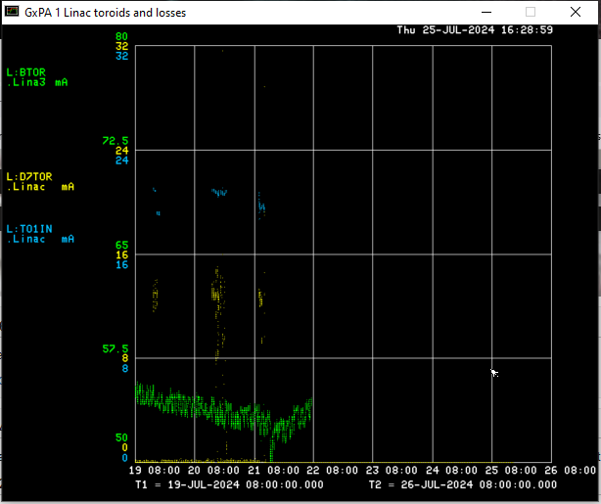
LINAC Shutdown Week 2
Shutdown activities this week:
Source B pulled out
Water skid maintenance
Klystron maintenance
Klystron LOTO test point installation
CUB Outage Saturday
Feeder 40 Power Outage Sunday
Sunday
Studies completed
Linac turned off
Monday
Ion Sources turned off
Tuesday
Linac in Supervised Access
Next week:
Source B cesium boiler fill
Klystron LOTO test point installation continues
LE maintenance
Klystron maintenance

