Slide 1
Mu2e report
Tom Diehl (FNAL), Greg Rakness (FNAL)
Friday 9am AD meeting
26-July-2024
https://indico.fnal.gov/event/65666/

Slide 2
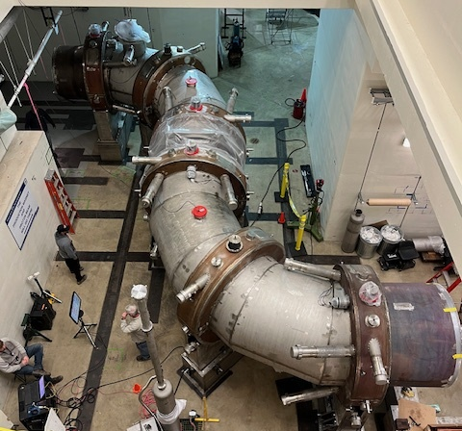
Recall: Mu2e physics process
105 MeV electron
8 GeV protons
Production Target
Muons
Stopping Target
Calorimeter
Tracker

Slide 3
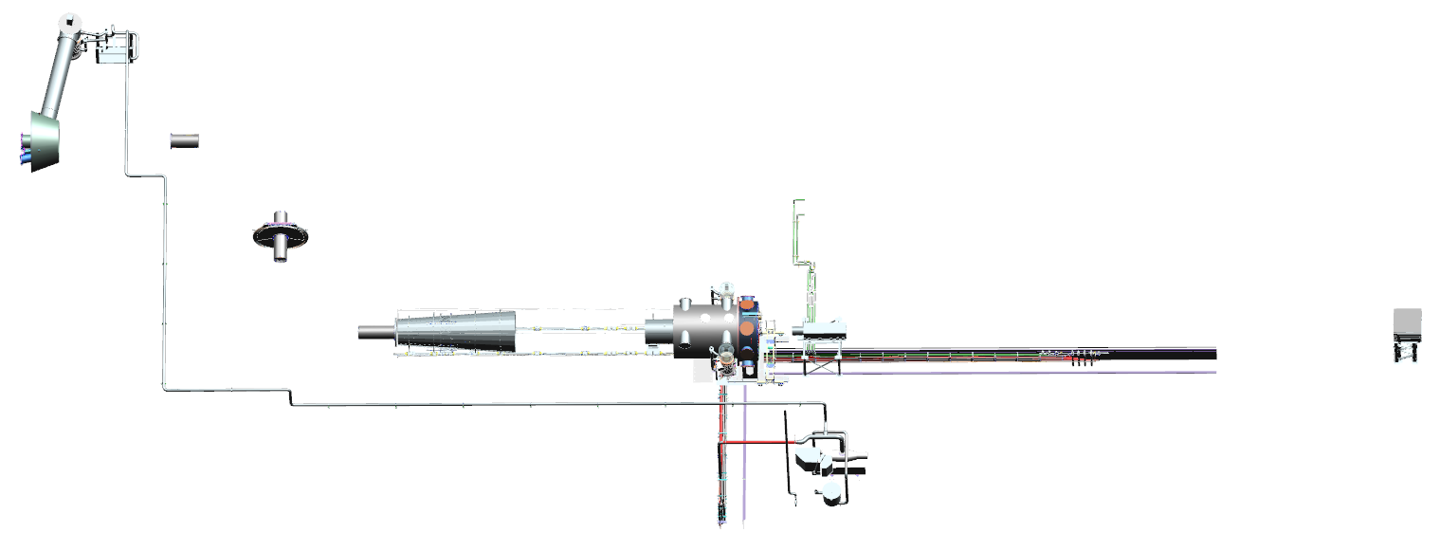
WBS 475.05 Muon Beamline Scope
Modified from G. Ginther (mu2e-docdb-49052)
Transport Solenoid
  Collimation system selects muon charge and momentum range
  Anti-proton window in the middle of central collimators
Upstream MB Vacuum Diffusion Pump
COL1 Collimator
Vacuum Pump Spool Piece
COL3u Collimator
Instrumentation Feedthrough Bulkhead
Antiproton Window Housing
PS End Cap
Muon Beam Stop
COL3d Collimator
Stopping Target Monitor
Upstream Infrastructure
COL5 Collimator
Muon Stopping Target
DS Internal Shielding
Stopping Target Monitor
Downstream Infrastructure
MB Vacuum Bypass Line
MB Vacuum Roughing System

Slide 4
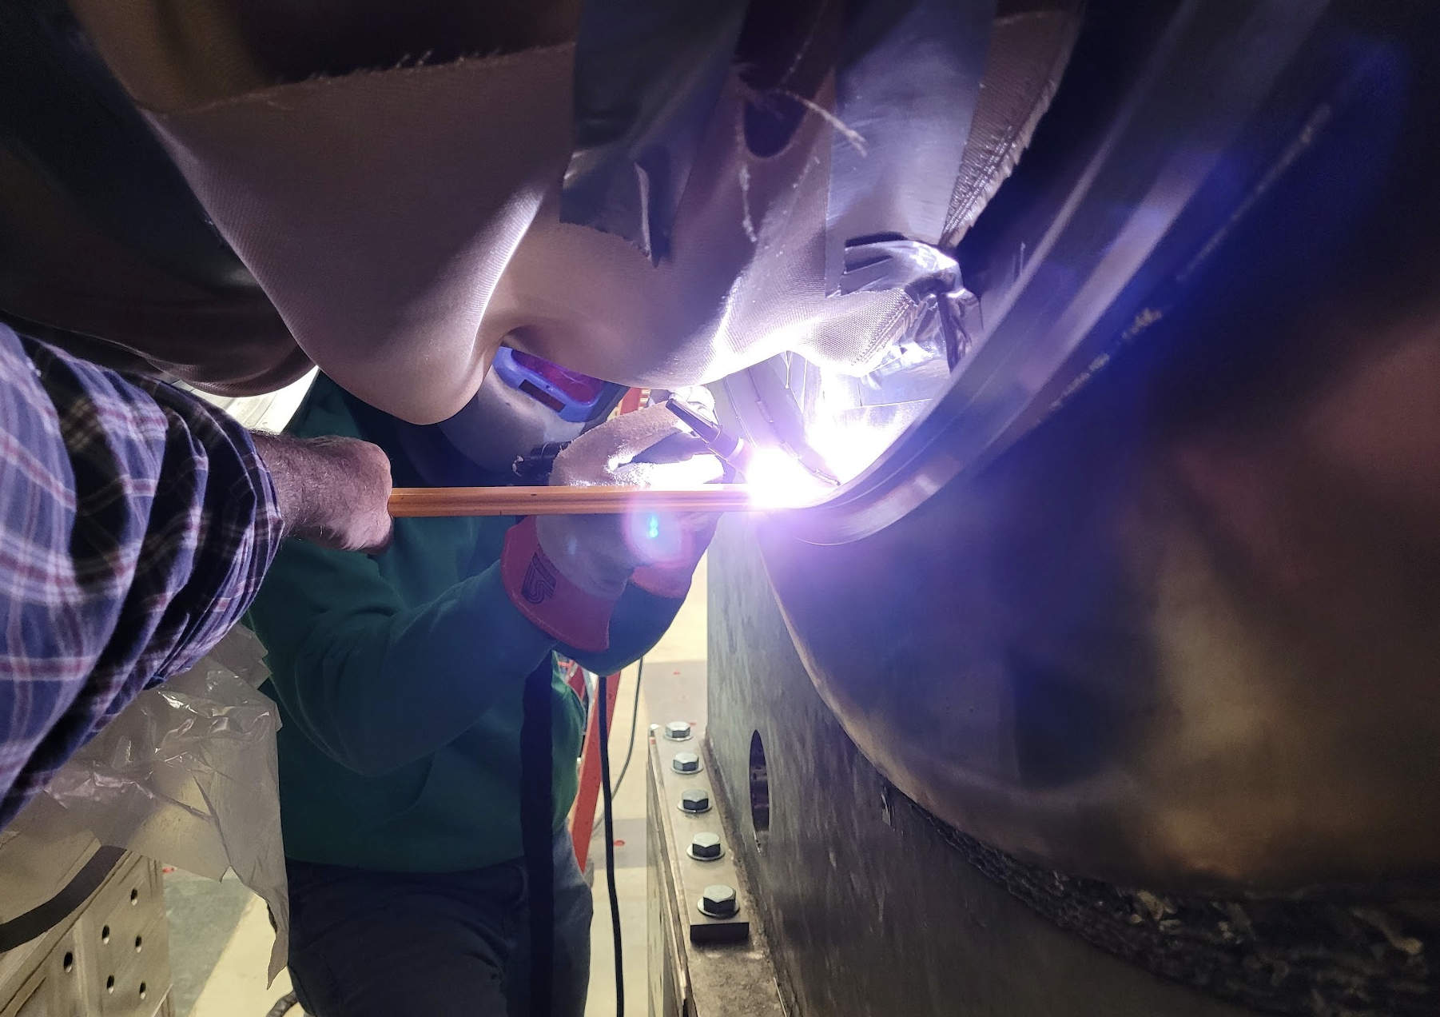
Mechanical interconnect between TSu and TSd…
… must minimally satisfy:
Robustness (magnetic forces)
Space (magnetic field uniformity)
Vacuum (target lifetime)
Rotatable collimator (muon sign-selection)

Slide 5
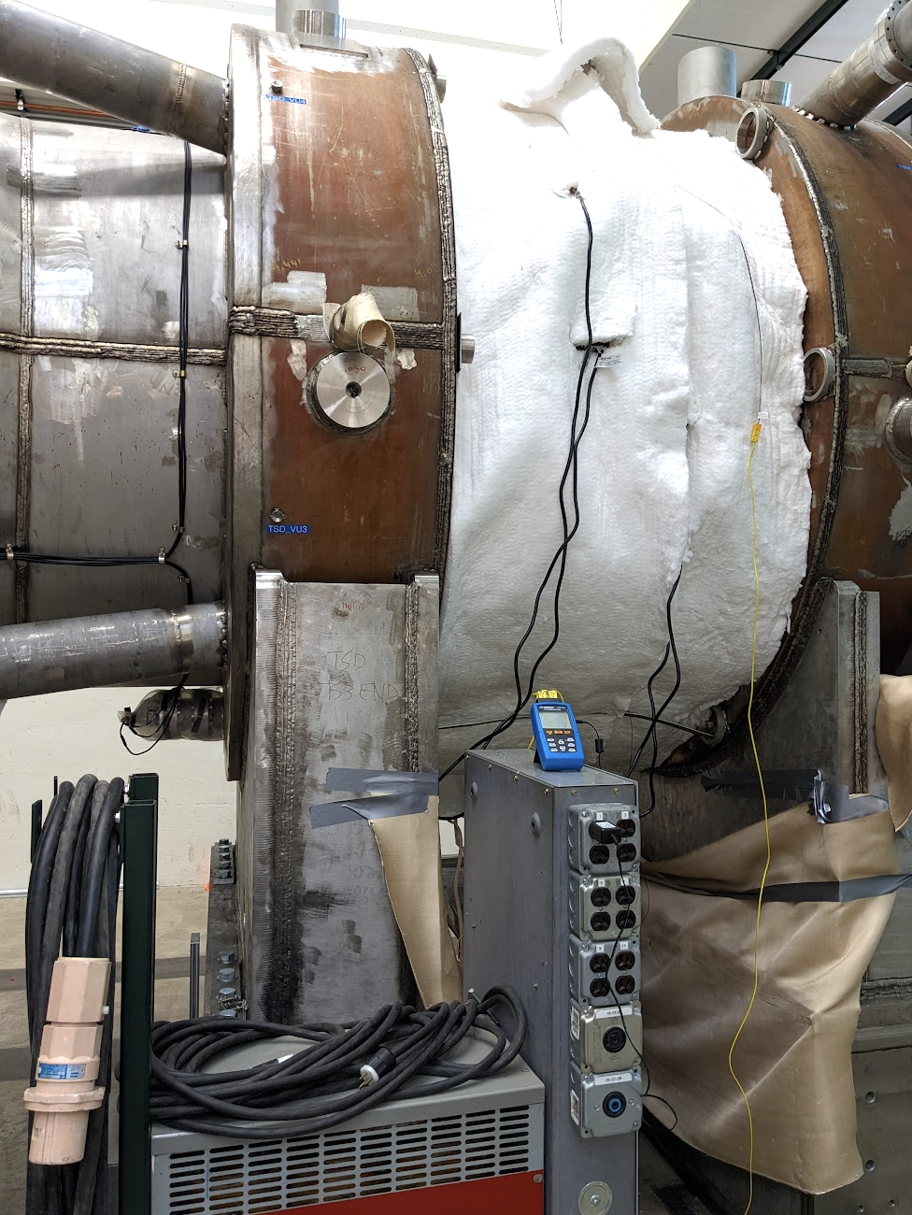
Have developed a scheme to allow rotation of collimators
This means we are nearly ready to make the connections of the solenoids to the cryogenic transfer line
  Making this connection means the final location of the solenoids are fixed

Slide 6
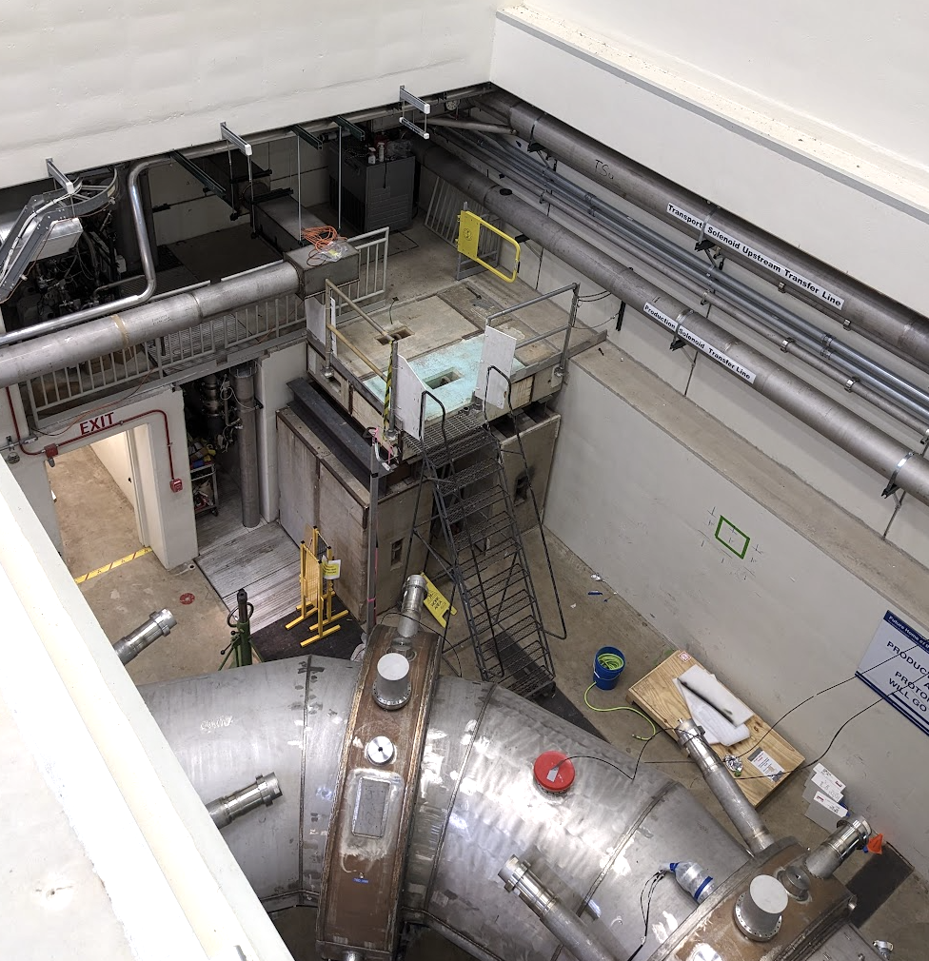
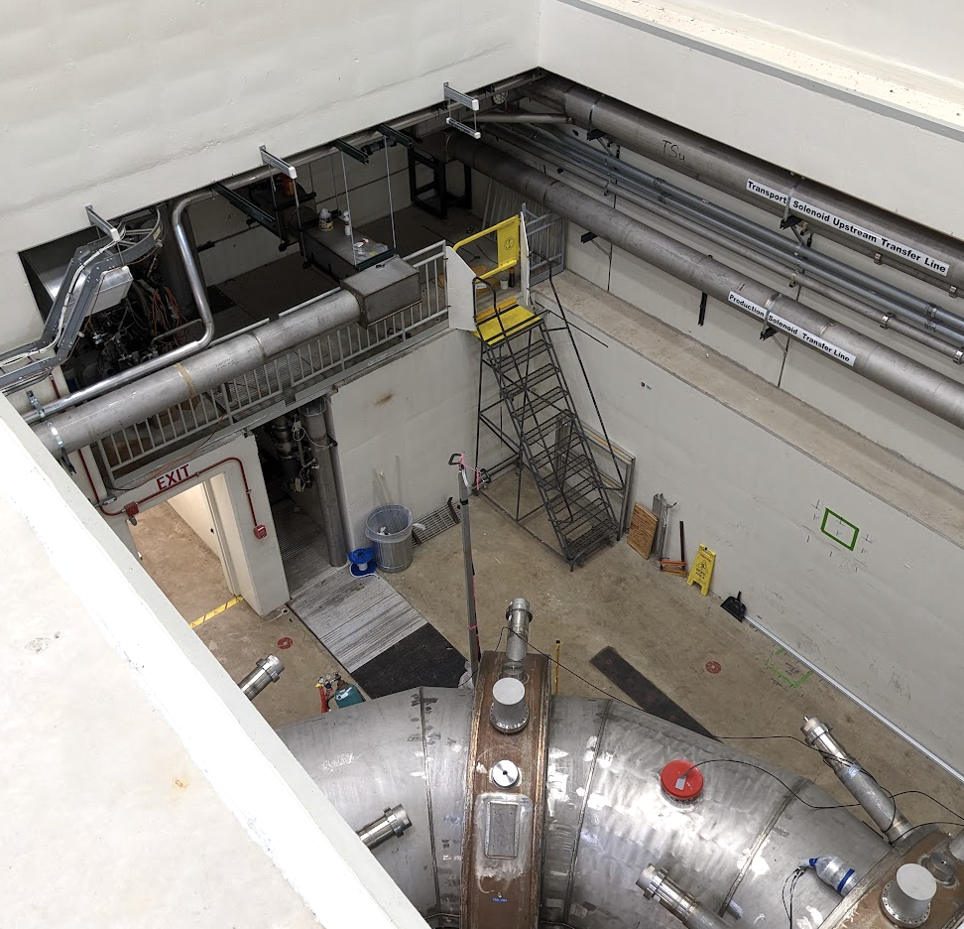
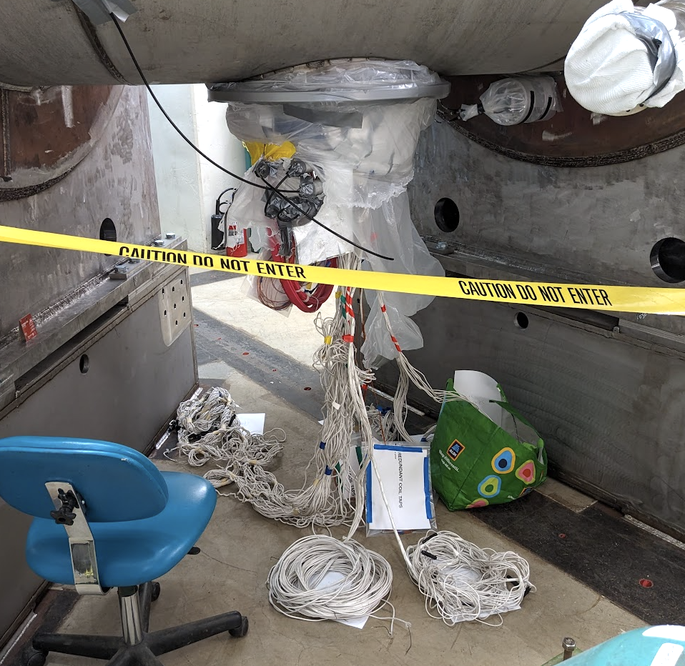
Removed blocks from pipe chase alcove…
Before
Now
.
… allowing us access the TSd connections to the cryogenic transfer line

Slide 7
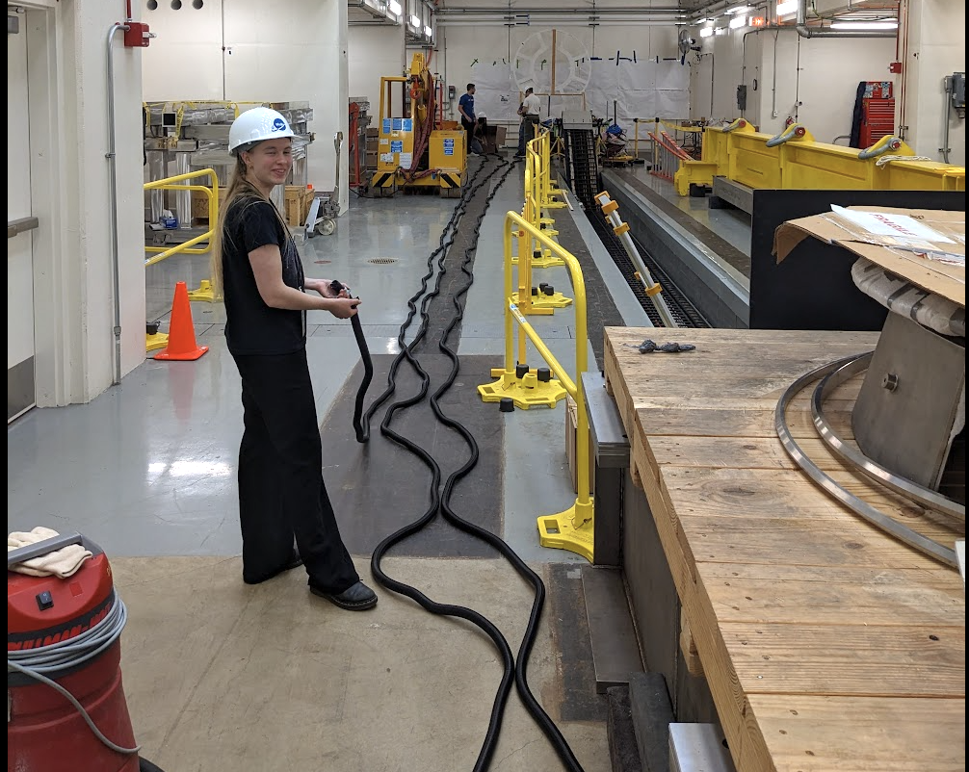
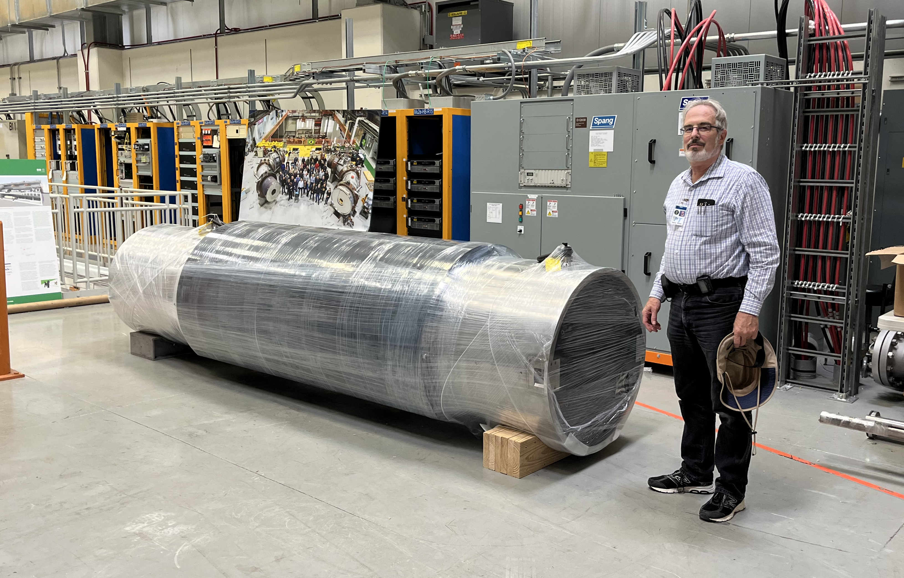
Other work ongoing
Chase
Anthony
Completed installing detector cables
  Rule that every cable in the cable tray has a well-defined label…
  … the last 3x spare conduits are labeled Anthony, Amber, Chase
Muon Beam stop arrived at Mu2e building
Amber

