Slide 1
MQXFA13b SG Data during Testing
L. Garcia Fajardo, D. Cheng, P. Ferracin, G. Vallone
07/29/2024
LBNL

Slide 2
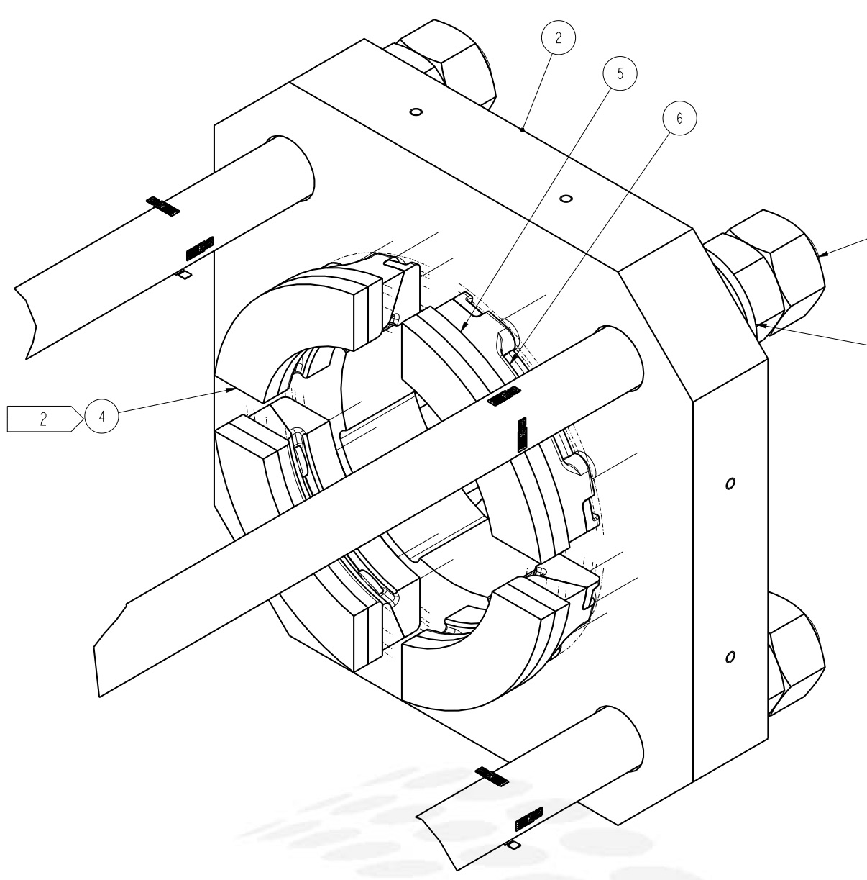
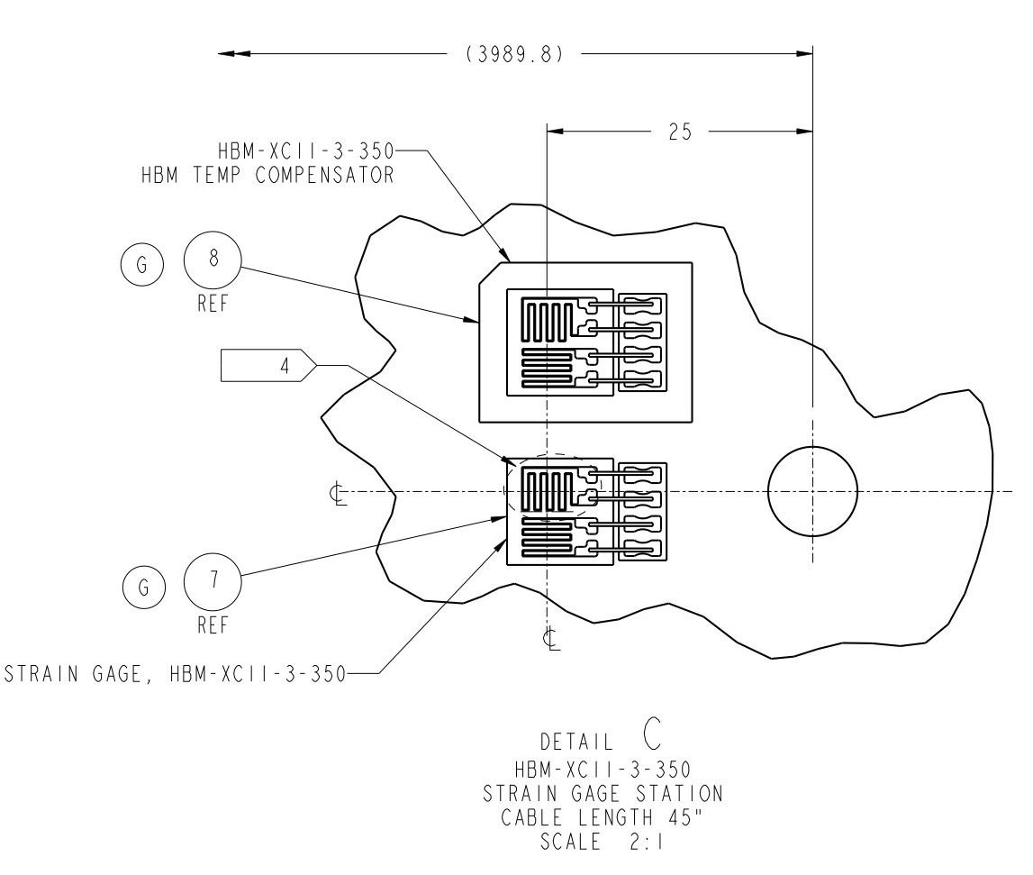
MQXFA SG Gauges Layout
LE
MID
RE
Shell 2
Shell 4
Shell 7
Coil Stations
Rod Stations
Only HBM gauges are installed.
Shell gauges --- three axial locations:
Shell gauges (T & Z): on shell 2, 4, & 7
Coil gauges (T & Z): on the axial location of 3989 mm (RE) from LE.
Rod stations are located on the RE
Each station is full bridge with four individual gauges.
Coil Stations
RE axial plate assembly

Slide 3
Data Processing Notes for MQXFA13b
No strain data on the coils: Electrical SGs were disconnected before shipping the magnet to BNL, and FBG strain gauges not used during the test.
7/11/24 – 7/16/24 ➔ 1st Cooldown
7/16/24 – 7/17/24 ➔ Low power ramps
7/18/24 ➔ Quenches 1, 2 and 3
7/22/24 ➔ Quenches 4 and 5
7/23/24 ➔ Quenches 6, 7 and 8
7/24/24 ➔ Quench 9
7/25/24 ➔ Quench 10

Slide 4
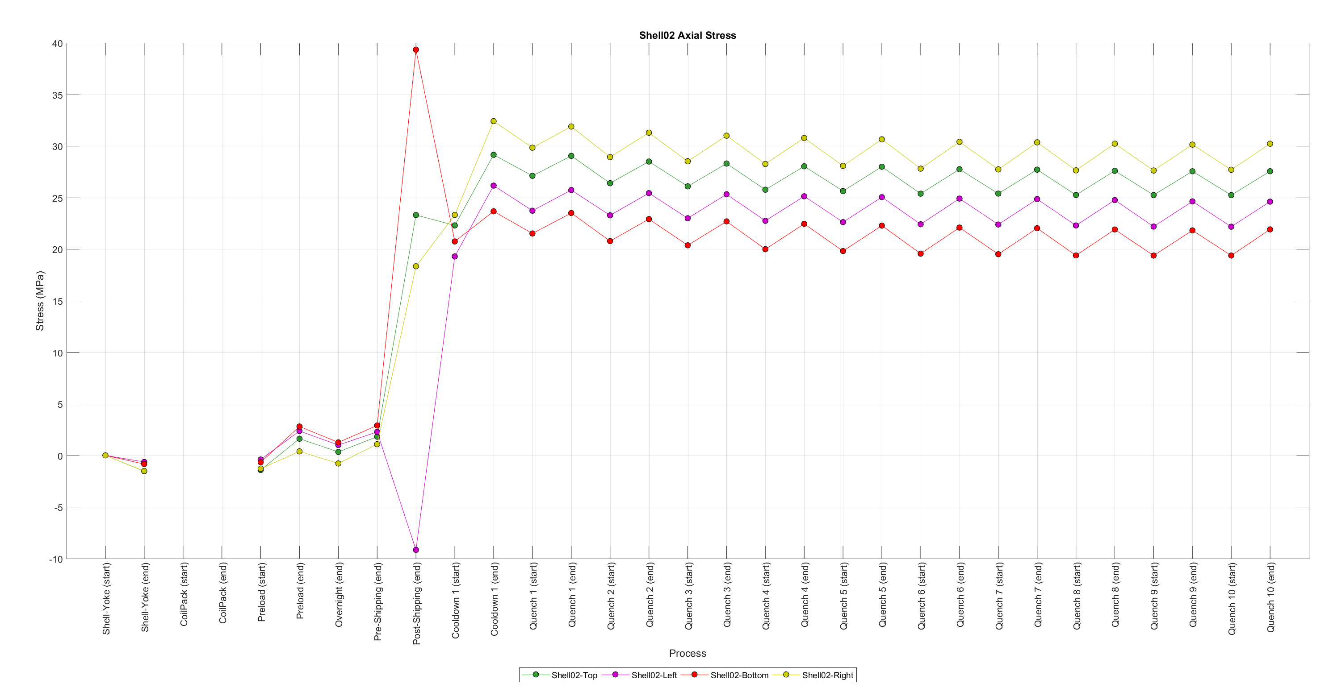
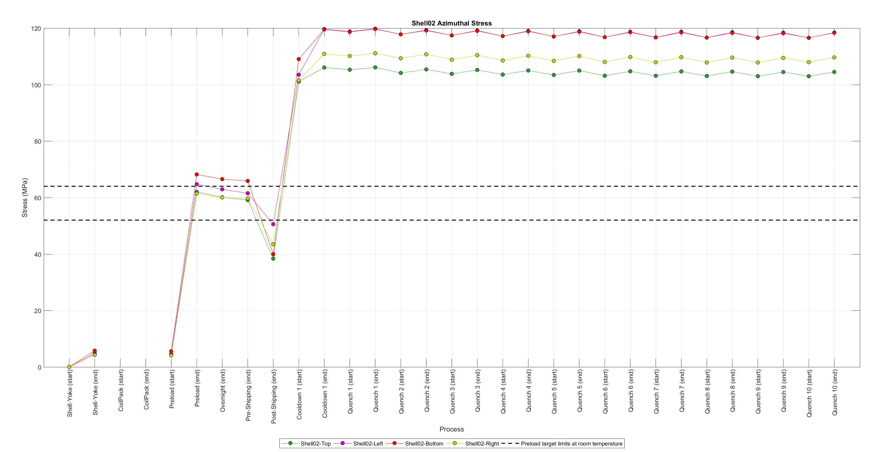
Shell02 stress. History plots

Slide 5
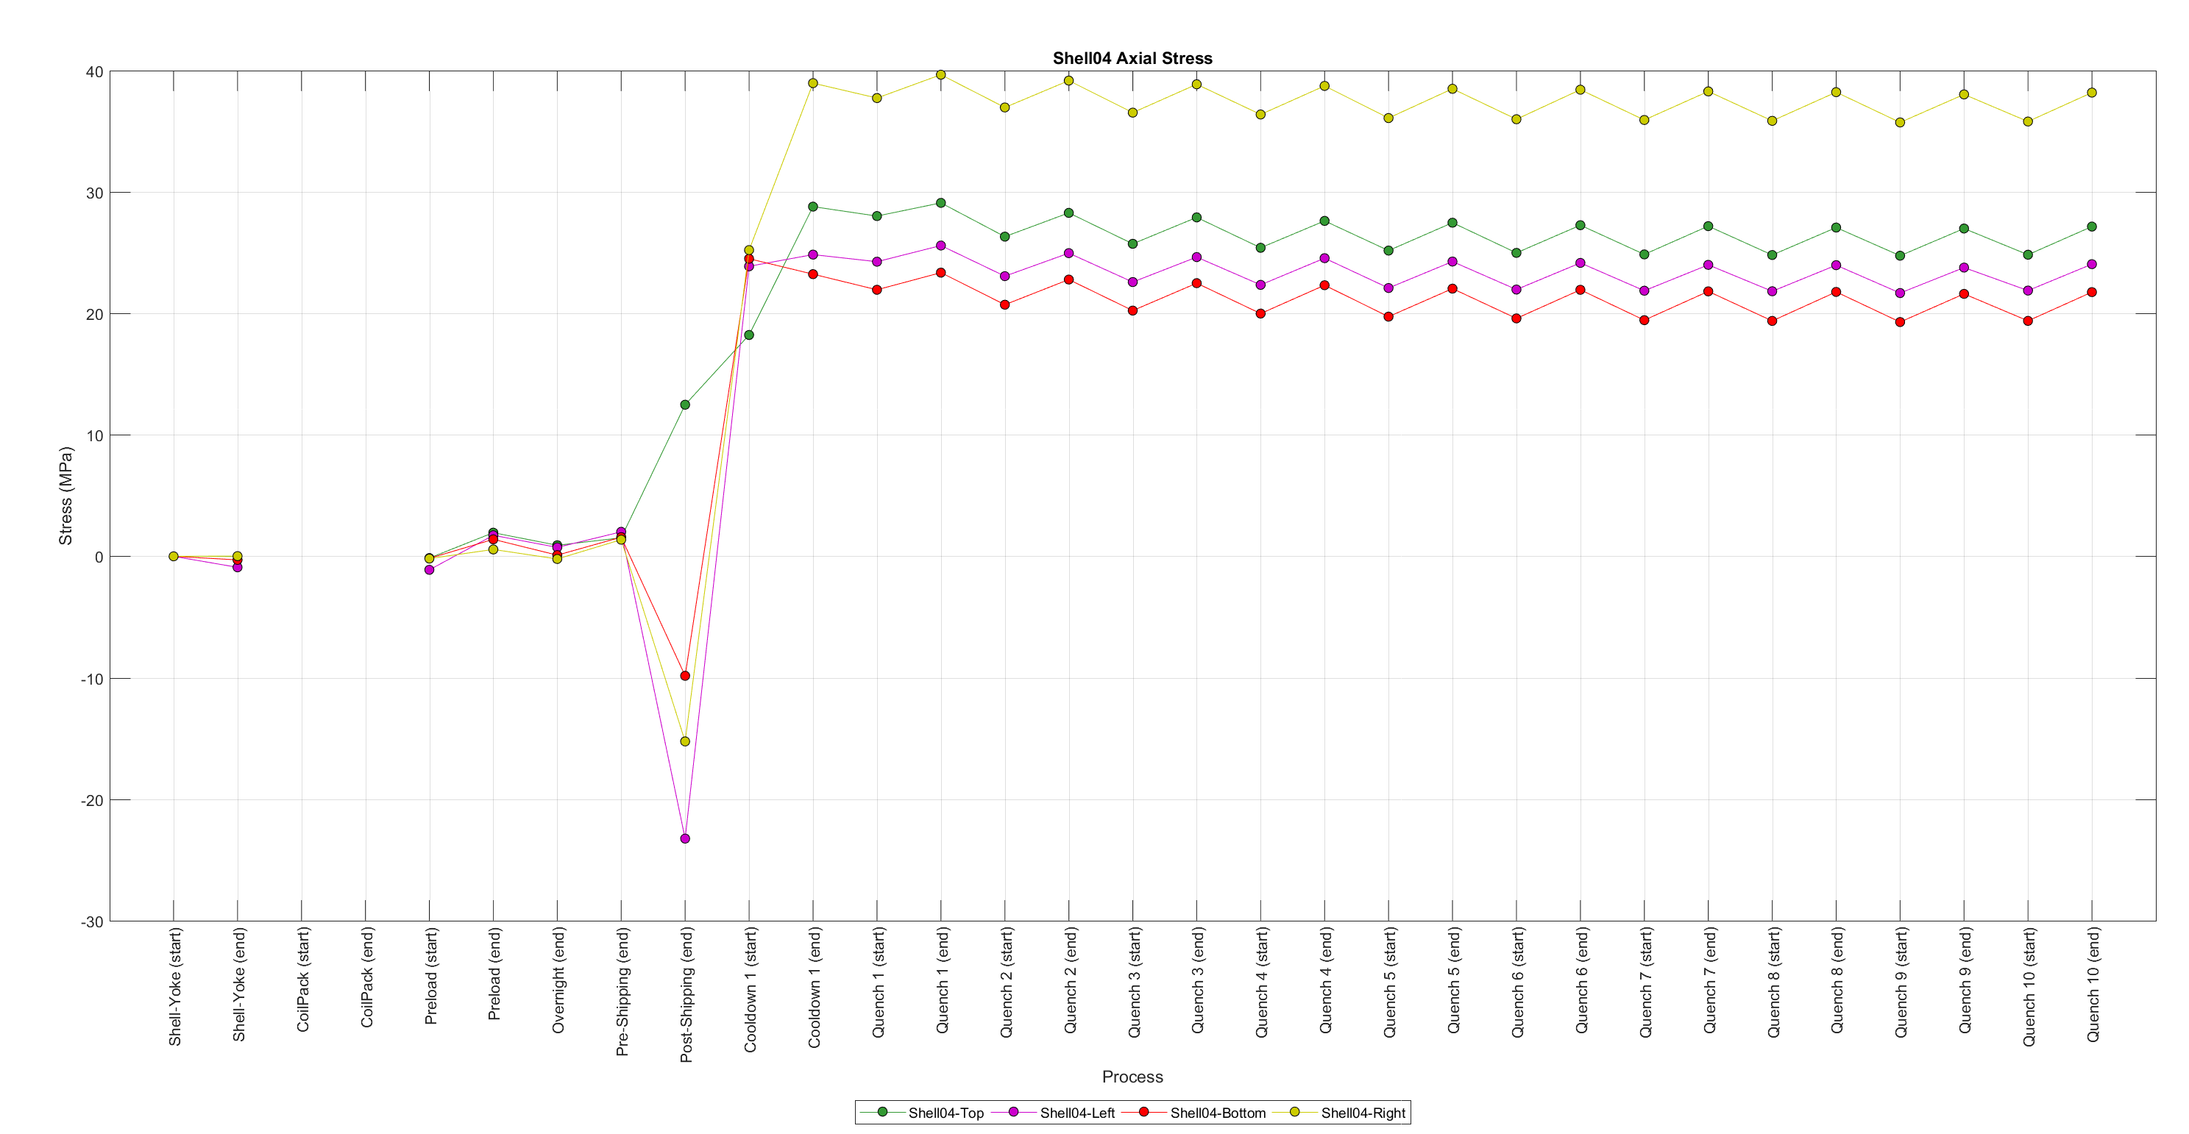
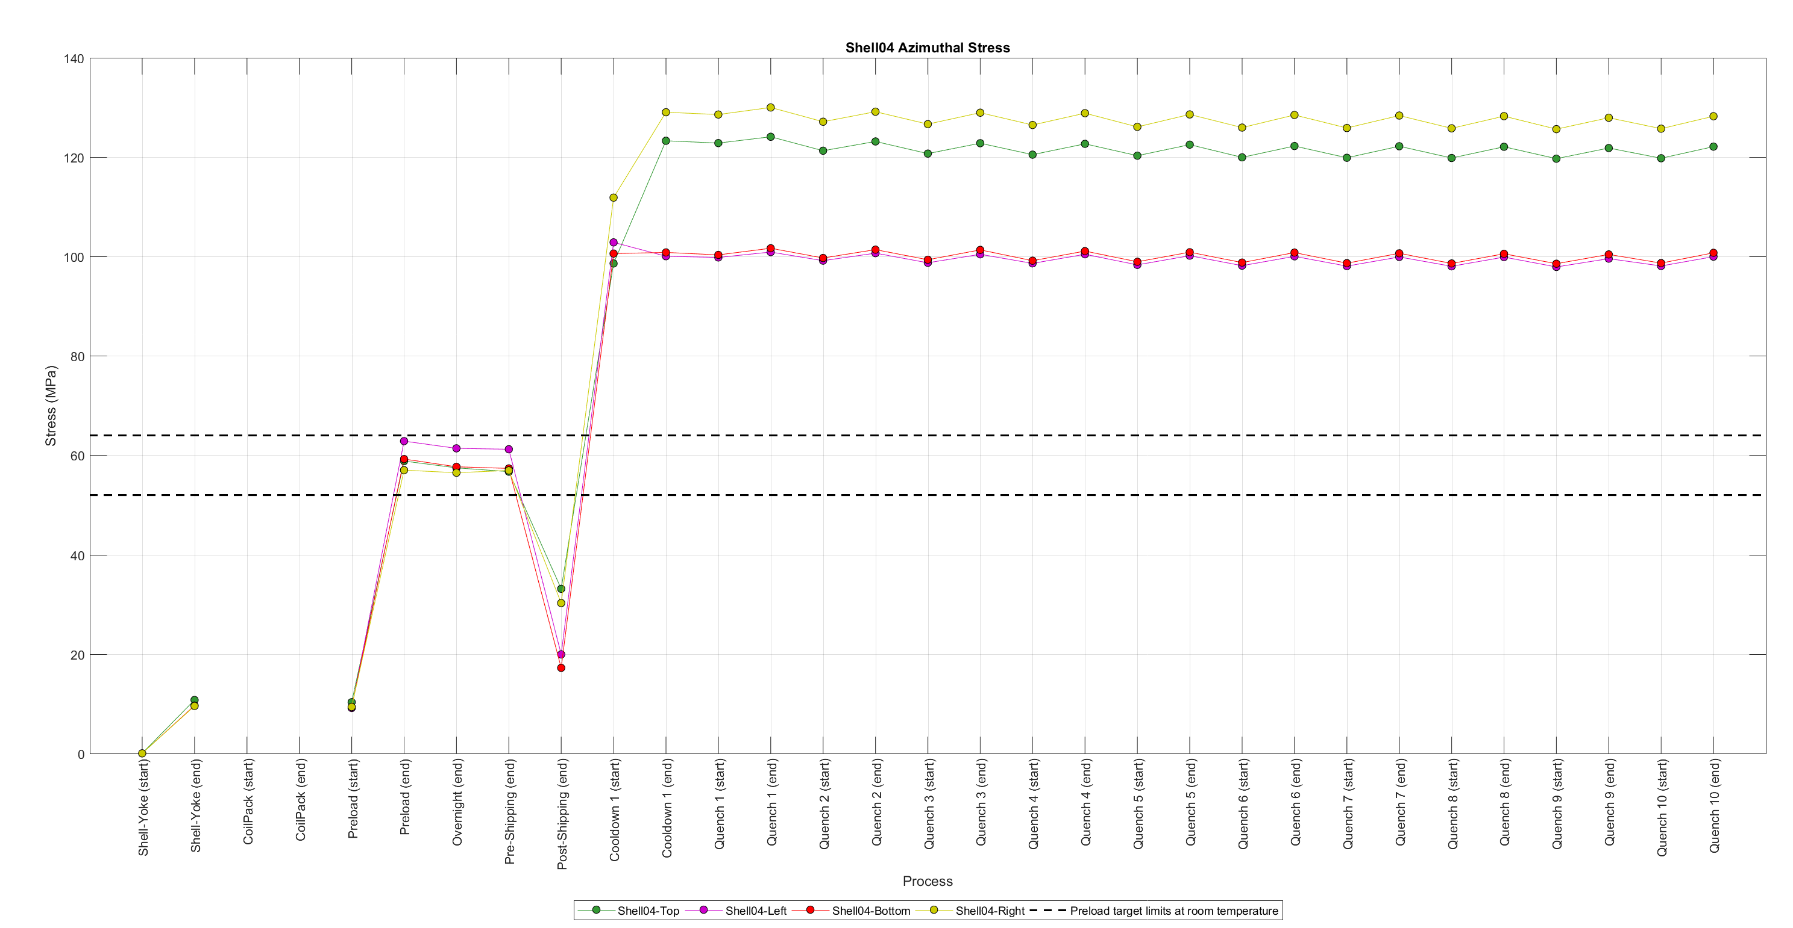
Shell04 stress. History plots

Slide 6
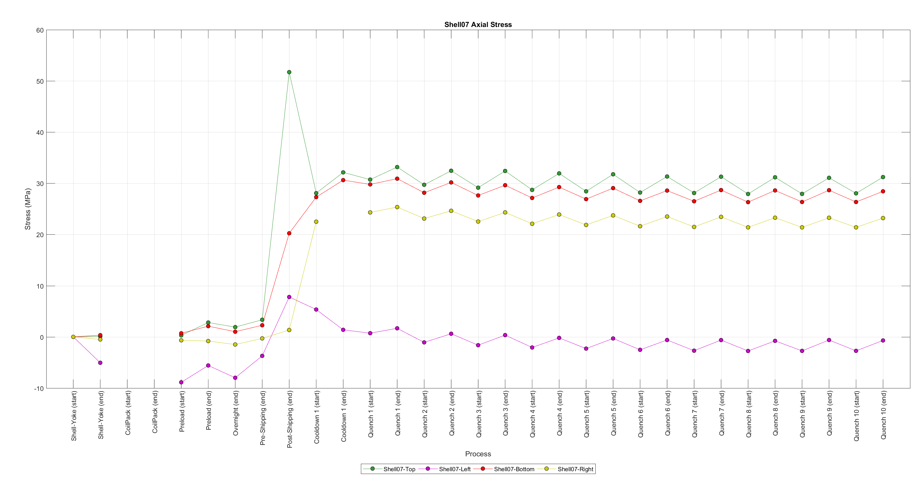
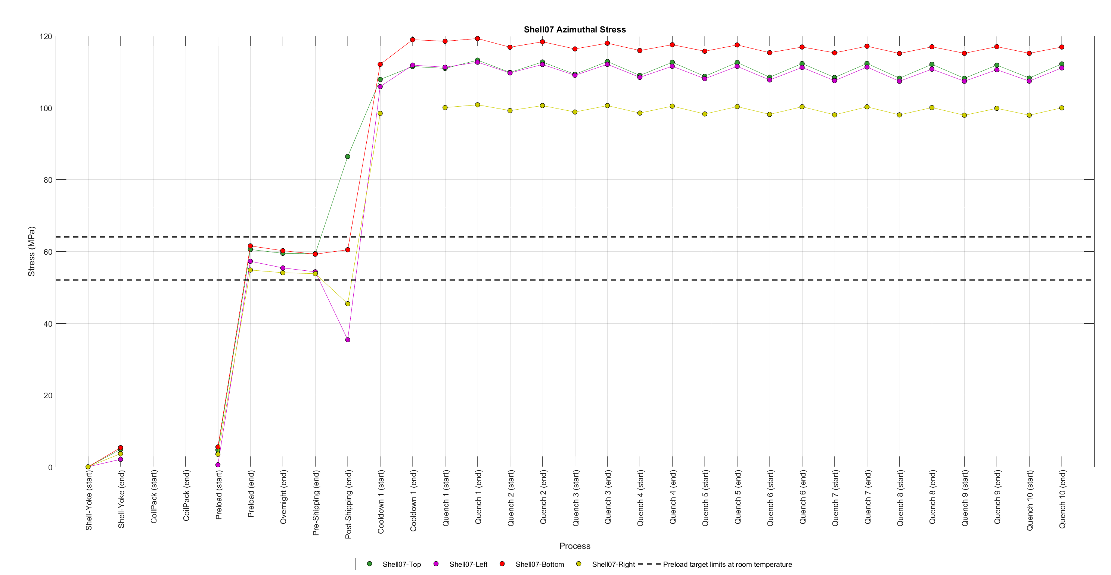
Shell07 stress. History plots

Slide 7
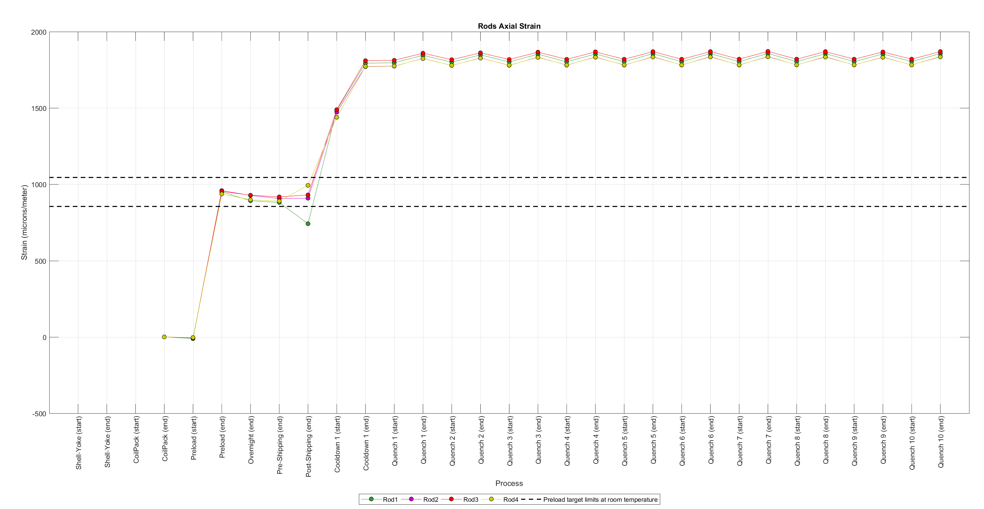
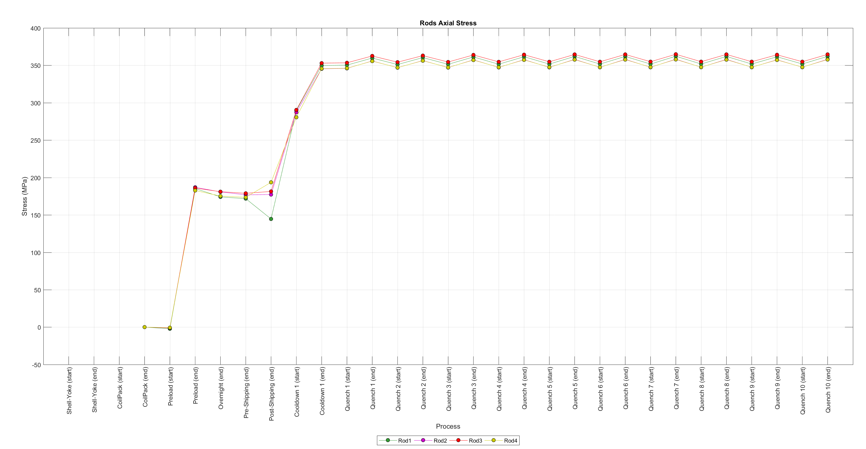
Rods’ strain and stress. History plots

Slide 8
SG Readings in the Cooldown 1

Slide 9
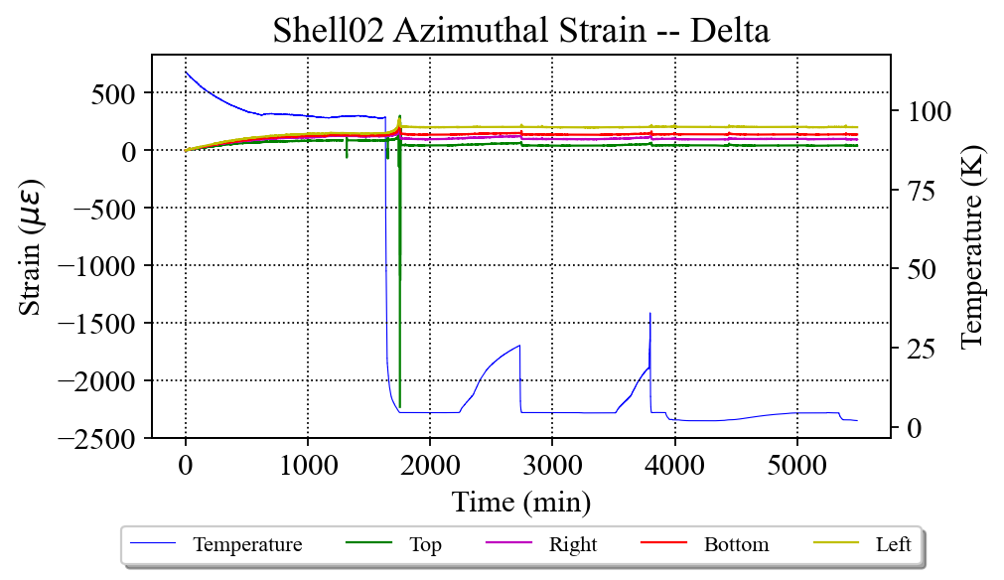
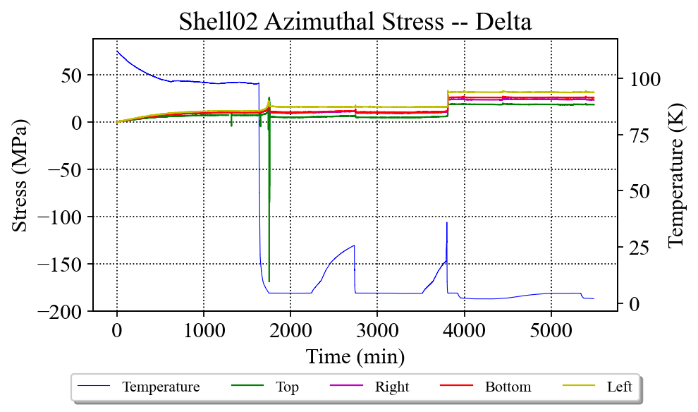
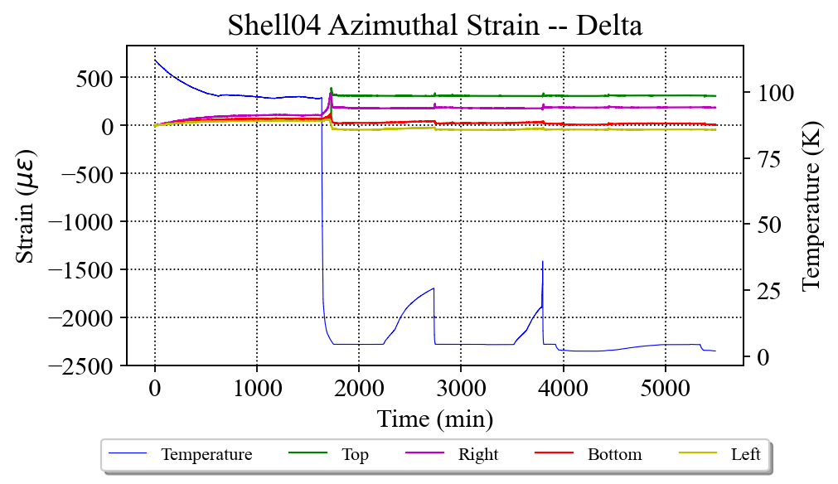
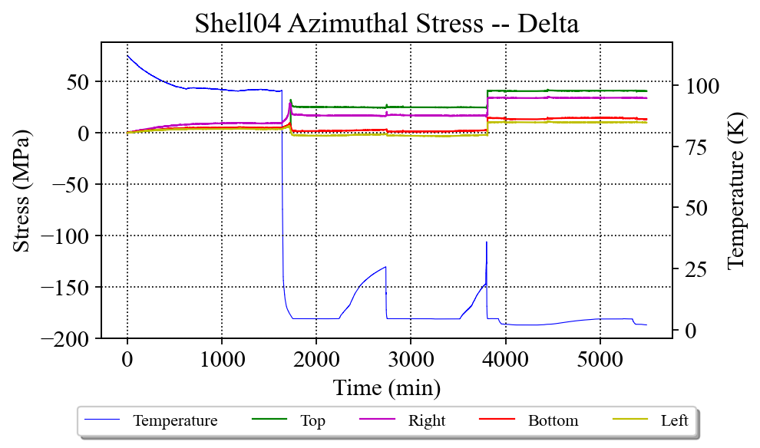
Shells

Slide 10
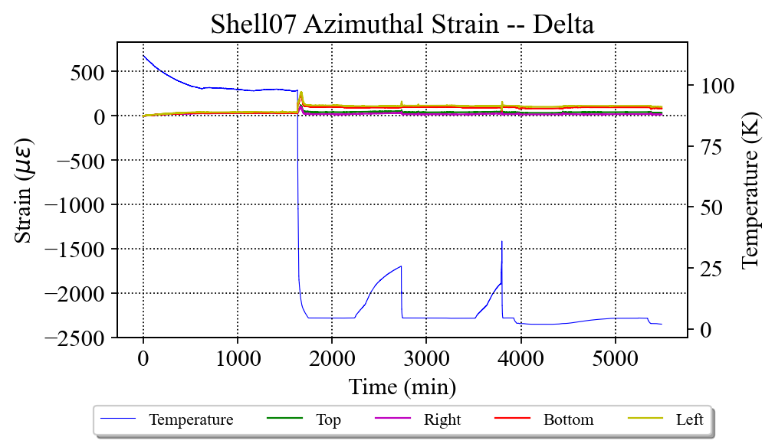
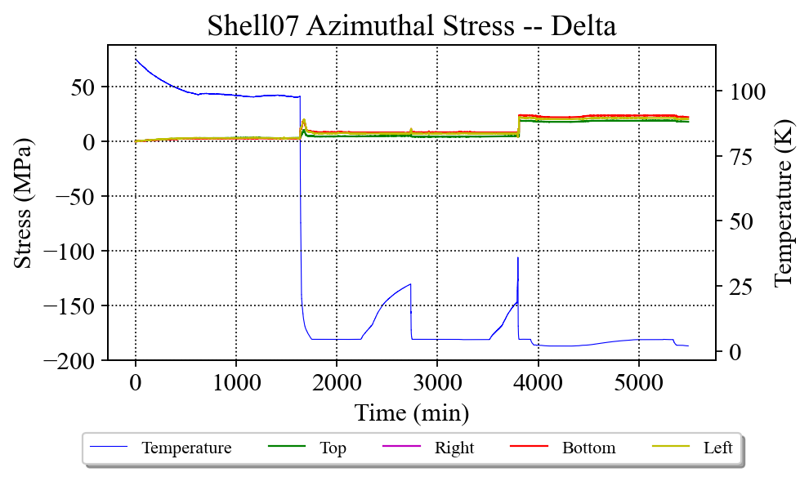
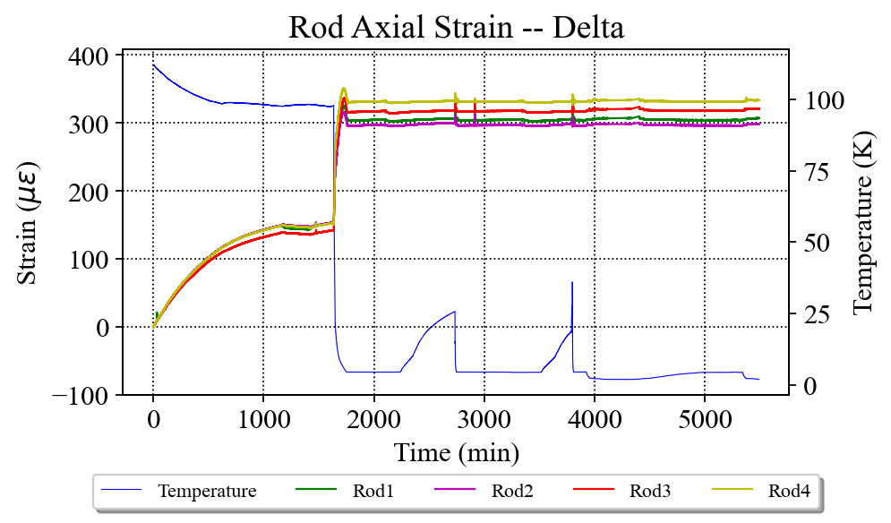
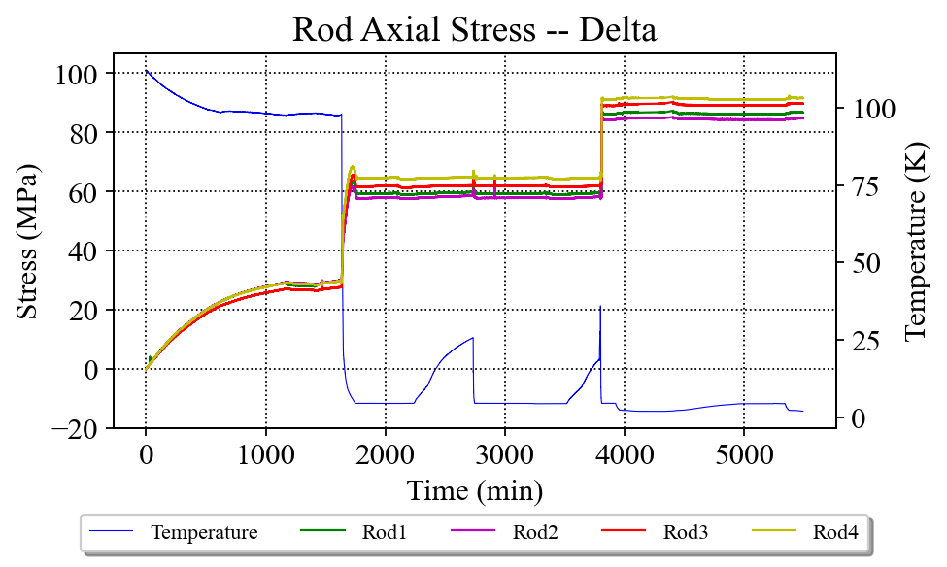
Shells and Rods

Slide 11
Multiplots: Quenches 1-10

Slide 12
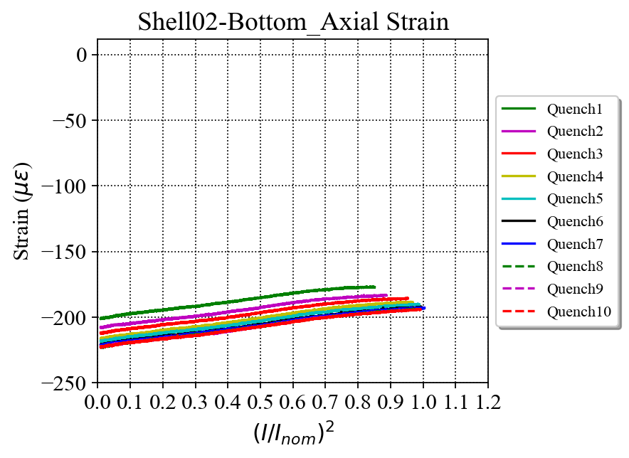
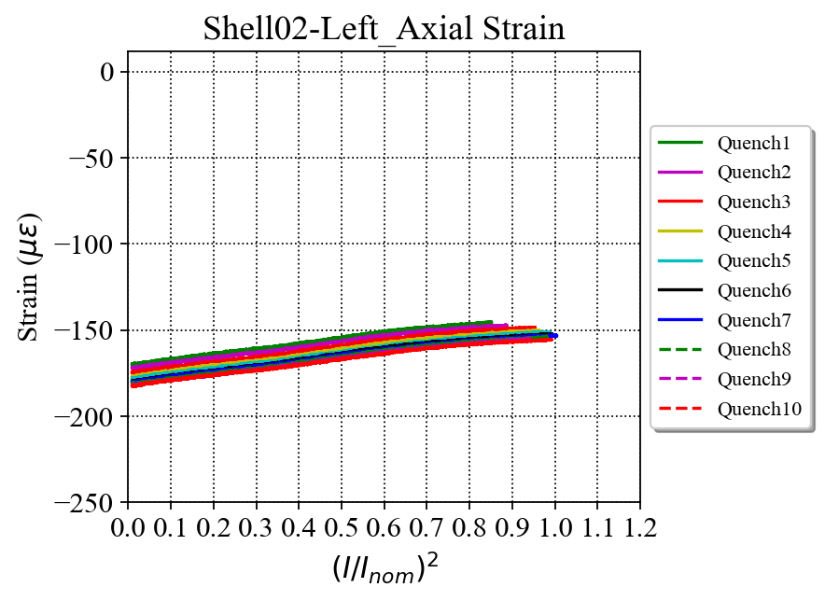
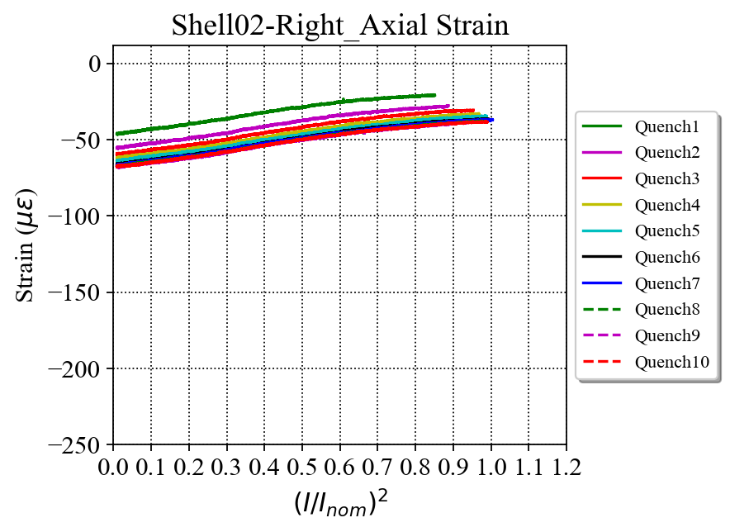
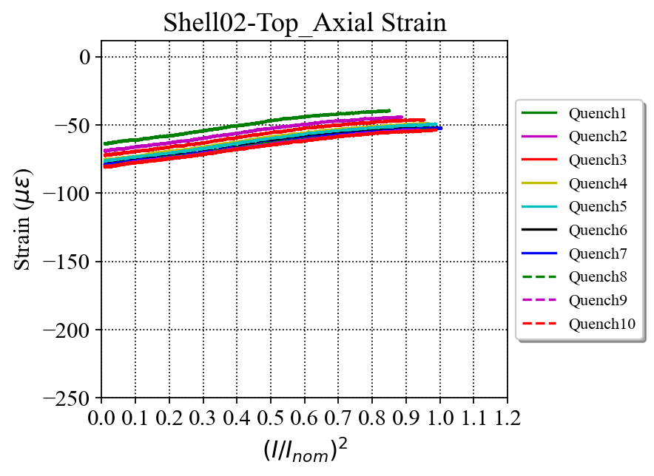
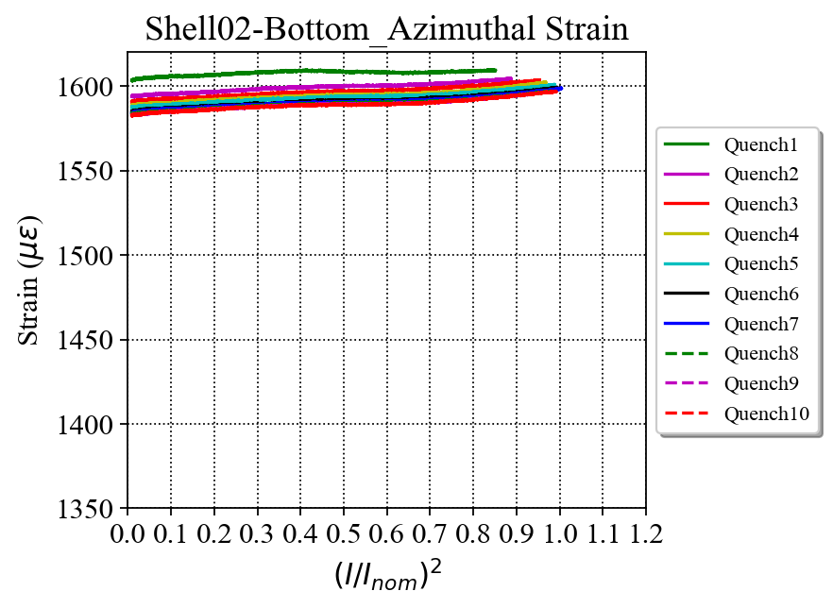
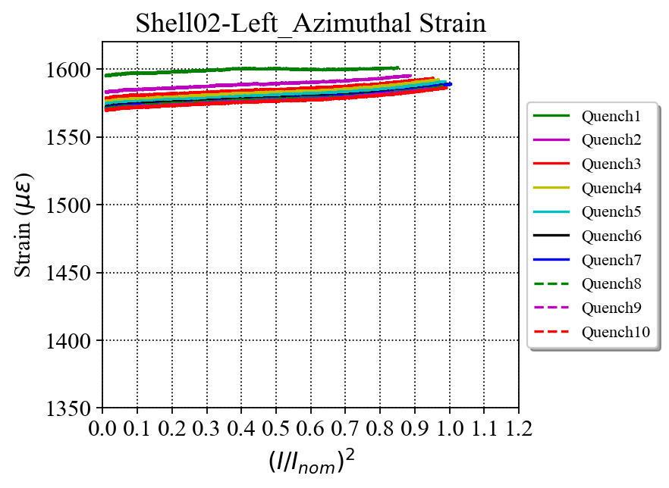
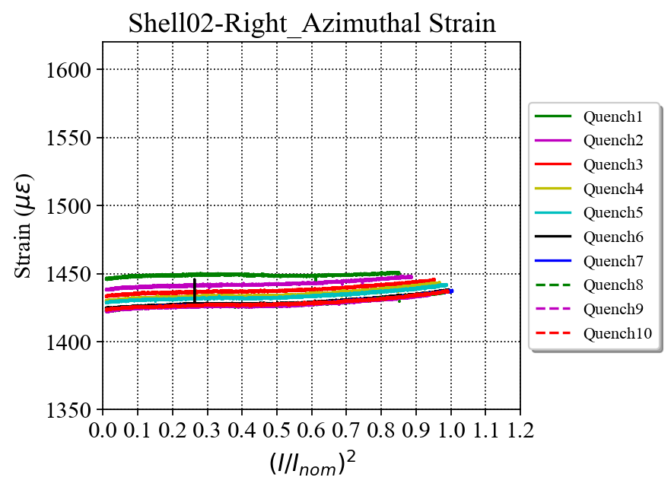
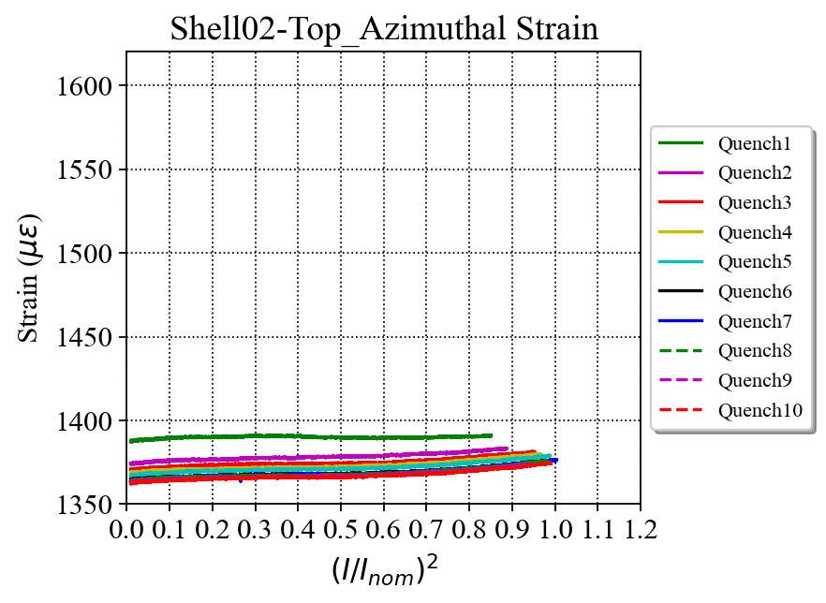
Shell 2 - Strain

Slide 13
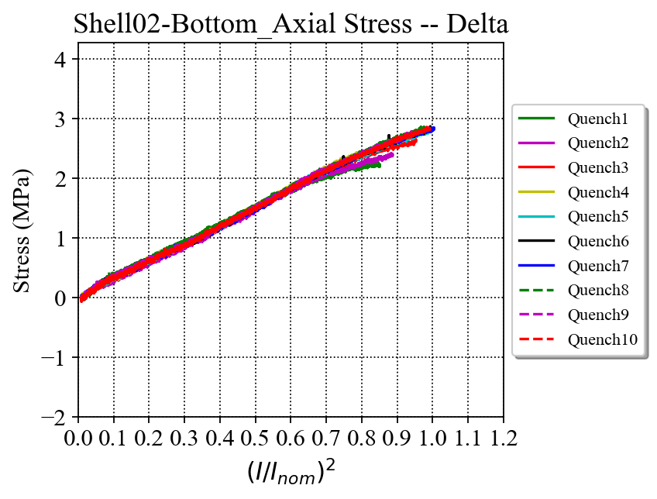
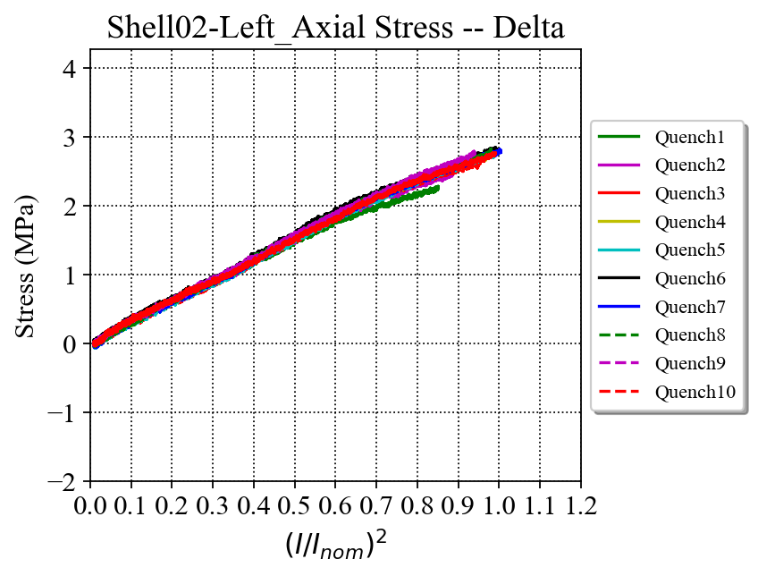
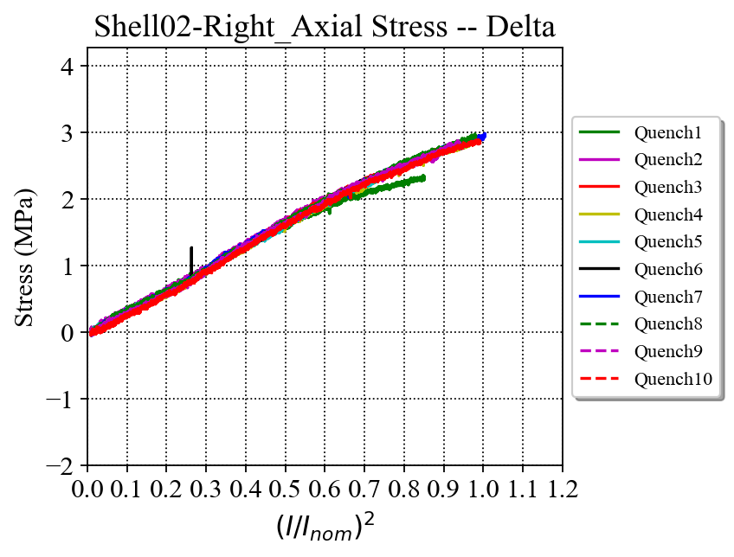
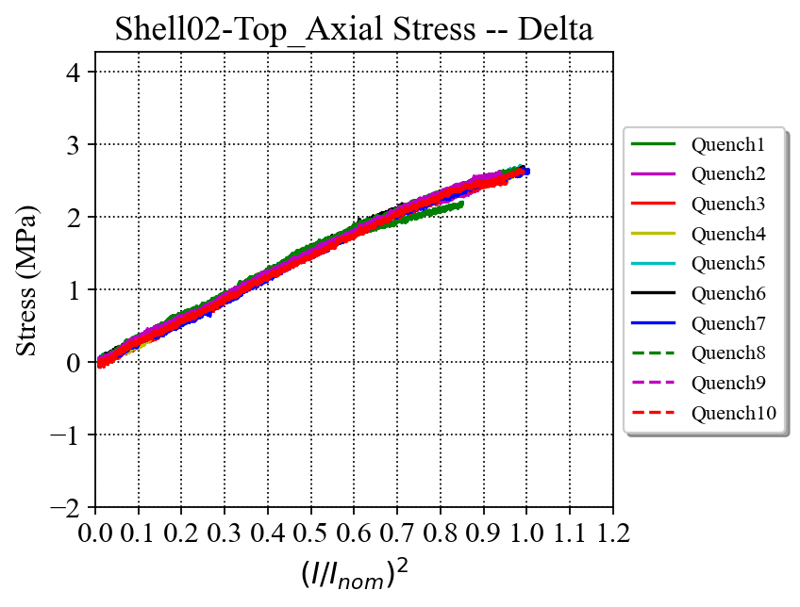
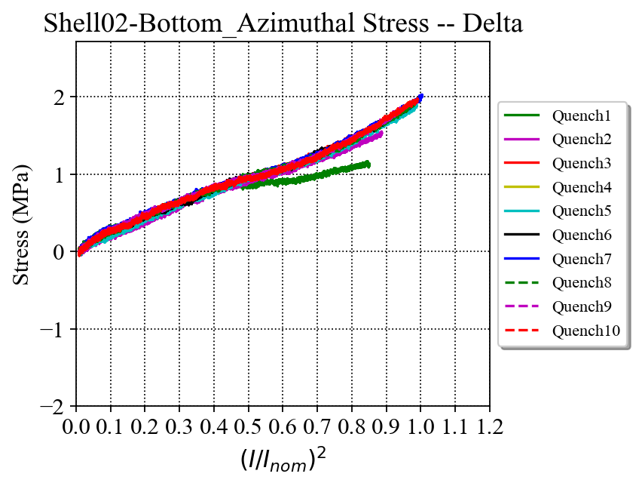
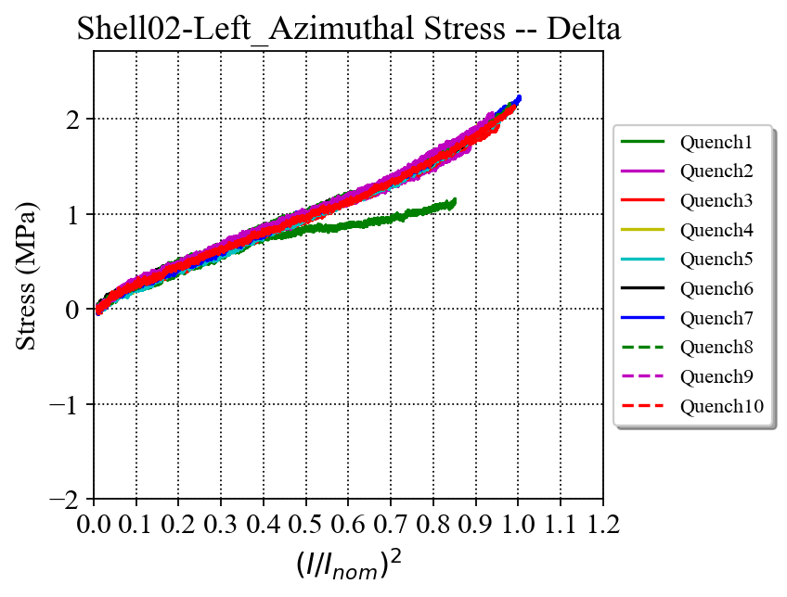
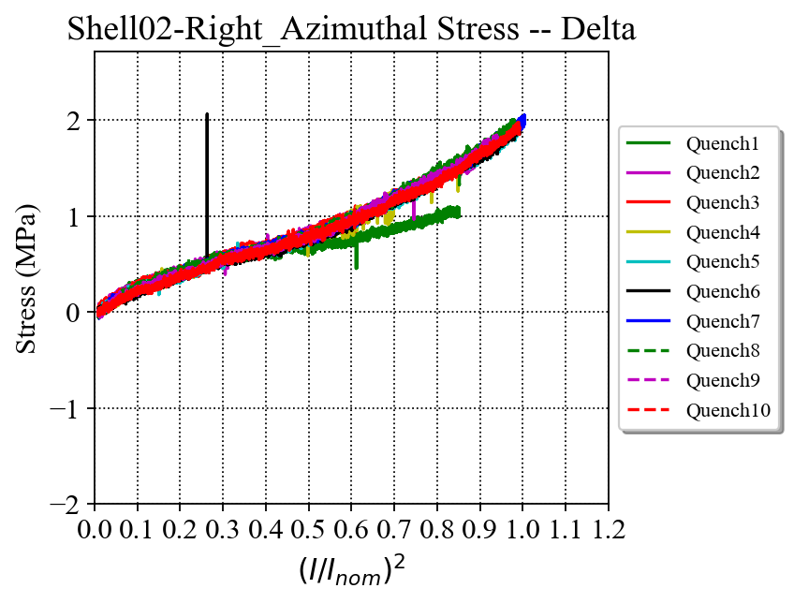
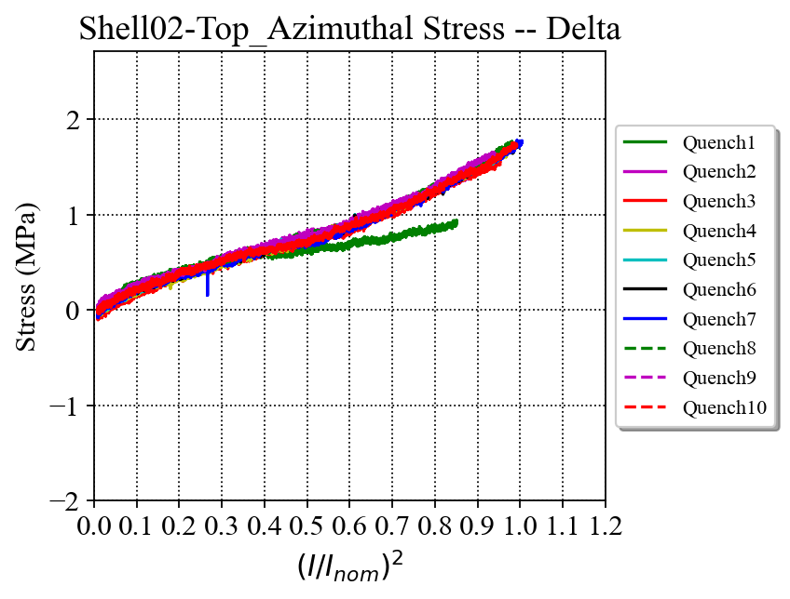
Shell 2 – Delta Stress

Slide 14
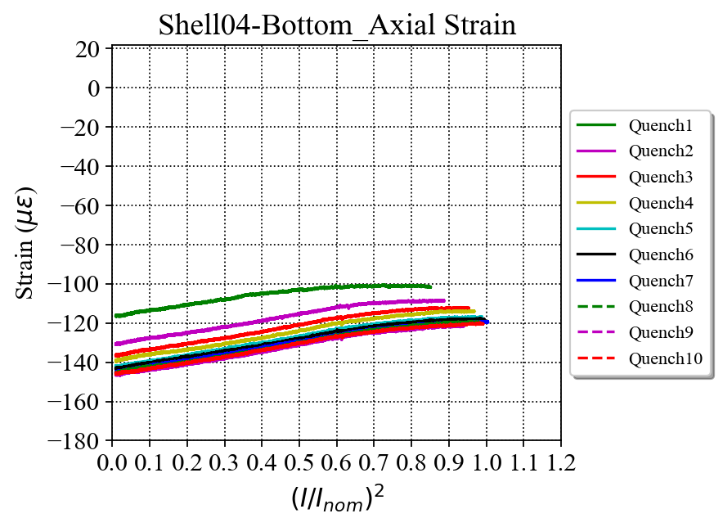
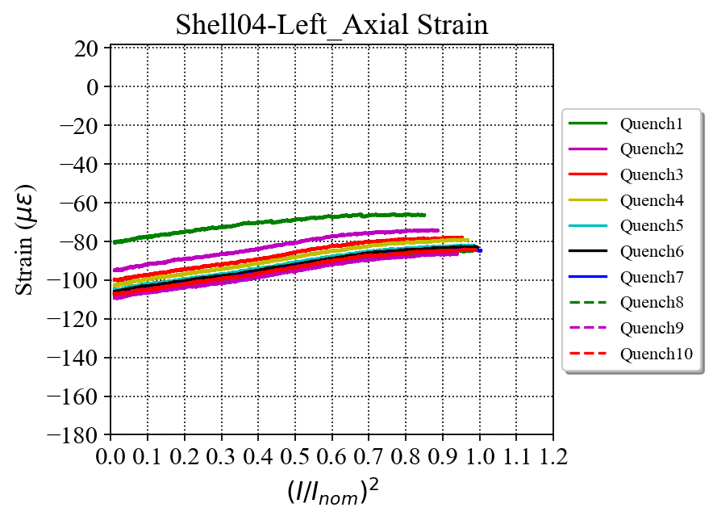
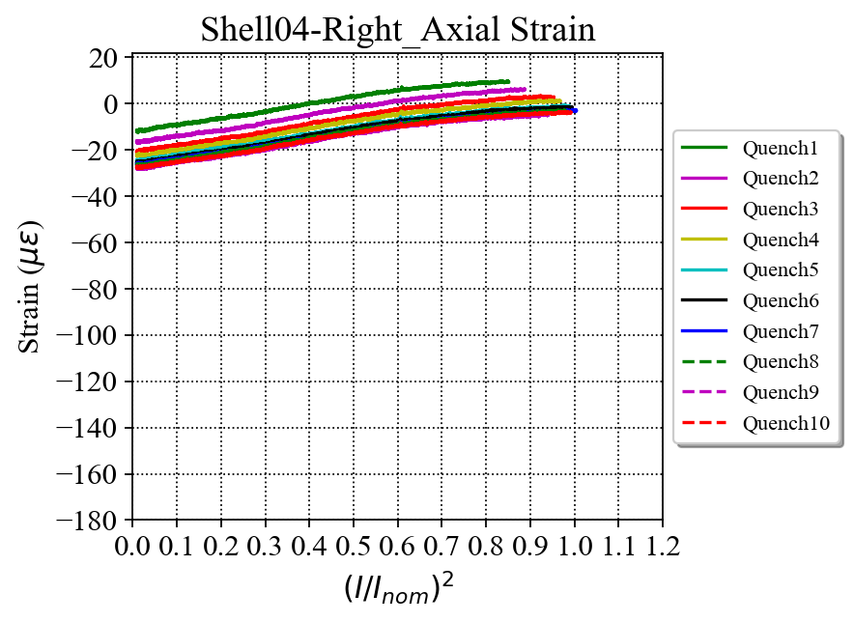
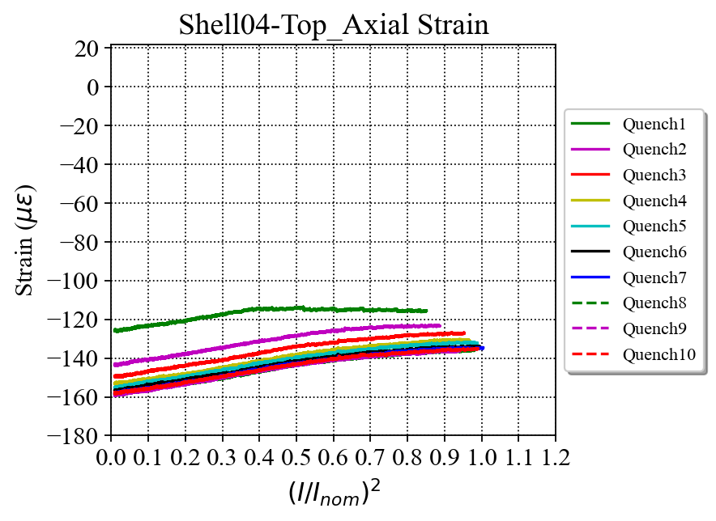
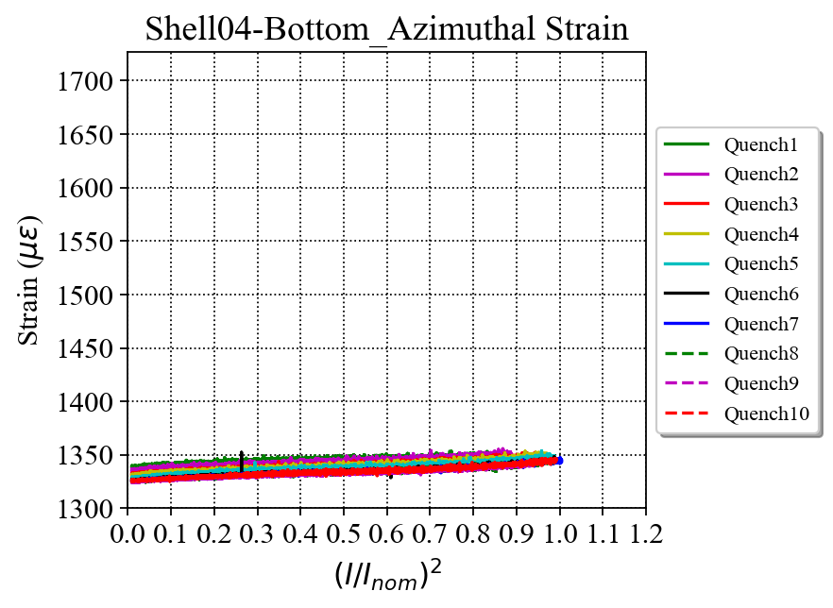
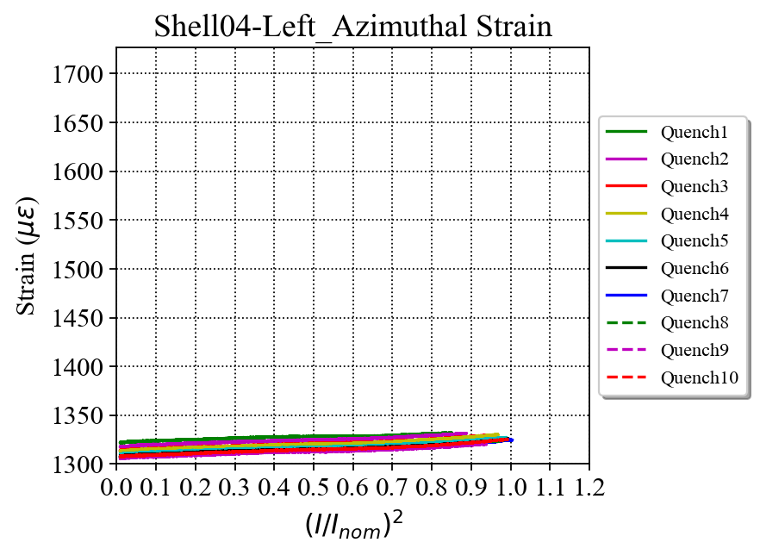
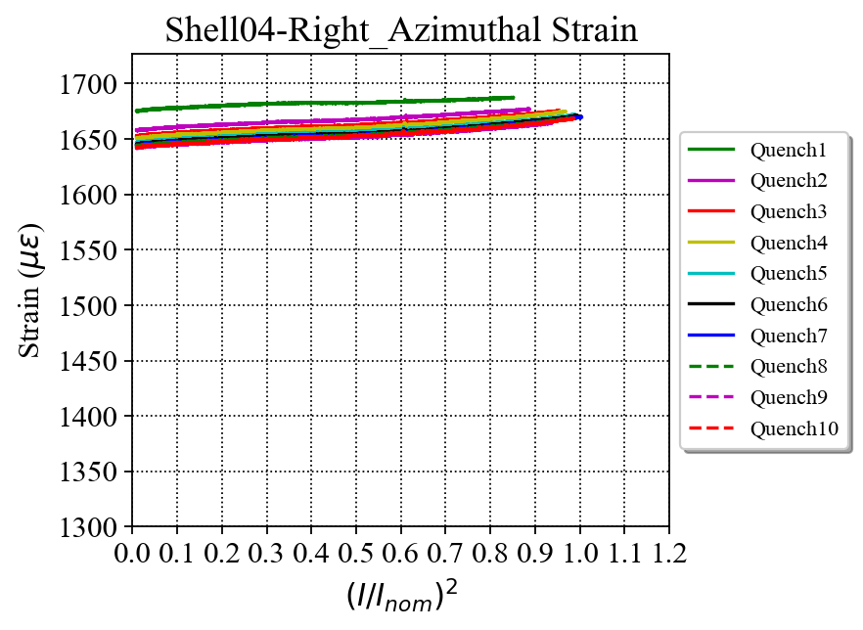
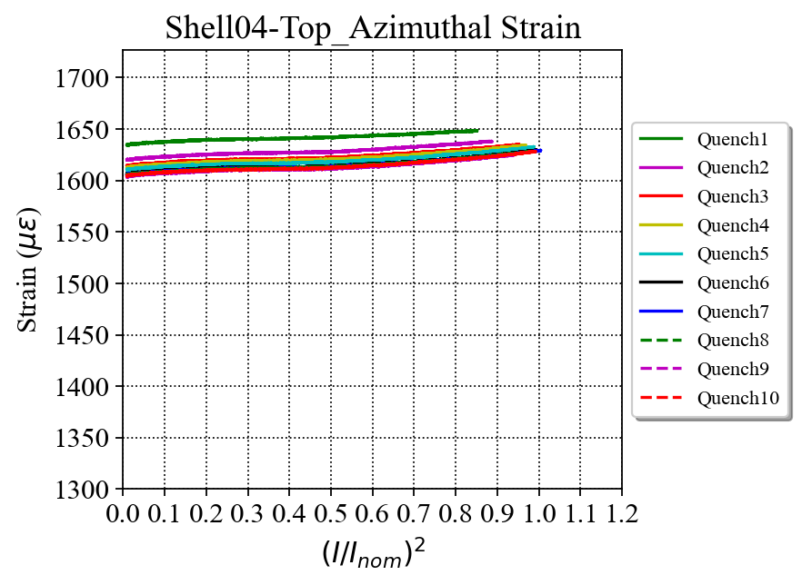
Shell 4 - Strain

Slide 15
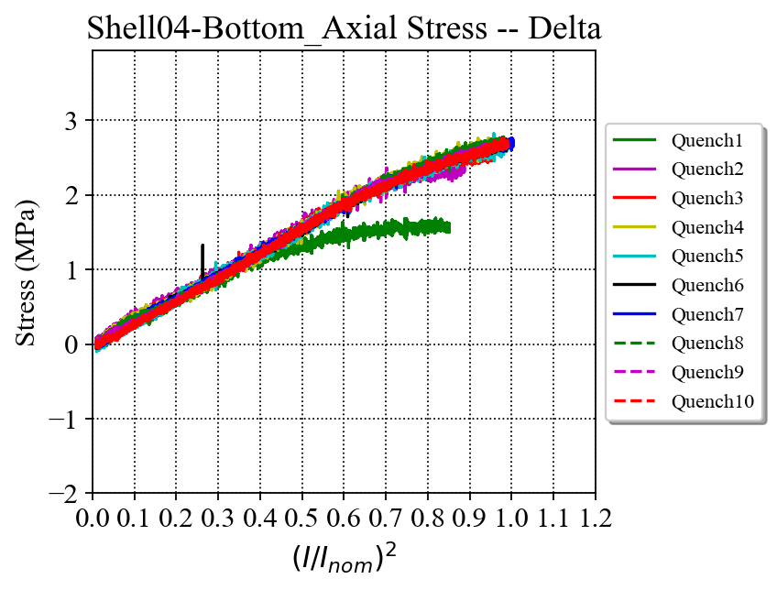
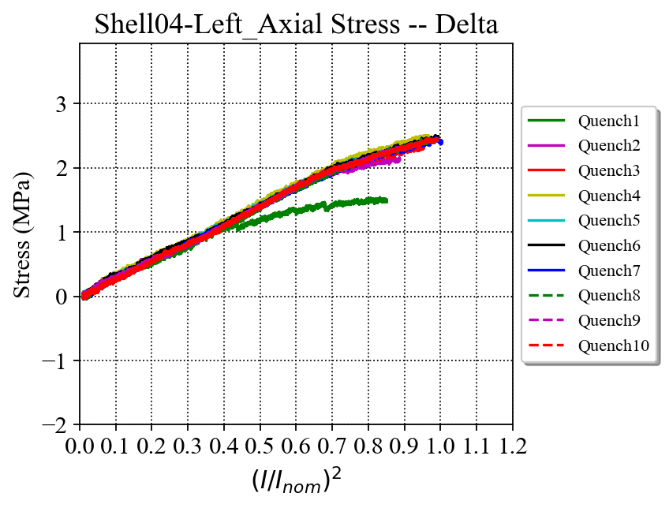
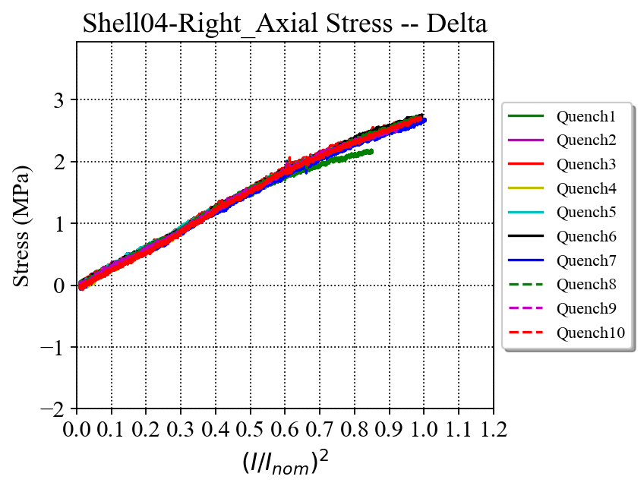
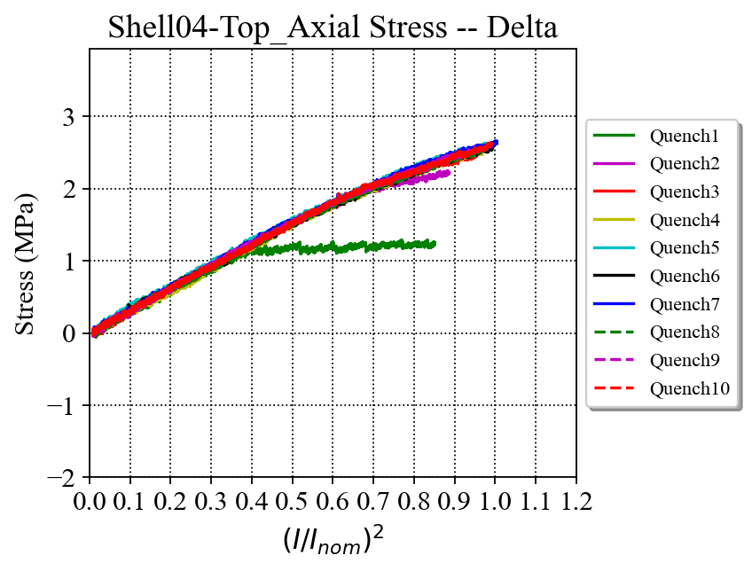
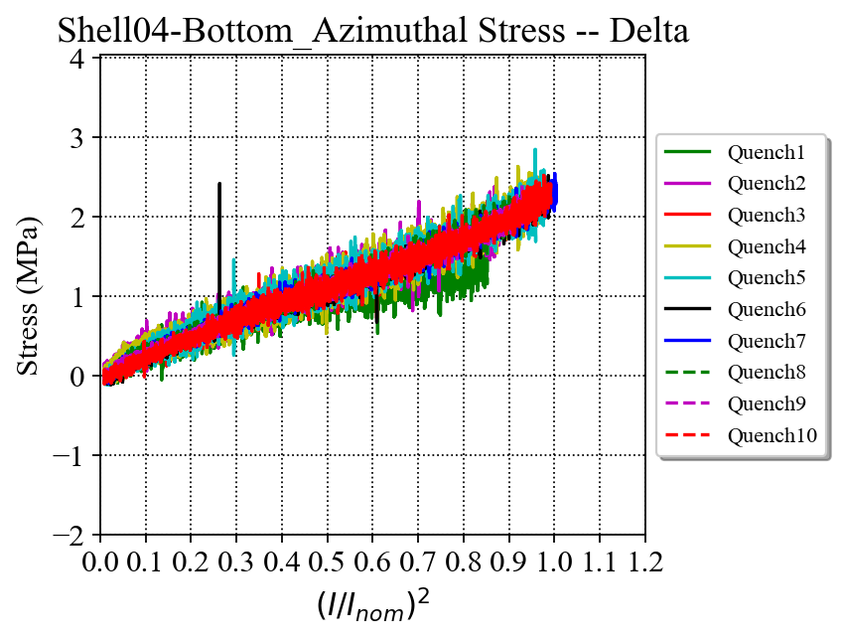
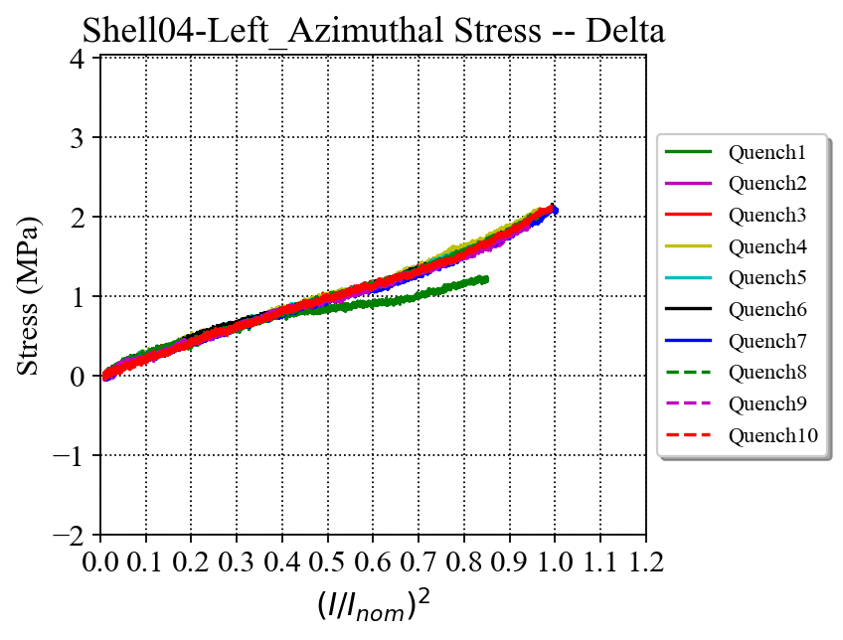
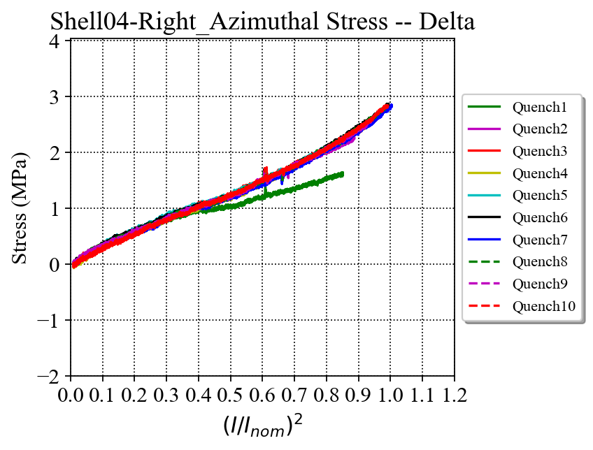
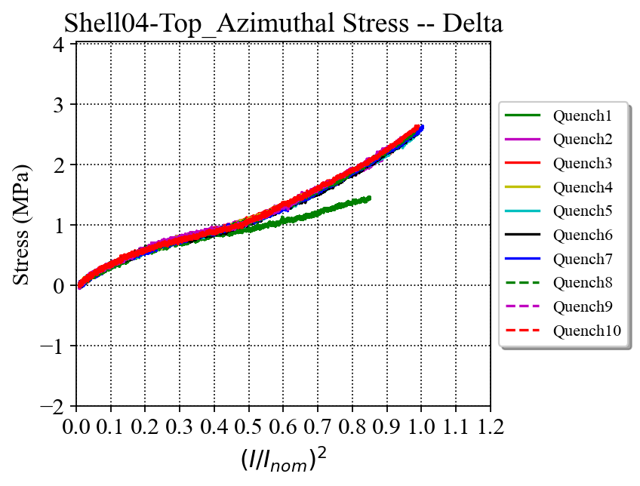
Shell 4 – Delta Stress

Slide 16
Shell 7 - Strain

Slide 17
Shell 7 – Delta Stress

Slide 18
Rods – Strain and Delta Stress

Slide 19
Preload – Coils, shells and rods

Slide 20
Appendix

Slide 21
Coil stress increase during powering (ramps-up and down averaged) Comparison with previous magnets
MQXFA03
Ramp to 16.65 kA
MQXFA04
Ramp to 16.55 kA
MQXFA05
Ramp to 16.46 kA
MQXFA06
Ramp to 16.45 kA
Av. delta stress: 101 MPa
Av. delta stress: 115 MPa
Av. delta stress: 102 MPa
Av. delta stress: 106 MPa
MQXFA07
Ramp to 15.45 kA
MQXFA08
Ramp to 16.50 kA
MQXFA10
Ramp to 16.54 kA
MQXFA11
Ramp to 16.54 kA
Av. delta stress: 107 MPa
Av. delta stress: 94 MPa
Av. delta stress: 89 MPa
Av. delta stress: 106 MPa

Slide 22
Coil stress increase during powering (ramps-up and down averaged) Comparison with previous magnets
Coil average delta azimuthal stress during excitation
Coil average delta axial stress during excitation
Maximum stress values of each coil were selected for these plots
In red: Coil quadrants with the highest stress increase
In blue: Coil quadrants with the lowest stress increase

Slide 23
E.M. Effect is Apparent on Coils and Shell 7 (this example is for magnet 5 but applies to all)
Despite not yet fully processing the files, the gauge readings of the coils and the shell 7 appear to be noisy during current ramps
Similar effects have been observed in earlier magnets
The noise on the signals is most likely from the dI/dt.
Noisy signal
LP Filter
Cutoff frequency:0.25 Hz
Clean signal
Clean signal
Noisy signal
(note the different scale from Shells 02 and 04 plots)

Slide 24
Reference: MQXFA03 Coil Azimuthal --- over I²
C204 ramp up
C204
LP Filter
Cutoff frequency:0.25 Hz
C110 & 111 ramp down
C110 & 111 ramp up
C110
Combined the ramp up and ramp down data, the three coils actually behave identically.
The readings of the “turn around” part are likely to be combined with inductive components;
The “up-warp” on the curves of C110 & 111 may be not mechanical. It is “bended” by the field.
C204 ramp down
The readings of this part may the combination of actual SG and inductive components
C111
I_{norm} = 16.47 kA

Slide 25
MQXFA04 Coil Strain --- over I²
The exact same behavior as seen in MQXFA03 (next slide).
From what we have learned from MQXFA03, there is no issue in the 10 kA ramp tests.
I_{norm} = 16.47 kA

