Slide 1
MQXFA12b – End Shell Inspection Crack Considerations
G. Vallone, G. Ambrosio, D. Cheng, P. Ferracin, L. Garcia Fajardo, J. Herrera
July 31, 2024
For discussion

Slide 2
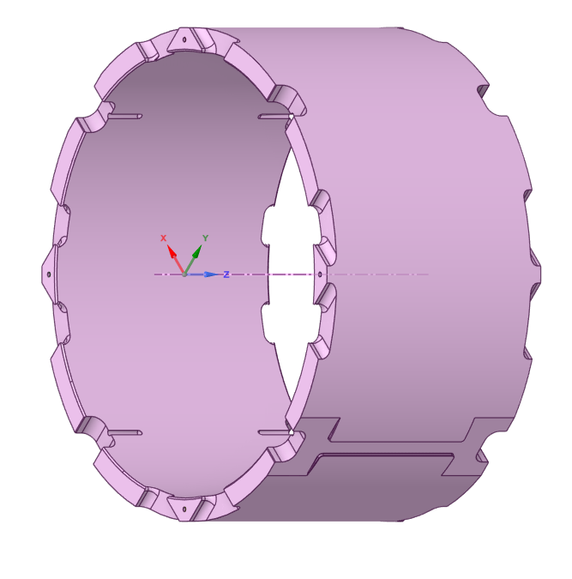
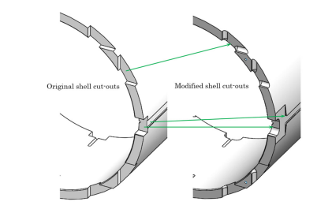
Introduction
Tapered loading keys increase the stress in the short shells at the magnet ends
With the nominal coil size, these were designed to have a ~20% margin with the MQXFAP1b target prestress level (130 MPa at cold on the central shell)

Slide 3
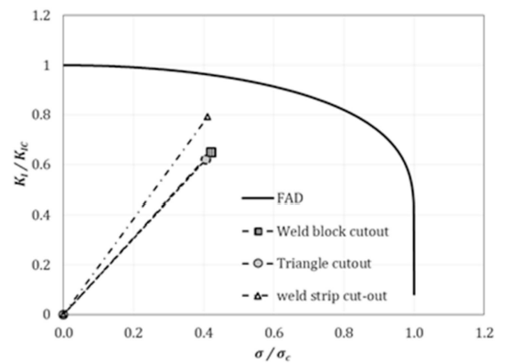
Shell Stress – Limiting Locations
Triangle
Weld block
Weld strip
Three dangerous locations identified with FE analysis
Limiting point:
‘Weld strip’ cut-out
Fillet radius=0.5 mm due to weld strips geometry limitations

Slide 4
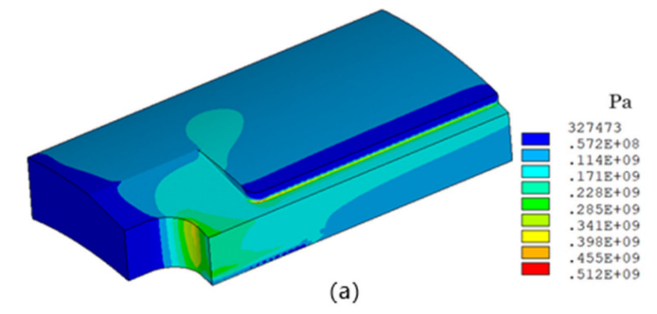
Shell Stress – Limiting Locations
Arrow points to magnet center
Lead
End
Weld strip cut-out
The peak stress is on the weld strip cut-out, on the magnet end side

Slide 5
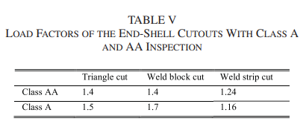
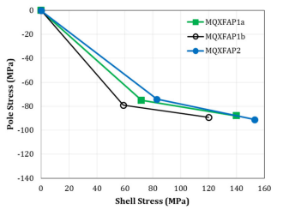
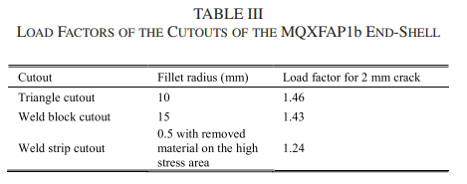
Shell Stress - Limits
Valid for AP1b case (130 MPa at cold, central shell)
Load factor from grade IV analysis, assuming 130 MPa shell stress at cold (MQXFAP1b):
Load factor of 1.24 on the weld strip cut out with a 2 mm crack

Slide 6
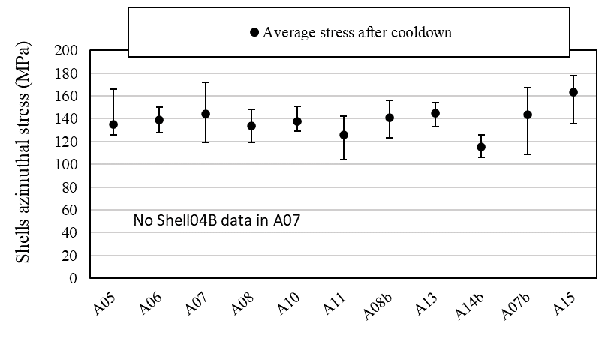
Shell Stress - Cool-Down, Measured
We can reasonably assume a central shell stress ~140 MPa at cold
10 MPa stress increase with respect to the A12b case
Not sure what happened on A15, but seems an outlier (but we better not be in that situation)
~8% load increase

Slide 7
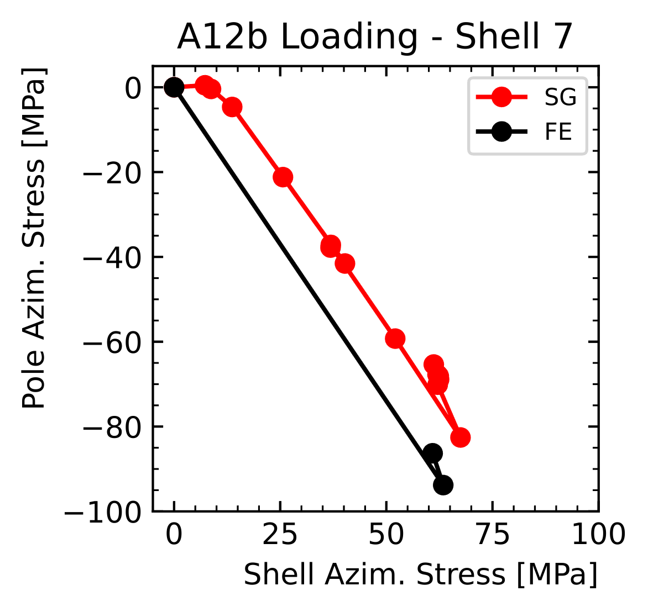
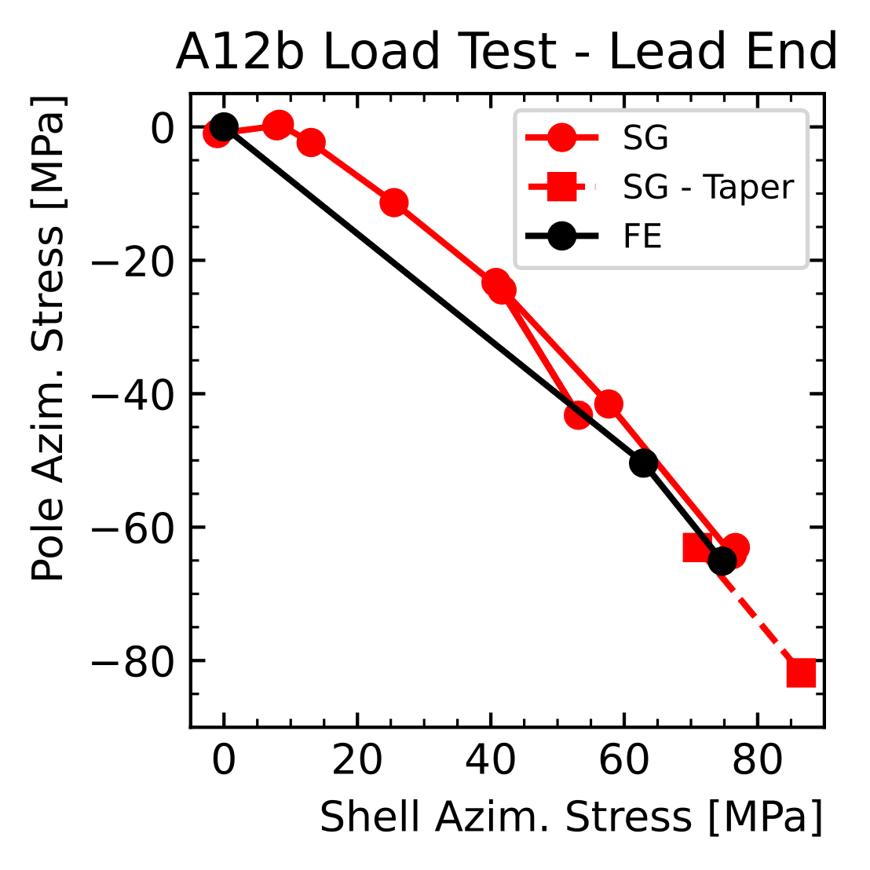
Assembly – Full Key - 2
We do not have a ‘precise’ measurement on the shell stress, just an estimate
SG were removed after full loading
The predicted stress in the shell is higher than expected
86 MPa (measured), 75 (model) ~ 11 MPa delta ~14%

Slide 8
Load Factor – From Old Study
Design load factor: 1.24
New load factor (8% load increase, 14% model error) ~ 1.00
Means no margin

Slide 9
Maximum Crack Size (Version 1…)
Quick estimate (non-conservative), assume:
$$K_{I}\left(a\right)∝σ\sqrt{πa}$$
If we want a load factor of 1.2, we have:
$$a_{2}={a_{1}\left(\frac{LF_{1}}{LF_{2}}\right)}^{2}=1.77×{\left(\frac{1.00}{1.24}\right)}^{2}=1.23 mm$$

Slide 10
Crack Size?!?
ASTM B594-19
Design Criteria
Actual Inspection
Heng’s Paper
I think there is an error in the design criteria
The actual flaw size specified in class AA is 1.2 mm
Am I missing something? It would mean that we are fine!

Slide 11
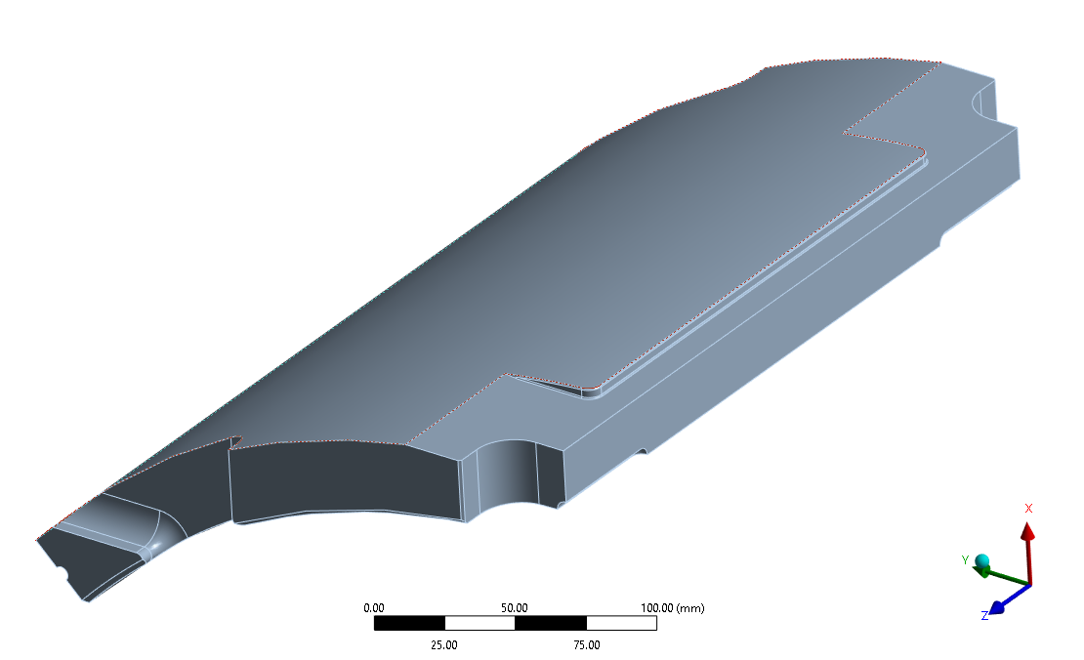
Crack Analysis – Interaction Integral Method
‘Design criteria’ crack analysis performed with weight functions
Pre-computed ‘influence coefficients’ of the separation forces on a crack in any region
K1c=24 MPa m2, K1 ~24*0.8=19.2 MPa m2
We can also compute the stress intensity factors on a real crack, on the short shell submodel
Global model: reference model with 133 MPa after cooldown stress on the central shell

Slide 12
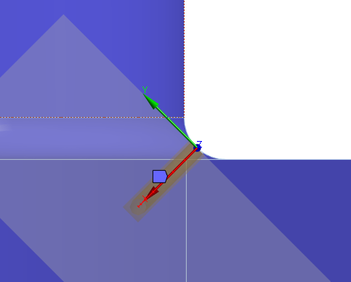
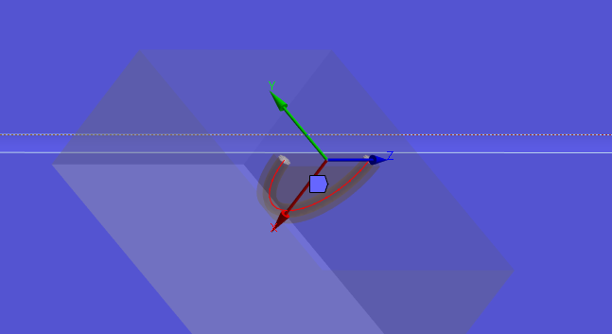
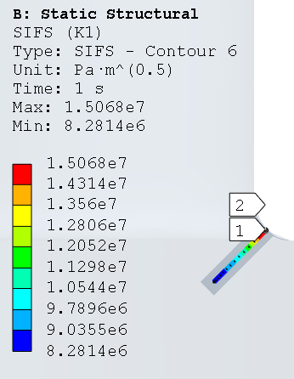
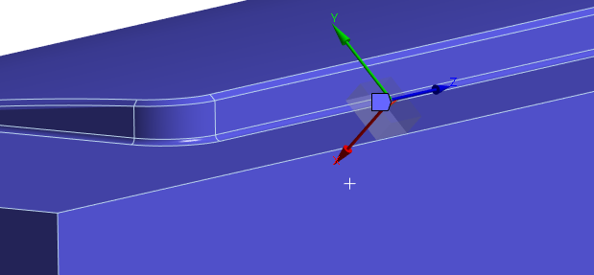
Crack Analysis – Tested Geometries (5)
Edge Crack normal to the XY plane seems the worst configuration (see back-up slides)

Slide 13
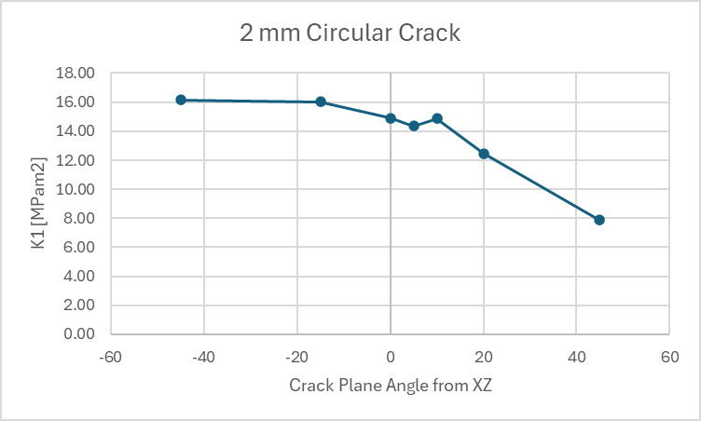
Crack Face Normal to XY Plane
K1, worst angle ~16 MPa m2 (2a = 2 mm)
Seems lower than what was obtained with the weight functions
However, getting closer to the corner increases K1
Assuming 17 MPa m2, this would be a ~30% margin over fracture
z | K1
225 | 15.1
250 | 15.6
259 | 16.7

Slide 14
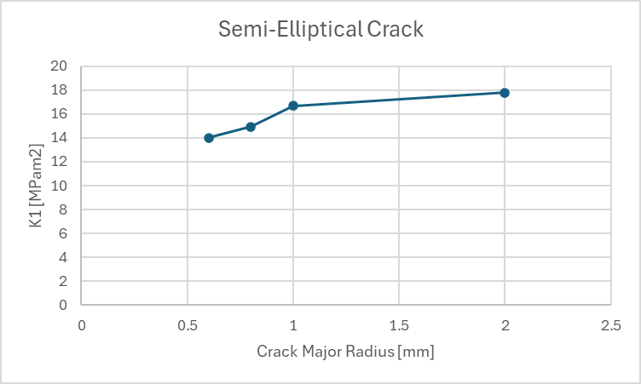
Crack Face Normal to XY Plane
SIF decreases with crack size

Slide 15
Conclusion
We have two factors reducing the margin:
Higher prestress
Higher than expected end-shell stress
This brings the load factor from 1.24 to 1.0 (no margin)
The load factor was estimated on a 1.77 mm crack
This seems to be non-consistent with the AA inspection criterion applied to our shells
This means that, for a required load factor of 1.2 we need a crack < 1.24 mm
Acceptable
A LEFM analysis was performed
Preliminary results suggest that the actual margin for a 2 mm round crack is ~30%

Slide 16
Summary
(Back up slides)
Subsurface cracks do not seem dangerous

Slide 17
Crack Face Normal to XY Plane
K1, worst angle ~16 MPa m2 (2a = 2 mm)
Seems lower than what was obtained with the weight functions
However, getting closer to the corner increases K1
z | K1
225 | 15.1
250 | 15.6
259 | 16.7

Slide 18
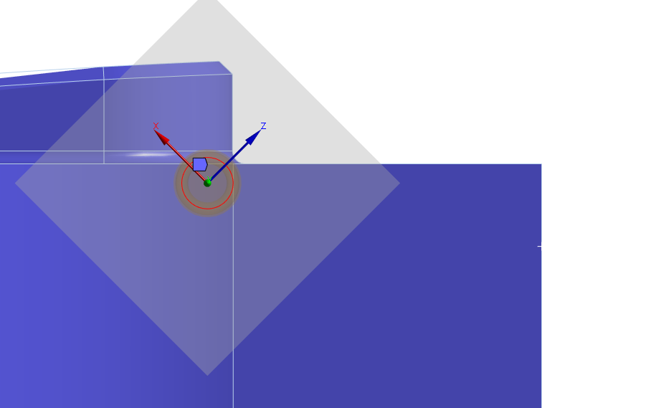
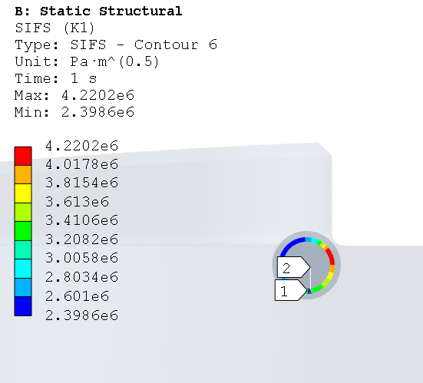
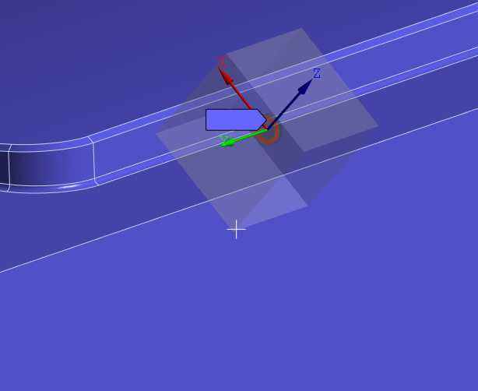
Crack Analysis – Tested Geometries (1)
Sub-surface crack in the XY plane (2a = 2 mm)
Can change x, y, z
Values seem low (2 mm diameter crack, very close to the edge)

Slide 19
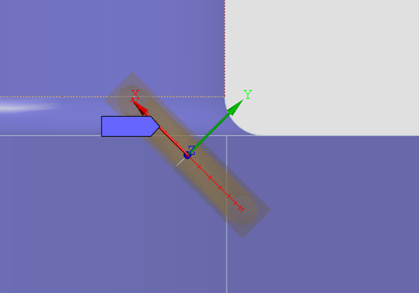
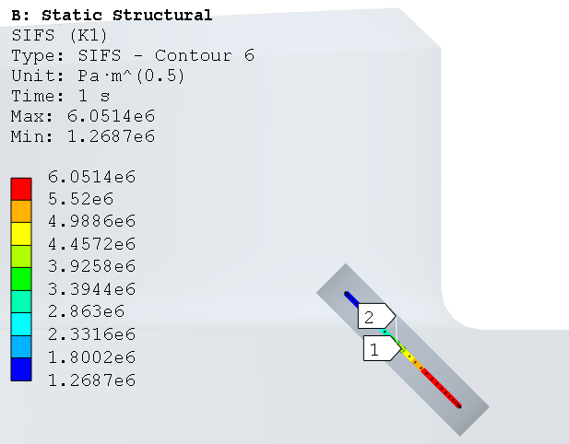
Crack Analysis – Tested Geometries (2)
Sub-surface crack in the XY plane (2a = 2 mm)
Can change x, y, z
Low stress

Slide 20
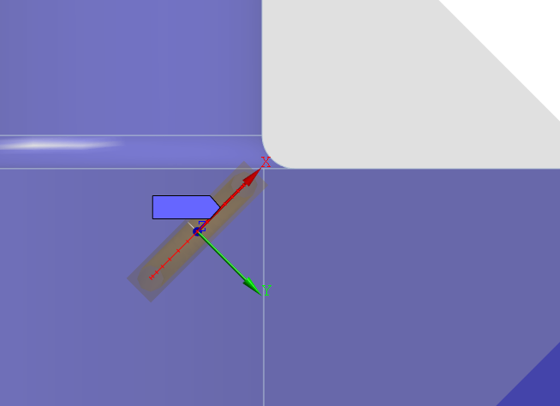
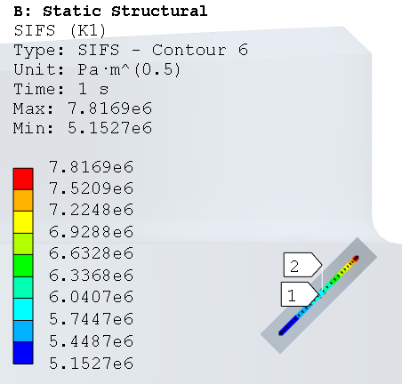
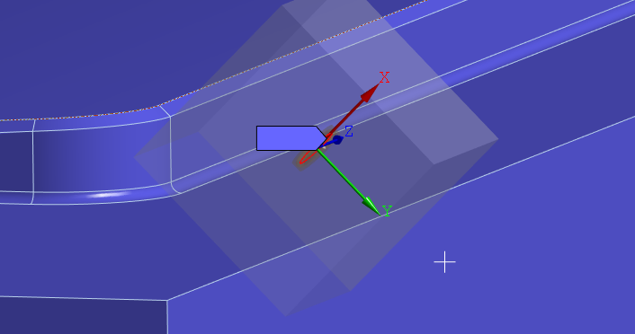
Crack Analysis – Tested Geometries (3)
Sub-surface crack in the XY plane, normal to the edge (2a = 2 mm)
Very close to the edge
Low stress

Slide 21
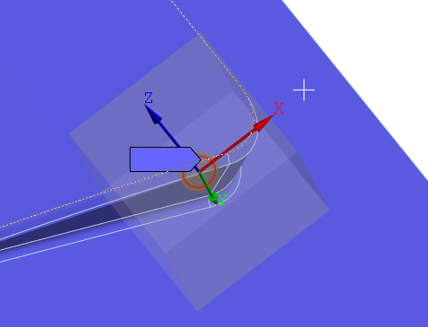
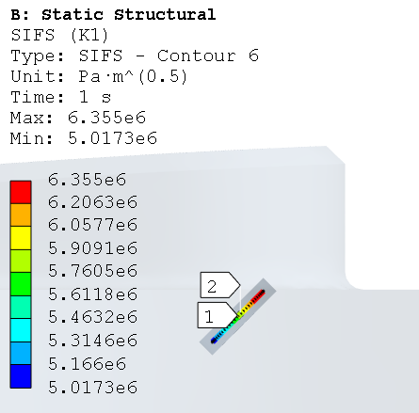
Crack Analysis – Tested Geometries (4)
Sub-surface crack in the XY plane, normal to the edge, near the corner (2a = 2 mm)
Worst case orientation not clear
Low stress – seems always the case for sub-surface cracks

Slide 22
Crack Analysis – Tested Geometries (5)
Edge Crack normal to the XY plane
Seems the worst configuration

Slide 23
Crack Face Normal to XY Plane
K1, worst angle ~16 MPa m2 (2a = 2 mm)
Seems lower than what was obtained with the weight functions
However, getting closer to the corner increases K1
z | K1
225 | 15.1
250 | 15.6
259 | 16.7

Slide 24
Crack Analysis – Elasto-Plastic
Etg | K1 | Jintegral | K1J
79.0 | 15.1 | 2.8 | 15.7
1.0 | 15.1 | 2.9 | 15.8
0.1 | 14.4 | 2.6 | 15.1
K1 is mostly used in linear elastic fracture mechanics
Checking how much we would be wrong with an equivalent J-integral evaluation on a plastic model
Assuming ~plane strain around the crack tip for the conversion
Seems ok to just use linear properties

Slide 25
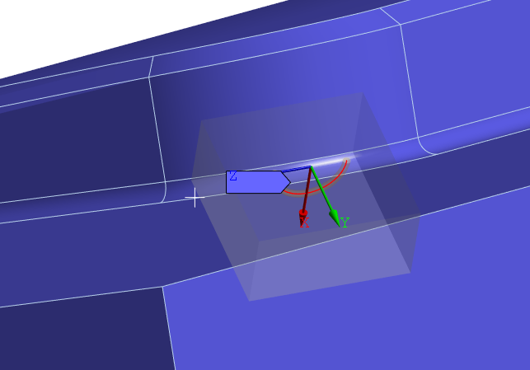
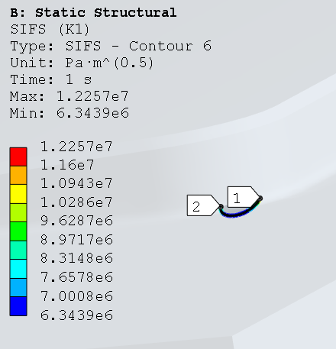
Crack Analysis – Tested Geometries (5)
Edge crack normal to the corner

Slide 26
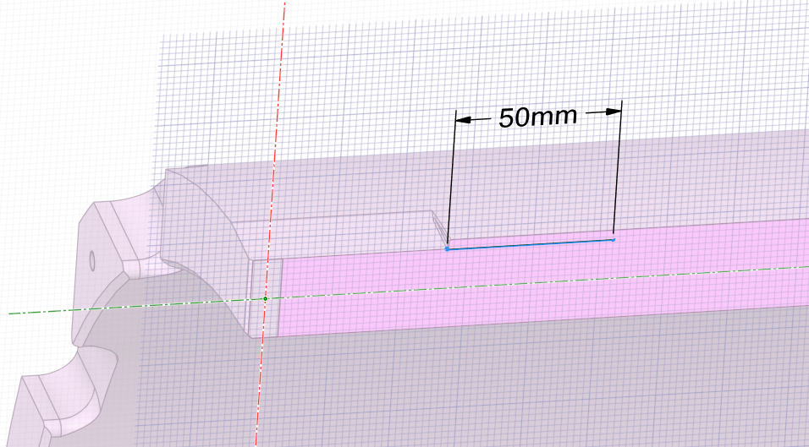
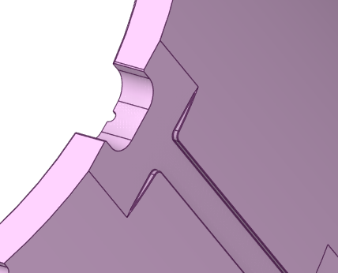
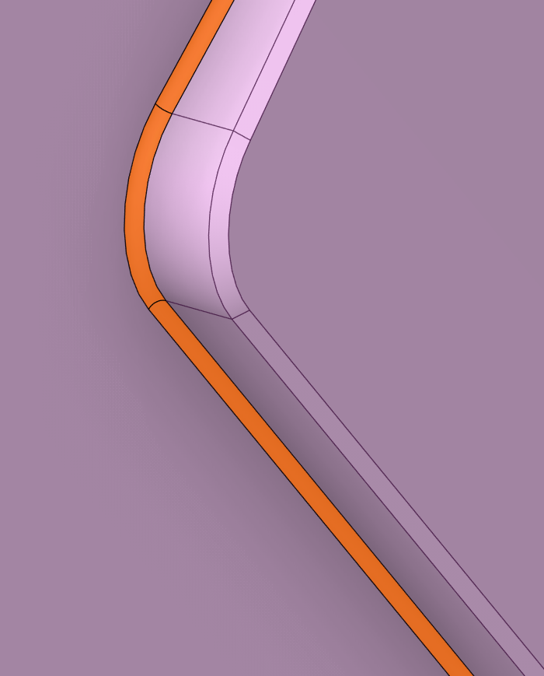
Inspection - Shell Stress – Limiting Location
Peak stress location
More images of the weld strip cut-out
Would inspect the region near the corner
~50 mm from the filled center on both sides
See last slide for maximum allowed crack ‘signal’

Slide 27
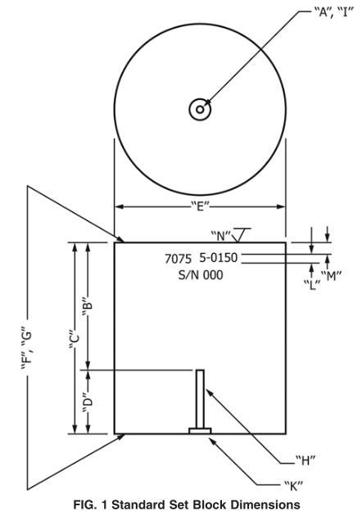
Sample Set-Up
Typical flat bottom specimen
Not sure if we can just do the same but with a smaller size
If they specify these ‘class’ sizes, probably the noise becomes too large when reducing it
We would need an expert opinion on this

