Slide 1
Accelerator
Summer Shutdown
Tony Busch
AD Shutdown Coordinator
Planning & Integration Department

Slide 2
Shutdown 2024 Timeline
Possible Pause
Milestone 1
Milestone 7
Define Shutdown Coordinators.
Milestone 3
Complete shutdown.
First pass resource level Schedule.
Milestone 5
Milestone 8
Final resource level Schedule.
Complete
Startup.
Milestone 2
ID Jobs to the 90% level.
Milestone 6
Milestone 4
Milestone 9
Second pass resource level Schedule.
Start Shutdown.
Return HEP
Dec
JAN
FEB
MAR
APR
MAY
JUN
JULY
AUG
SEP
OCT
NOV
DEC
Define Scope
Plan
Execute
Execute
HEP
Determine Jobs
Plan phase 1: Define schedule
Plan phase 2: Finalize Schedule
Crew Marching orders
Execute Shutdown
Execute Shutdown
Close out
Shutdown parameters
Original Duration: 10 weeks. Possible lab closure will extend shutdown ~3 extra weeks due to pause.
End of tunnel work/power outages if there is a pause
Week of Monday October 14th

Slide 3
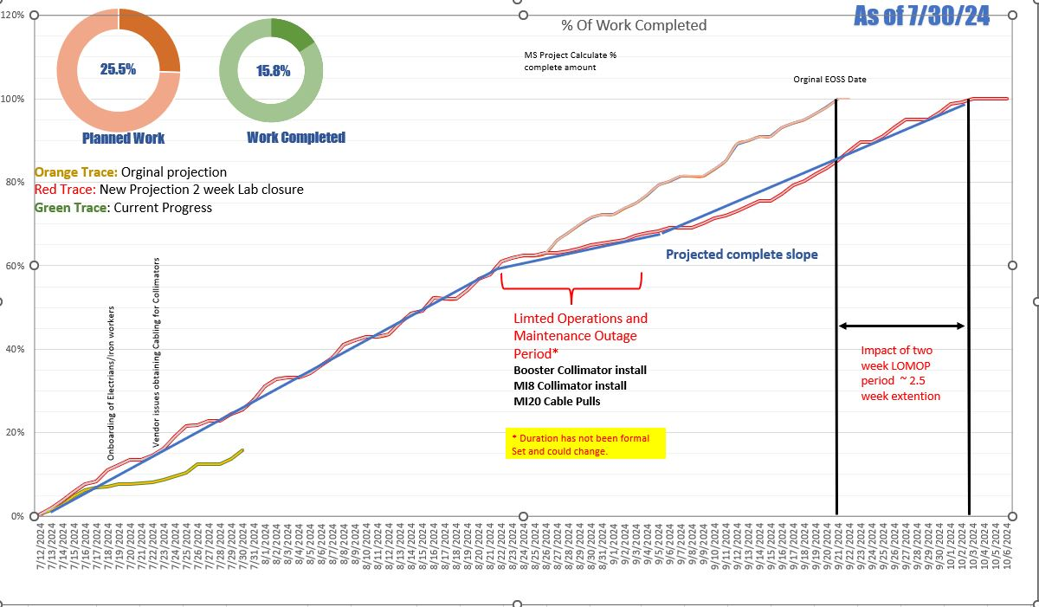
Shutdown Progress

Slide 4
Power outage progress

Slide 5
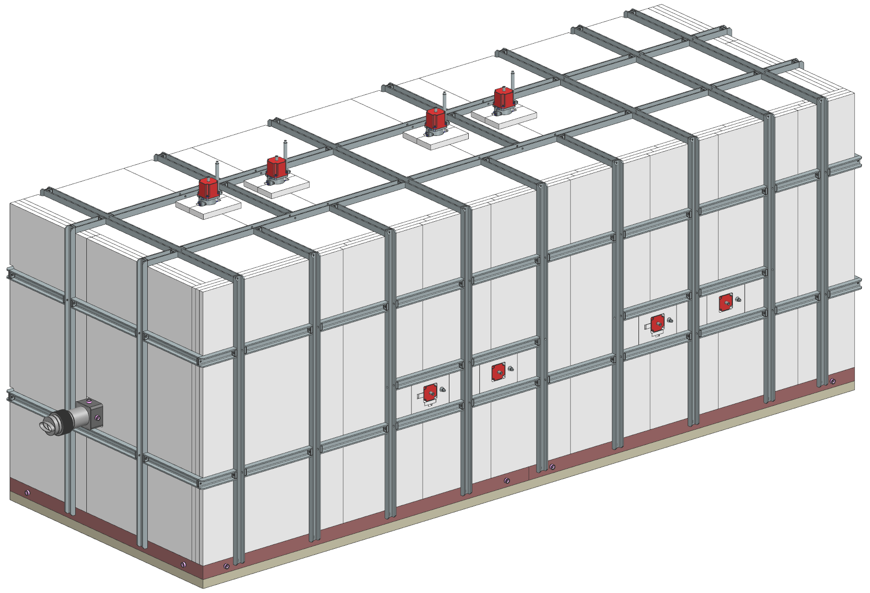
8 Gev Collimator
2 Collimators
825-826 and 827-828
Weight per collimator station: ~175,000 lbs. (88 tons)
Vertical motion controls
Installation plans for this shutdown.
Layout floor anchors
Cable pulls
Stack steel and align
Horizontal motion controls
Beam direction
Beamtube/ vacuum chamber

Slide 6
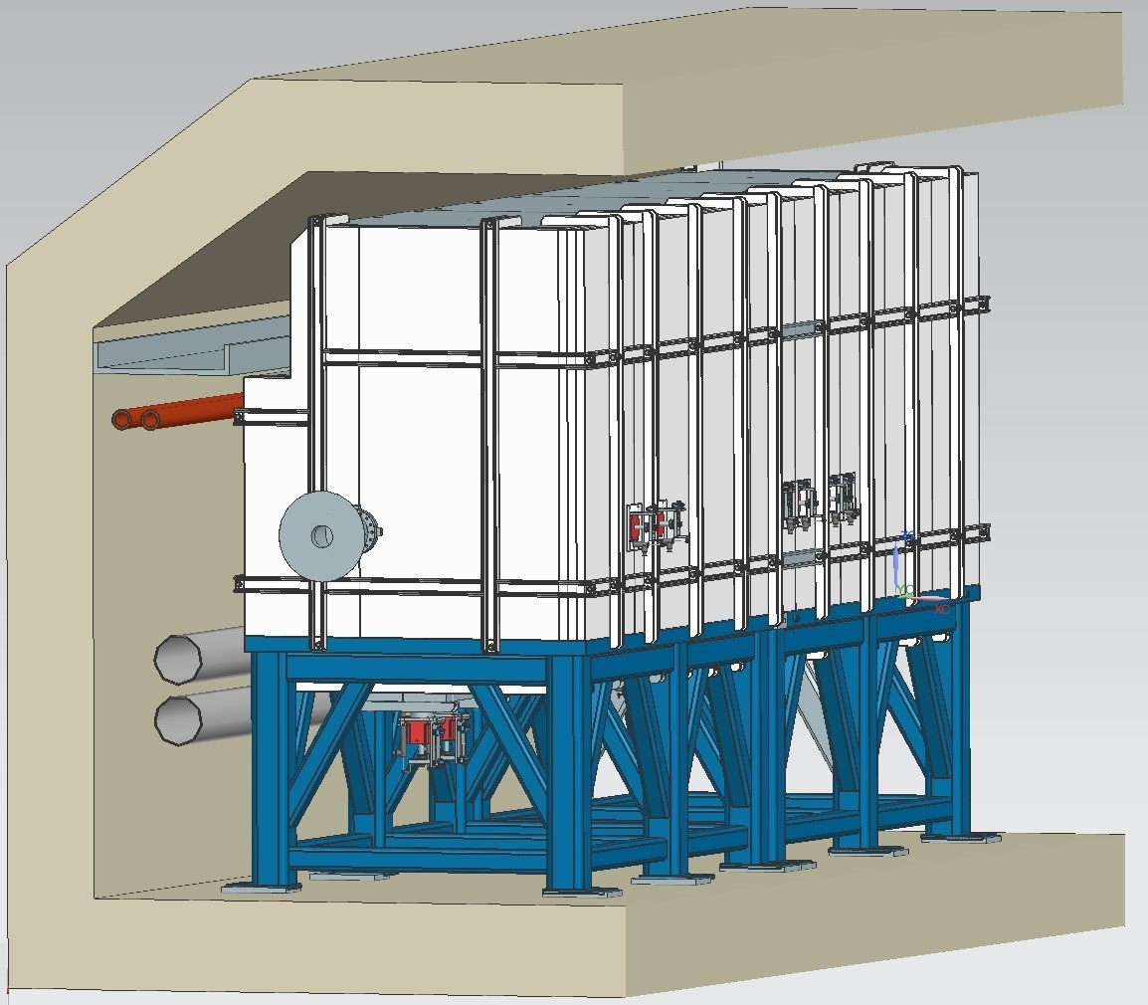
Booster Collimator
1 Collimator on 2 stands
Weight ~100,000 lbs.
Vertical motion controls
Installation plans for this shutdown.
Install floor anchors
Cable pulls
Stack steel and align
Beam direction

Slide 7
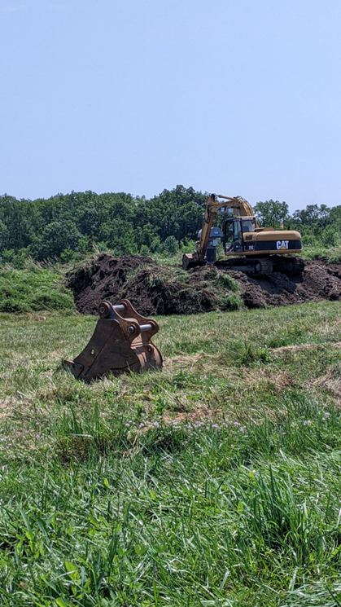
Other main jobs on the schedule
Dual PA upgrades in Main Injector.
Replacement of H202-5 and SWIC in Switchyard.
Q 205 Swap and installation of ESS1&2 at Muon Campus.
Up to 8 Choke repairs in Booster.
Sump discharge repairs in Main Injector
Cleaning of all Main Injector heat
exchangers.

Slide 8
ISD Shutdown work
Electrical
Lighting repairs
Tunnel relamping
Service Building relamping
Power panel inspections
Tunnel and service buildings
General Electrical repairs
Power outage across site
Mechanical
Sump repairs/replacement
Generator maintenance
MI service building AC unit replacement

Slide 9
Potential Impacts to Our Shutdown Schedule
Electrical work (Electricians)
What we need….
~10 Electricians to cover ALL of our jobs that have been requested for this summer shutdown.
What we currently have
~3-4 Electricians
Materials on hand
Still waiting on wire and other items to be delivered. (We need 18 rolls and have 5 rolls.)
Shipment of low level radioactive items
Only have 1 driver on site that can haul radioactive materials. This affects magnet and other shipments for work.

