Slide 1
ND/TMS magnet assembly
M.Oriunno Aug 14, 2024

Slide 2
Baseline Configuration
AISI 1006 steel
60 x 40 mm plates
40 x 15 mm plates
100 x 40 mm gap for detectors
6 x rectangular coils
±1 T B field in the active area between the coils
Sub-System | Metric tons
Steel | 711
External Coil x 4 | 26 (6.5 ea)
Internal Coil x 2 | 16 (8 ea)
Support Frame | 35
Detectors | 20
Racks and Cables | 5
Total = 813 tons

Slide 3
Coil Requirements
Same as CDR:
1T minimum in the active area
Expected max current required, 30 kA.turn
Max temperature rise from ohmic dissipation shall be < 60ºC (FPA 70, National Electric Code)
Change from the CDR:
Installation of coils pre-assembled and tested at the factory

Slide 4
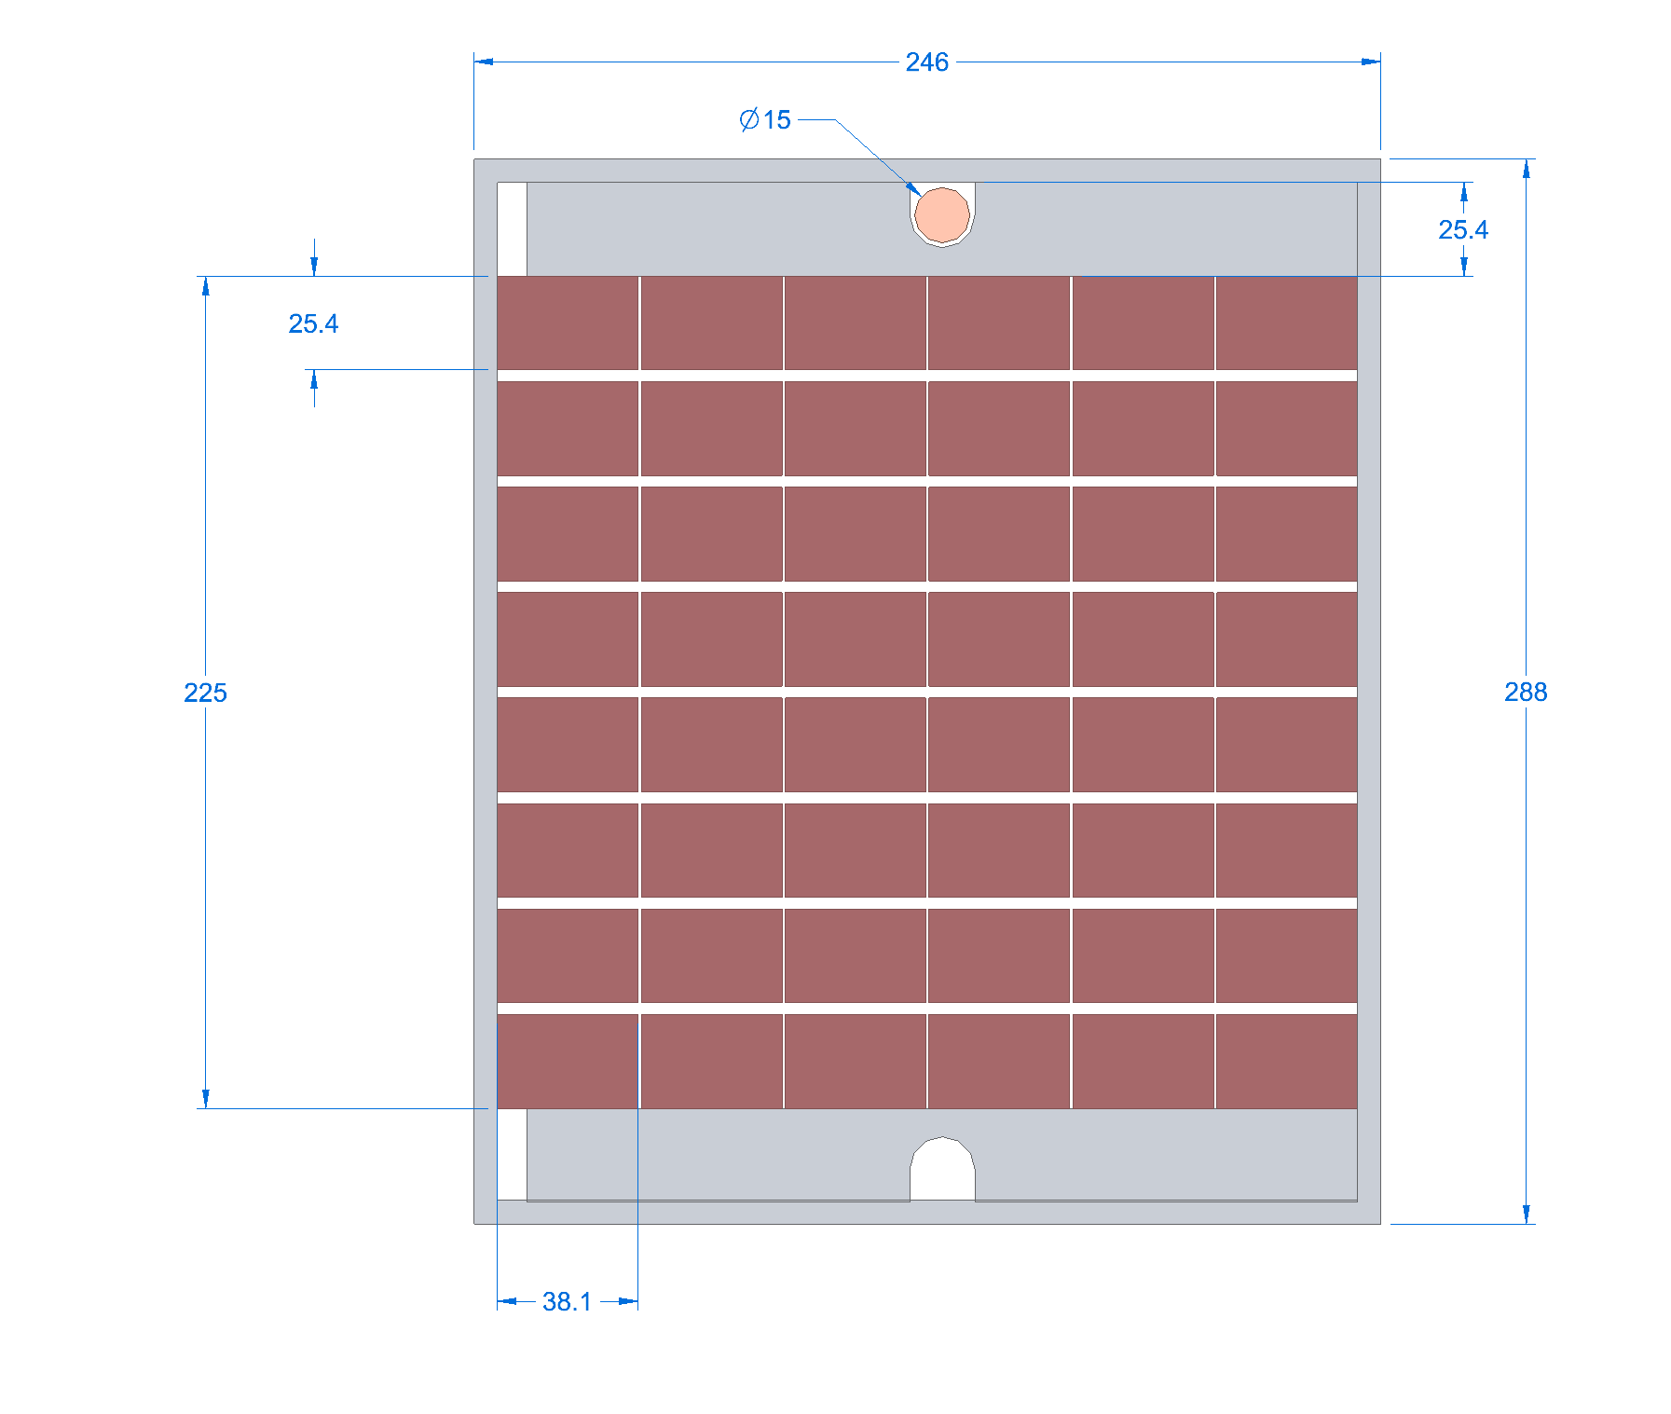
Coil Design – MINOS with cold plates
Plank Design a-la MINOS
Preliminary studies show that a single cold plate (top or bottom), single-pass 3 gpm, with 5/8” pipe, meets the requirement of < 60ºC
Cross section envelope of the coil package 246 mm x 288 mm (263mm)
Cold plate
Cooling circuit
Cold plate
7.2 m
3.5 m

Slide 5
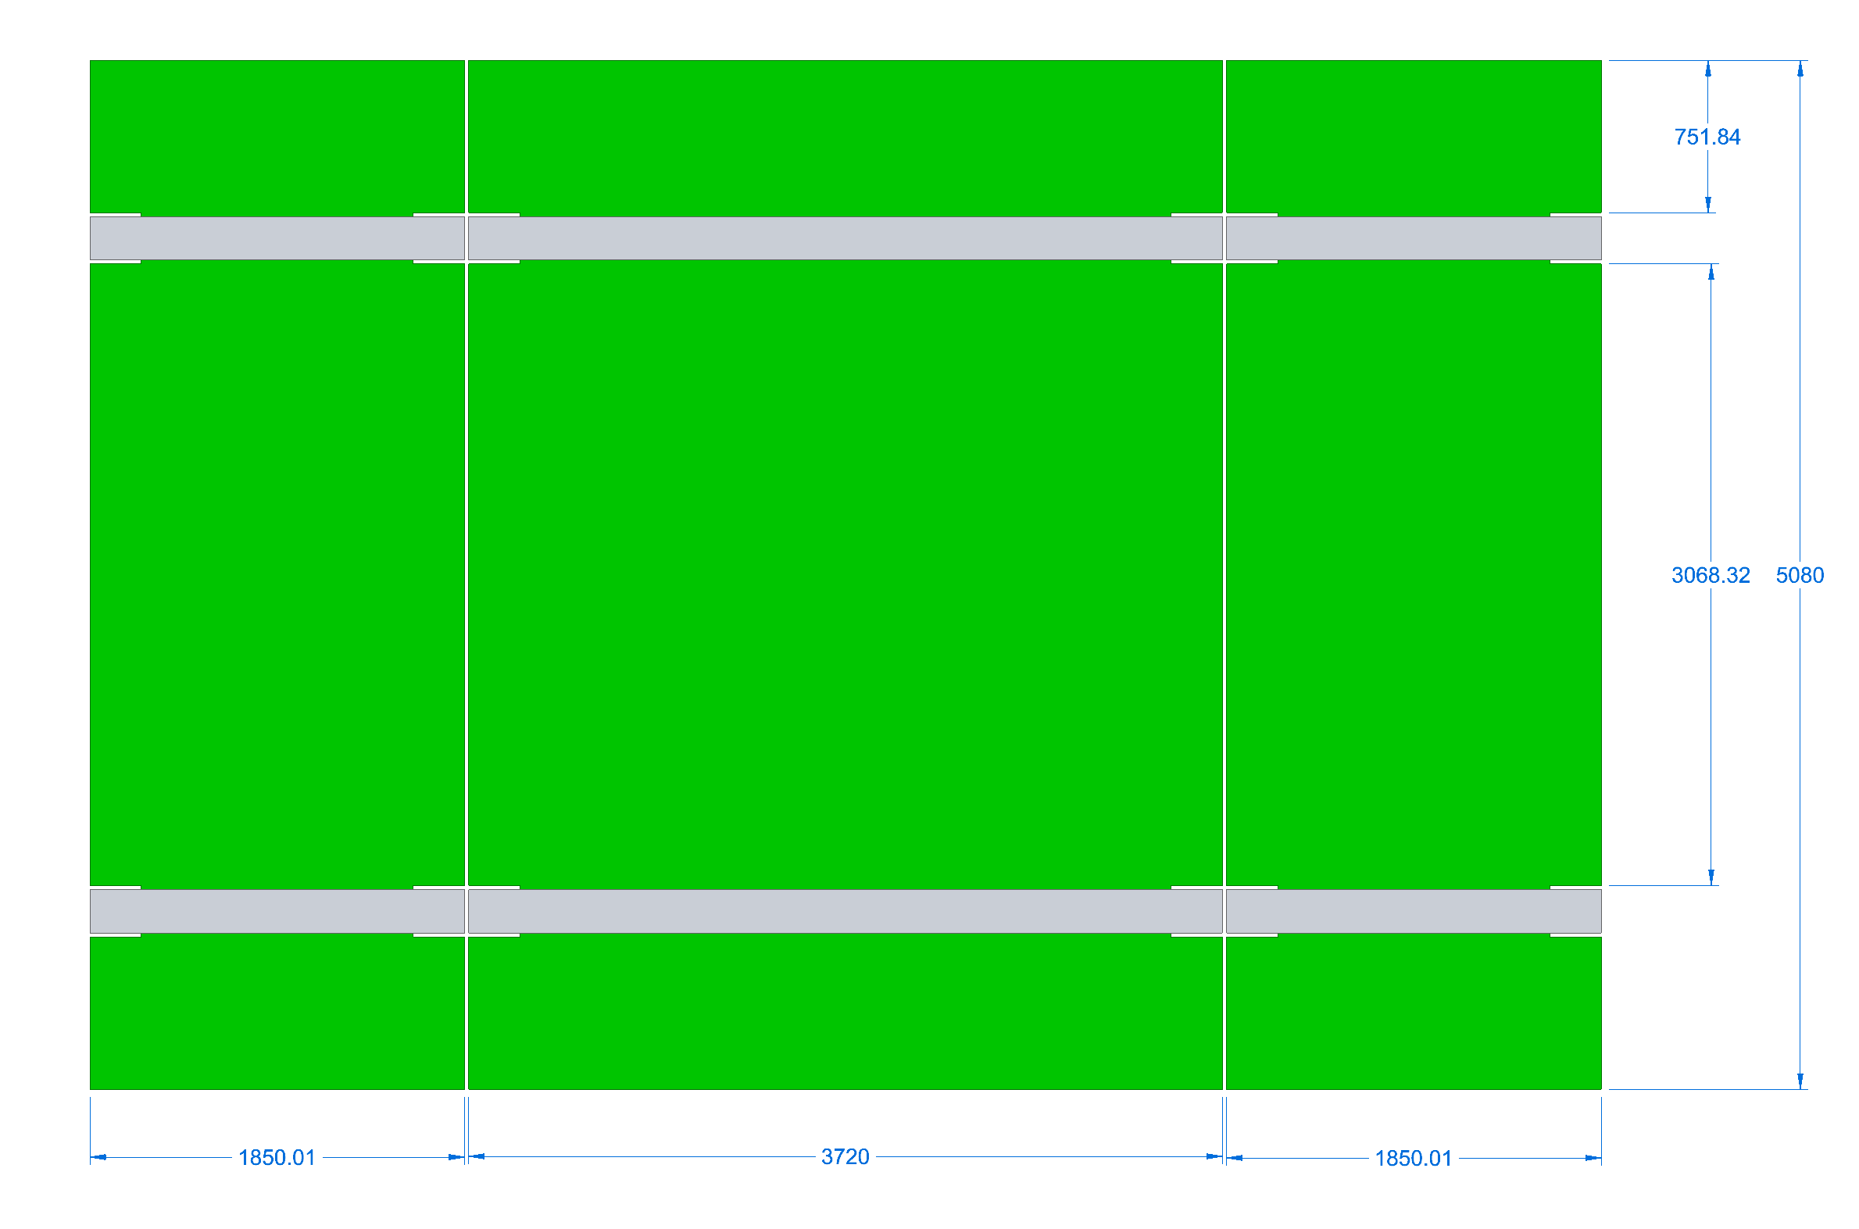
Steel Design – Changes from the CDR
The single layer is made of four plates, previously 3, with identical width, spaced horizontally by a 20mm gap (flatbed truck width < 3.5 m)
Shorter steel length beyond the coils, outside the fiducial volume
Low reluctance links to return the B-Field. 20% mass reduction
Space between the coils increased to 3.6 m to accommodate the cassette detectors for an increased active area
3
2
1
4
CDR, 820 tons
PDR, 711 tons. ~ 13% mass saving from CDR

Slide 6
Steel/coil integration parameters
5
5. The Notches in the iron plate from the CDR have been converted to Vertical Slots for the insertion of the pre-assembled coils
6. Coil package at 20 mm gap from the steel for installation clearance. Need to study the effect of the gap on the leakage field
6
6

Slide 7
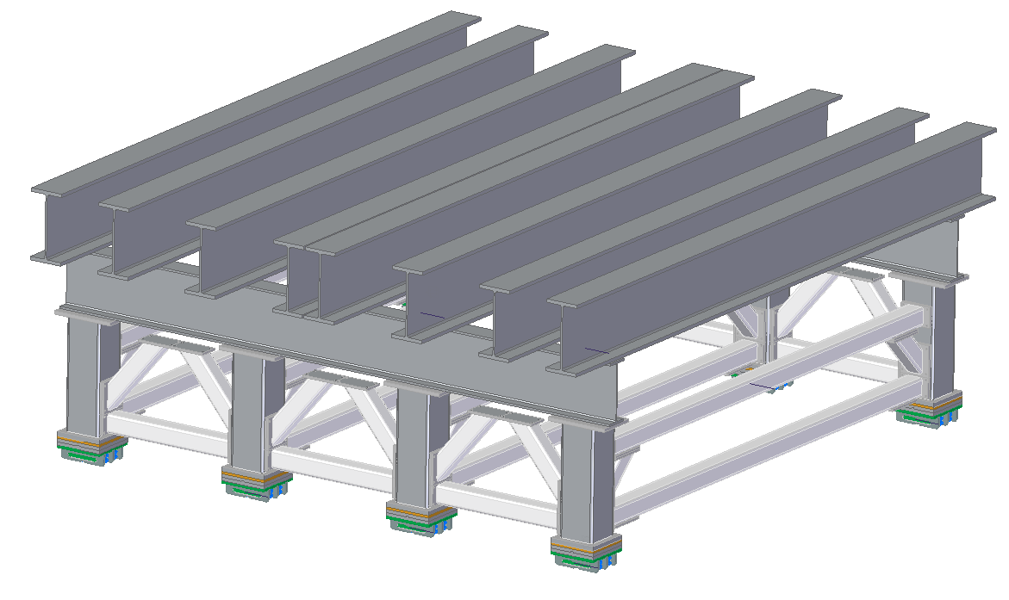
Support Frame – no changes from the CDR
The total mass of the support frame is 35 tons, A36 steel
The parts will be lowered in the cavern with 3-4lift
The assembly is welded and bolted underground
Commissioning with the PRISM motion system, before the assembly of TMS starts
PRIMS: Hilman rollers on steel rails

Slide 8
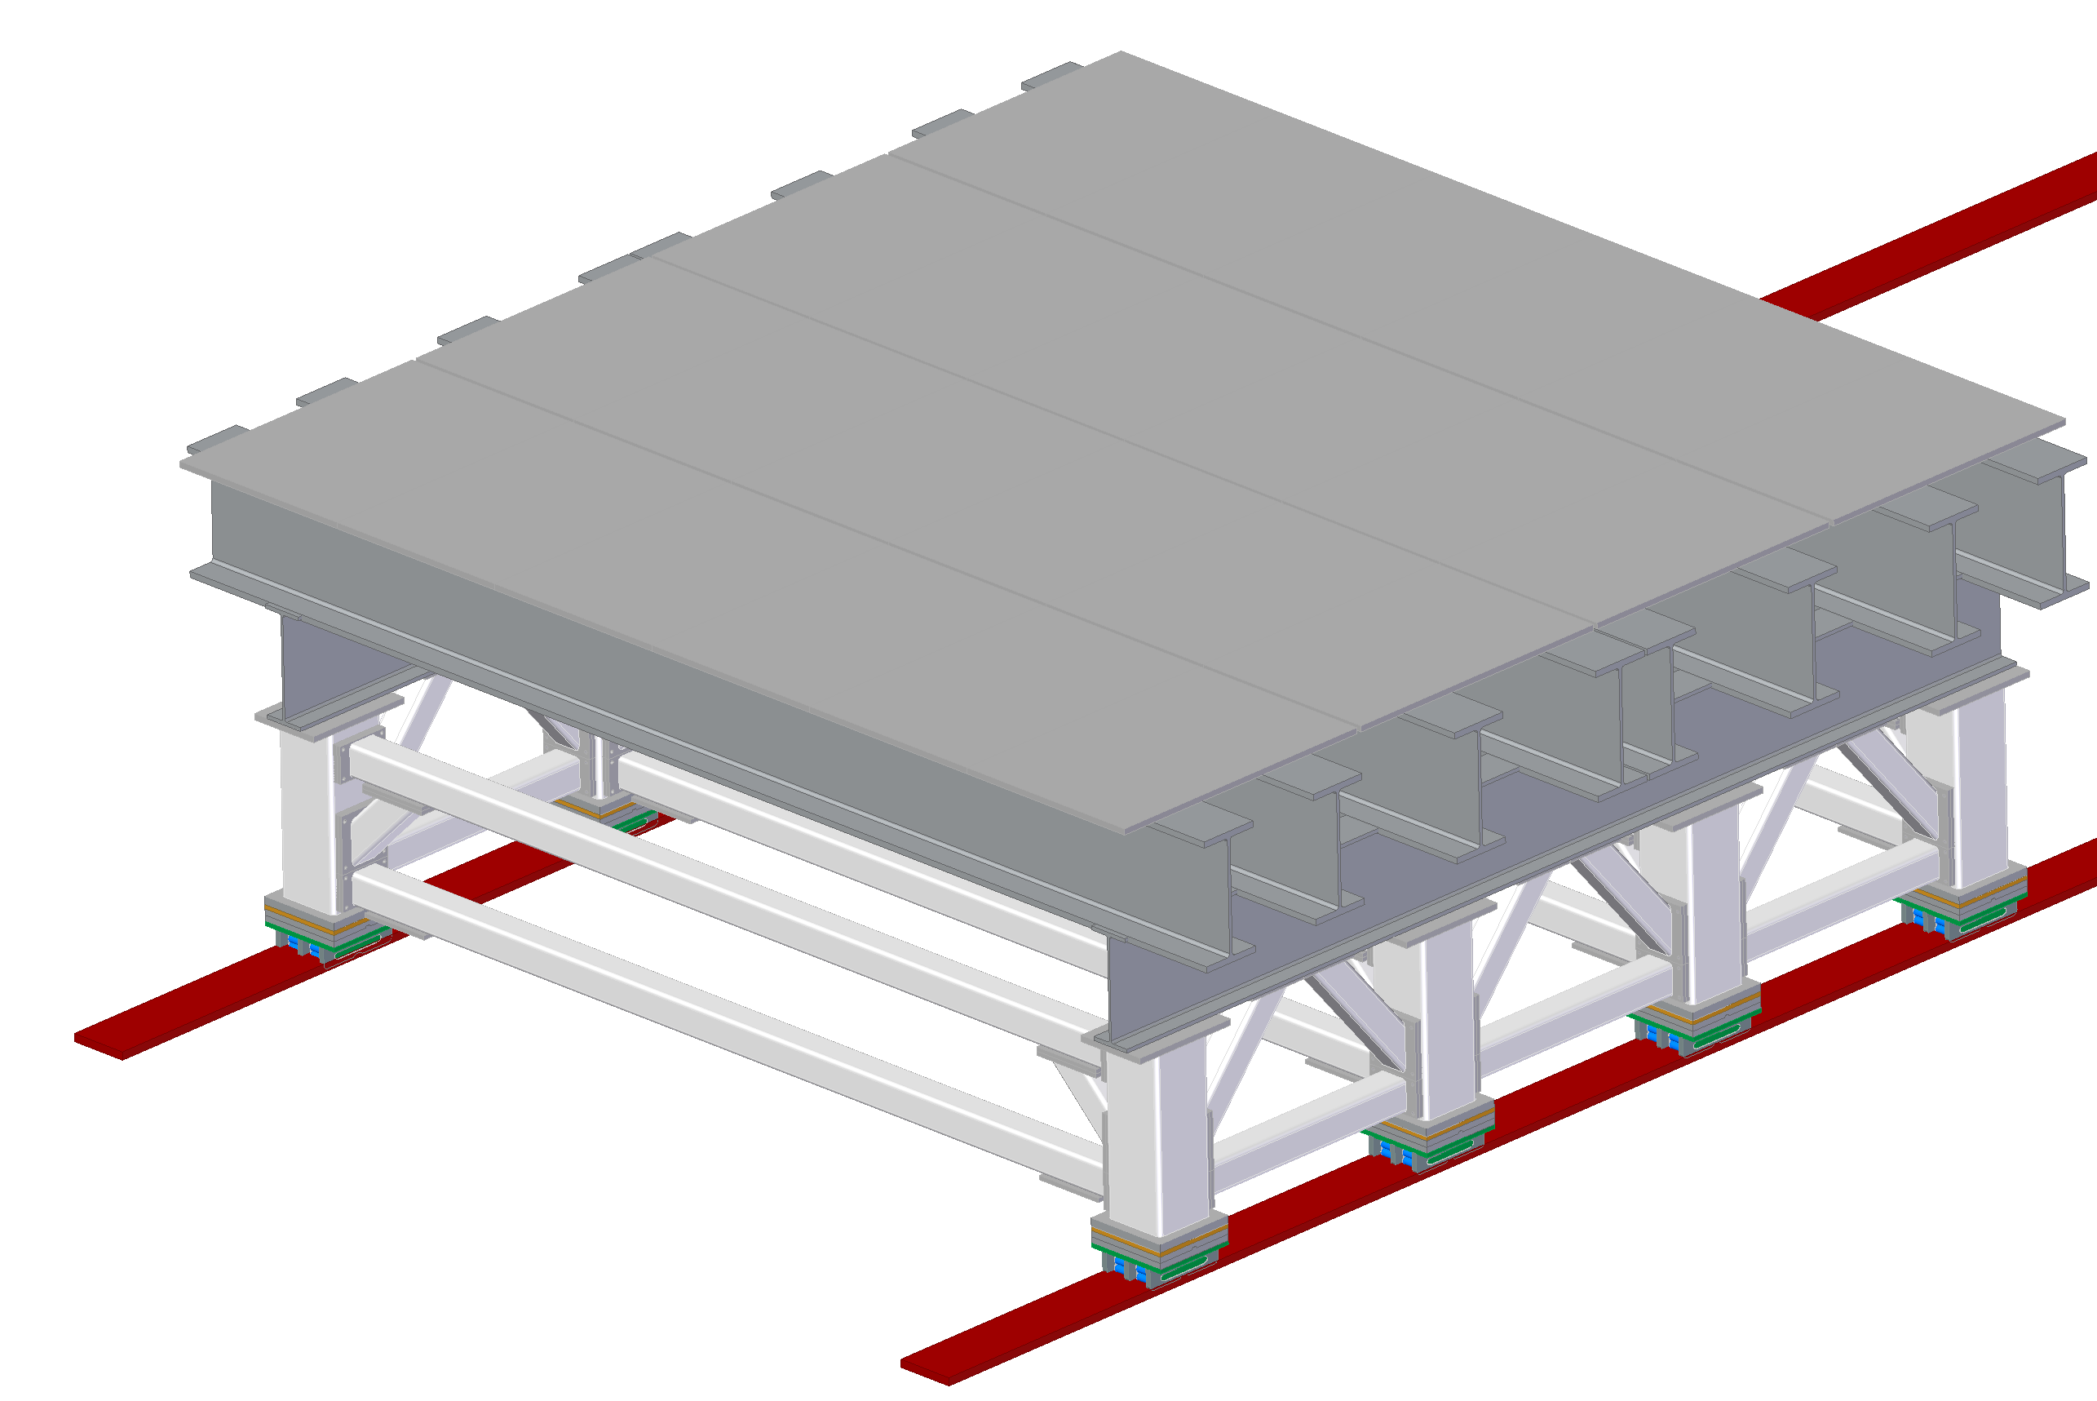
Magnetic isolation from the frame
The magnet is magnetically isolated from the frame by a bed of 4’x8’, 1.5” thick Aluminum tiles, to minimize local field distortion

Slide 9
Magnetic Forces
Despite the B-field analysis have been benchmarked on the results of CDR, we have still discrepancies on the magnetic forces for the steel plates and the coils
Directions and value of the magnetic forces are required to dimension the joints and interconnections
We believe that the B-flux return links mitigate substantially the problem, decreasing the magnitude of the attractive forces between the coil and steel and between the steel plates
The two end plates, will experience anyway large forces along the beam direction. The mitigation of this effect remains to be addressed. It is not complex either

Slide 10
Forces induced by B-field (CDR)
25kN
5kN
CDR studies, by V.Guarino et al.

Slide 11
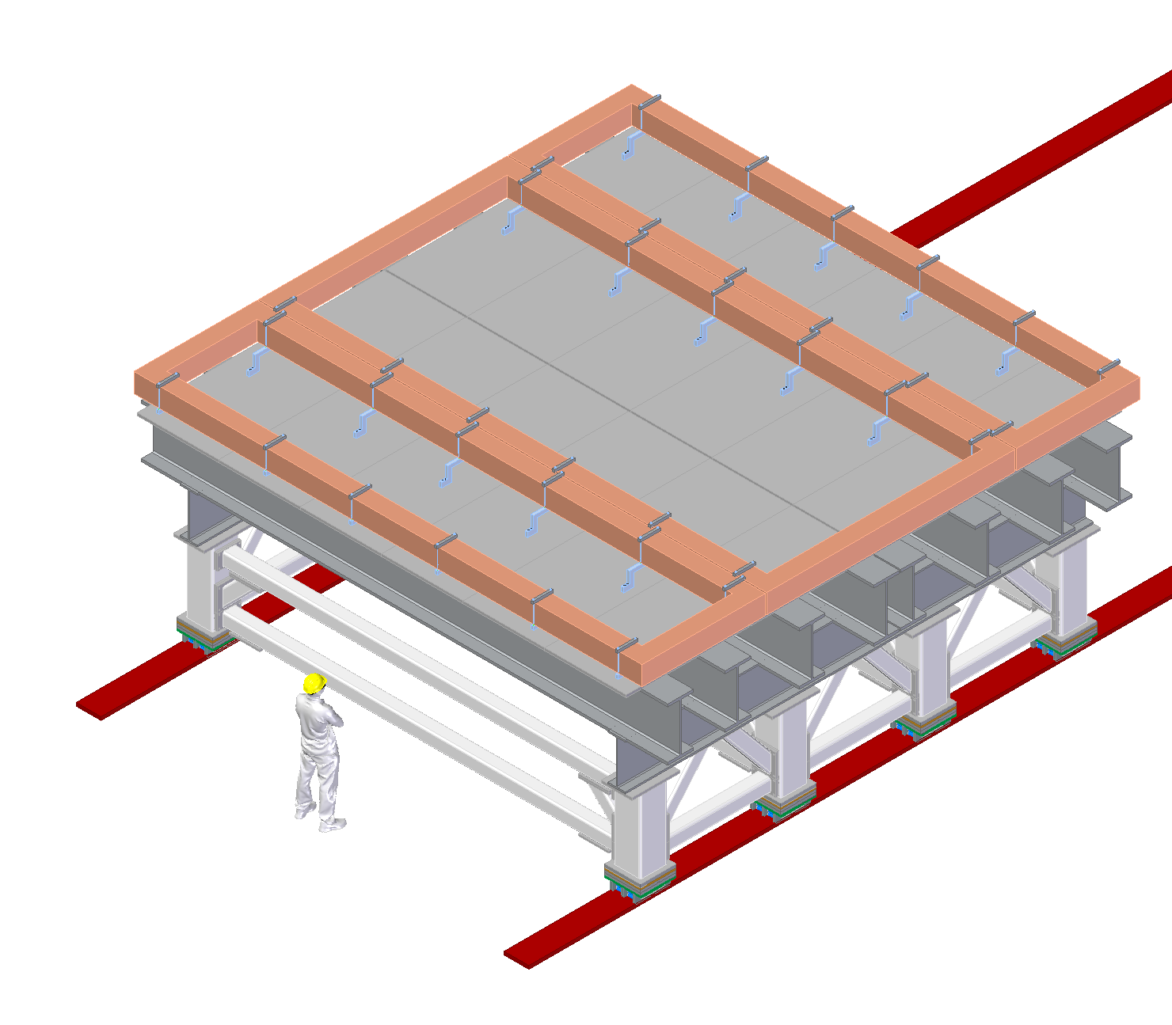
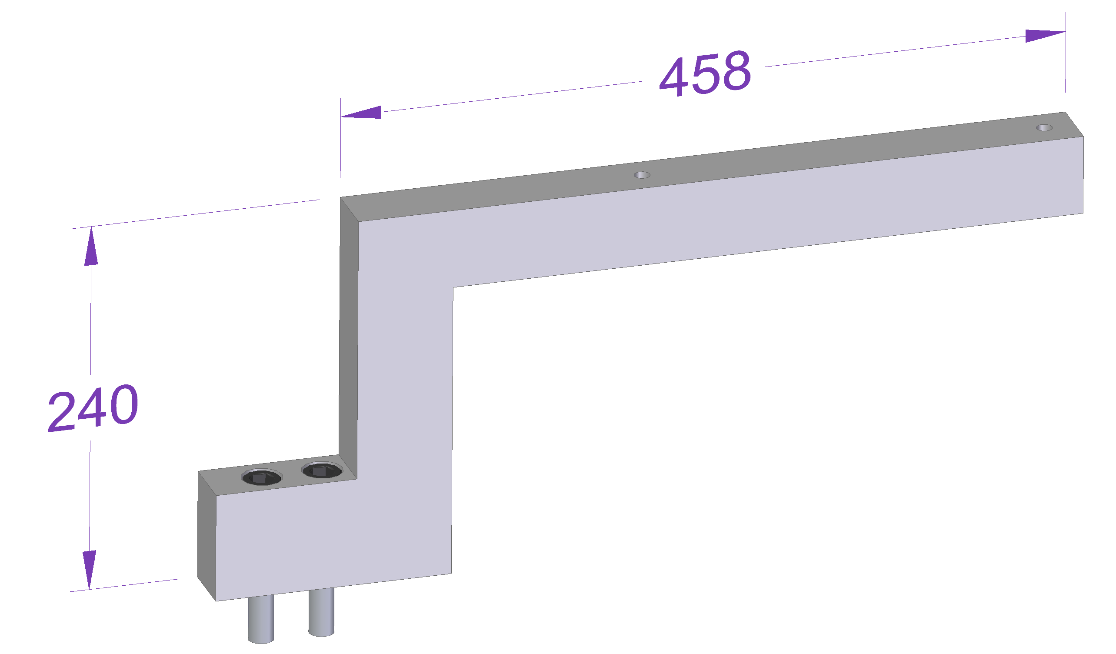
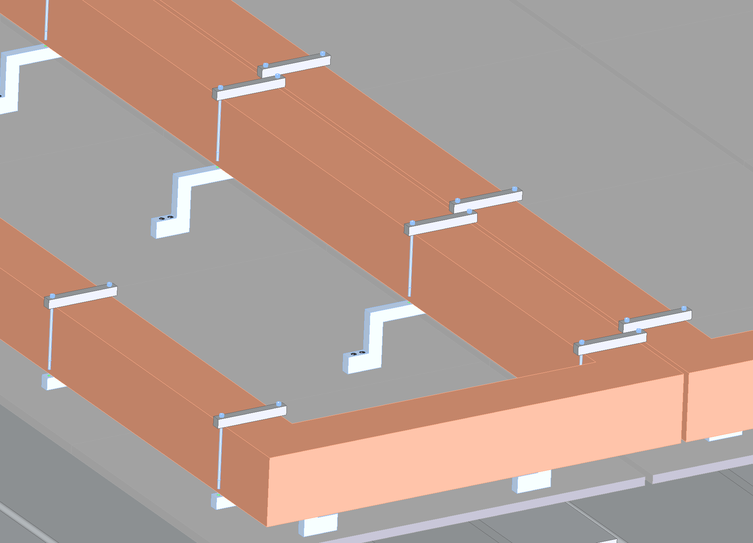
Installation of the Lower Coils
Coils mass, 6.5 and 8 tons each
The bed on the top of the support frame is equipped with Alu brackets, retraining the coils
Each coil segment is supported by six brackets
8 tons
6.5 tons

Slide 12
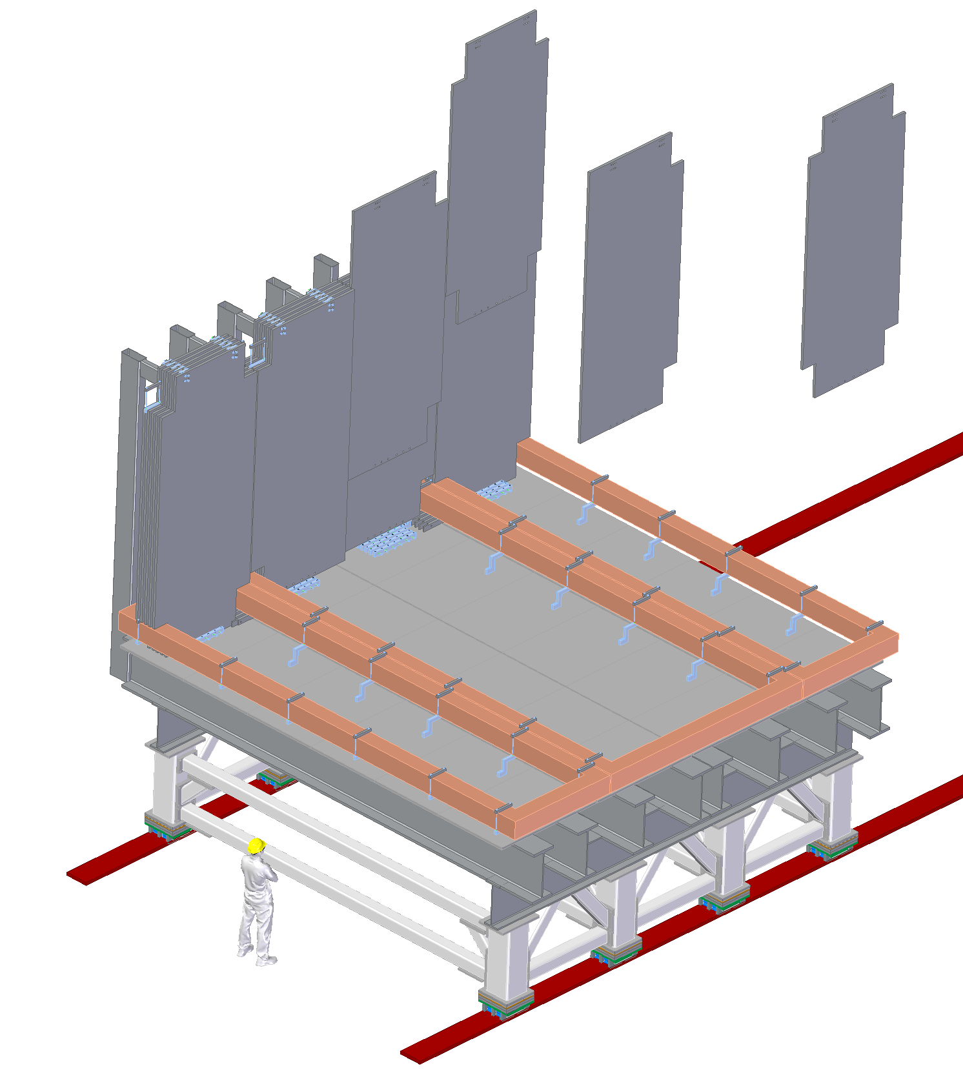
Steel Plate installation
The steel plate deck will be assembled sequentially, backward along the beam, i.e. 40mm plates first
A temporary support structure holds the first group of plates
Each plate is < 3 tons

Slide 13
Clamps/Spacer
A clamp/spacer is bolted to magnetic gap layer
It holds each plate to the support frame, reacting the magnetic forces
It set the gap between the plate along the beam direction
The clearance between the steel and coil is 20mm
required to accommodate the shape tolerances of the plate (±.125”)
Considered sufficient to keep the steel clear form the coil, when using a fine pitch crane hook

Slide 14
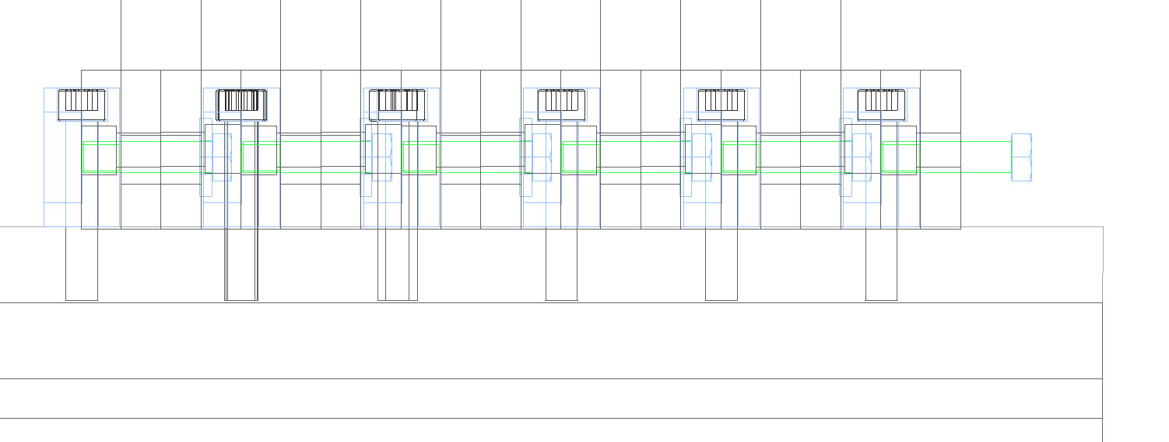
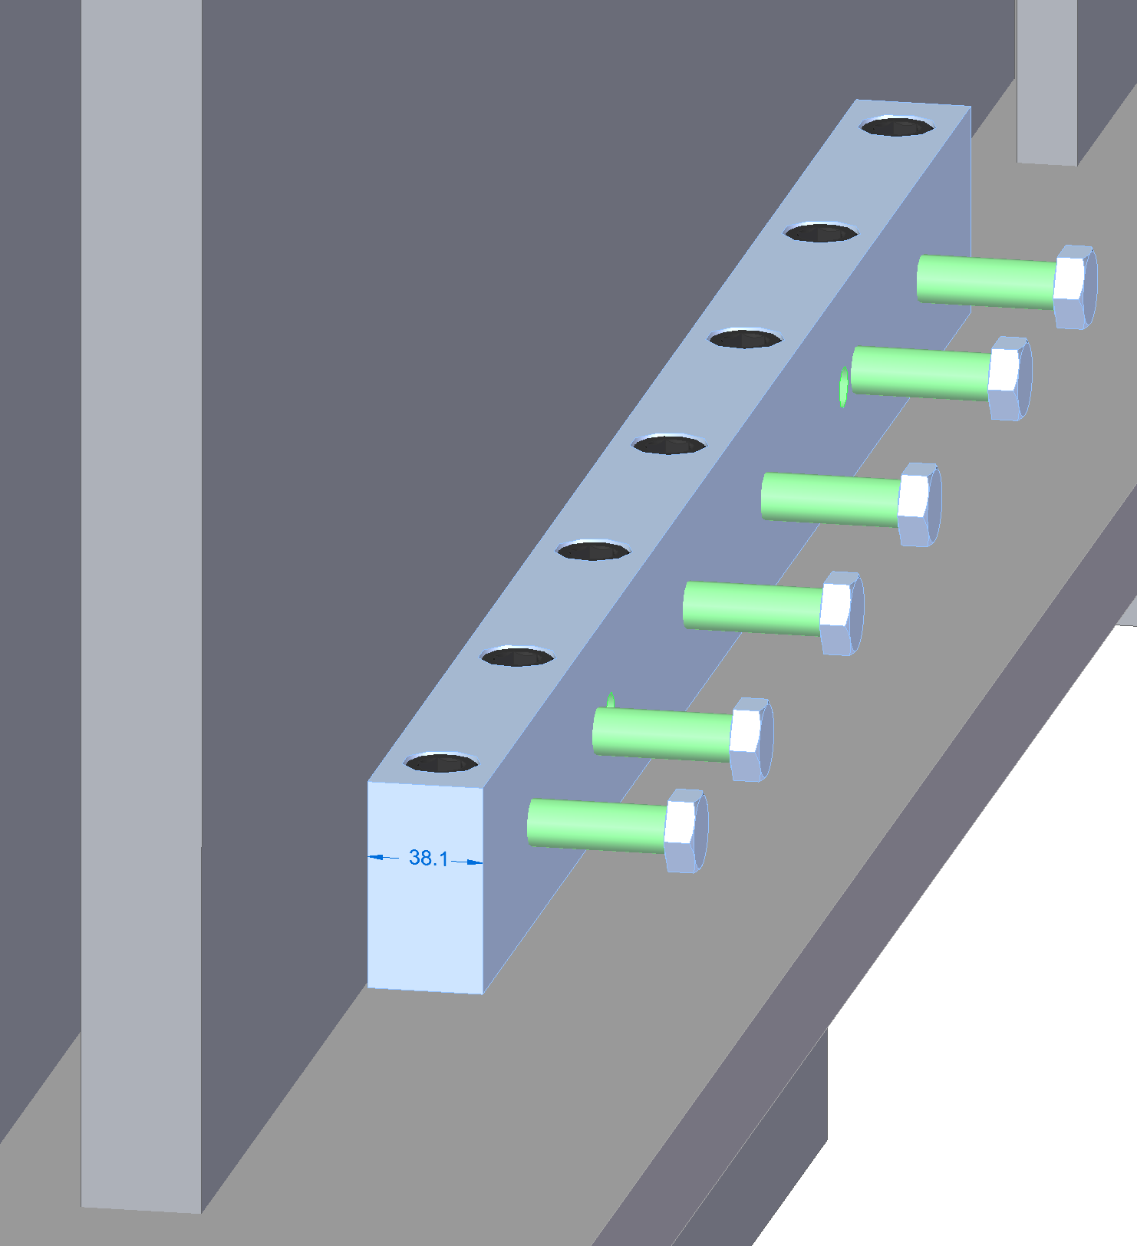
Spacer/clamp details
40mm
40mm
38mm
M16

Slide 15
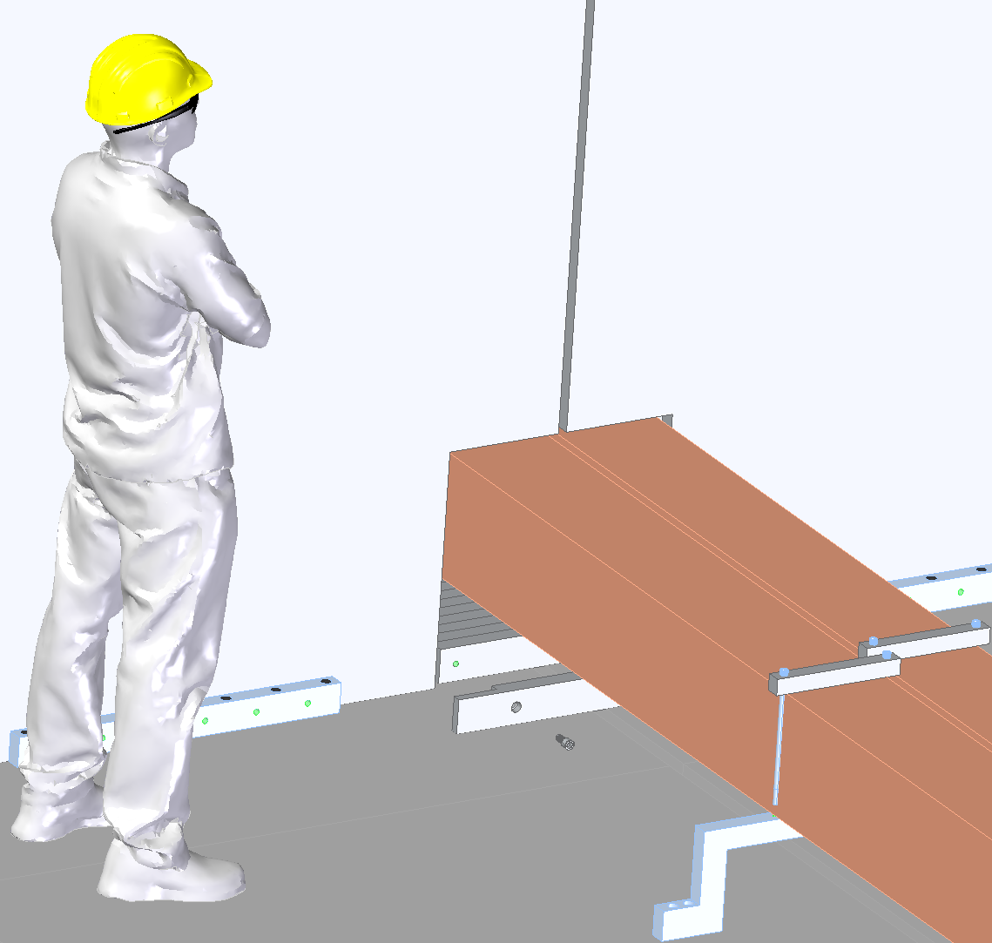
B-flux return links
The flux return links are installed individually, on each layer, while advancing through the assembly of the steel
M16 bolt
B-flux return link

Slide 16
Spacer/clamps & Upper coils supports
As the plate's assembly proceeds, additional spacers and support brackets for the upper coil are installed
Temporary supports
Upper coils bracket

Slide 17
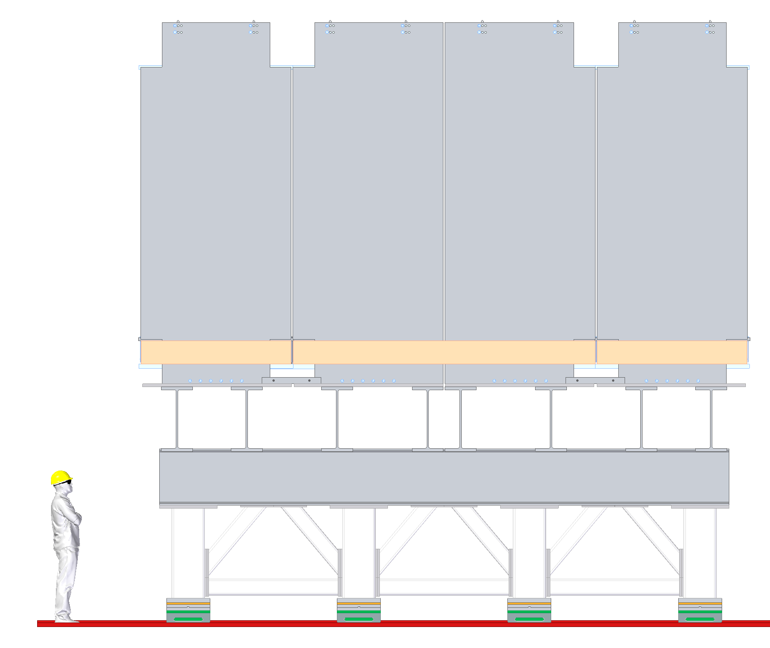
Before installation of the upper coils
The temporary support holding the first plates is removed, after a yet undefined number of plates has been secured to support frame
The full stack of 60 + 40 plates is completed, and it is ready for the installation of the upper coils

Slide 18
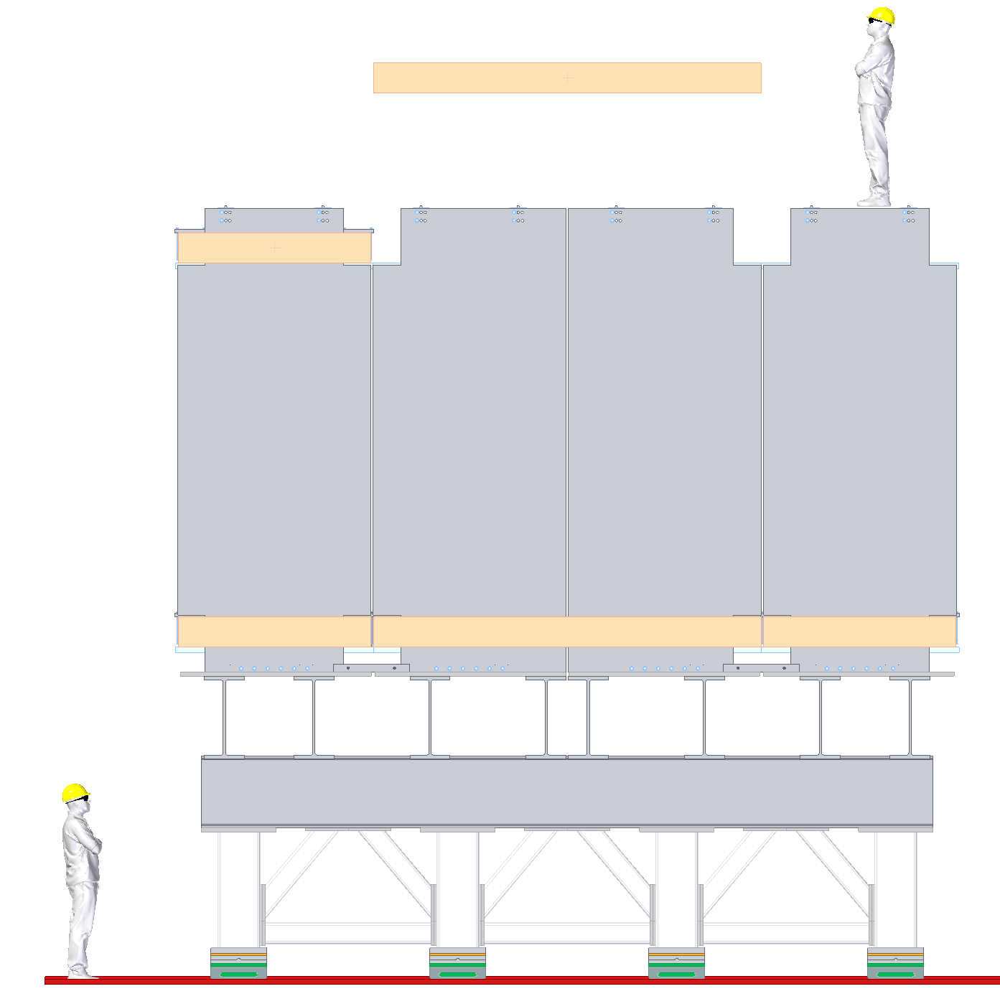
Upper coils installation
The Three pre-tested coils are lowered individually and attached to the support brackets
Fine pitch crane hook required to stay inside the 20 mm clearance form the steel
Handling fixtures
8 tons
6.5 tons

Slide 19
TMS ready for the Cassettes
Y detectors
U,V detectors

Slide 20
Cranes availability and working area
15 US tons crane on surface and 50 US tons underground
Pre-staging area on surface is limited and overbooked
The capacity of the crane and the area on surface are the limiting factor for proceeding faster
~ 60 critical heavy lifts required to lower the magnet and the support frame
With these parameters, we are assuming a sequential procedure where the individual steel plates flow continuously from the storage area to the cavern, with minimal prep before the lift
All the staging and pre-assembly work must be done underground
15 US tons
50 US tons

Slide 21
Underground Assembly area
TMS is assembled at center of the cavern in four different phases
Each phase duration is 3 months
Push-pull with ND/LAr

Slide 22
TMS frame at the end of the cavern

Slide 23
TMS magnet assembly area

Slide 24
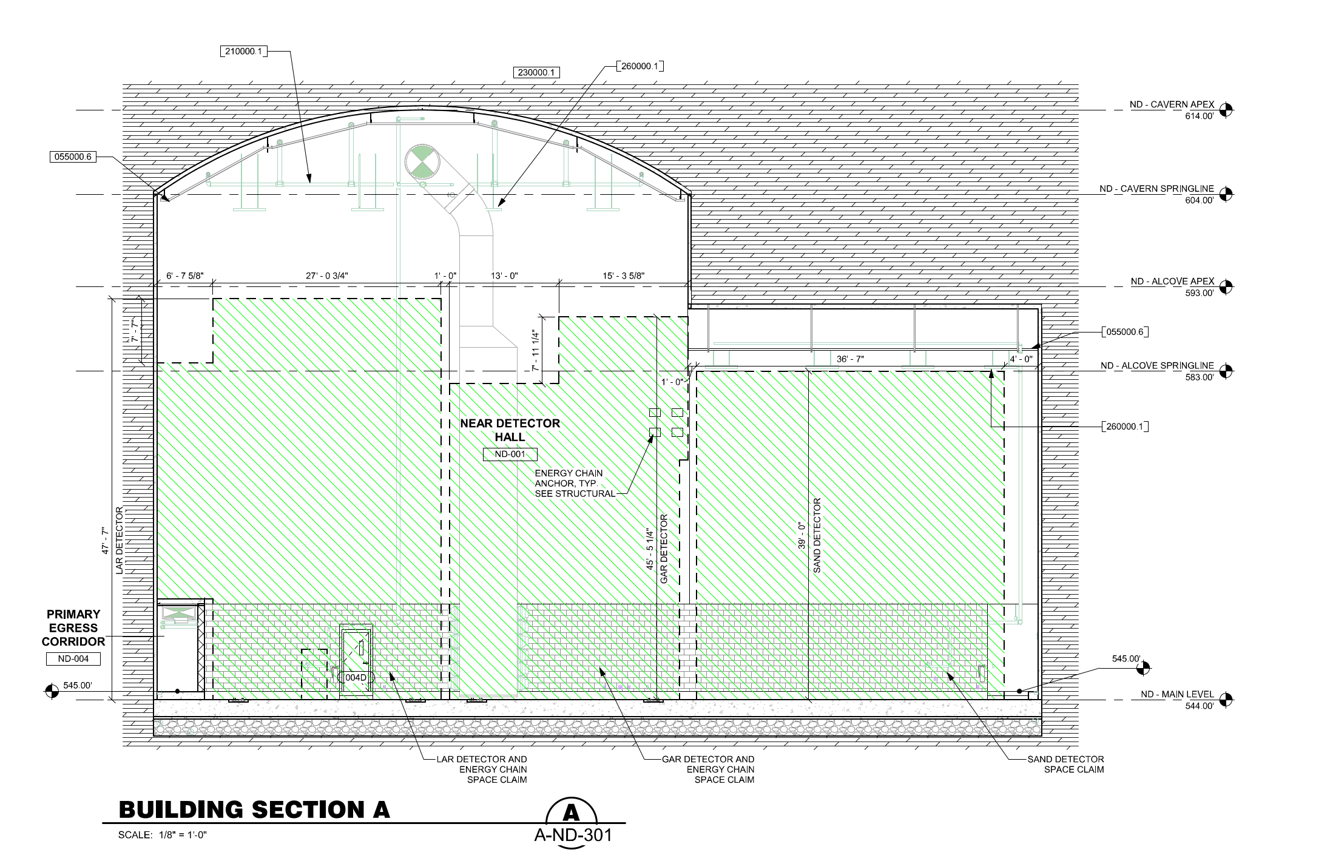
TMS envelope in the cavern
During the installation the ND/LAr and the TMS envelope are staggered along the cavern
Critical points:
The back of TMS is < 2 ft from the wall of the cavern
Limited crane coverage close to wall. Special lift beam required
At the nominal position on the beamline, TMS is at 1ft from ND/LAr
Crane access
ND/LAr
TMS

Slide 25
Steel procurement
Baseline with Steel AISI 1006
Two potential suppliers:
We have a budgetary quote of April 2021 from Ryerson
We added the option of Nucor, large still supplier in US. No quote yet, current cost estimation based on Steel price/lbs as market commodity.
Concern on the final tolerances achievable, affecting the design
Ryerson claims ±.125” for the profile edges
Nucor willing to quote for tighter ASTM A6 tolerances (see spare slides)
Considering of post-processing the plate with Waterjet cutting, + $600k, with an external vendor
Complex Logistic of moving 800 tons of steel from the vendor site to FERMILAB:
3.5 m is the size limitation of the flatbed truck
Expecting ~ 50 trips, no plans special transports
Supplier’s final selection will be based on a combination of scoring factors : cost, availability, final tolerances, logistic

Slide 26
Toward the PDR
I did not cover the design of the mezzanine(s), hosting the power supplies and the electronic racks. They will be structural part of the support frame. We need to converge on cabling routing and quantity and the location of the rack to allocate sufficient area
I did not address the concerns on the air gap for the cassette installation. The actual 40mm may turn out to not be enough.
Need to keep the cassette thickness envelope tight < 25 mm
Work with Steel supplier to investigate if possibility of getting tighter ASTM A6 specs ( ½ or ¼) is real but also cost and schedule impact
Or increase the gap from 40mm to 45 mm
Reach a sufficient level of confidence on the magnetic forces results from the FE analysis
Continue the development of the mechanical details of connections and interlinks
Waiting the outcome of the detectors size and coverage, for finalizing the dimensions of the steel plates before launching new Magnetic and Structural FEA

Slide 27
Toward the PDR - II
Although adjustment of the vertical space between the coils( 3.2 vs 3.6 m) won’t change the mechanical concept, we need to converge on the values, since at the PDR we must present a consistent overview: agreement between the FEA and the mechanical design dimensions
Continue the mechanical, thermal and electrical design of the coil
Continue working with I&I on crane access, special tool requires, storage and staging areas both on surface and underground
Not visible, a lot of work in the background, to finalize PRISM : Task Force with I&I, ND/LAr and TMS (represented by me) to develop common solutions for the most efficient motion system and its integration with the support frame

Slide 28
SPARE SLIDES
ASTMS A6 tolerances
Coil design
PRISM design
Images of the ND detectors underground

Slide 29
ASTM A6 tolerances

Slide 30
ASTM A6 Tolerances - Thickness
15 mm
± 380 um
40 mm
± 760 um

Slide 31
ASTM 6 Tolerances – Length and Width
19 mm
25.4 mm
28.6 mm
31.9 mm

Slide 32
Low Carbon - Flatness
± 25 mm
15 mm
40 mm
± 22 mm

Slide 33
Supplementary Requirements Flattness
The following standardized supplementary requirements are for use when desired by the purchaser.
Those that are considered suitable for use with each material specification are listed in the
specification. Other tests may be performed by agreement between the supplier and the purchaser.
These additional requirements shall apply only when specified in the order, in which event the
specified tests shall be made by the manufacturer or processor before shipment of the material.
± 12.5 mm
15 mm
40 mm
± 11 mm

Slide 34
Summary - ASTM 6
 | 15 mm | 40 mm
Thickness | ± 380 um | ± 760 um
Length | 19 mm | 28.6 mm
Width | 25.4 mm | 31.9 mm
Flatness | 25.4 | 22 mm
Enhanced Flatness | 12.5 mm | 11 mm

Slide 35
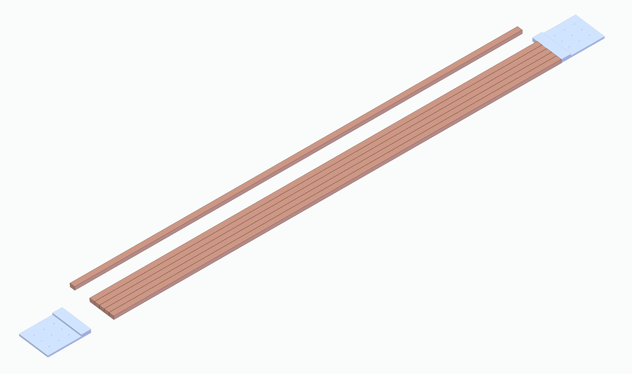
MINOS Planks Stack
Single planks made of multiple conductors
Stack of planks for each coil segment
Single plank
Electric contacts require careful engineering.
The problem has been solved for MINOS

Slide 36
Coil Cooling Circuit
ID15mm, 10 gpm
DP= 0.1 bar/m
17m
21m
17m

Slide 37
PRISM req.s
Move TMS across the beam line over a distance of 30m in < 8hr, including detector ramping down/up. Speed ~ 1-2 mm/s
Task Force to develop a common solution for TMS and ND/LAr
Powered Roller
Boogie
Rack and Pinion

