Slide 1
Project Activities for MSD
Mayling Wong-Squires
AD Operations Friday 9am Meeting
2 August 2024

Slide 2
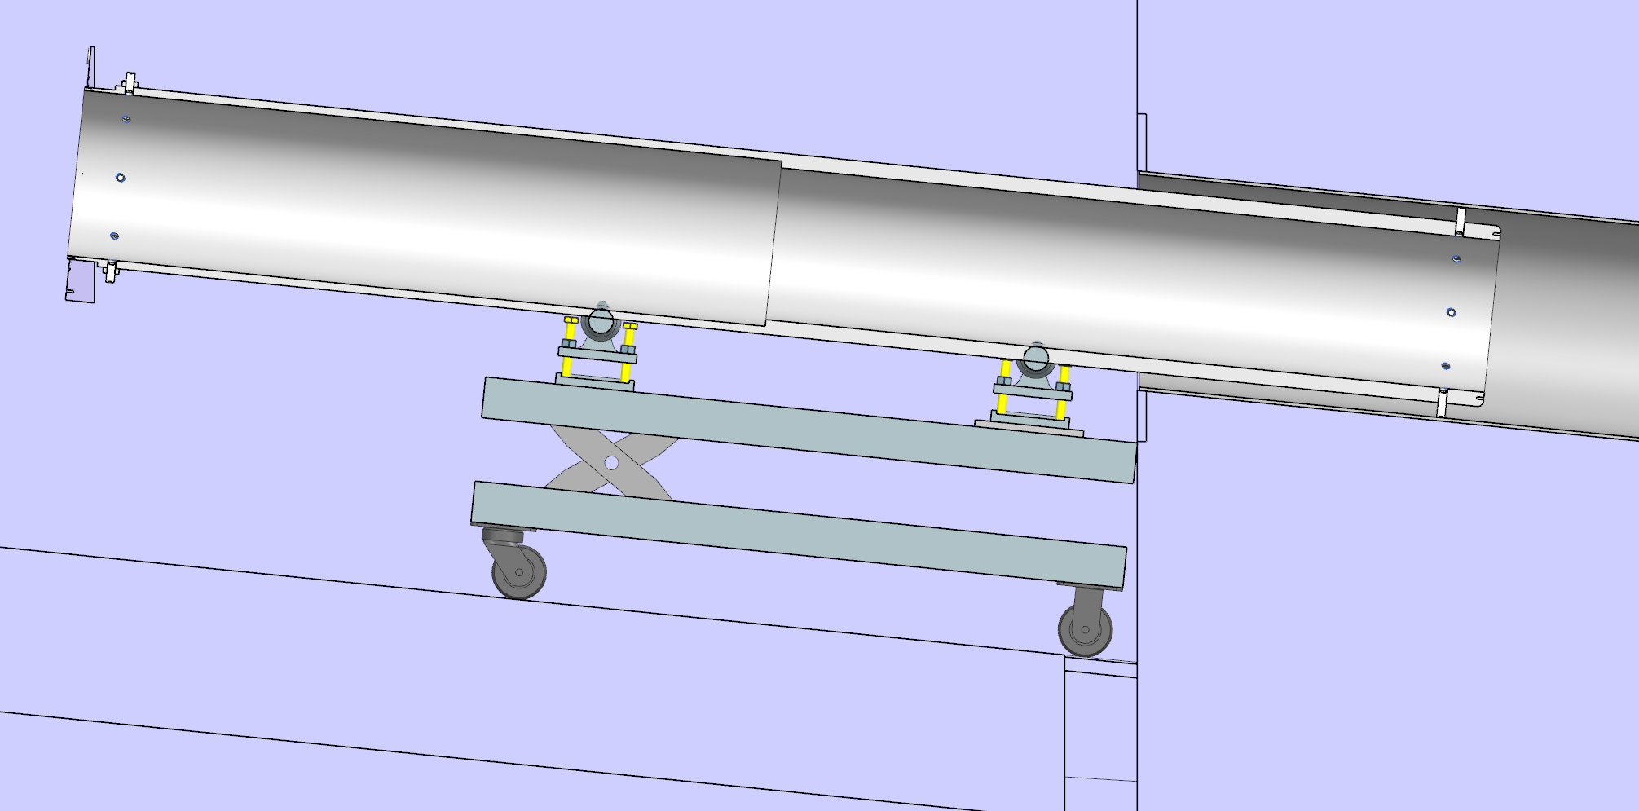
LBNF Primary Window Cartridge & Window Status Chris Ader, Clark Reid, Yuenian Huang, Greg Bulat
Working on
Procurement package of the rotating cartridge has been sent out for bid.
Bids sent out starting end of Jan. 2024
11 vendors were contacted, 9 were “no bid”
We received two bids: one from Magna and one from Eclipse
One bid is less than $200K and the other is over $400K
Greg has submitted a req for approval to Irma
Installation plan of the cartridge assembly is being worked on
FEA of the Beryllium window continues: adding residual stress for the analysis on flat window
Coming up
Testing of the rotation of the cartridge would occur at A0 with the help of the Beam-lines techs end of this year/early next year
Department resources needed
Engineering (vacuum window engineering note and installation planning)
Fabrication Procurement (rotating cartridge)
Design (installation and any needed vacuum window modifications)
Installation of the cartridge into the AECOM pipe using adjustable rollers and lift table.

Slide 3
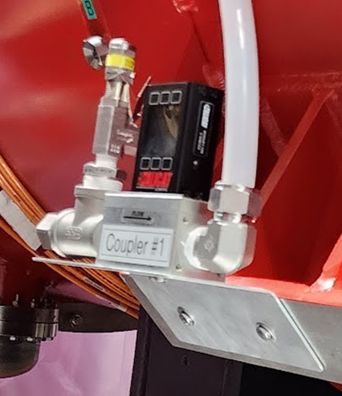
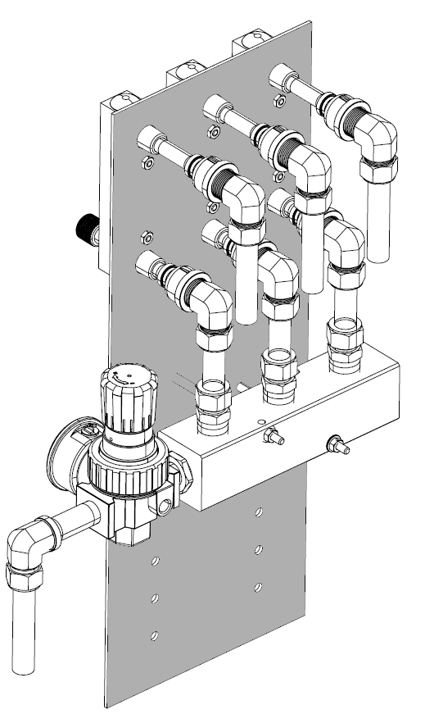
PIP-II LCW Update Maurice Ball, Michael Geelhoed, Jerzy Czajkowski (Retired), Michael Hanson, Jason Grischkat, Monika Sadowski, Frank Rios, Amos Horton
Milestones
Awarded: Process Cooling Water Pump Room’s Piping Installation Contract Awarded to Rachke Piping and Mechanical, Inc.
Completed: Procurement of compressed air manifold assemblies for RF couplers
Current work
Material procurement and review of submittals
Procurement readiness underway for WFE piping manifolds
Ion source, LEBT, MEBT
RFQ Skids and interconnecting piping
Compressed air manifold distribution to individual cryomodule RF couplers

Slide 4
CMTF LCW Status Maurice Ball, et al.
Accomplishments
Completed: LCW chiller preventative maintenance
Completed: Tunning of cryoplant’s Arctic chiller tuning under load
Current work:
Quotes underway for minor repairs of LCW chiller
Minor repairs and condenser preventative maintenance scheduled for cryoplant’s Arctic chiller
CMTF LCW Chiller receiving much needed PM and repairs

