Slide 1
Main Injector Shutdown Status
Marty Murphy
9 o’clock Meeting
August 2, 2024

Slide 2
General
Monday, all MI enclosures (MI-8, MI-10 and MI 20-62) are on shutdown keys.
MI-10 and MI 20-62 require KRS LOTO in the MCR
All three enclosures have unique RWPs that must be read and signed
-In the MCR or Online
Some areas of the tunnel will have work site specific PPE requirements.
MI-8 collimator area will require steel toe shoes, eye protection, gloves and hard hats.
September 23rd:
Beam to users???
2
MI Department Meeting | D. Morris
7/31/2024

Slide 3
Tunnel Work
MI-8 Collimator installation (10 weeks)
Base plates have been installed and are aligned
Grouting should be completed today
RF Dual PA cavity upgrades (3 stations)
Electrical pulls are complete
Upgrade four modulators (one spare)
Repair Ion Pumps
Replace last of the white LCW hose (underway)
Fix Recycler Vertical IPM cables, (vacuum was vented today)
Address found leaks (underway with TD support)
MI-201 Sump discharge line replacement (stairwell/alcove only)
MI-218 Sump discharge line replacement (entire line).
Underway.
Vacuum issues in P150 line (~704) being investigated
3
MI Department Meeting | D. Morris
7/31/2024

Slide 4
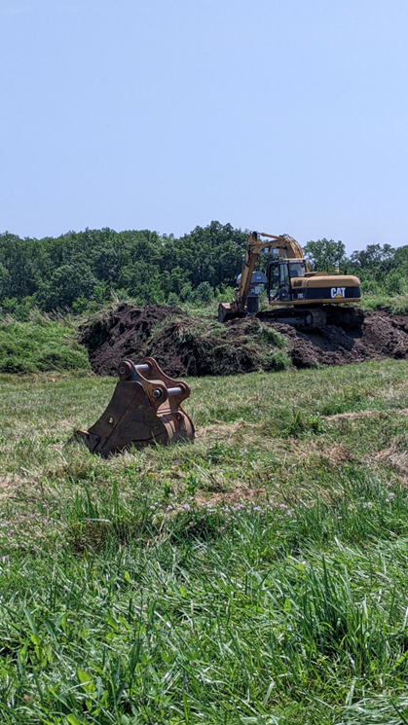
Upstairs Work
Main jobs:
MI-20 Upper transformer cable pulls
MI-20 Lower transformer cable pulls
Heat Exchanger cleaning: MI-62 finished,
MI-8 in progress (still). Offsite for a
few days
VCB PMs
Transformer/Switchgear PMs
PM all LCW pumps/motors
MI-218 excavation for sump line replacement
4
MI Department Meeting | D. Morris
7/31/2024

Slide 5
Conventional Power Outages
Please report any additional MI outages to the MCR.
5
MI Department Meeting | D. Morris
7/31/2024

