Slide 1
Muon Campus Shutdown Report
Jim Morgan
Friday 09:00 Shutdown Meeting
August 2, 2024

Slide 2
Muon Campus status
Many tunnel jobs still need engineering or planning details to be completed
LCW system recovered well after weekend CUB power outage
F-27 water skid turned back on after weekend CW outage, RF skid left off
MSD valved out CW lines on AP-50 RF skid, which is off for the summer
ELAM downstream motion issue resolved by moving Limit Switch brackets
M4 Final Focus LQ’s had more fiducials added because of power lead covers
Planning for Power Supply primary wiring and circuit breaker work
ESS2 cathode came back after electrochemical polishing
Has some warpage, but is thought to be acceptable
AP-0 A/C work Tuesday-Friday last week, but don’t think they’ve been back
Required access to AP-0 water cage and rad fence area
Study – M1-M3 Optics
Study – Alternative M5 optics

Slide 3
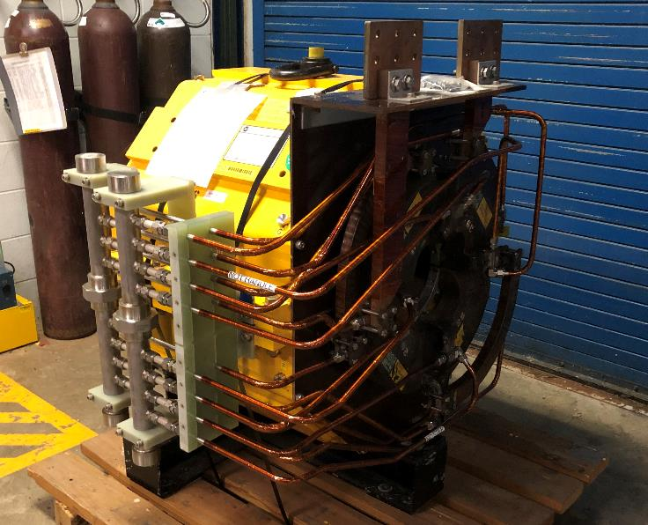
Rad hardened 8Q24 quadrupole
Rad hardened water lines, reworked by TD
Existing 8Q24 at Q205 in original BNL configuration

Slide 4
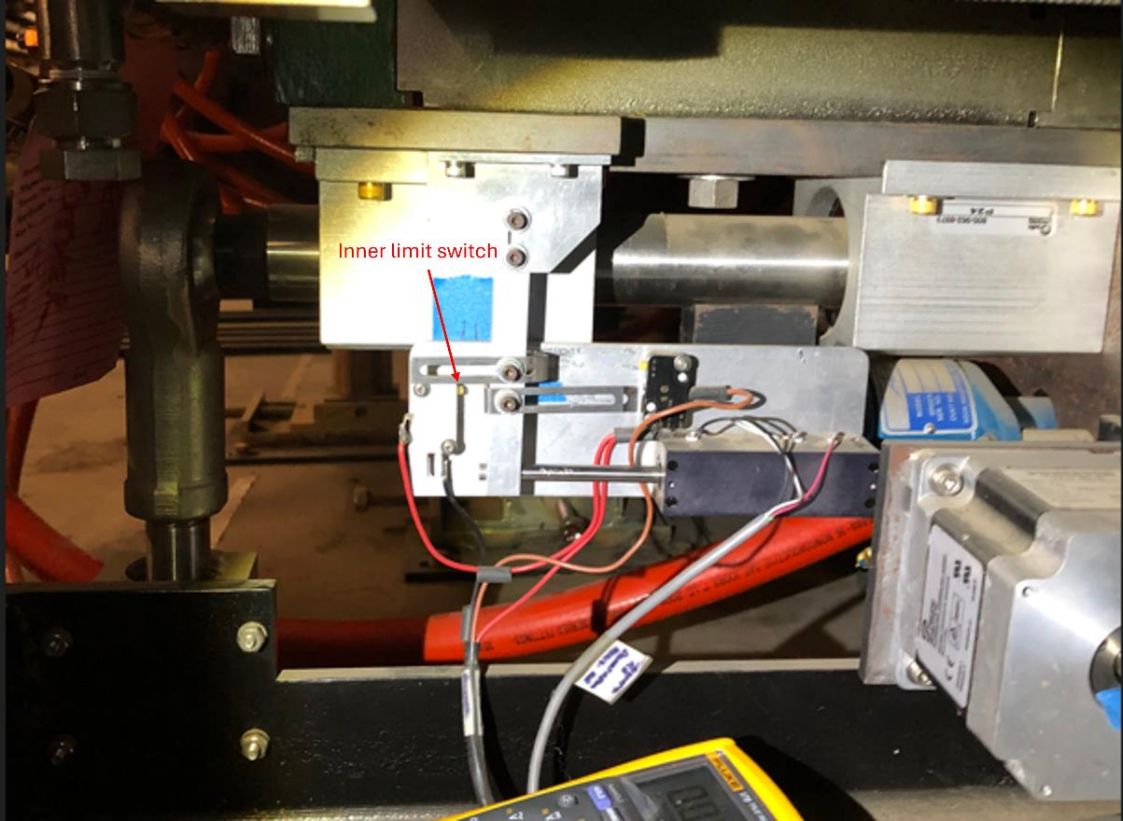
Extraction Lambertson downstream motion fix
Limit brackets moved

Slide 5
Upcoming work
Main worklist items
Install rad hard 8Q24 at Q205, send uninstalled 8Q24 to TD for rad hard water lines
Q205 vacuum pipe replacement to simplify vacuum connection to ELAM
Unroll ELAM (was rolled 24 mr to improve g-2 extraction trajectory)
Several alignment tasks including D30 level run and M4 Final Focus
ESS1 and ESS2 septum stand motion-control improvements
ESS fluorinert piping installation from AP-30 to tunnel
M4 Final Focus vacuum installation
Identify and fix Injection Kicker downstream horizontal motion problem
Need to check sizing of all power supply panel breakers, upgrade as necessary
Install additional steel shielding above ECMAG
Repair Kirk Key hardware on disconnects
AP-0 Dump system will be drained and water lines blown out
Hope to finish operational ESS2 and install it in tunnel late in shutdown
ESS2 (operational version in A0 Clean Room)
ESS2 cathode will probably be installed with the small warpage
Three-point cathode support adjustments may reduce the warpage
AP-0 A/C controls work paused; reason unknown
Jerry is on vacation; I’ll be main Muon Campus contact person until Wednesday

