Slide 1
Accelerator
Summer Shutdown
Tony Busch
AD Shutdown Coordinator
Planning & Integration Department

Slide 2
Shutdown 2024 Timeline
Operation limitations
Milestone 1
Milestone 7
Define Shutdown Coordinators.
Milestone 3
Complete shutdown.
First pass resource level Schedule.
Milestone 5
Milestone 8
Final resource level Schedule.
Complete
Startup.
Milestone 2
ID Jobs to the 90% level.
Milestone 6
Milestone 4
Milestone 9
Second pass resource level Schedule.
Start Shutdown.
Return HEP
Dec
JAN
FEB
MAR
APR
MAY
JUN
JULY
AUG
SEP
OCT
NOV
DEC
Define Scope
Plan
Execute
Execute
HEP
Determine Jobs
Plan phase 1: Define schedule
Plan phase 2: Finalize Schedule
Crew Marching orders
Execute Shutdown
Execute Shutdown
Close out
Shutdown parameters
Original Duration: 10 weeks. Operational limitation period will extend shutdown ~2 extra weeks due to pause.
End of tunnel work/power outages (last outage 10/10 in Main Injector.
Week of Monday October 7th

Slide 3
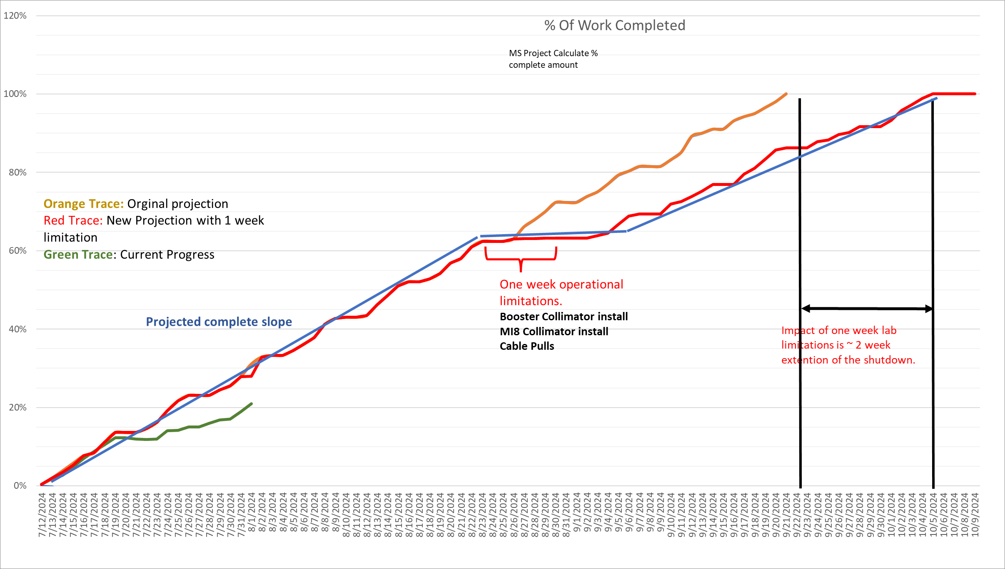
Shutdown Progress
As of 8/1/24

Slide 4
Power outage progress

Slide 5
Power Outages upcoming week
(Aug 5th – Aug 9th )
Tuesday August 5 through 6th
Feeder 96/97 pulsed power, MI8, MI14, MI40, MI52, MI60, MI62 all pulsed power
Spans: 8/5 08:20 - 8/6 16:00 hrs.
Thursday August 8th
Feeder 44, Education Center, MBD, MINOS, NOvA, SBFDB, LaRTF, Swan Lake, MiniBooNE, ICARUS
Spans 0800-1620
Friday August 9th
Linac, L1, L2, L3
Spans: 08:20 - 16:00 hrs.

Slide 6
Keep communications open
Over the next week we will be looking at any necessary adjustments to the schedules and work lists.
The collimator work and electrical work will continue during the operationally limited period.

