Slide 1
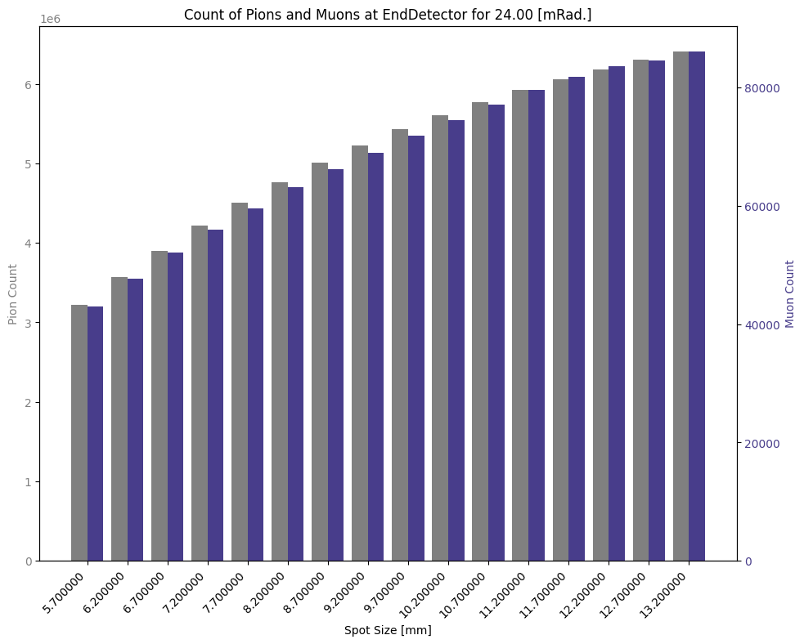
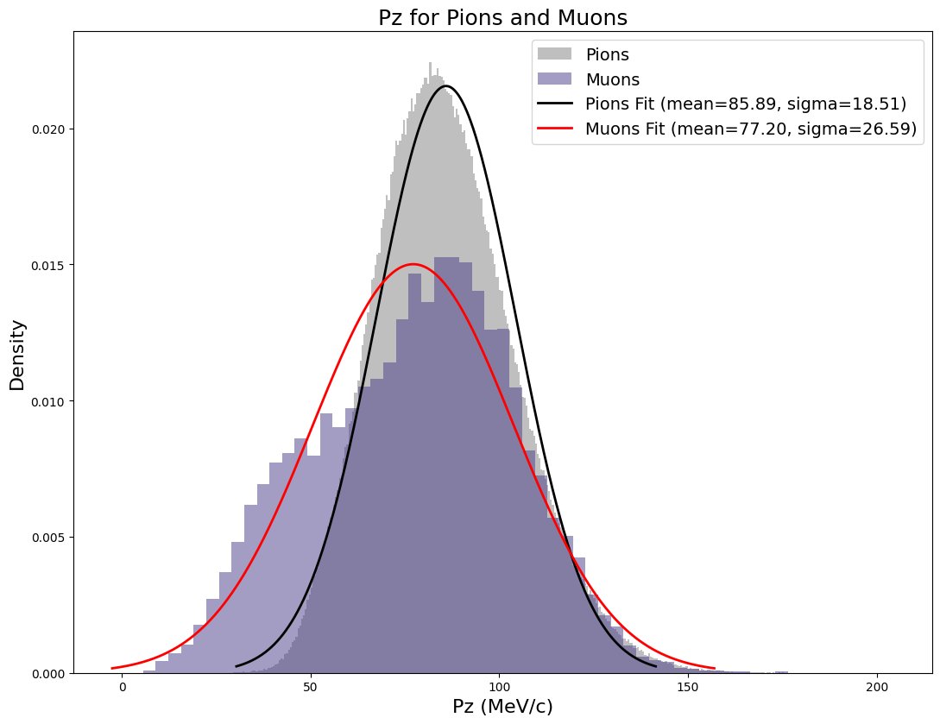
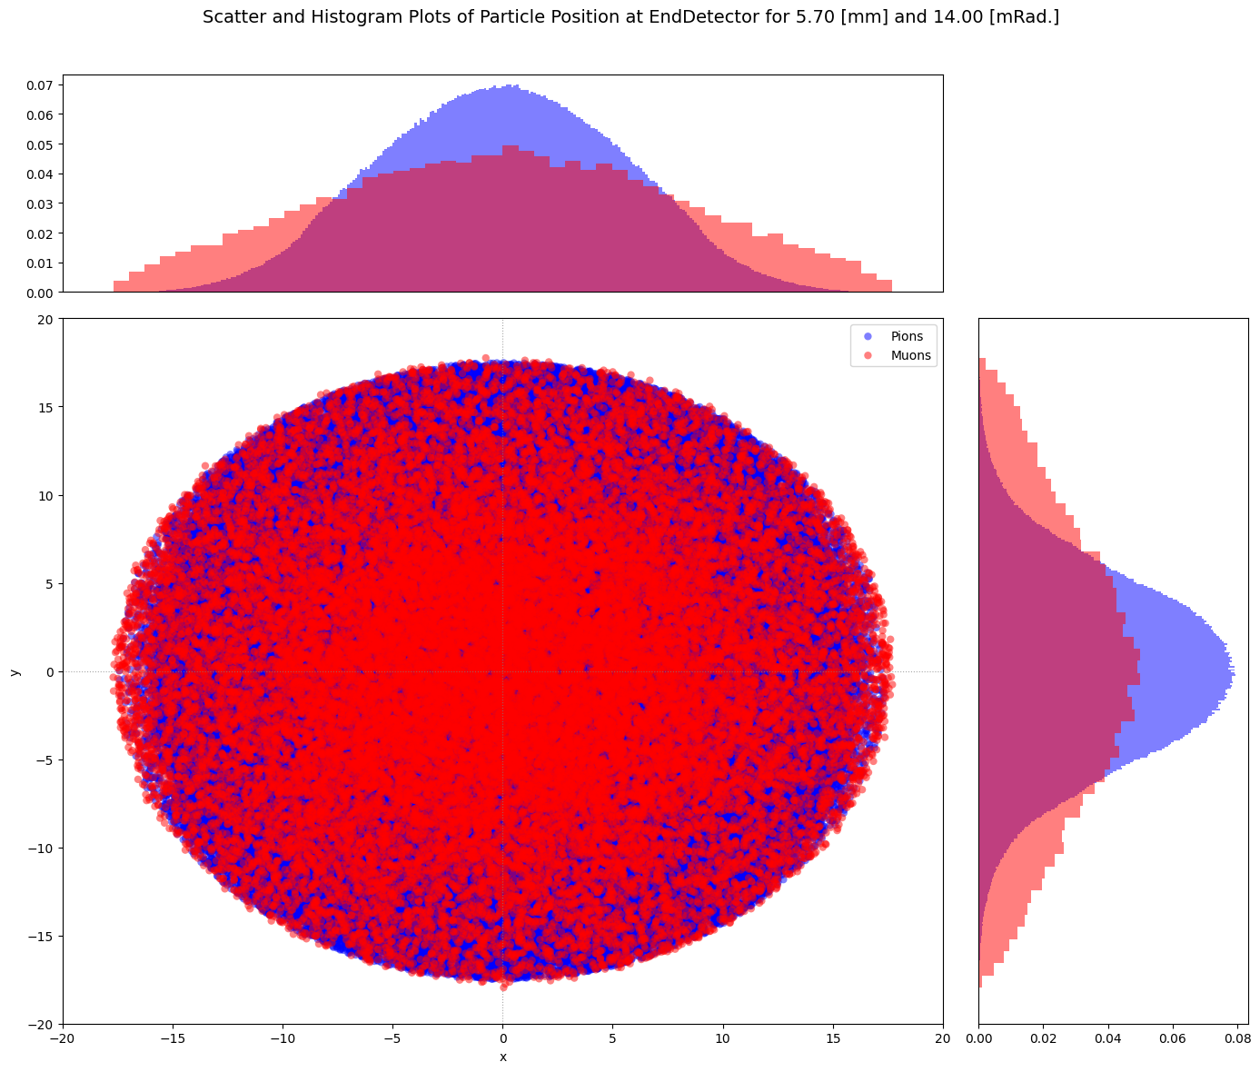
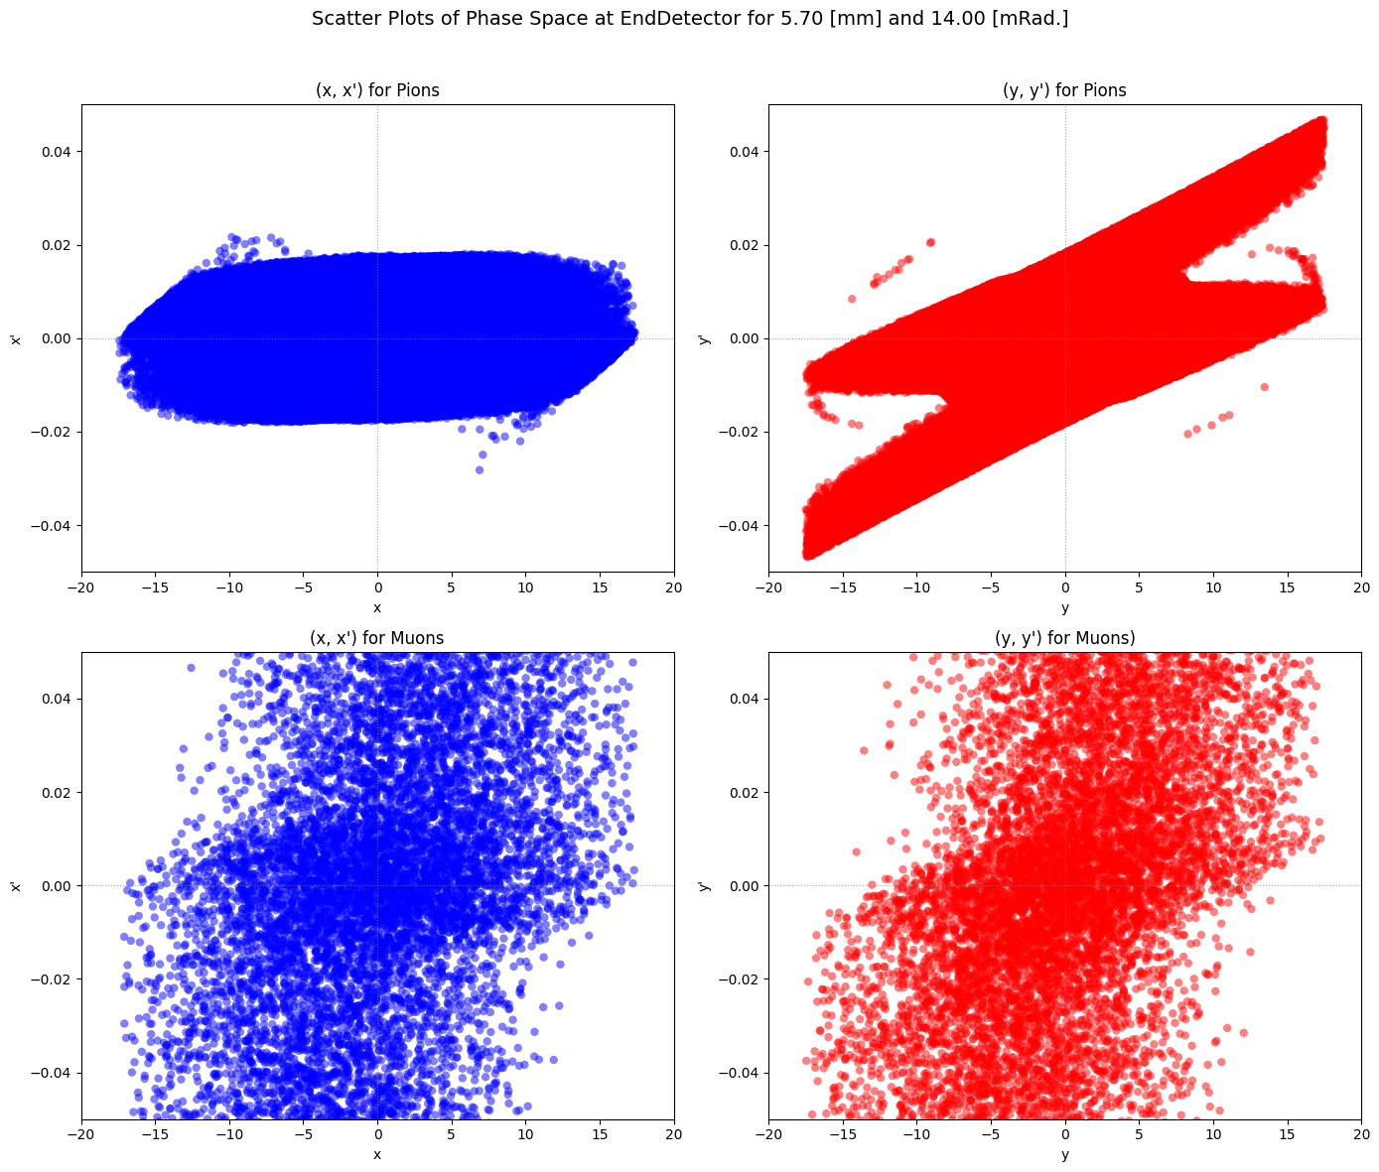
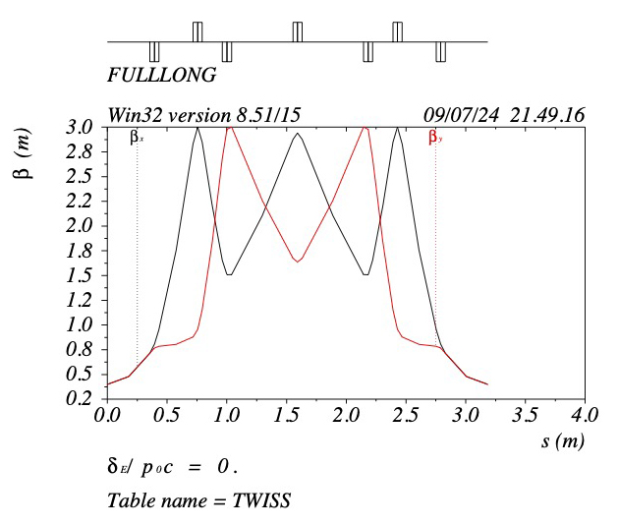
Secondary Beamline Lattice Design at the MeV Test Area (MTA)
Wesley Winter, Paradise Valley Community College
CCI Summer Intern, Advisor Dr. Carol Johnstone
FERMILAB-POSTER-24-0217-AD-STUDENT
The Secondary Beamline in the MTA Test Hall
Scaled Counts for Particles at the End of the Beamline
Spot Radius [mm] | pi- | mu-
5.7 | 3214658 | 43006
6.2 | 3569238 | 47620
6.7 | 3902805 | 52025
7.2 | 4213488 | 55939
7.7 | 4500953 | 59613
8.2 | 4763844 | 63149
8.7 | 5006725 | 66135
9.2 | 5224017 | 69009
9.7 | 5426673 | 71846
10.2 | 5608093 | 74409
10.7 | 5772786 | 77130
11.2 | 5922691 | 79548
11.7 | 6059197 | 81795
12.2 | 6185079 | 83617
12.7 | 6300254 | 84499
13.2 | 6410660 | 86114
Average Pions per Muon |  | 74.97744761
The MTA is currently configured to produce a secondary pion beam from a tungsten target, which subsequently generates muons from decay in flight. In its present lattice configuration, the currently installed air core quadrupoles are strength-limited in their ability to deliver a high muon flux to the end user. Recently, seven strong iron-core quadrupole spares from the 400-MeV Linac were acquired. Based on these quadrupoles, a new lattice has been designed that maximizes both pion transport and muon capture the line based on significantly shorter magnetic lengths, strong magnetic gradients, and consequently an enhanced angular acceptance. For this project, we demonstrated that the ratio of muons to pions increased by over an order of magnitude (approximately $75$ for lattice configurations were studied), successfully capturing a phase space area as large as $13.2 \left[mm\right] x$ $24 \left[mRad\right]$in simulation.
Initial Design Methodology
Methodical Accelerator Design (MAD) and G4Beamline Analysis
We identified several constraining factors associated with the MTA hall during this phase giving:
MTA Infrastructure
The angle between the primary and secondary line at $30.6°$
Maximum line length at 5 meters
Current Secondary Beam Dynamics
Tungsten target with peak pion production momentum of $75 MeV/c.$
Large tertiary muon production decay angles due to low momentum
Upgrade Element Characteristics
Seven elements in total
Aperture of $3.8 \left[cm\right]$ centimeters
Element length of$6.985 \left[cm\right]$
Relative to the target vacuum housing the minimum placement distance for the first quadrupole is 14 inches away from the target source. This placement constraint defines the initial maximum angular acceptance. The pion beam transport with realistic short quad spacings (~18”) then defines the maximum pion phase space that can be transported given the quad aperture. Given these geometric constraints, we derived initial optics parameters which optimized the transport using the elliptical emittance envelope of the pion beam, specifically the Courant Snyder functions and phase advance.
Based on emittance transport of a phase space ellipse and short quad to quad spacings, the peak beta was determined and minimized using MAD8 (a thick lens matrix propagation code). Reflective symmetry was then imposed to generate a very low- beta of $0.4m$at the end of the line for maximum pion/muon phase space density. (Note the low-beta of the Tevatron collision region was 0.4m) This configuration was then implemented in G4Beamline, to assess pion/muon transport through multiple initial source terms – pions were launched in a constant, rectangular space/angle density.
Preliminary Calculations
Line Configuration Output from MAD
Matching Quad
$K =−15.19 \left[m^{−2}\right]$
Drift $L=0.286 \left[m\right]$
First Focusing Quad
$K=17.84 \left[m^{−2}\right]$
Drift $L=0.1692873 \left[m\right]$
Defocusing Quad $K =−32.90 \left[m^{−2}\right]$
Drift $L=0.515 \left[m\right]$
Second Focusing Quad
$K= 37.71 \left[m^{−2}\right]$
Beam Configuration for G4Beamline
Flat Profile $ε_{x}=ε_{y}$
$Σ=\left[\begin{matrix}48π \left[mm^{2}\right] & 0 \\ 0 & 300π \left[mRad^{2}\right]\end{matrix}\right]$
Number of Events $10E6$
$μ_{p}=75 \left[{MeV}/c\right]$
$σ_{p}=25\left[{MeV}/c\right]$
Calculated initial conditions from component and placement constraints:
$x_{max}=19 \left[mm\right]$
$x_{max}^{′}=44.75 \left[mRad.\right]$
$s_{drift}=0.4255 [m]$
First phase of optimization calculations focused on maximum emittance transport using thick lens derivations:
$β_{targ}=\frac{{\left(Δx\right)}^{2}}{ε}$ $β_{Qap}=\frac{{\left(19\right)}^{2}}{ε}$
$$β_{quad}=β_{targ}+\frac{s^{2}}{β_{targ}}$$
$\frac{dε}{dΔx}=\frac{{19}^{2}−2Δx^{2}}{s\sqrt{{19}^{2}−Δx^{2} }}⇒$ $Δx=13.44\left[mm\right]$
Initial analyses indicate successful capture of more muons with larger angles and spot size than the transport ellipse
$$ℓ=69.85 \left[mm\right]$$
$$s=425.5 \left[mm\right]$$
Spatial scatter plot showing the distribution of pions (blue) and muons (red) at the end of the line, with histograms representing the probability density of these distributions on the left , and the phase space at the end of the line on the right.
$$θ =44.75 \left[mRad\right]$$
$$D=38.0 \left[mm\right]$$
$$2Δx$$
Beta functions from the initial lattice design using MAD8 code
Future Work
$β_{\max{x,y}}=3.0 \left[m\right]$ $β_{0 x,y}=0.4 \left[m\right]$
$$ε=120 \left[mm × mRad.\right]$$
$$x_{max}≈7 \left[mm\right]⇒5.7 \left[mm\right]$$
$$x_{max}^{′}≈17 \left[mRad.\right]⇒14 \left[mRad.\right]$$
Our study demonstrated a significant improvement in muon flux delivery by optimizing the MTA’s lattice configuration by upgrading the current quadrupoles. By designing a periodic lattice that enhances pion transport, we significantly capture more muons per pion capture. The new configuration, achieved a pion-to-muon ratio averaging approximately 75 for simulations in G4Beamlibe with initial source beam parameters for the pions scaled up to $13.2 \left[mm\right]$ and $24 \left[mRad\right]$. These results indicate that the proposed upgrade could substantially enhance the capability of the MTA secondary beamline to support many applications, ensuring a higher and competitive muon flux relative to current international muon facilities.
$$L=355.6 \left[mm\right]$$
This manuscript has been authored by Fermi Research Alliance, LLC under Contract No. DE-AC02-07CH11359 with the U.S. Department of Energy, Office of Science, Office of High Energy Physics.
This work was supported in part by the U.S. Department of Energy, Office of Science, Office of Workforce Development for Teachers and Scientists (WDTS) under the Community College Internship (CCI)

