Slide 1
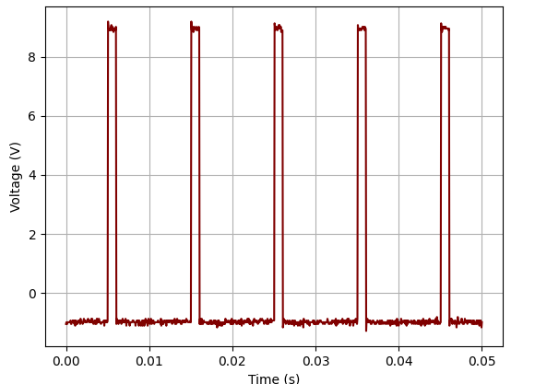
FERMILAB-SLIDES-24-0204-AD-STUDENT
Oscilloscope Data Push Program
Jason Osei-Tutu, Wilbur Wright College—CCI Intern
Jose Berlioz Rivera, Fermi National Accelerator Laboratory
Introduction
Data Acquisition
Data Filtering.
Data Analysis
Data acquisition (DAQ) is a complex and costly process. Creating DAQ systems for analyzing a system requires expensive electronics and a dedicated team of engineers for support, posing a challenge for users who readily need data.
This project is a proof of concept to create a temporary or “one-off” DAQ system using equipment commonly available to every team. We aim to automate the data acquisition process from the Rhode & Schwarz RTO 1044 oscilloscope, convert the acquired binary data into floating point values, and store the results in a csv file format. By developing a Python program, to handle these tasks, we seek to reduce the manual effort involved in data collection, significantly increasing efficiency.
Function Generator With Wave Settings.
Oscilloscope With Wave Data
Methods
Python Program containing class structure and algorithm
Images of processed and filtered waveform data.
Equipment
Rhode & Schwarz 1044 Oscilloscope
Computer Connection via Ethernet or USB
Programming Language: Python
Libraries Used: PyVisa, RsInstrument, Matplotlib, NumPy.
Development:
Created a Python class for managing data conversion and acquisition.
Implemented functions to:
Set trigger options.
Acquire data from specified channels
Save waveform data to CSV.
Plot waveforms
Save Data
User
Results
Efficiency: The automation process increases data collection efficiency.
Customization: The flexibility of the program allows the user to personalize the type of acquired data.
Accuracy: Ensured precise data conversion from binary to floating points.
Storage: Storing of data in a desired path by user.
Scope
Data Processing
Summary
Achievements:
Developed a Python program to automate data acquisition from an R&S oscilloscope.
Successfully implemented functions for data handling and visualization.
Future Work:
Integrate cloud database storage for continuous data collection.
Enhance real-time processing capabilities.
Save
Manual representation of Wave Data Collection
This manuscript has been authorized by Fermi Research Alliance, LLC under contract No. DE-AC02-07CH11359 with the U.S. Department of Energy, Office of Science, Office of High Energy Physics. This work was supported in part y the U.S. Department of Energy, Office of Science, Office of Workforce Development for Teachers and Scientists (WDTS) under the Community College Internship (CCI)

