Slide 1
Cryostat Update
R. Rabehl
August 5, 2024

Slide 2
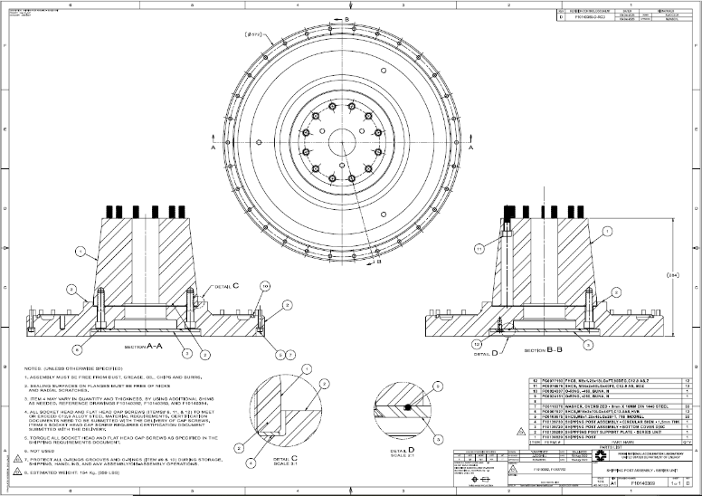
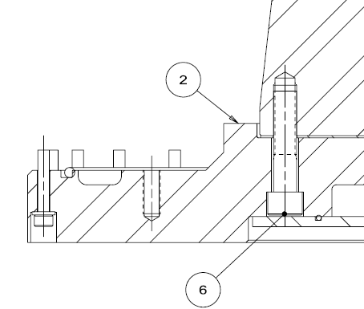
Cryostat – Shipping Posts
Teamcenter Engineering Order Form ED0033225 submitted
Remaining 2 sets of shipping posts/support plates/cover discs. (Req. 354738 / P.O. 712185)
May 10, 2024 promised date
All items received, in QC
Chamfer on all 6 support plates to be corrected at Village Machine Shop.
All bolting hardware for the remainder of the project. (Req. 357424)
Placed on SAM.gov due to vendor error in indicating foreign-sourced material.
A set of bolting hardware for CA-02 has been ordered (P.O. 714732). June 17 promised date. Delivered June 20, in QC.

Slide 3
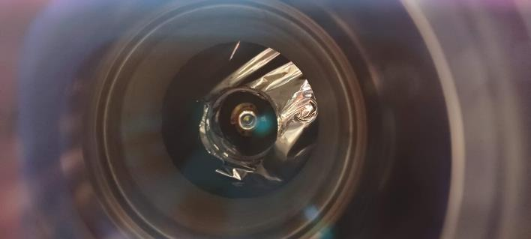
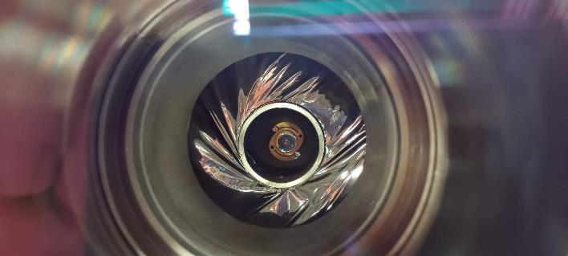
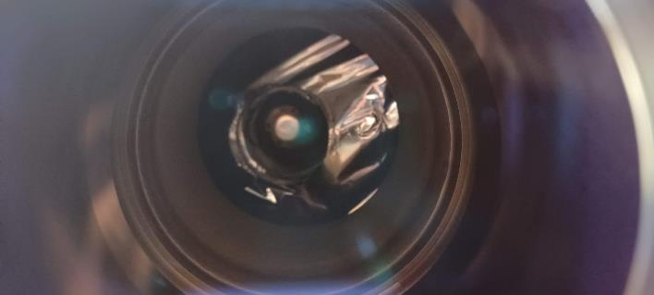
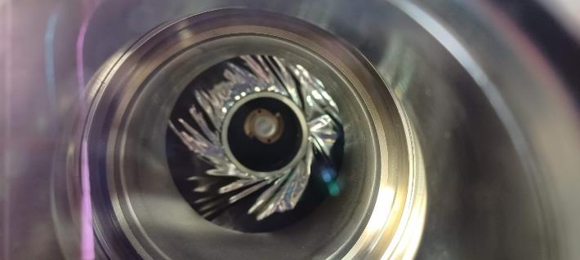
Cryostat – CA-02 FSI targets
In CERN’s operating experience, signal from FSI targets was lost when cold.
On IB1 Test Stand 4, viewing windows were installed at two FSI locations.
At both locations, the targets became cloudy once cold.
FSI_IP_4
FSI_Center_3
Warm (July 12, 2024)
Warm (July 12, 2024)
Cold (July 31, 2024; vacuum 2.5 x 10⁻⁷ Torr)
Cold (July 31, 2024; vacuum 2.5 x 10⁻⁷ Torr)

Slide 4
Cryostating – CA-02
CA-02 DRs
13503: Unidentified surfaced blemishes on LD pipe. Awaiting disposition.
13526: Contact between IFS capillaries and thermal shield extrusions. Awaiting disposition verification.
13527: FSI target installation screws not torqued to specified value to due lack of an appropriately-rated torque wrench. Awaiting disposition verification.
13545: Unable to install three studs attached the fixed point support post to the Cold Mass saddle. Closed.
13552: Thermal shield is ~5 mm too far towards the Non-IP end such that the thermal shield support pieces cannot be installed at the fixed support post. Awaiting disposition.
13575: IFS-A wired in the wrong orientation. Closed.
13583: IFS-A RTD miswiring. Awaiting disposition.
13584: Misalignment between new IFS-A cover and interface ring after welding. Awaiting closure.
CA-02 NCRs
Cold Mass saddle threads/support post installation (LHC-LQXFA-QN-0006) – WP Evaluation.
Thermal shield misalignment (LHC-LQXFA-QN-0007) – Actions Underway.
Central support post bearing bolts (LHC-LQXFA-QN-0008) – WP Evaluation.

