Slide 1
Accelerator
Summer Shutdown
Tony Busch
AD Shutdown Coordinator
Planning & Integration Department

Slide 2
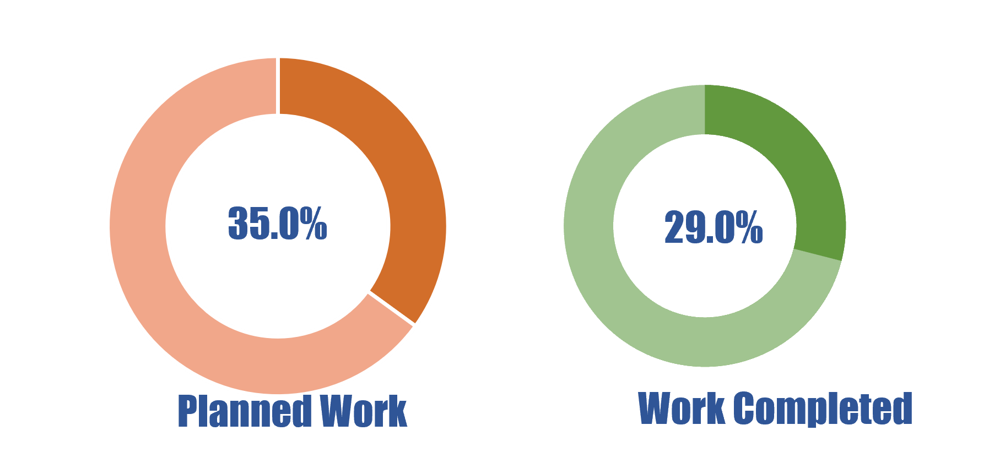
Shutdown Progress
As of 8/1/24

Slide 3
Power outage progress (including next week)

Slide 4
Keep communications open
Over the next week we will be looking at any necessary adjustments to the schedules and work lists.
The collimator work and electrical work will continue during the operationally limited period.

