Slide 1
Muon Campus Shutdown Report
Jim Morgan
Friday 09:00 Shutdown Meeting
August 9, 2024

Slide 2
Muon Campus status
Many tunnel jobs still need engineering or planning details before work begins
Injection Kicker horizontal motion-control issue fixed
Bent pin on the upstream motor drive connector
M4 Final Focus LQ’s fiducial work continued, discovered more were needed
Power lead covers block some of the original fiducials
Planning for Power Supply primary wiring and circuit breaker work
ESS2 assembly should begin in a week or so
A0 Clean Room deep-cleaning, followed by component cleaning and assembly
Prototype ESS2 will need to be removed from DR prior to running beam
Related to buyback accounting between Mu2e Project and AD spares funds
Hope that operational ESS2 will be ready for installation in early October
Will evaluate options if operational ESS2 is delayed significantly
AP-0 A/C work back on hold after a few days of controls activity two weeks ago
Study – M1-M3 Optics
Study – Alternative M5 optics

Slide 3
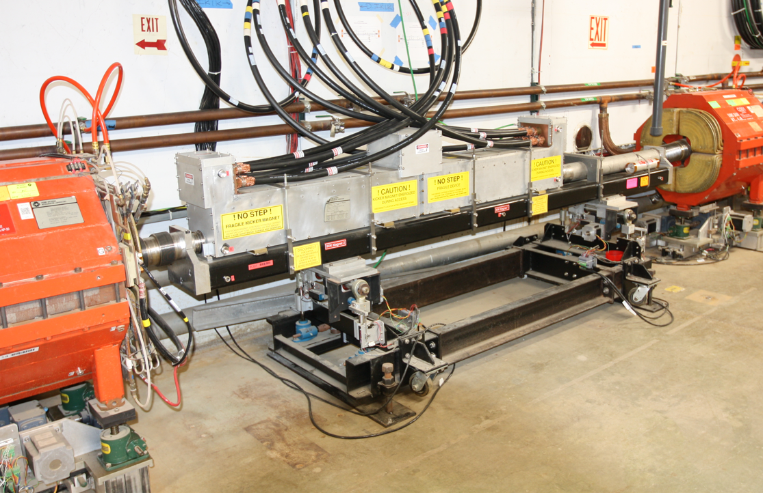
Delivery Ring Injection Kicker
Beam direction
Q301
Q202

Slide 4
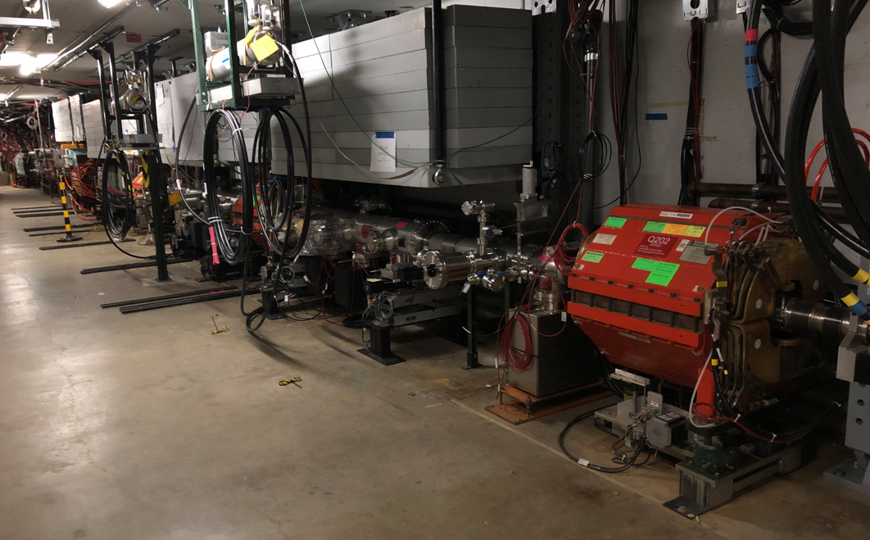
Delivery Ring Injection Kicker and ESS1&2
Beam direction
ESS2
ESS1
Injection
Kicker

Slide 5
Injection kicker aperture size relative to ESS and beam
Foil Tensioning/Retraction
Baffle
Cathode
Frame
Injection Kicker aperture
HV Stand-off
-86 kV
Beam
Foil Plane
S.Werkema
12 mm

Slide 6
Upcoming work
Main worklist items
AP-0 Dump system will be drained and water lines blown out next week
ESS fluorinert piping installation from AP-30 to tunnel (week of 8/19)
Install rad hard 8Q24 at Q205, send uninstalled 8Q24 to TD for rad hard water lines
Q205 vacuum pipe replacement to simplify vacuum connection to ELAM
Unroll ELAM (was rolled 24 mr to improve g-2 extraction trajectory)
Profilometer extraction profile monitor vacuum Tee installed upstream of ELAM
Several alignment tasks including D30 level run and M4 Final Focus
ESS1 and ESS2 septum stand motion-control improvements
M4 Final Focus vacuum installation, A/C dipole installation
Need to check sizing of all power supply panel breakers, upgrade as necessary
Install additional steel shielding above ECMAG
Repair Kirk Key hardware on disconnects
Hope to finish operational ESS2 and install it in tunnel late in shutdown
ESS2 (operational version in A0 Clean Room)
ESS2 cathode will be installed with the small warpage
Three-point cathode support adjustments may reduce the warpage
AP-0 A/C controls work paused; reason unknown
Jerry is back from vacation!

