Slide 1
Project Activities for MSD
Mayling Wong-Squires
AD Operations Friday 9am Meeting
9 August 2024

Slide 2
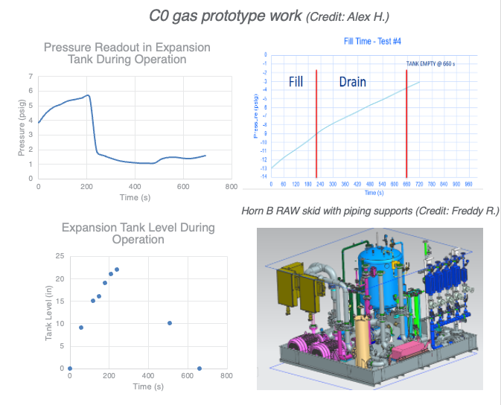
LBNF RAW Updates
Abhishek Deshpande, Alex Humenik, Freddy Roman
Horn B RAW system fabrication drawings are complete. Working on piping support structures in the skid. Below the complete skid model:
The testing on C0 LBNF gas prototype is complete. Engieneers are compiling data to create a report and a presentation.
Sized the pressure safety valve for Horn C RAW skid spray manifold to keep pressure below 60 Psi.
Piping parts for MI-60 FC-40 kicker load are here.
  Installation can begin once the load is out there.
Ordering a parts for FC-40/ Opticool swap for the gallery skid.
Working with TSD engineer on RAW system piping in Target Utility Corridor(TUC) and Target Bunker(TB) of in the Target Hall.

Slide 3
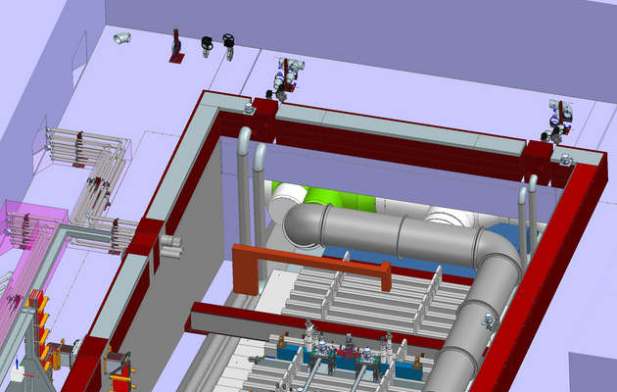
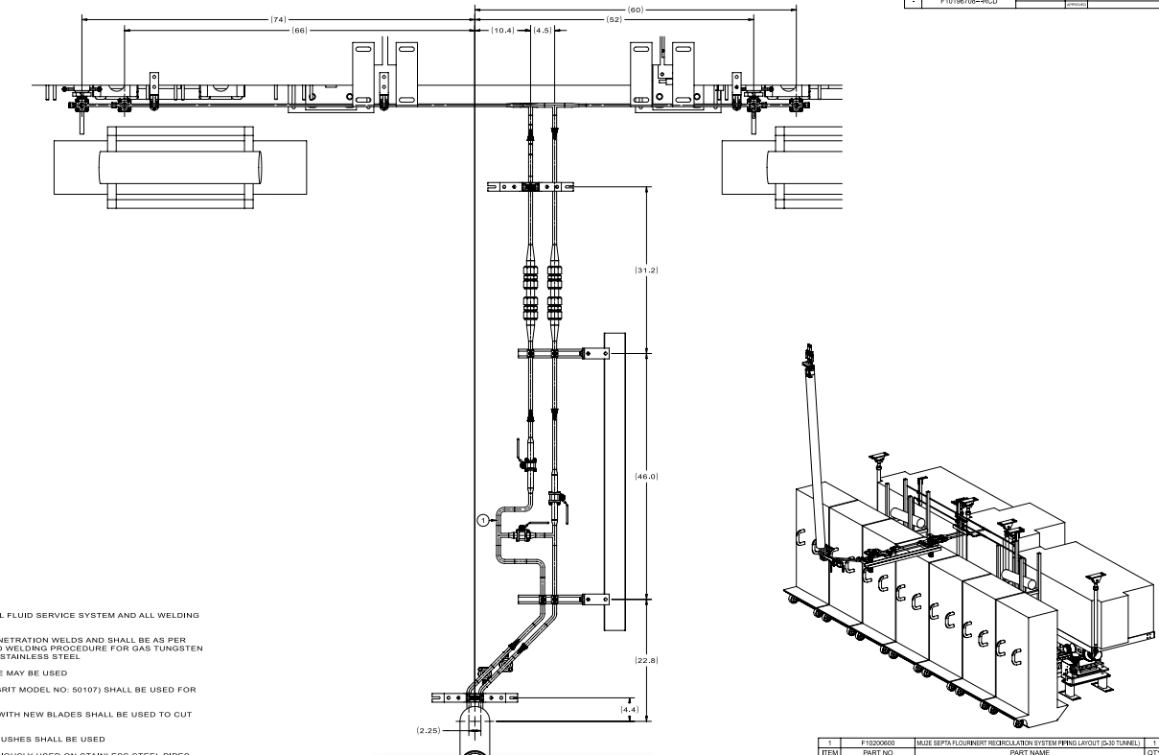
Mu2E LCW Updates
Abhishek Deshpande, Prudhvi Gutta, Will Derylo
Horn C RAW piping in TUC
    PO 716855 issued for the FC-40 piping installation work in AP30 and Delivery Ring (Muon Campus). Scheduled for either week of August 19 or September 9.
TSP RAW system headers
FC-40 piping for ESS in AP30 and Delivery Ring
(Credit: Prudhvi and Will D

Slide 4
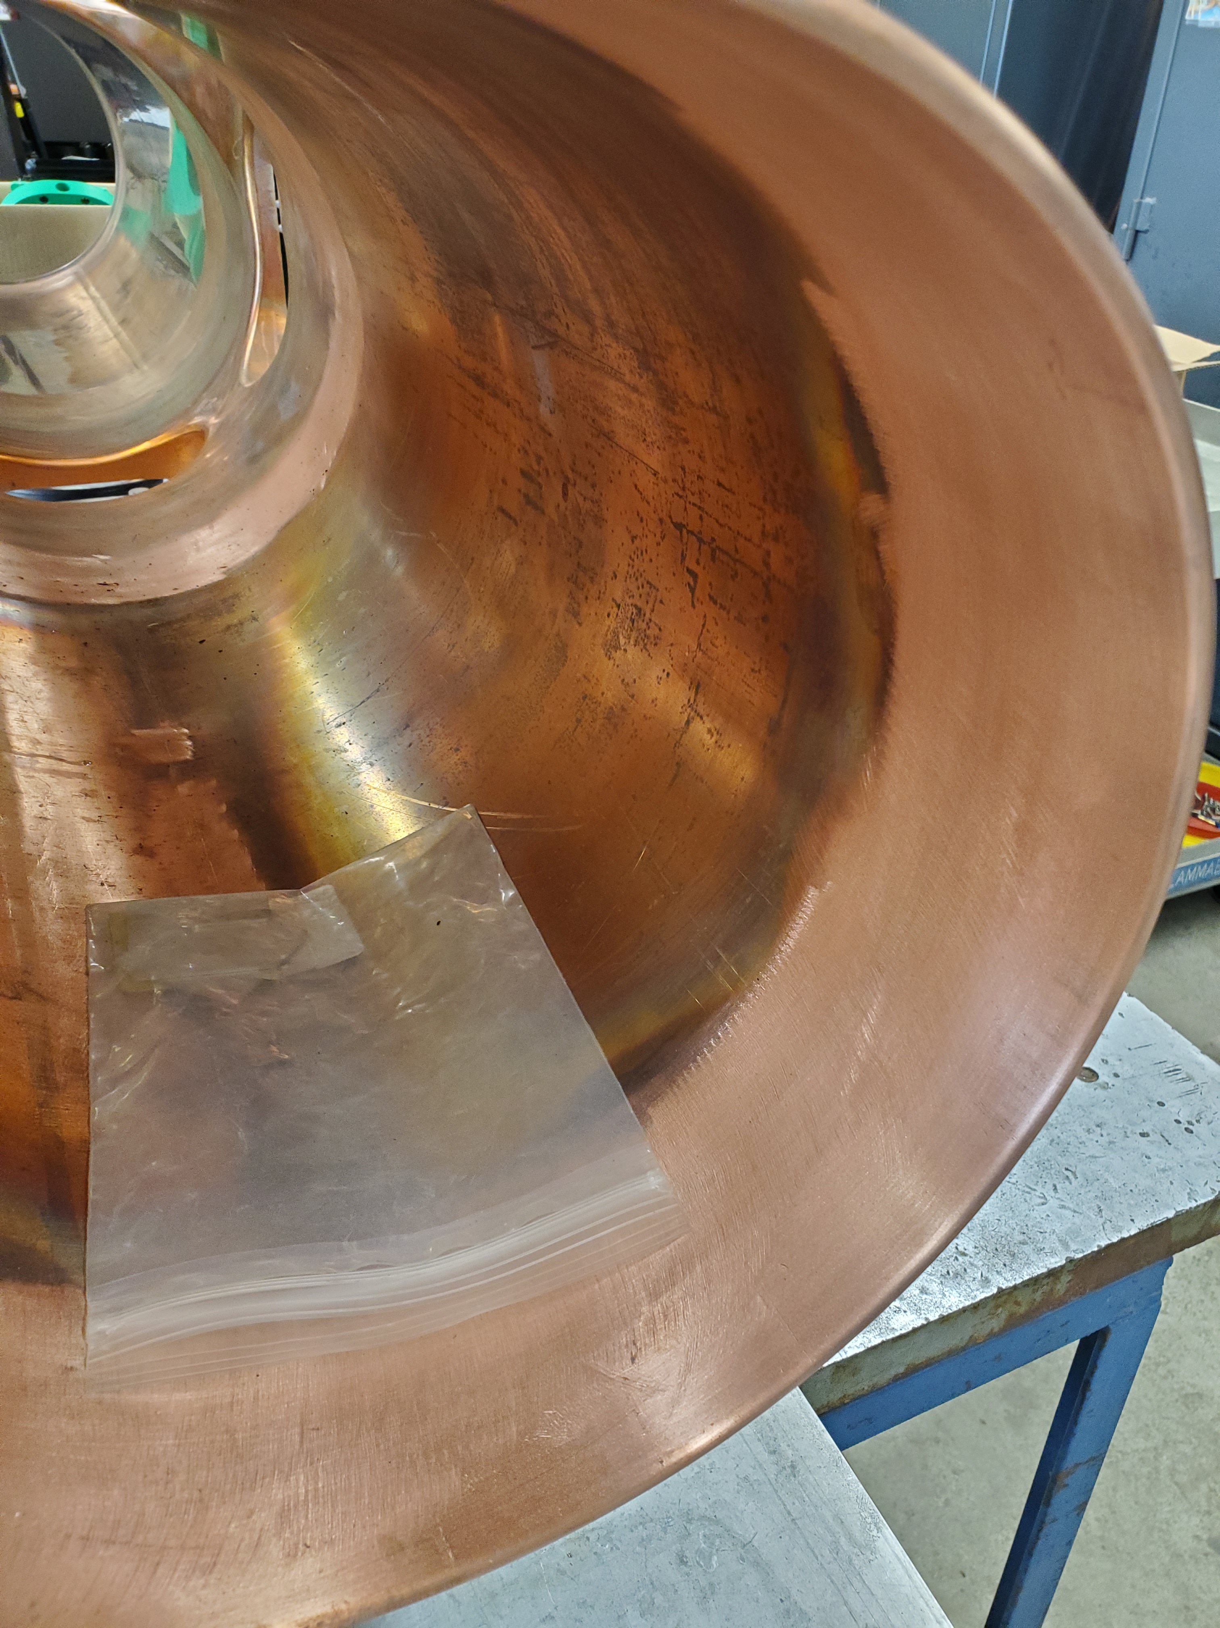
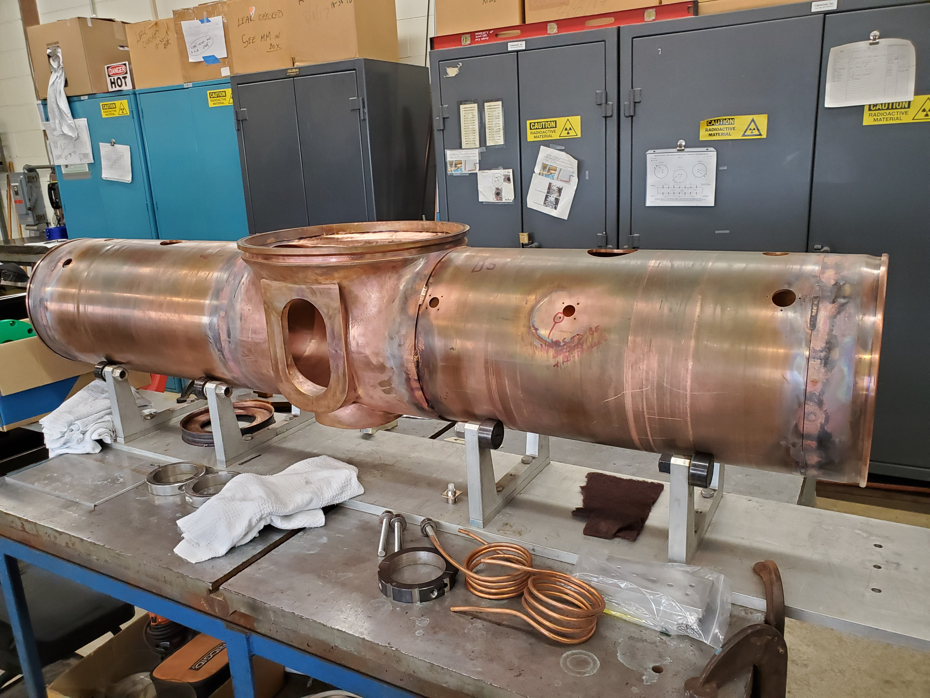
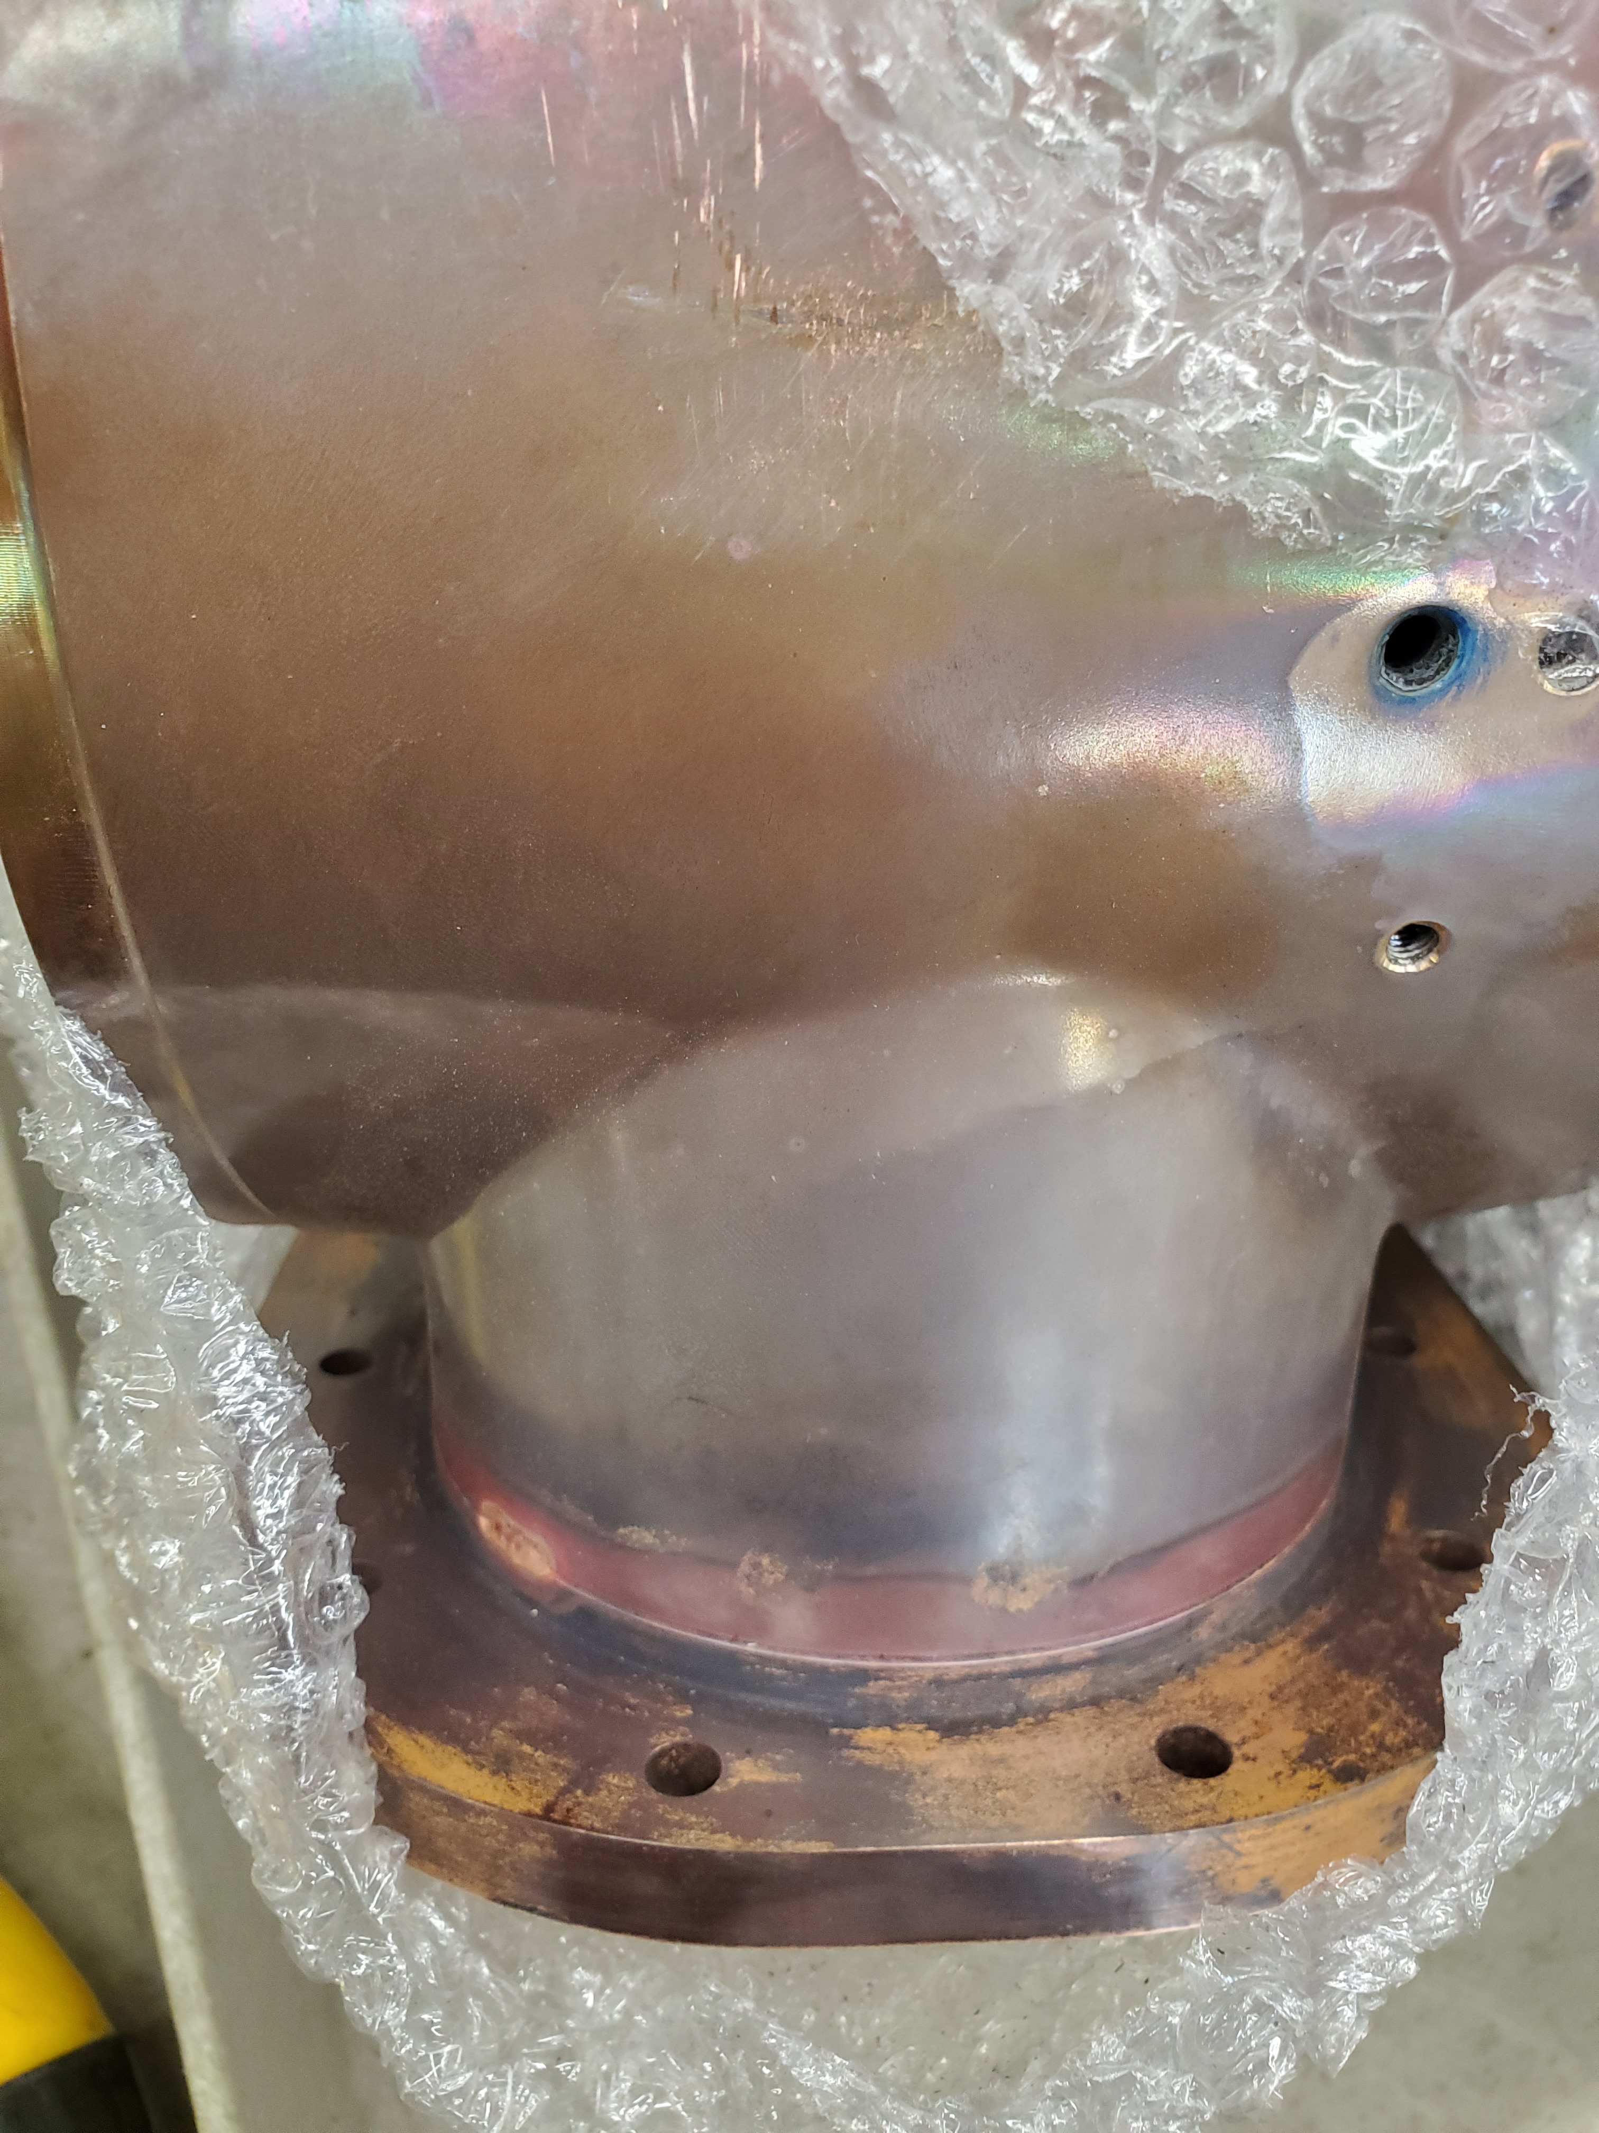
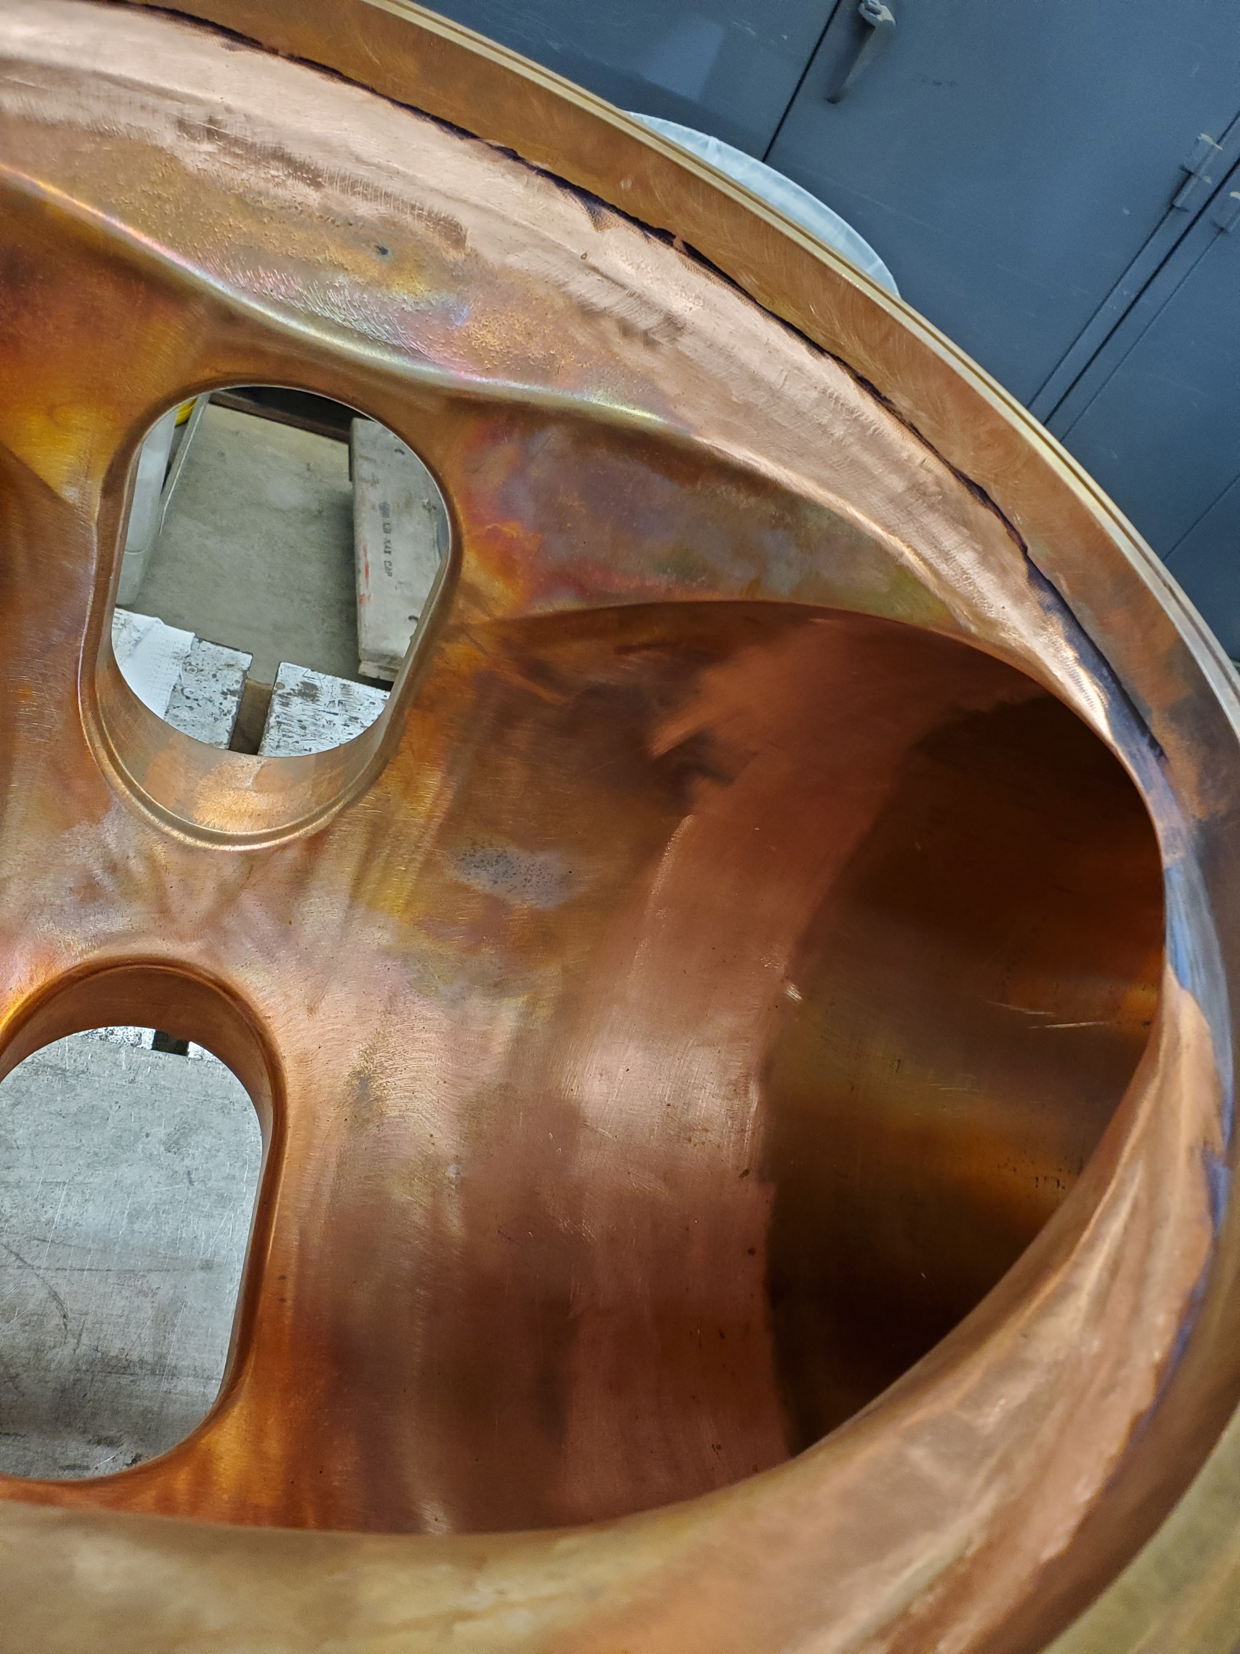
PIP-II RF Booster Cavity Updates
Patrick Minton, MSD’s RF Cavity Group
Fabrication of plumbing for girder three has been started.
The center castings for the new cavity tuners have been welded.
The center casting and main outer shell components have been welded and sanded smooth.
The bus bars for the inner packing of the new tuners have been prepped and shipped for brazing.
Inspection of the new tuner ferrites is underway.
Study – M1-M3 Optics
Study – Alternative M5 optics
KPS5A PFL Repair
MC-1 Controlled Access
G-2 Trolley Run
Intentional Accelerator
Standby Period
<------------Week Days -------------------→

Slide 5
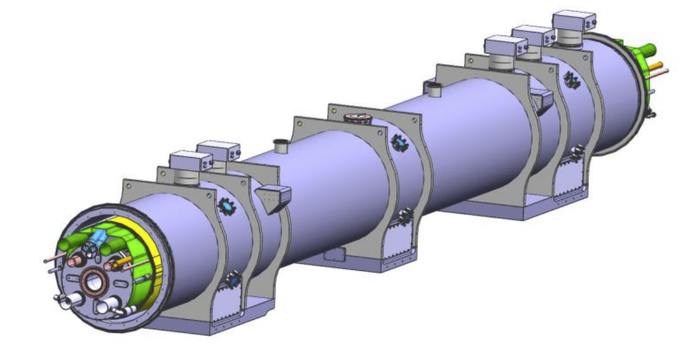
Hi-LuMI LHC Accelerator Upgrade – Updates
Bob Steinberg, Alex Chen, James Williams
The leak testing procedure, authored by AD and APS-TD personnel, was formally approved by CERN in April.
Cryo-assembly #2 (CA02) leak tests began in June. Completed two of the four leak checks. Schedule needs necessitated CA02 be sent to IB1 for cryogenic testing. Further CA02 leak testing is on hold for now.
APS-TD personnel completed the initial leak tests of CA02 using the approved leak testing procedure and vacuum equipment procured for this task.
Remaining tasks include completing CA02 leak tests, vacuum equipment maintenance and upkeep between tests, and overseeing CA03-CA10 tests. CA03 starts October ‘24
Cryo-assembly built at APS-TD’s ICBA building for CERN

