Slide 1
MQXFA18 magnet specifications
P. Ferracin, D. Cheng, J. Doyle, L. Garcia Fajardo, S. Prestemon, K. Ray, G. Sabbi, M. Solis, G. Vallone, X. Wang
on behalf of the MQXF collaboration
MQXFA Spec meeting
August 16th, 2024
LBNL, Berkeley, CA, USA

Slide 2
Outline
Introduction
Shell-yoke sub-assembly specs
Coil-pack sub-assembly specs
Magnet assembly and loading specs
Assembled magnet specs

Slide 3
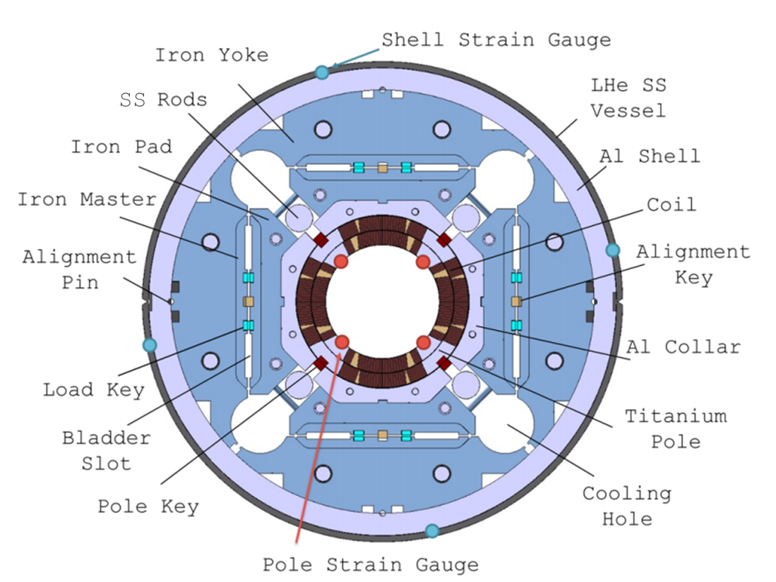
Introduction

Slide 4
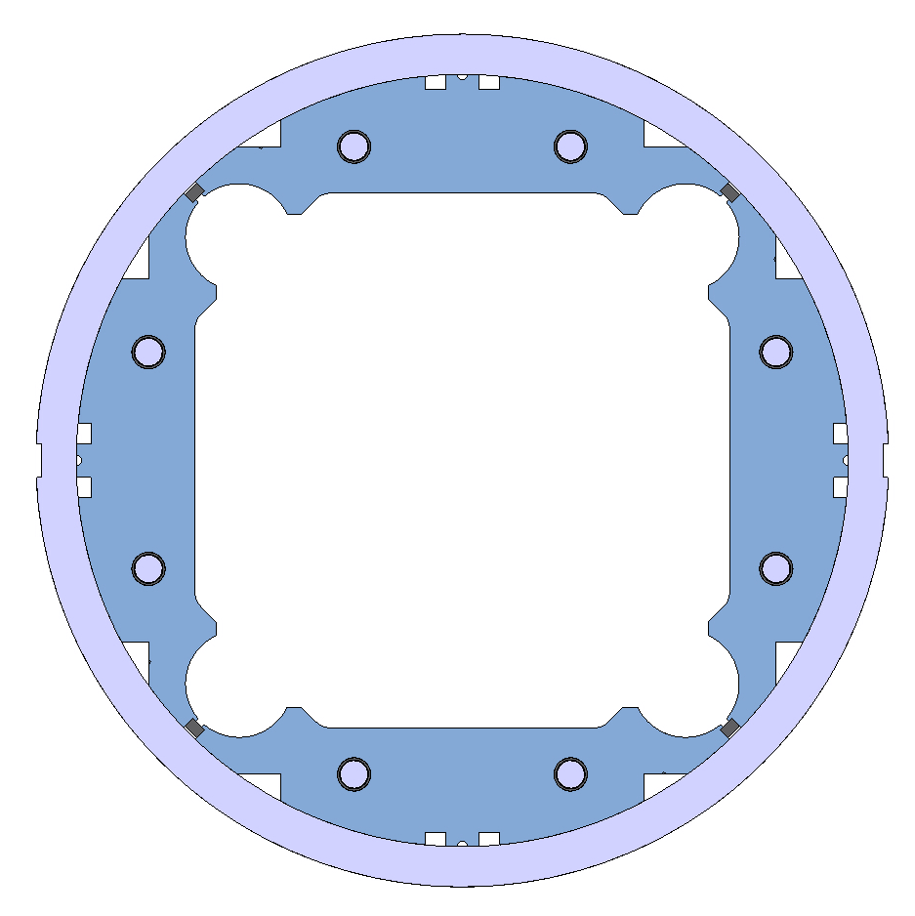
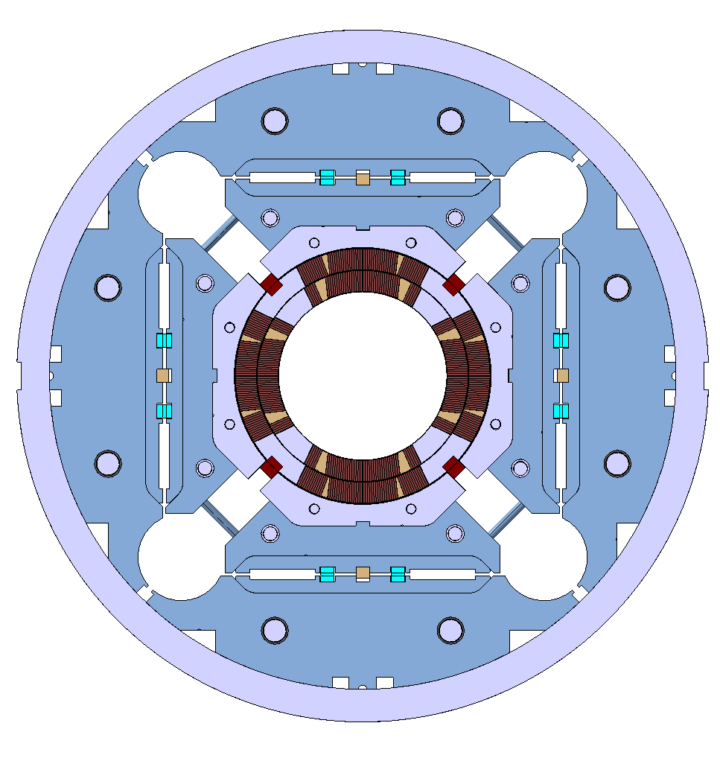
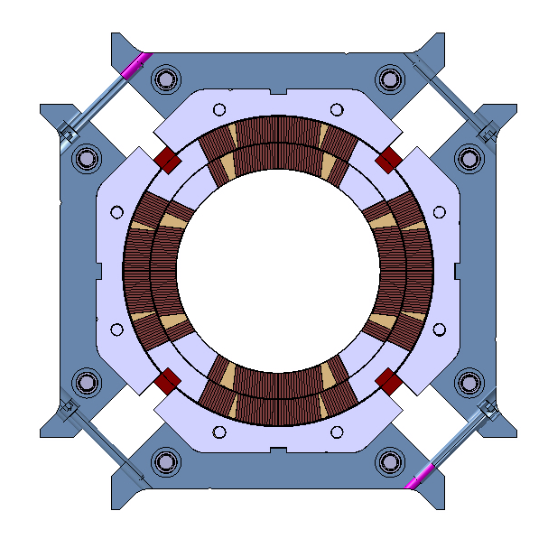
Introduction
List of specifications in “chronological” order
  From shell-yoke to coil-pack to magnet pre-load
Definition based on dimensional, magnetic, electrical, and strain measurements
  Some specs defined by “design and analysis” (example: peak stress)
  Some defined by experience from previous successful magnet (example: coil pack uniformity/squareness)

Slide 5
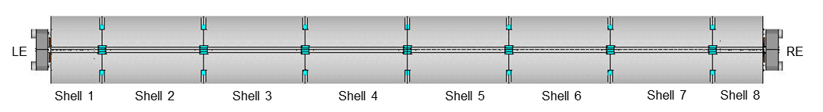
Introduction
On strain measurements….
  Strain gauge locations
    Shell: 3 axial location, 4 quadrants, azimuthal and axial
      Shell 2, shell 4, shell, 7
    Coil: 1 axial location, 4 coils (pole), azimuthal and axial
      Center of shell 7
    Axial rods: 1 axial location, 4 rods, axial
Shell gauges
Shell gauges
Shell and coil gauges

Slide 6
Introduction
On strain measurements….
  Six fiber optic gauges installed on Q1 and Q2:
    Three azimuthal (Z-gauges)
    Three axial gauges (T-gauges)
  They are located at three positions along the coils:
    700 mm
    1900 mm
    3800 mm
Sensor 5: 700-T
Sensor 3: 1900-T
Sensor 1: 3800-T
LE
RE
Sensor 6: 700-Z
Sensor 4: 1900-Z
Sensor 2: 3800-Z

Slide 7
Outline
Introduction
Shell-yoke sub-assembly specs
Coil-pack sub-assembly specs
Magnet assembly and loading specs
Assembled magnet specs

Slide 8
Shell-yoke sub-assembly
Half-length module assembled vertically
  Yoke stacks insertion
  Bladder operation
    Insertion of yoke key with 0.100 mm interference
    yokes locked and shell pretensioned
Shell strain measured during/after bladder operation
Check proper reading from strain gauges and size of shells and yokes

Slide 9
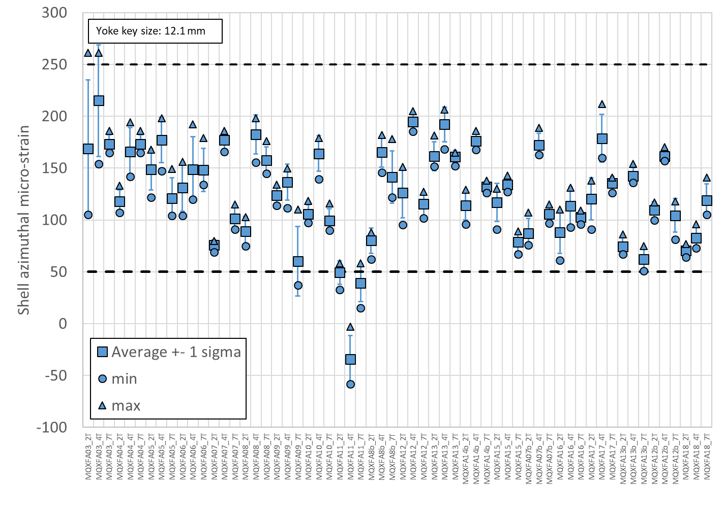
Shell-yoke sub-assembly
Specification
For the shell azimuthal strain after shell-yoke sub-assembly:
  The shell strain in the azimuthal direction after shell-yoke sub-assembly shall be within +50/+250 micro-strain
One gauge per quadrant on 3 shells

Slide 10
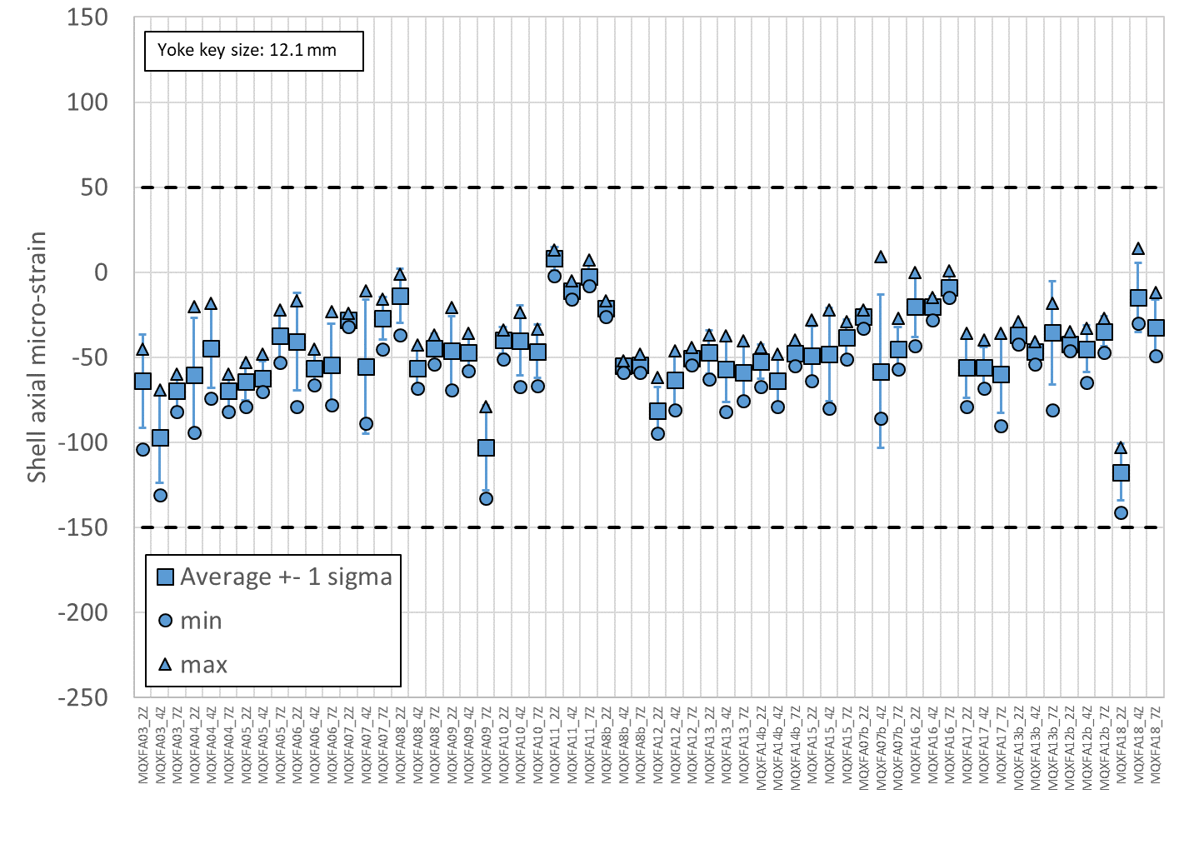
Shell-yoke sub-assembly
Specification
For the shell axial strain after shell-yoke sub-assembly:
  The shell strain in the axial direction after shell-yoke sub-assembly shall be within -150/+50 micro-strain
One gauge per quadrant on 3 shells

Slide 11
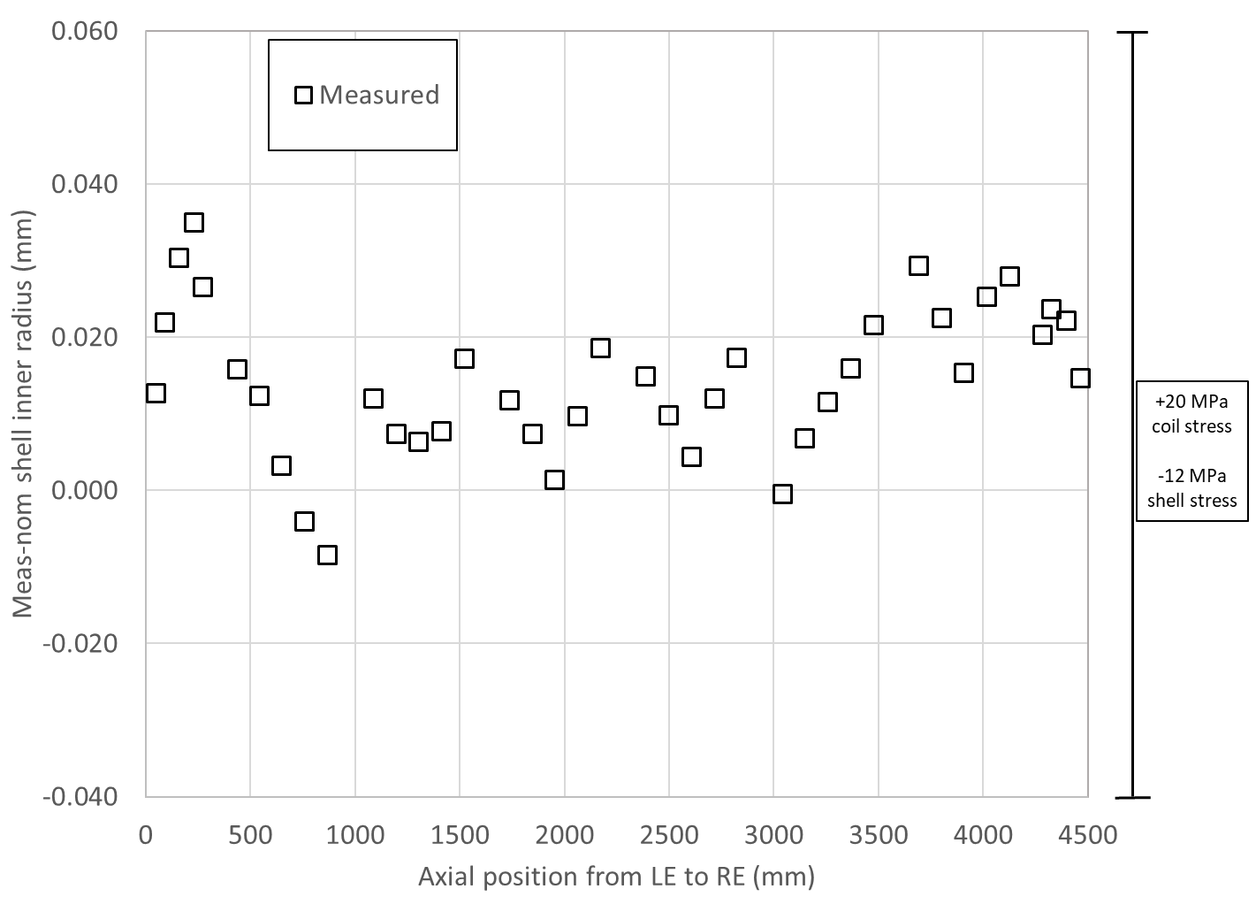
Shell inner radius dimensions and sensitivity analysis

Slide 12
Shell-yoke sub-assembly
1 mm axial protrusion yoke stacks from shell edges on the bottom (from tooling)
  Bottom → center of the magnet
    Yoke to yoke contact guaranteed when 2 modules are combined
After insertion of yoke key → dimensional measurements
  Protrusion of the yoke stacks on the RE and LE
  Size of yoke cavity
Check of yoke, stacks, and shell dimensions

Slide 13
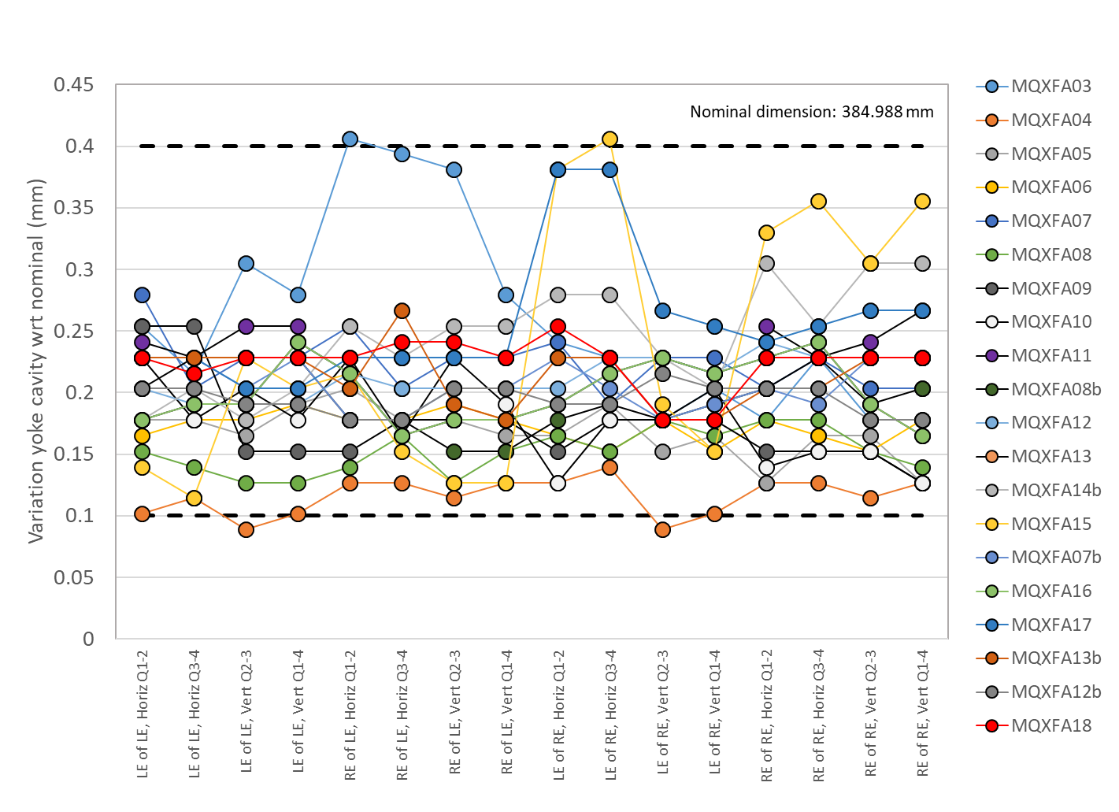
Shell-yoke sub-assembly
Specification
For the yoke cavity size after shell-yoke sub-assembly:
  The variation of yoke cavity dimension with respect to nominal shall be within +0.100/+0.400 mm
Two horizontal and two vertical measurements taken on both side of the two modules

Slide 14
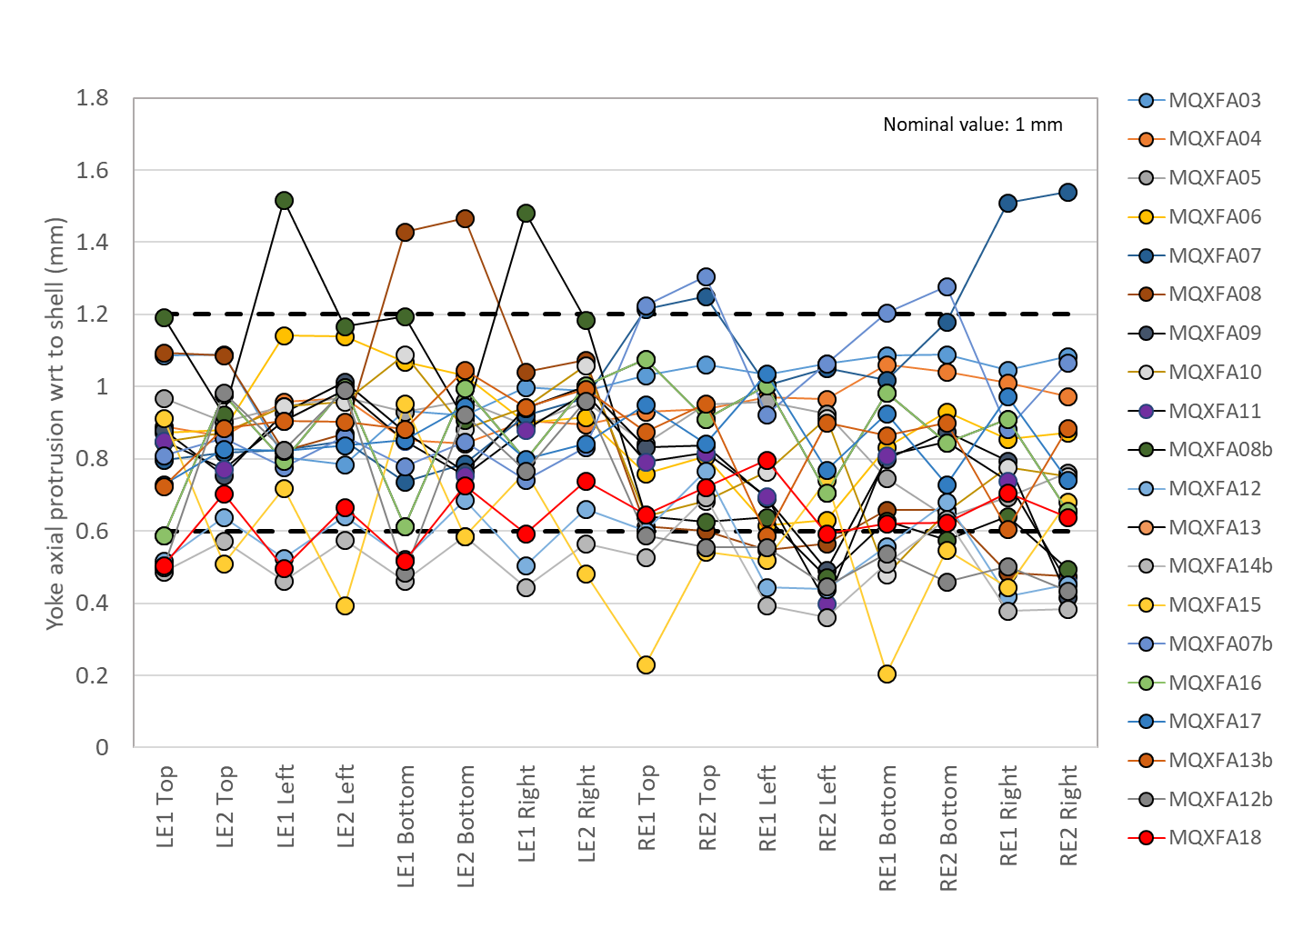
Shell-yoke sub-assembly
Specification
For the yoke protrusion with respect to the shell:
  The yoke protrusion with respect to the shell shall be within +0.600/+1.200 mm
Two measurements are taken per each quadrant on the “coil end” side of each module

Slide 15
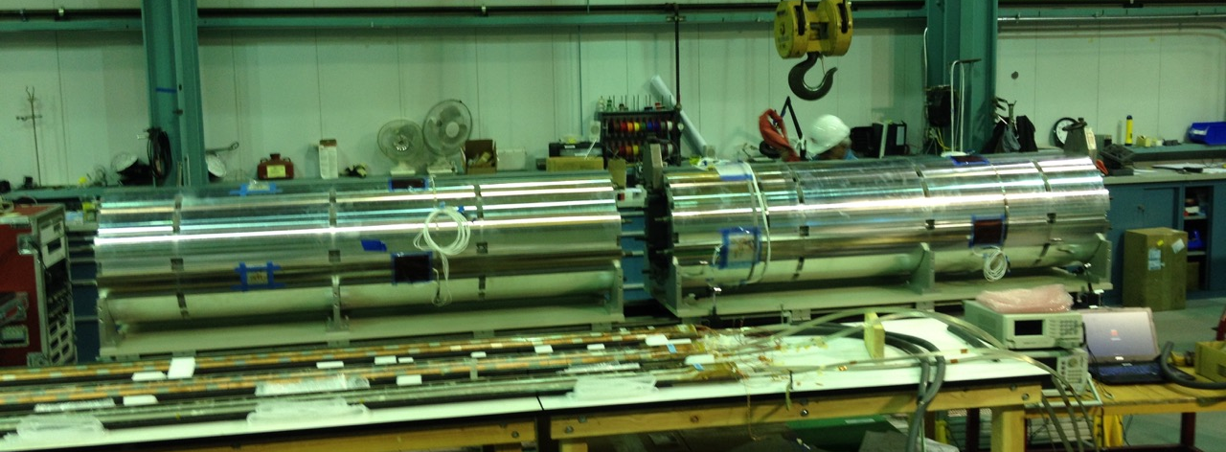
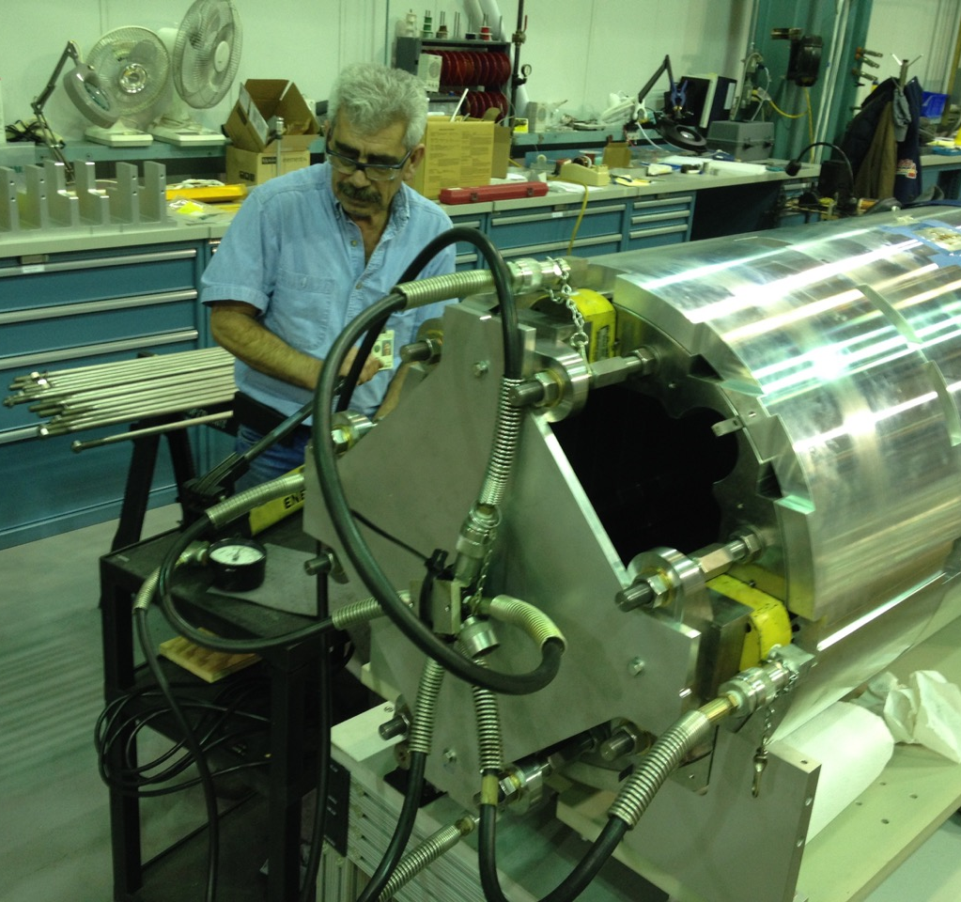
Shell-yoke sub-assembly
When both half-length sub-assembly modules are joined together, the short yoke tension rods are replaced with full-length ones.
For the pre-tension of the full-length tie rods of the yoke:
  The piston (RSM 200 cylinder with effective area of 4.43 in²) shall be pressurized to 4100 ± 200 PSI and the nuts shall turned to contact.

Slide 16
Shell-yoke sub-assembly
The shell-yoke sub-assembly straightness is monitored by measuring
  vertical and horizontal absolute position of fiducial in the
    mid-plane shell cut-outs (one side, either left of right from the lead end view)
    and in the top shell cut-outs.
  Measurements are taken in 7 longitudinal locations (in between shell segments).
The fiducials are placed in contact with the yoke laminations, which are accessible through the cut-outs.

Slide 17
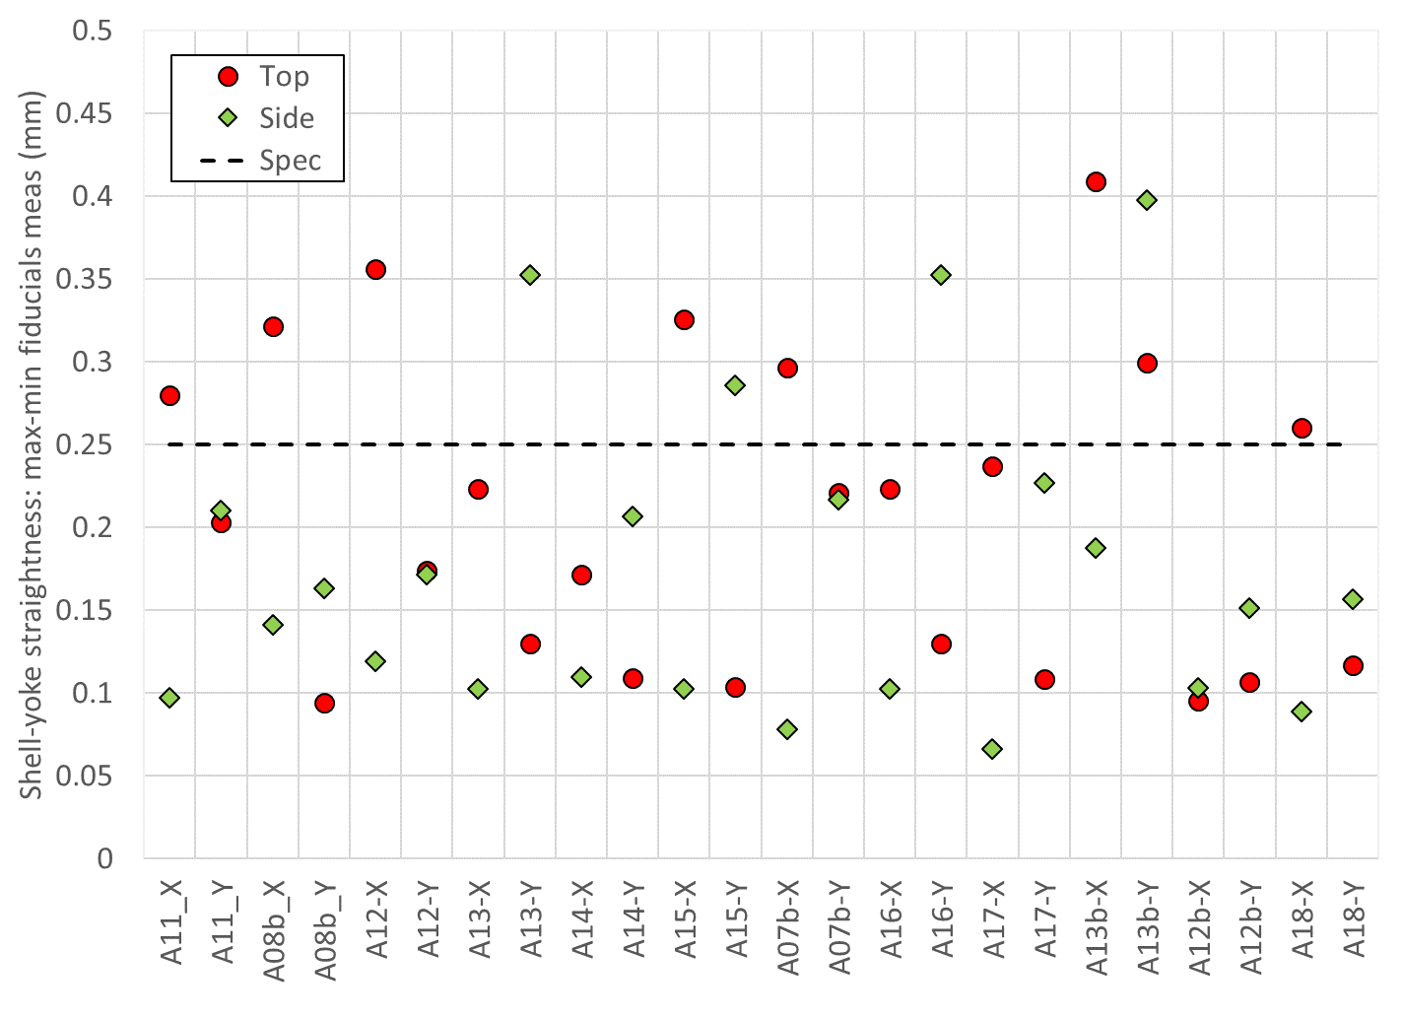
Shell-yoke sub-assembly
Specification
For the straightness of the shell-yoke sub-assembly, the following specifications are set:
  The maximum spread (max – min) of the vertical and horizontal position of the fiducials in the top shell cut-outs along 7 longitudinal locations shall be ≤ 0.250 mm.
  The maximum spread (max – min) of the vertical and horizontal position of the fiducials in one side of the mid-plane shell cut-outs along 7 longitudinal locations shall be ≤ 0.250 mm.

Slide 18
Outline
Introduction
Shell-yoke sub-assembly specs
Coil-pack sub-assembly specs
Magnet assembly and loading specs
Assembled magnet specs

Slide 19
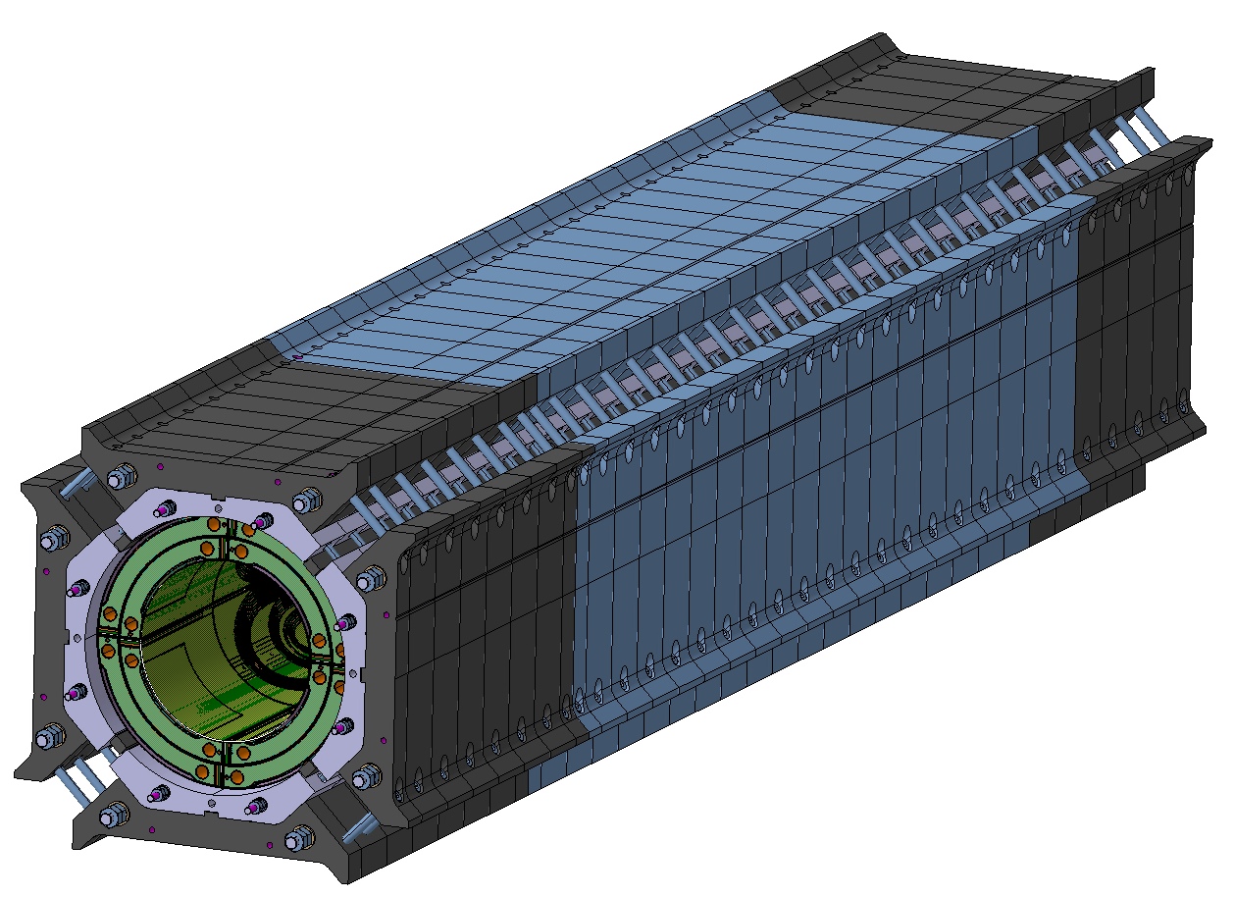
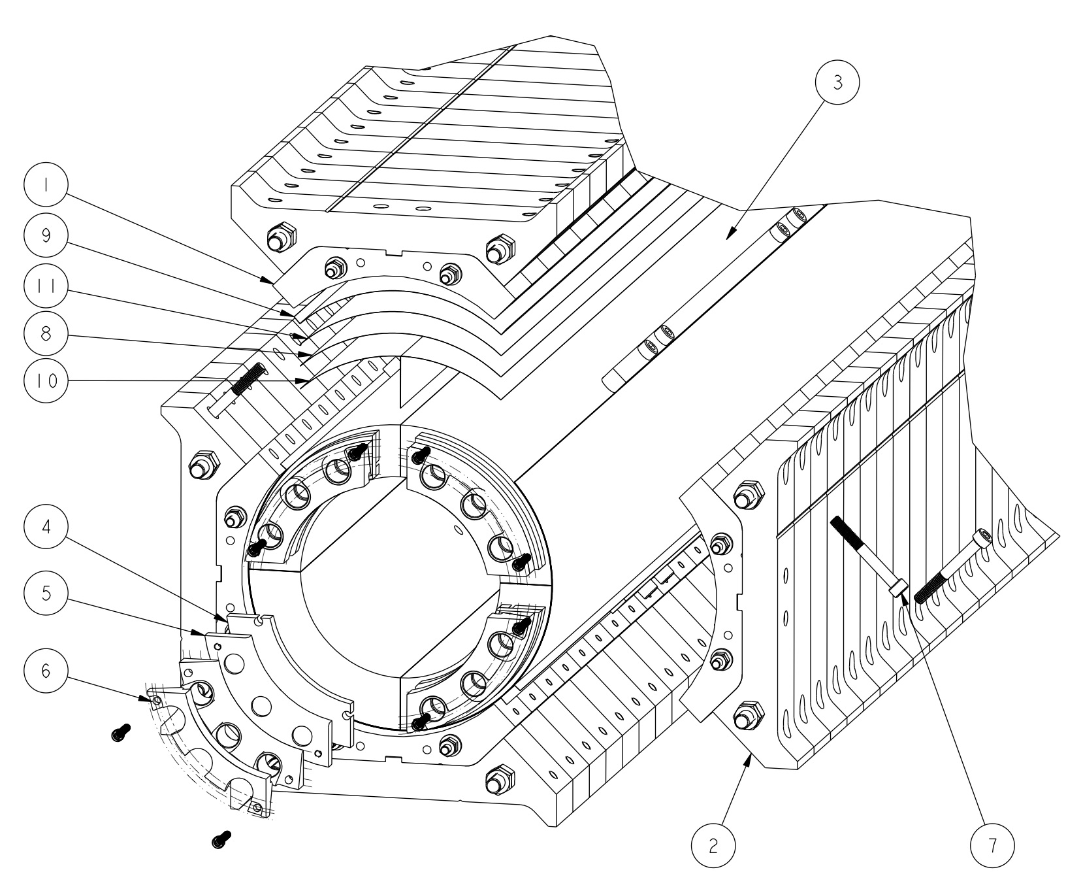
Coil-pack sub-assembly
Assembly of the coils, collars and pads
Starts by placing the bottom pad-collar stack, then the two-side pad-collar stacks, and the top
What we monitor (with specs)
  Insulated Coil OR and radial shims
  Dimensional uniformity and squareness
  Pole key gap
  Field quality
  Electrical integrity
Subscale version, identical design as MQXFA

Slide 20
Coil-pack sub-assembly
Coil OR and radial shims
Nominal radial gap coil to collars
  0.624 mm (GPI + radial shims)
Final layers of radial shims depend on
  Coil size: larger/smaller coils after mid-plane shimming can be compensated by less/more radial shims
  Missing shims for “LQ effect”
    0.125 remove from radial shims
So, from 0.624 mm to 0.500 mm

Slide 21
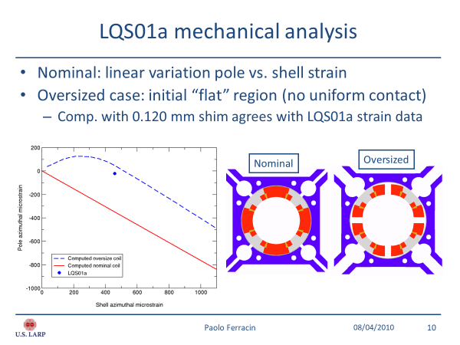
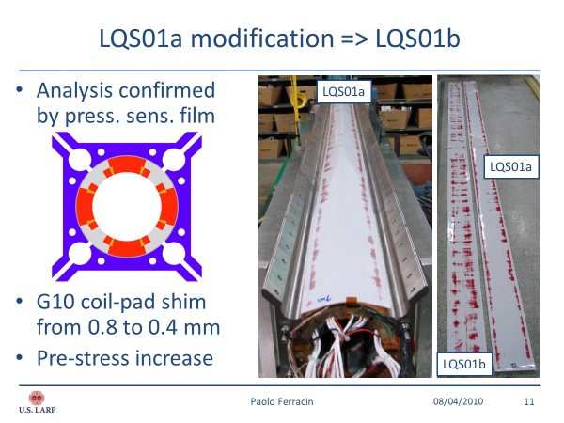
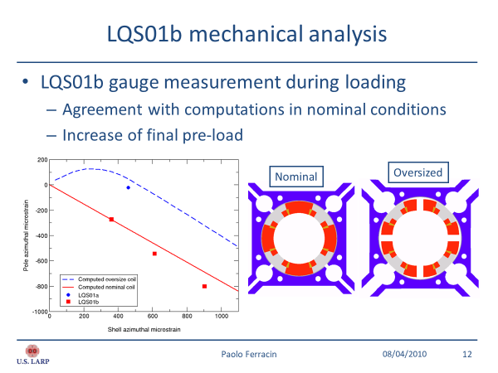
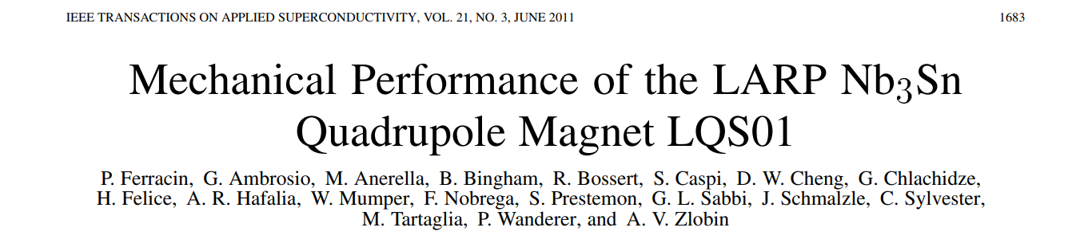
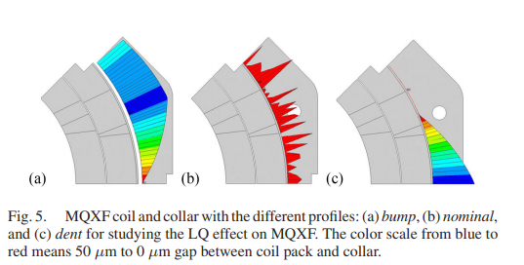
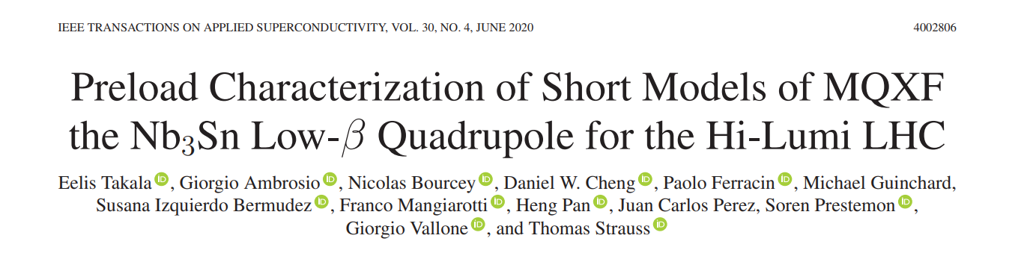
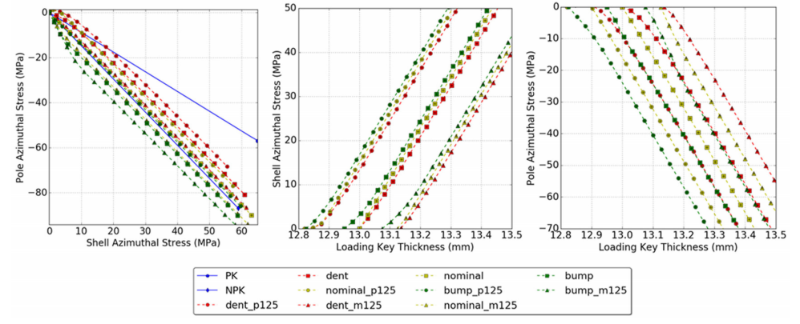
Coil-pack sub-assembly
“LQ effect”

Slide 22
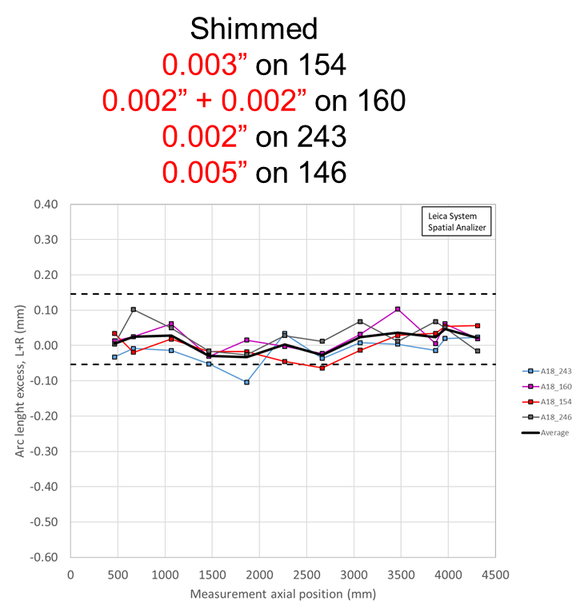
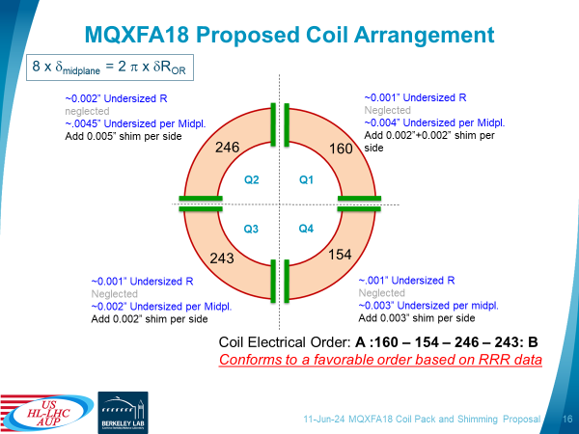
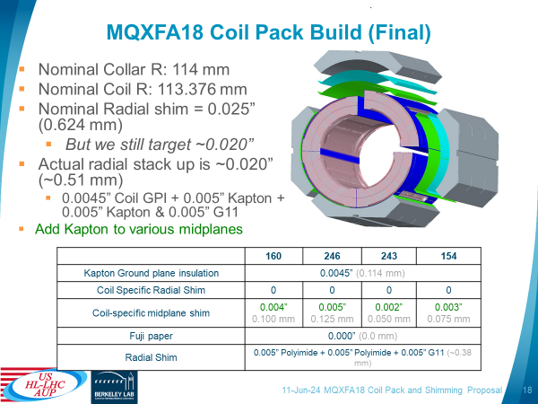
Coil-pack sub-assembly
Specification
For the gap between collars and insulated coils
  The variation along the longitudinal direction of the gap between collars and insulated coils, considering for each z location the average among the four coils, shall be -0.125 mm -0.100 / +0.050 mm.

Slide 23
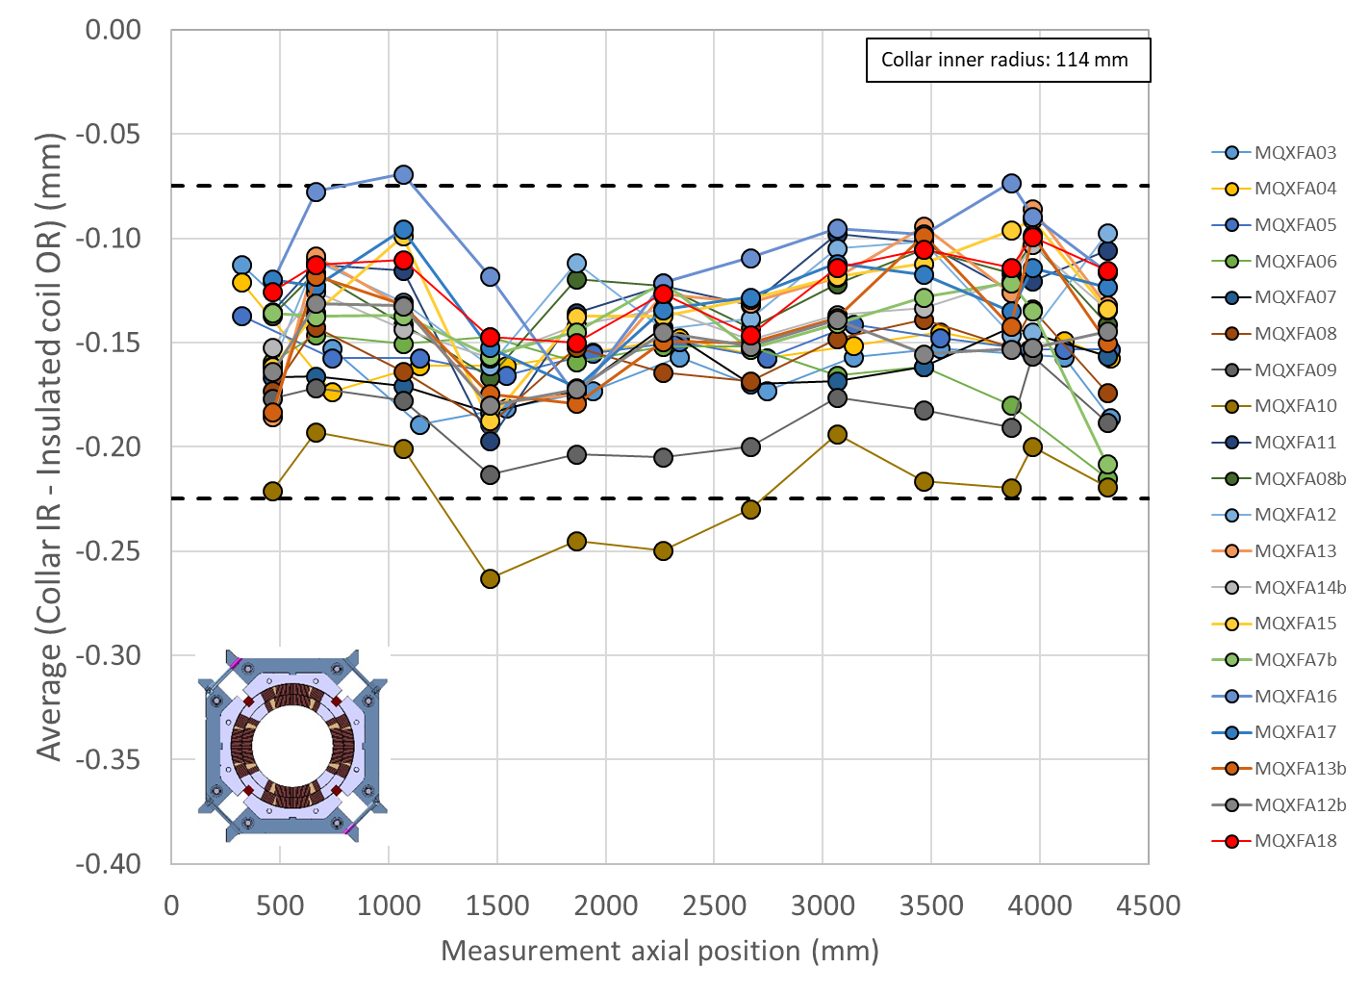
Coil-pack sub-assembly
Specification
For the gap between collars and insulated coils
  The variation along the longitudinal direction of the gap between collars and insulated coils, considering for each z location the average among the four coils, shall be -0.125 mm -0.100 / +0.050 mm.
Insulated coil OR based on coil dimensions meas. and mid-plane shims
  ΔR_{coil} = (arc_length_excess + 2*midplane_shim) *2/π

Slide 24
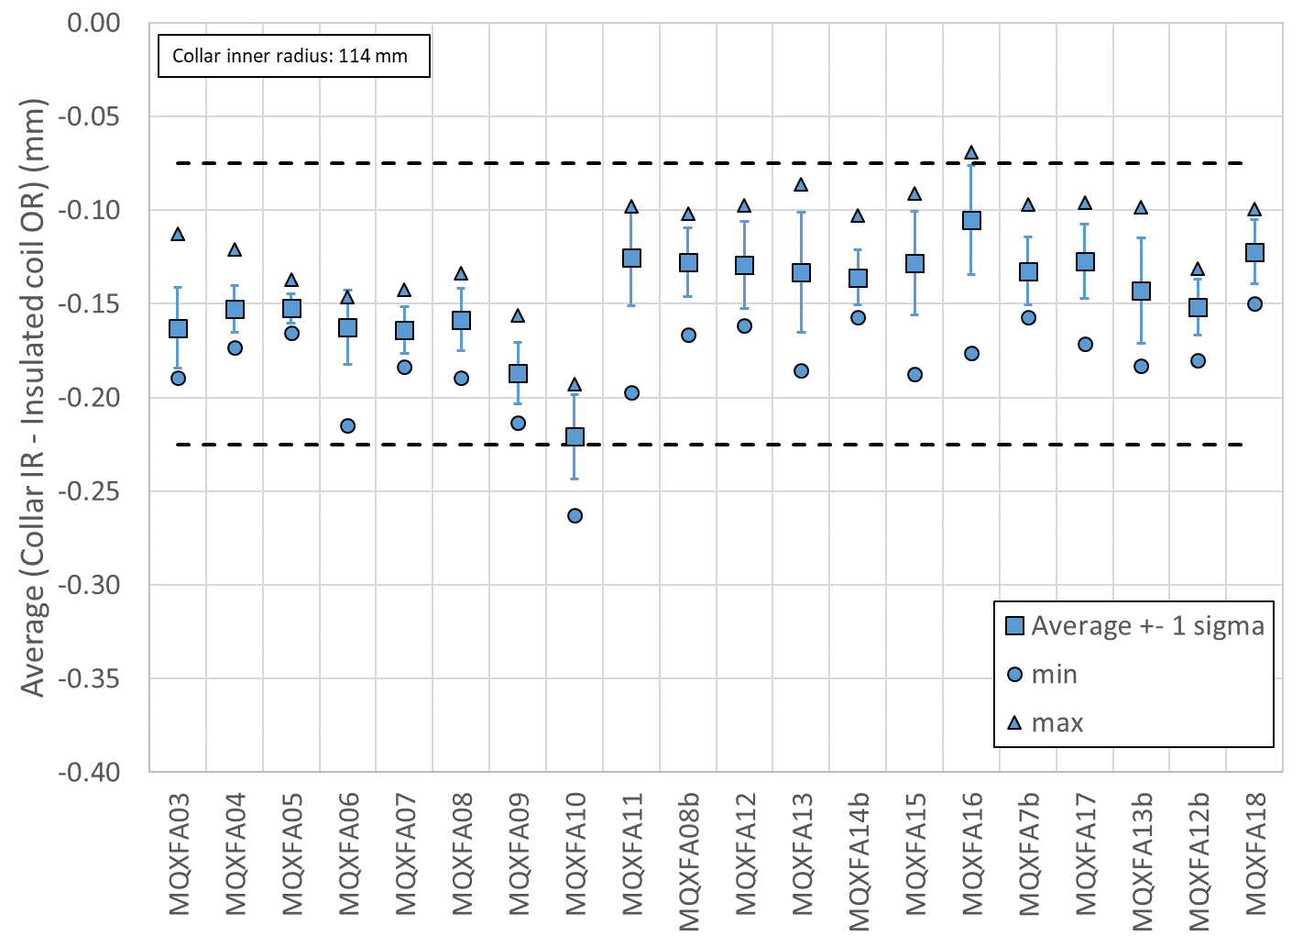
Coil-pack sub-assembly
Specification
For the gap between collars and insulated coils
  The variation along the longitudinal direction of the gap between collars and insulated coils, considering for each z location the average among the four coils, shall be -0.125 mm -0.100 / +0.050 mm.
Insulated coil OR based on coil dimensions meas. and mid-plane shims
  ΔR_{coil} = (arc_length_excess + 2*midplane_shim) *2/π

Slide 25
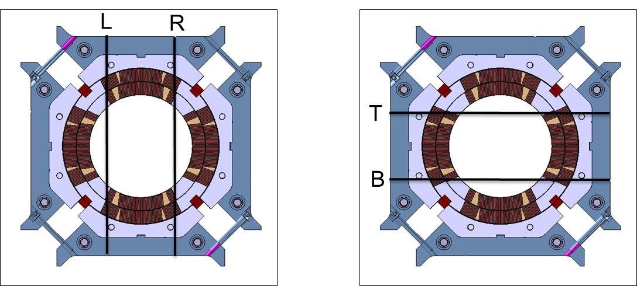
Coil-pack sub-assembly
Coil pack dimensional measurements
Coil pack dimensions measured on 11 locations
  Two horizontal and two vertical meas.
Uniformity
  The difference of the average of the two meas. in each cross-section with respect to the average of the entire coil pack
Squareness
  The difference of the of the two meas. in each cross-section.

Slide 26
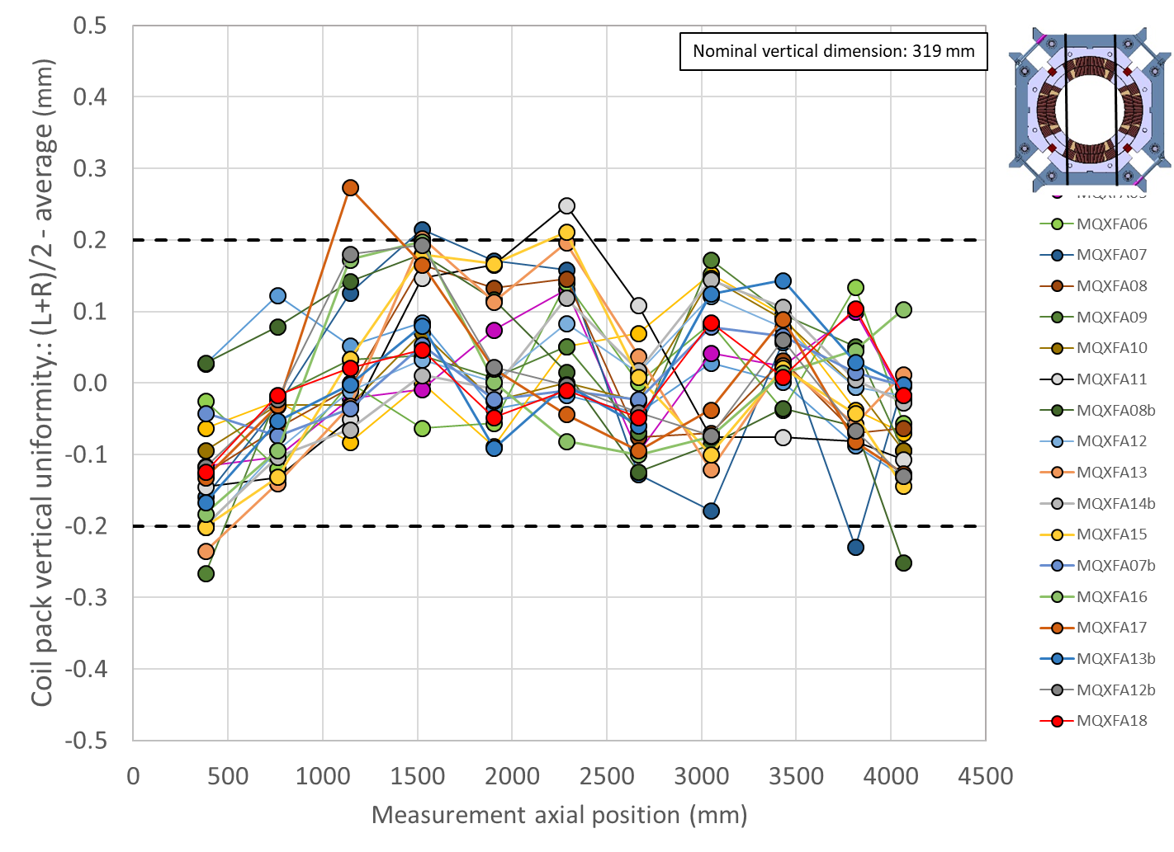
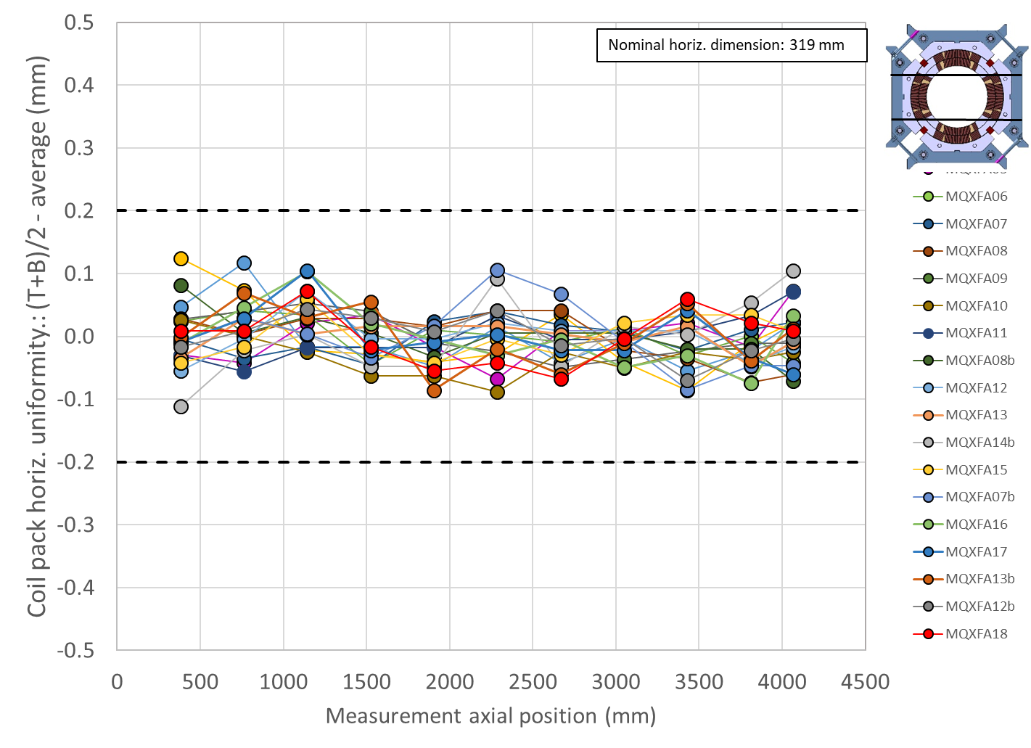
Coil-pack sub-assembly
Specification
For the coil-pack uniformity:
  The uniformity of the vertical and horizontal dimensions along the z axis shall be within ±0.200 mm

Slide 27
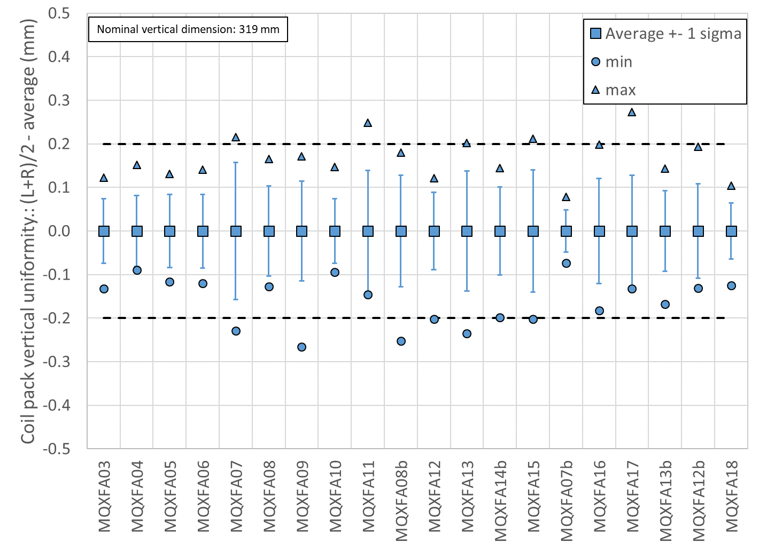
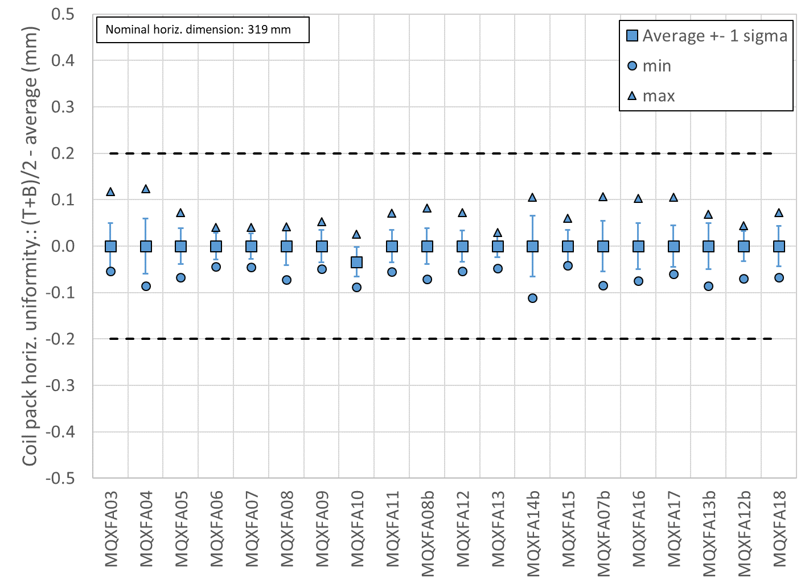
Coil-pack sub-assembly
Specification
For the coil-pack uniformity:
  The uniformity of the vertical and horizontal dimensions along the z axis shall be within ±0.200 mm

Slide 28
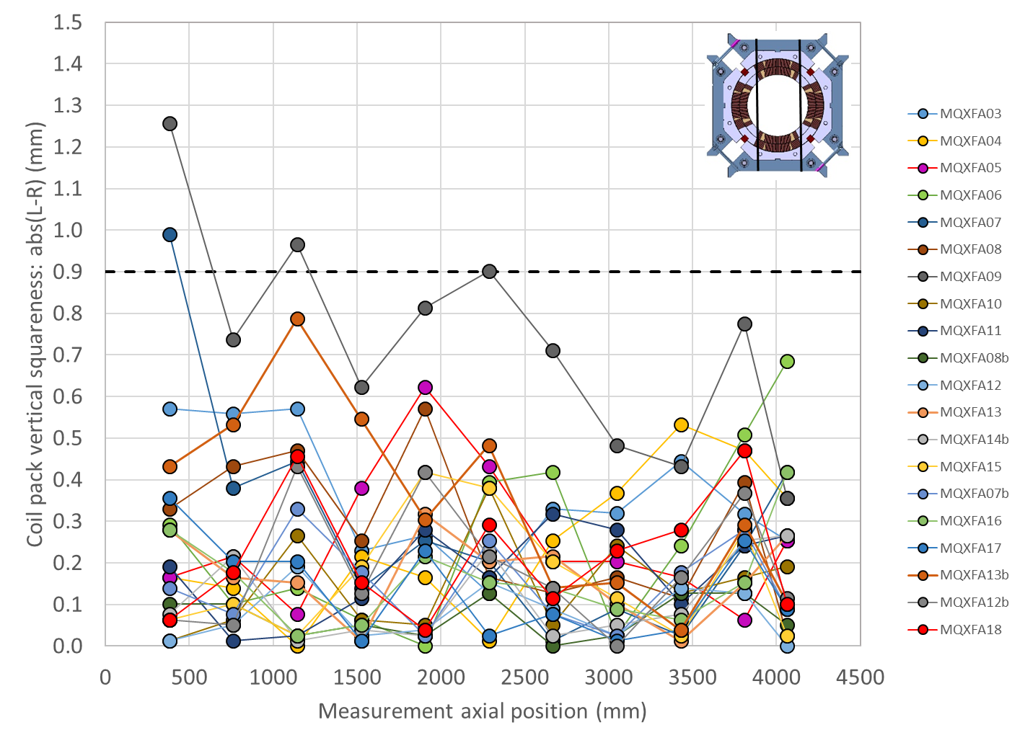
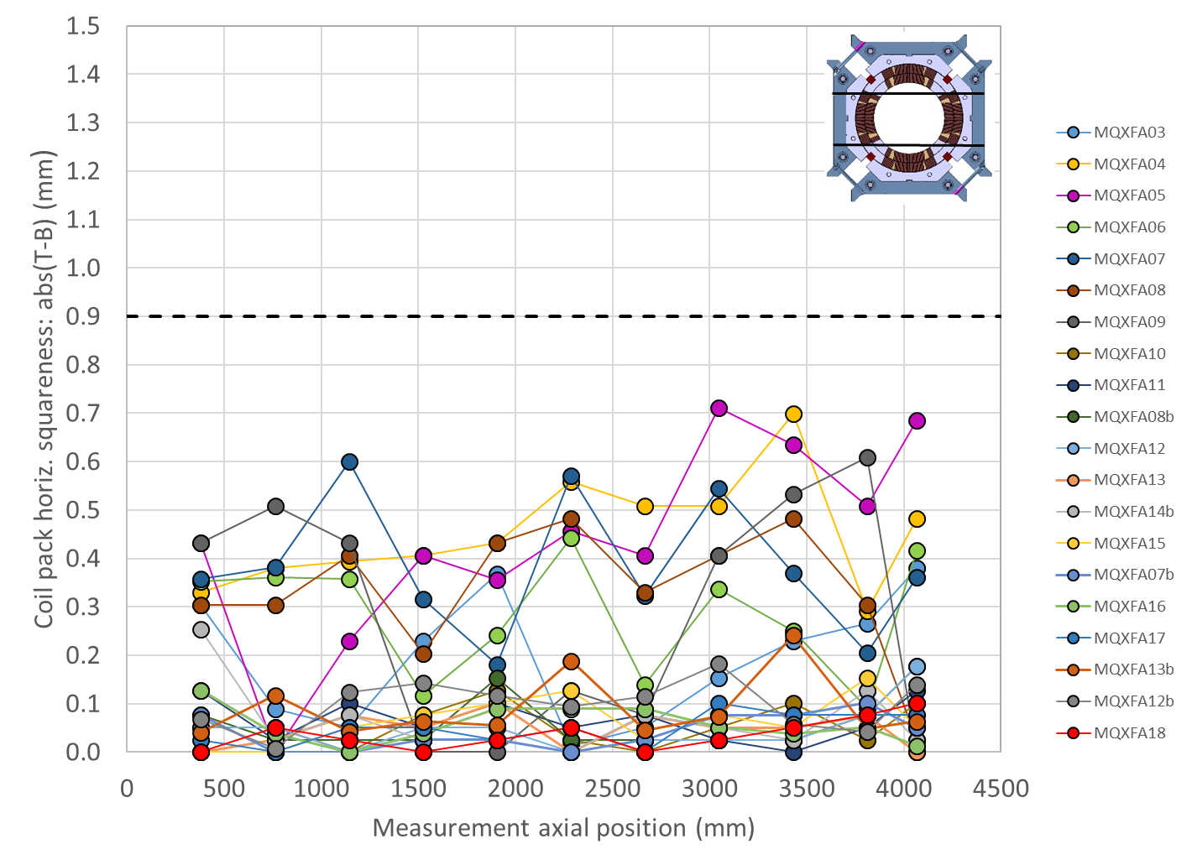
Coil-pack sub-assembly
Specification
For the coil-pack squareness:
  The squareness of the vertical and horizontal dimensions along the z axis shall be within +0.900 mm

Slide 29
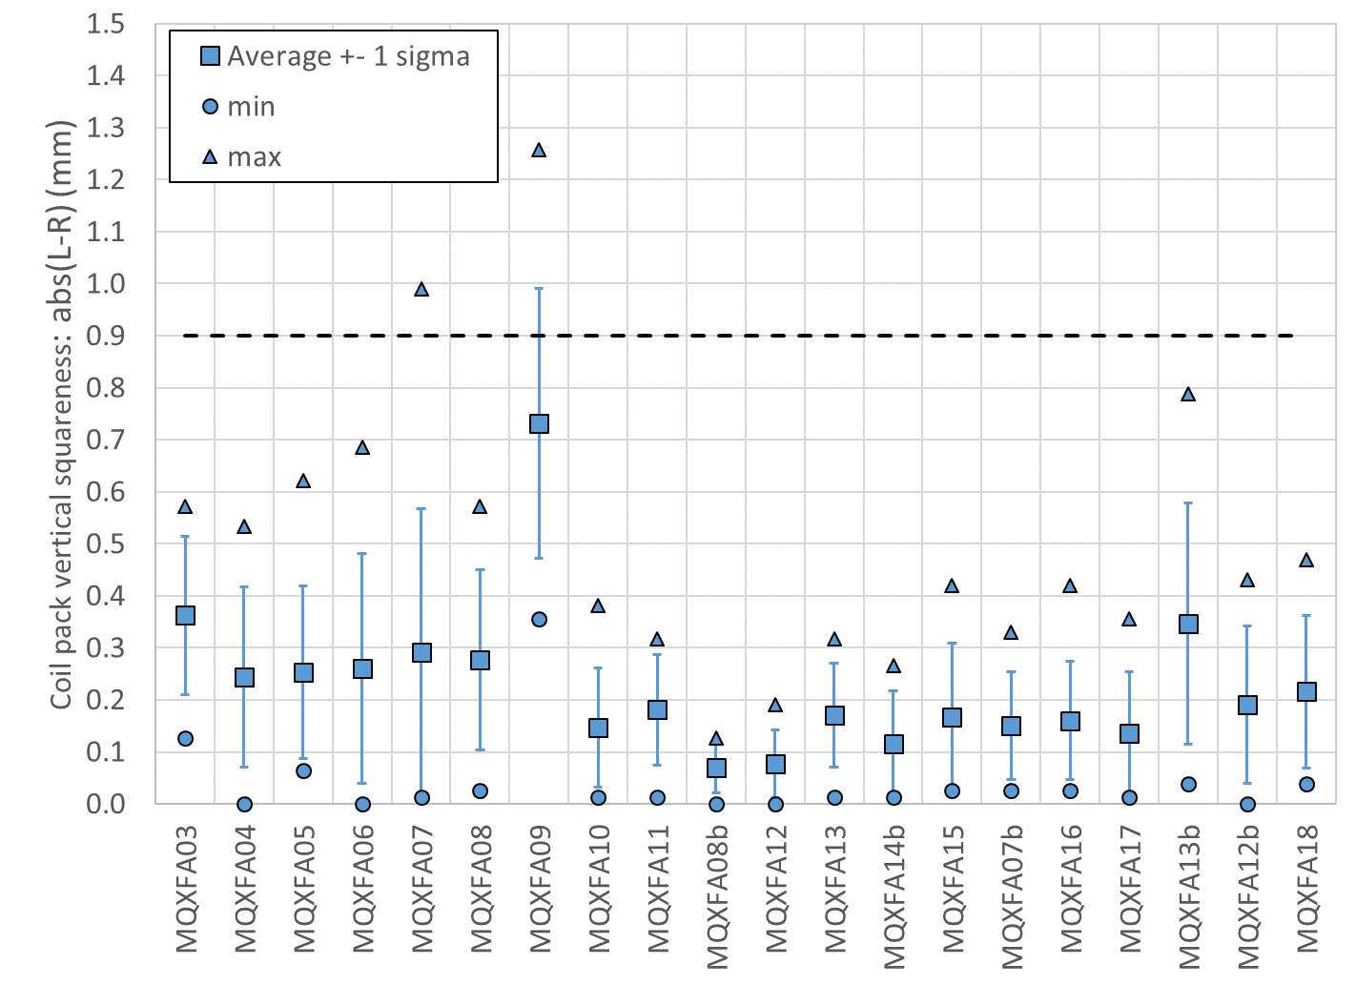
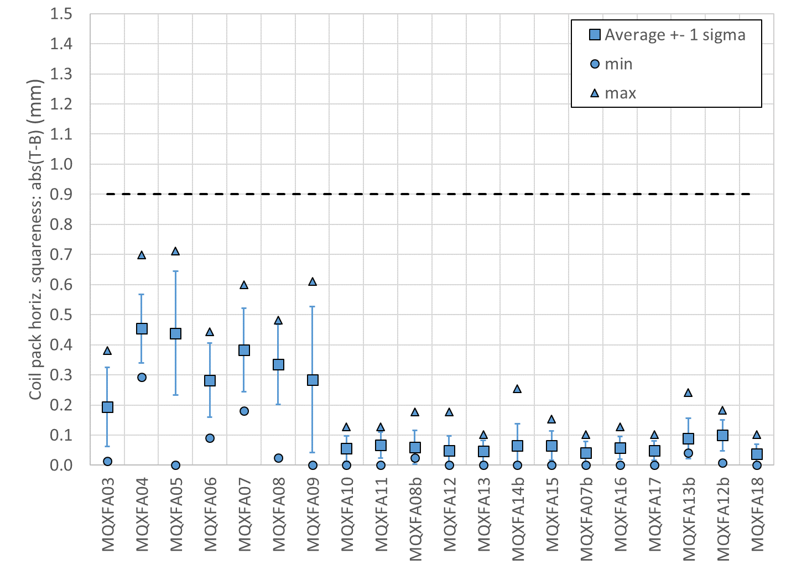
Coil-pack sub-assembly
Specification
For the coil-pack squareness:
  The squareness of the vertical and horizontal dimensions along the z axis shall be within +0.900 mm

Slide 30
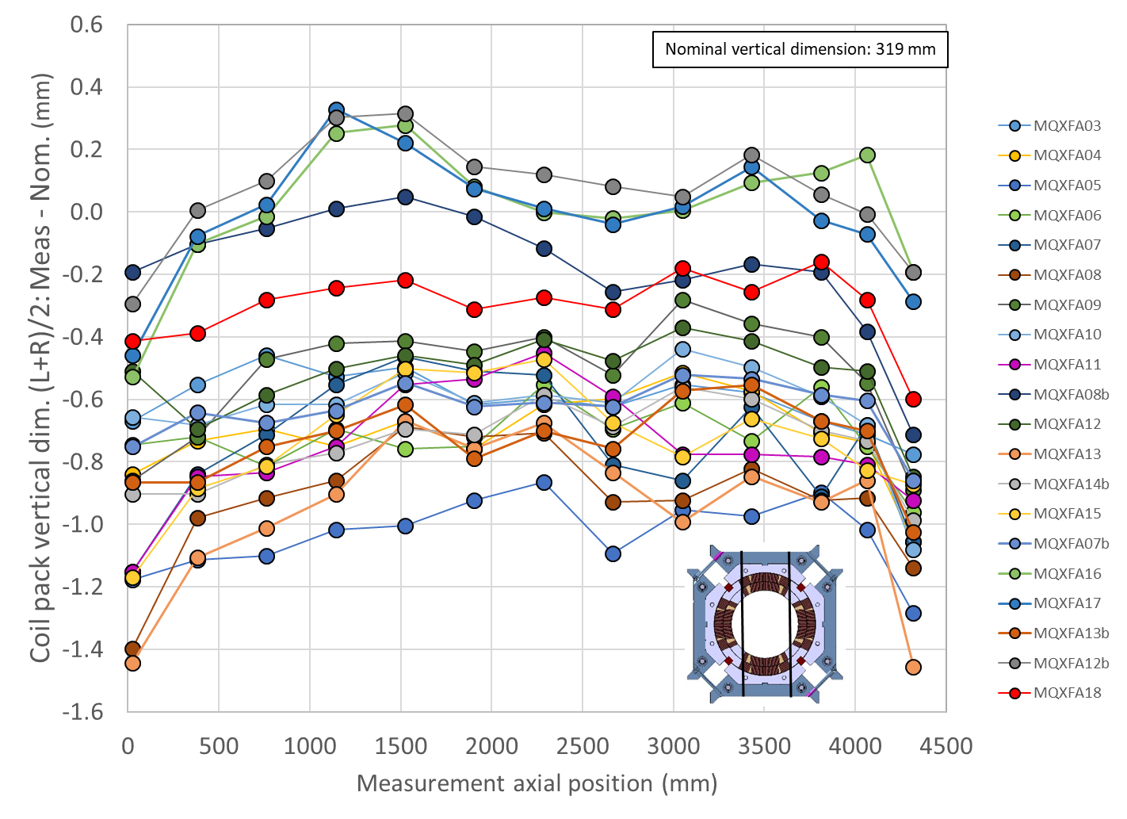
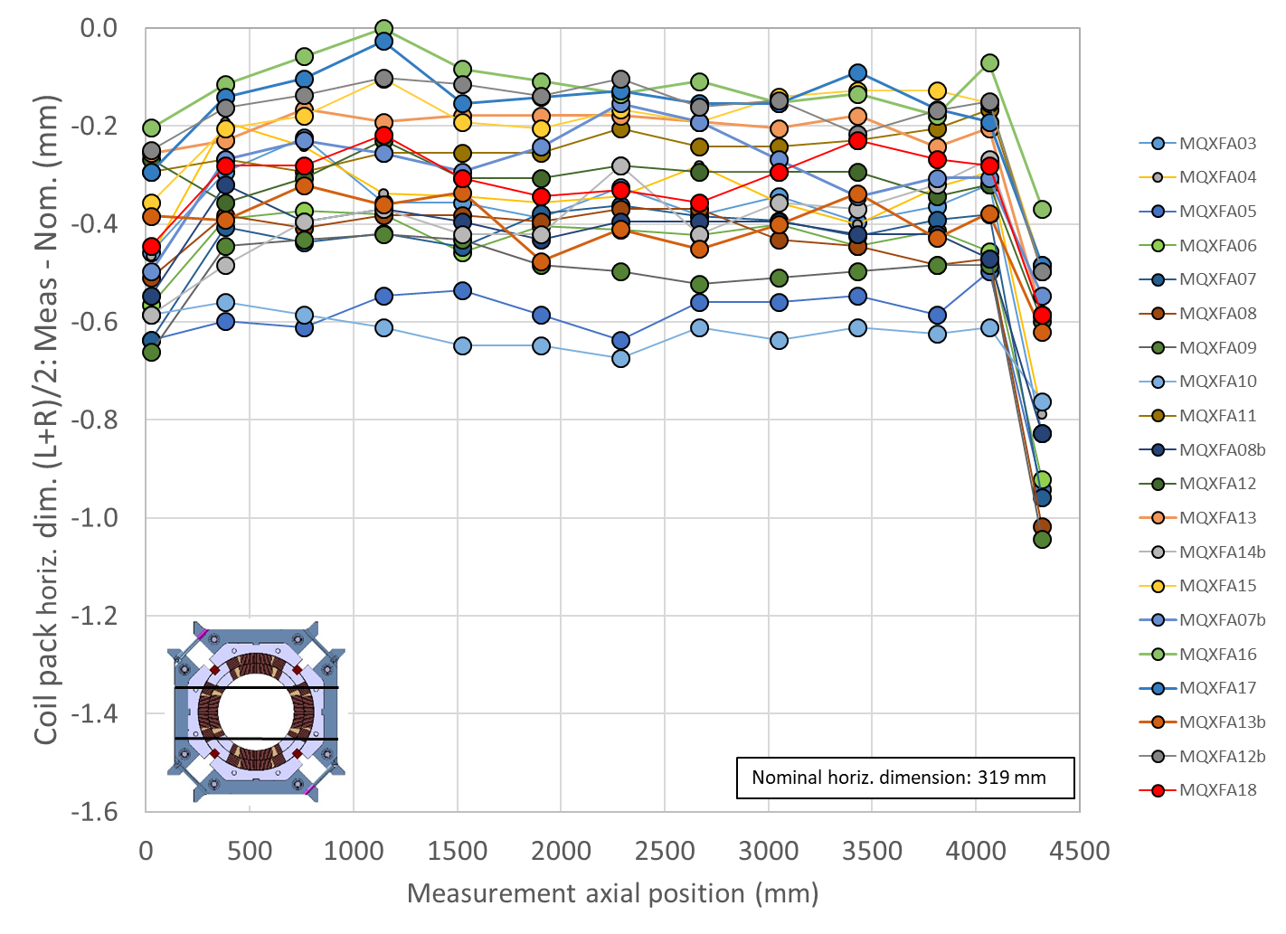
Coil-pack vertical and horizontal dimension

Slide 31
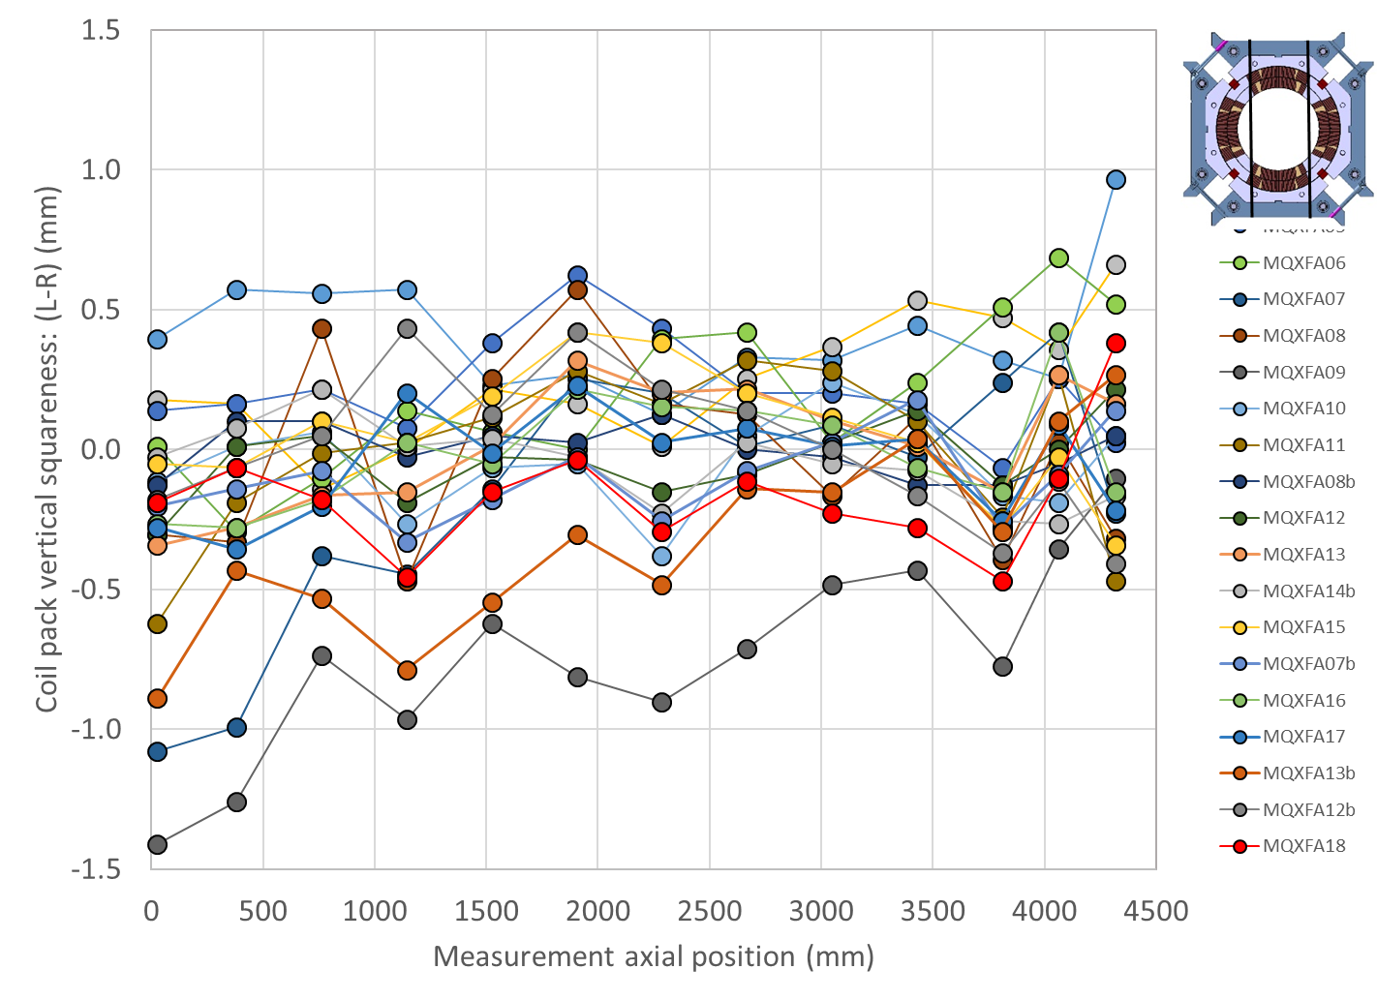
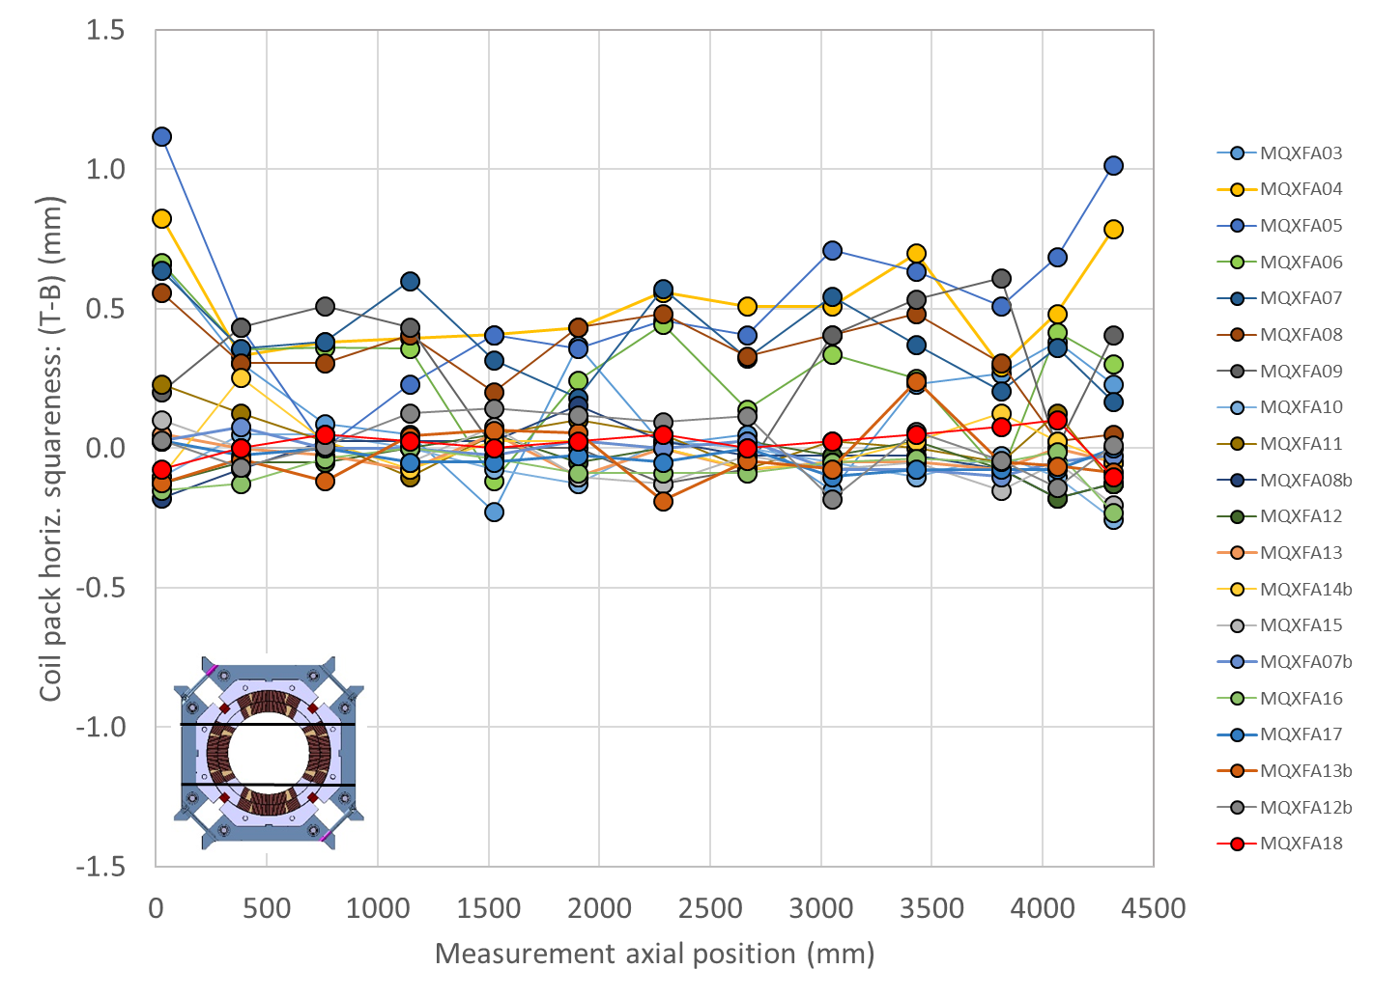
Coil-pack vertical and horizontal squareness

Slide 32
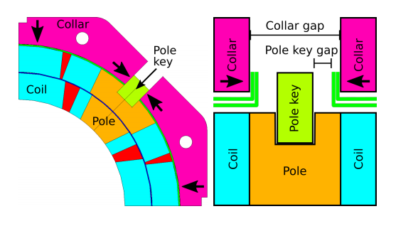
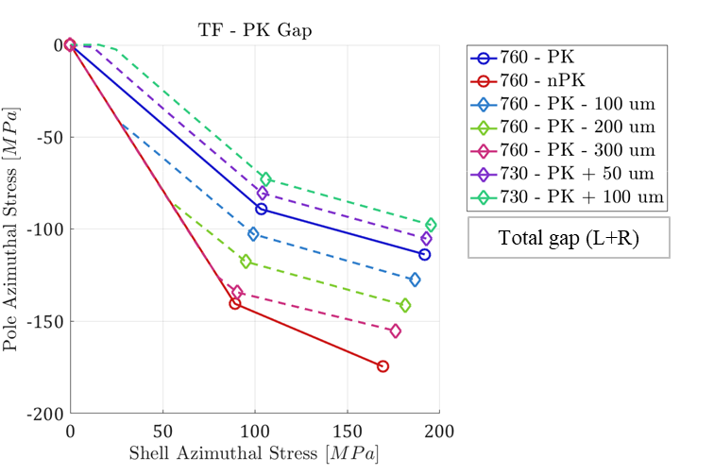
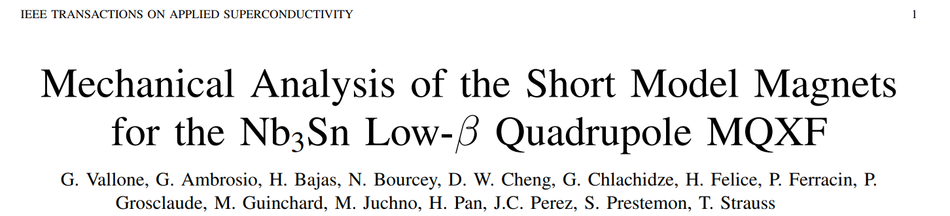
Coil-pack sub-assembly
Pole key gap
According to computations, a gap of 0.200 mm per side at the end of coil-pack bolting → contact collar to pole-key at 1.9 K.
  1.9 K, no force interception and azimuthal alignment between collars and coil guaranteed
By E. Takala

Slide 33
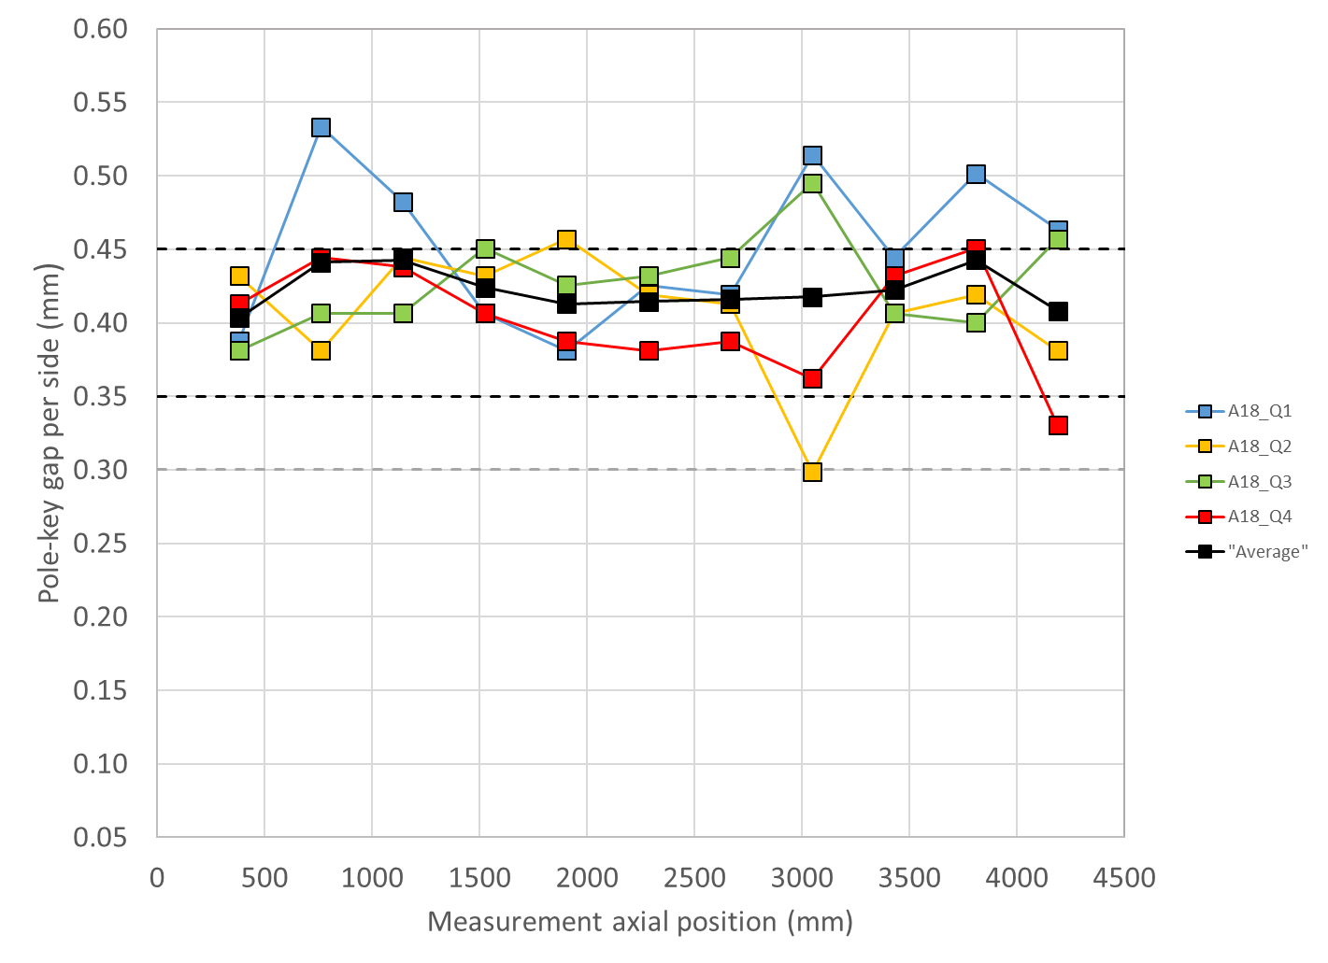
Coil-pack sub-assembly
Specification
For the pole key gap, the following specifications are set:
  The pole key gap, average per side and all quadrants, shall be +0.400 ±0.050 mm in each longitudinal locations.
  The minimum pole key gap, average per side, shall be ≥0.300 mm in each quadrant and in each longitudinal location.

Slide 34
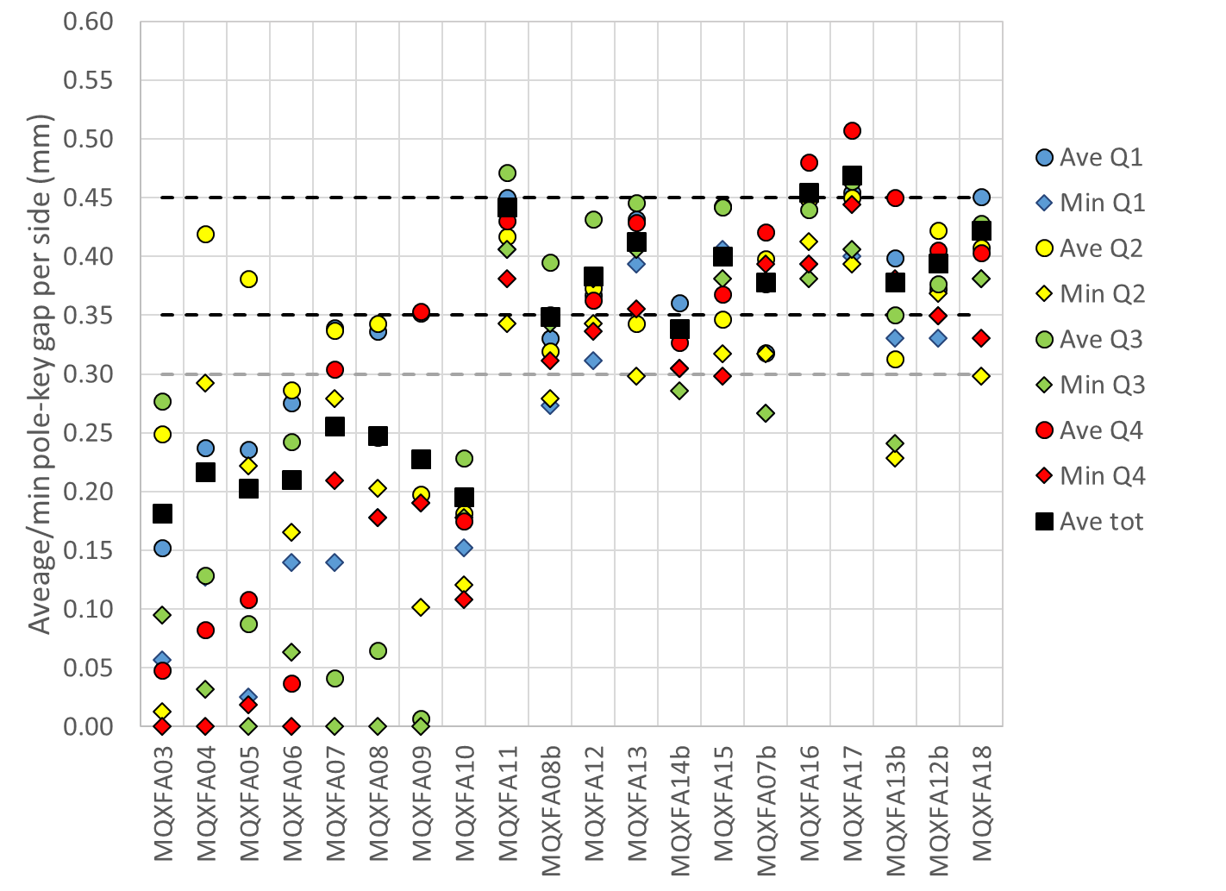
Coil-pack sub-assembly
Pole key gap
Overview plot
  Ave tot: average along length and among quadrants
  Ave: average along length
  Min: local minimum

Slide 35
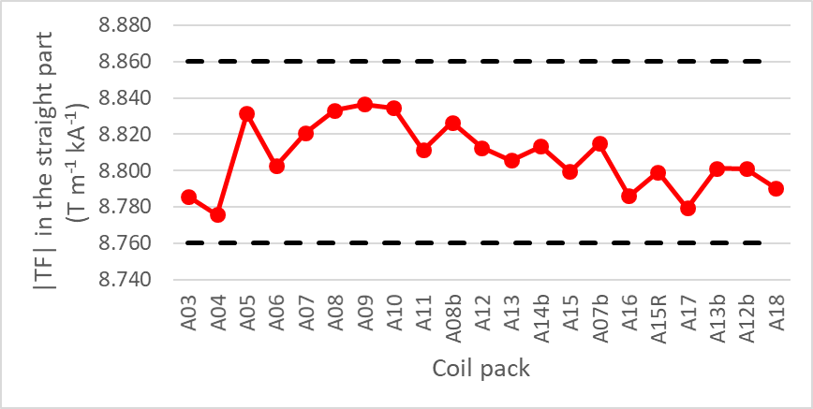
Coil-pack sub-assembly
Specification
For the main field transfer function, :
  The absolute value of the main field transfer function averaged over the straight part of the coil pack shall be within +8.760 T/(m kA) and +8.860 T/(m kA).
Data were taken using a 110 mm long rotating coil

Slide 36
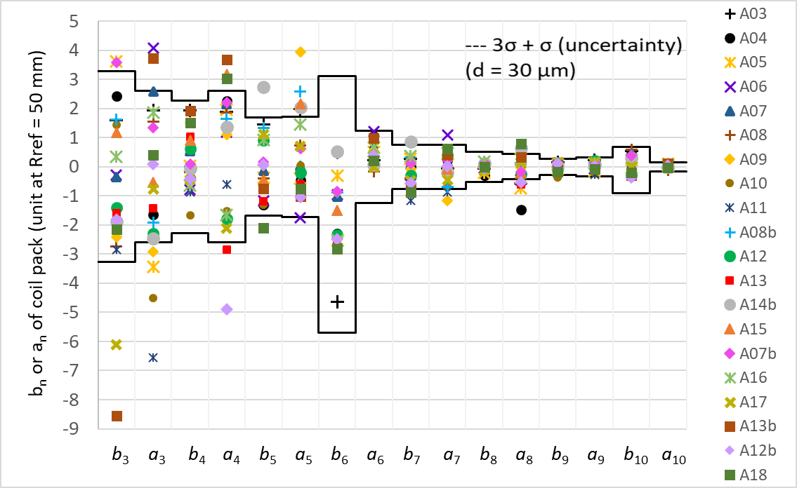
Coil-pack sub-assembly
Target
For the field errors, :
  The field errors in units averaged in the straight part of the coil pack with a reference radius of 50 mm should be within the upper and lower bounds determined according to the Triplet Field Quality Table in Table 1 of [8]
    A systematic component (0.9 units) associated with assembly and cooldown for b6 are considered.
[8] ACCEPTANCE CRITERIA PART A: MQXFA MAGNET, US-HiLumi-doc-1103
Data were taken using a 110 mm long rotating coil

Slide 37
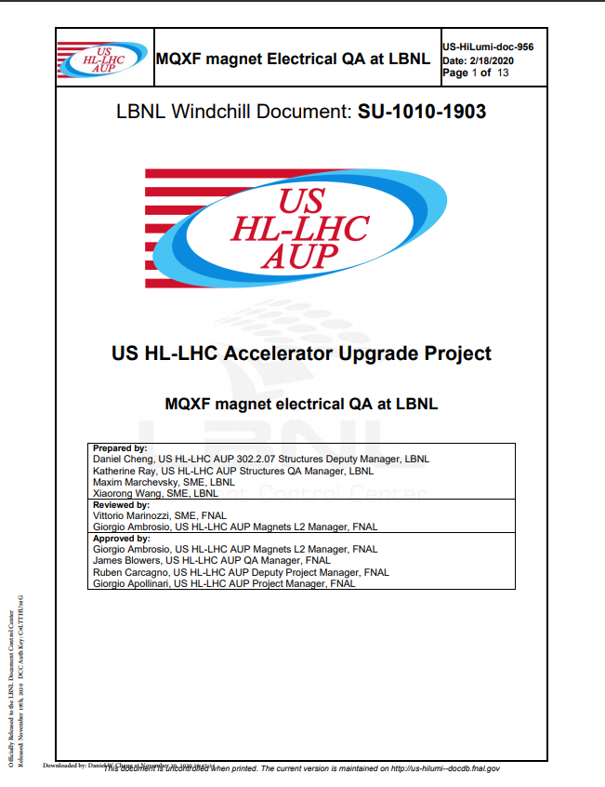
Coil-pack sub-assembly
Specification
For the electrical tests of the coil pack:
  1. Resistance check with hand-held multimeter
    a. Coil to structure
    b. Coil to coil
    c. Coil to PH
  2. Hipot.
    Individual coil to structure, 3680 V.
  3. Impulse test up to 2500 V, Direct- and Reversed-polarity.
    a. 1000 V, 1500 V, 2000 V, 2500 V

Slide 38
Outline
Introduction
Shell-yoke sub-assembly specs
Coil-pack sub-assembly specs
Magnet assembly and loading specs
Assembled magnet specs

Slide 39
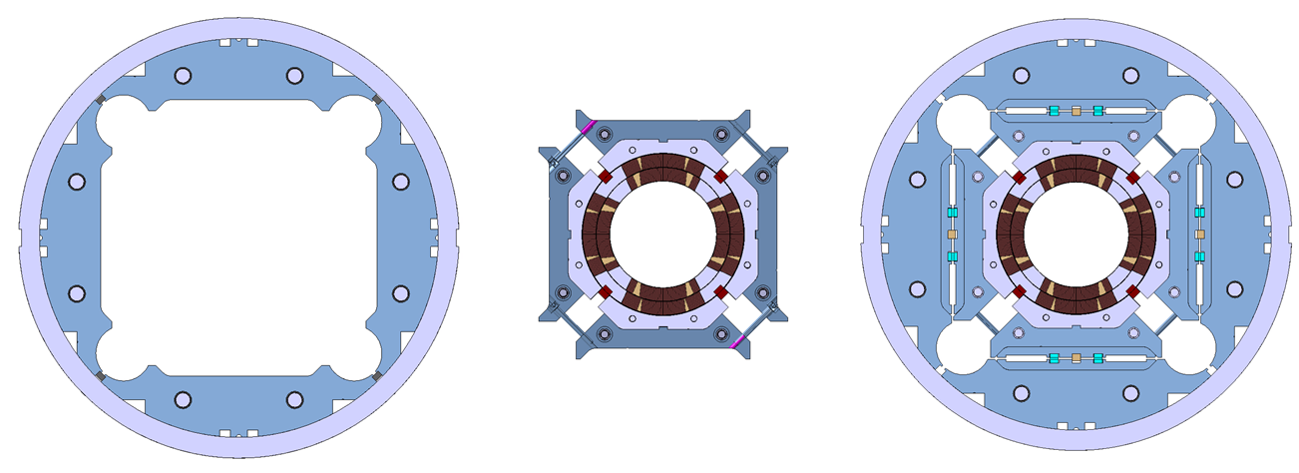
Magnet assembly and loading
Assembly-loading sequence
The coil-pack slid inside the shell-yoke
Master keys and bladders inserted
Axial loading rig is attached to the axial rods
Bladders inflated → the load keys shimmed
In parallel, the axial rods pre-tensioned.

Slide 40
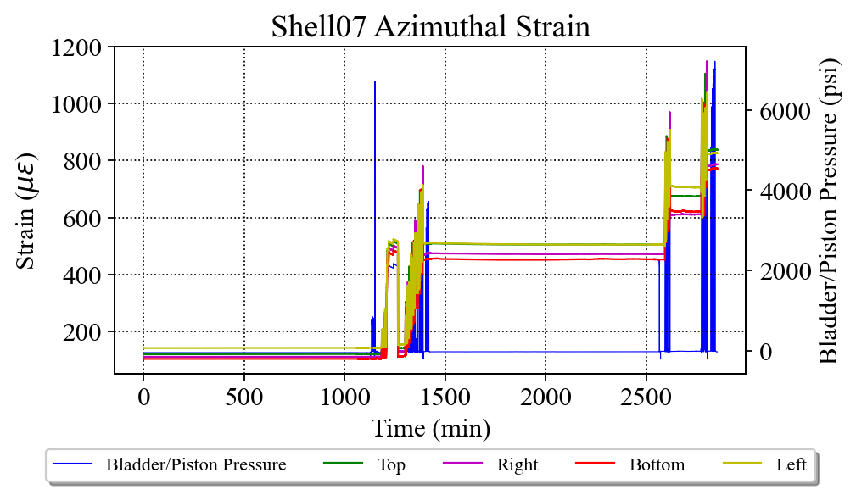

Magnet assembly and loading
Specifications
For the pre-load operation sequence:
  The loading operation shall follow the sequence described below:
    Pre-load axial rods to a measured average of ~50 µε
    Apply 50% azimuthal pre-load
    Apply 50% axial pre-load
    Apply 100% azimuthal pre-load with tapered shim
    Apply 100% axial pre-load

Slide 41
Target loading key shim
For final loading key shim size reached during the pre-load operations, the following target is set:
At the end of the pre-loading operation, the sum of the loading shim size and the coil-pack radial dimension deviations in straight section, LE and RE shall be within the range achieved in magnets MQXFA14b and MQXFA05
  If, with such load key shim targets, the coil stress measured in 2+ strain gauges during the loading or during bladder inflation indicate that the coil stress may reach values above the coil stress spec. during subsequent loading steps or at the end of the loading, priority should be given to keeping the coil stress within the specs.

Slide 42
Summary and proposal
 | Ave ss | Key | Shim | Ishim | Ave ss + ishim
 | mm | mm | mils | mm | mm
A18 up | -0.025 | 13.84 | 43 | 0.533 | 0.508
A18 low | -0.025 | 13.79 | 41 | 0.483 | 0.457
 | LE | Key | Shim | Ishim | LE + Ishim
 | mm | mm | mils | mm | mm
A18 up | -0.167 | 13.82 | 42 | 0.508 | 0.341
A18 low | -0.167 | 13.79 | 41 | 0.483 | 0.315
 | RE | Key | Shim | Ishim | RE + Ishim
 | mm | mm | mils | mm | mm
A18 up | -0.106 | 13.79 | 41 | 0.483 | 0.376
A18 low | -0.106 | 13.74 | 39 | 0.432 | 0.326
Proposed target: 41-43 mils

Slide 43


Key-shim size vs. bladder pressure
To be updated

Slide 44


Key-shim size vs. bladder pressure

Slide 45



Coil-radial dimensions + shim

Slide 46
Coil-radial dimensions + shim

Slide 47
Magnet assembly and loading
Specifications (shells)
For the pre-load targets at the end of the pre-load:
  The target average measured stress on coils, shells and rods at the end of the loading (after at least 24 h) shall be
    Shell average azimuthal stress: +58 ±6 MPa
Channel | SC01TT | SC01RT | SC01BT | SC01LT | Average
Preload (end) | 69 | 75 | 74 | 72 | 72
Overnight (end) | 68 | 74 | 73 | 71 | 72
Channel | SC02TT | SC02RT | SC02BT | SC02LT | Average
Preload (end) | 68 | 66 | 68 | 64 | 67
Overnight (end) | 60 | 60 | 67 | 63 | 63
Channel | SC04TT | SC04RT | SC04BT | SC04LT | Average
Preload (end) | 58 | 56 | 53 | 62 | 57
Overnight (end) | 57 | 56 | 58 | 61 | 58
Channel | SC07TT | SC07RT | SC07BT | SC02LT | Average
Preload (end) | 59 | 55 | 55 | 58 | 57
Overnight (end) |  |  |  |  | 57

Slide 48




Magnet assembly and loading
Specifications (shells)

Slide 49




Magnet assembly and loading
Specifications (shells)

Slide 50
Magnet assembly and loading
Specifications (coils)
For the pre-load targets at the end of the pre-load:
  The target average measured stress on coils, shells and rods at the end of the loading (after at least 24 h) shall be
    Coil (winding pole) average azimuthal stress: -80 ±8 MPa
Channel | CQ1T | CQ2T | CQ3T | CQ4T | Average
Preload (end) | -85 | -76 | -81 | -90 | -83
Overnight (end) | -85 | -75 | -81 | -89 | -82
Channel | CQ1T-LE | CQ2T-LE | CQ3T-LE | CQ4T-LE | Average
Preload (end) | -72 | -74 | -80 | -89 | -79
Overnight (end) | -72 | -74 | -79 | -88 | -78

Slide 51


Magnet assembly and loading
Specifications (coils)

Slide 52


Magnet assembly and loading
Specifications (coils)

Slide 53
Magnet assembly and loading
Specifications (coils)
Channel | CQ1-700Ts | CQ2-700Ts | CQ3-700Ts | CQ4-700Ts | CQ1-1900Ts | CQ2-1900Ts | CQ3-1900Ts | CQ4-1900Ts | CQ1-3800Ts | CQ2-3800Ts | CQ3-3800Ts | CQ4-3800Ts | Average
Preload (end) | -85 | -111 | -93 | -94 | -86 | -116 | -91 | -89 | -59 | -77 | -62 |  | -88
Overnight (end) | -85 | -117 | -92 | -95 | -86 | -127 | -90 | -97 | -58 | -77 | -61 |  | -97

Slide 54



Magnet assembly and loading
Specifications (coils)

Slide 55



Magnet assembly and loading
Specifications (coils)

Slide 56





Magnet assembly and loading
Specifications (coils)
For the maximum stress reached during the pre-load operations:
  During the entire pre-load operation, the maximum compression measured on each coil shall never exceed -120 MPa

Slide 57
Magnet assembly and loading
Specifications (coils)
For the maximum stress reached during the pre-load operations:
  During the entire pre-load operation, the maximum compression measured on each coil shall never exceed -120 MPa
Peak stress on coils (MPa)
Electrical SGs
CQ1 | CQ2 | CQ3 | CQ4
-112 | -104 | -124 | -111
FBGs
CQ1-700 | CQ2-700 | CQ3-700 | CQ4-700 | CQ1-1900 | CQ2-1900 | CQ3-1900 | CQ4-1900 | CQ1-3800 | CQ2-3800 | CQ3-3800 | CQ4-3800
-112 | -136 | -126 | -108 | -116 | -154 | -128 | -116 | -106 | -104 | -100

Slide 58

Magnet assembly and loading
Specifications (coils)

Slide 59


Coil delta stress during powering (ramps-up and down averaged)
Spread in the delta azimuthal stress
Magnet MQXF_ | A03 | A04 | A05 | A06 | A07 | A08 | A10 | A11 | A08b
Coil with the largest delta stress | CQ1 | CQ2 | CQ1 | CQ3 | CQ2 | CQ1 | CQ1 | CQ3 | CQ3
Coil with the smallest delta stress | CQ2 | CQ3 | CQ4 | CQ4 | CQ1 | CQ2 | CQ4 | CQ2 | CQ2
MQXFA07 didn’t reach the nominal current.
The current of MQXFA07 in these plots is 15.45 kA, whereas for the other magnets, the current ranges from 16.45 to 16.65 kA
Spread in the delta axial stress
Magnet MQXF_ | A03 | A04 | A05 | A06 | A07 | A08 | A10 | A11 | A08b
Coil with the largest delta stress | CQ1 | CQ2 | CQ1 | CQ3 | CQ3 | CQ3 | CQ1 | CQ1 | CQ4
Coil with the smallest delta stress | CQ2 | CQ3 | CQ4 | CQ4 | CQ1 | CQ2 | CQ4 | CQ2 | CQ2

Slide 60

Magnet assembly and loading
Specifications (rods)
For the pre-load targets at the end of the pre-load:
  The target average measured stress on coils, shells and rods at the end of the loading (after at least 24 h) shall be
    Rod average strain: +950 µε ±95 µε
Channel | ROD1 | ROD2 | ROD3 | ROD4 | Average
Preload (end) | 192 | 194 | 194 | 192 | 193
Overnight (end) | 893 | 927 | 929 | 899 | 912

Slide 61

Magnet assembly and loading
Specifications (rods)

Slide 62


A18
Coil arc length and coil stress measurements
Av straight section = 0.010 mm (465-4310 mm)
Min LE = -0.181 mm (260-300 mm)
Min RE = -0.100 mm (4340-4380 mm)
Computed on SG loc = SG data

Slide 63


A18
Shell dimension and shell stress measurements

Slide 64





Transfer function during loading

Slide 65



A18 transfer function

Slide 66

All, transfer function

Slide 67

Magnet assembly and loading
Sensitivity analysis
However, stress is measured only in one location
To estimate the stress in the coil along the length
  Sensitivity analysis: coil and shell stress vs coil size
    Assumption: stress given by average coil size → coils view a single cylinder (no pole key)

Slide 68

Magnet assembly and loading
Sensitivity analysis
+0.100 mm of coil outer radius increase
  -20 MPa of coil stress variation
  +12 MPa of shell stress variation
+0.100 mm of total coil arc-length increase (0.050 per mid-plane)
  -13 MPa of coil stress variation
  +8 MPa of shell stress variation
FE values confirmed in short models, like MQXFS4
By E. Takala

Slide 69

Magnet assembly and loading
Specifications
For the maximum coil size (arc length) variation along the coil length:
  Average coil size (arc length) after shimming shall range within ±100 µm with respect to average coil size measured in strain gauge location.

Slide 70
Outline
Introduction
Shell-yoke sub-assembly specs
Coil-pack sub-assembly specs
Magnet assembly and loading specs
Assembled magnet specs

Slide 71

Assembled magnet specifications
Coil aperture
Requirement R-T-01
  The minimum free coil aperture at room temperature after coil bumpers installation, magnet assembly and preload shall be 146.7 mm. This guarantees an annulus free for HeII of minimum thickness 1.2 mm, average thickness larger or equal to 1.5 mm
    Note: Due the presence of strain gauges and the wires the last Pion location cannot be confirmed

Slide 72

Assembled magnet specifications
OD
Requirement R-T-02
  The MQXFA nominal outer diameter without preload is 614 mm. The MQXFA outer diameter best-fit after assembly and preload shall not exceed 615 mm

Slide 73

Assembled magnet specifications
Straightness
The magnet straightness is monitored by measuring
  vertical and horizontal absolute position of fiducial in the
    mid-plane shell cut-outs (both sides, left and right from the lead end view)
    and in the top shell cut-outs.
  Measurements are taken in 7 longitudinal locations (in between shell segments).
The fiducials are placed in contact with the yoke laminations, which are accessible through the cut-outs.

Slide 74

Assembled magnet specifications
Straightness
For the straightness of the magnet, the following specifications are set:
  The maximum spread (max – min) of the vertical and horizontal position of the fiducials in the top shell cut-outs along 7 longitudinal locations shall be ≤ 0.250 mm.
  The maximum spread (max – min) of the vertical and horizontal position of the fiducials in both sides of the mid-plane shell cut-outs along 7 longitudinal locations shall be ≤ 0.250 mm.

Slide 75



Assembled magnet specifications
Straightness

Slide 76



Assembled magnet specifications
Straightness

Slide 77



Assembled magnet specifications
Cooling channels/passages
Requirement R-T-06 and R-T-08
  The minimum diameter of the MQXFA yoke cooling channels that will provide an adequate gap around the heat exchanger tubes is 77 mm
  The MQXFA shall have provisions for the following cooling passages:
    (1) Free passage through the coil pole and subsequent G-11 alignment key equivalent of 8 mm diameter holes repeated every 50 mm;
    (2) free helium paths interconnecting the four yoke cooling channels holes; and
    (3) a free cross-sectional area of at least 150 cm2
FNAL’s HX bore gauge in Q1 and Q2 cooling holes were used

Slide 78

Assembled magnet specifications
Splices and coil/heaters hipot
Requirement R-T-14 and R-T-15
  Splices are to be soldered with CERN approved materials.
  Voltage Taps: the MQXFA magnet shall be delivered with three redundant (3x2) quench detection voltage taps located on each magnet lead and at the electrical midpoint of the magnet circuit; and two (2) voltage taps for each internal MQXFA Nb3Sn-NbTi splice. Each voltage tap used for critical quench detection shall have a redundant voltage tap
Requirement R-T-16
  The MQXFA magnet coils and quench protection heaters shall pass the hi-pot test specified in Table 3 before cold test.

Slide 79
Assembled magnet specifications
Radiation resistance and interface specs
Requirement R-T-20
  All MQXFA components must withstand a radiation dose of 35 MGy, or shall be approved by CERN for use in a specific location as shown in MQXFA Materials List [EDMS 1786261].
  The MQXFA magnets shall meet the interface specifications with the following systems: (1) other LMQXFA Cold Mass components; (2) the CERN supplied power system; (3) the CERN supplied quench protection system, and (4) the CERN supplied instrumentation system. These interfaces are specified in Interface Control Document [25].

Slide 80

Assembled magnet specifications
Field quality
Objective Requirement MQXFA-R-O-02
  The field errors in units averaged in the straight part of the coil pack with a reference radius of 50 mm should be within the upper and lower bounds determined according to the Triplet Field Quality Table in Table 1 of [8]
    A systematic component (0.9 units) associated with assembly and cooldown for b6 are considered.
[8] ACCEPTANCE CRITERIA PART A: MQXFA MAGNET, US-HiLumi-doc-1103

Slide 81

Assembled magnet specifications
Field quality coil pack vs after loading

Slide 82


Assembled magnet specifications
Field quality
Objective Requirement MQXFA-R-O-01
  The positions of the local magnetic center and magnetic field angle are measured along the magnet axis with values obtained by averaging sections ≤ 500 mm. In each section, the local magnetic center is to be within ±0.5 mm from the magnet magnetic axis both in horizontal and in vertical direction. The local magnetic field angle in each section is to be ±2 mrad from the average magnetic field angle of the whole magnet, with the exception of the first measurement in the connection side where field angle is affected by magnet leads.
Magnetic center in the horizontal direction
Magnetic center in the vertical direction
*A12b data: shims not yet installed

Slide 83

Assembled magnet specifications
Field quality
Objective Requirement MQXFA-R-O-01
  The positions of the local magnetic center and magnetic field angle are measured along the magnet axis with values obtained by averaging sections ≤ 500 mm. In each section, the local magnetic center is to be within ±0.5 mm from the magnet magnetic axis both in horizontal and in vertical direction. The local magnetic field angle in each section is to be ±2 mrad from the average magnetic field angle of the whole magnet, with the exception of the first measurement in the connection side where field angle is affected by magnet leads.
*A12b data: shims not yet installed

Slide 84

Assembled magnet specifications
Field quality
For the main field transfer function, the following specifications are set:
  The absolute value of the main field transfer function averaged over the straight part of the coil pack shall be within +8.810 T/(m kA) and +8.910 T/(m kA).
Data were taken using a 110 mm long rotating coil
*A12b data: shims not yet installed

Slide 85

Assembled magnet specifications
Magnet length
For the total length, the following specifications are set:
  The total magnet length after loading at room temperature shall be 4906.7 ±3.5 mm
Measurement: 4907.58 mm mm

Slide 86
Appendix

Slide 87


Slide 88
MQXFA18 coil dimensions
P. Ferracin, Dan Cheng, Jennifer Doyle, Katherine Ray, Michael Solis
on behalf of the MQXF collaboration
MQXFA18 Coils Acceptance Review
May 21st, 2024
LBNL, Berkeley, CA, USA

Slide 89
Outline
Data taking and processing
Impregnated coil dimensional tolerances
Results (straight section)
  Arc length excess
  Outer radius profile deviation
  Inner radial deviations (coil blocks)
  Inner radial deviations (pole)
  Key slot deviations
  Best-fit outer radius
Appendix

Slide 90
Outline
Data taking and processing
Impregnated coil dimensional tolerances
Results (straight section)
  Arc length excess
  Outer radius profile deviation
  Inner radial deviations (coil blocks)
  Inner radial deviations (pole)
  Key slot deviations
  Best-fit outer radius
Appendix

Slide 91


Data taking and processing
Leica System
  AT960 with T-Probe
Data processed using
  Spatial Analyzer

Slide 92

Post processing
Each cross section is treated separately.
  Coils cross-sections are measured in 15 different locations along the coil length, from 70 mm close to the lead end to 4426 mm close to the return end.
  The 12 so-called straight section locations, where the pole key slot is present, are from 465 mm close to the lead end to 4310 mm close to the return end.
  The strain gauge is at location 3965 mm.

Slide 93
Outline
Data taking and processing
Impregnated coil dimensional tolerances
Results (straight section)
  Arc length excess
  Outer radius profile deviation
  Inner radial deviations (coil blocks)
  Inner radial deviations (pole)
  Key slot deviations
  Best-fit outer radius
Appendix

Slide 94

Impregnated coil dimensional tolerances
(for series coils)

Slide 95

Impregnated coil dimensional tolerances
Arc length excess (straight section)
The impregnated coil is accepted for use in MQXFA if its arc length excesses along the straight section are within the following tolerances: +0.150/-0.250 mm
The arc length excess, which is difference between the measured coil arc length and the nominal one, is determined by fitting outer radius and mid-planes points with the nominal profile, with equal weighting and imposing as symmetrical the two mid-planes offsets. The sum of the two measured mid-plane offsets provides the arc length excess

Slide 96
Impregnated coil dimensional tolerances
Arc length excess (ends)
At 260 and 300 mm (for the lead end) and at 4340 and 4380 mm (for the return end) the absolute value of the coil delta arc-length must not exceed 210 mm.
  The coil delta arc-length is the difference between the coil arc length at each location in the ends and the average coil arc-length in the straight section.

Slide 97
Impregnated coil dimensional tolerances
Outer radius profile deviation
The impregnated coil is accepted for use in MQXFA if its outer radius profile deviations along the straight section are within the following tolerances: +0.200/-0.250 mm
The outer radius profile deviation, which is given by the variation of each point on the outer radius with respect to the nominal outer radius, is determined by fitting outer radius and mid-planes points with the nominal profile, with equal weighting and imposing as symmetrical the two mid-planes offsets. Positive deviation indicates more material than nominal, negative indicates less material than nominal.

Slide 98
Impregnated coil dimensional tolerances
“Coil blocks” inner radius profile deviation
The impregnated coil is accepted for use in MQXFA if its “coil blocks” inner radius profile deviations (E-F in next slide) along the straight section are within the following tolerances: +0.150/-0.250 mm
The “coil blocks” inner radius profile deviations, which is given by the variation of each point on the inner radius with respect to the nominal radius, is determined by fitting outer radius and mid-planes points with the nominal profile, with equal weighting and imposing as symmetrical the two mid-planes offsets. Positive deviation indicates more material than nominal, negative indicates less material than nominal.

Slide 99

Impregnated coil dimensional tolerances

Slide 100
Impregnated coil dimensional tolerances
“Pole” inner radius profile deviation
The impregnated coil is accepted for use in MQXFA if its “pole” inner radius profile deviations (C-E and D-F in next slide) along the straight section are within the following tolerances: +0.000/-0.250 mm*
The “pole” inner radius profile deviations, which is given by the variation of each point on the inner radius with respect to the nominal radius, is determined by fitting outer radius and mid-planes points with the nominal profile, with equal weighting and imposing as symmetrical the two mid-planes offsets. Positive deviation indicates more material than nominal, negative indicates less material than nominal.

Slide 101
Impregnated coil dimensional tolerances
* Cross-section measurements shall be taken close to all possible bumper locations. In addition, data shall be taken on the surface surrounding the pole holes where bumpers are inserted and projected on the closest measured cross-section.

Slide 102
Impregnated coil dimensional tolerances
Pole key slot mis-alignment
The impregnated coil is accepted for use in MQXFA if its pole key slot mis-alignment along the straight section are within the following tolerances: +0.250/-0.250 mm
The pole key slot mis-alignment, which is the misalignment of the center of the pole key slot with respect to the nominal position, is determined by fitting outer radius and mid-planes points with the nominal profile, with equal weighting and imposing as symmetrical the two mid-planes offsets.
  View from LE, positive shift towards left

Slide 103

Best-fit outer radius
The best-fit outer radius is determined by best-fitting only the outer radius points.
No tolerance is specified
  Used to monitor coil-to-collar contact surfaces (“LQ effect”)

Slide 104
Outline
Data taking and processing
Impregnated coil dimensional tolerances
Results (straight section)
  Arc length excess
  Delta arc length excess straight section - ends
  Outer radius profile deviation
  Inner radial deviations (coil blocks)
  Inner radial deviations (pole)
  Key slot deviations
  Best-fit outer radius
Appendix

Slide 105

Arc length excess

Slide 106
Impregnated coil dimensional tolerances
Arc length excess (straight section)
The impregnated coil is accepted for use in MQXFA if its arc length excesses along the straight section are within the following tolerances: +0.150/-0.250 mm
The arc length excess, which is difference between the measured coil arc length and the nominal one, is determined by fitting outer radius and mid-planes points with the nominal profile, with equal weighting and imposing as symmetrical the two mid-planes offsets. The sum of the two measured mid-plane offsets provides the arc length excess

Slide 107

Arc length excess straight section

Slide 108

Arc length excess straight section

Slide 109
Arc length excess straight section
Conclusions
  Coils 246 and 244 with several points out of spec
Action items
  The coils will be shimmed on the mid-plane to compensate

Slide 110
Outline
Data taking and processing
Impregnated coil dimensional tolerances
Results (straight section)
  Arc length excess
  Delta arc length excess straight section - ends
  Outer radius profile deviation
  Inner radial deviations (coil blocks)
  Inner radial deviations (pole)
  Key slot deviations
  Best-fit outer radius
Appendix

Slide 111
Impregnated coil dimensional tolerances
Arc length excess (ends)
At 260 and 300 mm (for the lead end) and at 4340 and 4380 mm (for the return end) the absolute value of the coil delta arc-length must not exceed 210 mm.
  The coil delta arc-length is the difference between the coil arc length at each location in the ends and the average coil arc-length in the straight section.

Slide 112

Arc length excess full length

Slide 113

Arc length excess LE

Slide 114

Arc length excess RE

Slide 115

Delta between arc length excess straight section and spacer-wedge transition
Red & dark blue markers: measured at 207 mm and 4426 mm
Orange & light blue markers: measured at 260-300 mm and 4340-4380 mm

Slide 116

Delta between arc length excess straight section and spacer-wedge transition
The “min 240-260 mm is in average 0.021 mm smaller than the 207 mm value

Slide 117
Delta arc length excess straight section - ends
Conclusions
  Coils 244, 161, 246 Out of spec
Action items
  “If Delta arc-length is slightly above 210 um, disposition may be to set minimum magnet preload > 80+ MPa”

Slide 118
Outline
Data taking and processing
Impregnated coil dimensional tolerances
Results (straight section)
  Arc length excess
  Delta arc length excess straight section - ends
  Outer radius profile deviation
  Inner radial deviations (coil blocks)
  Inner radial deviations (pole)
  Key slot deviations
  Best-fit outer radius
Appendix

Slide 119
Outer radius profile deviation

Slide 120
Impregnated coil dimensional tolerances
Outer radius profile deviation
The impregnated coil is accepted for use in MQXFA if its outer radius profile deviations along the straight section are within the following tolerances: +0.200/-0.250 mm
The outer radius profile deviation, which is given by the variation of each point on the outer radius with respect to the nominal outer radius, is determined by fitting outer radius and mid-planes points with the nominal profile, with equal weighting and imposing as symmetrical the two mid-planes offsets. Positive deviation indicates more material than nominal, negative indicates less material than nominal.

Slide 121

Outer radius profile deviations straight section (min-max)

Slide 122

Outer radius profile deviations straight section

Slide 123
Outer radius profile deviations straight section
Conclusions
  All coils within spec
Action items
  No action items

Slide 124
Outline
Data taking and processing
Impregnated coil dimensional tolerances
Results (straight section)
  Arc length excess
  Delta arc length excess straight section - ends
  Outer radius profile deviation
  Inner radial deviations (coil blocks)
  Inner radial deviations (pole)
  Key slot deviations
  Best-fit outer radius
Appendix

Slide 125
Inner radial deviations (coil blocks)

Slide 126
Impregnated coil dimensional tolerances
“Coil blocks” inner radius profile deviation
The impregnated coil is accepted for use in MQXFA if its “coil blocks” inner radius profile deviations (E-F in next slide) along the straight section are within the following tolerances: +0.150/-0.250 mm
The “coil blocks” inner radius profile deviations, which is given by the variation of each point on the inner radius with respect to the nominal radius, is determined by fitting outer radius and mid-planes points with the nominal profile, with equal weighting and imposing as symmetrical the two mid-planes offsets. Positive deviation indicates more material than nominal, negative indicates less material than nominal.

Slide 127

Coil blocks inner radial deviations straight section (min-max)

Slide 128

Coil blocks inner radial deviations straight section

Slide 129
Coil blocks inner radial deviations straight section
Conclusions
  All coils in spec
Action items
  No action items

Slide 130
Outline
Data taking and processing
Impregnated coil dimensional tolerances
Results (straight section)
  Arc length excess
  Delta arc length excess straight section - ends
  Outer radius profile deviation
  Inner radial deviations (coil blocks)
  Inner radial deviations (pole)
  Key slot deviations
  Best-fit outer radius
Appendix

Slide 131
Inner radial deviations (pole)

Slide 132
Impregnated coil dimensional tolerances
“Pole” inner radius profile deviation
The impregnated coil is accepted for use in MQXFA if its “pole” inner radius profile deviations (C-E and D-F in next slide) along the straight section are within the following tolerances: +0.000/-0.250 mm*
The “pole” inner radius profile deviations, which is given by the variation of each point on the inner radius with respect to the nominal radius, is determined by fitting outer radius and mid-planes points with the nominal profile, with equal weighting and imposing as symmetrical the two mid-planes offsets. Positive deviation indicates more material than nominal, negative indicates less material than nominal.

Slide 133

Pole inner radial deviations straight section
(min-max)

Slide 134

Pole inner radial deviations straight section

Slide 135
Pole inner radial deviations straight section
Conclusions
  Several out of spec positions, in all coils,
    Coil bumper thickness to be corrected to compensate
Action items
    Coil bumper thickness to be corrected to compensate

Slide 136
Outline
Data taking and processing
Impregnated coil dimensional tolerances
Results (straight section)
  Arc length excess
  Delta arc length excess straight section - ends
  Outer radius profile deviation
  Inner radial deviations (coil blocks)
  Inner radial deviations (pole)
  Key slot deviations
  Best-fit outer radius
Appendix

Slide 137
Key slot deviations*
  *View from LE, positive shift towards left

Slide 138
Impregnated coil dimensional tolerances
Pole key slot mis-alignment
The impregnated coil is accepted for use in MQXFA if its pole key slot mis-alignment along the straight section are within the following tolerances: +0.250/-0.250 mm
The pole key slot mis-alignment, which is the misalignment of the center of the pole key slot with respect to the nominal position, is determined by fitting outer radius and mid-planes points with the nominal profile, with equal weighting and imposing as symmetrical the two mid-planes offsets.
  View from LE, positive shift towards left

Slide 139

Key slot deviations

Slide 140

Key slot deviations

Slide 141

Key slot deviations
Conclusions
  Coil 161 marginally out of spec
*See LBNL note and Record of Decision in Docdb-2844

Slide 142
Outline
Data taking and processing
Impregnated coil dimensional tolerances
Results (straight section)
  Arc length excess
  Delta arc length excess straight section - ends
  Outer radius profile deviation
  Inner radial deviations (coil blocks)
  Inner radial deviations (pole)
  Key slot deviations
  Best-fit outer radius
Appendix

Slide 143
Best-fit outer radius
The best-fit outer radius is determined by best-fitting only the outer radius points.
No tolerance is specified
  Used to monitor coil-to-collar contact surfaces (“LQ effect”)

Slide 144

Best-fit outer radius deviations

Slide 145

Best-fit outer radius deviations

Slide 146
Best-fit outer radius deviations
Conclusions
  Data consistent with previous magnets

Slide 147
Out of specs
Arc length excess
  Coils 246 and 244 with several points out of spec
    The coils will be shimmed on the mid-plane to compensate
Delta arc length excess straight section – ends
  Coils 244, 161, 246 Out of spec
    “If Delta arc-length is slightly above 210 um, disposition may be to set minimum magnet preload > 80+ MPa”
Outer radius profile deviation
  All coils within spec
Inner radial deviations (coil blocks)
  All coils within spec
Inner radial deviations (pole)
  Several out of spec positions, in all coils,
    Coil bumper thickness to be corrected to compensate
Key slot deviations
  Coil 161 marginally out of spec
Best-fit outer radius deviations
  Data consistent with previous magnets

Slide 148
Loading shim proposal for A18
Paolo Ferracin, Dan Cheng, Laura Garcia Fajardo, Giorgio Vallone
on behalf of the MQXF collaboration
MQXFA18 Structure & Shims Review
LBNL, USA
May 14th, 2024

Slide 149
Outline
A14b and A05 and A13 quench performance
Computation radial build-up in A14b and A05
Target loading shim size in A18

Slide 150



Quench performance
After the test of A13, we focused on the analysis of the pre-load in A14b and A05
  At that time, they had the fewest training quenches up to the acceptance current, and both of them met requirements
A14b
A05
A13

Slide 151
Outline
A14b and A05 and A13 quench performance
Computation radial build-up in A14b and A05
Target loading shim size in A12b

Slide 152

Room temperature pre-stress
The final coil and shell pre-load achieved at the end of the bladder and key operation is determined by the combination of
  the size of the load key shim
  the radial dimensions of the shimmed coil pack
    (under the assumption that collars, pads, masters, yoke, and shell have nominal dimensions).

Slide 153
Size of the load key shim
A14b
Loading shim size: 43 mils, 1.092 mm
Total key size: 13.84 mm
A05
Loading shim size: 41 mils, 1.041 mm
Total key size: 13.79 mm

Slide 154
Size of the load key shim
A14b
Loading shim size: 43 mils, 1.092 mm
Total key size: 13.84 mm
A05
Loading shim size: 41 mils, 1.041 mm
Total key size: 13.79 mm
A portion of the total key/shim is to create contact (contact key/shim), and a portion to produce the pre-load (interf. Key/shim)
contact shim : 22 mils, 0.483 mm
contact key size: 13.31 mm

Slide 155


Radial dimensions of the shimmed coil pack
The coil arc-length is usually undersized
With the mid-plane shim we bring the coil “almost” to the nominal dimensions
  In reality 1) shim has finite given thickness and 2) coil has size variations along the length (and shim is full length with constant thickness)
So, we can produce a radial deviation resulting from the final shimmed azimuthal deviation (average of the coils)
  Δr_{_ave} = Δ_arc-length_{_ave} * 2/ π
A14b
A05
 | Ave ss | LE min | RE min
 | mm | mm | mm
A14b | -0.007 | -0.129 | -0.107
A5 | -0.025 | -0.154 | -0.105

Slide 156


Radial dimensions of the shimmed coil pack
There is also a radial deviation due to OR+mid-plane fit of the coil dimensional measurement data
 | OR Ave ss | OR LE min | OR RE min
 | mm | mm | mm
A14b | -0.029 | -0.056 | -0.050
A5 | -0.025 | -0.050 | -0.050

Slide 157


Radial build-up of the structure
“under the assumption that collars, pads, masters, yoke, and shell have nominal dimensions”
A14b
A05

Slide 158
Summary
By adding up the interf. Shim and the coil radial size……
  We get an upper bound (A14b) and a lower bound (A05)
 | Ave ss | OR_Ave ss | Sum_ss | LE min | OR_LE_min | Sum_LE | RE min | OR_RE_min | Sum_RE | Key | Shim | Shim | Ave ss + ishim | LE + ishim | RE + ishim
 | mm | mm | mm | mm | mm | mm | mm | mm |  | mm | mils | mm | mm | mm | mm
A14b | -0.007 | -0.029 | -0.037 | -0.129 | -0.056 | -0.185 | -0.107 | -0.050 | -0.157 | 13.84 | 43 | 1.092 | 0.497 | 0.348 | 0.377
A5 | -0.025 | -0.025 | -0.050 | -0.129 | -0.050 | -0.179 | -0.105 | -0.050 | -0.155 | 13.79 | 41 | 1.041 | 0.433 | 0.303 | 0.327

Slide 159
Outline
A14b and A05 and A13 quench performance
Computation radial build-up in A14b and A05
Target loading shim size in A18

Slide 160

Proposed mid-plane shim for A18

Slide 161

Radial deviations of 18
 | Ave ss | OR_Ave ss | Sum_ss | LE min | OR_LE_min | Sum_LE | RE min | OR_RE_min | Sum_RE
 | mm | mm | mm | mm | mm | mm | mm | mm | mm
A18 | 0.006 | -0.032 | -0.025 | -0.115 | -0.052 | -0.167 | -0.063 | -0.043 | -0.106

Slide 162
Target loading key shim
For final loading key shim size reached during the pre-load operations, the following target is set:
At the end of the pre-loading operation, the sum of the loading shim size and the coil-pack radial dimension deviations in straight section, LE and RE shall be within the range achieved in magnets MQXFA14b and MQXFA05
  If, with such load key shim, the coil stress measured in 2+ strain gauges at the end of the loading or during bladder inflation is above the coil stress spec., priority should be given to keeping the coil stress within the specs.

Slide 163



Review of all magnets
Straight section
LE
RE

Slide 164
Summary straight section
Coil radial (shimmed) deviation + key/shim size
 | Ave ss | Key | Shim | Ishim | Ave ss + ishim
 | mm | mm | mils | mm | mm
A18 up | -0.025 | 13.84 | 43 | 0.533 | 0.508
A18 low | -0.025 | 13.79 | 41 | 0.483 | 0.457
A14b | -0.037 | 13.84 | 43 | 0.533 | 0.497
A5 | -0.050 | 13.79 | 41 | 0.483 | 0.433

Slide 165
Summary LE
Coil radial (shimmed) deviation + key/shim size
 | LE | Key | Shim | Ishim | LE + Ishim
 | mm | mm | mils | mm | mm
A18 up | -0.167 | 13.82 | 42 | 0.508 | 0.341
A18 low | -0.167 | 13.79 | 41 | 0.483 | 0.315
A14b | -0.185 | 13.840 | 43 | 0.533 | 0.348
A5 | -0.179 | 13.790 | 41 | 0.483 | 0.303

Slide 166
Summary RE
Coil radial (shimmed) deviation + key/shim size
 | RE | Key | Shim | Ishim | RE + Ishim
 | mm | mm | mils | mm | mm
A18 up | -0.106 | 13.79 | 41 | 0.483 | 0.376
A18 low | -0.106 | 13.74 | 39 | 0.432 | 0.326
A14b | -0.157 | 13.84 | 43 | 0.533 | 0.377
A5 | -0.155 | 13.79 | 41 | 0.483 | 0.327

Slide 167
Summary and proposal
 | Ave ss | Key | Shim | Ishim | Ave ss + ishim
 | mm | mm | mils | mm | mm
A18 up | -0.025 | 13.84 | 43 | 0.533 | 0.508
A18 low | -0.025 | 13.79 | 41 | 0.483 | 0.457
 | LE | Key | Shim | Ishim | LE + Ishim
 | mm | mm | mils | mm | mm
A18 up | -0.167 | 13.82 | 42 | 0.508 | 0.341
A18 low | -0.167 | 13.79 | 41 | 0.483 | 0.315
 | RE | Key | Shim | Ishim | RE + Ishim
 | mm | mm | mils | mm | mm
A18 up | -0.106 | 13.79 | 41 | 0.483 | 0.376
A18 low | -0.106 | 13.74 | 39 | 0.432 | 0.326
Proposed target: 41-43 mils

Slide 168

Tapered load shim (TLS)
Distance from coil end to 0.050 mm TLS end: 439 mm
Distance from coil end to 0.100 mm TLS end: 363 mm
Δr_{_ave} = Δ_arc-length_{_ave} * 2/ π
Δ_arc-length_{_ave} = Δr_{_ave} * π/2 → 0.100 mm rad = 0.157 mm arc_length
The max arc-length excess will be +0.100 mm at 300 mm

