Slide 1
UPDATES Coils
Wes Craddock
August 16, 2024

Slide 2
Coil ANSYS RESULTS
An equivalent straight model of the Center Coil was created.
Vastly improves meshing, accuracy of answers and solution time
Thin G-10 with long lengths was the primary problem.
The model was created with aluminum plates on both top and bottom with two double counterflow tubes in each aluminum plates. Easy to check on differences between single and double aluminum cooling plates.
Based on lengths, a Center Coil is 8.6 kW of heat. I have added an extra 20% to account for contact resistance giving 10.36 kW.

Slide 3
Coil ANSYS RESULTS
Center Coil Modeled as a 22.7 meter straight section
Water flow per plate = .126 kg/sec = 2.0 GPM
Heat Load 10,000 W/m³ From Solid Edge 1.10 m³ of Copper = 11.0 kW
Coefficient for water 2400 W/m² C
For this run only the lower plate has water flowing in it with two tubes
Tinlet = 22 C Tmax = 52.9 C
From overall balance of power T = Q/m x Cp = 41.0 C

Slide 4
Coil ANSYS RESULTS
Center Coil Modeled as a 22.7 meter straight section
Water flow per plate = .126 kg/sec = 2.0 GPM
Heat Load 10,000 W/m³ From Solid Edge 1.10 m³ of Copper = 11.0 kW
Coefficient for water 2400 W/m² C
Two aluminum cooling plates – One on top and one on bottom
For this run only the lower plate has water flowing in it with two tubes
Tinlet = 22 C Toutlet = 42.4 C Tmax = 47.2 C
From overall balance of power T = Q/m x Cp = 41.0 C

Slide 5
Coil Manufacture and Design
UPDATES and SUMMARY
The long lengths remain as multiple copper bars skip welded together. Copper and Brass Sales say that 1” X 3” bars are rather a common size. This means that bar welding time/cost and distortion will all be significantly reduced. Three bars per plank instead of six bars per plank
1/8” Thick G-10 sheets between layers (This will most likely go down to 3/32” thick G-10)
Plating will still be investigated. It will reduce hot spots in the corner joints. Tin plating is cheaper than silver plating. But for now it will not be in our PDR.
Our PDR design will use both top and bottom cooling plates. This may not be necessary in a perfect world, but there will almost certainly be small gaps between plates and G-10. This could lead to higher than expected internal hot spots. Plates on top and bottom will help mitigate this risk.
Thermal work will continue, but coil banding, coil handling and assembly technique will be the focus of going forward.

Slide 6
The following slides are from prior work. They are not as accurate as the slides above.

Slide 7
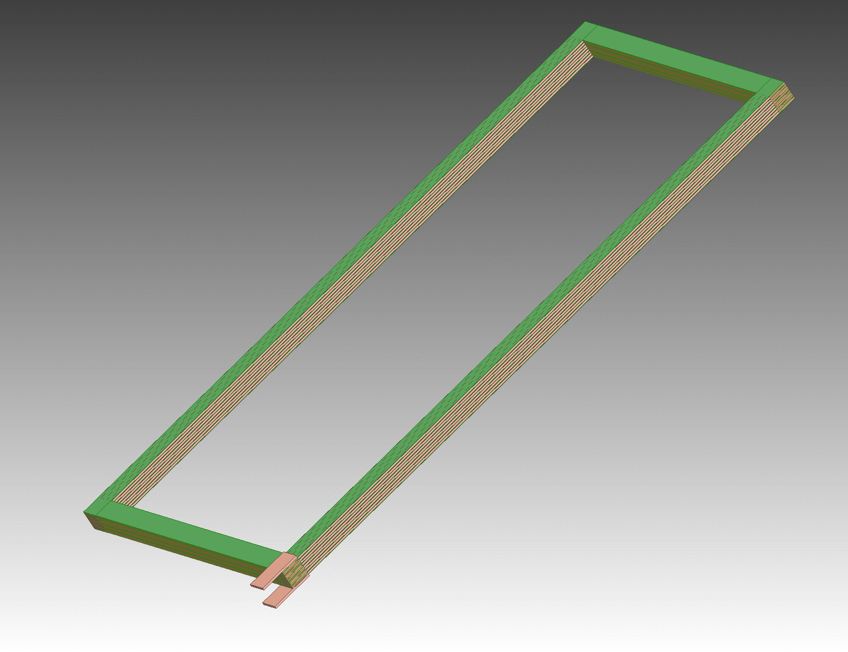
Coil Manufacture and Design
No Corner Transition Pieces Direct Plank to 6 Bar Plank Connections
Green is G-10
Input and Output Terminals

Slide 8
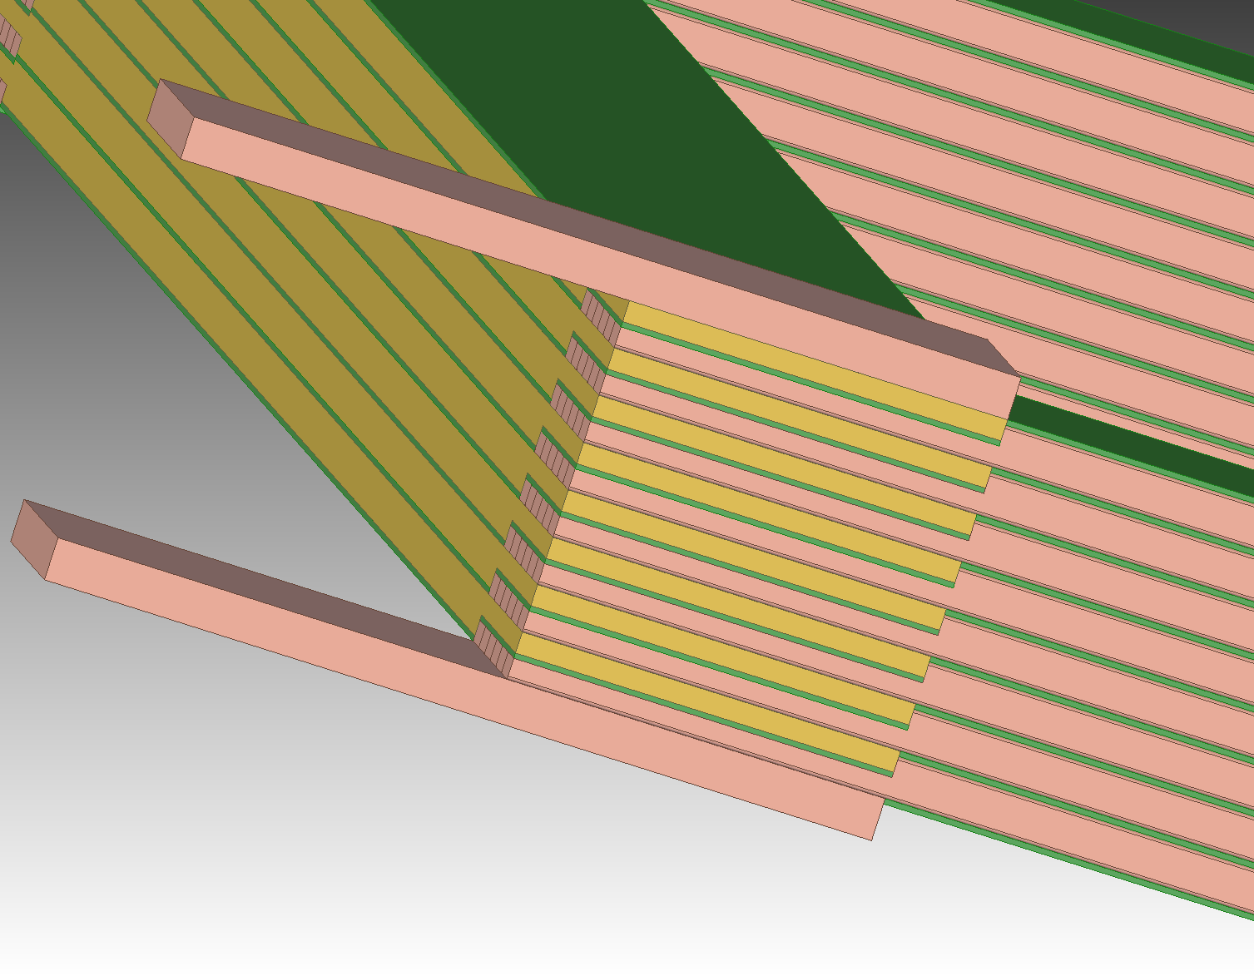
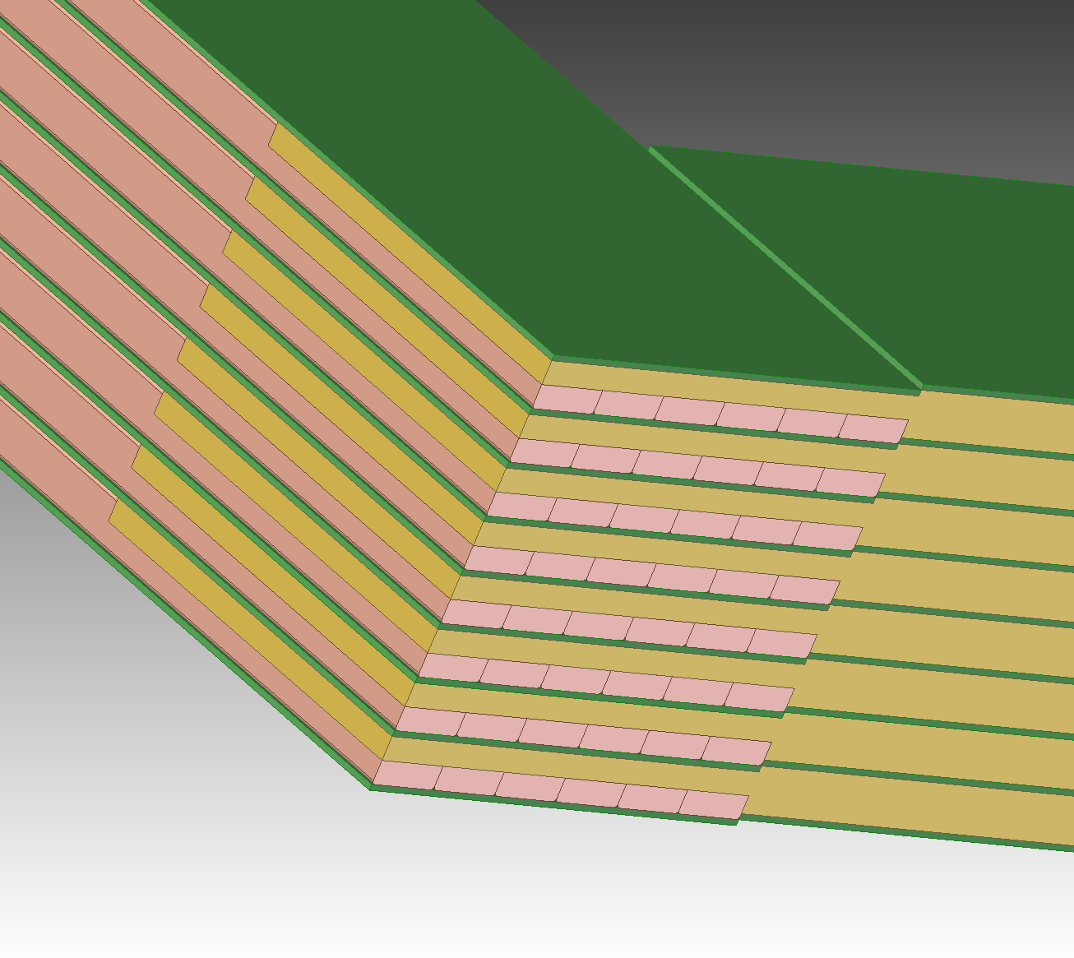
Coil Manufacture and Design
Current Corner Detail
(opposite from Current In/Out)
Current Input/Output Corner Detail
Notice double sided machining on plank end and G-10 step mismatch

Slide 9
Coil Manufacture and Design
Bar Machined End At Both Ends – Bolt holes not shown
Bars Formed Into Plank (Skip welds not shown)
Input and Output Terminals

Slide 10
Need 32 Plates 1” X 9.17” X 71” long
Need 16 Plates 1” X 9.17” X 144” long
Plate Machined End At Both Ends – Bolt holes not shown
Typical at both ends of bars

Slide 11
Coil Manufacture and Design
End Plates at Cross Over on End Opposite to Current Input/Output End
Need 32 Plates 1” X 9.17” X 71” long
Need 16 Plates 1” X 9.17” X 144” long
Plate Machined End At Both Ends – Bolt holes not shown

Slide 12
Coil Manufacture and Design
End Plates at Cross Over on Current Input/Output End
Need 32 Plates 1” X 9.17” X 71” long
Need 16 Plates 1” X 9.17” X 144” long
Need 32 Plates 1” X 9.17” X 71” long
Need 16 Plates 1” X 9.17” X 144” long
Plate Machined Ends
Bolt holes not shown
Typical at other end of bar
Typical at Current In/Out end of bar

Slide 13
Required Plates for 6 Coils
Two Center Coils:
Outside Length = 7.5 m, Inside Length = 7.1 m
Outside Width = 3.65 m, Inside Width = 3.29 m
Need 32 plates 1” X 295” and 32 plates 1” X 144”
4 Outer Coils
Outside Length = 7.5 m, Inside Length = 7.1 m
Outside Width = 1.8 m, Inside Width = 1.44 m
Need 64 plates 1” X 295” and 64 plates 1” X 71”
Total Plates Needed
96 plates 1” X 295” 576 bars
32 plates 1” X 144”
64 plates 1” X 71”
Total Mass of All Plates = 50,480 kg = 111,130 lbs

Slide 14
Coil Manufacture and Design
Vendor for Copper Planks and Bars for Planks:
Copper and Brass Sales -- Division of TKMNA, Thyssenkrup
Copper and Brass Sales functions like a Ryerson -- Sourcing materials from manufacturers and machining from outside vendors (Some in house machining?)
Bulk ETP copper price = $7.50 /lb
Total Bulk Copper Price = $833,500
G10-FR 3/32” thick sheets = $29,799 Interstate Plastics
Waiting for finished machined bar and plank prices from Copper and Brass Sales
Can only supply in ETP copper bars without purchasing oversees. Length is the issue.
Will supply end planks in ETP copper. Maybe possible to get OFHC in US through Revere. Revere is the big gorilla for copper in the US.
No luck in contacting Luvato for OFHC Copper. I never had luck in contacting Luvato.

Slide 15
Coil Manufacture and Design
ETP vs OFHC
ETP copper is 90% of the electrical copper used in the US.
ETP is much easier to get
ETP has the same electrical conductivity as OFHC
OFHC is much easier to weld and braze
ETP is a bit easier to machine than OFHC
ETP has oxygen in it. This makes welding and brazing more difficult. A TIG welding/brazing method will be used. Silicon-bronze and other alloys are recommended.
Need to buy ETP samples with different filler rods and have Bob Conley try them out. Material cost ~ $400 and 1 day of Bobs time.

Slide 16
Coil Connection Plating
S+S Industries (Houston, TX) has come back with a budgetary quote for silver plating the ends of the copper planks. It is $1089 per end per part. This translates to $418,000.
This is probably out of our price range.
This will take more work to see if it is really necessary.
Maybe there are other companies that are cheaper. Especially with regards to the end turn planks. S+S Industries has the largest/longest setup in the US.
Perhaps there is some advantage to just plating one side of each joint.
Tin plating is cheaper

Slide 17
Coil Thermal Analysis
Green is G-10
Outer Coil
No Corner Transition Pieces Direct Plank to 6 Bar Plank Connections
Input and Output Terminals

Slide 18
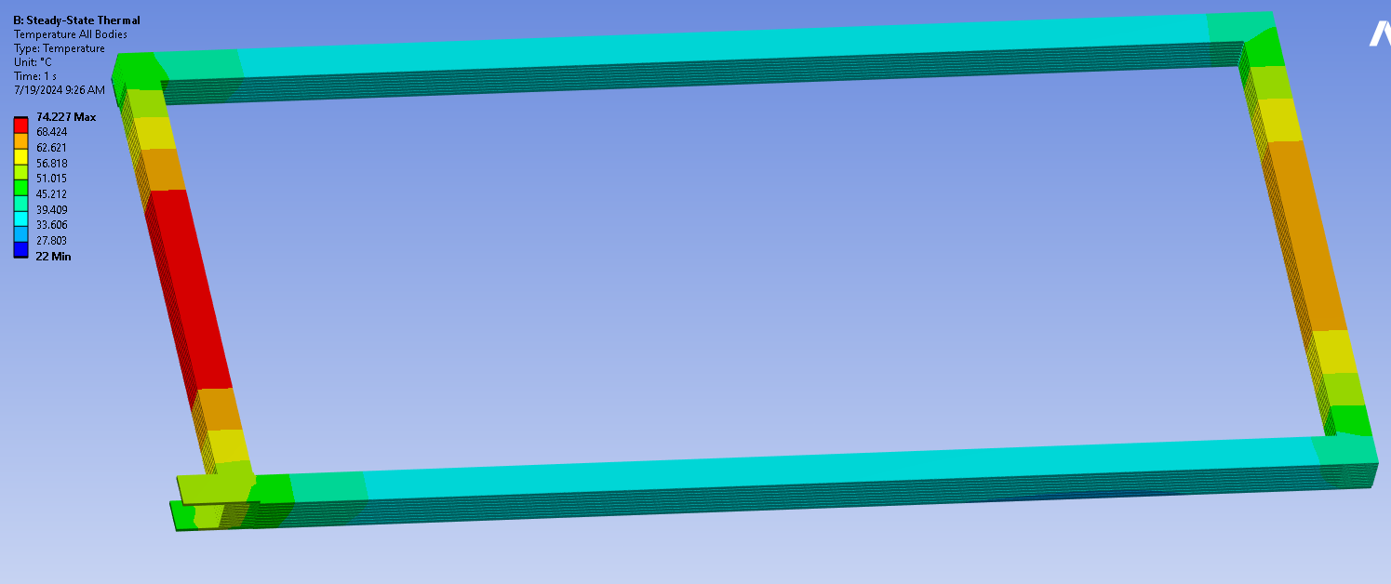
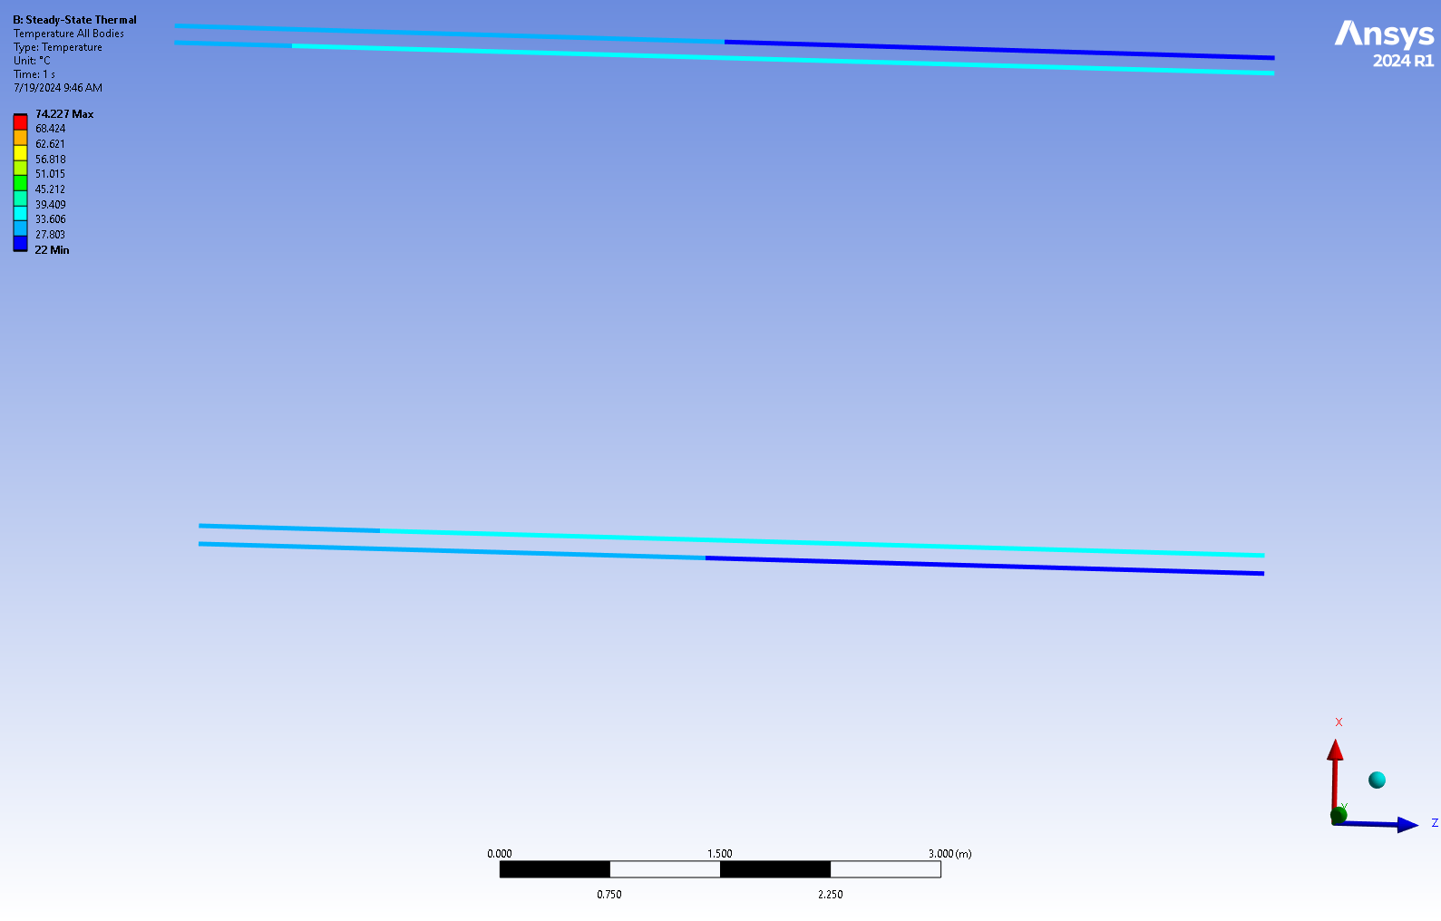
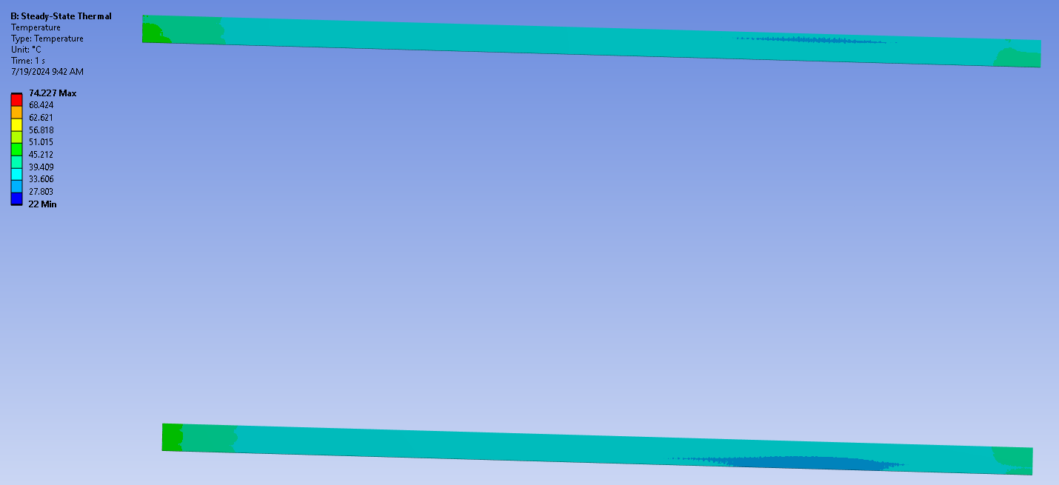
Coil ANSYS RESULTS
Water flow per plate = .063 kg/sec = .82 GPM
Cooling plates only on long sections
Film Coefficient for water 1200 W/m² C (stagnant water)
Tinlet = 22 C Tmax 74 C
In
Out
Out
In

Slide 19
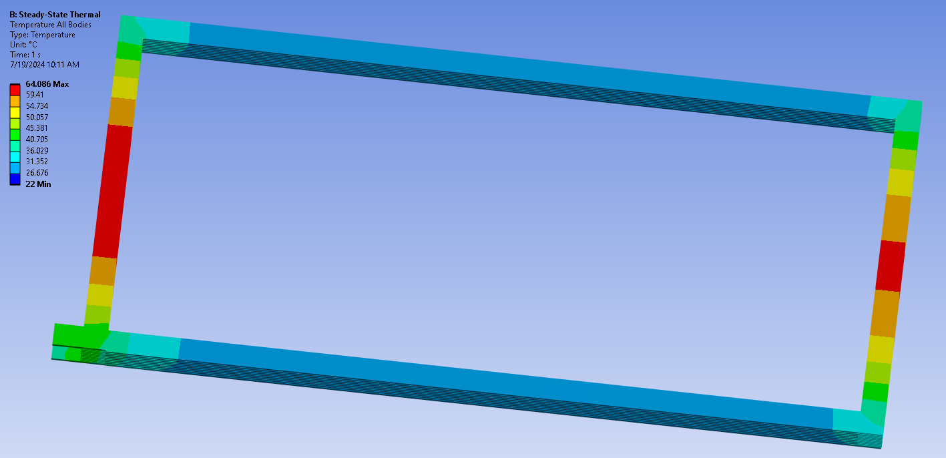
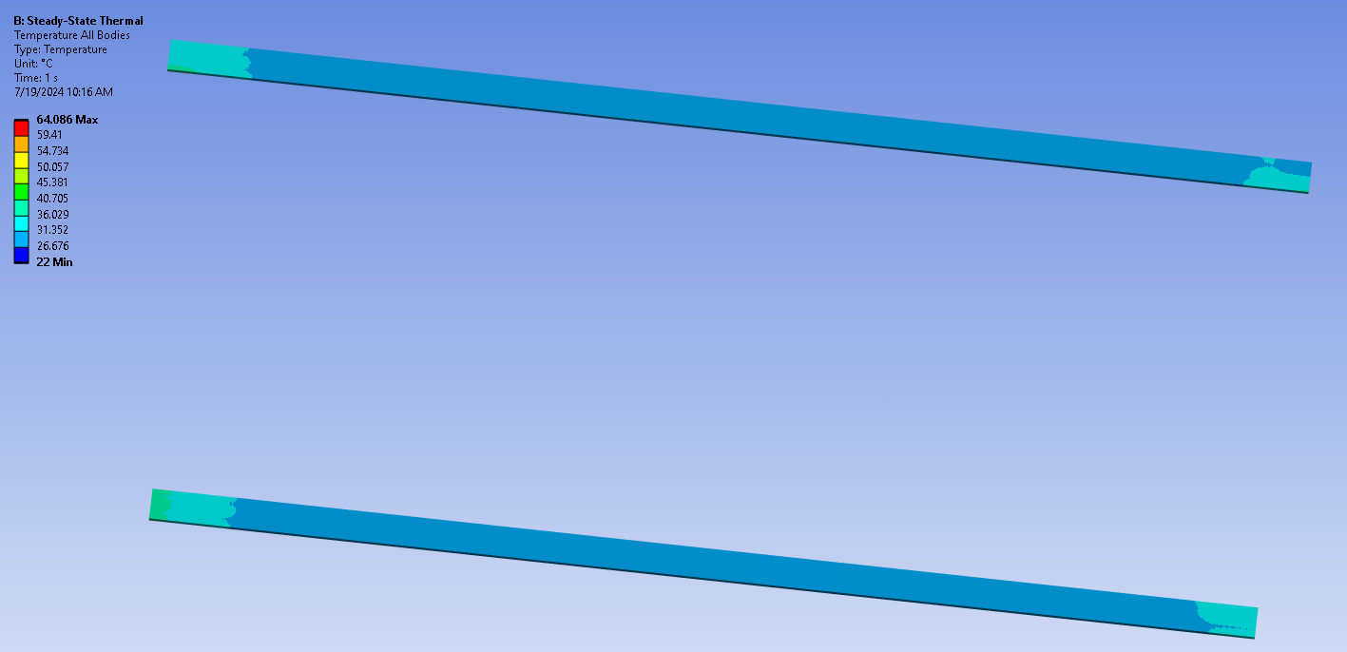
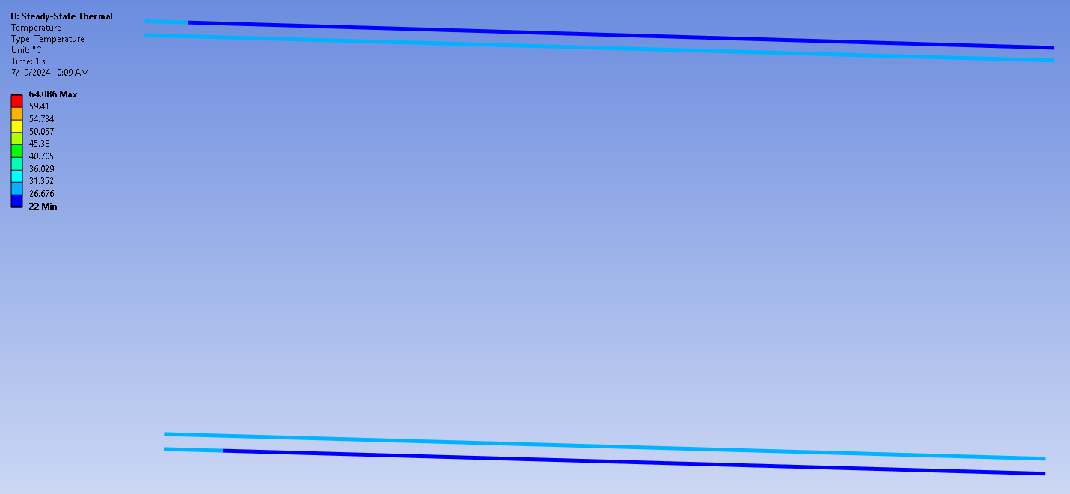
Coil ANSYS RESULTS
Outer Coil
Water flow per plate = .126 kg/sec = 1.64 GPM
Cooling plates only on long sections
Film Coefficient for water 2400 W/m² C
Tinlet = 22 C Toutlet = 29.4 & 28.6 C Tmax 64 C
In
Out
Out
In

Slide 20
Coil ANSYS RESULTS
Center Coil
In
Water flow per plate = .126 kg/sec = 2.0 GPM
Heat Load 10,000 W/m³ From Solid Edge 1.10 m³ of Copper = 11.0 kW
Coefficient for water 2400 W/m² C
No Heat Transfer in the Inner Water Loop
Tinlet = 22 C Toutlet = 40.9 C Tmax 53 C
Overall balance of power ΔT = Q/m x Cp = 42.9 C

Slide 21
Coil ANSYS RESULTS
Center Coil
In
Water flow per plate = .126 kg/sec = 2.0 GPM
Heat Load 10,000 W/m³ From Solid Edge 1.10 m³ of Copper = 11.0 kW
Coefficient for water 2400 W/m² C
Tinlet = 22 C Toutlet = 40.9 C Tmax 49.0 C
Overall balance of power ΔT = Q/m x Cp = 42.9 C

Slide 22
Coil ANSYS RESULTS
Center Coil
Water flow per plate = .126 kg/sec = 2.0 GPM
Heat Load 10,000 W/m³ From Solid Edge 1.10 m³ of Copper = 11.0 kW
Coefficient for water 2400 W/m² C
Tinlet = 22 C Toutlet = 43.3 C Tmax 77.9 C
Overall balance of power ΔT = Q/m x Cp = 42.9 C
Second run Refined Mesh

Slide 23
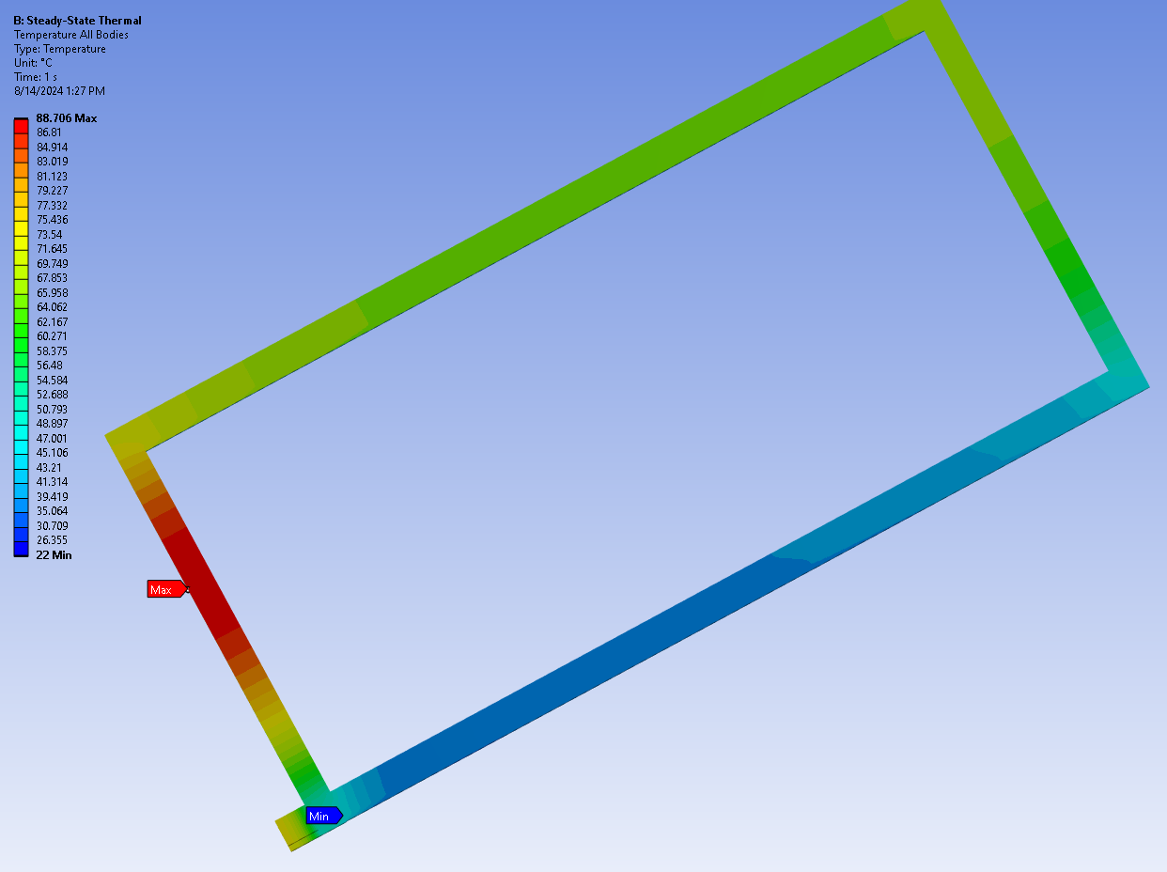
Coil ANSYS RESULTS
Center Coil
Water flow per plate = .126 kg/sec = 2.0 GPM
Heat Load 10,000 W/m³ From Solid Edge 1.10 m³ of Copper = 11.0 kW
Coefficient for water 2400 W/m² C
Double counter flow water path
Tinlet = 22 C Toutlet = 41 C Tmax = 88.7 C Tmax (Water) = 44.6
Overall balance of power ΔT = Q/m x Cp = 42.9 C
New Mesh Each layer of copper bars is replaced with one plank

Slide 24
Coil ANSYS RESULTS
Center Coil
Water flow per plate = .126 kg/sec = 2.0 GPM
Heat Load 10,000 W/m³ From Solid Edge 1.10 m³ of Copper = 11.0 kW
Coefficient for water 2400 W/m² C
Tinlet = 22 C Toutlet = 43.3 C Tmax 77.9 C
Overall balance of power ΔT = Q/m x Cp = 42.9 C
Second run Refined Mesh

Slide 25
Coil ANSYS RESULTS
Center Coil
In
Water flow per plate = .189 kg/sec = 3.0 GPM
Heat Load 10,000 W/m³ From Solid Edge 1.10 m³ of Copper = 11.0 kW
Coefficient for water 2400 W/m² C
Water flow through the up and back circuits – Two passes per Al plate
Tinlet = 22 C Toutlet = 34.6 C Tmax = 52.6 C
Overall balance of power ΔT = Q/m x Cp = 35.9 C

Slide 26
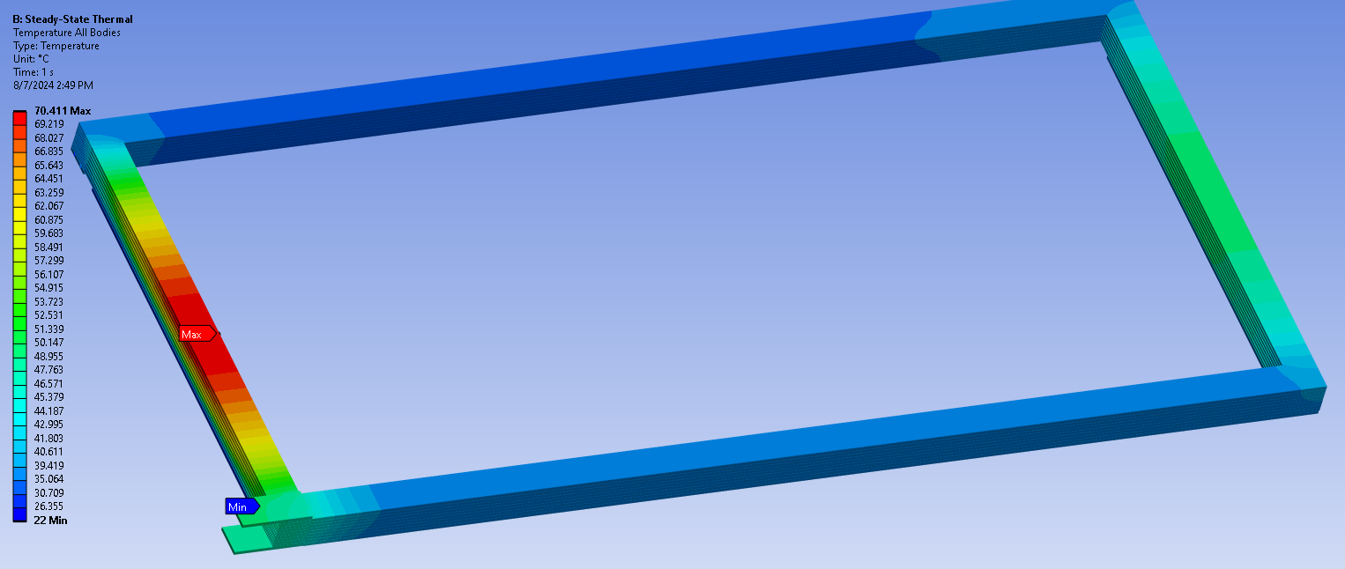
Coil ANSYS RESULTS
Center Coil
Water flow per plate = .189 kg/sec = 3.0 GPM
Heat Load 10,000 W/m³ From Solid Edge 1.10 m³ of Copper = 11.0 kW
Coefficient for water 2400 W/m² C
Water flow through the up and back circuits – Two passes per Al plate
Tinlet = 22 C Toutlet = Tmax = 70.4 C
Overall balance of power ΔT = Q/m x Cp = 35.9 C
Second run Refined Mesh

Slide 27
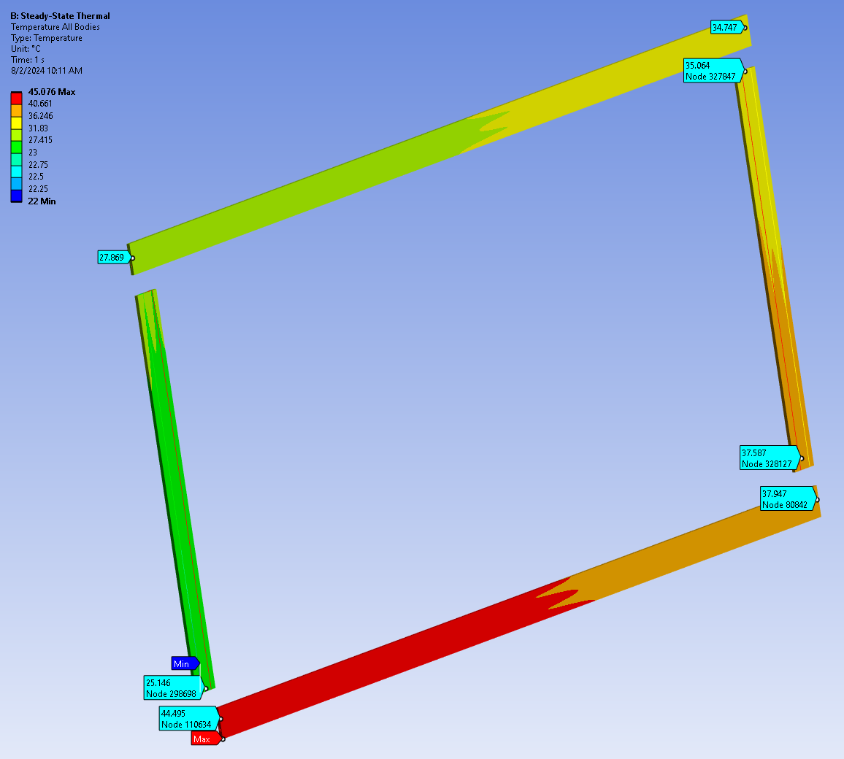
Verification of ANSYS Results
Center Coil
Water flow in tubes (5/8” OD X .049” wall) = 0.126 kg/s = 20.2 GPM
Total Heat Flow into Bottom of All 4 Aluminum Cooling Plates = 10.36 kW
Tinlet flow temp = 22 C Toutlet flow temp = 41.6 C Max Temp on Plates = 45.1 C
Overall balance of power ΔT = Q/m x Cp = 41.7 C
Only 4 Aluminum Cooling Plates with 8 tubes used in the analysis

Slide 28
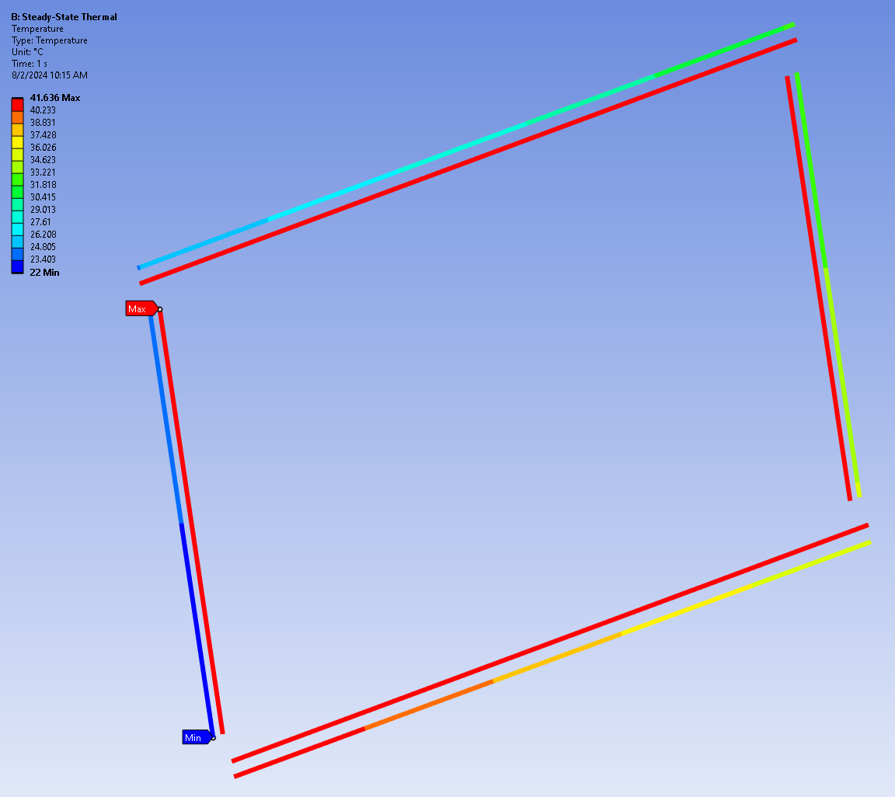
Verification of ANSYS Results
Center Coil
Water Outlet
Water Inlet

Slide 29
Coil Thermal Analysis
The cooling plates will be connected in a outer pass / inner pass counter flow arrangement. All flow under consideration is turbulent.
The cooling plates will be part of the structure of the straps going around the coil

Slide 30
COIL COOLING & WATER CHILLER
COIL COOLING:
Water cooled 1” thick aluminum plates are attached to the magnet iron side of all four lengths of all 6 coils. Each plate has two grooves for insertion of ½” Type K water tubing (5/8” x .049” wall).
Each coil will have its own separate water circuit. With final analysis two outer coils may be plumbed in series. Temperature is the concern, not pressure drop.
House chilled water available at 300 psi will be used. It will probably be regulated down to 150 psi.
Total power of all 6 coils = 46 kW exclude electrical contact resistance
Adding 20% for contact resistance gives a total power of 55 kW
An overall 10.5 GPM is needed for 20 C water outlet temperature rise; 21 GPM for 10 C rise. A greater water flow is required to keep temperatures down in the copper.
For 3 GPM in an outer coil flow the pressure drop is 20 psig.

