Slide 1
Proposal for TMS Detector Steel and Detector Dimensions for a 6m x 3m Active Area with Orthogonal X-Y Scintillator
16 August 2024
T. Markiewicz/SLAC

Slide 2
Parameters
It has been suggested that TMS would satisfy its physics requirements with a 6m x 3m active area and orthogonal X and Y counters. The attached slides show that the relevant dimensions as follows.
Bar width decreased to 31mm from 36mm
Stack up tolerance/detector increased from 5 to 10mm
Detector width then 1006mm = 32*31+2*2(side walls)+10mm (stack up)
X and Y Scintillator length = 3000mm (now shown explicitly on pictures)
150mm length added for WFS & readout: Total length = 3150mm
Clearance to coils ~50mm for X and larger for Y
Steel inter-coil gap decreased to 3250mm from 3600mm and set by X counters
Overall steel height is 3250+2*550=4350mm down from 4700mm in the 7m x 3m design
Steel width decreased to 1600mm from 1850mm/panel
25% less steel than CDR and 20% less steel than the 7m wide design

Slide 3
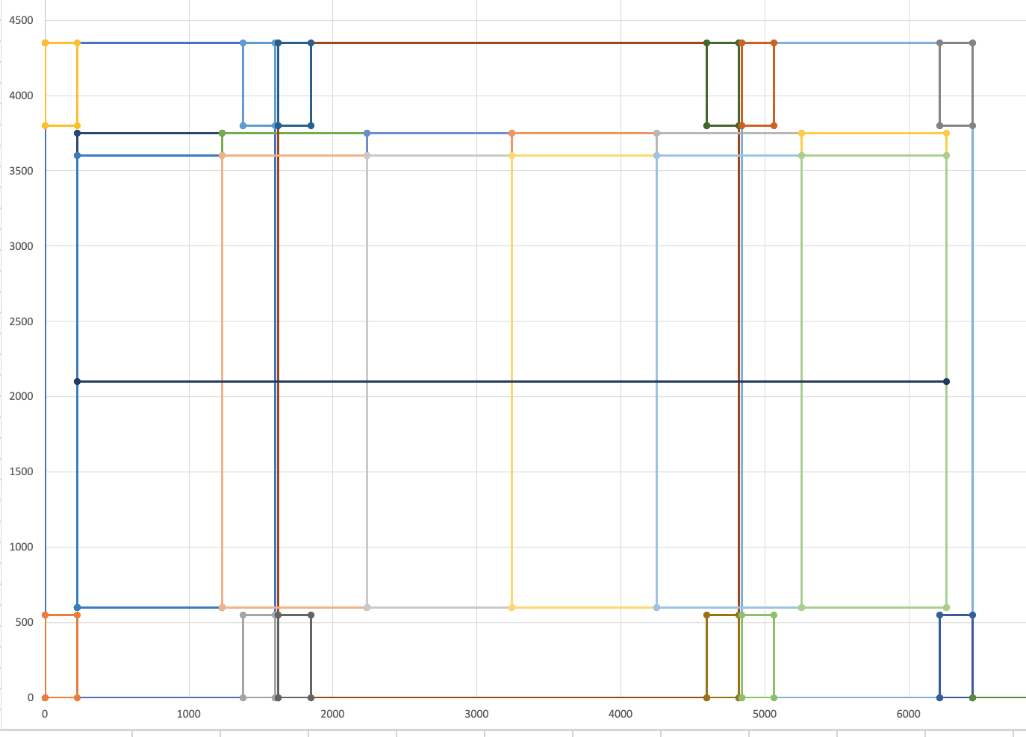
X Counter Dimensions

Slide 4
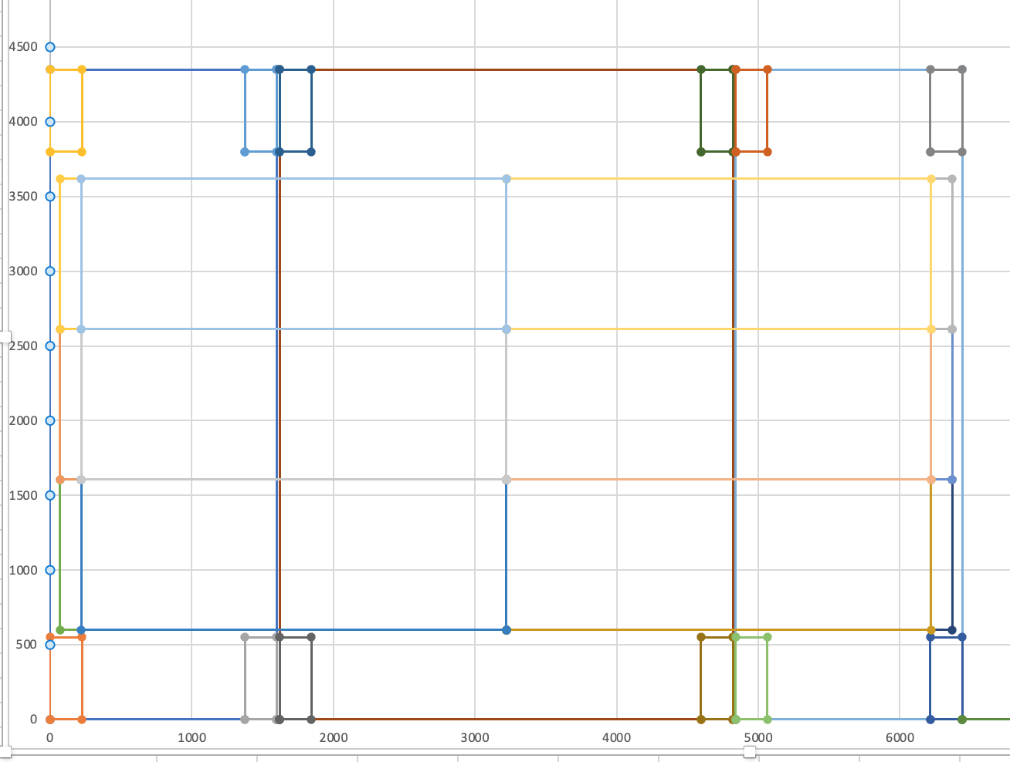
Y Counter Dimensions

Slide 5
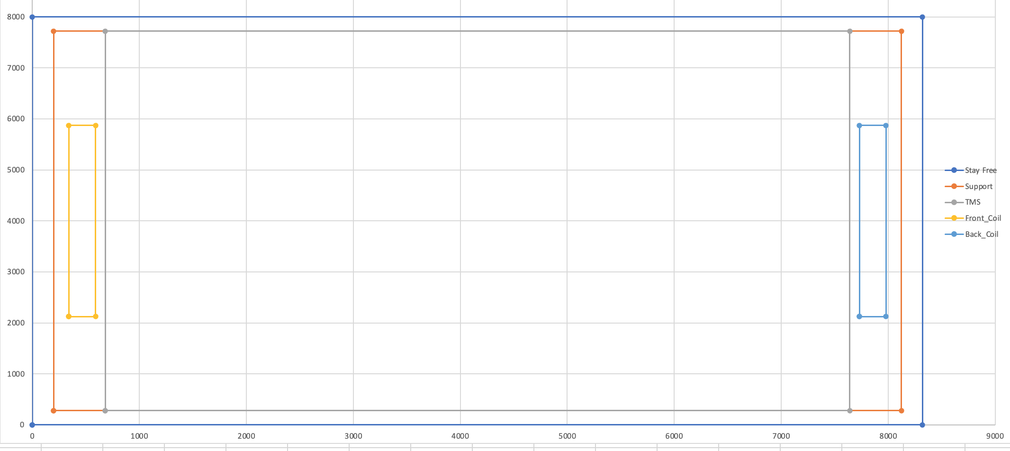
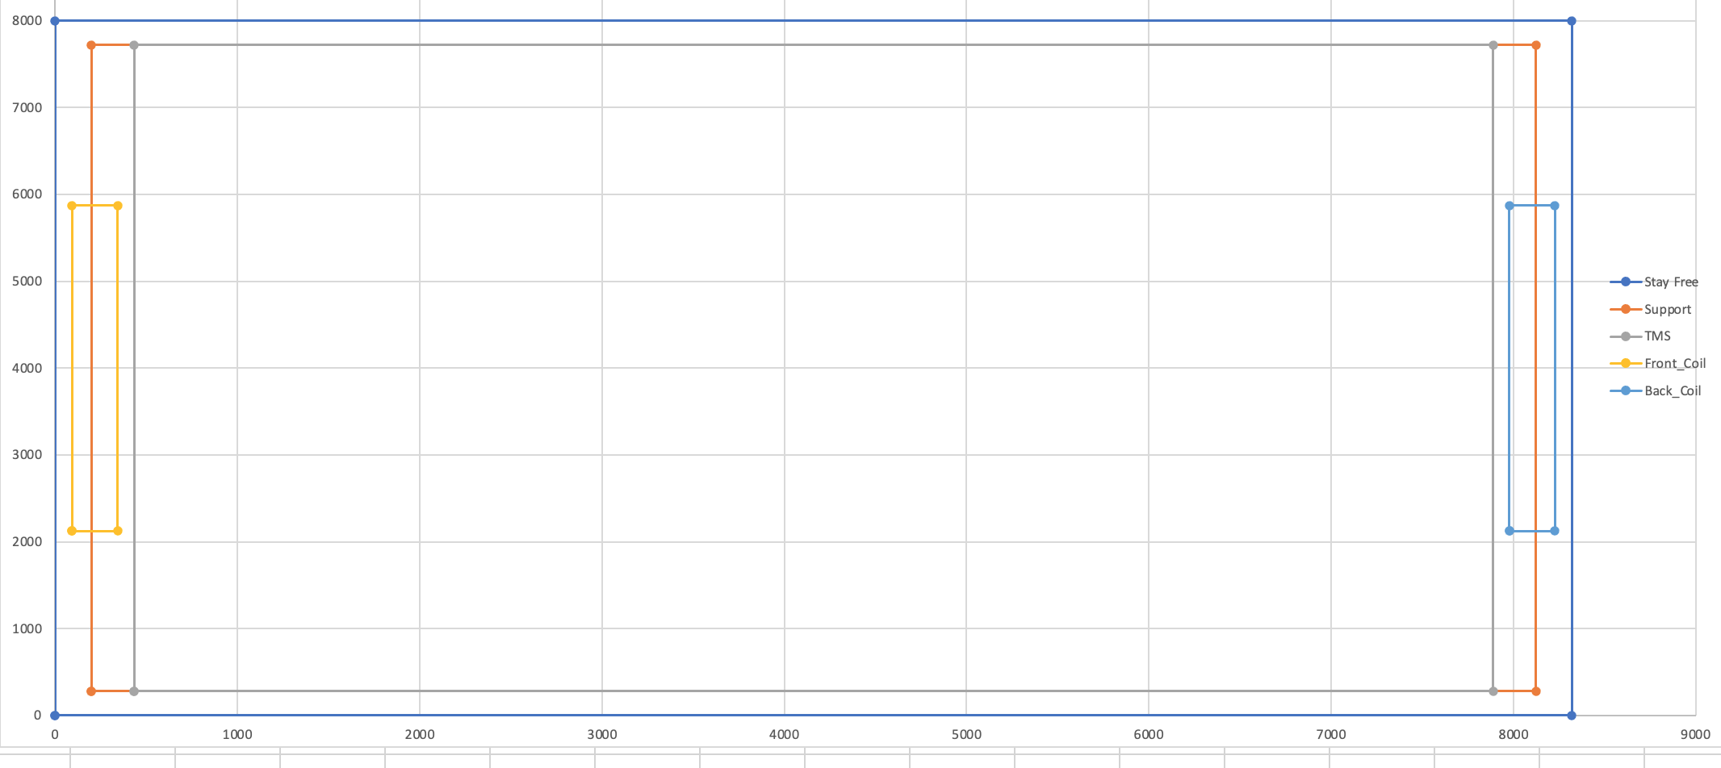
Plan View of TMS (Gray box) in Stay Free (Outer Box) on 26’ CDR Support Girders(Orange Box)
99 40mm gaps
250mm wide coils spaced 90mm from 1st and last plate
Temporary Support for Initial Rear Plates Assumed to have been Removed
Stay Clear
99 45mm gaps
Support Girders per CDR

