Slide 1
302.4.04 – Cryo-assemblies Horizontal Test Weekly status report
Guram Chlachidze
Aug 12th, 2024

Slide 2
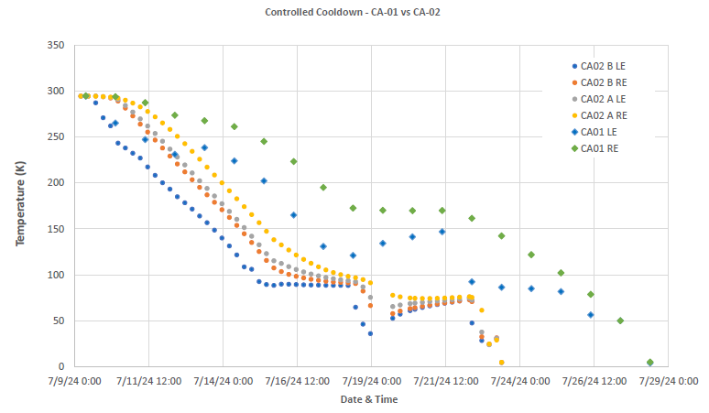
CA02 controlled cooldown
CA02
CA01
18 g/s
9 g/s
CrowdStrike

Slide 3
Next Steps
HVWT (Hi-pot) passed successfully at 1.9 K
SSW measurements completed at 4.5 K
Metrology measurements this morning. Post-alignment SSW measurements - Done
Connecting HFU/CLIQ cables, complete QLM verification – Done
Clean/silver plate Copper flags and connect flexible power leads – Done
QP tests: ramps to 1 kA and 6 kA - Done
Splice resistance measurements – Done
Ramp to acceptance current

Slide 4
1.9 K Operation summary
Estimated operation time at 1.9 K in two test cycles is ~144 hours
Optimistic estimate, without quenches, trips and any kind of issues
Week of Aug. 5: Planned 32 hours, delivered 17 hours
Planned Test Completion Date – Oct. 10
CA-02 transportation from IB1 to ICBA
Expected Test Completion Date – Oct. 12
Based on remaining 1.9 K operation time

Slide 5
New Cold Box (ALAT) Status
ALAT Cold Box is operational, still running on reduced make rate
First liquid transfer from ALAT CB to LHe reservoir performed on Friday, Aug. 5

