Slide 1
Vacuum Equipment Update
R. Rabehl
August 12, 2024

Slide 2
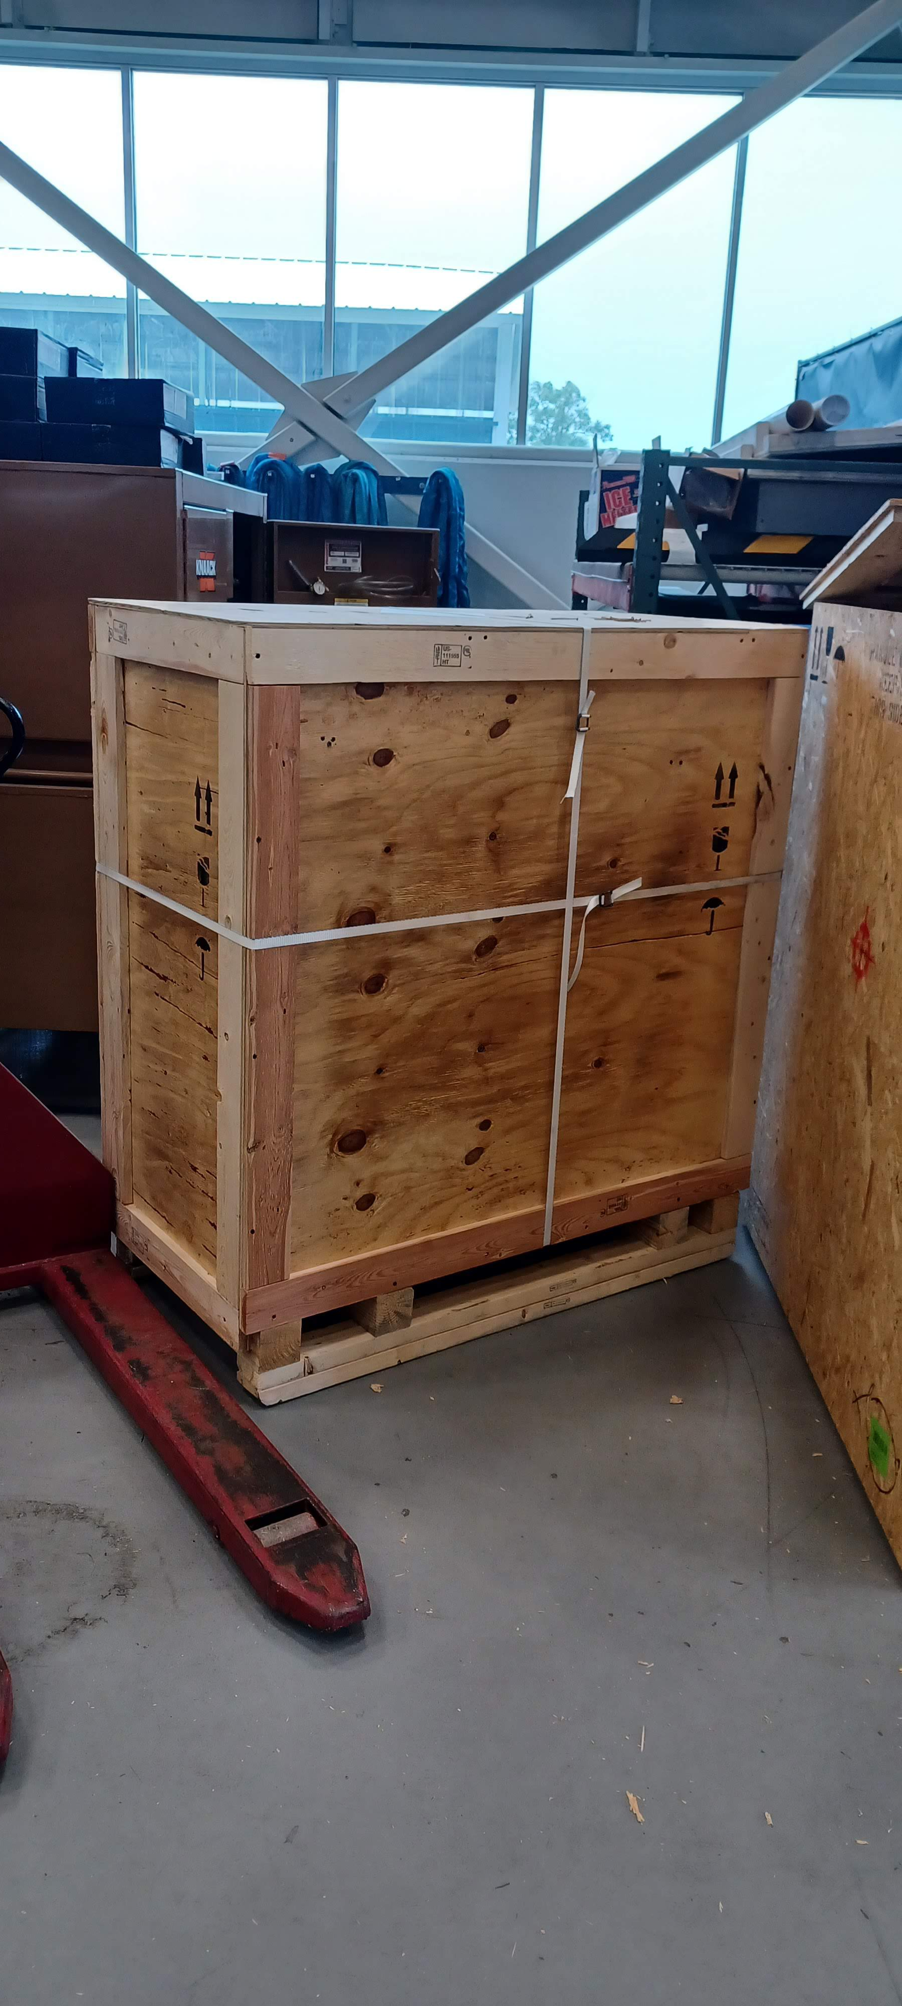
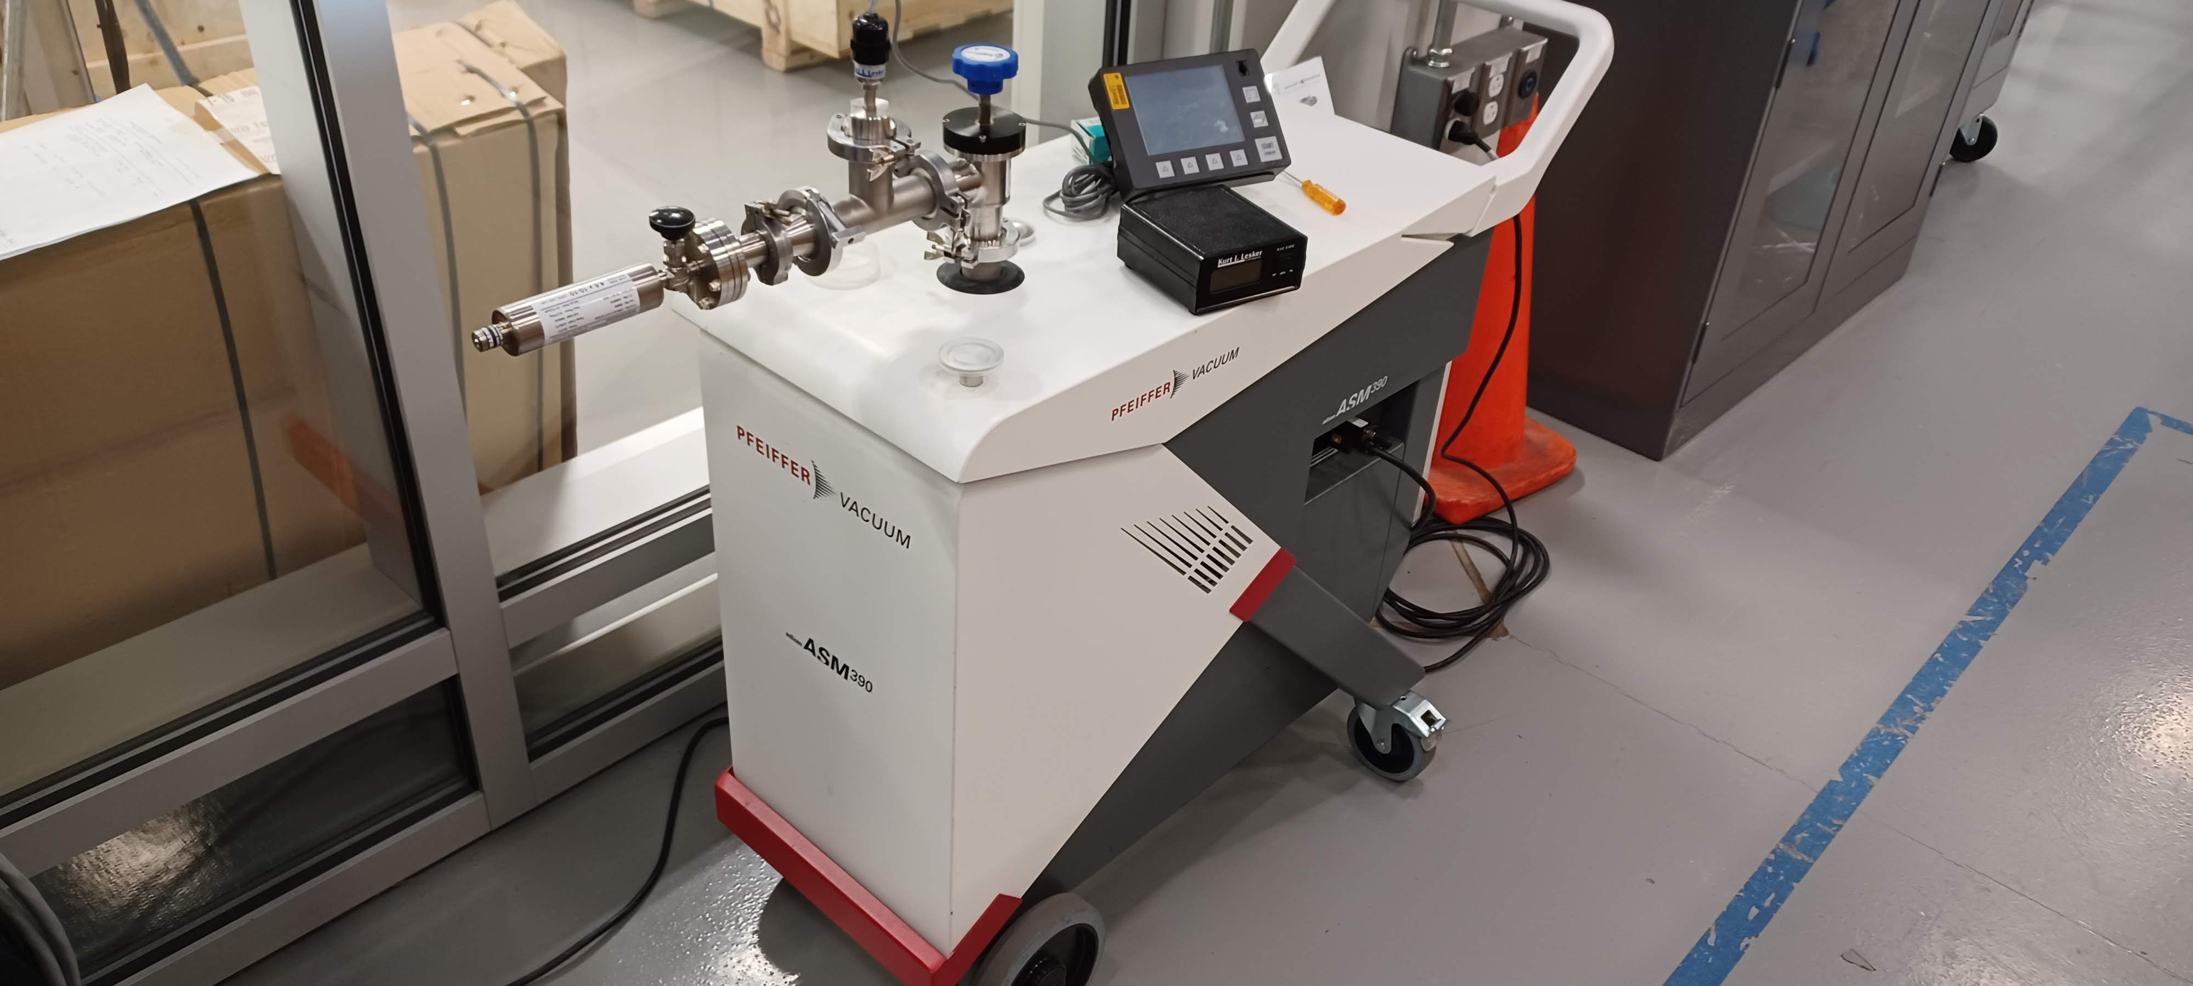
Cryostat – Leak detectors
Received a quote for evaluation of the ICBA unit ($1.6k for evaluation, up to $10k for refurbishment – Req. 354494/P.O. 710456).
Crating completed Friday, June 28 crating by Basic Crating.
Submitted a new Declaration of Contamination to Pfeiffer to get a new Return Authorization (previous one has expired). Still waiting for new Return Authorization.

Slide 3
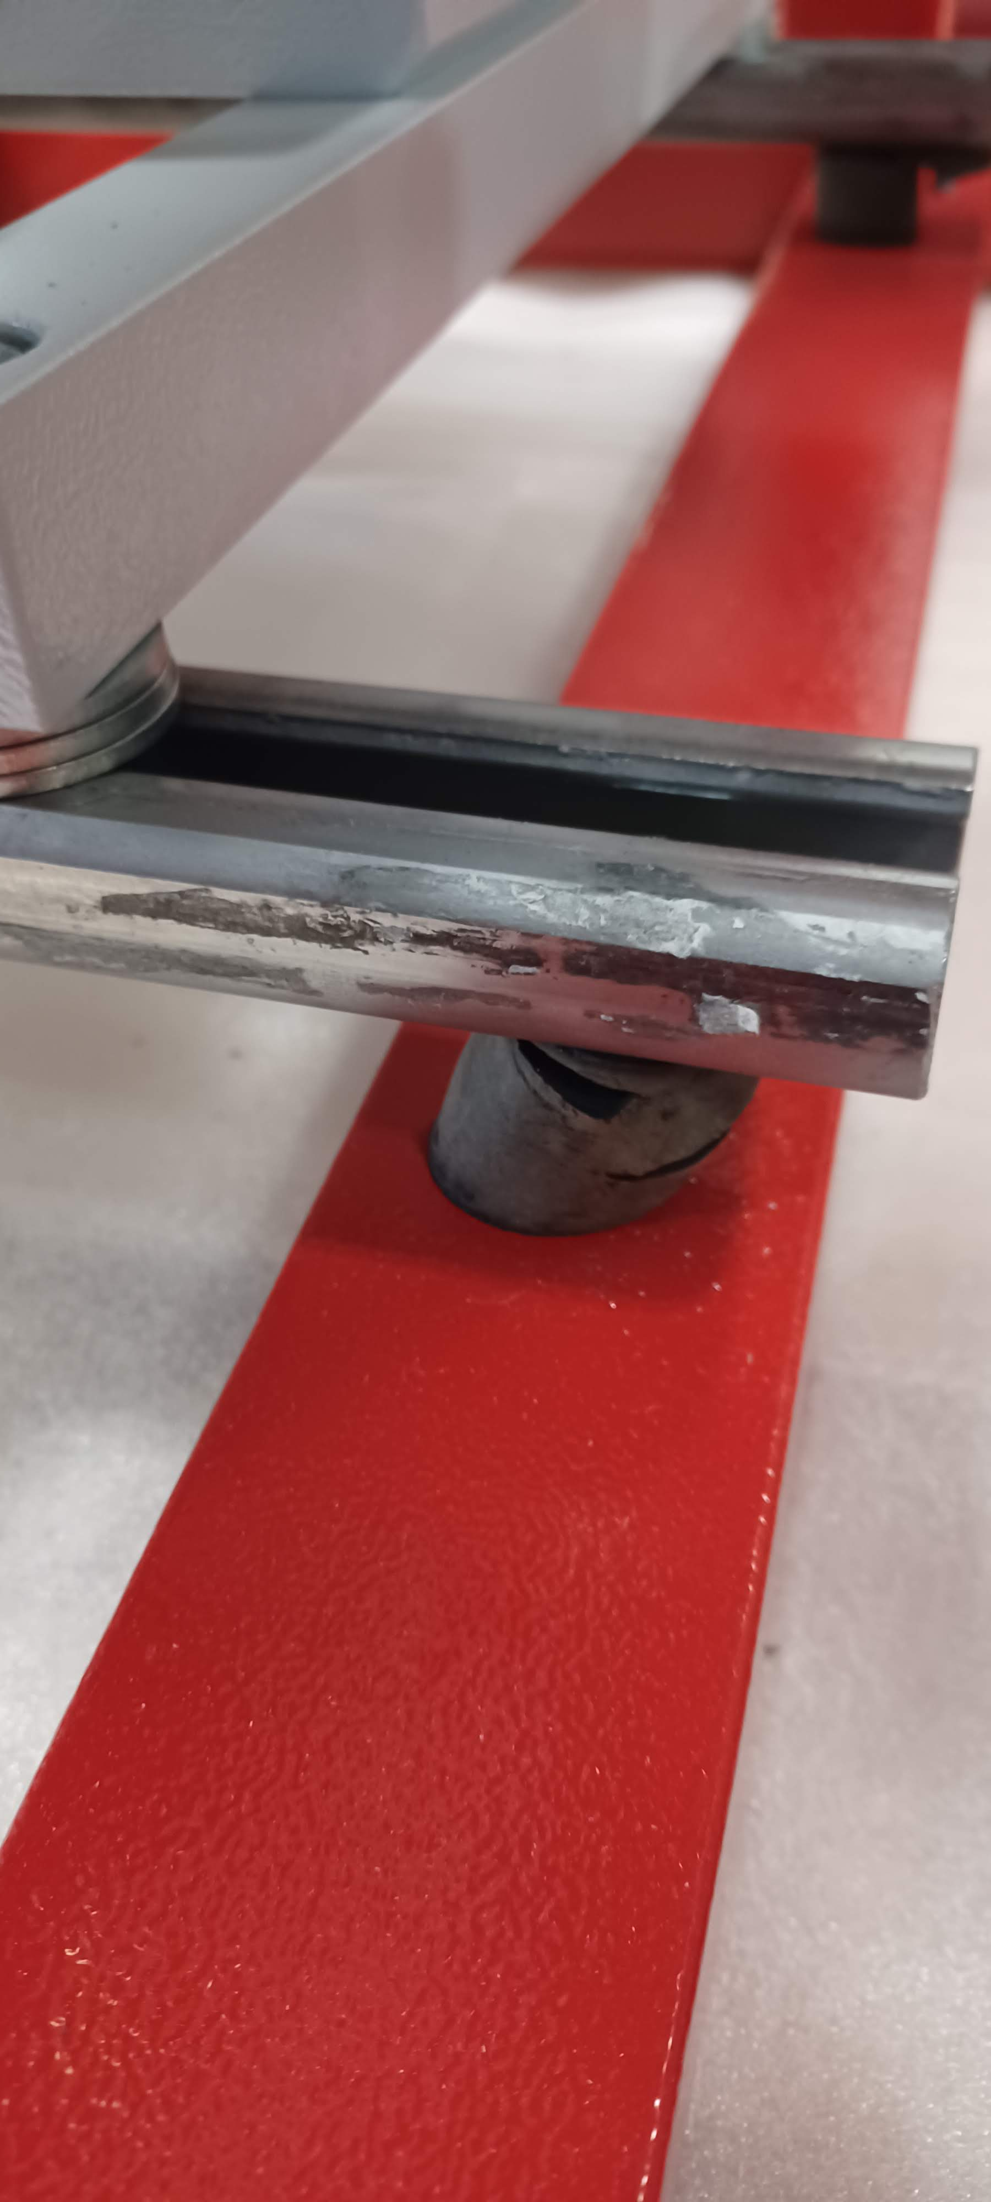
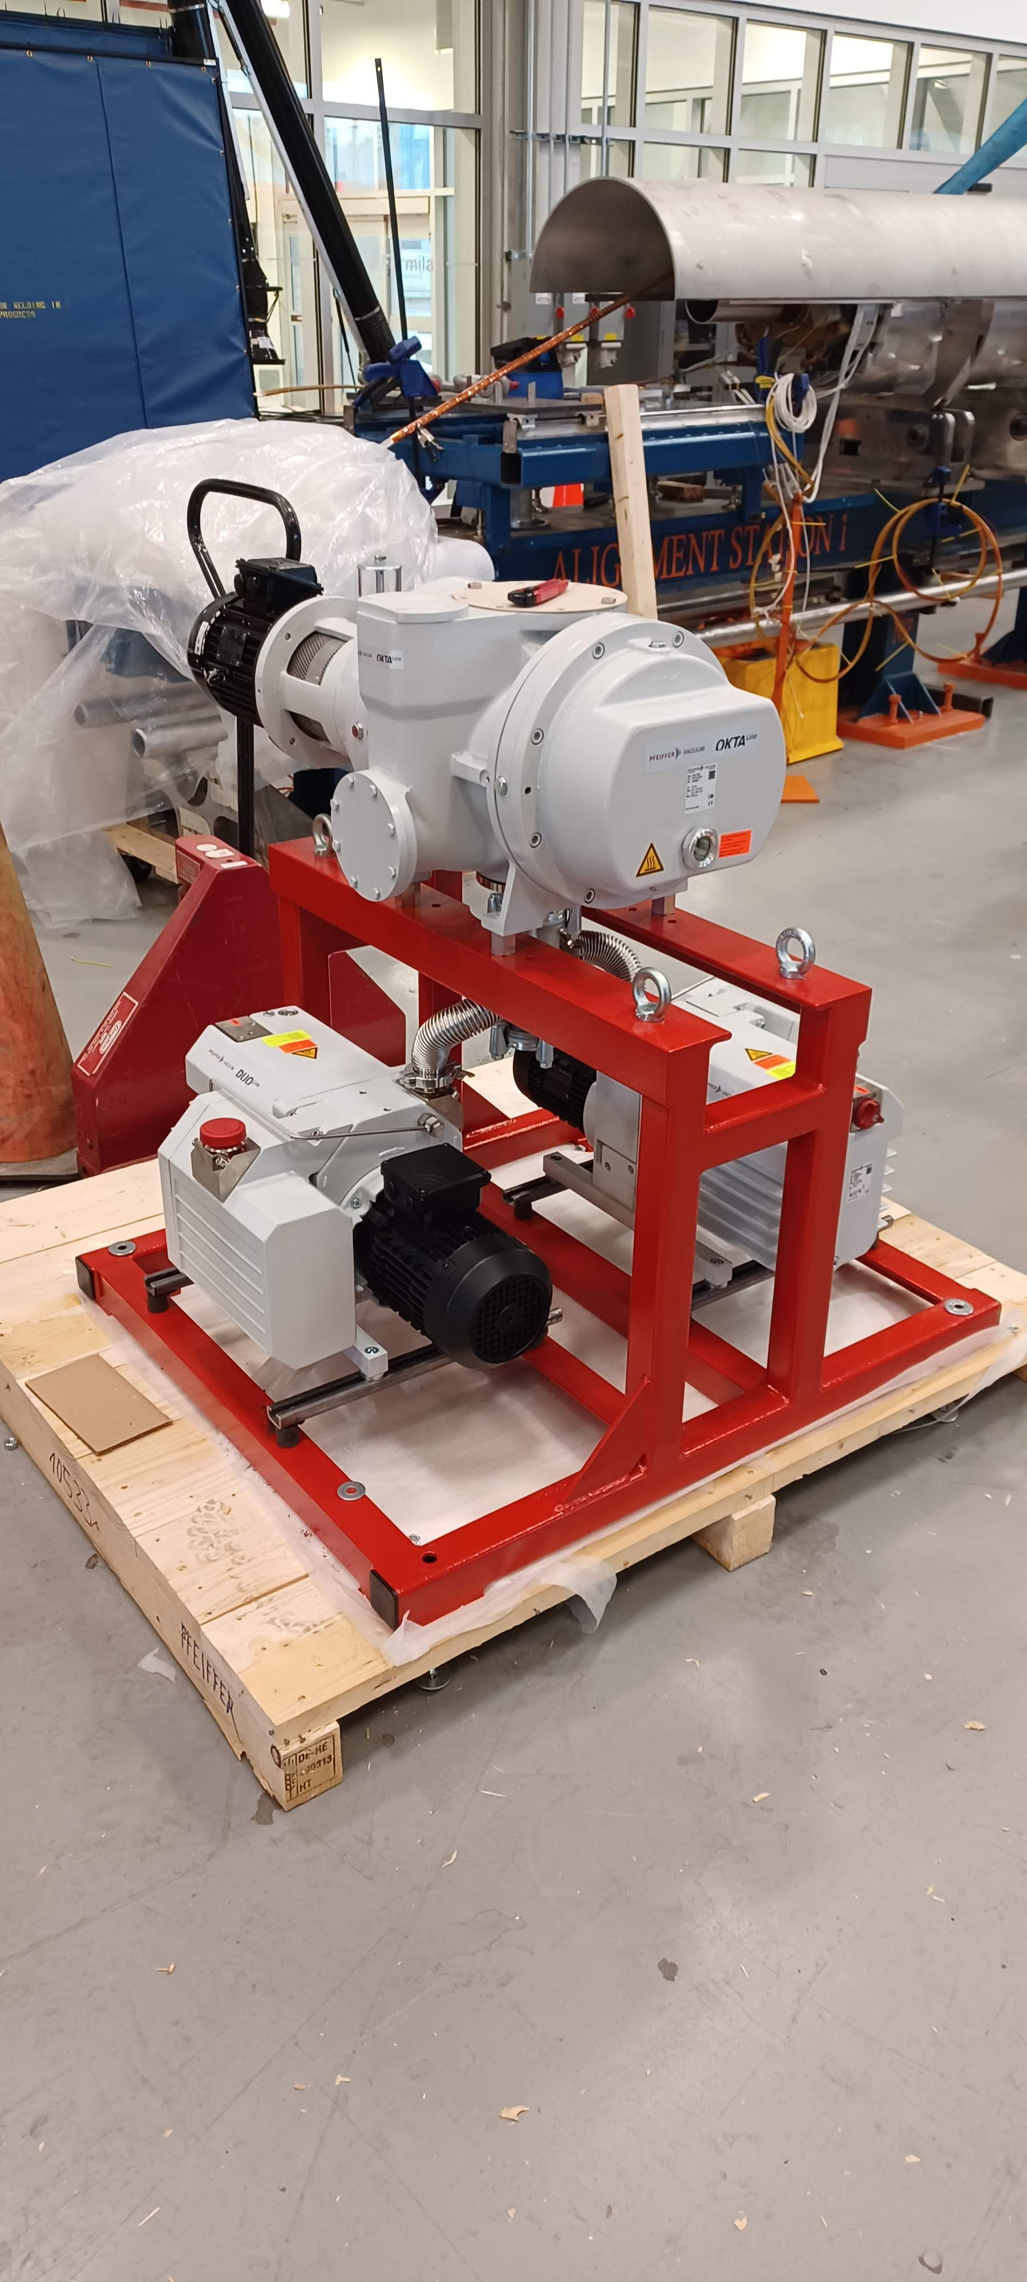
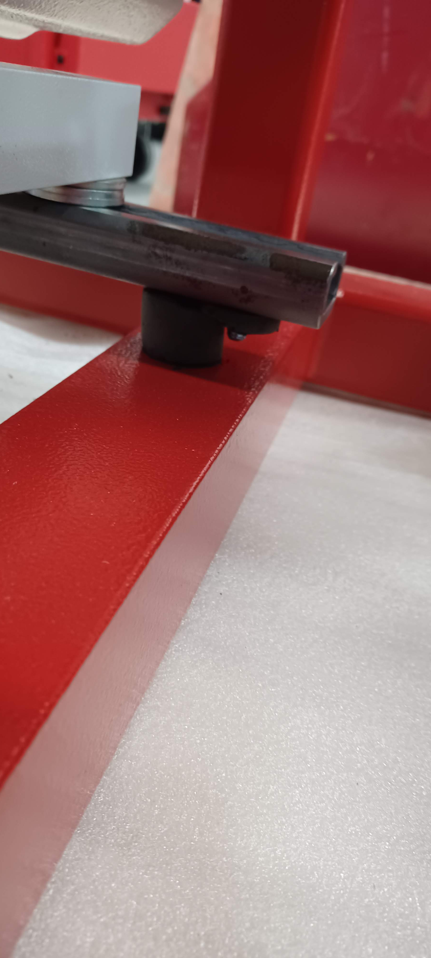
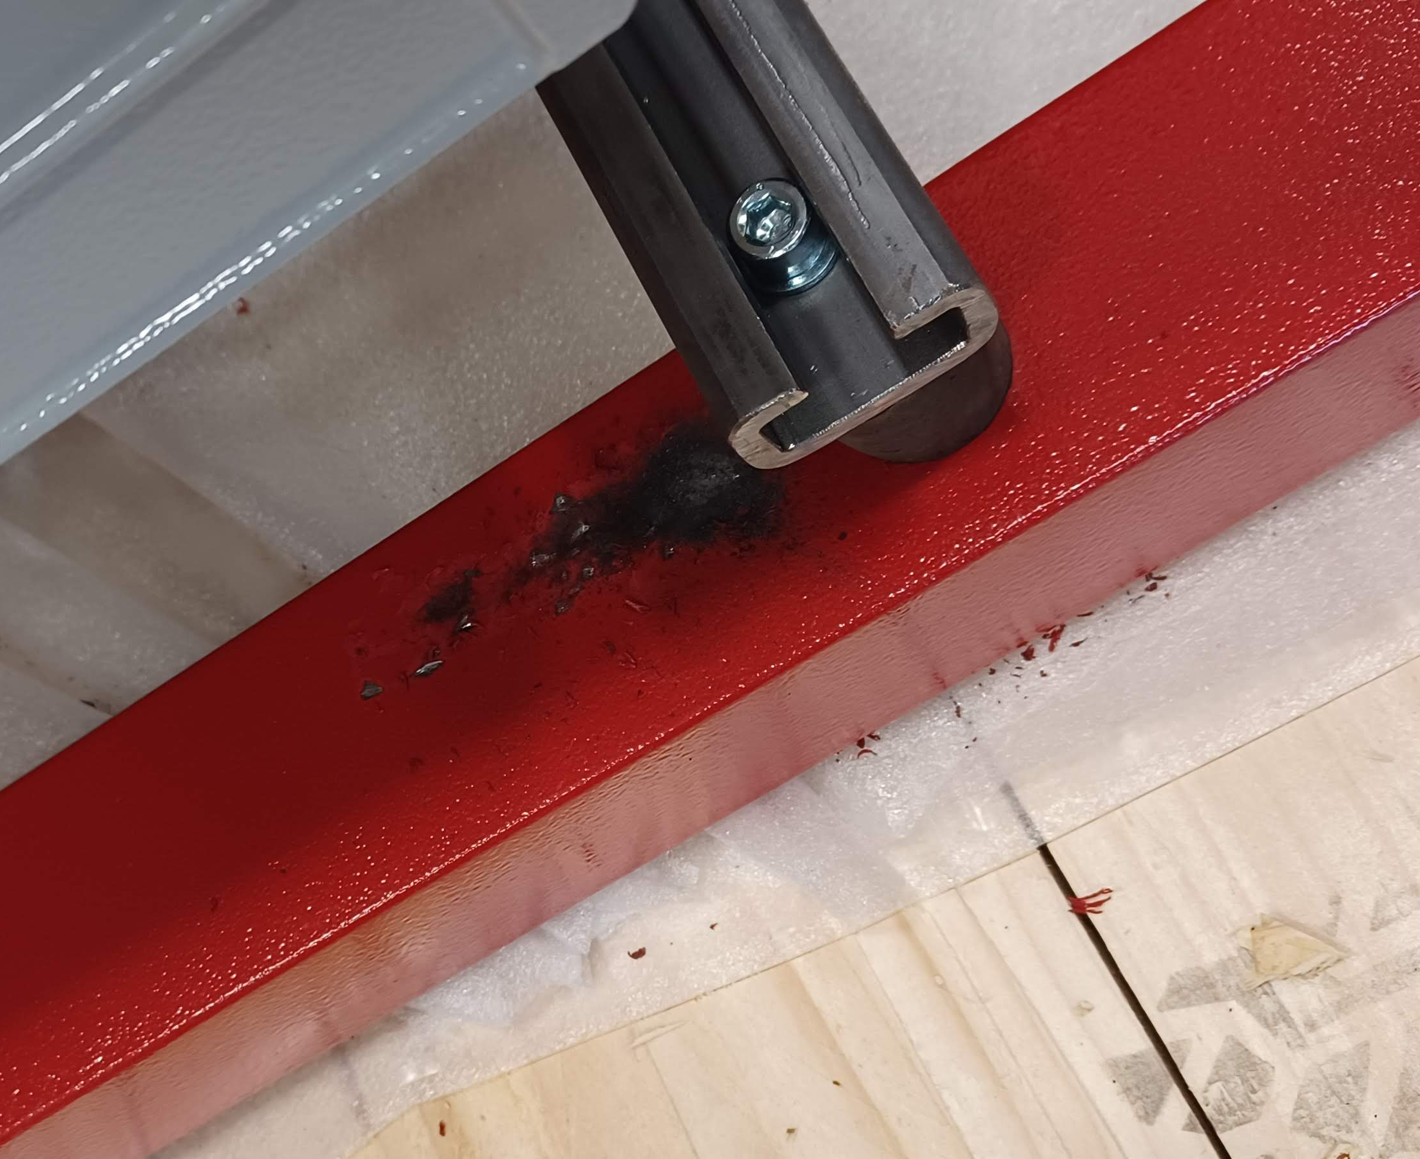
Cryostat – Combination pressure/leak test equipment
Remaining equipment (P.O. 700401)
Two blower skids received.
Waiting for feedback from vendor concerning broken mounts.
Met with Luciano on Thursday to discuss wiring of these skids.
Functional Requirements Specification has been written (doc-db-5346).

