Slide 2
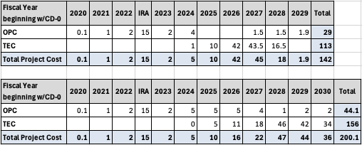
Funding Profile
Director’s CD-1 review, May 2024

Slide 3
Funding Profile
New funding profile received July 9th from DOE/HEP.

Slide 4
Project Scope
Previous Accelerator Power Systems Scope
16 power supplies distributed around the complex.
Current Accelerator Power Systems Scope
Booster and Main Injector Power Supplies
21 Magnet power supplies and control
42 RF bias power supplies and control
1152 Ion pump power supplies
The rest of the project scope has remained the same.

Slide 5
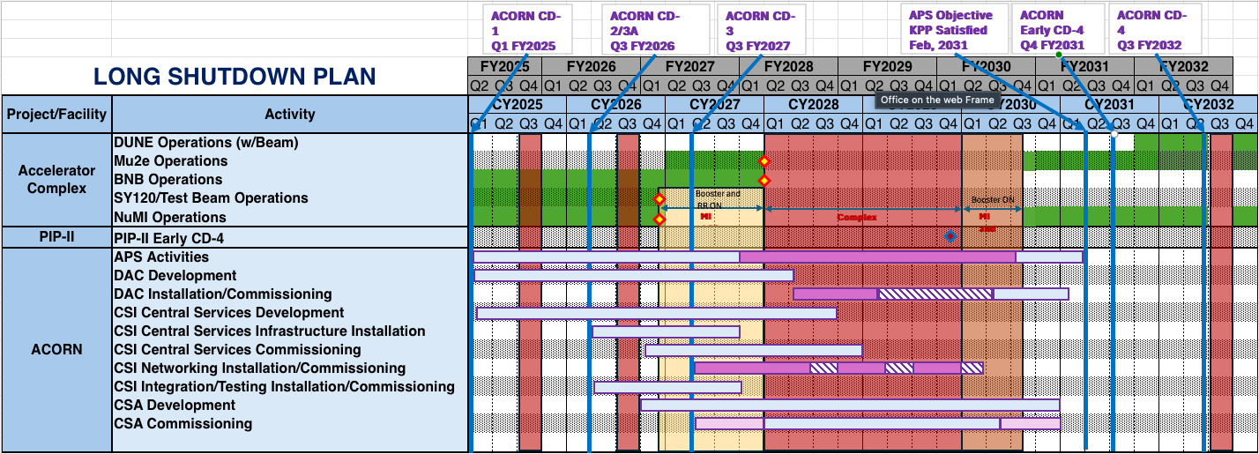
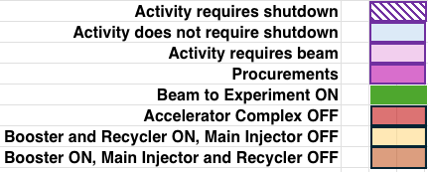

Slide 6
Thank you
Questions?

