Slide 1
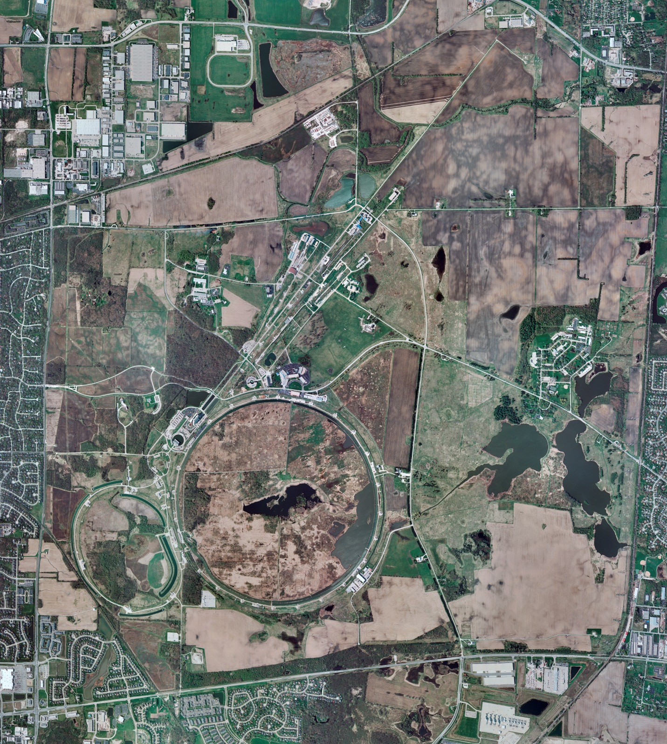
Helium Cryogenics
Status 8/23/2024 J.Makara
CMTF: SCP at RT for maintenance; instr air compr found failed
CMTS: HECM31 installation ongoing
PIP2IT: South Stand CM being modified for SSR2 pCM
North Stand CM empty
MCTF: cryo system shut down at RT
MDB/HTS: at RT
MDB/STC: at RT
MDB Magnet: at RT
NML/FAST: Cryo system is shut down and isolated for extended shutdown period;
CC1: at RT
CC2: at RT
CM: at RT
IB1: cryo system operations running fine with CTi and ALAT CBs cold, no problem recovery from short planned power outage
Muon Campus: at RT with comprs off and system depressurized; LN2 system at RT; g-2 Expt Hall at ODH=0 (not ODH area)
Misc:…Andy Pond back online to CMTF/NML; Casey Pond flow reduction in near future.

