Slide 1
Main Injector Shutdown Status
Denton Morris, Marty Murphy
AD 0:900 Scheduling Meeting
August 23, 2024

Slide 2
Tunnel Work
MI-8 Collimator installation
Cable pulls completed
Collimator steel is being staged at MI-8
Iron workers start Monday (Aug. 26th)
RF Dual PA cavity upgrades (3 stations)
Electrical pulls are complete
Upgrading four modulators (one spare)
NOTE: Unable to test any RF until KRS pulsed power returns
Address found LCW leaks (underway with TD support)
332 Dipole will be addressed next week
MI-201 Sump discharge line replacement – underway
MI-218 Sump discharge line replacement – completed, waiting on
topo analysis
Vacuum issues in P150 line (~704) being investigated
2
MI Department Meeting | D. Morris
8/23/24

Slide 3
Upstairs Work
Main jobs:
Heat Exchanger cleaning: MI-62, MI-8, MI-10, 20 and 30, 50 are finished*
MI-40 in progress
Investigating pitting and corrosion in end shells
VCB PMs continue ring wide
Transformer/Switchgear PMs (paused)
PM all compressors LCW filters/pumps/motors
MI-20 Upper transformer cable pulls
MI-20 Lower transformer cable pulls
3
MI Department Meeting | D. Morris
8/23/24

Slide 4
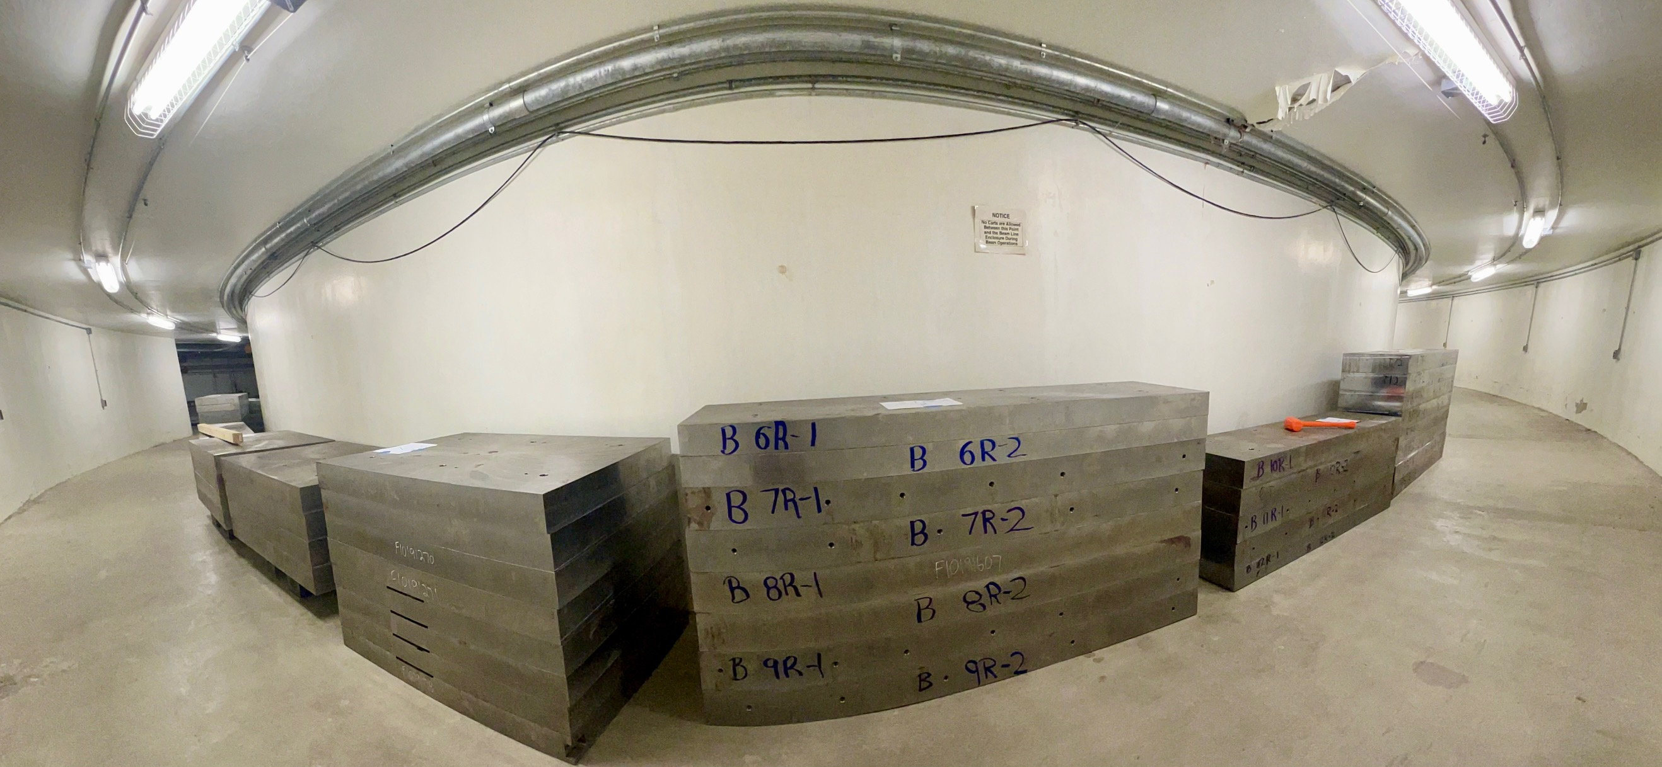
Kyle’s Pile of steel staged underground in the MI-8 MVA.

Slide 5
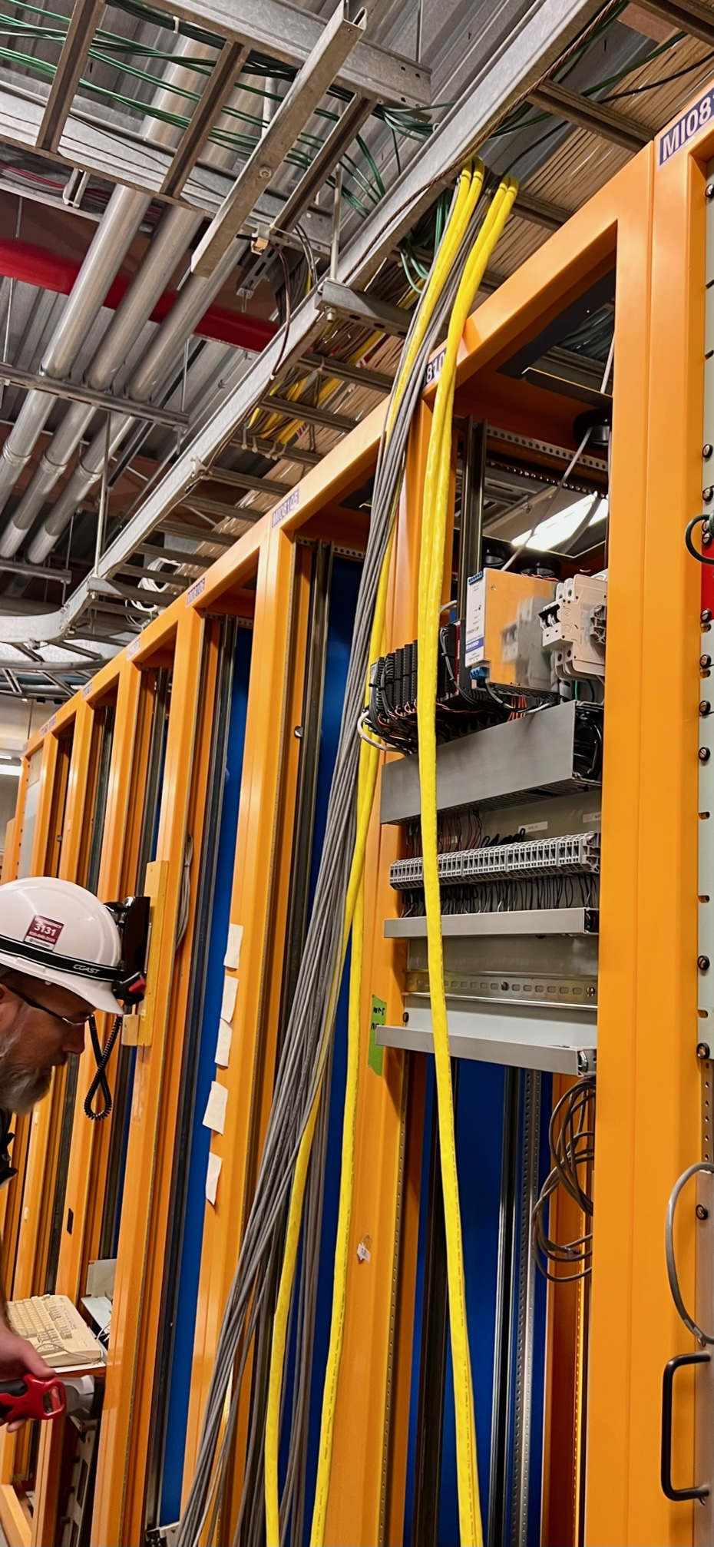
Freshly pulled instrumentation cables
In the MI-8 electronics room.

Slide 6
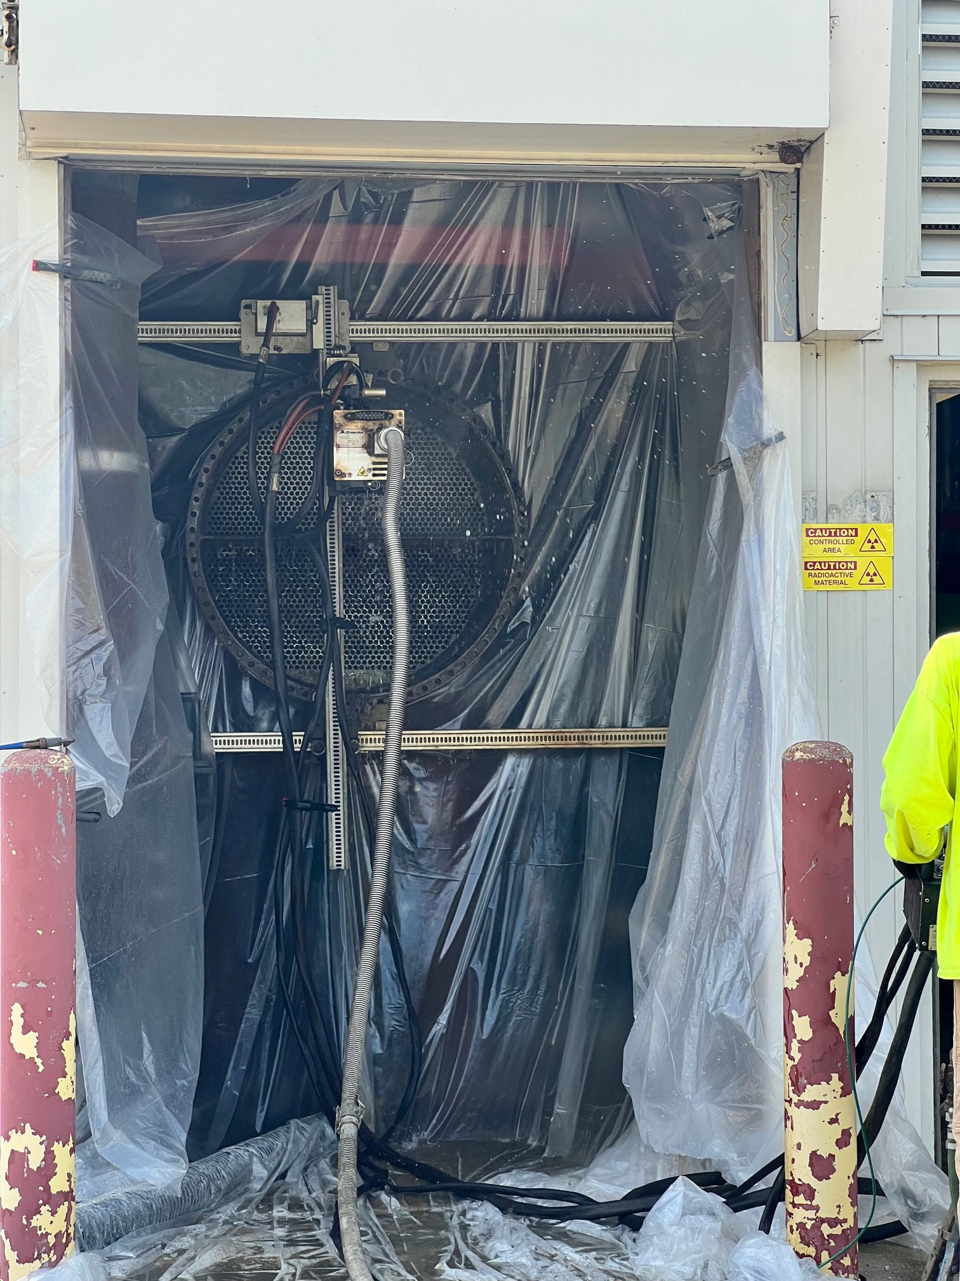
MI-50 pond/LCW heat exchanger cleaning.

Slide 7
Conventional Power Outages
Please report any additional MI outages to the MCR.
7
MI Department Meeting | D. Morris
8/23/24

