Slide 1
Mu2e report
Tom Diehl (FNAL), Greg Rakness (FNAL)
Friday 9am AD meeting
23-Aug-2024
https://indico.fnal.gov/event/65977/

Slide 2
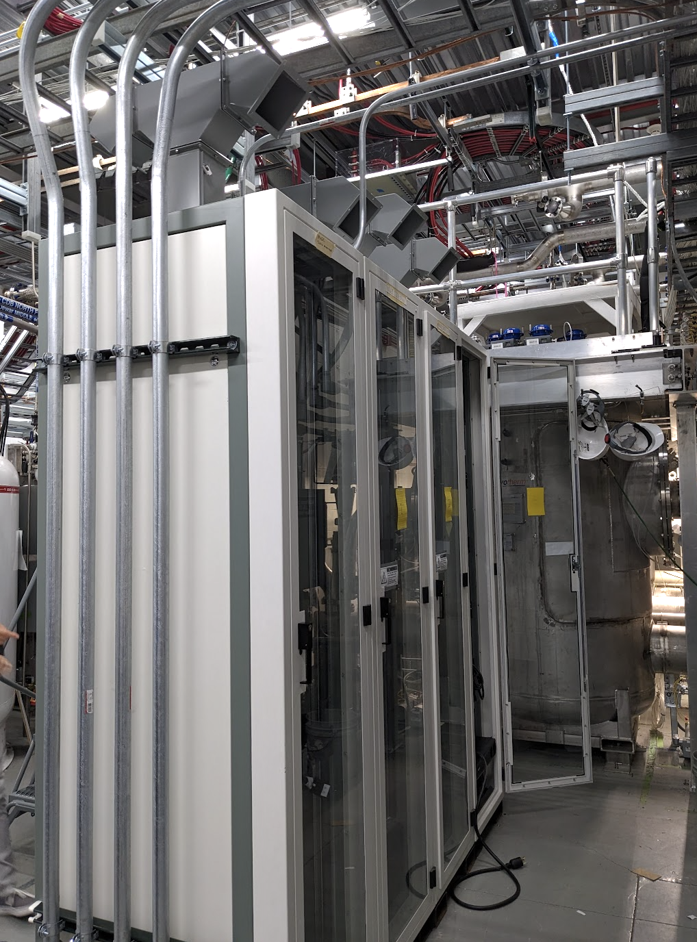
Some progress on some issues
Plan has been developed to fix short cycling of air compressor
Refurbishment of liquid nitrogen tank continues. We want to get this done...
… before cooling down magnets
… while the weather is good
Electrician work continues
Example: quench protection racks in Solenoid Power Supply Room
Requirements and constraints being fleshed out for access platform(s) for Tracker and Calorimeter
… to work on when they come to the Mu2e building…

Slide 3
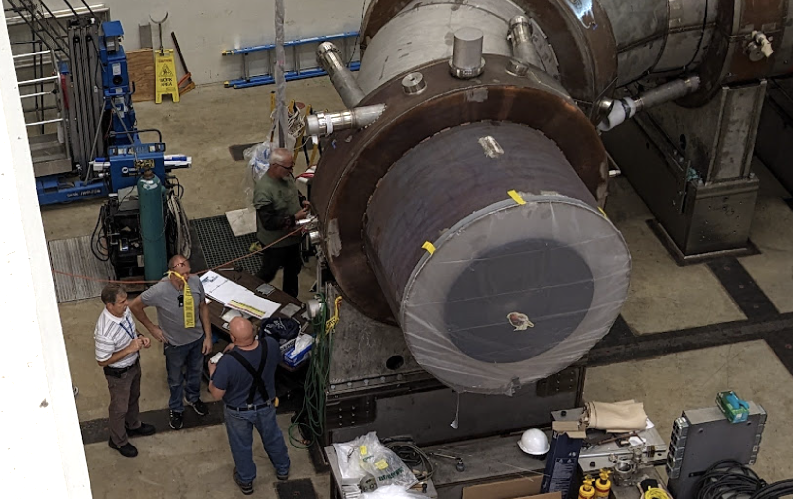
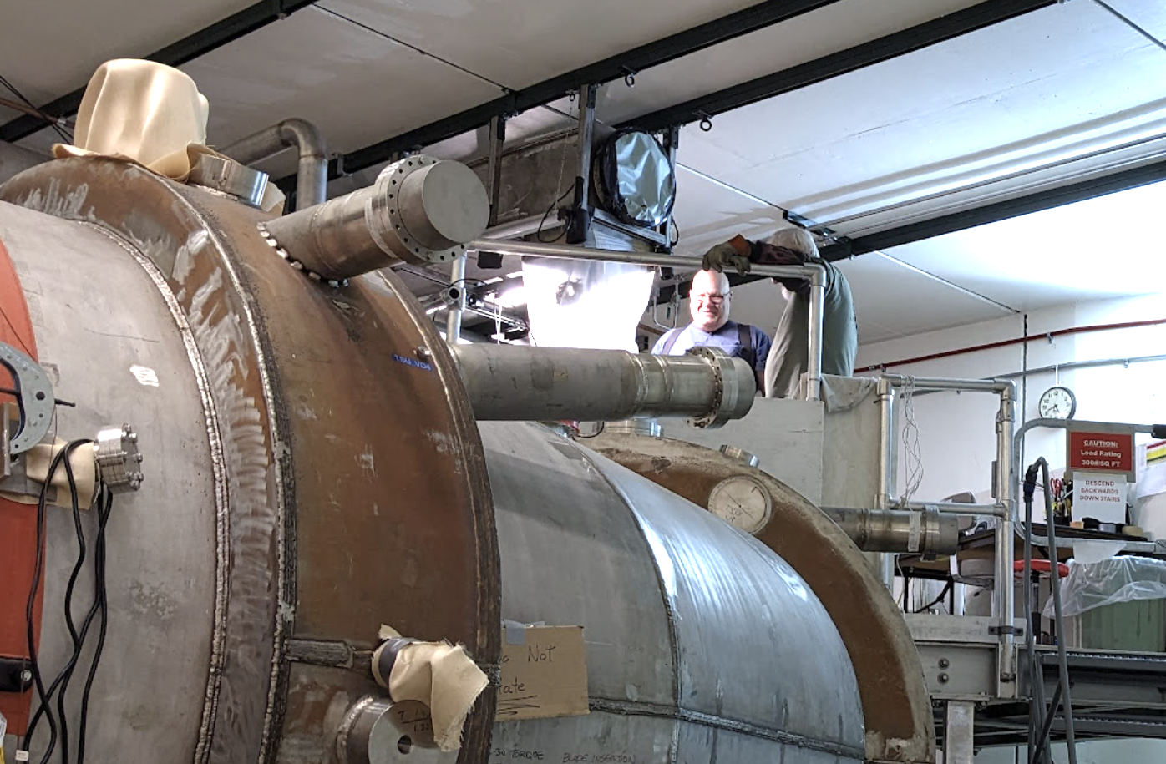
Experts discussing solenoid / transfer line interconnects
.

Slide 4
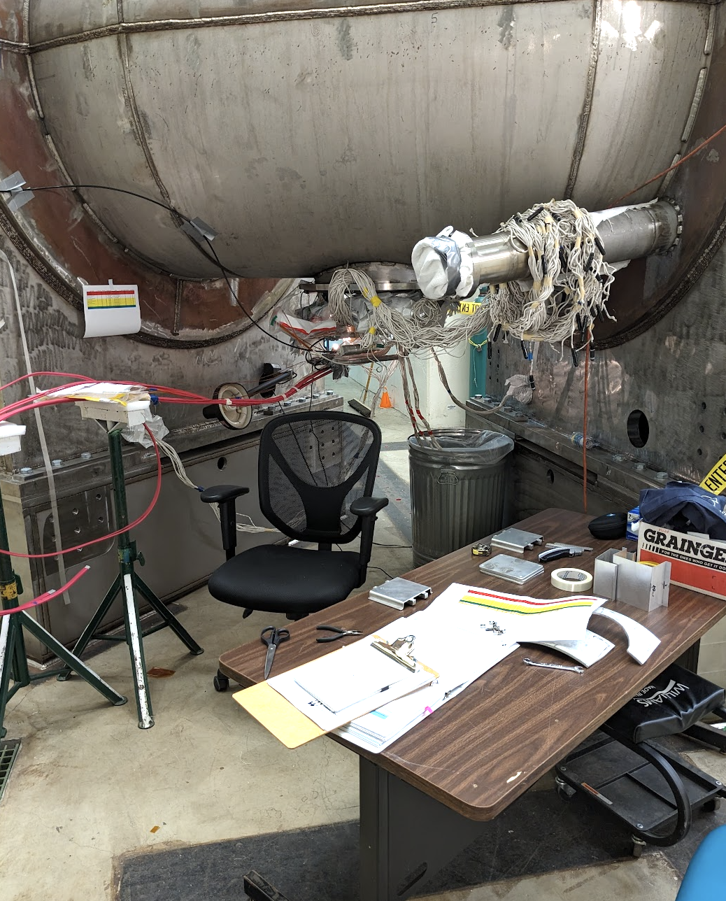
Downstream Transport Solenoid interconnect “office”
Work area has been set up down by TSd transfer line interconnect…
…because this is a job that takes a lot of doing…
Liquid helium
Gaseous helium
Liquid nitrogen
Gaseous nitrogen
Current (kA)
Monitoring

