Slide 1
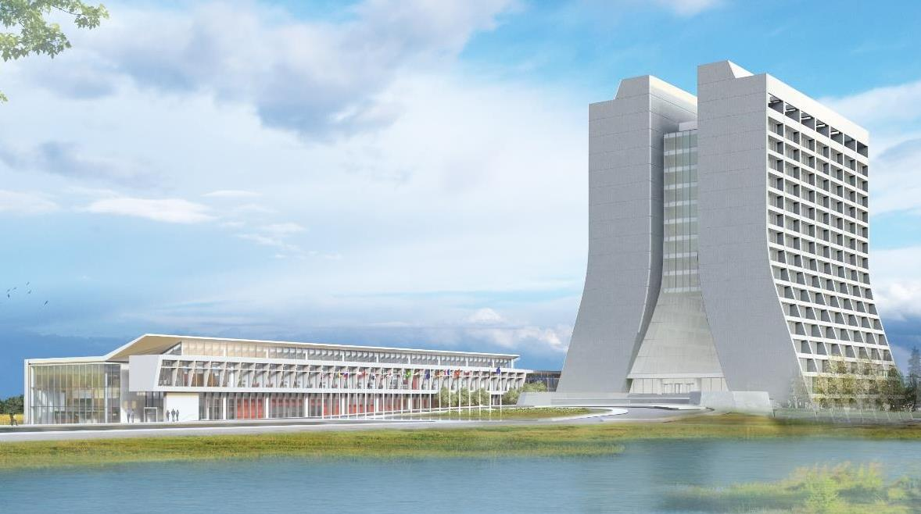
Infrastructure Services Division Updates
Pressing Issues / Special Topic:
  Linac Loft Area - is getting some reactive HVAC work done, affecting some parking. Parts are on order.
  NS3 – Electric removal in progress and Roof is next in line.
Noteworthy Items:
  DOE Leadership Walks – Walks are happening more often and being more detailed with findings – as issues come up we will reach out to AD leadership for a path forward. Site 67 as an example.
  R & G has been performing weed killing. We have been working on notifying the buildings effected when we find out.
Mechanical and Utility Outages: Slide #4 – See slide
Active Projects and Contractors Onsite: Slide #5 & #6
Safety Success – Several buildings have had some grounds clearing for safety and various projects that are being done.
See next slide for photos.

Slide 2
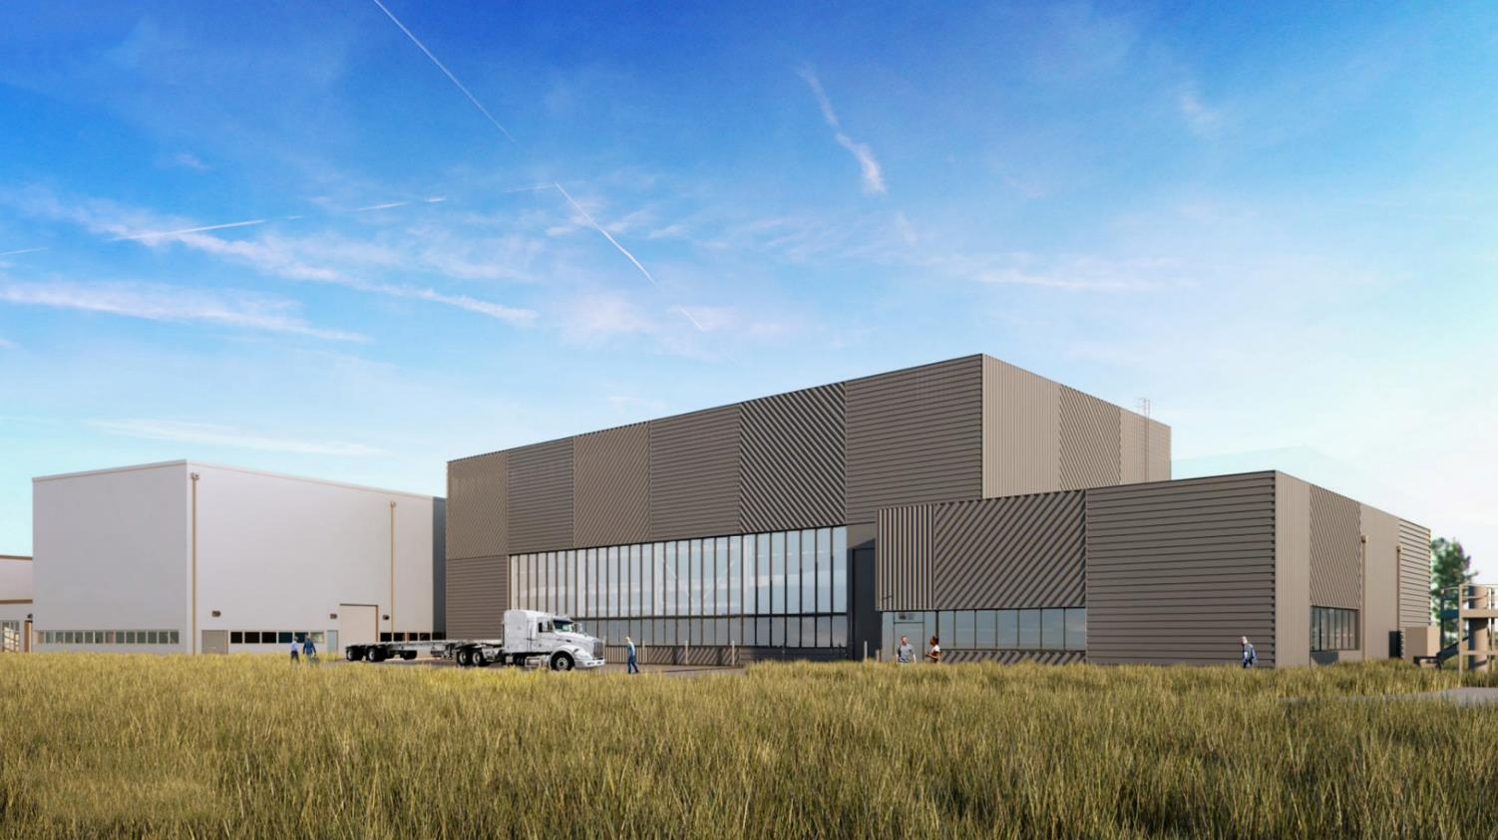
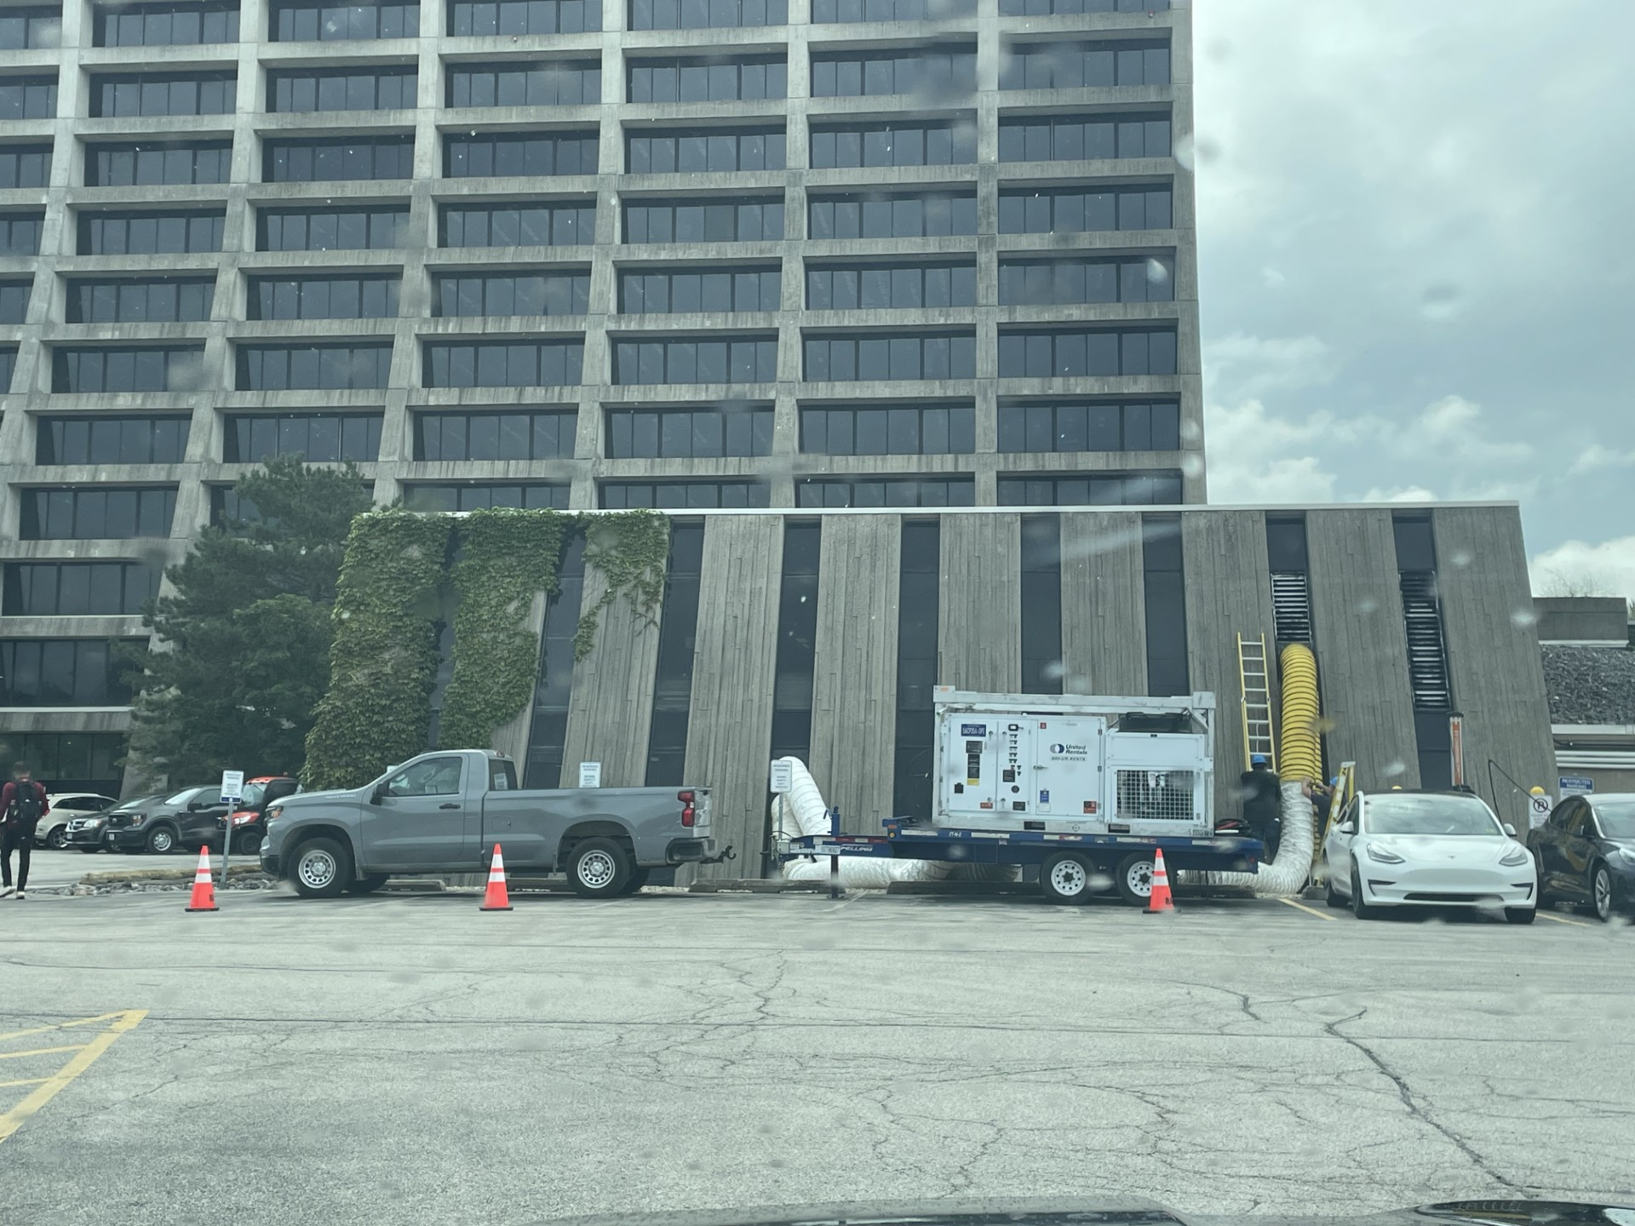
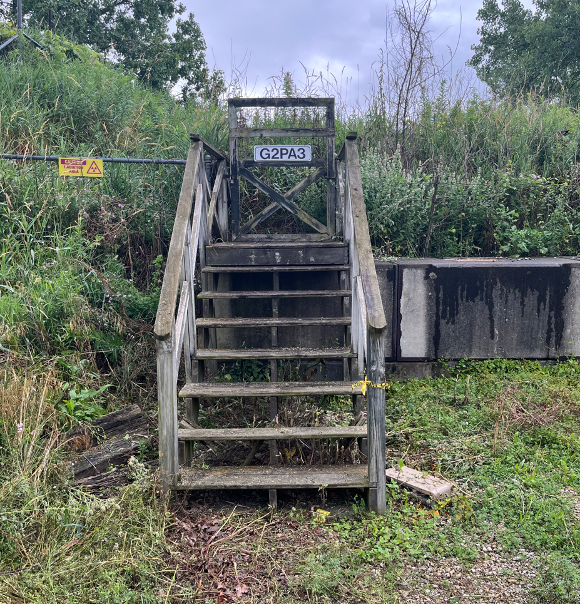
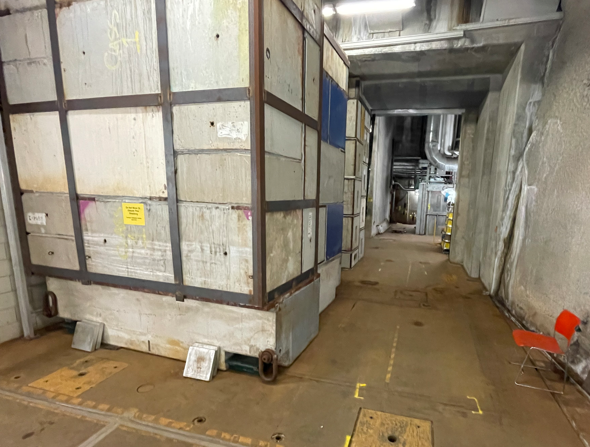
Special Topic:
G-2 – Currently prepping for paint
NS0 – Finished painting, new signage in progress
MI65/NUMI – Shield door concerns – Safety Concerns – in progress/planning
MI65 Weather Station – Currently contemplating locations best suited for the rooftop evaporator. In discussion/review currently
PIPII –
  Having AEDs installed and continues to have concrete poured. Safety Concern Installed ✅
SEA 2nd Floor Renovations Moving along - ACBM remediation scheduling and lighting plan being designed. – In progress
Office Remodeling - concerns are being worked through to find the best course of action moving forward. We value and appreciate the feedback from all.

Slide 3
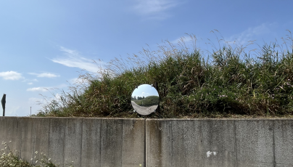
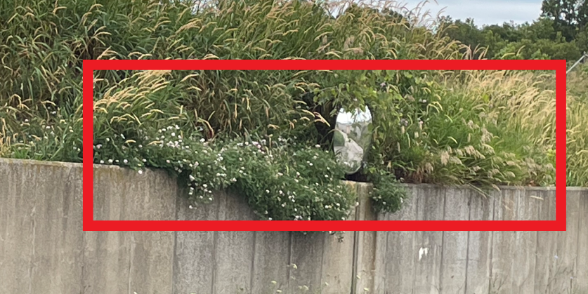
Noteworthy Items
CMTF Generator PMs – In progress
C-0 Floors – Abatement – The abatement teams are starting to be mobilized again and items are being scheduled – Waiting on LOMO to end.
Discovery Road – Painting project for the buildings on discovery road is in the planning phase. Req/SOW turned and being reviewed.
  NS0 and G-2 – are being completed now. New signage in progress
Old/Unused Equipment – Working on Roof Cleanups and MMR’s for stuff around the buildings. Planning with departments on getting items not needed off the roof. In Process.
Service Agreement – Verifying AD/ISD equipment is moving along nicely at about 30% of roughly 8000-line items. In Progress
🎉Another big KUDOS to the R & G’s Teams and the MMR Teams for working to cleanup our grounds and make travel safer. 🎉

Slide 4
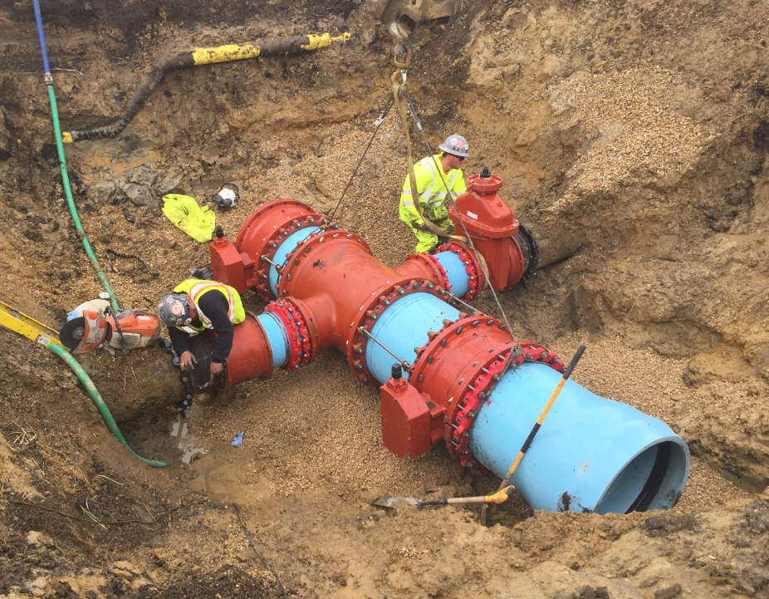
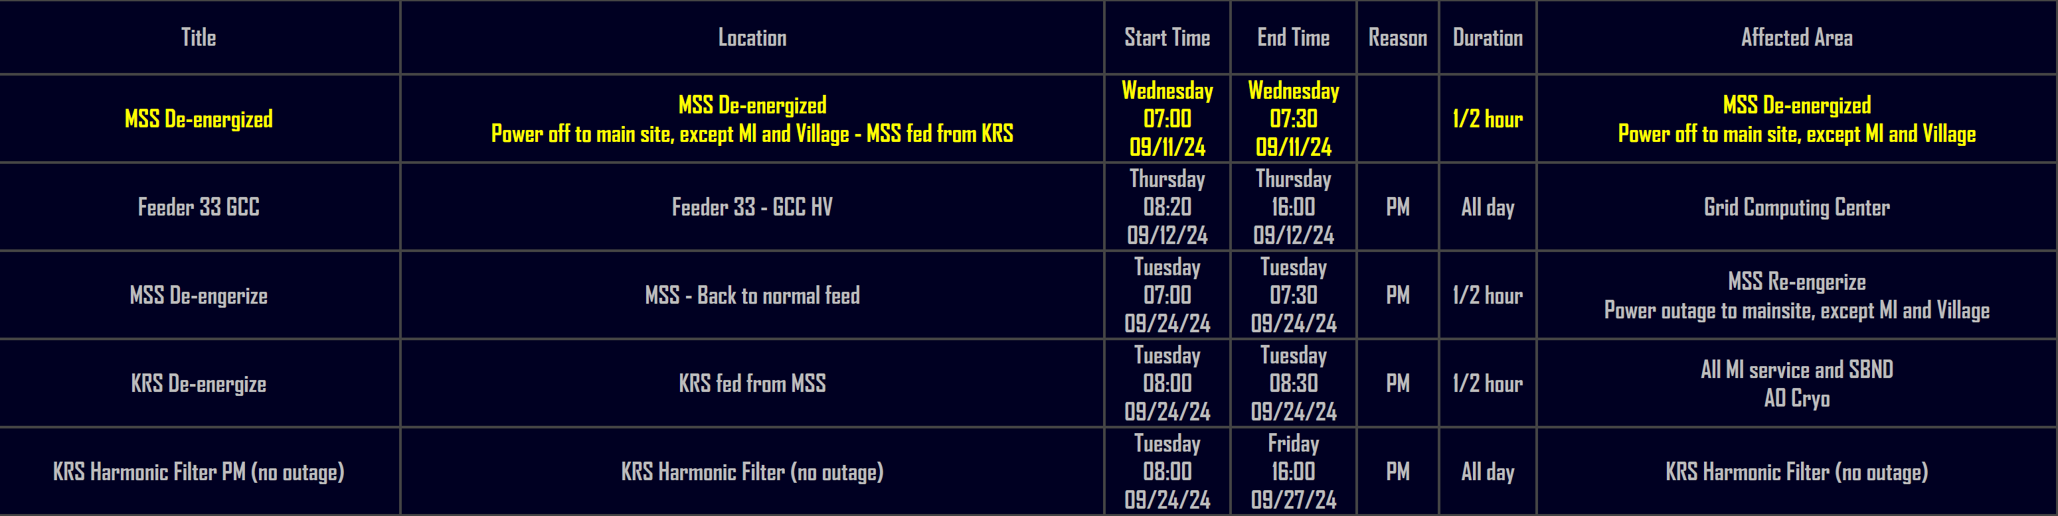
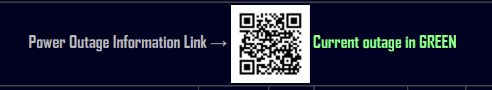
Planned Power Outages
Current Outage Schedule is populated.
Shutdowns are being scheduled for May/June.
Mechanical and Utility Outages

Slide 5

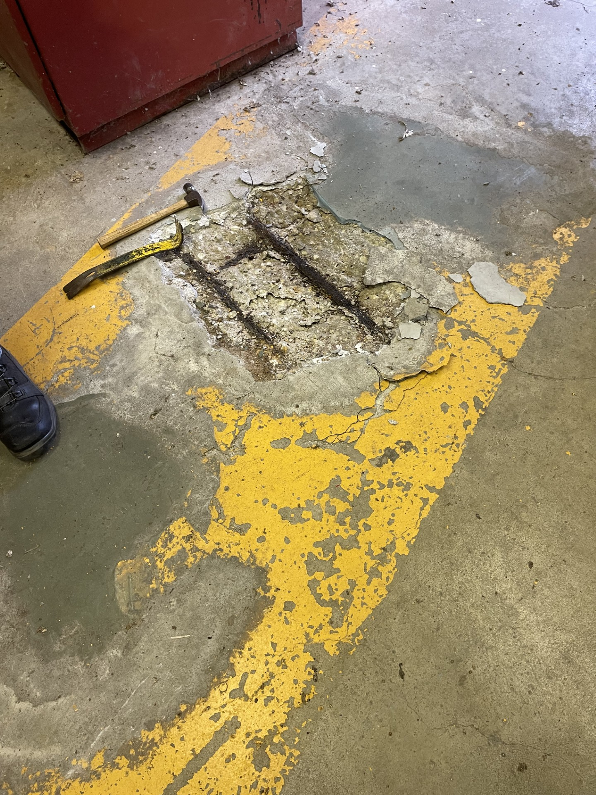
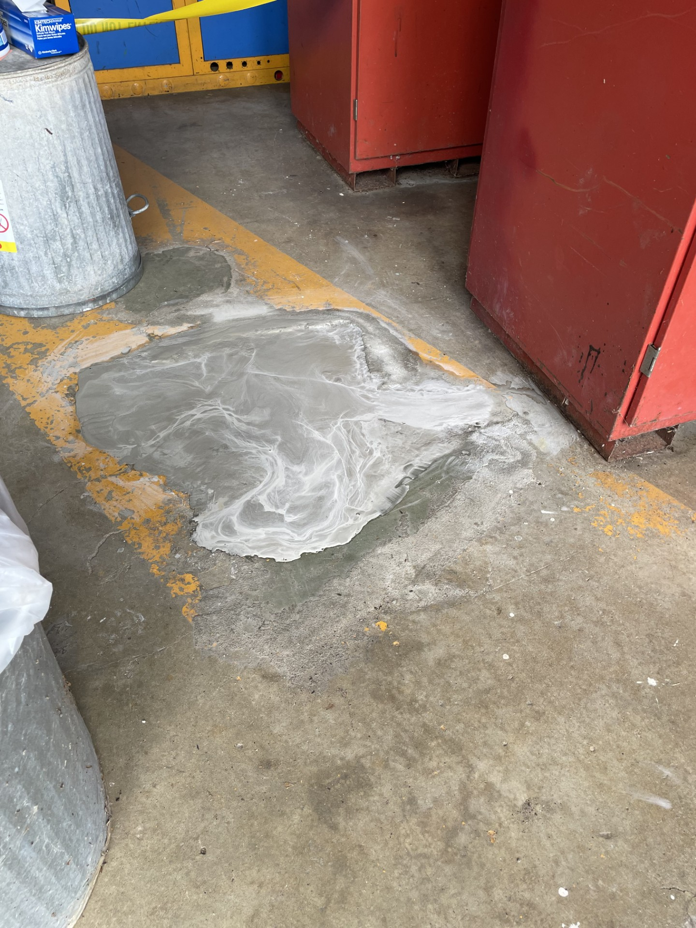
Active Projects still in motion and Contractors on Site
AD Projects:
Door EOL Replacements – Requisition for 13 doors on the EOL list is in progress. Plus 4 others on a fast track working with Scott on locations like SWA, ME7, & AP0, MT Worm. No Change – Awaiting Approval
Office Refurbishing – TGC-113/SEA-212 Approved, XGE-106/TGC-109 Approved, XGC-129/XGW-114 Approved, XGE-124/TGS-125 Approved, WGW-106/XGW-108 Approved, XGW-107 Approved, Building Req’s now – no change
Exterior Ladder EOL replacements – Currently 24 ladders are targeted. SOW is being developed. In Progress – no change
AD Elevator/Dumbwaiter Maintenance – Larger Plan being developed
- SSB repair in design mode as more damage was done initially thought. ☹
New Roofs – HAB almost complete, Minos is prepping (Emergency Roof on highbay in progress), Village Gym/Fuel Station are next up and just waiting on different phases of the projects to firm up dates.
Minos – Emergency Roof – In review process. In Progress
NS3 – Emergency Roof – In review process. In Progress
Pagoda – Floor repairs completed

Slide 6
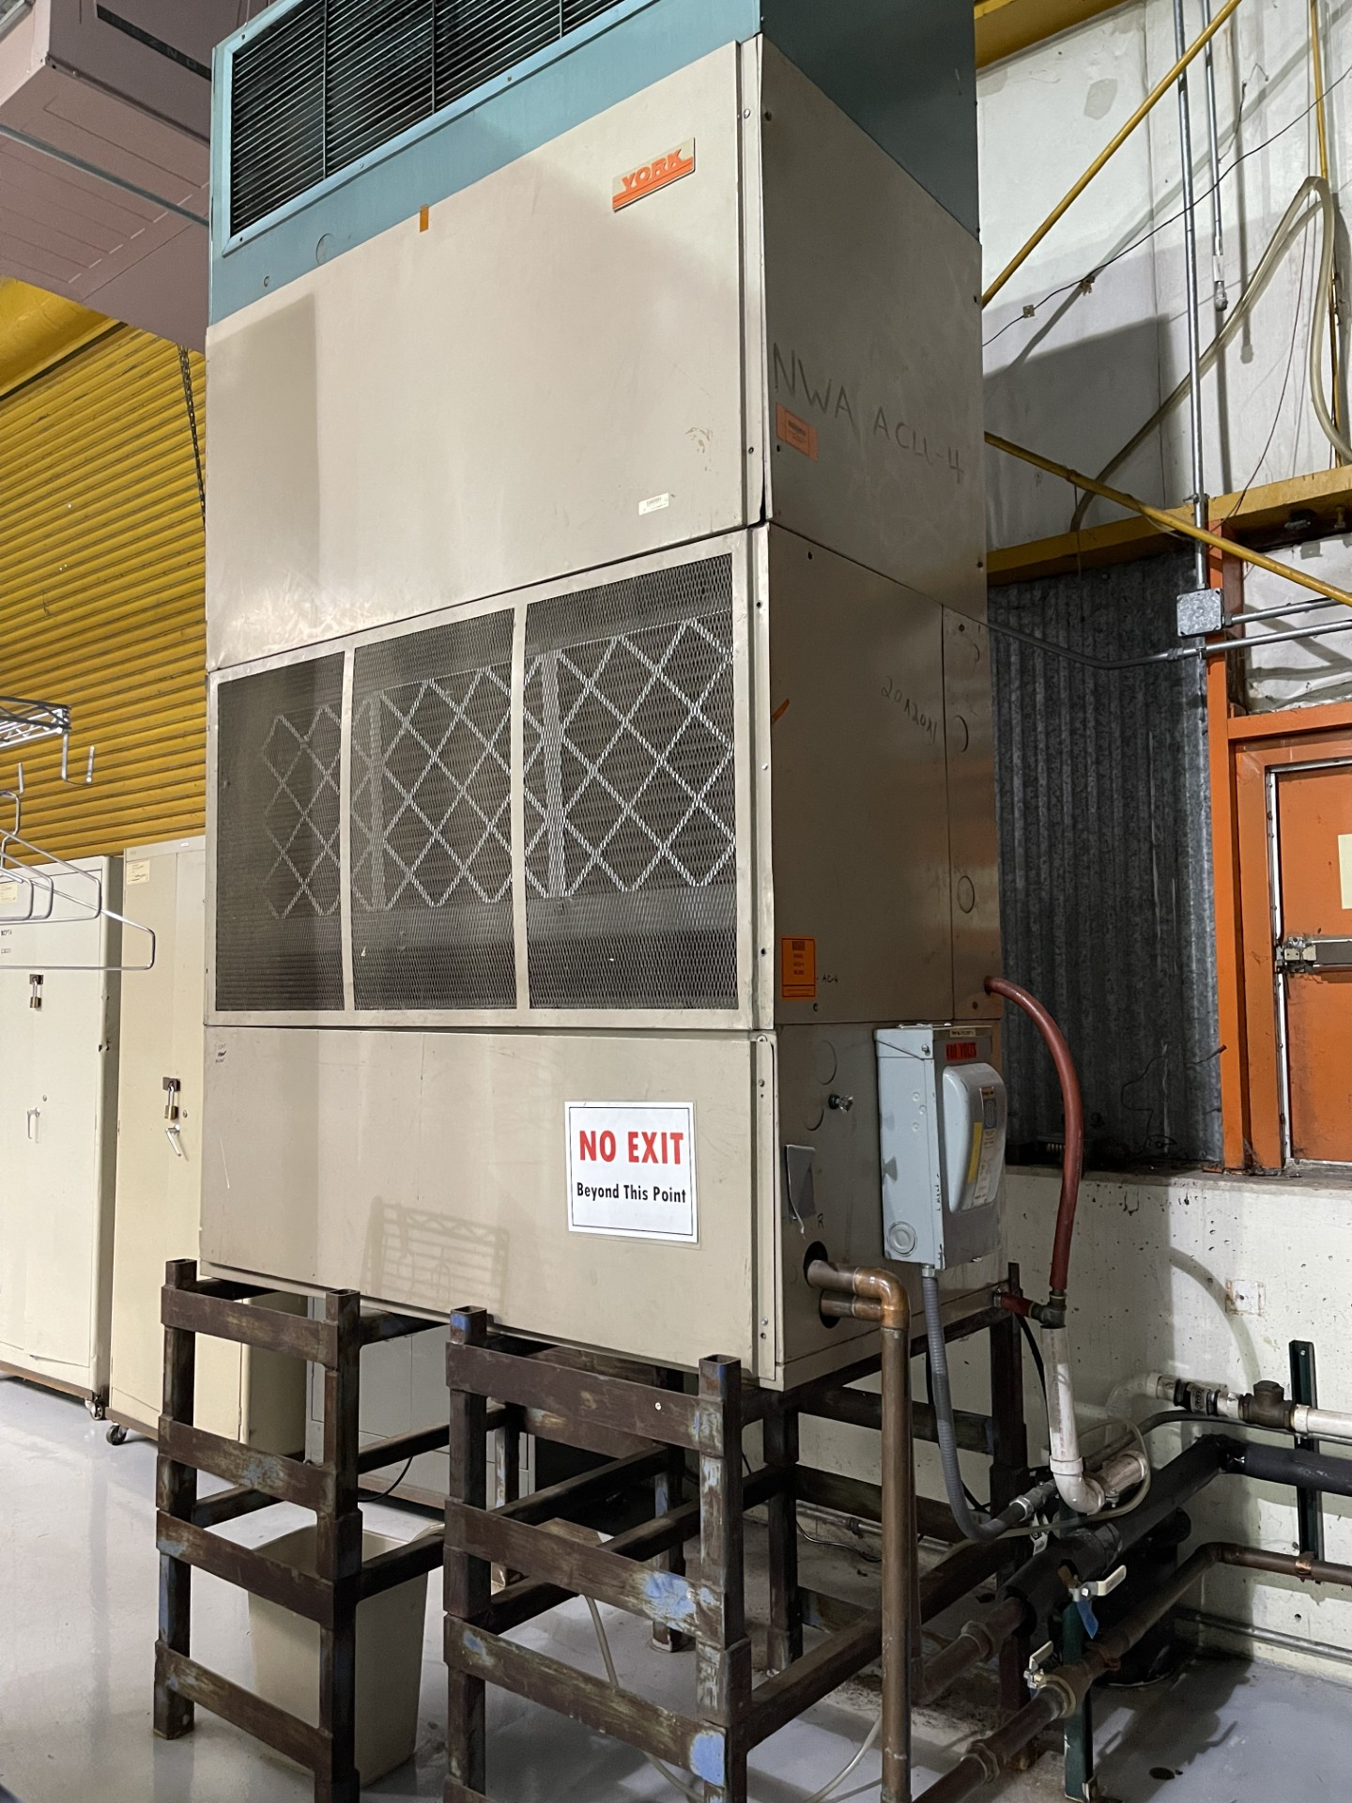
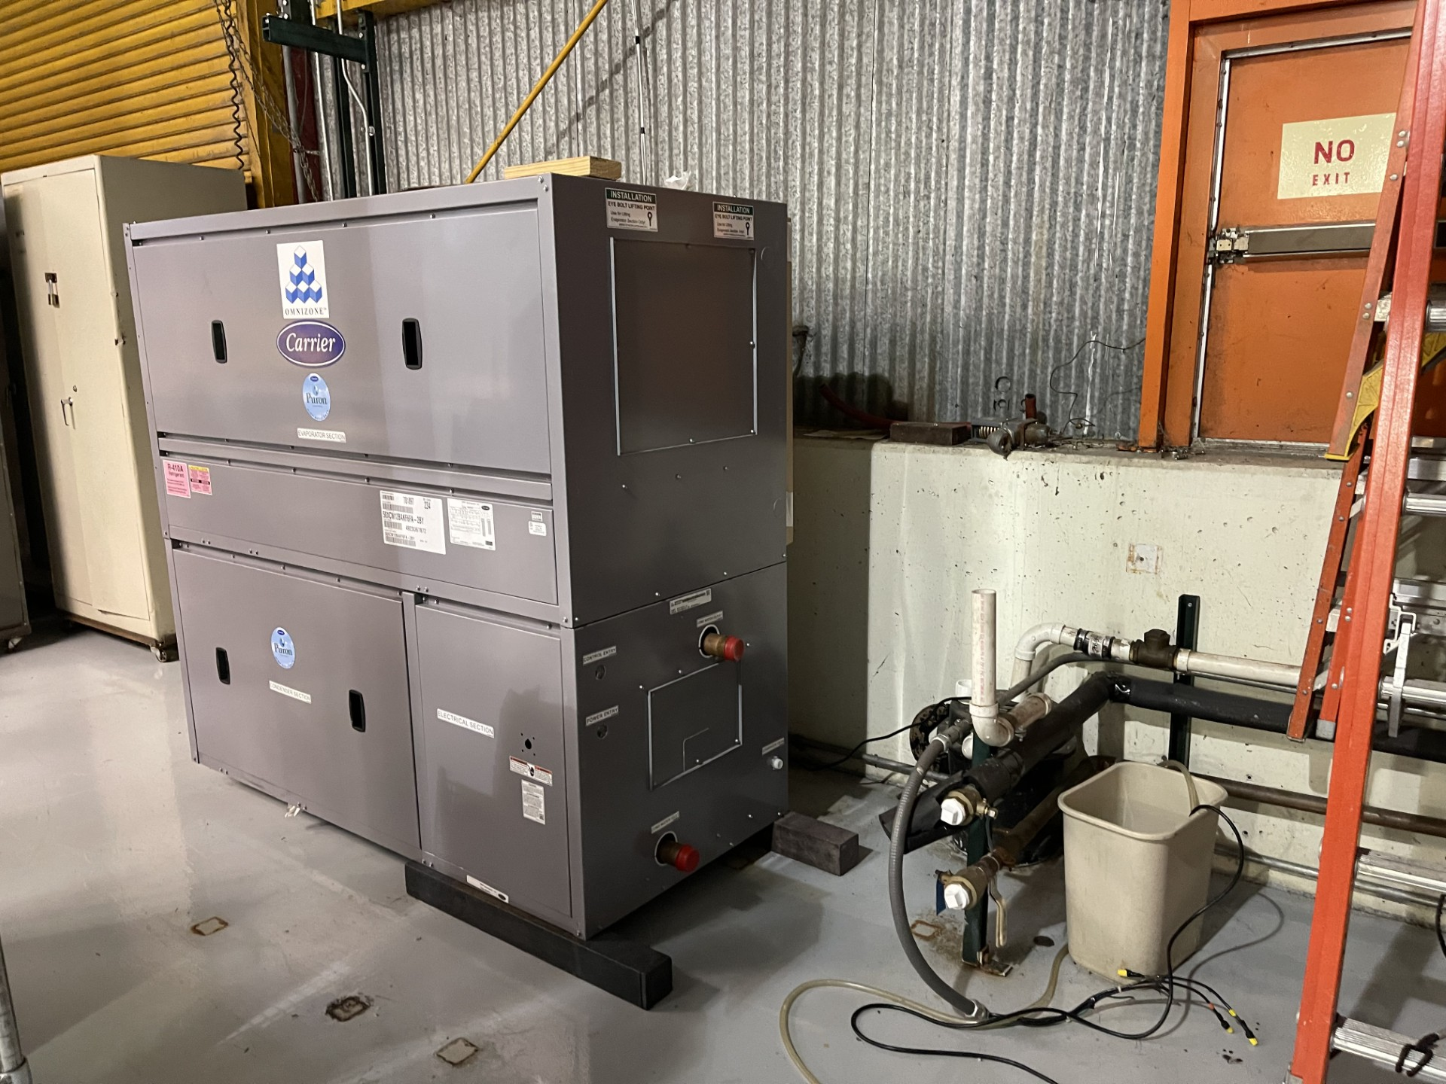
Active Projects still in motion and Contractors on Site
AD Projects:
NTF Safety Project – Area scanned and ready to schedule the rail install.
Potential next Projects – APOTH Door & Frame Replacement (waiting on quote), A0 cleanroom sanitary line replacement (performed walkdown and waiting on quote), MI Building Concrete Coatings, C0 Service Building (in beginning phase). – No Change
Lighting Work/Upgrades – CMTF have been halted due to other lab priorities - Received new scheduling information from CMTF and working the FPCs to see if we can work into the schedule.
Foundation Leaks – MT6/MC2/Wilson Hall – In procurement.
Electrification Project – In Motion
NWA & NS4 – Various work orders are being handled/planned/scheduled.
Property and R&G – special thank you! In this month alone AD has gotten a total of 13 various tickets completed. From moving out pallets and vegetation clearing for PMs and maintenance work.
And More…

Slide 8
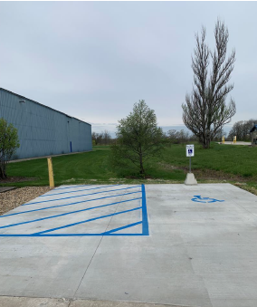
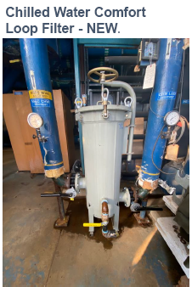
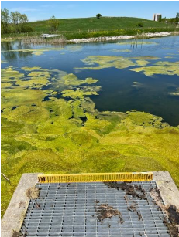
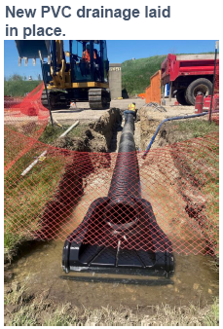
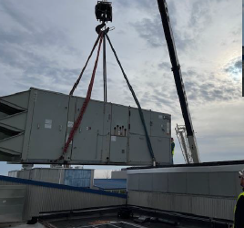
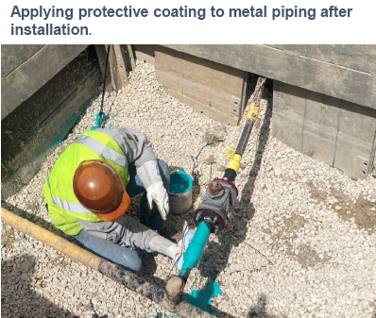
Lab Wide Mentions
CUB – picked up new “Slip-Stream” filters
Warehouse 2 – ADA requirements have been installed, new parking spot, and automatic door openers
MW9 gas leaks – after the repairs and new install we are wrapping them with a protective coating to prevent soil condition deterioration.
LAB B – pulled down their old rooftop unit and replaced it with a new one.
PS6 – received some new drain work
Pond Algae Treatment – mechanics are/were cleaning intake grating a couple times a day.

Slide 9
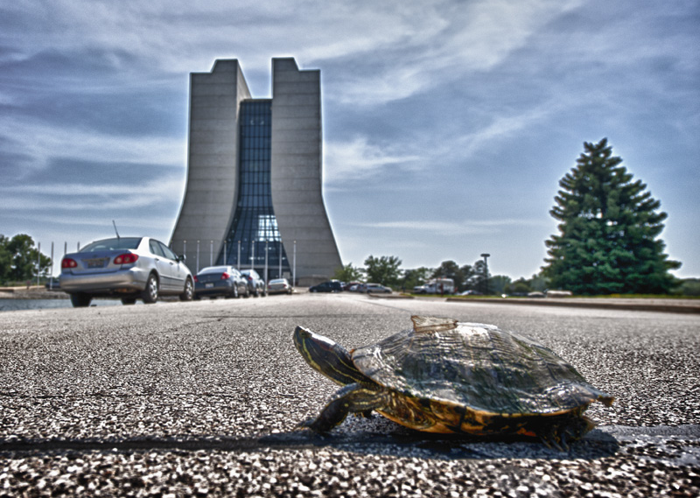
Road Closures
Closures from Fermilab today or R&G site
  Lab closures
  Closures close to WH

