Slide 1
Muon Campus Shutdown Report
Jim Morgan
Friday 09:00 Shutdown Meeting
September 6, 2024

Slide 2
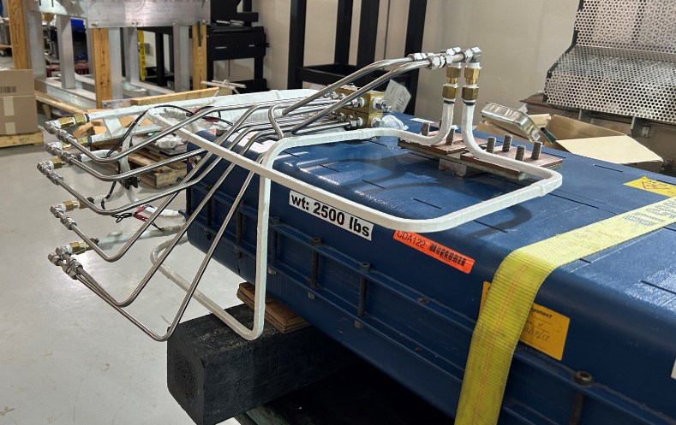
Muon Campus status
LOMO Week
TD installed rad hard water lines on CDA dipole for downstream M4 Line
Progress on constructing A/C dipoles for M4 line
ESS2 internal components installed at A0 Clean Room, awaiting survey
Many D30 tunnel jobs still need planning details or parts before work can start
Numerous LCW leaks, loosing about 20 Gal/Day
Largest leaks on sub-header connection and a Delivery Ring sextupole
ESS1 & 2 Fluorinert piping installation nearly complete
Connects future AP-30 cooling skid with surge resistors in the tunnel
Prototype ESS2 will need to be removed from DR prior to running beam
Related to buyback accounting between Mu2e Project and AD spares funds
Hope that operational ESS2 will be ready for installation in October
Will evaluate options if operational ESS2 is delayed significantly
Domestic water leaks near AP-0
AP-0 north door being replaced today
AP-0 A/C work continues to be stalled
Study – M1-M3 Optics
Study – Alternative M5 optics
Rad hard CDA dipole

Slide 3
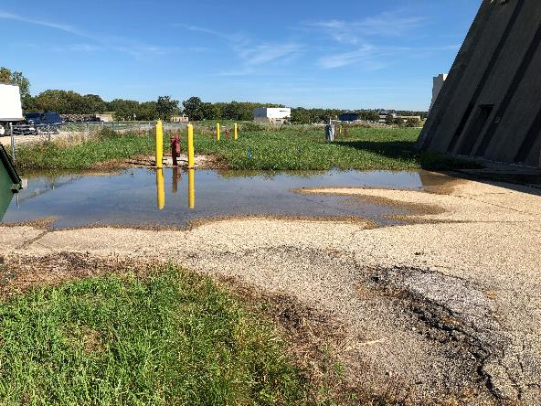
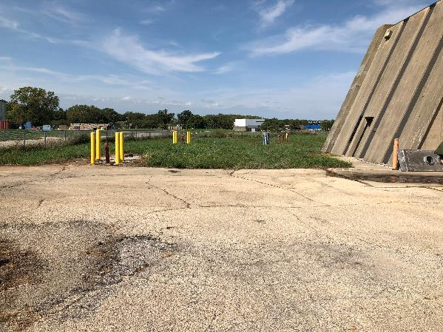
AP-0 after domestic water leak on August 23
August 23
September 2
September 5

Slide 4
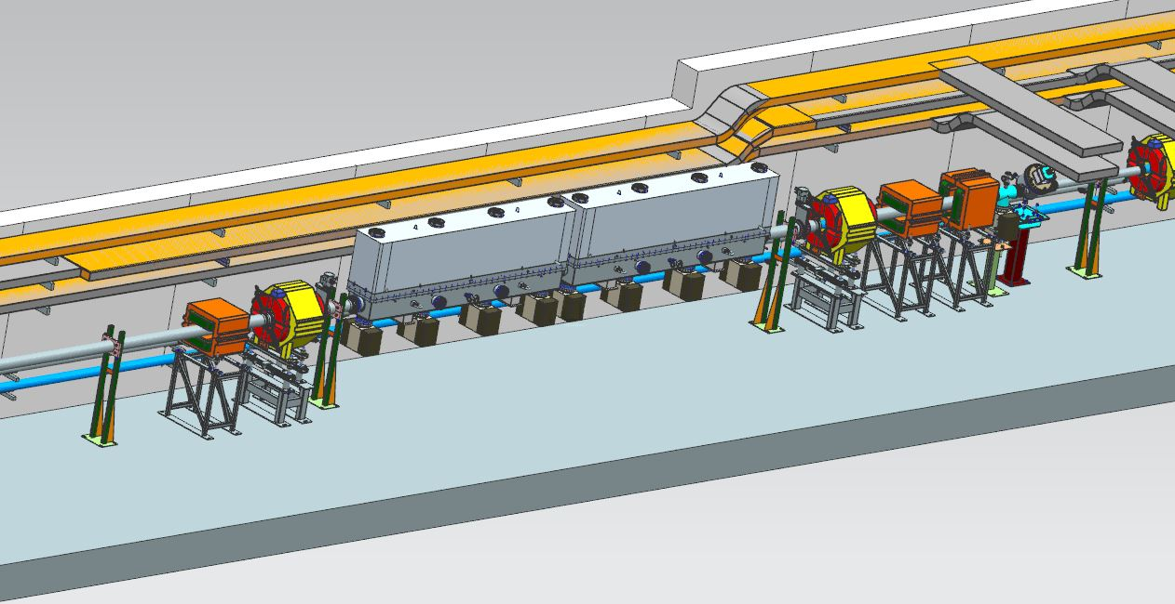
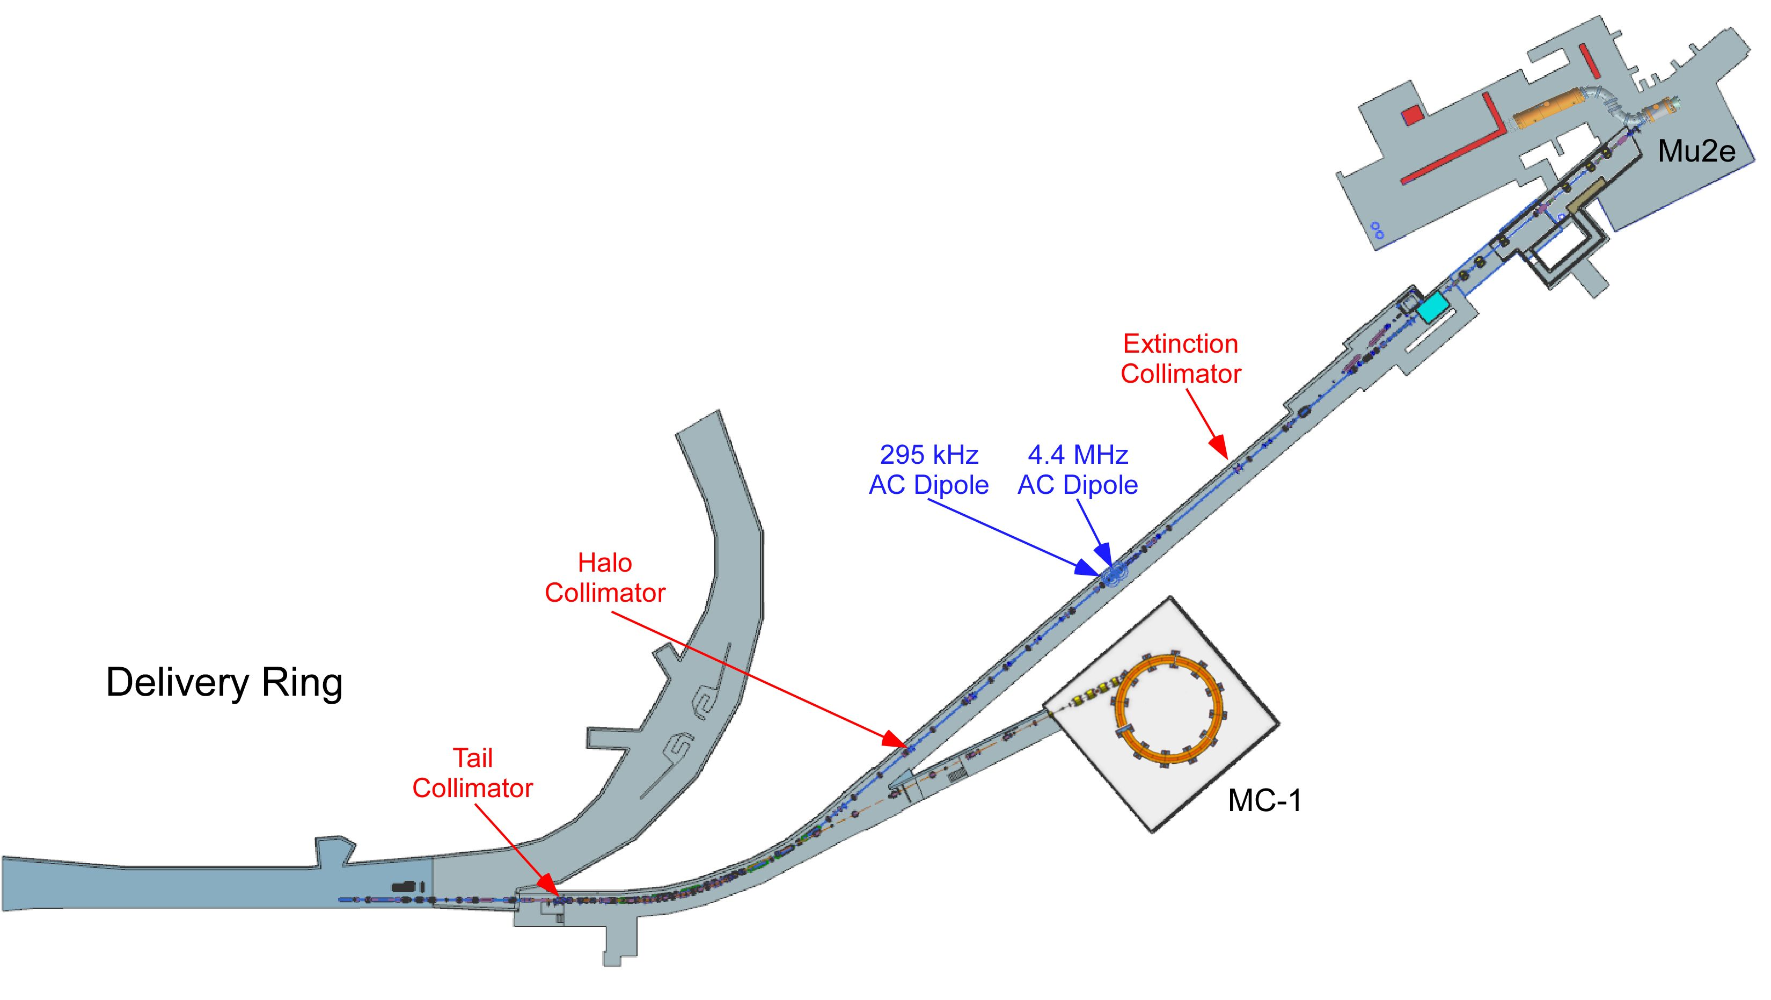
A/C Dipole location in the M4 Line

Slide 5
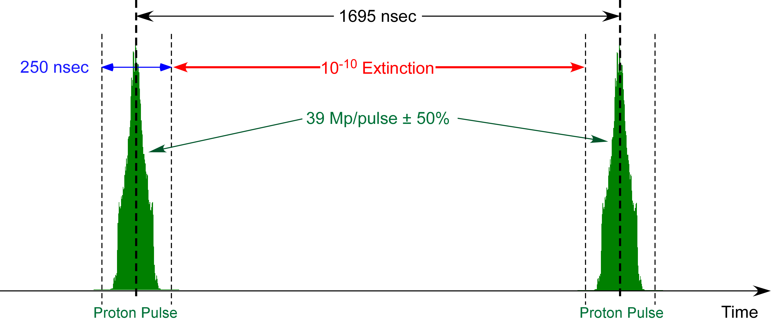
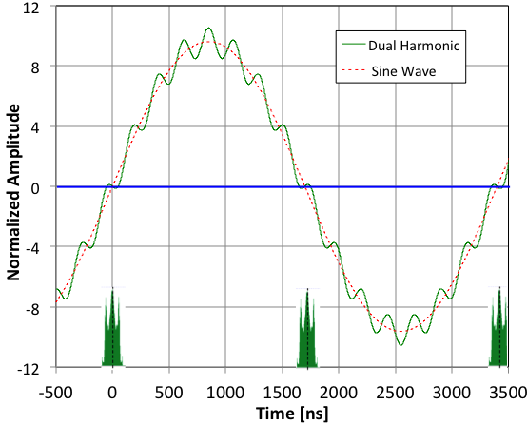
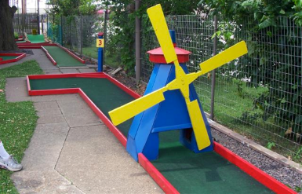
The function of the A/C Dipole
The Mu2e experiment has very stringent limits on the amount of beam that appears between pulses, the A/C Dipole helps eliminate out of time beam
Study – M1-M3 Optics
Study – Alternative M5 optics
Think miniature golf
From Eric Prebys

Slide 6
Upcoming work
Main worklist items and other upcoming work
AP-0 Dump system will be drained and water lines blown out
Install rad hard 8Q24 at Q205, send uninstalled 8Q24 to TD for rad hard water lines
Q205 vacuum pipe replacement to simplify vacuum connection to ELAM
Unroll ELAM (was rolled 24 mr to improve g-2 extraction trajectory)
Profilometer extraction profile monitor vacuum Tee installed upstream of ELAM
Several alignment tasks including D30 level run and M4 Final Focus
ESS1 and ESS2 septum stand motion-control improvements
M4 Final Focus vacuum installation, A/C dipole installation
Need to check sizing of all power supply panel breakers, upgrade as necessary
Numerous LCW leaks
Install additional steel shielding above ECMAG
Repair Kirk Key hardware on disconnects
Hope to finish operational ESS2 and install it in tunnel late in shutdown
Repair of domestic water break near AP-0 may disturb Transport berm
ESS2 (operational version in A0 Clean Room)
Survey next week, followed by vacuum leak check and transport to NWA for testing
AP-0 A/C controls work paused; reason unknown

