Slide 1
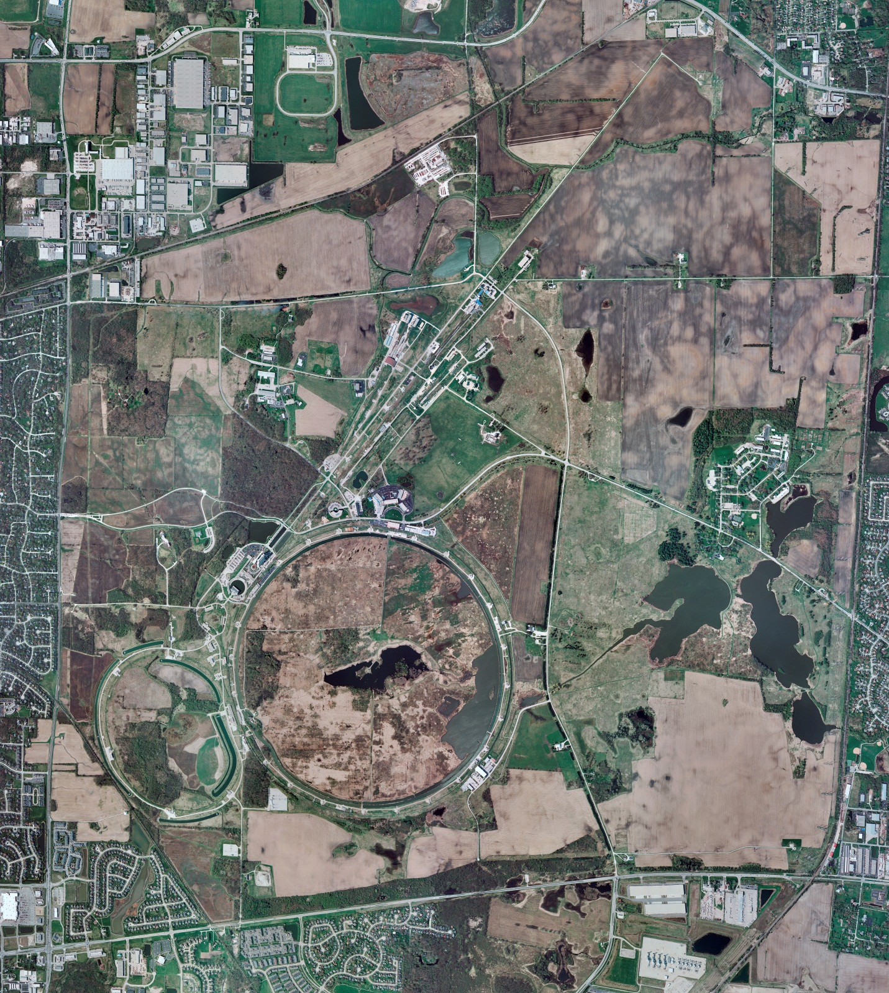
Helium Cryogenics
Status 9/6/2024 J.Makara
CMTF: SCP at RT but restart activities in progress (LN2 Purifier and comprs running)
CMTS: HECM31 installation ongoing, anticipate cooldown next week
PIP2IT: South Stand CM being modified for SSR2 pCM
North Stand CM empty
MCTF: cryo system cooldown in progress
MDB/HTS: at RT
MDB/STC: at RT but to be cooled down for SSR2 cavity testing
MDB Magnet: at RT
NML/FAST: Cryo system is shut down and isolated for extended shutdown period;
CC1: at RT
CC2: at RT
CM: at RT
IB1: cryo system operations running fine with CTi and ALAT CBs cold
Muon Campus: at RT with comprs off and system depressurized; LN2 system at RT; g-2 Expt Hall at ODH=0 (not ODH area)
Misc:…

