Slide 1
FAST / IOTA Shutdown 2023-2024
Enclosure STATUS: ODH-0 & Supervised Access (“same as it ever was”)
General: -IOTA Bake GFCI (AD/Web 57570). No movement
-ESB Laser Lab electrical work on hold for vestibule
ES&H: -OSC Mode in LL. New South Gate. Interlock Install.
-There was an Access Violation in MI yesterday (266318)
IPI: -ESB 480/120VAC Electric Req being generated (still).
-DON’T TOUCH beamline stuff.
Water: -Chiller needs repair since Jan. PO (717353) (6 wks)
-ICW was off 8/26 through 8/28 for pond work. Went OK.
AD Shutdown’24: Power outages: 9/11 07:00, MSS T86 to KRS
— Inform FAST RunCo of any work on the accelerator—

Slide 2
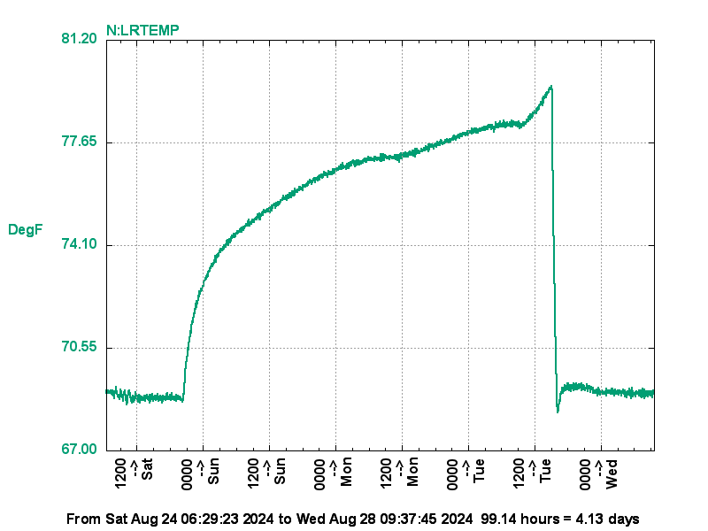
ICW Outage at NML, 08/24 – 08/27
NML High-bay Temps
Tuesday 8am-3pm up to 82°
Normal otherwise
OUTTMP peaked at 96° that week
(@ Tuesday 15:42)
Laser Lab Room Temperature
80°F
—Sat. 20:00
Tue. 15:00—
– 80°F nom –

