Slide 1
Partial Return Yoke

Slide 2
Outline
Introduction and Concept
Engineering
PRY ‘Light’
Field at Cryocooler Heads
Performance
Risk mitigation

Slide 3
Concept
Partial Return Yoke (a.k.a. “shield”, PRY?)
Concept presented at MICE CM 2012
Shielding plates
wall thickness >10 cm
weight: 35t
Performance
Reduces stray field outside of shield to 5-10 Gauss
H Witte. Step IV & VI: Local Flux Return. MICE CM 34, October 2012.
(Note: not to scale)

Slide 4
Engineering Updates
Detailed drawings
Steel source investigation
Quotes
Interferences
Colour scheme for identified interferences
Meeting Steve Plate / Jason Tarrant / Andy Nichols
Courtesy of S. Plate

Slide 5
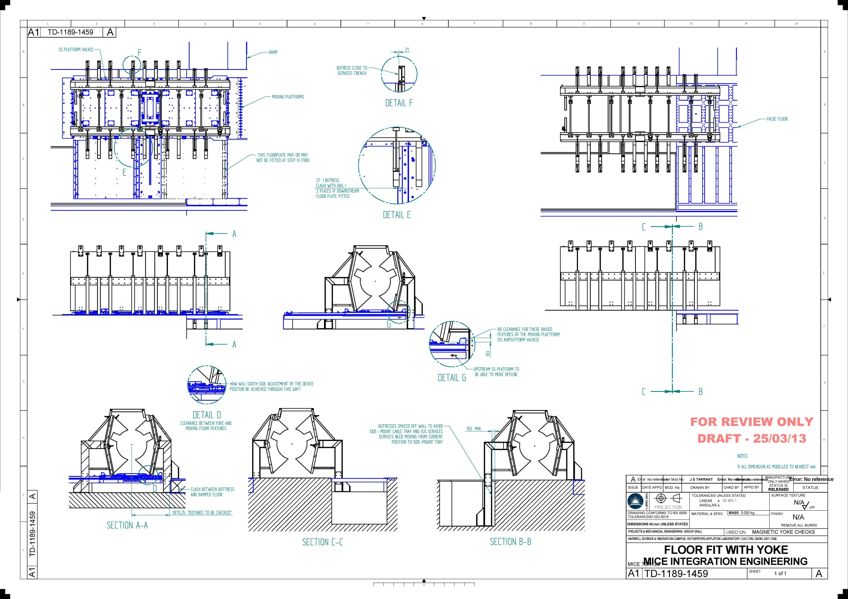
Interferences
C
Courtesy of S. Plate / J. Tarrant

Slide 6
MICE – PRY Light
Review: investigate ‘light’ option
No/little modification to MICE hall
Two parts: Step IV and Step V+VI (not considered)
Step IV: mezzanine
Currently needs to be raised by 200 mm
PRY
Reduce shield by 200 mm on one side
(Alternative shield geometry?)

Slide 7
200 MeV Flip Mode
10 cm shield

Slide 8
Frontal View
10 cm shield
2.5 m
200 MeV Flip
240 MeV Solenoid

Slide 9
Error Field Caused by Shield
Method: coupling variable
Extrude magnetization of PRY
Separate simulation to evaluate fields caused by shield
Concern: asymmetry
Difference of error field
M (A/m)

Slide 10
Error Field
240 MeV Solenoid
B_{x}
B_{y}

Slide 11
Cryocooler Heads
1.463 m
CAD model courtesy of S. Plate / J. Tarrant

Slide 12
Field Cryocooler Heads
200 MeV Flip Mode
Full
‘Light’

Slide 13
Field Cryocooler (no PRY)
200 MeV Flip Mode
Set to air
PRY reduces field by 20-30%

Slide 14
Field Cryocooler Head

Slide 15
Performance – Risks
Software simulations
Two different FEA codes show similar performance
Simple concept
Low risk
Material Properties
Magnetization curve AISI 1010
Mitigation strategies
Margin (increase shield thickness 10→12 cm or booster plates)
Different material

Slide 16
Iron Alloys
Carbon content
AISI 1010: 0.080 - 0.13 %
AISI 1008: <0.1 %
Operating Point PRY
W. L. Cheney: Preparation and Properties of Pure Iron Alloys. Scientific Papers of the Bureau of Standards. Washington, July 24, 1922.

Slide 17
AISI 1010: μ_{r}
12cm
10cm

Slide 18
10 cm Shield

Slide 19
12 cm Shield

Slide 20
Booster Plates – Concept
Pros:
can be added later if necessary
Procurement not an issue
3 cm thick plates
Cover MICE Spectrometer Solenoid

Slide 21
Booster Plates

Slide 22
Performance
Simulation assumes 3 mm gap between
PRY and additional plates

Slide 23
Comparison Forces
No Booster Plates
 | 200 MeV Flip | 240 MeV Flip | 200 MeV Sol | 240 MeV Sol | Case 5 Sol
Fx | -29580.6 | -33917.6 | -9455.05 | -9113.06 | -12386.88
Fy | -2.186 | -2.534 | -0.5866 | -0.6699 | -1.4982
Fz | 2.1758 | 2.818728 | -0.5866 | 0.014174 | -0.021206
Booster Plates
 | 200 MeV Flip | 240 MeV Flip | 200 MeV Sol | 240 MeV Sol | Case 5 Sol
Fx | -29925.26609 | -34291.38436 | -9503.251273 | -9161.08259 | -12407.63104
Fy | 1.404746766 | ≈0 | 1.398601169 | 1.441031702 | 2.022168792
Fz | 2.073699882 | -6.362225624 | -1.495318119 | -1.487569578 | -1.421299777
All forces in Newton

Slide 24
Summary
Engineering
Progresses as planned
Interferences and detailed drawings
Steel source investigation
PRY Light (Step IV)
Looks like an option
Cost advantage?
Field for cryocoolers
PRY reduces field by 20-30%
Performance / Risk mitigation
Shield thickness / booster plates

Slide 25
Additional Slides

Slide 26
Tolerance PRY / Virostek Plate
Interface Virostek shield / Partial Return Yoke
Vertical gaps detrimental for performance
Separate parts: gap?
Gap between backing up plate and other structures: 0.5 mm

Slide 27
Field R=1.5m

Slide 28
Field Cryocooler Head

