Slide 1
RR/MI Beam Loss Budget
Rob Ainsworth
PIP-2 Accelerator Physics Meeting
10 September 2024

Slide 2
Loss budget
Loss budget follows 1W/m
MI & RR share the same enclosure of length 3.3km
Combined loss <3.3kW
Typically, 1W/m applies to areas we want hands on access and so collimators are excluded
All loss (controlled and uncontrolled) are included in this budget
PIPII requirements
75E12 @ 1.2s
MI can ramp at 1.067s so we will consider loss budget for 75E12 @ 1.067s

Slide 3
Slip-stacking
Significant source of DC beam
Either sent to abort in RR if in Inj gap
Captured in MI collimator

Slide 4
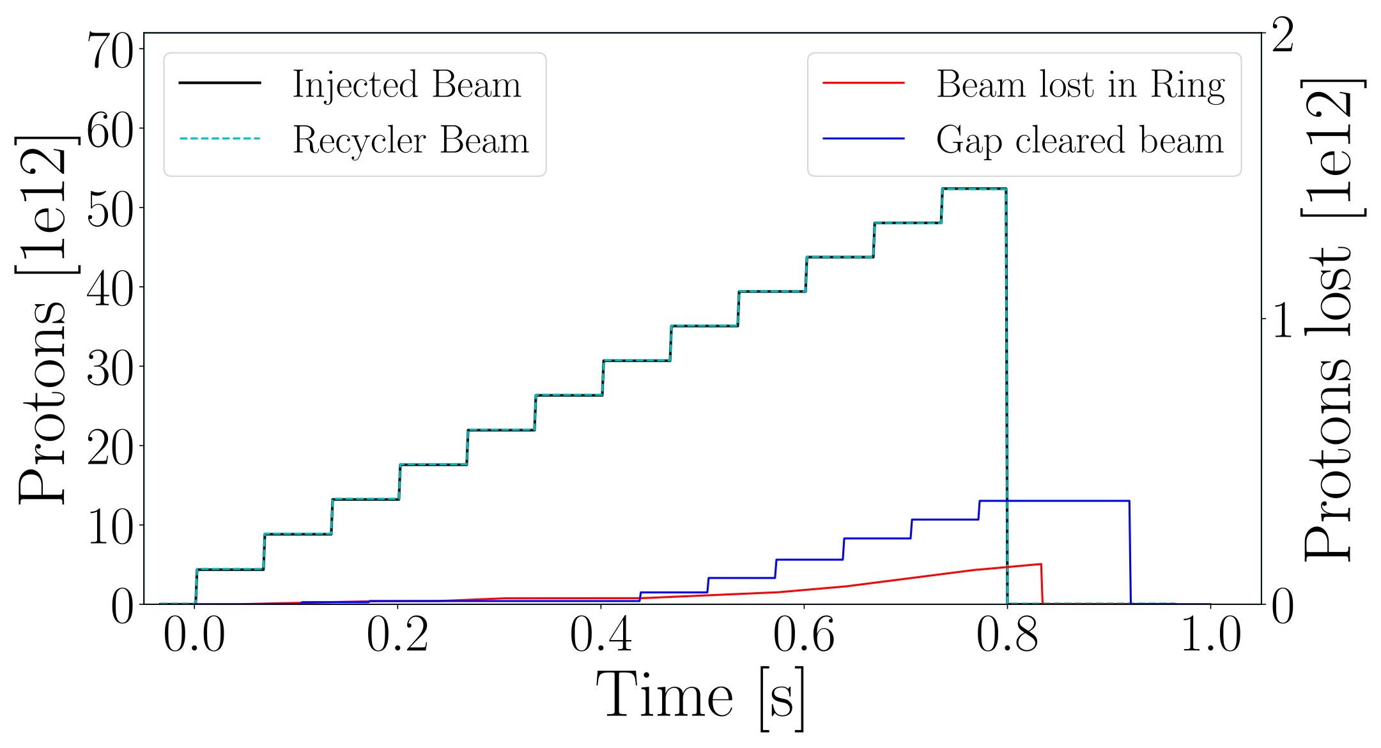
RR loss (current)
Loss separated into
DC beam from slip-stacking that makes it way to injection gap sent to abort
Beam loss to ring (including collimators)
Typical pulse (~50E12@1.067s)
DC beam loss - 485 W
Ring loss – 190 W

Slide 5
PIPII changes
Intensity per pulse 50E12 -> 75E12
DC beam loss - 485 W -> 728 W
Ring loss - 190W -> 285 W
20 Hz booster means larger slip-stacking separation
Simulations show DC beam expected to drop by factor of 3
DC beam loss - 728 W -> 243 W

Slide 6
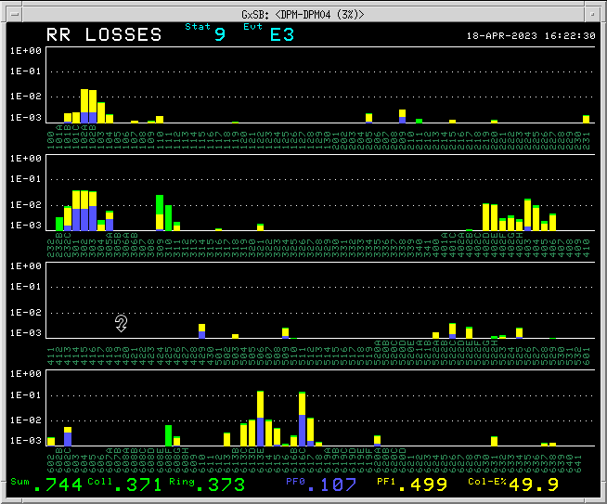
Typical RR loss pattern
Injection
RR->MI
Transfer
Abort
High loss
Location
Extraction
To Muon
Collimation

Slide 7
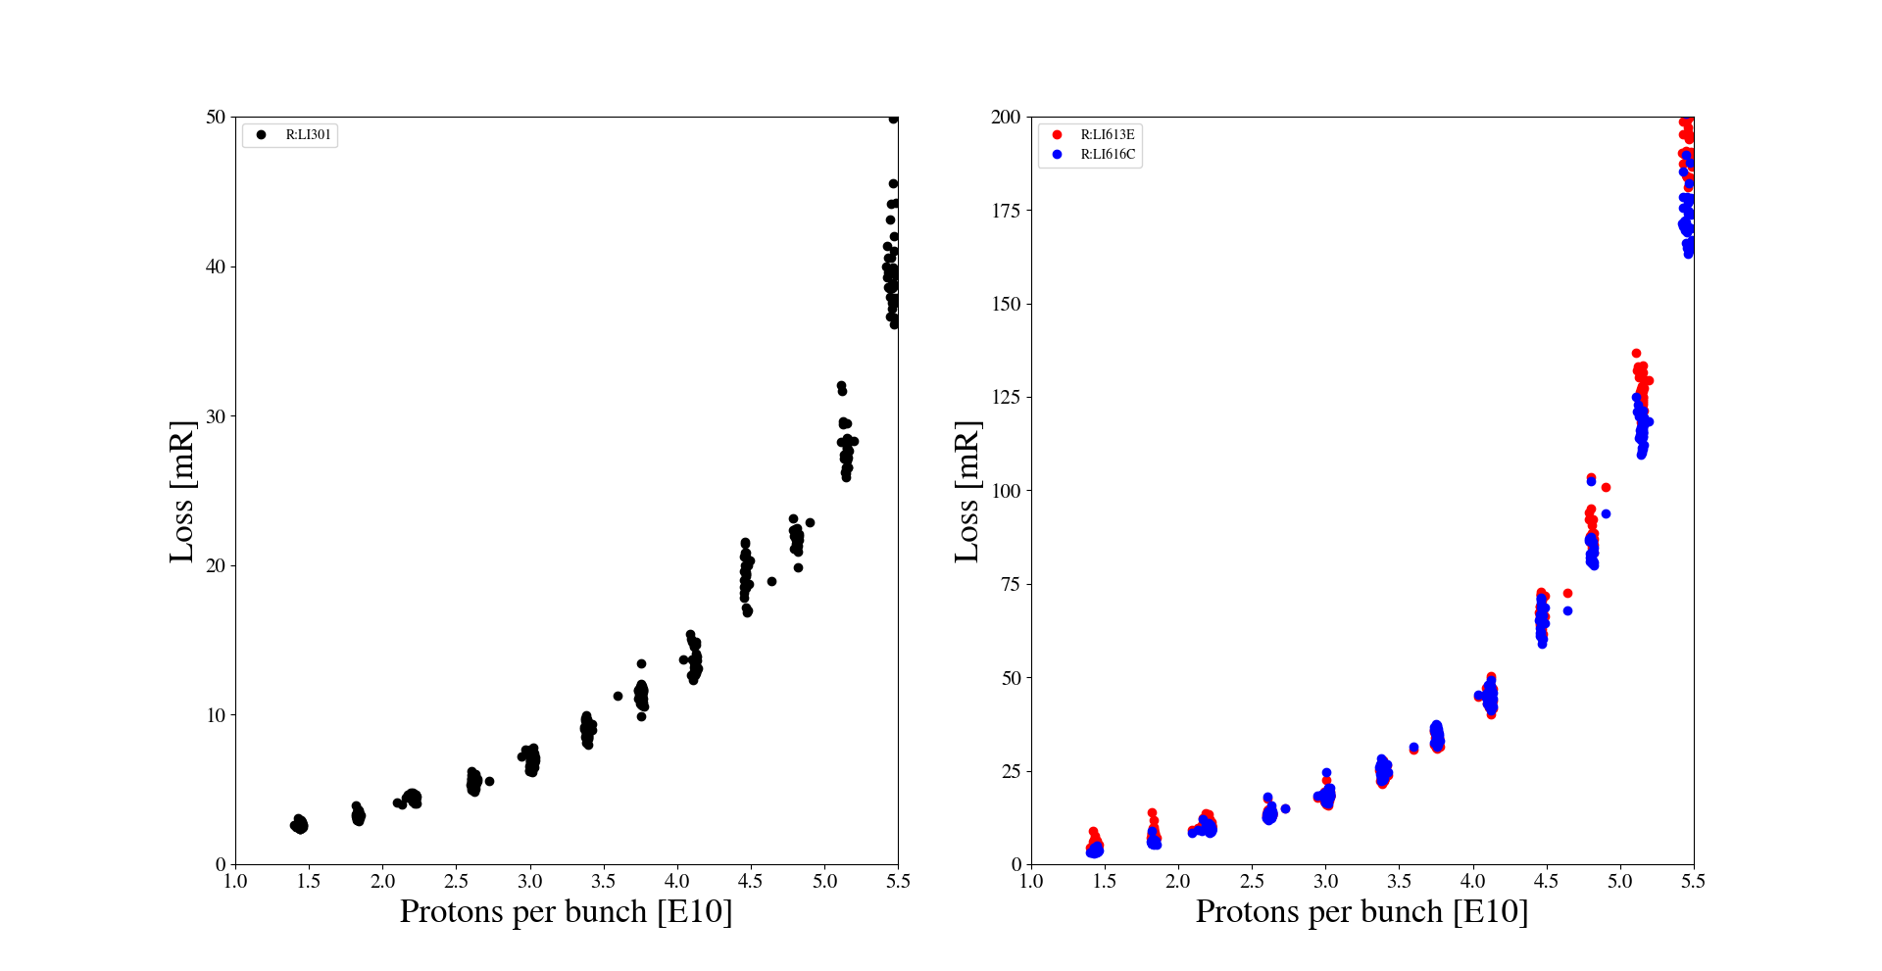
Loss increase is not linear

Slide 8
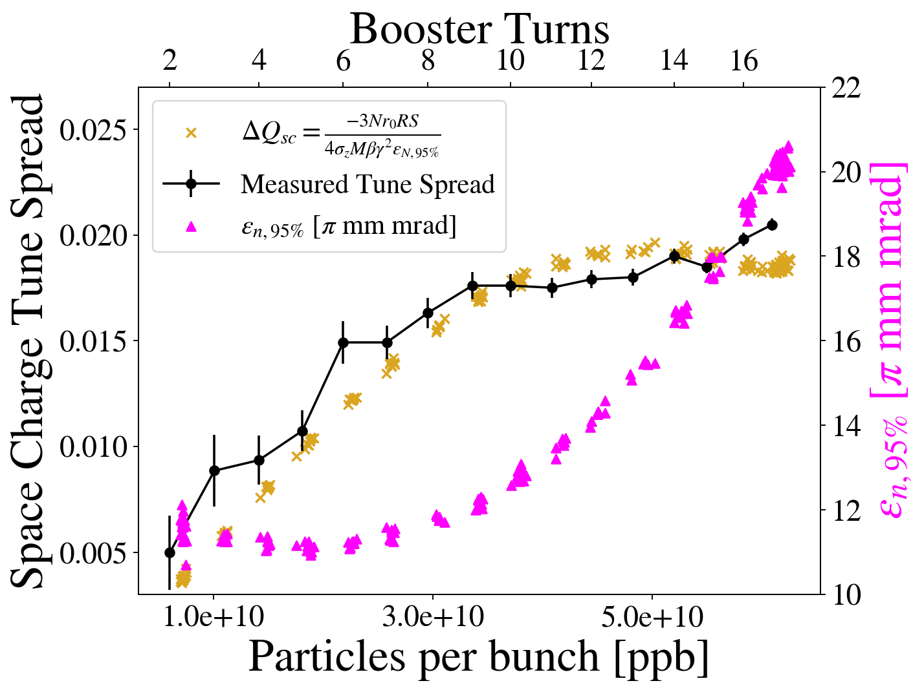
Emittance with intensity
Cristhian Gonzalez Ortiz

Slide 9
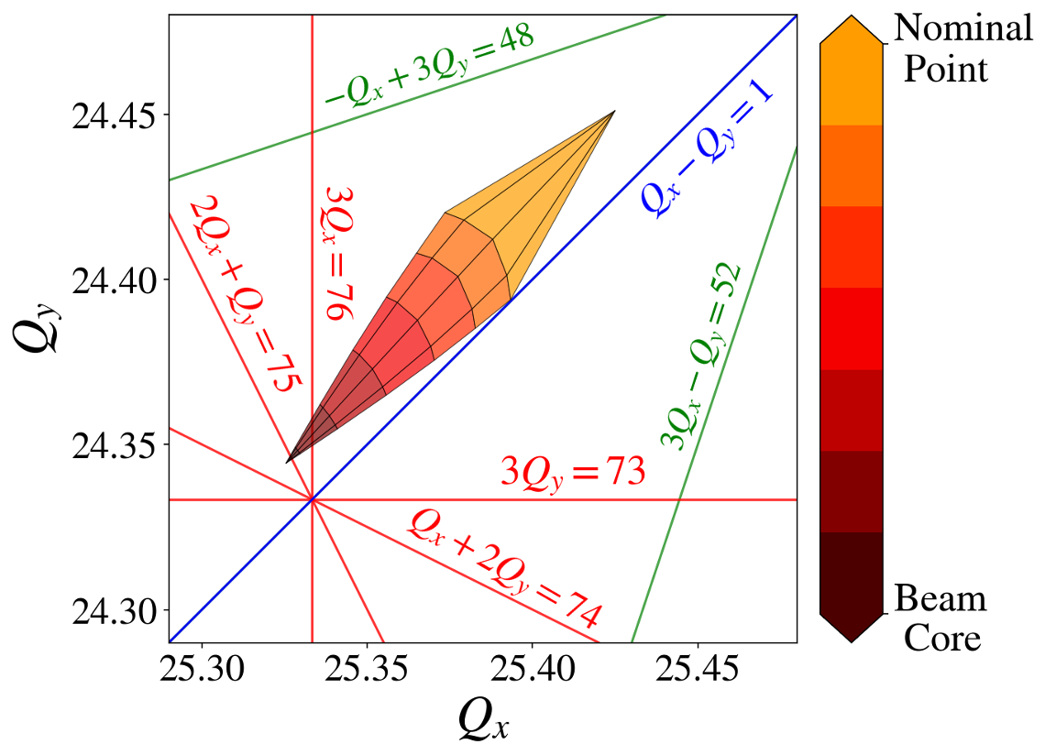
Space charge tune shift

Slide 10
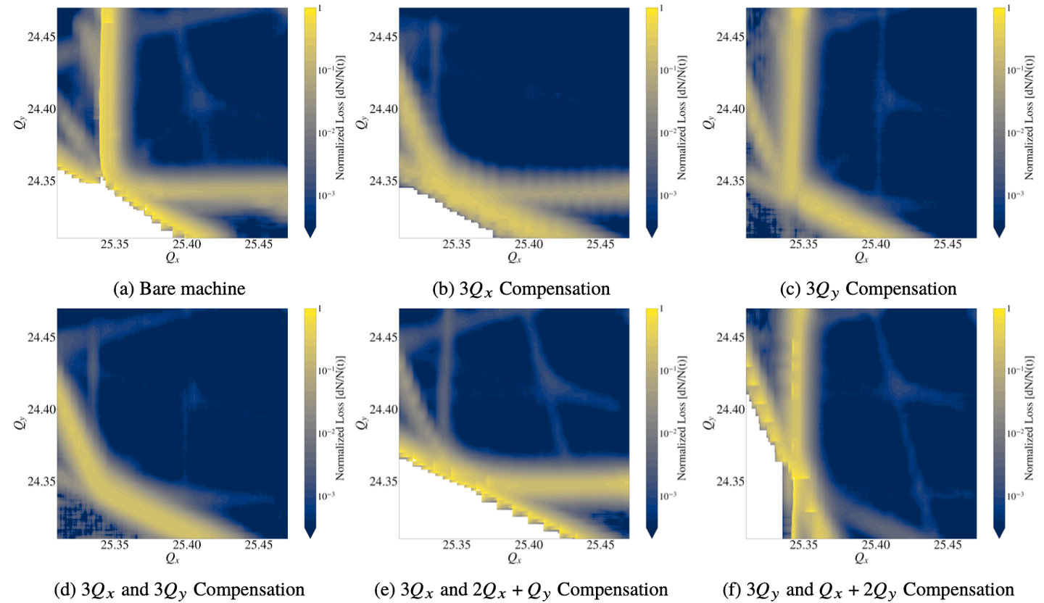
Resonance correction efforts

Slide 11
Ring loss at PIP2
Current power loss is at current highest intensity
Assume incoming beam quality will be no worse for PIP2 i.e. <20 pi mm mrad
New MI8 collimators in injection line will help with tails
Resonance correction efforts should mitigate space charge effects
Assume linear beam loss from 50E12 to 75E12

Slide 12
Main Injector
MI is 98.5% efficient
Lose 1.5% beam
1% beam loss due to DC beam from Slipstacking
Captured in MI collimators @9 GeV
0.25% beam loss to transverse scraping
Mostly at collimation @9 GeV
0.25% beam loss at transition crossing
@ 21 GeV

Slide 13
Beam Loss for PIP2
For 75E12, DC beam loss at 1% is 1012 W
20 Hz will drop DC beam by factor of 3
Power loss is 337 W
Ring loss at 0.25% is 253 W
Transition loss at 0.25% is 590 W
Gamma-t jump is expected to reduce this loss
On-going sims including realistic errors suggest at least a factor of 3 reduction -> 197 W

Slide 14
Beam loss budget for MI/RR (3.3kW)
 | Machine | Momentum (GeV) | Current loss scaled to 75E12 (W) | Mitigation | Power loss (W)
DC beam from slip-stacking | RR | 8.835 | 728 | 1680 Hz separation due to 20 Hz booster | 243
Ring loss | RR | 8.835 | 285 | MI8 collimators, Resonance correction | 285
DC beam from slip-stacking | MI | 9 | 1012 | 1680 Hz separation due to 20 Hz booster | 337
Ring loss | MI | 9 | 253 |  | 253
Transition loss | MI | 21 | 590 | Gamma-t jump | 197
Total |  |  | 2868 |  | 1315

