Slide 1
Coil ordering in MQXFA19 based on conductor properties
Maria Baldini, Vittorio Marinozzi

Slide 2
MQXFA19 cables: RRR estimations
Maximum coil to ground voltage at quench with ordering: 353 V (EDMS 1963398, Us-HiLumi Docdb 879)
COIL | CABLE
156 | P43OL1197
163 | P43OL1210
161 | P43OL1209
248 | P43OL1147
244 | P43OL1195
251 | P43OL1205
Rolled and minor edge extracted samples used to estimate RRR of the coil
Each cable: 40 strands in parallels coming from several spools
Spools come from different billets.
There is one rolled sample value per billet.
If the Cu/NCu value of the spool used for the cable is not present, the Cu/NCu of a particular spool is estimated averaging data from spools belonging to the same billet.
A weighted mean (weight= # of strands) is used to estimate cable RRR rolled samples and Cu/NCu values.
Minor and Major edge extracted samples are collected only from the most represented billets. Values are averaged
Witness sample RRR are also collected on representative billets. Data are not measured anymore starting from cable 1134

Slide 3
MQXFA19 coils
COIL | RRR rolled | RRR minor edge | RRR major edge
156 | 206.9 | 258.8 | 302.2
163 | 200.9 | 252.2 | 240.4
161 | 186.25 | 266.2 | 301.8
248 | 202.3 | 291.6 | 337.6
244 | 202.875 | 252.2 | 308.4
251 | 232.05 | 259.8 | 307.8
COIL | Cu/nCu
156 | 1.181
163 | 1.194
161 | 1.158
248 | 1.1816
244 | 1.184
251 | 1.190

Slide 4
RRR estimate values

Slide 5
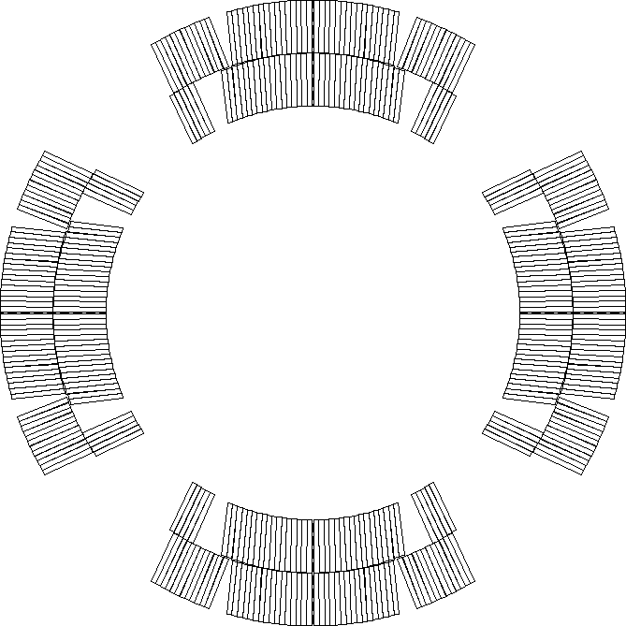
Peak voltages assumptions
Current: 16470
Old nominal, since electrical design criteria are based on old nominal current
Nominal protection (CLIQ 600 V - 40 mF, OL QH 300 V – 7.05 mF)
Coils are reported in mechanical ordering
Peak voltages have been computed using rolled and minor edge RRR values. All coil orderings resulting in peak voltage to ground less than 353 V with both assumptions and for all failure cases have been identified
Peak voltages computed using STEAM-LEDET app provided by CERN
Combinations of coils are considered
(248 251 161 156 244)
(248 251 161 156 163)
For each combination, nominal scenario plus 3 failure scenarios are considered
P2
P1
P3
P4
Notes:
Need to be u

Slide 6
Acceptable coil ordering (244 spare)
Coils are reported in mechanical order
There are 62 (with coil 244) acceptable coil orderings with voltage < 353 V that are common for both rolled and minor edge RRR values (values reported for rolled RRR)
P1 | P2 | P3 | P4 | Volt
244 | 161 | 156 | 251 | 333
244 | 161 | 251 | 156 | 333
248 | 161 | 156 | 251 | 333
248 | 161 | 244 | 251 | 333
248 | 161 | 251 | 156 | 333
248 | 161 | 251 | 244 | 333
156 | 161 | 244 | 251 | 334
156 | 161 | 251 | 244 | 334
156 | 161 | 251 | 248 | 334
244 | 161 | 251 | 248 | 334
244 | 161 | 248 | 251 | 334
248 | 161 | 156 | 244 | 334
248 | 161 | 244 | 156 | 334
156 | 161 | 244 | 248 | 335
156 | 161 | 248 | 244 | 335
156 | 161 | 248 | 251 | 335
244 | 156 | 248 | 161 | 335
244 | 161 | 156 | 248 | 335
244 | 161 | 248 | 156 | 335
244 | 248 | 156 | 161 | 335
156 | 244 | 248 | 161 | 336
P1 | P2 | P3 | P4 | Volt
156 | 248 | 244 | 161 | 336
156 | 248 | 251 | 244 | 336
248 | 156 | 244 | 161 | 337
248 | 244 | 156 | 161 | 337
244 | 248 | 251 | 156 | 338
156 | 244 | 251 | 248 | 339
156 | 251 | 244 | 248 | 340
244 | 248 | 156 | 251 | 341
248 | 244 | 156 | 251 | 341
156 | 248 | 244 | 251 | 342
244 | 156 | 251 | 248 | 342
248 | 156 | 244 | 251 | 342
248 | 244 | 251 | 156 | 342
248 | 251 | 244 | 156 | 342
244 | 251 | 156 | 248 | 343
251 | 156 | 244 | 248 | 343
251 | 244 | 156 | 248 | 343
251 | 248 | 156 | 244 | 343
248 | 156 | 251 | 244 | 343
156 | 251 | 248 | 244 | 344
244 | 251 | 248 | 156 | 344
P1 | P2 | P3 | P4 | Volt
161 | 244 | 248 | 251 | 344
161 | 248 | 244 | 251 | 344
251 | 248 | 244 | 156 | 344
248 | 251 | 156 | 244 | 344
244 | 156 | 248 | 251 | 345
161 | 156 | 248 | 251 | 345
161 | 248 | 156 | 251 | 345
156 | 244 | 248 | 251 | 346
251 | 156 | 248 | 244 | 346
251 | 244 | 248 | 156 | 346
161 | 156 | 244 | 251 | 347
161 | 244 | 156 | 251 | 347
251 | 156 | 244 | 161 | 351
251 | 244 | 156 | 161 | 351
156 | 248 | 251 | 161 | 352
251 | 156 | 248 | 161 | 352
251 | 244 | 248 | 161 | 352
251 | 248 | 156 | 161 | 352
251 | 248 | 244 | 161 | 352
156 | 251 | 248 | 161 | 353

Slide 7
Acceptable coil ordering (spare 163)
Coils are reported in mechanical order
There are 67 (with coil 163) acceptable coil orderings with voltage < 353 V that are common for both rolled and minor edge RRR values (values reported for rolled RRR)
P1 | P2 | P3 | P4 | Volt
248 | 161 | 163 | 251 | 332
163 | 161 | 156 | 251 | 333
163 | 161 | 251 | 156 | 333
163 | 161 | 251 | 248 | 333
163 | 248 | 251 | 156 | 333
156 | 161 | 163 | 251 | 333
156 | 248 | 251 | 163 | 333
248 | 161 | 156 | 251 | 333
248 | 161 | 251 | 163 | 333
248 | 161 | 251 | 156 | 333
163 | 161 | 156 | 248 | 334
163 | 161 | 248 | 156 | 334
156 | 161 | 251 | 163 | 334
156 | 161 | 251 | 248 | 334
248 | 161 | 163 | 156 | 334
248 | 161 | 156 | 163 | 334
163 | 156 | 248 | 161 | 335
163 | 248 | 156 | 161 | 335
156 | 163 | 248 | 161 | 335
156 | 161 | 163 | 248 | 335
156 | 161 | 248 | 163 | 335
156 | 161 | 248 | 251 | 335
156 | 248 | 163 | 161 | 335
P1 | P2 | P3 | P4 | Volt
163 | 161 | 248 | 251 | 336
156 | 248 | 163 | 251 | 336
248 | 156 | 163 | 251 | 336
163 | 156 | 251 | 248 | 337
163 | 251 | 156 | 248 | 340
251 | 156 | 163 | 248 | 340
248 | 156 | 251 | 163 | 340
251 | 248 | 163 | 156 | 341
248 | 163 | 156 | 161 | 341
248 | 156 | 163 | 161 | 341
248 | 251 | 156 | 163 | 341
156 | 163 | 251 | 248 | 342
248 | 163 | 156 | 251 | 342
163 | 248 | 156 | 251 | 343
156 | 251 | 163 | 248 | 343
251 | 163 | 156 | 248 | 343
251 | 248 | 156 | 163 | 343
163 | 251 | 248 | 156 | 345
156 | 251 | 248 | 163 | 345
161 | 156 | 248 | 251 | 345
161 | 248 | 156 | 251 | 345
248 | 163 | 251 | 156 | 345
248 | 251 | 163 | 156 | 346
P1 | P2 | P3 | P4 | Volt
163 | 156 | 248 | 251 | 347
156 | 163 | 248 | 251 | 347
161 | 248 | 163 | 251 | 347
163 | 248 | 251 | 161 | 348
251 | 163 | 248 | 156 | 348
251 | 156 | 163 | 161 | 348
251 | 156 | 248 | 163 | 348
163 | 251 | 248 | 161 | 349
251 | 163 | 156 | 161 | 349
251 | 248 | 163 | 161 | 349
161 | 163 | 156 | 251 | 350
161 | 156 | 163 | 251 | 350
251 | 163 | 248 | 161 | 350
163 | 156 | 251 | 161 | 351
163 | 251 | 156 | 161 | 352
156 | 248 | 251 | 161 | 352
161 | 156 | 248 | 163 | 352
161 | 248 | 156 | 163 | 352
251 | 156 | 248 | 161 | 352
251 | 248 | 156 | 161 | 352
156 | 251 | 248 | 161 | 353

Slide 8
Backup slides

Slide 9
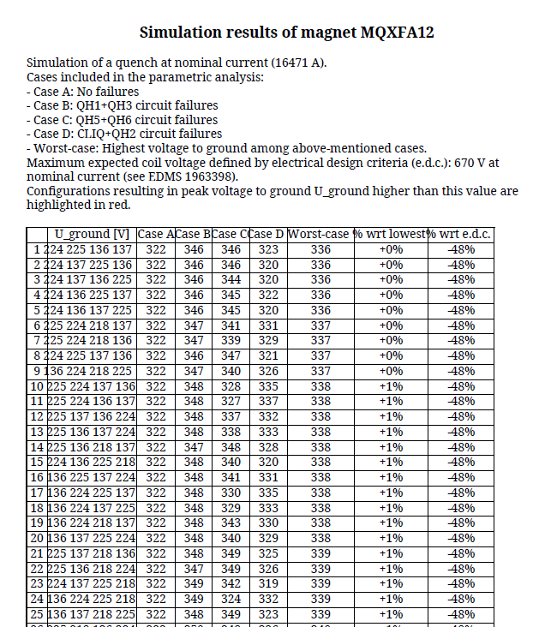
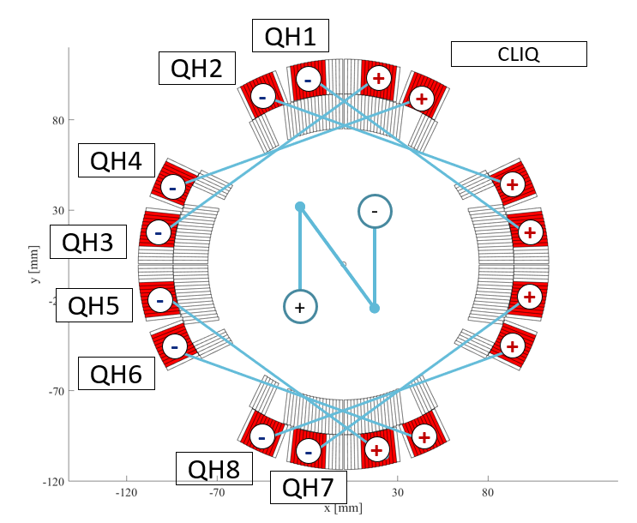
Peak voltages report
Old value, since design criteria are based on old nominal current

