Slide 1
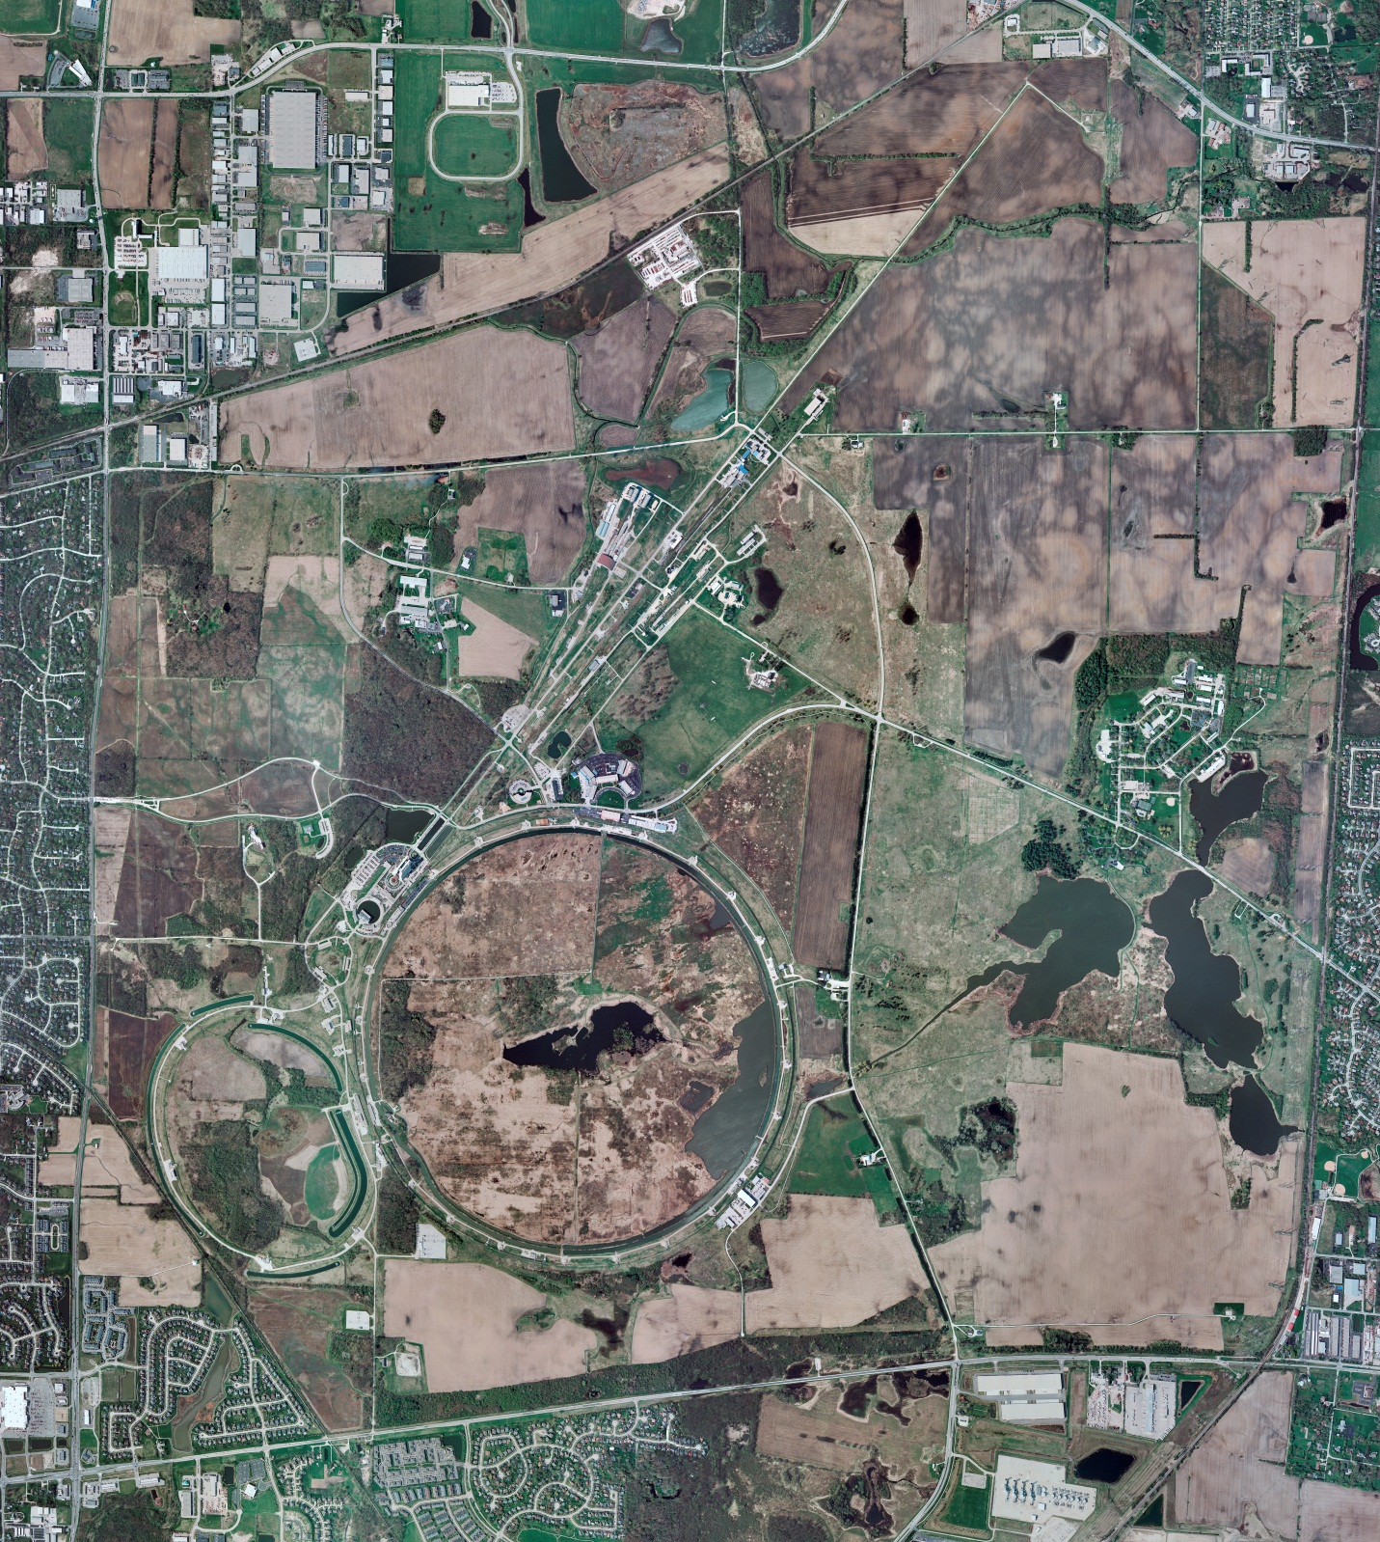
Helium Cryogenics
Status 9/13/2024 J.Makara
CMTF: SCP cold and running fine; planned power outage recovery went fine
CMTS: HECM31 controlled cooldown in progress
PIP2IT: South Stand CM being modified for SSR2 pCM
North Stand CM empty
MCTF: cryo system is cold with 3 Comprs and 2 Fridges running
MDB/HTS: at RT
MDB/STC: at 2 K for SSR2 cavity testing
MDB Magnet: at RT
NML/FAST: Cryo system is shut down and isolated for extended shutdown period;
CC1: at RT
CC2: at RT
CM: at RT
IB1: cryo system running fine with CTi and ALAT CBs coldboxes
Muon Campus: at RT with comprs off and system depressurized; LN2 system at RT; g-2 Expt Hall at ODH=0 (not ODH area)
Misc: All cryo systems recovered fine from planned power outage

