Slide 1
Muon Campus Shutdown Report
Jim Morgan
Friday 09:00 Shutdown Meeting
September 13, 2024

Slide 2
Muon Campus status
ESS2 survey of cathode and wire plane at A0 Clean Room
Second survey required after adjusting cathode supports to reduce warp
D30 downstream mechanical work waiting on key Q205 part (~2 weeks out)
Transport “Y” sump check valve replaced
LCW leak rate greatly reduced after MSD repaired or valved out known leaks
Largest leaks on sub-header connection and a Delivery Ring sextupole
Resistivity has been declining, may be time to change DI bottles at CUB
ESS1 & 2 Fluorinert piping installation complete
Connects future AP-30 cooling skid with surge resistors in the tunnel
Prototype ESS2 will need to be removed from DR prior to running beam
Related to buyback accounting between Mu2e Project and AD spares funds
Hope that operational ESS2 will be ready for installation in October
Will evaluate options if operational ESS2 is delayed significantly
Domestic water leaks near AP-0 adjacent to Transport berm
AP-0 north door replaced
AP-0 A/C work continues to be stalled
Study – M1-M3 Optics
Study – Alternative M5 optics

Slide 3
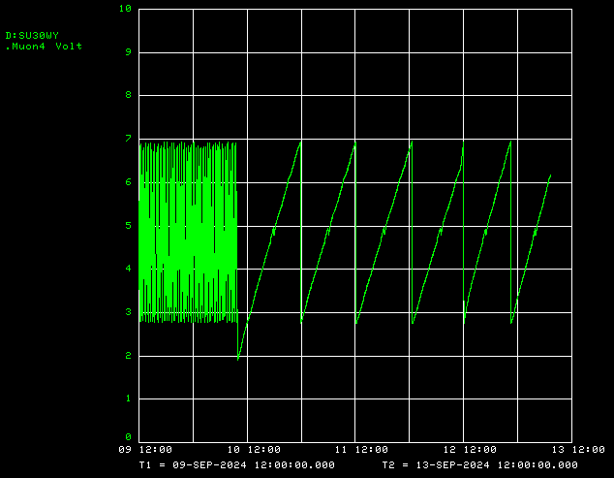
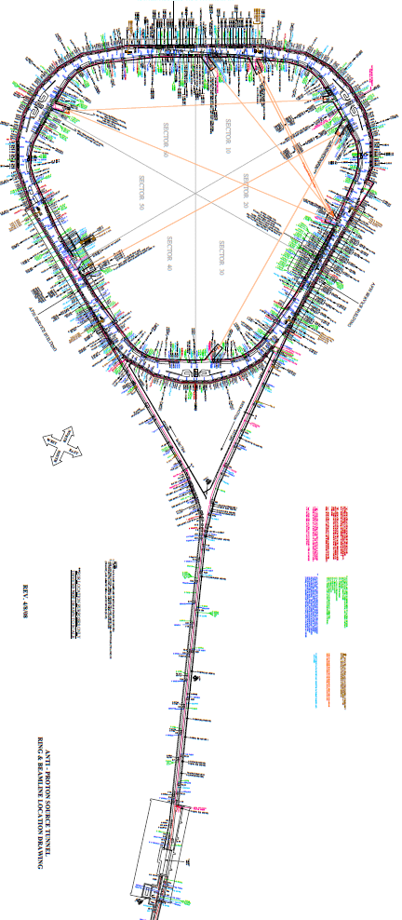
Transport “Y” sump check valve replaced

Slide 4
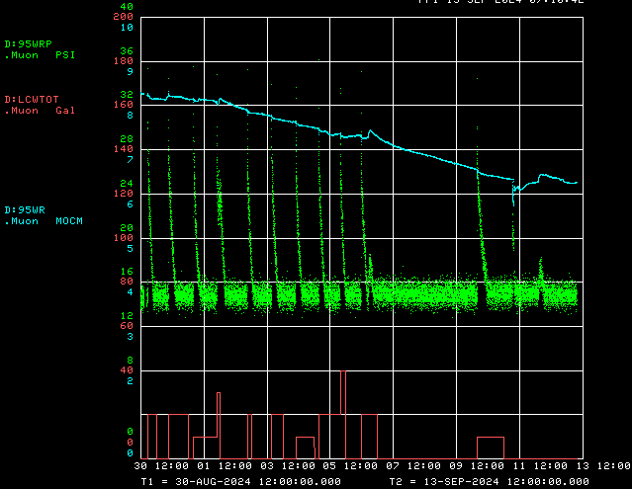
Muon LCW make-up rate and decline in resistivity
LCW resistivity
LCW return pressure
LCW make-up

Slide 5
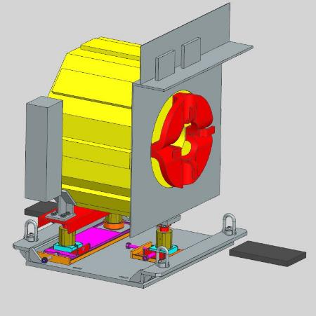
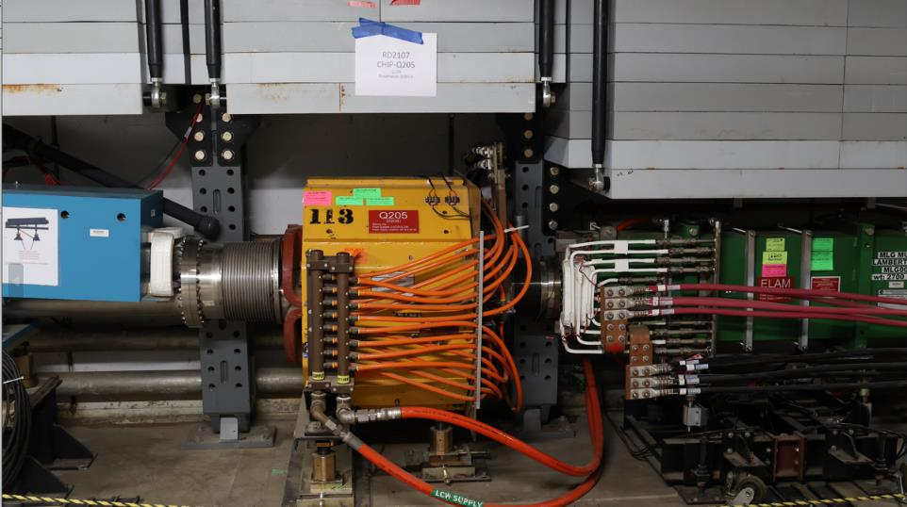
Delivery Ring extraction region
M4 Line
Special vacuum pipe
Extraction C-Magnet
Extraction Lambertson
Q205
Delivery Ring
Q205 on support “plate”

Slide 6
Upcoming work
Main worklist items and other upcoming work
AP-0 Dump system will be drained and water lines blown out
Install rad hard 8Q24 at Q205, send uninstalled 8Q24 to TD for rad hard water lines
Q205 vacuum pipe replacement to simplify vacuum connection to ELAM
Unroll ELAM? (was rolled 24 mr to improve g-2 extraction trajectory)
Profilometer extraction profile monitor vacuum Tee installed upstream of ELAM
Several alignment tasks including D30 level run and M4 Final Focus
M4 Final Focus vacuum installation, A/C dipole installation
Need to check sizing of all power supply panel breakers, upgrade as necessary
Repair Kirk Key hardware on disconnects
Most LCW leaks repaired, but a few left to fix
Install additional steel shielding above ECMAG
ESS1 and ESS2 septum stand motion-control improvements
Hope to finish operational ESS2 and install it in tunnel late in shutdown
Repair of domestic water break near AP-0 may disturb Transport berm
ESS2 (operational version in A0 Clean Room)
After survey, vacuum leak check and transport to NWA for high voltage conditioning
AP-0 A/C controls work paused; reason unknown

