Slide 1
Project Activities for MSD
Mayling Wong-Squires
AD Operations Friday 9am Meeting
13 September 2024

Slide 2
LBNF Primary Vacuum and Magnet Installation
Kevin Duel, Ty Funk, Jason Morin, Parth Gandhi, Kathrine Laureto, Dirk Hurd, Scott Oplt, Dan Vrbos
Magnet Installation
  Corrector magnet installation fixture drawings released
  Corrector magnet stand drawings being updated for prototype procurement
  NuMI quad magnet retrieval procedures being created and equipment located
    ~9 NuMI quads will be re-purposed for LBNF
  Primary Beam Enclosure dipole stand design modeling and engineering note updates in progress
  Toroid, RWCM, and BPM stand design modeling in progress
Primary Vacuum
  Kicker ceramic beam tube TiN coating
    Waiting for 12” long tube samples from vendor
  Kicker magnet top level assembly drawing work continues
  Creating models and drawings for relocation of MI components the LBNF beamline interferes with at MI-10

Slide 3
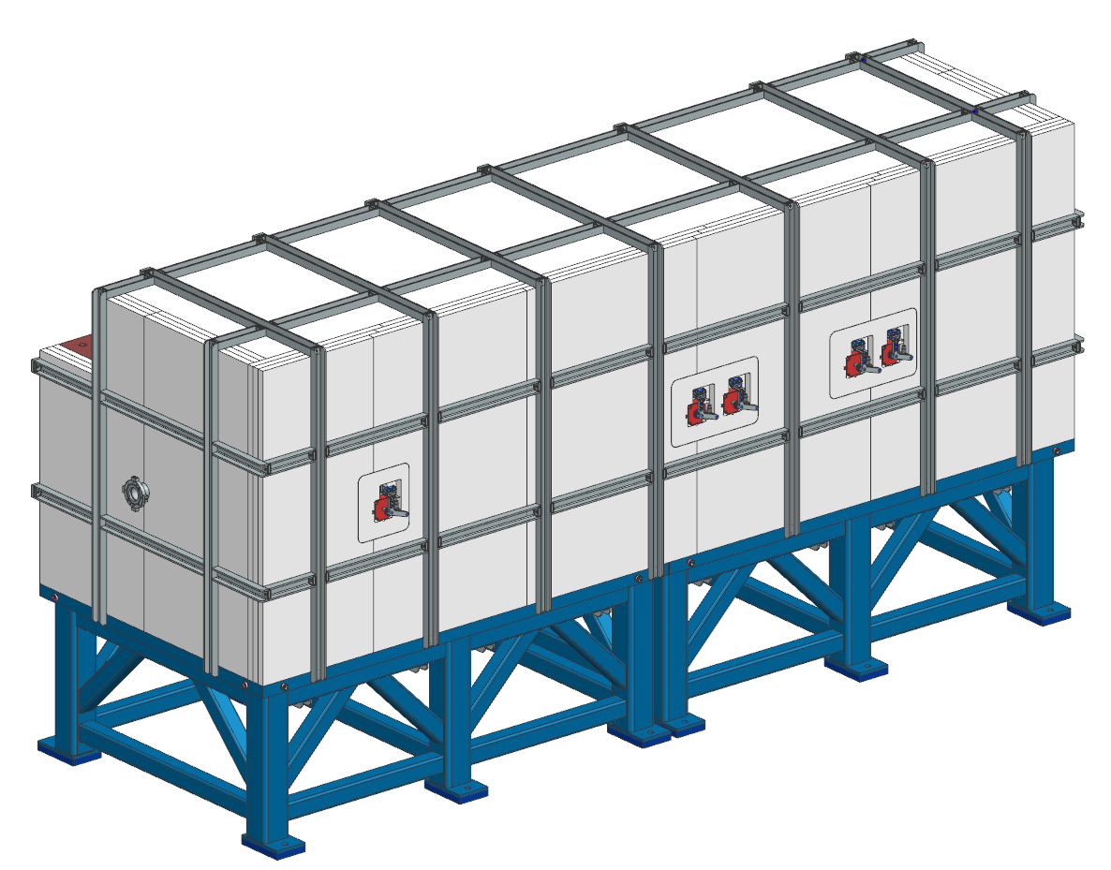
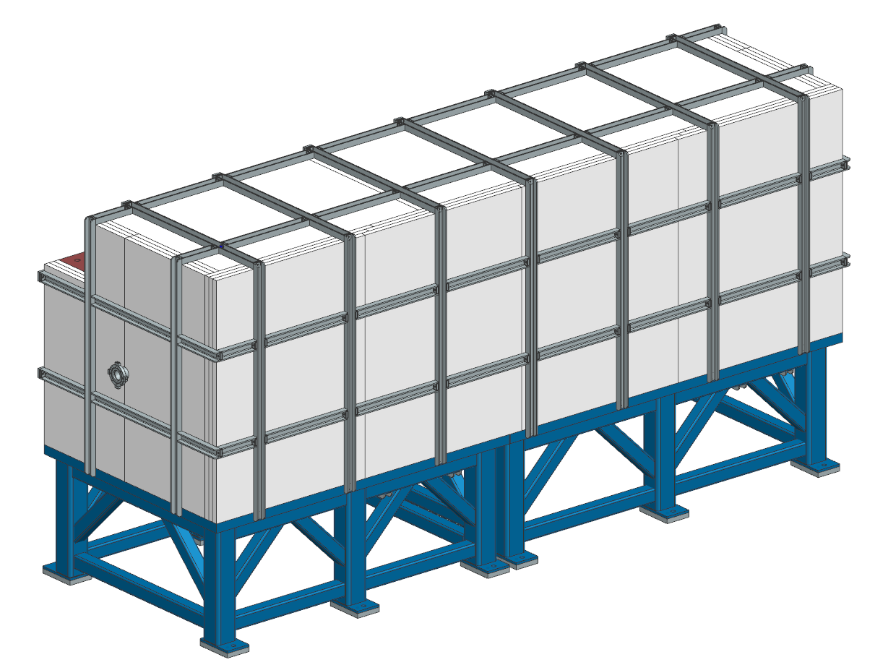
PIP-II BTL Collimators
Bob Donahue
PRR deliverables are complete
  Engineering note approved and released
  All drawings released
Currently working on PRR procurement spreadsheet and teamcenter items
Schedule PRR this month
  Initiate procurements/fabrications after PRR complete
Horizontal collimator
Vertical collimator

