Slide 1
Mu2e report
Tom Diehl (FNAL), Greg Rakness (FNAL)
Friday 9am AD meeting
13-Sep-2024
https://indico.fnal.gov/event/66182/

Slide 2
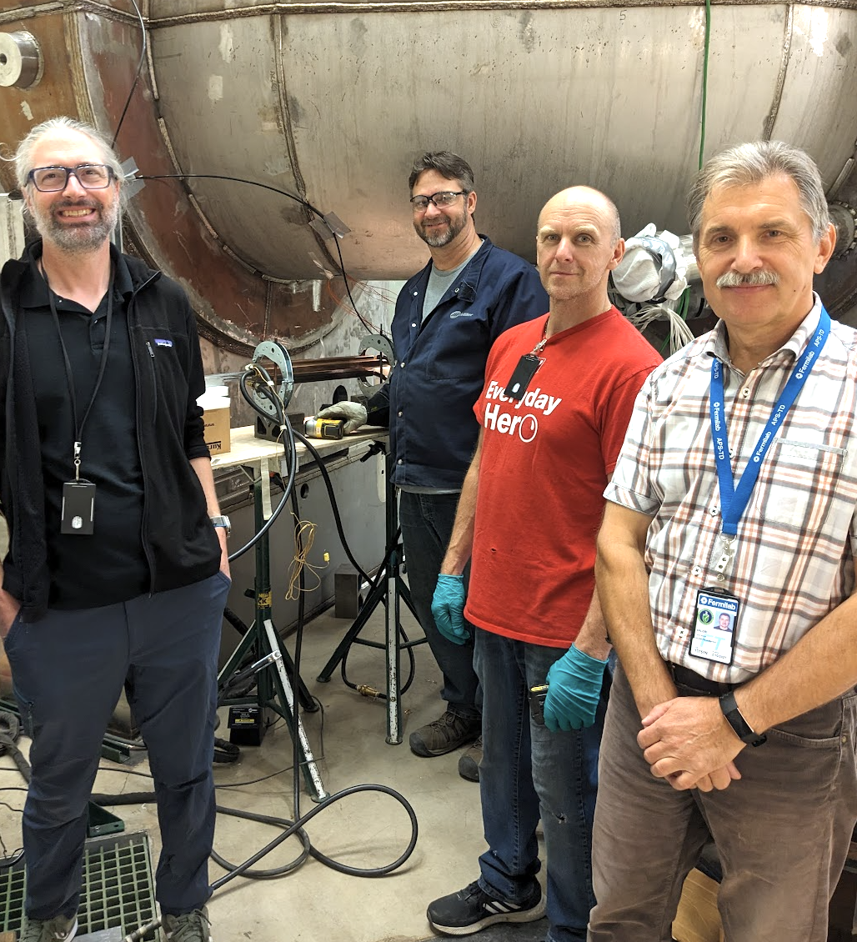
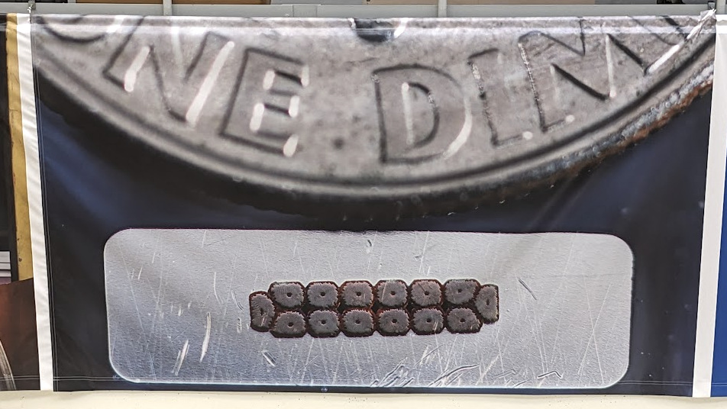
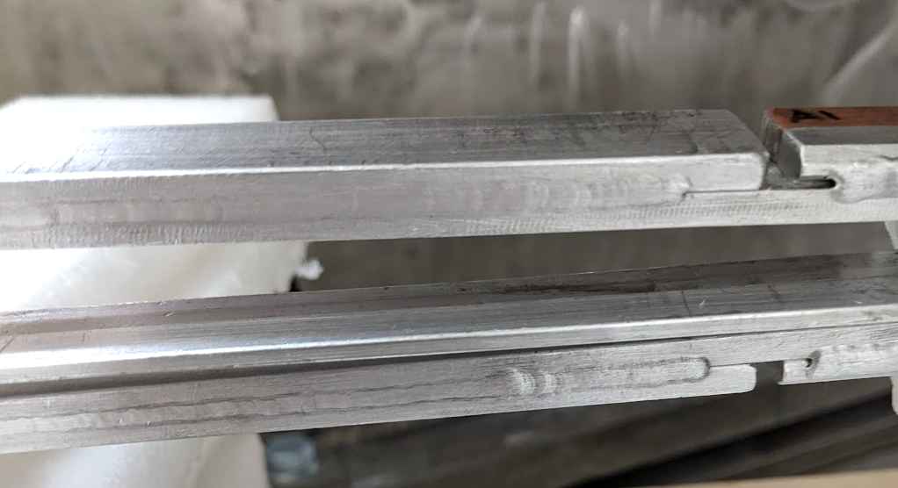
Splices completed to upstream Transport Solenoid
Completed this final mile!

Slide 3
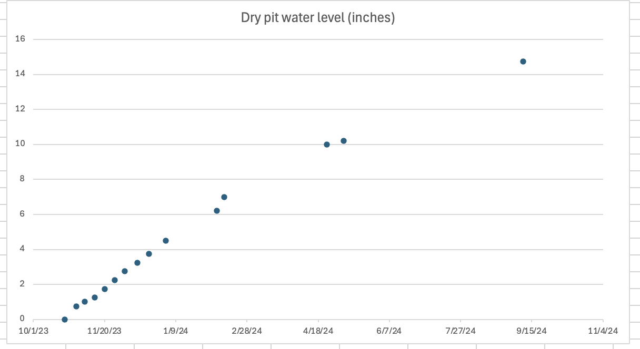
High dew points → condensation on cold surfaces
Data consistent with water collecting during summer months
Extinction Monitor room
ODH penetration near Production Solenoid
On wall in the catwalk above TSu and ceiling above PS
Data not consistent with water collecting only during the summer months
“Dry” pit near sump
Theory guides,
experiment decides…

