Slide 1
Proposal for TMS Detector Steel and Detector Dimensions for a 6m x 3m Active Area
20 September 2024
T. Markiewicz/SLAC

Slide 2
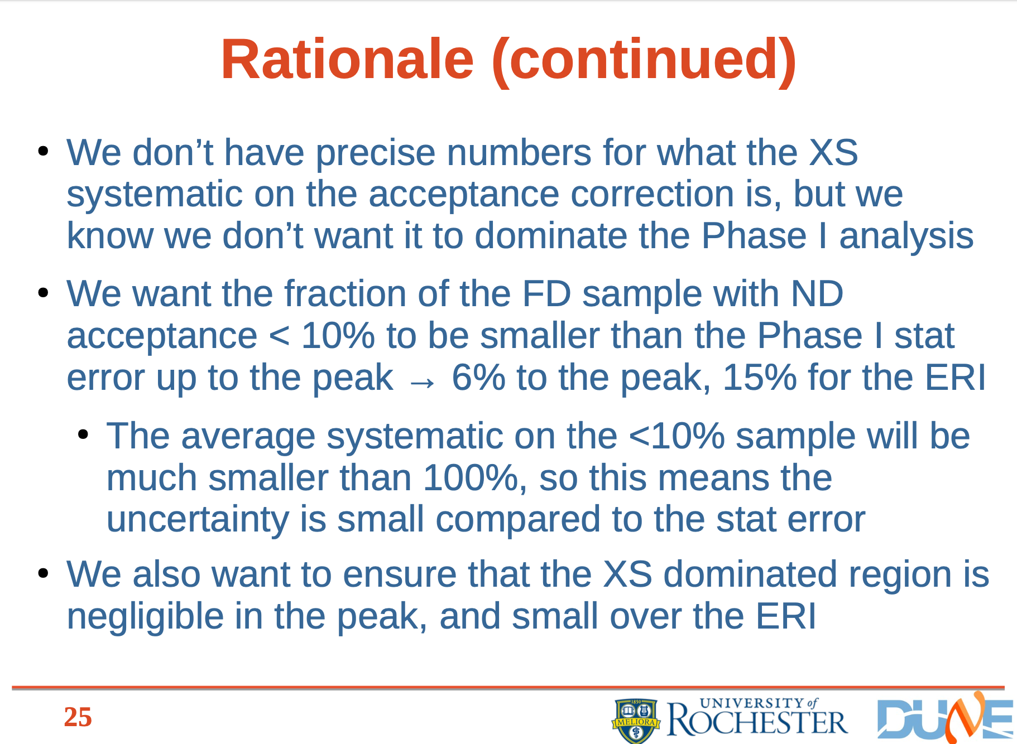
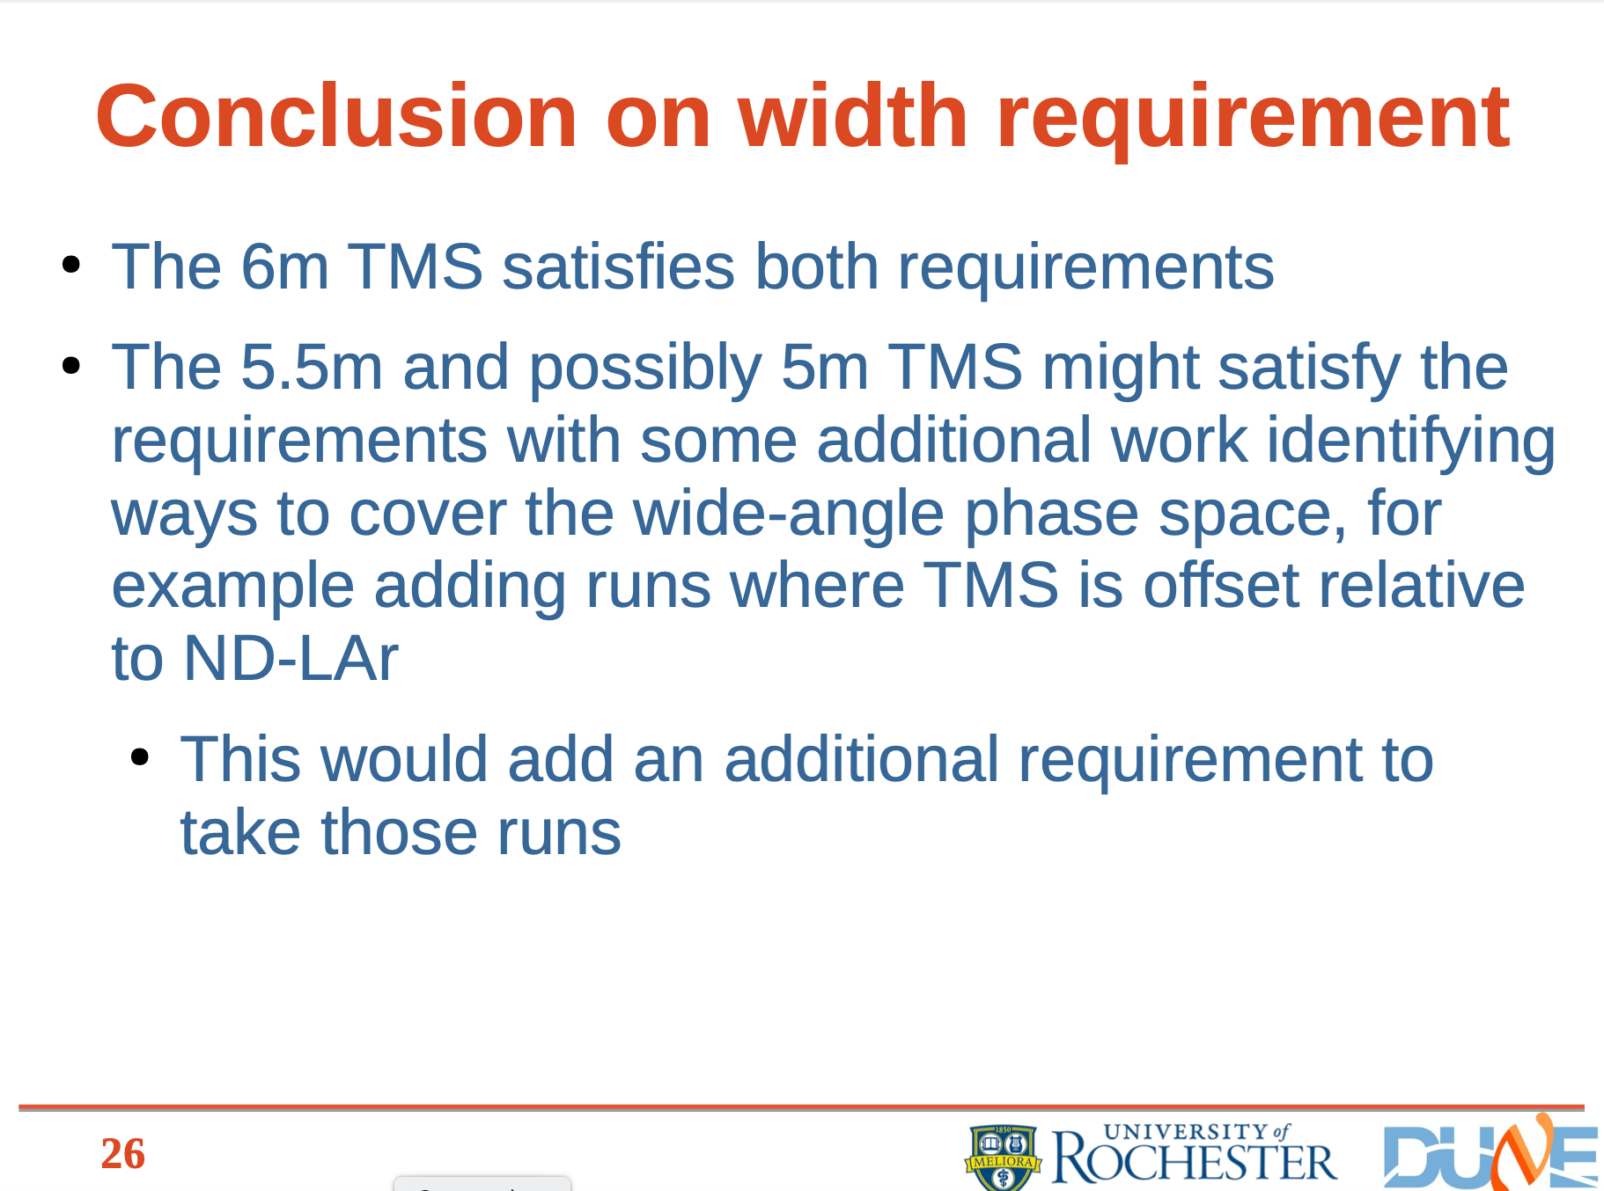
TMS physics requirements: width
KiYoung Jung, Chris Marshall University of Rochester 12 September, 2024

Slide 3
Parameters: As designed by a Physicist with a Spreadsheet
It has been suggested that TMS would satisfy its physics requirements with a 6m x 3m active area and orthogonal X and Y counters. The attached slides show that the relevant dimensions as follows.
Bar width decreased to 31mm from 36mm
Stack up tolerance/detector increased from 5 to 10mm
Detector width then 1006mm = 32*31+2*2(side walls)+10mm (stack up)
X and Y Scintillator length = 3000mm (now shown explicitly on pictures)
150mm length added for WFS & readout: Total length = 3150mm
Clearance to coils ~50mm for X and larger for Y
Steel inter-coil gap decreased to 3250mm from 3600mm and set by X counters
Overall steel height is 3250+2*550=4350mm down from 4700mm in the 7m x 3m design
Steel width decreased to 1600mm from 1850mm/panel
25% less steel than CDR and 20% less steel than the 7m wide design

Slide 4
Numerical Comparison

Slide 5
Comparison
6m design
  20% less steel: Cost, handling weight, …
  Less steel between coils
    Less bending given spacers at top & bottom
    Less magnet current (?)
  All counter lengths the same
  Possible need for extra mechanical engineering
    Support structure?
    Final magnetic fields and forces still needed for either design
7m design
  Conservatism
    Lateral space is available, why not use it
  3300mm U, V or X active scintillator length provides large margin for cable plant, etc.
    Due to fact that the relatively fewer Y-counters are defining the coil-to-coil gap

Slide 6
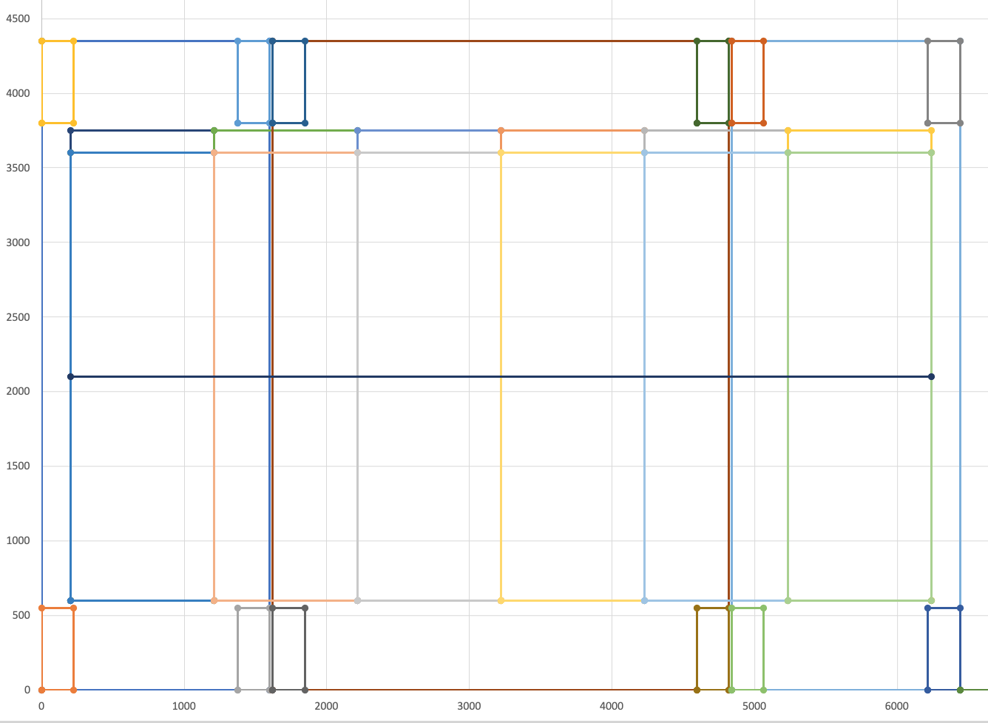
X Counter Dimensions: “6m”

Slide 7
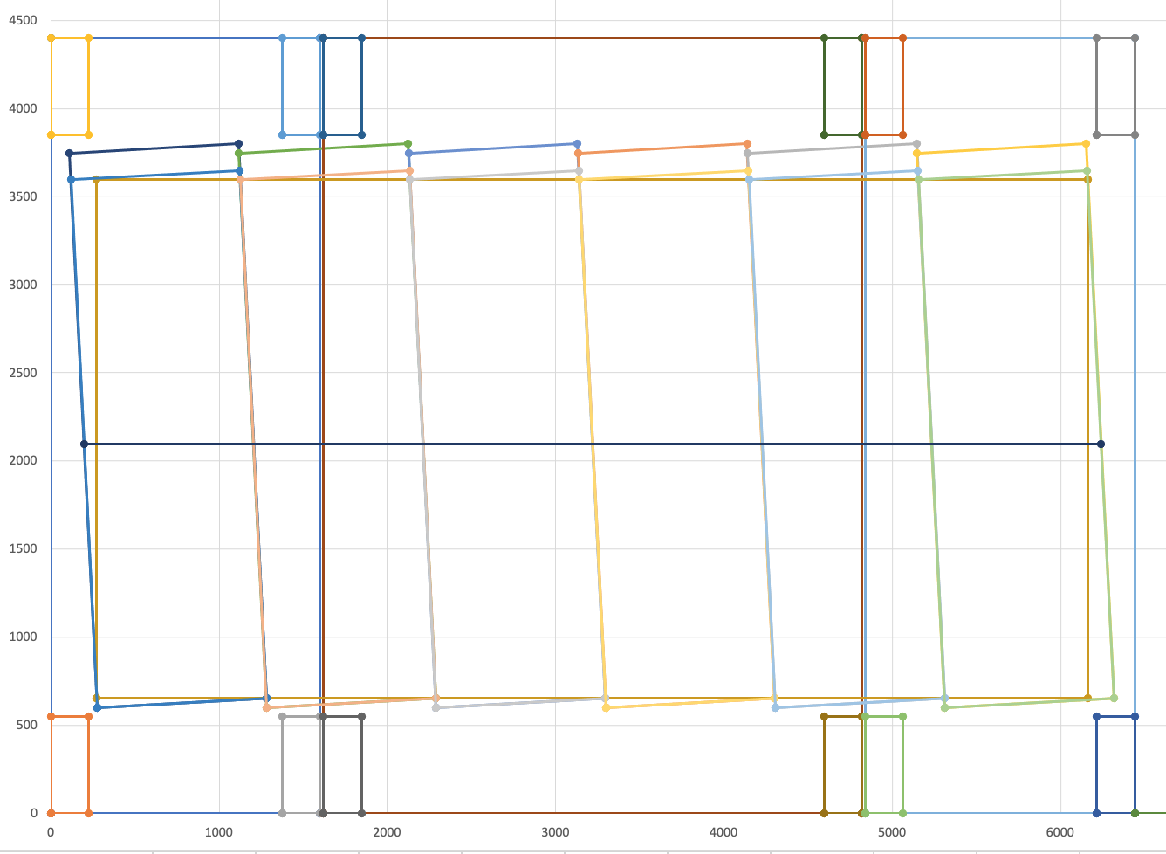
U Counter Dimensions: “6m”

Slide 8
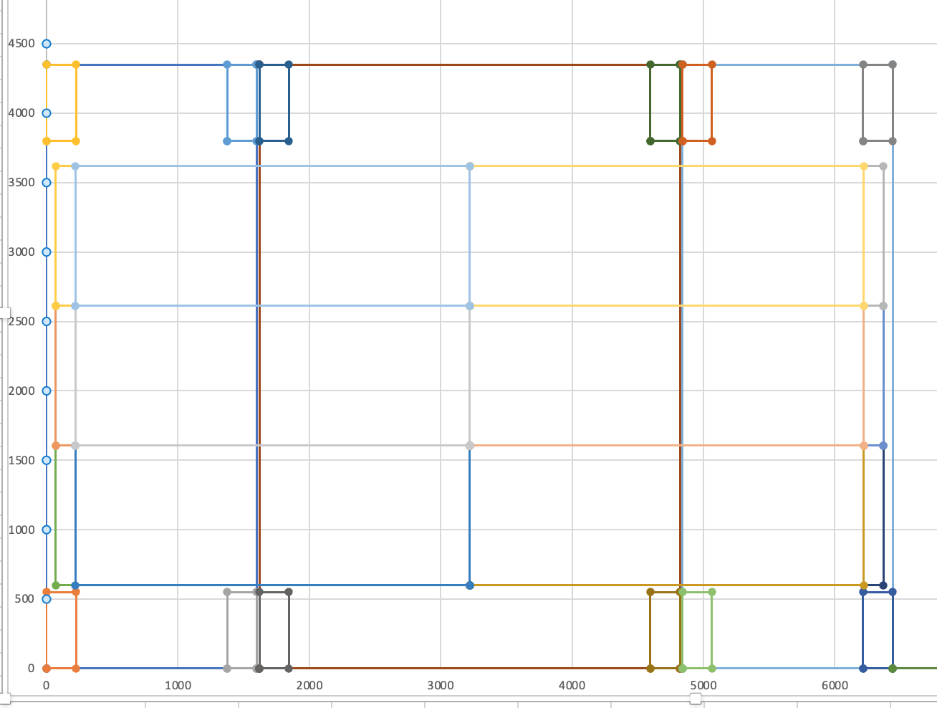
Y Counter Dimensions: “6m”

Slide 9
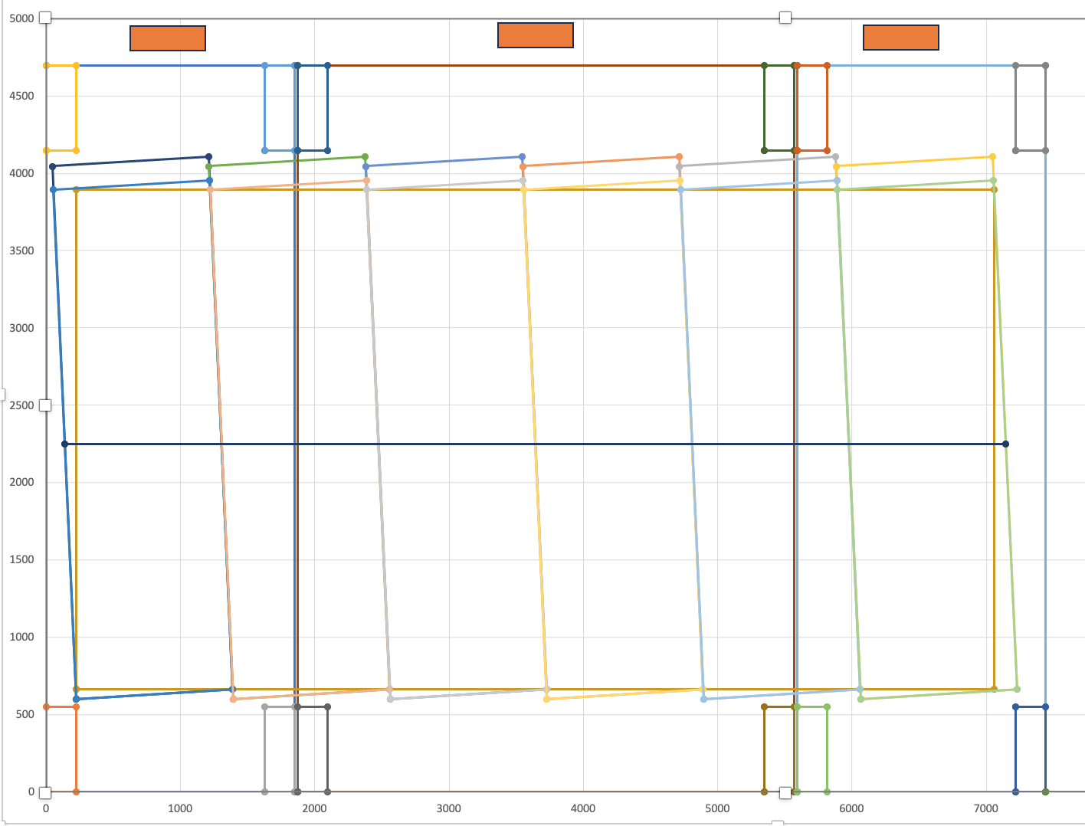
U Counter Dimensions “7m”

Slide 10
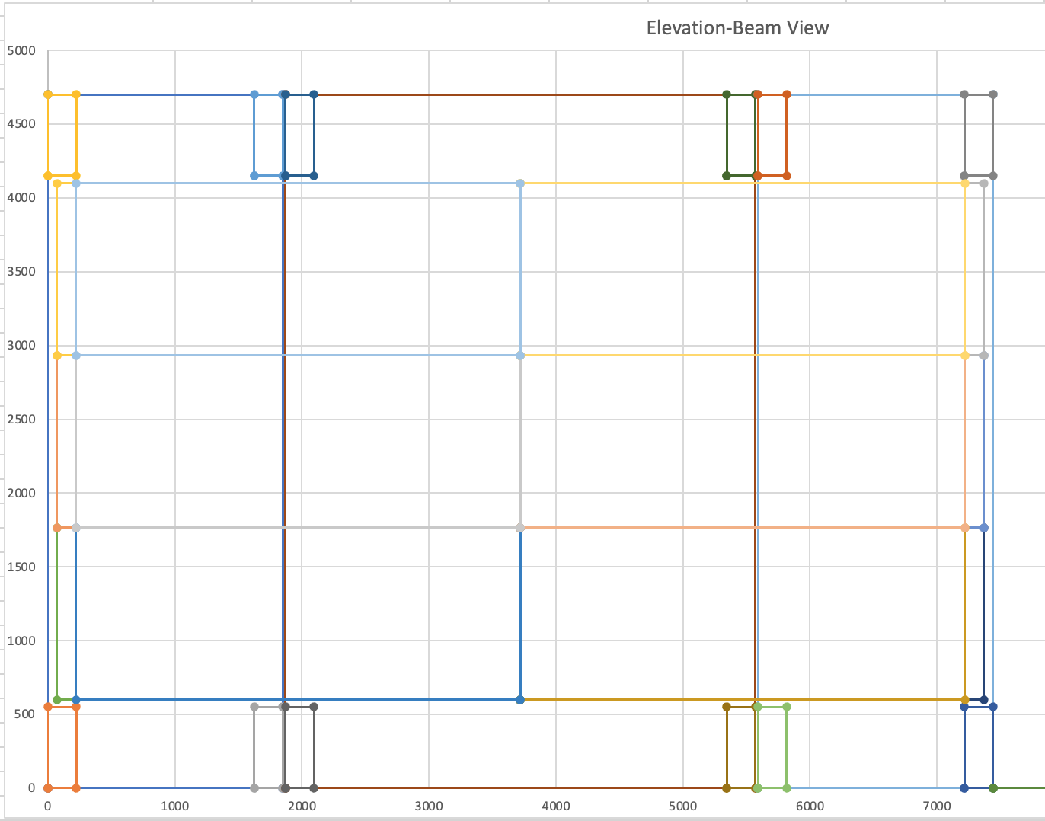
Horizontal Counter Dimensions

Slide 11
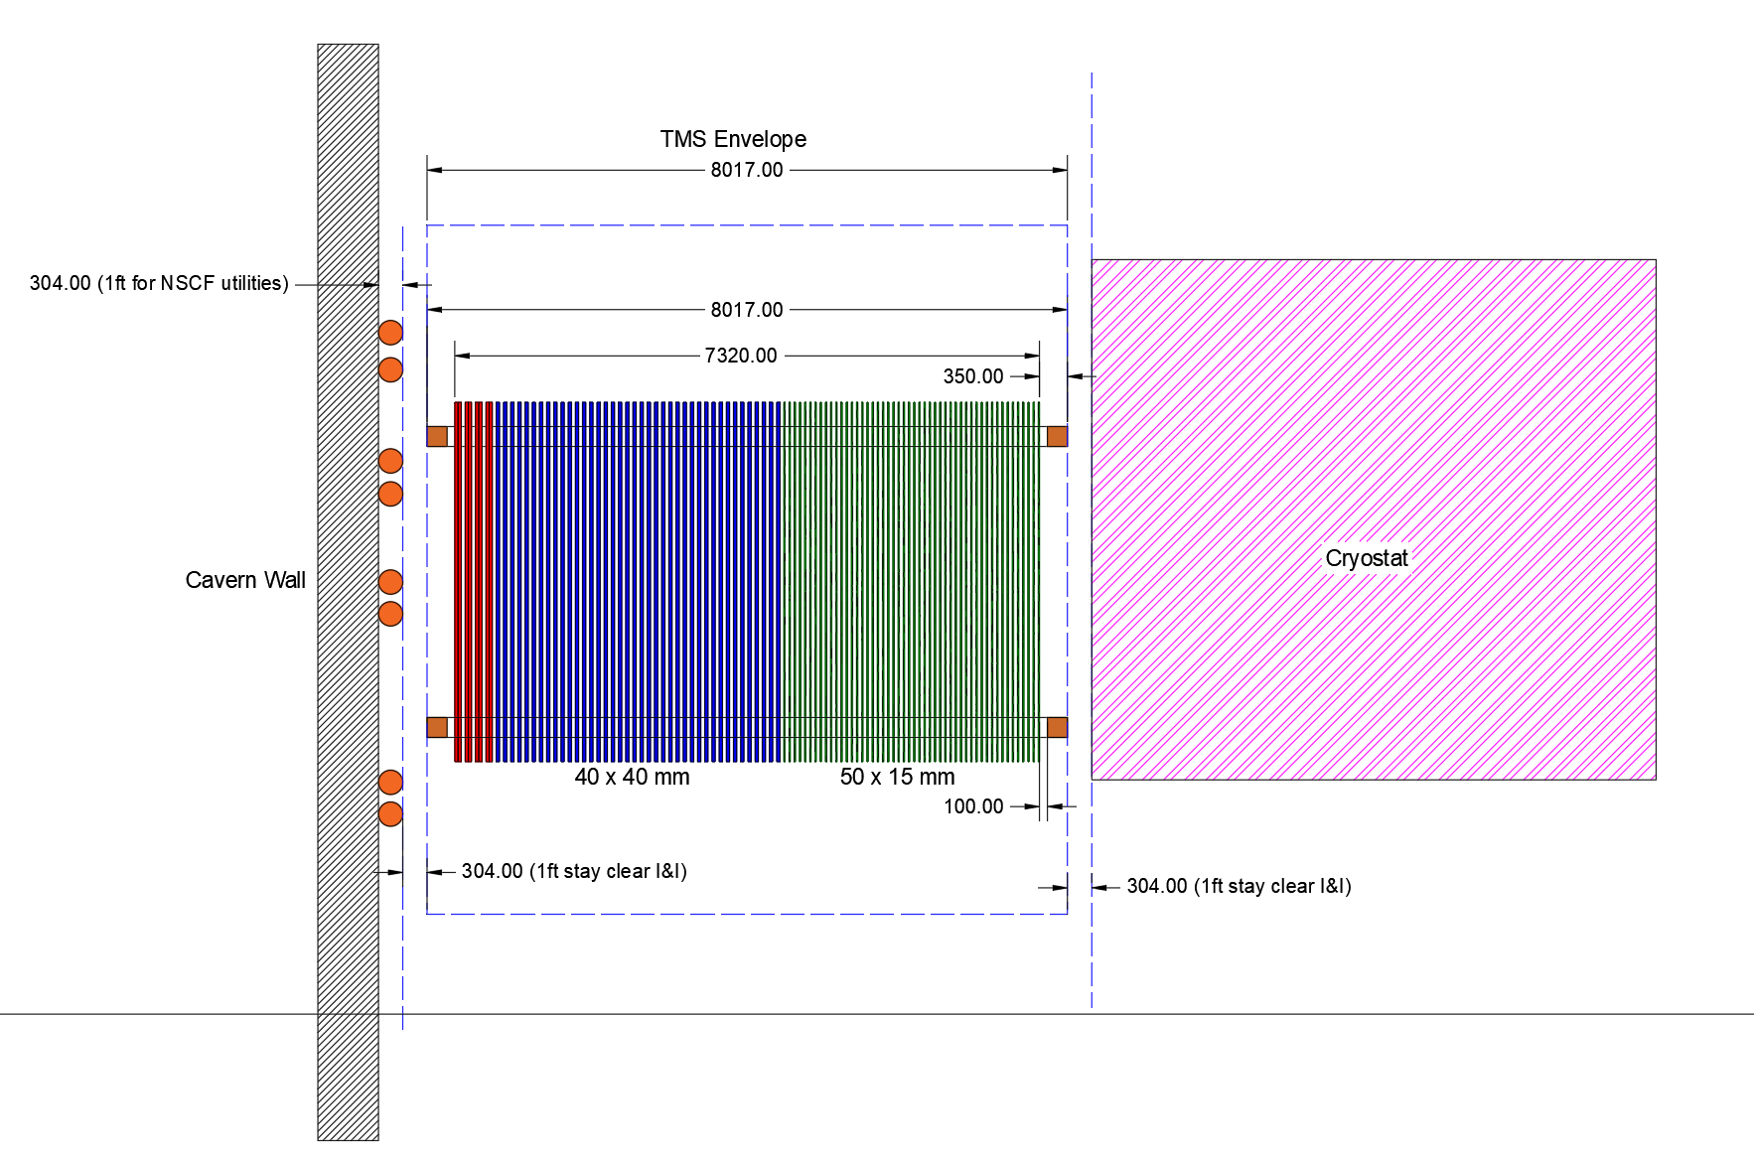
Length Issues
We are 8017mm

Slide 12
Two Ways of achieving required length
Coils stick out 350mm each side
First-Last Plate must be <= 8017-700=7317mm
2x as many 80mm steel plates at rear
91 internal detector planes
80mm Less steel, 93 internal detector planes

