Slide 1
FSD Lid Support Frame
Jay Jablonski
ND-LAr Engineering Meeting
September 20th, 2024

Slide 2
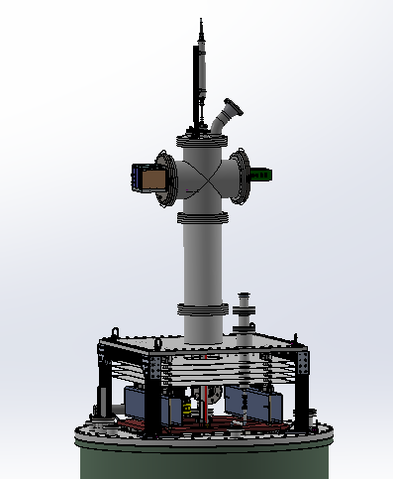
FSD Lid Support Frame
Supports TPC & Physics Lid ~0.5m above top of Cryostat
Safely access area between top of TPC Physics Lid
Final cable routing
Install Extension Spool piece
Align HV cable
Allows for installation of Indium Seal

Slide 3
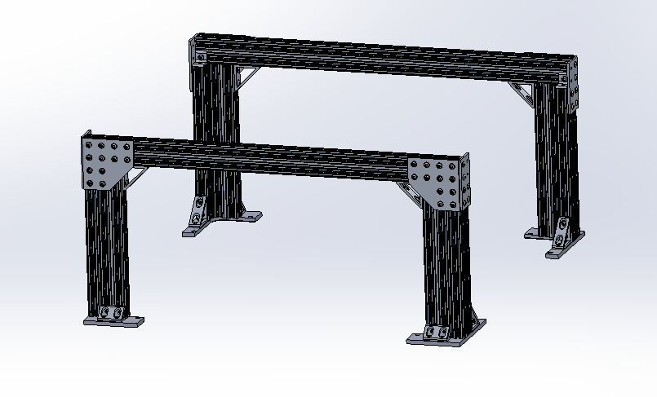
FSD Lid Support Frame

Slide 4
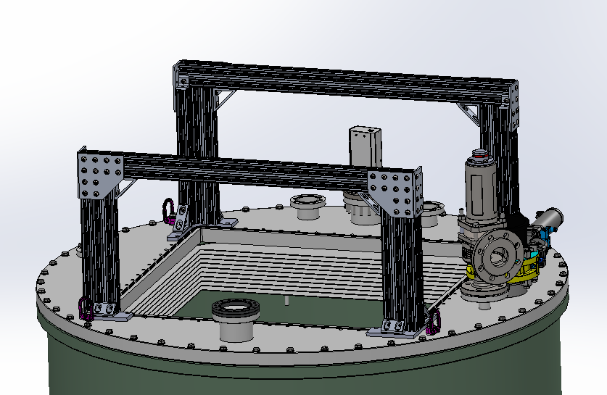
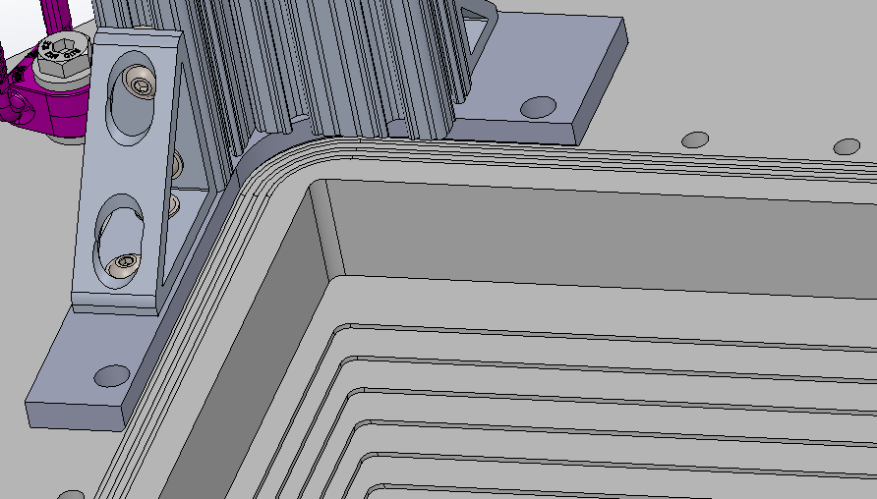
FSD Lid Support Frame

Slide 5
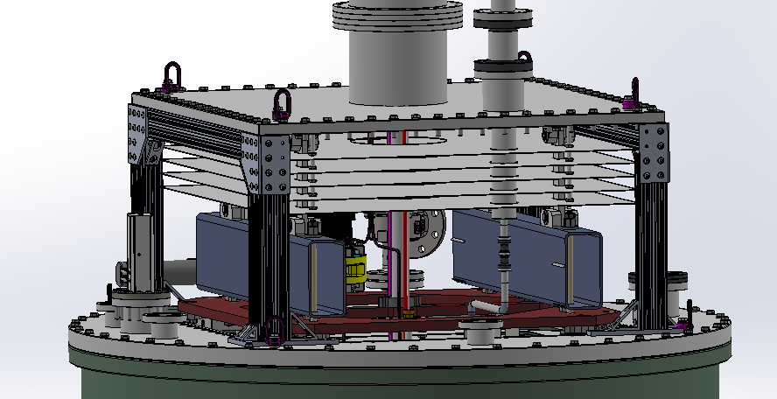
FSD Lid Support Frame

