Slide 1
Switchyard & Meson Report
Michael K. Olander
AD 9:00 Meeting
20 September 2024

Slide 2
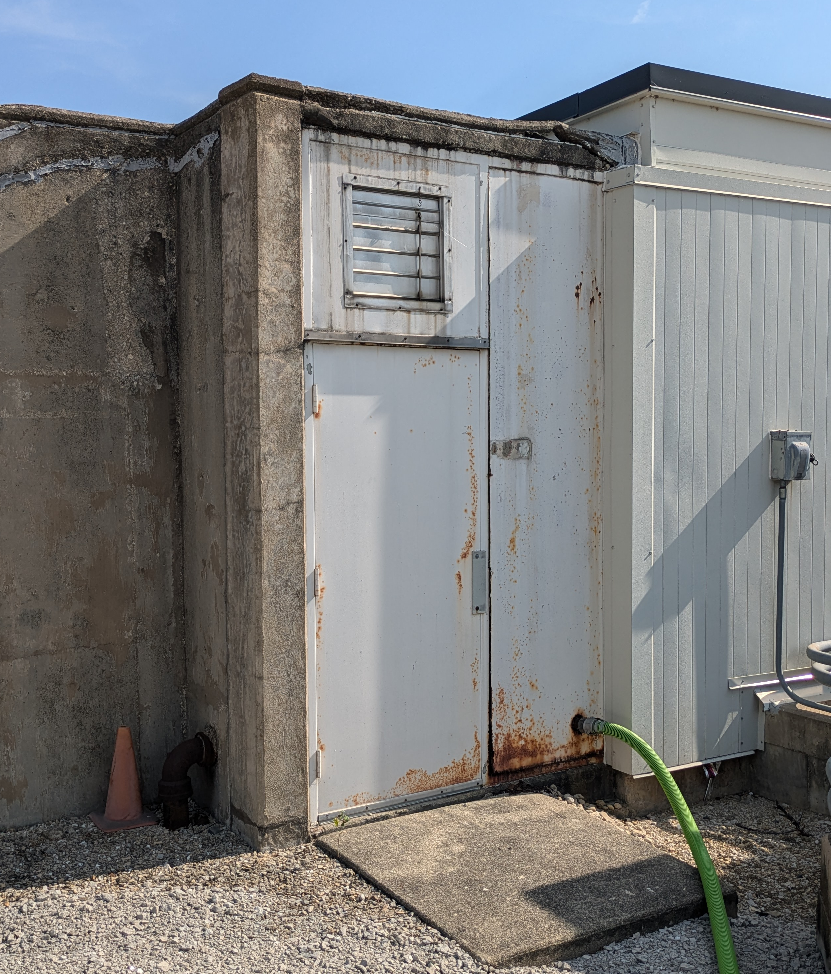
Tevatron F4 Enclosure Emergency Exit Door & Wall
The Emergency Exit Door and Wall at F4 is rusting out.
The bottom panel can be deformed enough to see outside.
Repair planning in progress.
The wall and door still act as a barrier for a human to prevent entry, however a temporary patch plan is being explored.
Possible reason for rust here and not at other service buildings is snowmelt and salt from the adjacent parking lot to the North.

Slide 3
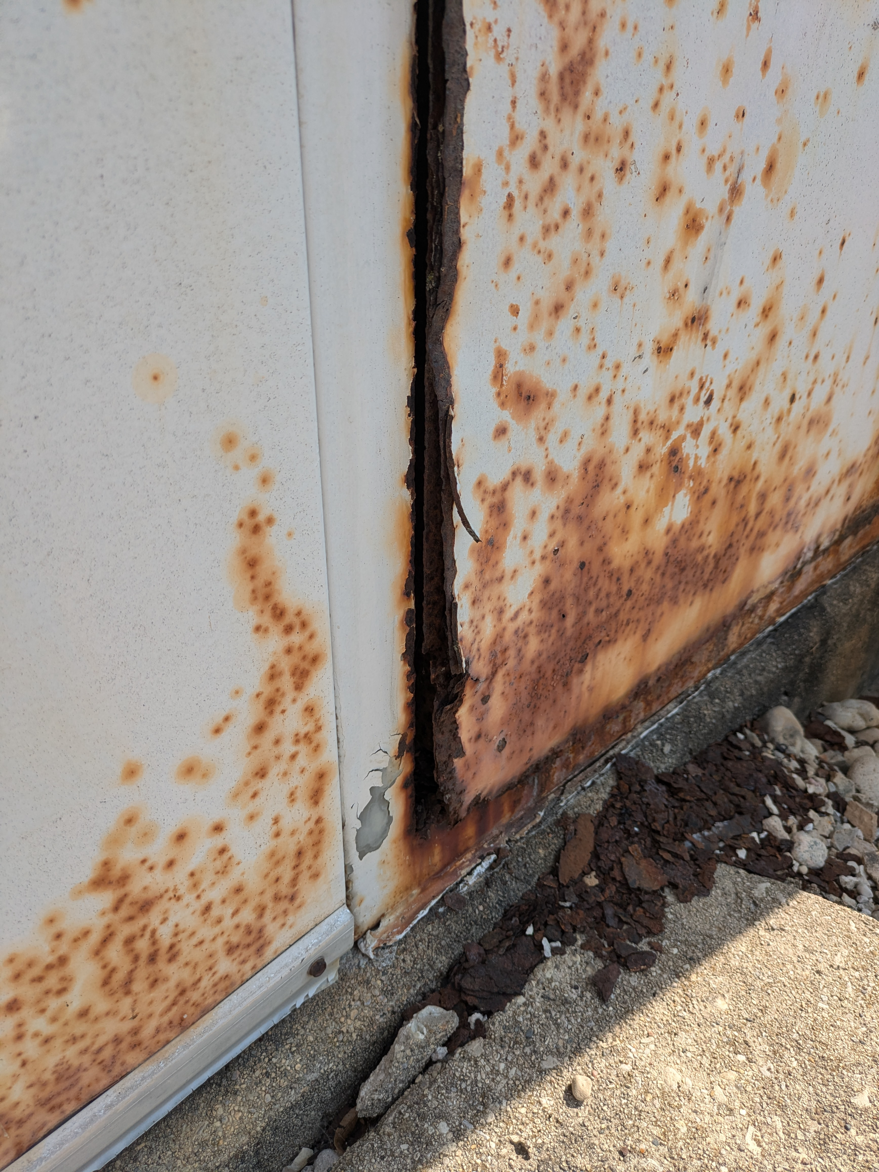
Tevatron F4 Enclosure Emergency Exit Door & Wall
Closeup of damage.

Slide 4
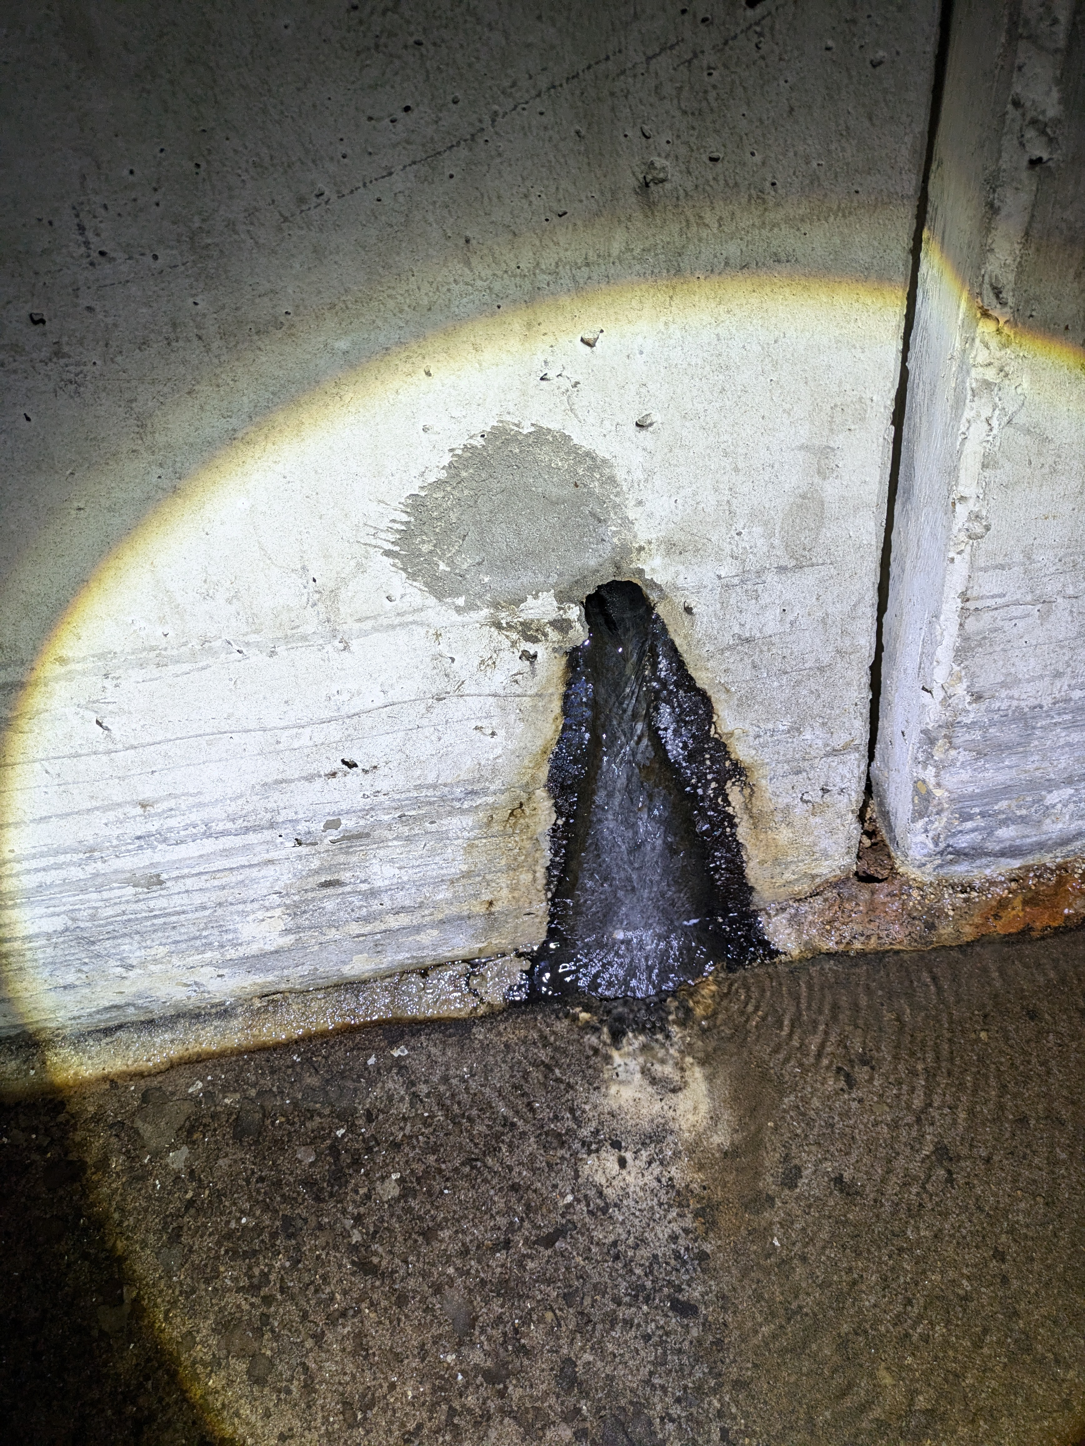
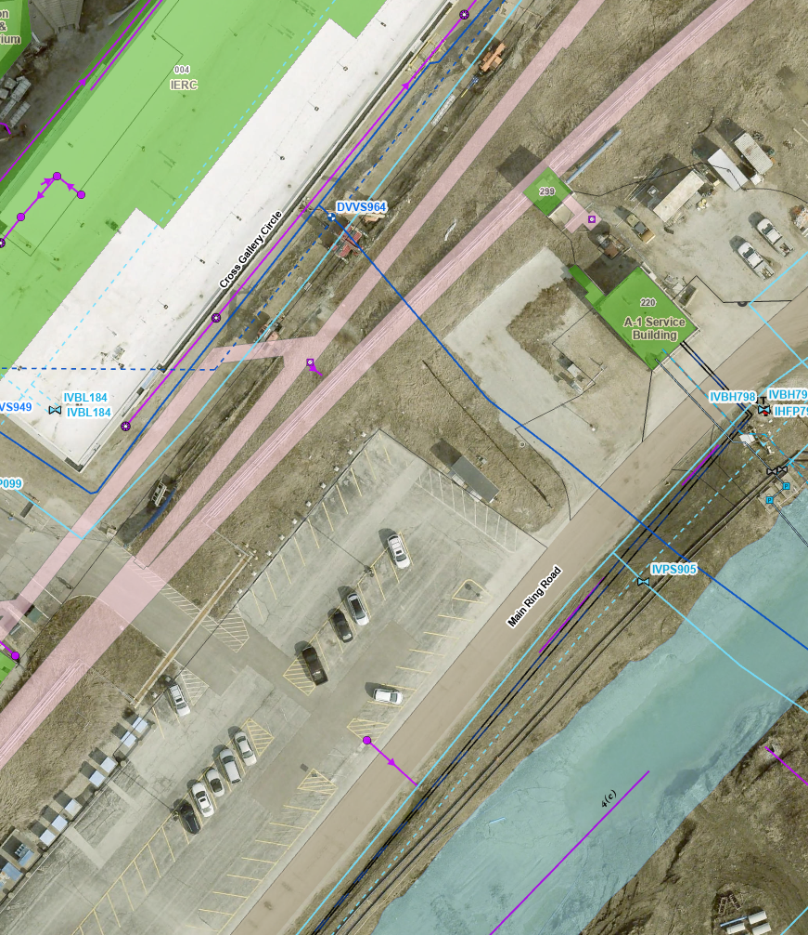
Transfer Hall Water Infiltration
Flowing water was found in Transfer Hall between A0 and A1, coming from the aisle-side tunnel wall in several locations.
(Tunnel lights are out in the region.)
Rough location of infiltration is near a domestic water line that feeds PIP-II. ISD has been informed.

Slide 5
Other News
SWIC Install (S203 [Sorry Bob!]) / Removal (S200) by MSD.
Vacuum station repairs by MSD.
MS2 is Warm. (Holding around 87°F with no power supplies on.)
Transfer Hall lighting in the A0 straight has 8 working light banks and a lot of ballasts.
  There are 8’ ballasts that run the entire length of Transfer Hall in the A0 Straight, with no space between them, on both sides.
  The A0 Straight is about 546’
  Without correcting for the MVA, That’s 68 ballasts per side, 136 total. (Should be close.)
  About 6% of the lights in Transfer Hall are working…

