Slide 1
Muon Campus Shutdown Report
Jim Morgan
Friday 09:00 Shutdown Meeting
September 20, 2024

Slide 2
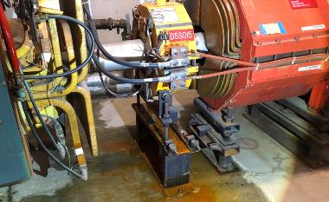
Muon Campus status
ESS2 survey was completed, followed by completion of vacuum work
Successful leak check after ion pumps installed, ready to transport to NWA
D30 downstream mechanical work waiting on key Q205 part (next week?)
AP-0 Dump System drained and lines dried, Vault shielding blocks back in place
Fire Hydrant near AP-10 valved out due to underground water leak
LCW leak rate greatly reduced after MSD repaired most known leaks
Largest leak was on sub-header
A Delivery Ring sextupole has an internal leak and needs to be replaced
Resistivity has been declining, may be time to change DI bottles at CUB
Prototype ESS2 will need to be removed from DR prior to running beam
Related to buyback accounting between Mu2e Project and AD spares funds
Hope that operational ESS2 will be ready for installation in late October
Will evaluate options if operational ESS2 is delayed significantly
Domestic water leaks near AP-0 adjacent to Transport berm
AP-0 A/C work continued Thursday, after a month pause
Study – M1-M3 Optics
Study – Alternative M5 optics

Slide 3
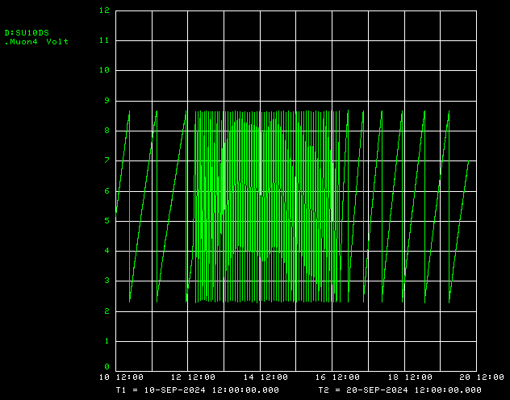
AP-10 downstream sump activity after hydrant flushing
AP-10 fire hydrant flushing
AP-10 fire hydrant valved out

Slide 4
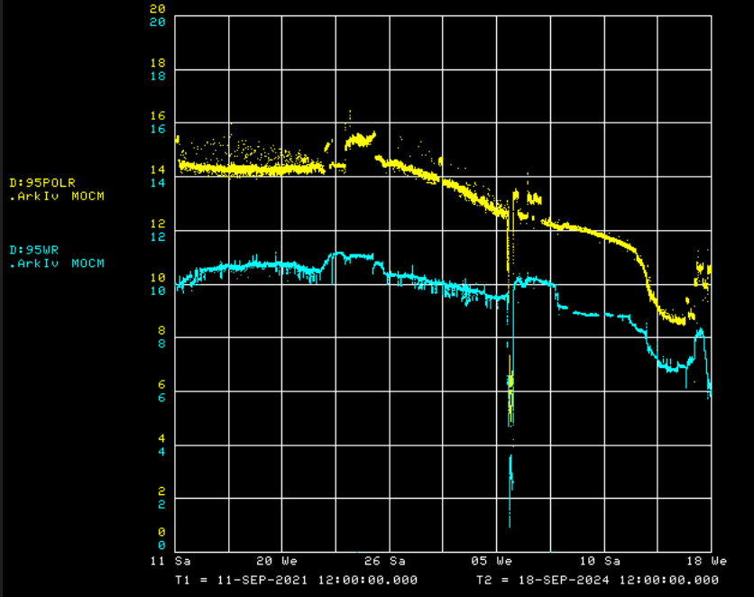
Muon LCW resistivity decline in the past two years
LCW polish resistivity
LCW resistivity

Slide 5
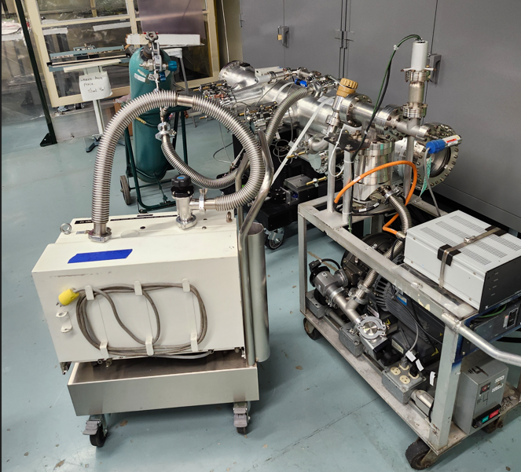
ESS vacuum leak-check in A0 Clean Room

Slide 6
Upcoming work
Main worklist items and other upcoming work
Repair Kirk Key hardware on disconnects
Leaking Delivery Ring sextupole needs to be replaced
Install rad hard 8Q24 at Q205, send uninstalled 8Q24 to TD for rad hard water lines
Q205 vacuum pipe replacement to simplify vacuum connection to ELAM
Unroll ELAM? (was rolled 24 mr to improve g-2 extraction trajectory)
Profilometer extraction profile monitor vacuum Tee installed upstream of ELAM
Several alignment tasks including D30 level run and M4 Final Focus
M4 Final Focus vacuum installation, A/C dipole installation
Need to check sizing of all power supply panel breakers, upgrade as necessary
Install additional steel shielding above ECMAG
ESS1 and ESS2 septum stand motion-control improvements
Hope to finish operational ESS2 and install it in tunnel late in shutdown
Repair of domestic water break near AP-0 may disturb Transport berm
ESS2 (operational version in A0 Clean Room)
Transport to NWA planned for today for eventual high voltage conditioning
AP-0 A/C will hopefully continue and finish

