Slide 1
Accelerator
Summer Shutdown
Tony Busch/Cons Gattuso
AD Shutdown Coordinator
Planning & Integration Department September 20th

Slide 2
Critical Path
Site Power Configuration and Remaining Outage
Assessments/repairs at both substations are underway
The goal is to get at least 4 of the 8 main transformers in an Operational State
We have a plan as to how power and distribute loads between the substations.
We will need to balance/verify loads between the substations
Still not clear how much of the complex we will be able to run
We have an associated risk in running in this mode
Remaining power outage
These maintenance Power Outages must occur prior to turning on. (working getting them scheduled)
Linac L1/L2/L3
MI Pulse/Conventional power at MI8, MI10, MI20, MI30, MI40
MI Heat Exchange
During cleaning process, it was discovered that over the years we have lost thickness due to corrosion.
We have a vendor coming next week to inspect the heat exchangers and give us a better Idea as to how much material we have left, which will indicate our next course of action.
To run BNB will need MI LCW flowing ring wide. But not at full capacity.

Slide 3
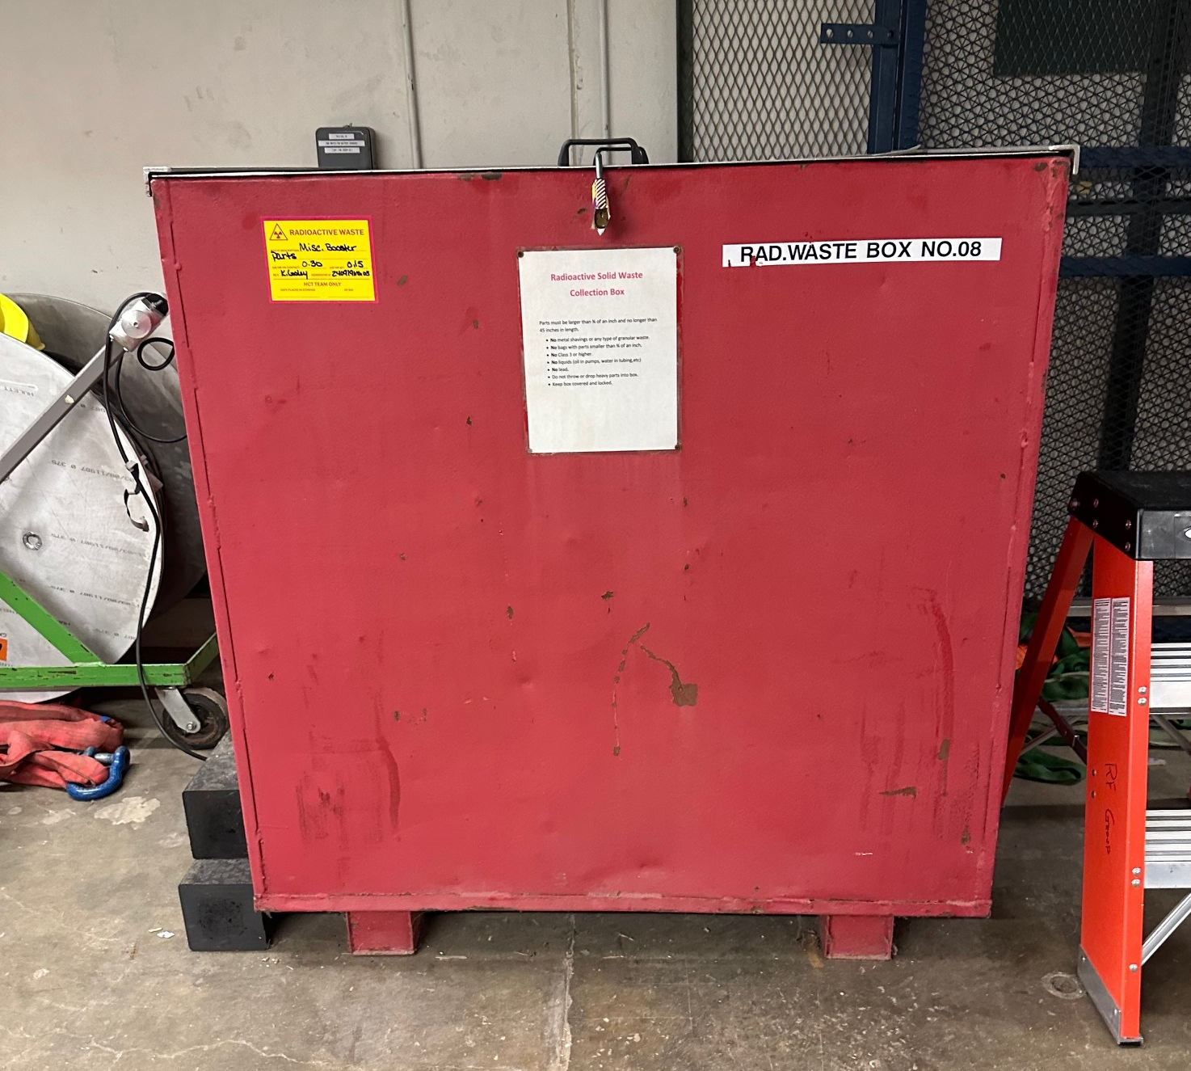
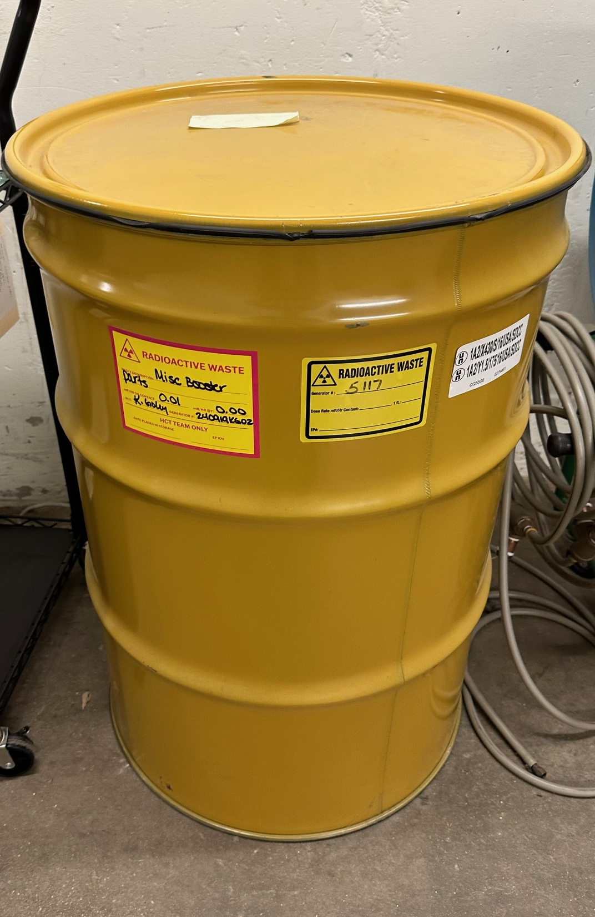
Tunnel Clean up
Clorica will begin cleaning of the tunnel spaces next week (Subject to change). Rich White is coordinating/managing this effort.
Linac: Wed 9/25
MTA: Thurs 9/26
Booster: Fri 9/27
MI12A/B: Mon 9/30
MI10: Mon 9/30 – Thurs 10/3
MI20-62: Fri 10/4- Wed 10/9
F-Sector: Wed 10/9 – Thurs 10/10
Muon Campus
Transport Us/Mid/Ds Fri 10/11
Delivery Ring/Extract/M4 Week of Oct 14th
Rad waste Disposal (generated over the years)
A4 Service Bldg. (picked up already)
(6) Rad barrels
Booster (to be picked up next week)
(1) 4ft x 4ft x 4ft Container
(3) Rad barrels
In the queue, we have waste from MI/NuMI/Muon Campus, etc.)
~ 10-15 Barrels
(6-7) 4ft x 4ft x 4ft Container
~ 5-7 Pallets of material
Maybe more????
Work on processing other waste stream disposal is underway….

Slide 4
Moving Towards Beam Operations
Linac
Complete Secure of Linac the weekend of Sept 28th
Enclosure will remain Controlled Access
Complete Safety system interlock testing
Monday October 1st
RF Turn on is driven by the following
Master/Kautz Sub station configuration
Linac Power outage complete
DI bottle issue resolved for water skids
Booster
Recore back to operational key set at the EOB Mon Sept 30th
Complete Secure of Booster Tuesday evening shift Oct. 1st
Safety system testing Wednesday October 2nd
BNB (MI12A/B)
Complete Secure of MI12A/B the October 6th
Enclosure will remain Controlled Access
Complete Safety system interlock testing
Monday October 7th
MI-8
Driven by Collimator install completion and restore LCW operations

Slide 5
Reminder
I will be acting ShutCo until 18:00 hrs today….
Tony resumes his responsibilities..
Any questions?

