Slide 1
VD FC Module-Assembly Workshop
Report
November 5, 2024
Jaehoon Yu
For the UTA FC Group

Slide 2
Workshop Fundamentals
Had an all-day VD FC module assembly workshop on Sat. Nov. 2 with 10 members taking part
First time for many group members
Goals of the workshop
Learn the VD FC module assembly and QC procedure
Hands-on training of the module assembly procedure and complete the procedure documentation
Exercise and document the module QC procedure sufficient for draft implementation to the QC iPAD app
Make an informed decision on the assembly table height

Slide 3
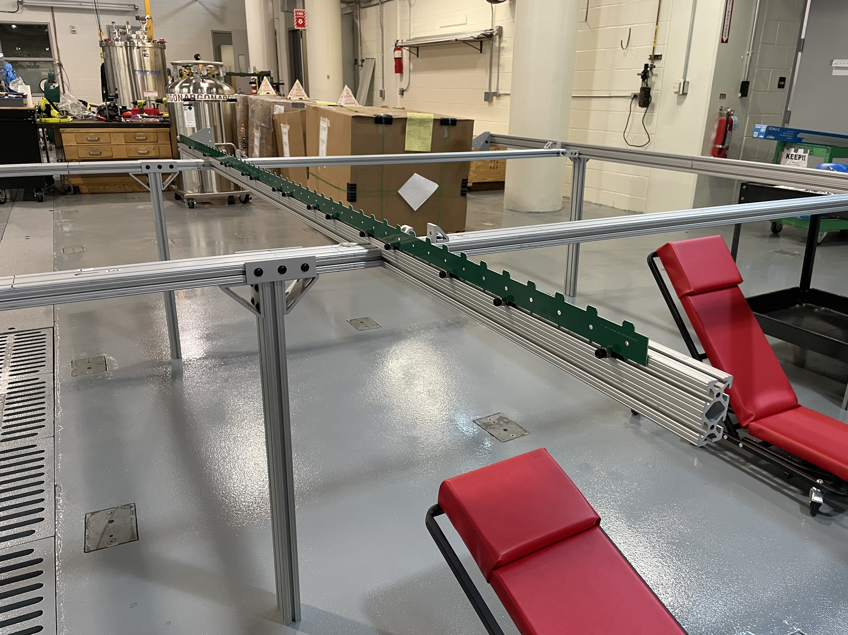
Lessons learned - module assembly 1
Minimum 2 members work as a team, 3rd may be helpful
Set up the assembly table with the various alignment tools
Profile alignment teeth mounted on the assembly table
We only had one side mounted ➔ made it quite difficult to get the screws in

Slide 4
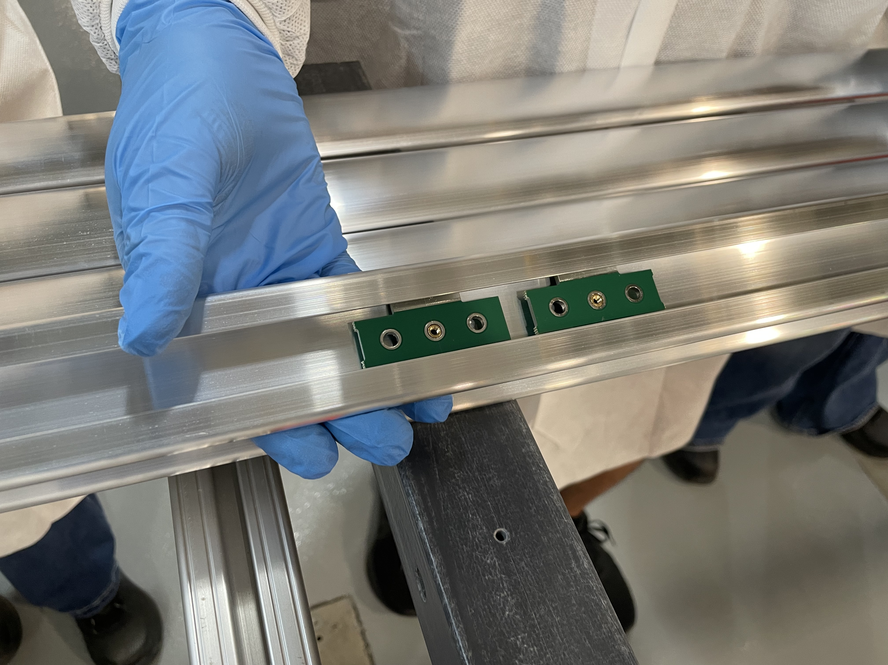
Lessons learned - module assembly 1
Minimum 2 members work as a team, 3rd may be helpful
Set up the assembly table with the various alignment tools
Profile alignment teeth mounted on the assembly table
We only had one side mounted ➔ made it quite difficult to get the screws in
Preassembled and ultrasonic cleaned screws save time substantially
L-bracket for profile end alignment
Box beam end alignment plates
Would be very helpful to have a profile lock down tools with the proper spacing enforcement gadget ➔ helping keeping the profiles in place
Two people take a profile carefully, check the surface quality from either ends with about 1m overlap and apply the anti-oxidation coat
Insert the combination of 1 non-locking and 2 locking slip-nuts from either ends and position them into the roughly the correct location ➔ the same person does the same insertion (parts for each follow the person on a cart)

Slide 5
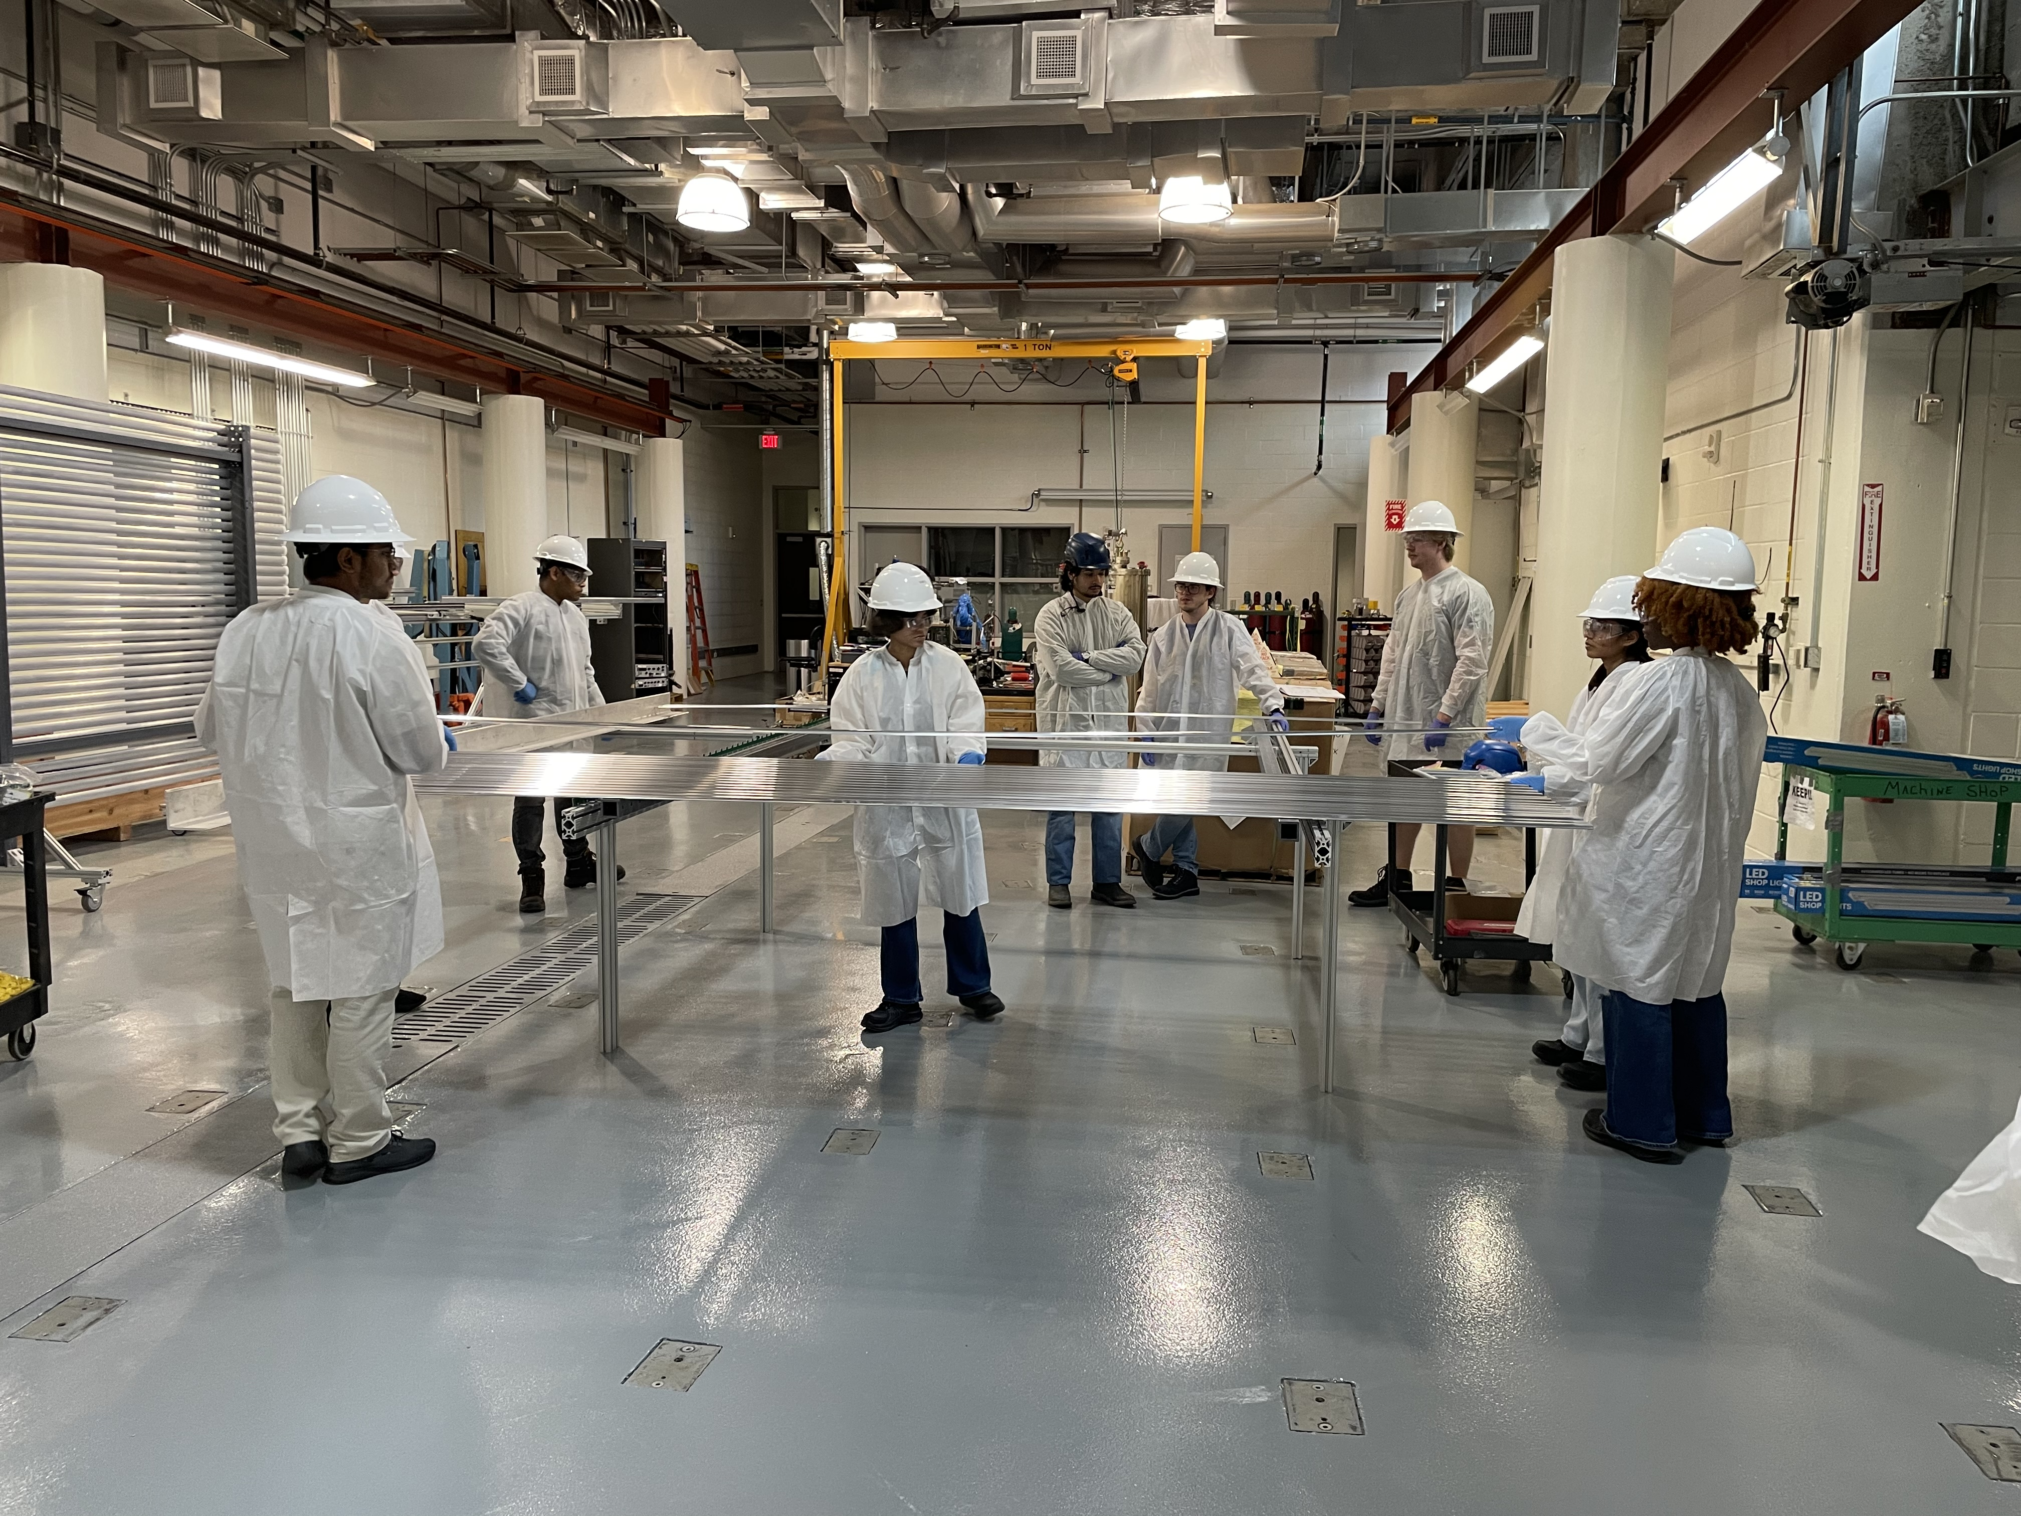
Lessons learned - module assembly 1
Minimum 2 members work as a team, 3rd may be helpful
Set up the assembly table with the various alignment tools
Profile alignment teeth mounted on the assembly table
We only had one side mounted ➔ made it quite difficult to get the screws in
Preassembled and ultrasonic cleaned screws save time substantially
L-bracket for profile end alignment
Box beam end alignment plates
Would be very helpful to have a profile lock down tools with the proper spacing enforcement gadget ➔ helping keeping the profiles in place
Two people take a profile carefully, check the surface quality from either ends with about 1m overlap and apply the anti-oxidation coat
Insert the combination of 1 non-locking and 2 locking slip-nuts from either ends and position them into the roughly the correct location ➔ the same person does the same insertion (parts for each follow the person on a cart)
One person stand in between the box beams and help position the profile in the correct location on the box beams ➔ this may not be needed if we have the profile alignment teeth either side
Once all profiles are placed, lock them in place with the lock down tool (if exist)

Slide 6
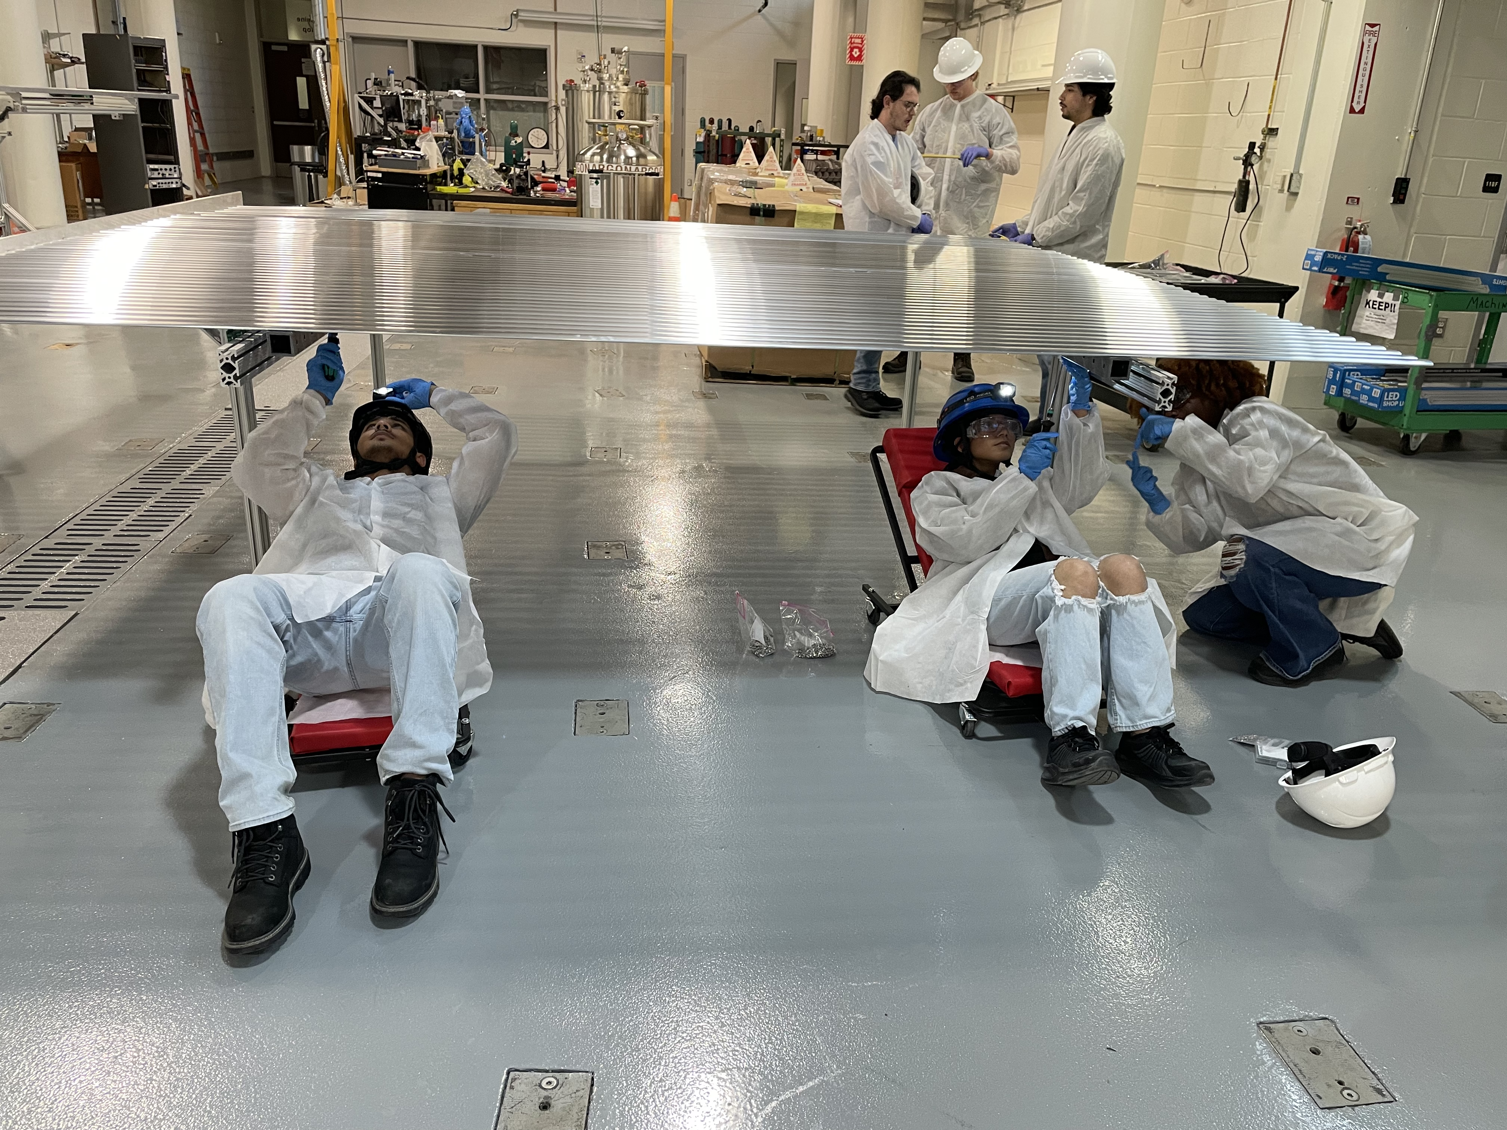
Lessons learned - module assembly 2
Two members go under the table on a creeper or on a chair and start inserting and tightening the screws using the torque screw drive set to 30cN-cm
A bag of preassembled screws was with each person
A pair of safety glasses are necessary for protection

Slide 7
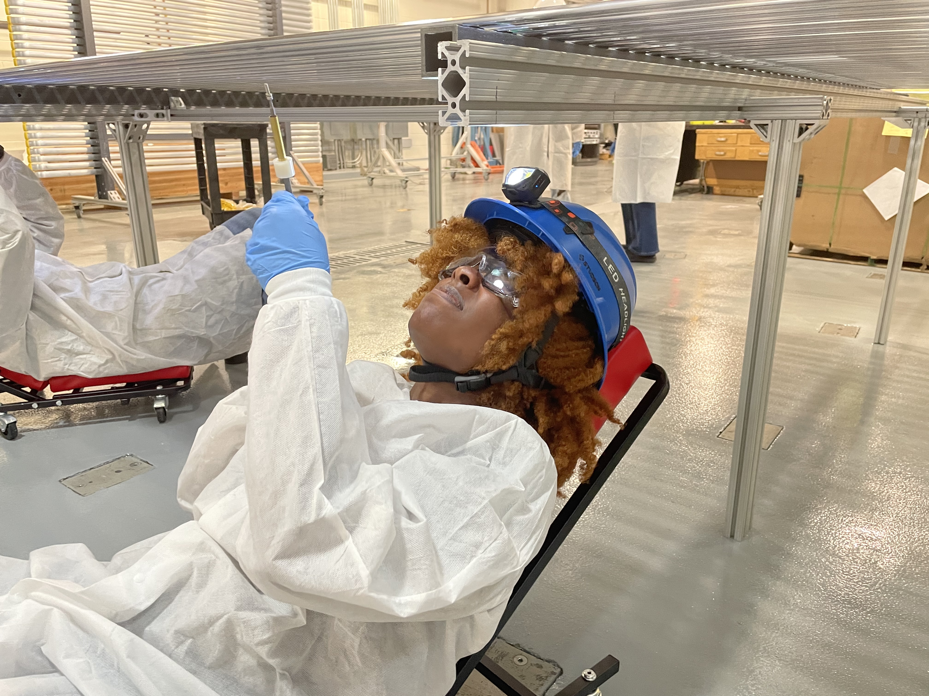
Lessons learned – The assembly table height
We started with the short 85cm table first but haven’t had a chance to try the taller table ~55”
By the end of the workshop, ~4 students were able to progress rather quickly
Members had to lay on a creeper ➔ once the comfortable angle of the creeper is set, most the members feel fine
Two felt the back strained
Over 50% felt the arms get tired rather quickly
Took some time for members to find the proper angle to aim the light to see the screw hole

Slide 8
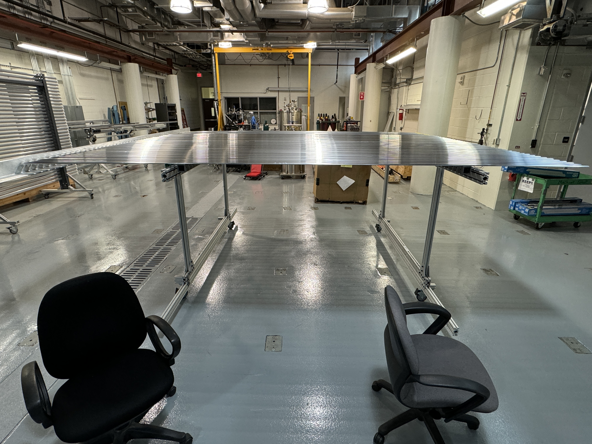
Lessons learned – The assembly table height
Took a while to switch to a taller table ~55” but just had enough time to set up the new table
We plan on trying this height throughout the week this week
Some students rolled around underneath on a chair with the hardhat just to see how they feel ➔ they seem to like the sitting down position

