Slide 1
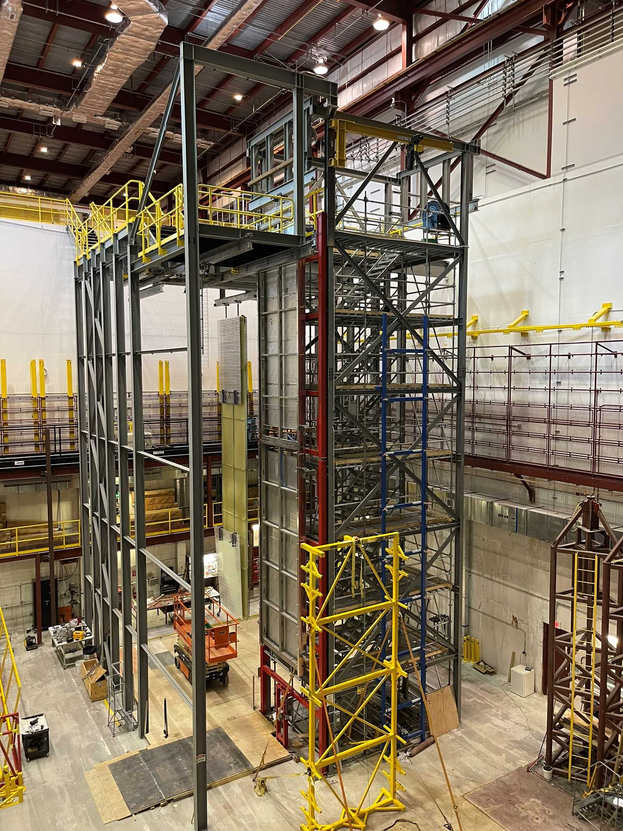
HV Consortia Equipment at Ash River
Ship to SURF List
Lessons Learned-Row 25
William Miller
12 November 2024
Phase 2 DSS support structure at Ash River

Slide 2
Schedule for Decommissioning
Matt has received some feedback from an RFI to understand what the costs would be to decommission. We will put out a formal bid package late Dec./early Jan. We have several companies interested.
We will ship all equipment to SURF, PSL and East (flooring) the last few weeks of January, so the area is clear for disassembly of the steel structures.
Timeline on DUNE funding is we would run out in ~March depending on costs of shipping and decommissioning.

Slide 3
What to ship to SURF
We have started a general list of what we have at Ash River. MANY of the useful items we had at Ash River are being used at CERN.
I have a detailed list of equipment that was purchased and there are some items that need to be decided on left over from the Soudan Lab.
We can’t take anything that would be needed for decommissioning NOvA that was purchased with University/NOvA grants.
Consortia TPC Equipments | EDMS #
APA Equipment
APA Assmbly Frame/accuator /Controls | 2112698 |  | PSL
Old APA Frames |  |  | PSL
APA yoke and assorted fittings |  |  | PSL
APA Trolleys | 2733998 |  | Ash River
HV End Wall and FC Equipment
CPA Assembly Frame | 2382268 |  | HV
End Wall tooling | 2786837 |  | Ash River
Assorted FC tooling
FC installation tooling | 2786834 |  | HV
FC storage carts | 2788024 |  | HV
FC Assembly Table | 2787710 |  | HV
FC Latches |  |  | HV
CPA and End Wall Trolleys |  |  | Ash River
CPA | 2633164 |  | HV
End Wall | 2633165 |  | HV
FC | 2633166 |  | HV
Shuttle beam tooling
A Clear list needs to be made during The December visit

Slide 4
Interface Document - 2459136
Field-Cage assembly area needs: AR has one
A spreader bar up to 1.2m long and 100kg load capacity to lift a field cage off the assembly table will be provided by I&I.
Field Cage storage needs: AR has one TBFC storage cart and ~12 roller bases
1 TBFC storage cart 2.5m (L) x 2.5m(W) x 3.6m(H) is needed in the cleanroom to securely store the assembled TBFC module before integration with the CPAs.
For each EW installation, up to 24 EWFC modules are assembled in the cleanroom. These modules are attached to roller bases and moved into the cryostat waiting for installation. The floor space needed for these modules inside the cryostat is approximately 8m x 6m.
Field Cage installation process interface: AR has one FRP beam and set of winches, one tube support link
HVS will provide the EW installation tools (winches and beam-pushers)
Cathode General: AR has several CPA trollies more details on assembly frame
The DSS beams and CPA trolleys are provided by I&I.
An assembly frame for stacking the CPA units will be transported from Ash River. It will be installed onto a stair tower inside the cleanroom by I&I prior to the CPA assembly activities.
Cathode assembly area needs: In design plan
The CPA assembly frame is attached to a side of the stair well inside the cleanroom. A temporary beam is provided by I&I for integrating the CPA panel pairs with 4 FC modules. An overhead crane is needed to move each CPA panel to the temporary beam, and to lift the TBFC modules from the FC storage cart to connect to the CPA panels.
One scissor lift with a 13m reach. Additional buffer space for the scissor lift to move about.

Slide 5
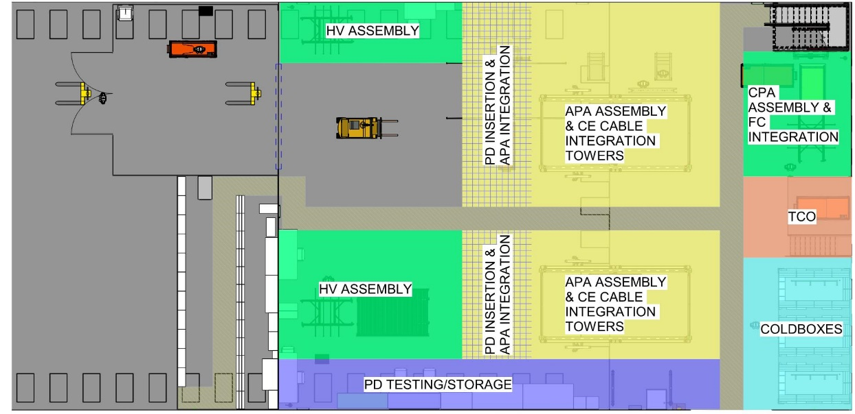
Interface Document - 2459136
Action Items
Final cleanroom design areas need to be updated by I&I. Requirements document should be revisited: https://edms.cern.ch/document/2264352
Review Installation procedures
Items supplied by HV Consortia and I&I

Slide 6
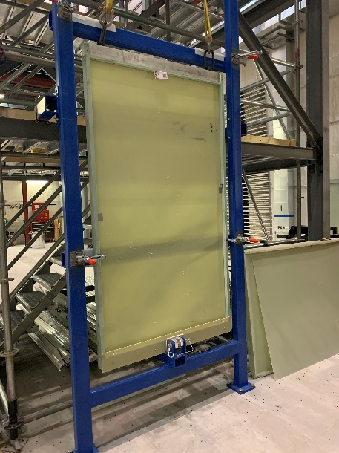
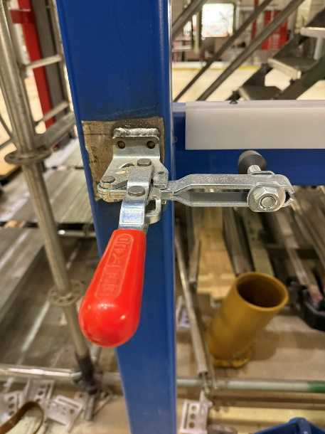
CPA Assembly Frame
CPA Assembly Frame was delivered to ash River in 3 pieces. Two of them are 5’ by 20’. The third one is shorter
The brackets to attach to the APA Tower are not in the same place as the attachment points on the Cleanroom and will need to be adjusted. These are welded to the APA Tower.
The CPA clamps are also welded in place. These we will have to grind off. Hopefully, they can be saved but we may need to purchased a few new ones
We can ship the assembly frame flat, but it will have to go underground stood up to fit in the cage.

Slide 7
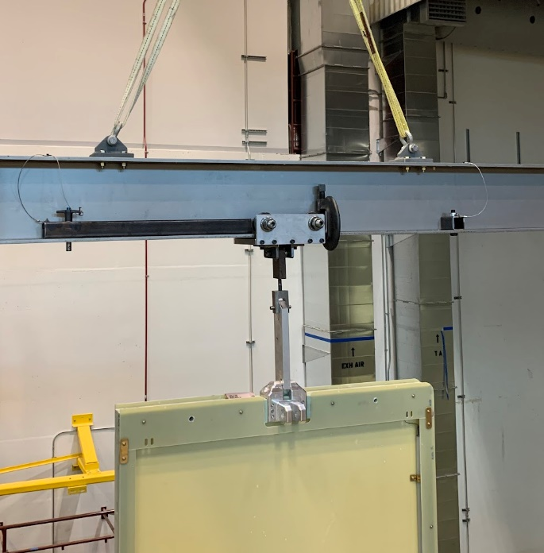
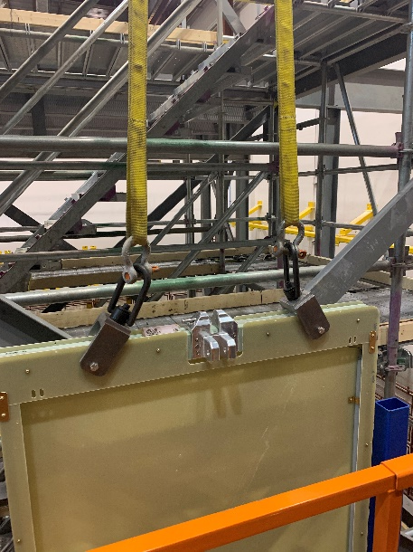
CPA Assembly Tools
Lifting tools we located at AR
APA/CPA Lifting Beam-Several versions
CPA Trolley-Yes
CPA Panel lifting Bar-Yes
CPA Top Lifting Fixture-Yes
Numerous photos from CPA assembly
https://photos.app.goo.gl/gSn6CcTV7TPNyujk6
What about the CPAs? Ship them and all associated hardware for training and testing underground?

Slide 8
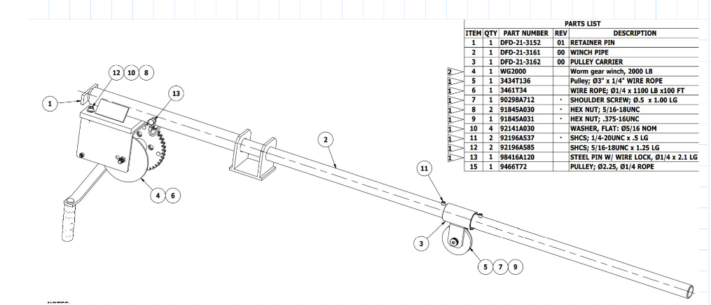
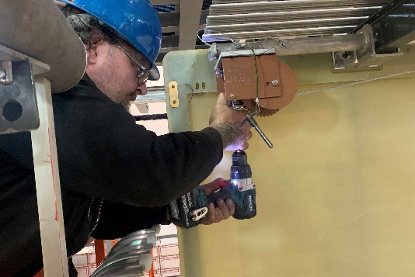
FC Assembly Tools
FC cart-Yes
Two Field Cage Deployment Tools-Yes
Small Spreader Bar –Yes
What About the 4 Field Cages? Take them apart and ship for use in training and testing underground?
Or just save any hardware and cut them up for scrap?

Slide 9
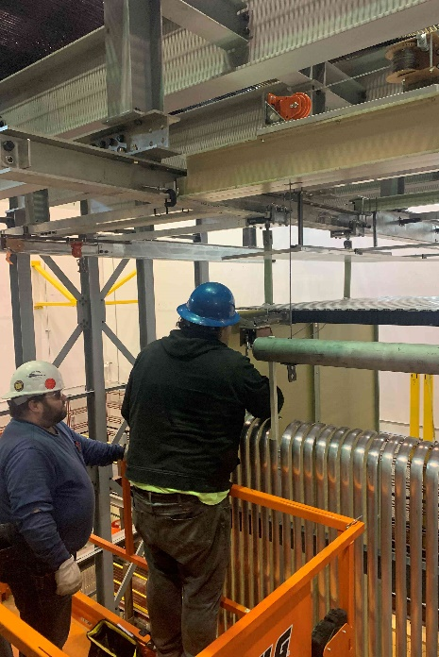
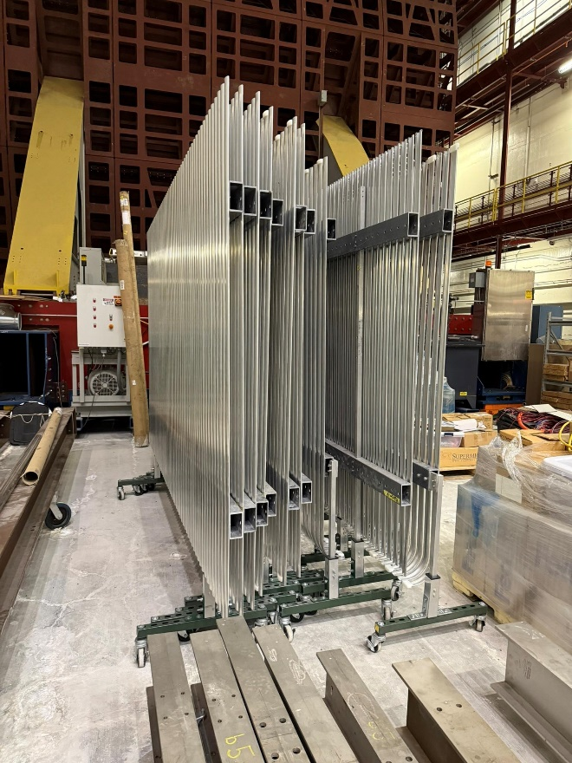
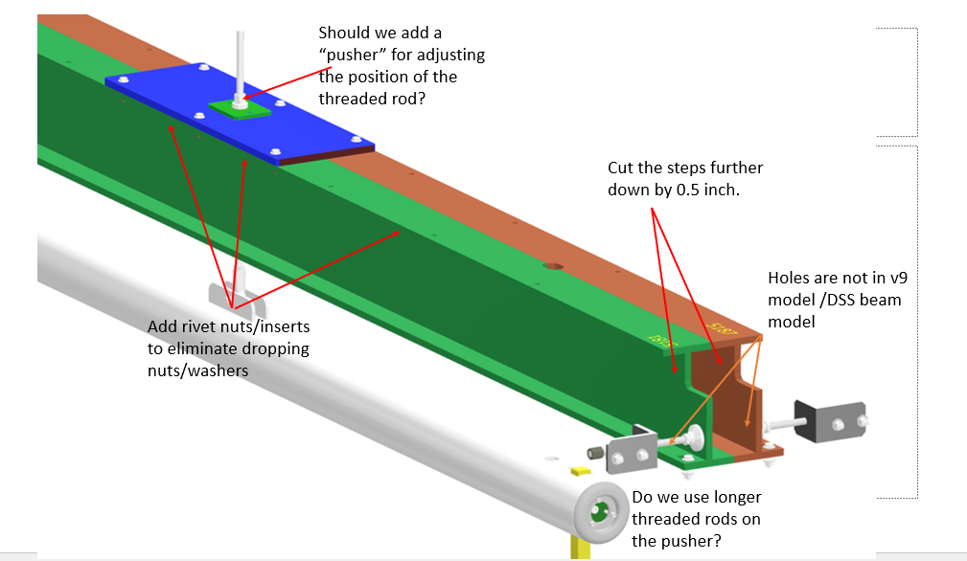
End Wall Assembly Tools
End Wall rolling supports
One End Wall hoist beam, with 2 hoists and End Wall Hanger
One hanger bar with associated hardware
Old style End Wall assembly frame
We have 2 end walls, Do we want them taken apart and shipped for training and testing underground?
Or should we take them apart for scrap?

