Slide 1
Photo by LIDINE2017 organizers
Noble Element Detectors
Dr. Elena Gramellini, 11/11/2024, EDIT School, Fermilab

Slide 2
Setting expectations
What you will get → an overview of general techniques applied in noble element detectors … and not get: → a list of every experiment using noble elements ever (sorry if I missed your favorite) → every detail of detection techniques A huge thank your to Jen Raaf & Roxanne Guenette whose slides this talk is heavily based on.

Slide 3
Setting expectations
What you will get → an overview of general techniques applied in noble element detectors … and not get: → a list of every experiment using noble elements ever (sorry if I missed your favorite) → every detail of detection techniques A huge thank your to Jen Raaf & Roxanne Guenette whose slides this talk is heavily based on.

Slide 4
This lecture roadmap
Fundamentals of particle detection → What’s so special about noble elements? → How noble element detectors work Application of noble element detectors to: → Neutrino physics (with detour on medium microphysics) → Dark matter → Neutrinoless double beta decay Novel detection methods and future R&D

Slide 5
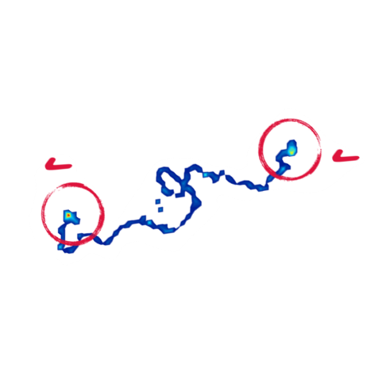
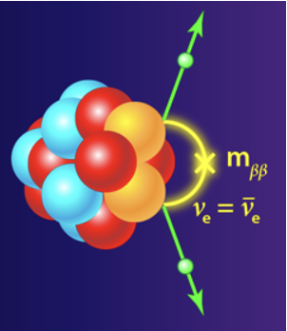
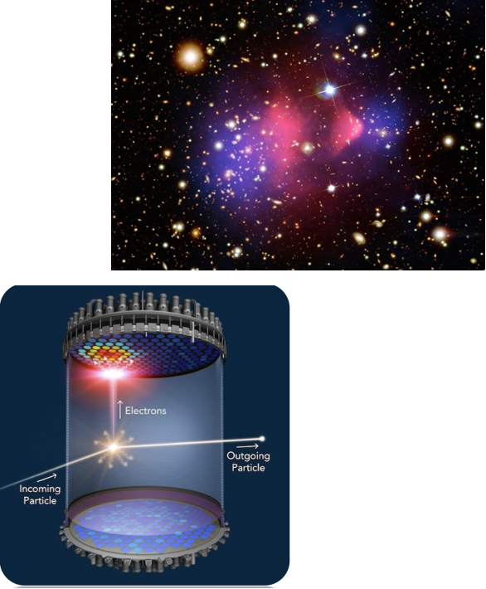
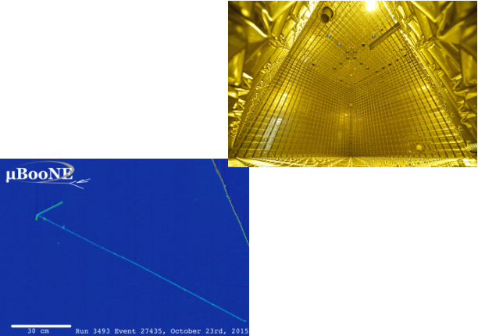
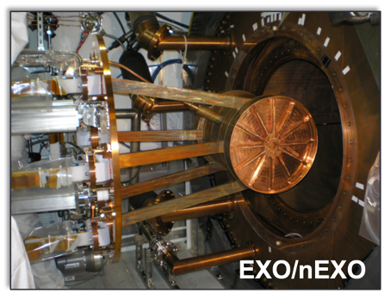
A flexible tool for fundamental physics…
Neutrinos Oscillation measurements (δ_{CP}, mass ordering, θ₂₃ octant, sterile νs) ν interactions (CEνNS → DIS) astro-neutrinos
Dark Matter
Direct detection (WIMPS, …)
0νββ
Search for Majorana neutrinos

Slide 6
Fundamentals of particle detection (with a focus on nobles)

Slide 7
Particle interactions w/ matter
Charged particles lose energy primarily by two processes: → Inelastic collisions with atomic electrons in a material ⇒ causes excitation of atom (“soft” collisions) or ionization (“hard” collisions) → Elastic scattering from nuclei (less frequent than electron collisions) ⇒ known as multiple Coulomb scattering; changes particle trajectory (can be used to measure the particle’s momentum) These processes are the basis for tracking detectors. Neutral particles can only be detected if/when they interact to produce charged particle(s). → Understanding/recovering energy lost from undetected neutral particles is a big deal for precision neutrino experiments; ask me later!

Slide 8
Particle interactions w/ matter
Additional processes for energy loss leveraged in detectors (not covered here): → Emission of Cherenkov radiation → Bremsstrahlung
Charged particles lose energy primarily by two processes: → Inelastic collisions with atomic electrons in a material ⇒ causes excitation of atom (“soft” collisions) or ionization (“hard” collisions) → Elastic scattering from nuclei (less frequent than electron collisions) ⇒ known as multiple Coulomb scattering; changes particle trajectory (can be used to measure the particle’s momentum) These processes are the basis for tracking detectors. Neutral particles can only be detected if/when they interact to produce charged particle(s). → Understanding/recovering energy lost from undetected neutral particles is a big deal for precision neutrino experiments; ask me later!

Slide 9
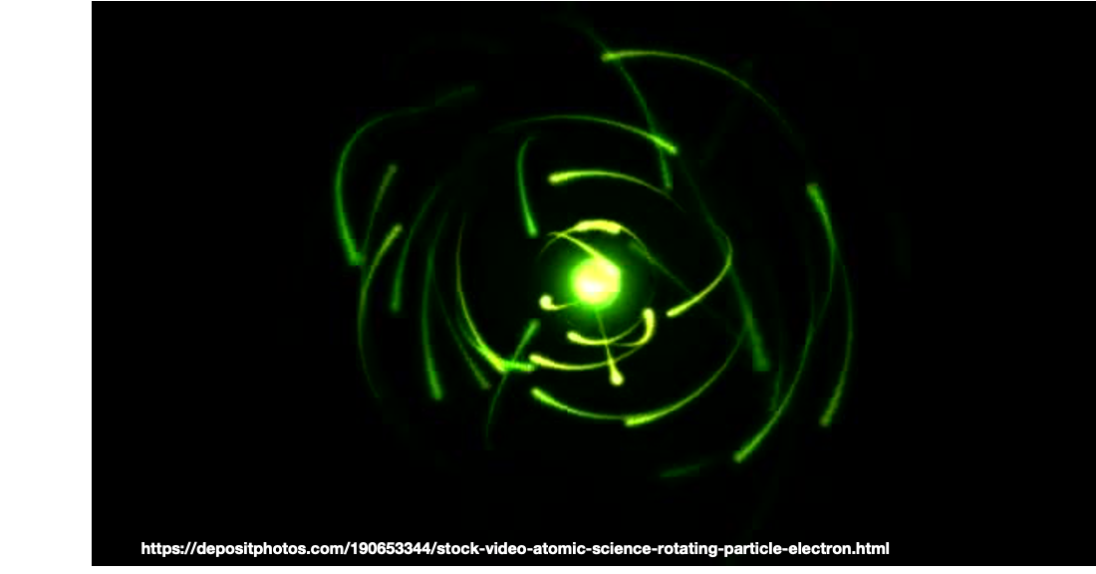
Why Nobles?
Noble elements detectors “see” charged particles traversing the medium by leveraging to two crucial processes: Scintillation → Light emission in the VUV
Ionization → Noble = NO e⁻ attachment, Good dielectric = High Voltages => long drift distance = scalable detectors

Slide 10
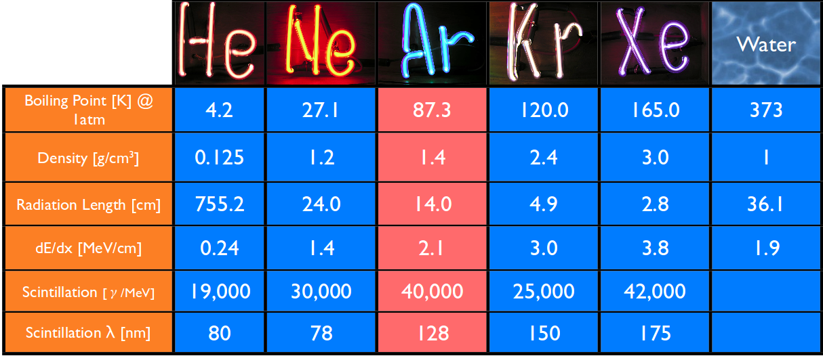
Why Nobles?
Dense → More interaction centers for rare processes Ionize easily → e.g. Ar 55,000 electrons / cm
Non-reactive → High e⁻ lifetime Lots of scintillation light → Transparent to light produced
Ar is more abundant than Xe (1% of the atmosphere) → cheaper! But its nuclear structure is not favorable for some experiments, and 128 nm light is challenging

Slide 11
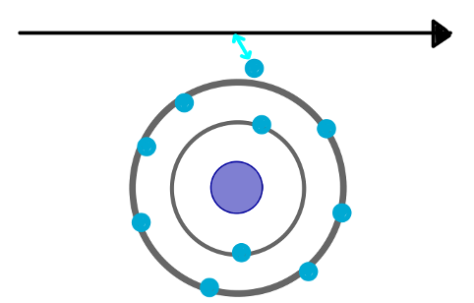
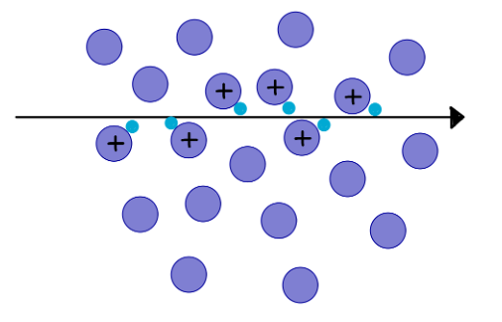
Inelastic collisions with atomic electrons: ionization (and δs)
Charged particles with energy larger than the binding energy of electrons in an atom lose energy by ionizing the atoms, kicking an electron loose from the atom
Single collision
Particle Trajectory

Slide 12
Inelastic collisions with atomic electrons: ionization (and δs)
Charged particles with energy larger than the binding energy of electrons in an atom lose energy by ionizing the atoms, kicking an electron loose from the atom
Sometimes a freed electron has enough kinetic energy to cause other ionization events called delta rays

Slide 13
Inelastic collisions with atomic electrons: ionization (and δs)
Charged particles with energy larger than the binding energy of electrons in an atom lose energy by ionizing the atoms, kicking an electron loose from the atom
Sometimes a freed electron has enough kinetic energy to cause other ionization events called delta rays
Not all collisions cause ionization; some just cause excitation of the atom. De-excitation produces low energy photons (scintillation light) → # photons is proportional to the amount of energy deposited by the ionizing particle
Scintillation Light

Slide 14
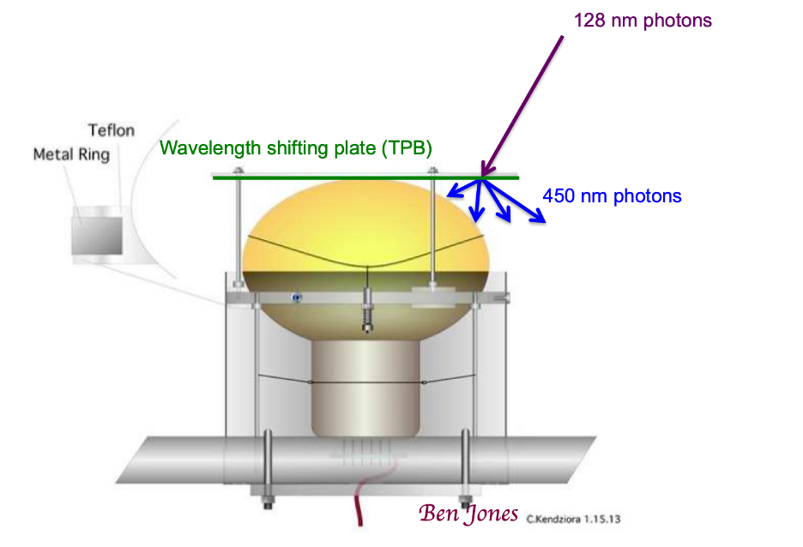
Scintillation light
Each noble has its own scintillation wavelength (not alway compatible with traditional photon detectors)
Wavelength shifters are often needed to detect scintillation light

Slide 15
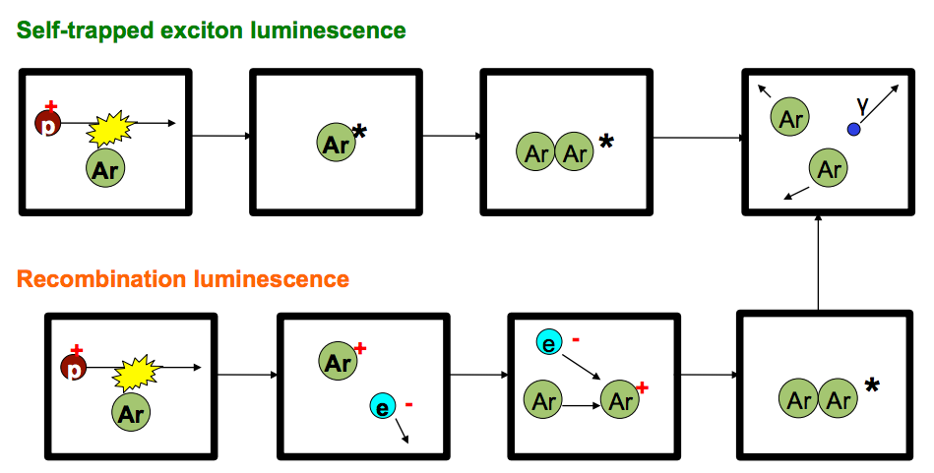
Scintillation light
Simplified model
LAr first excited state
Some of the energy from the charged particle is transferred in the form of atomic excitation: → Light output per unit length is proportional to the stopping power (dE/dx) → Rydberg dimers decay to ground state by emitting photons: scintillation light
Rydberg excimer excited energy state
128nm photon
Ground state energy of LAr
J. Asaadi
Nobel elements are transparent to their own light over large distances → light can be collected.
B. Jones

Slide 16
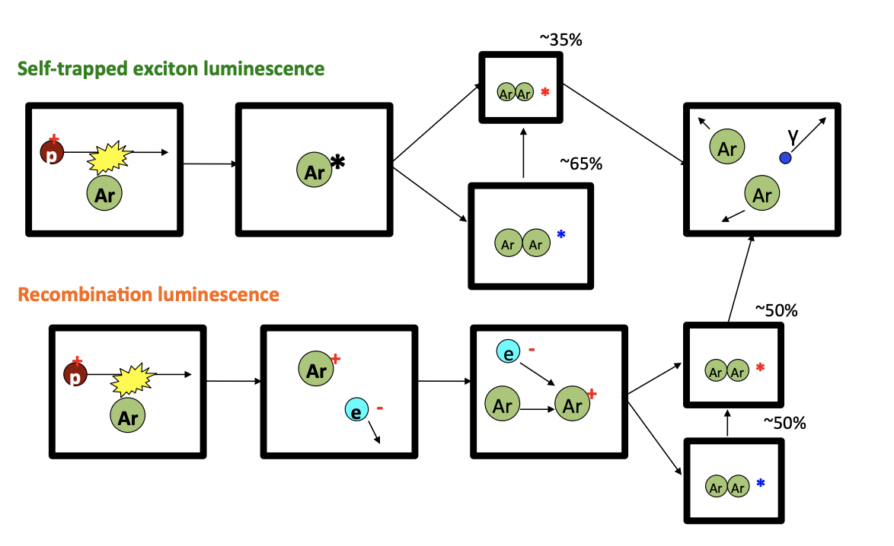
Scintillation light: time components
Rydberg dimers Fast component from singlets: o(ns) Slow component from triples: o(μs)
B. Jones

Slide 17
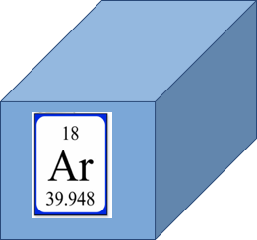
Time Projection Chambers 101
→ A block of noble elements (Ar, Xe), Size varies 0.24 ton (ArgoNeuT) to 10kTon (DUNE)

Slide 18
Time Projection Chambers 101
→ A block of noble elements (Ar, Xe), Size varies 0.24 ton (ArgoNeuT) to 10kTon (DUNE) → Sandwich it in a parallel planes capacitor:
- Cathode at negative HV - Segmented anode to see the charge signal
Traditionally, 2 or more planes of parallel wires a few millimeters apart
Cathode
Anode

Slide 19
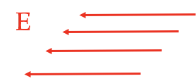
Time Projection Chambers 101
→ A block of noble elements (Ar, Xe), Size varies 0.24 ton (ArgoNeuT) to 10kTon (DUNE) → Sandwich it in a parallel planes capacitor:
- Cathode at negative HV - Segmented anode to see the charge signal
→ Create an electric field as uniform and as constant as possible
Cathode
Anode

Slide 20
Time Projection Chambers 101
→ A block of noble elements (Ar, Xe), Size varies 0.24 ton (ArgoNeuT) to 10kTon (DUNE) → Sandwich it in a parallel planes capacitor:
- Cathode at negative HV - Segmented anode to see the charge signal
→ Create an electric field as uniform and as constant as possible → Equip with a light collection system (usually mounted behind the anode)
Cathode
Anode

Slide 21
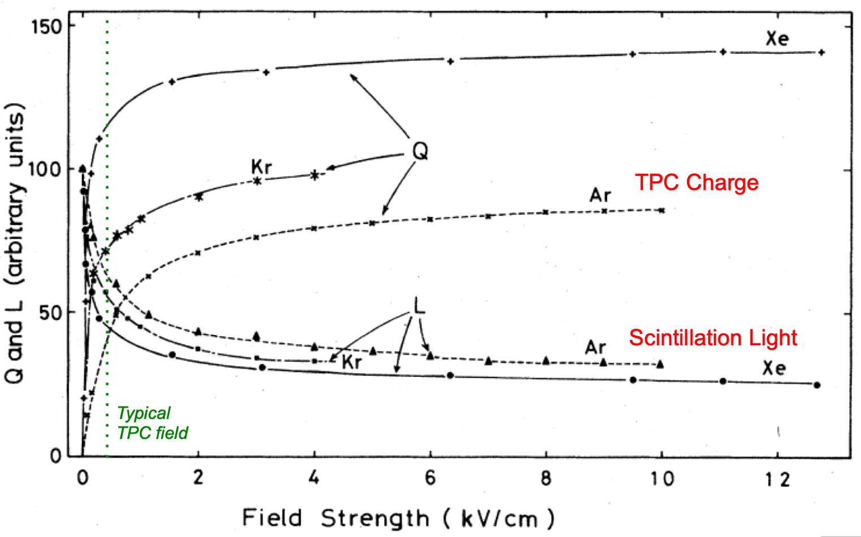
Light & Charge in a TPC
Time Projection Chamber uses both ionization and scintillation
Charge and light are complementary & interconnected!!

Slide 22
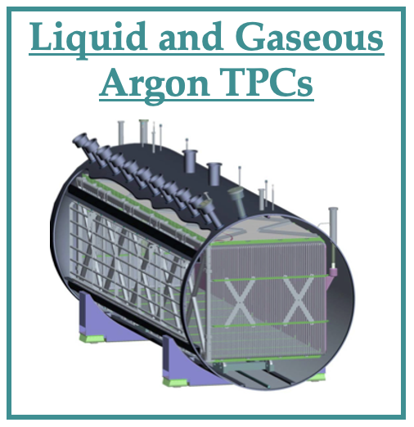
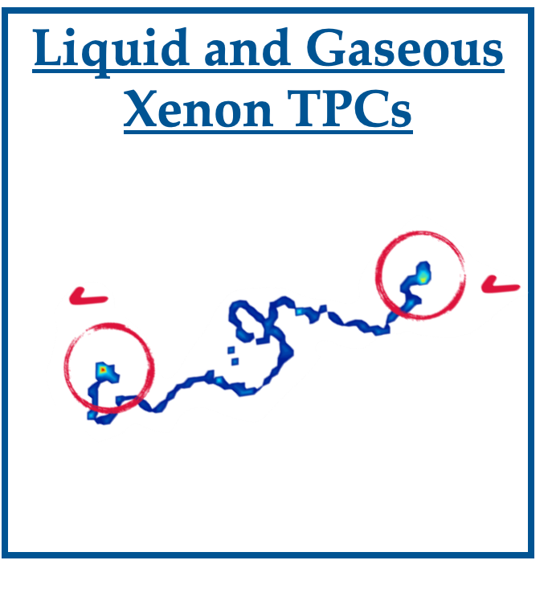
A flexible tool for fundamental physics… but not one-size-fits-all!
Neutrinos Neutrino oscillation physics needs the study of thousand of interactions of GeV AND 10s MeV neutrinos
Dark Matter Dark matter detection requires detection thresholds as low as keV
0νββ Extremely low background and need extraordinary good energy resolution

Slide 23
Noble element detectors for neutrino physics

Slide 24
ν-oscillations experiment 101
STEP 1: Making a beam
L = 1300 km
An intense & pure muon neutrino beam

Slide 25
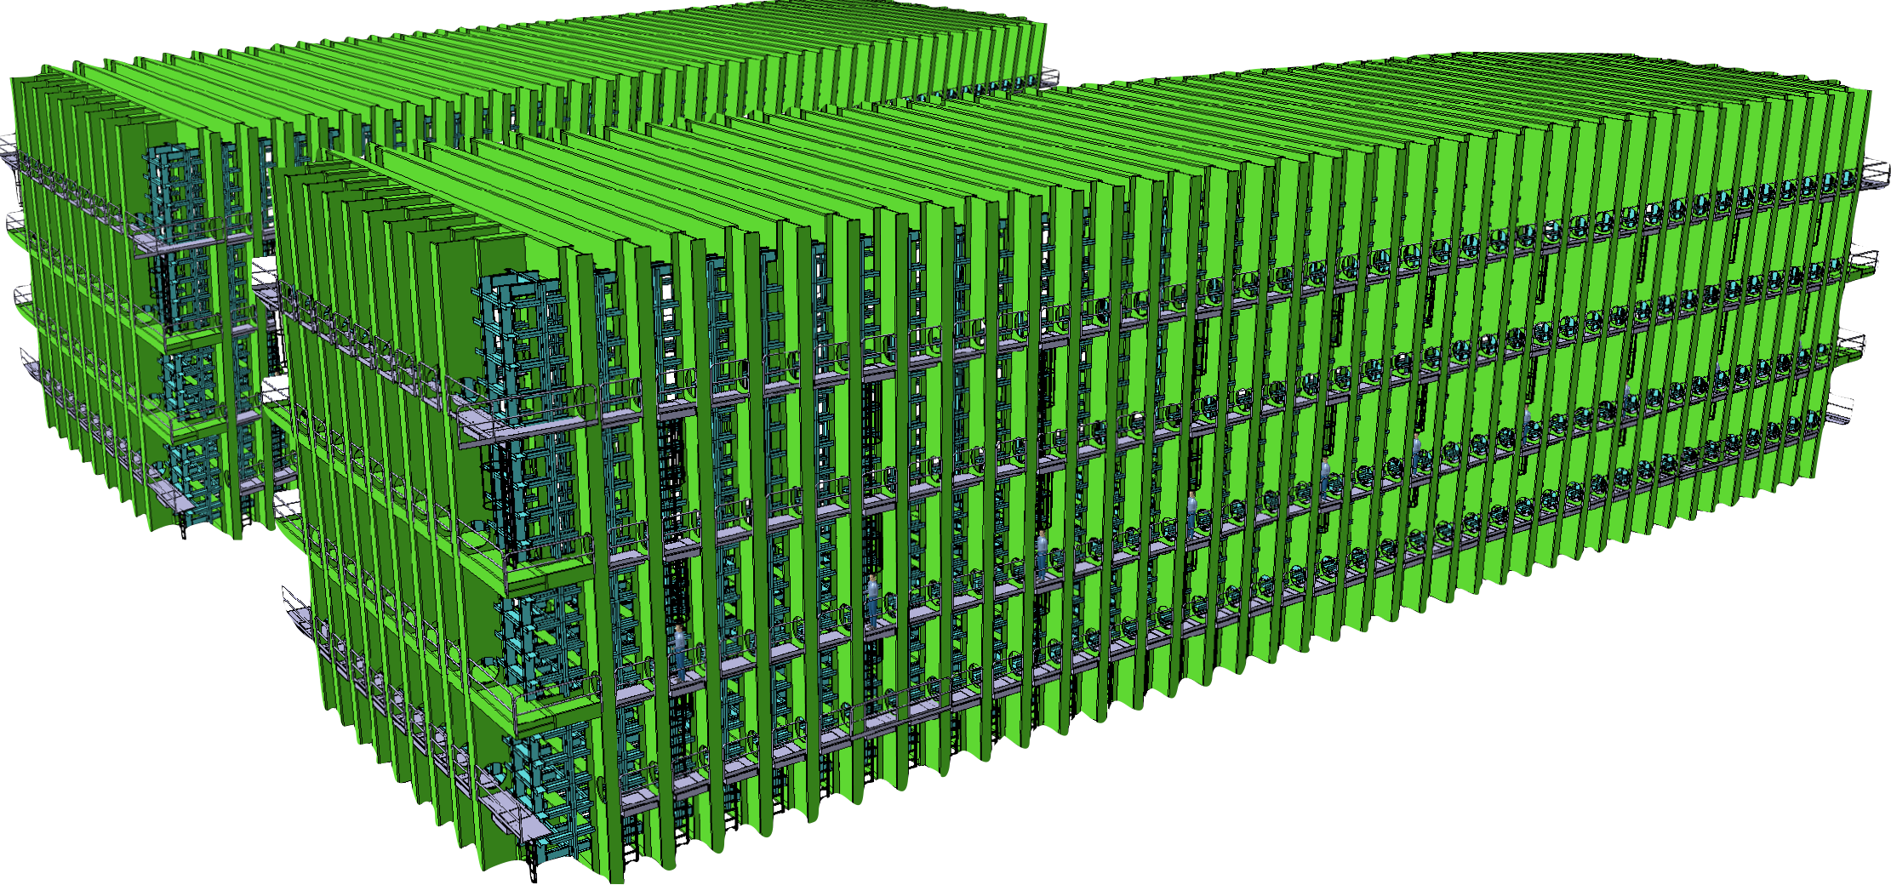
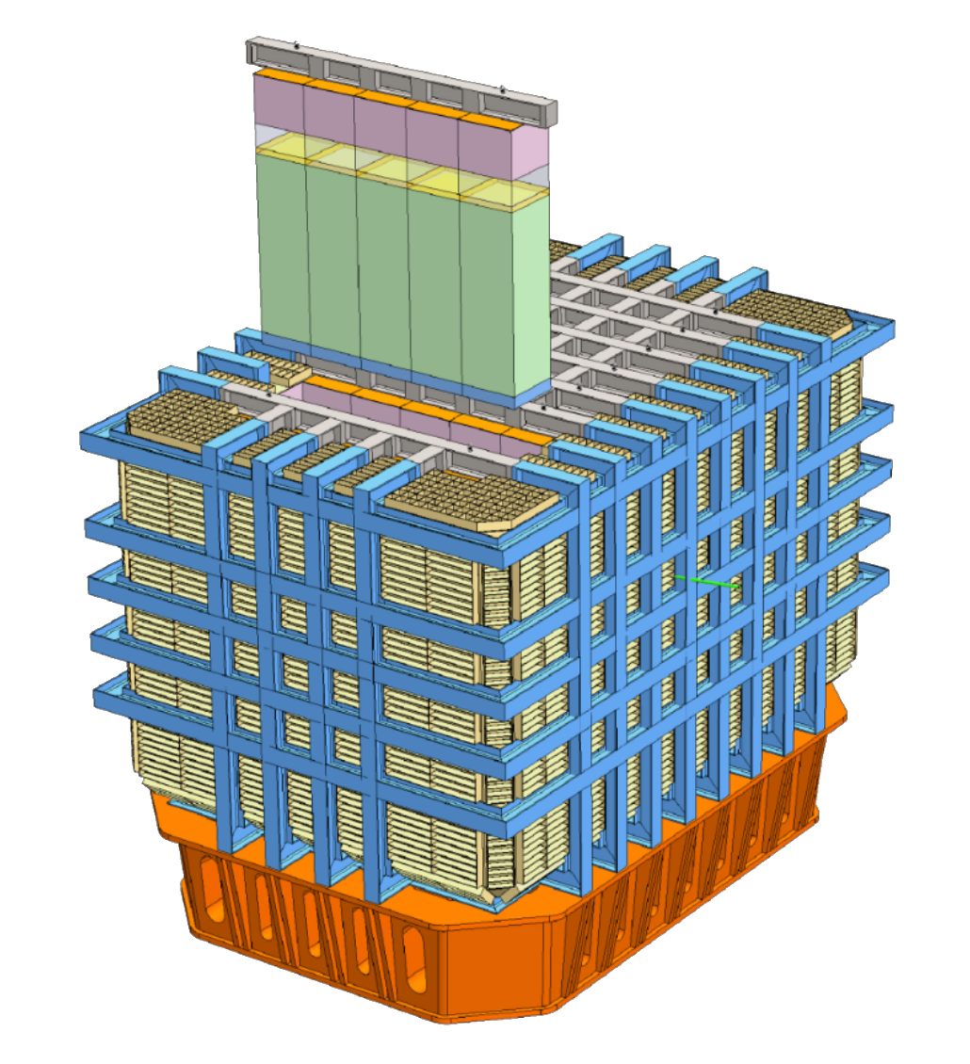
ν-oscillations experiment 101
STEP 1: Making a beam STEP 2: Checking twice
N^{μ→ e}_{FD}(Er): Number of ν_{e} in reco energy
N^{μ}_{ND}(Er): Number of ν_{μ} in reco energy
L = 1300 km
An intense & pure muon neutrino beam

Slide 26
ν-oscillations experiment 101
STEP 1: Making a beam STEP 2: Checking twice STEP 3: Gonna find out if you’ve more of one type
N^{μ→ e}_{FD}(Er): Number of ν_{e} in reco energy
N^{μ}_{ND}(Er): Number of ν_{μ} in reco energy
L = 1300 km
An intense & pure muon neutrino beam

Slide 27
ν-oscillations experiment 101
STEP 1: Making a beam STEP 2: Checking twice STEP 3: Gonna find out if you’ve more of one type
N^{μ→ e}_{FD}(Er) = ∫ ϕ^{μ}_{FD} (Et) P_{μ→e}(Et)σ^{e}(Et)ε^{e}(Et)U_{FD}(Et, Er)dEt
Detector Response
Neutrino Flux
Signal efficiency
Oscillation Probability
ν_{e}Cross Section
N^{μ}_{ND}(Er) = ∫ ϕ^{μ}_{ND} (Et) σ^{μ}(Et)ε^{μ}(Et)U_{ND}(Et, Er)dE
The near and far detectors count number of neutrino interactions of as a function of reconstructed energy… The ability to distinguish CC and NC and ν_{e} CC vs ν_{μ}CC is fundamental to oscillation analysis.

Slide 28
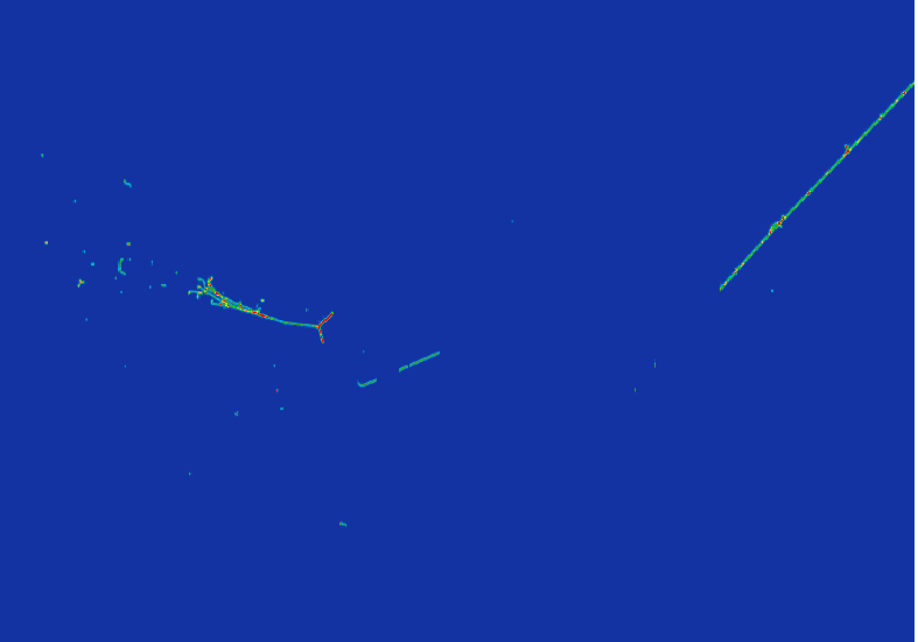
Why Step 2 is hard
This is all you see in your detector: we never see the neutrino directly!
You identify the final state particles to infer neutrino flavor: count how many ν_{e} and ν_{μ} From the reconstructed particles’ momenta you infer neutrino energy: P(osc) ~ sin²( L / E_{ν})
e
ν_{e}
π
??
Event display courtesy of

Slide 29
Why Step 2 is hard
This is all you see in your detector: we never see the neutrino directly!
You identify the final state particles to infer neutrino flavor: count how many ν_{e} and ν_{μ}
Dear Santa, for the next years, we would like:
→ Kilo-ton scale and dense detectors able to see GeV νs!
→ A technology able to perform calorimetry and particle ID with a “low” energy threshold for high ν detection efficiency, good background rejection → An excellent calibration of that technology
Love, the neutrino community
e
ν_{e}
π
??
Event display courtesy of

Slide 30
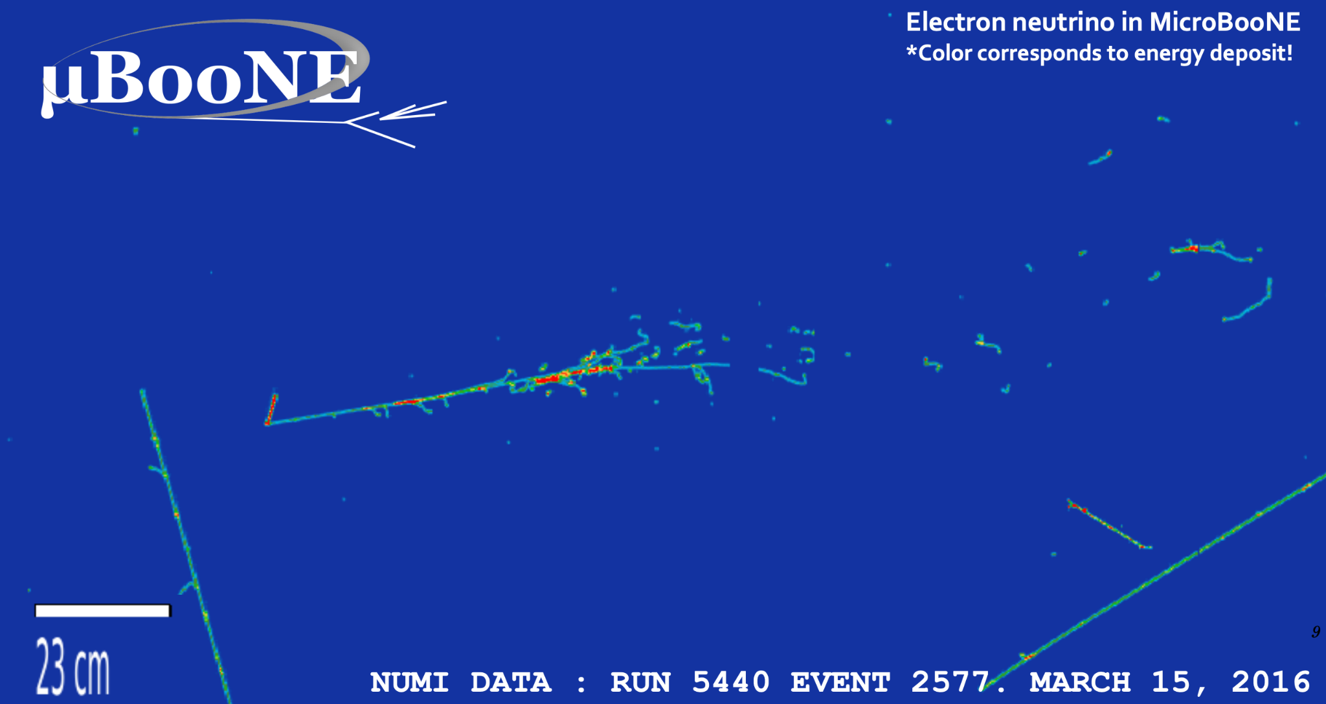
LArTPCs are the ideal choice
Extremely detailed 3D images + calorimetry + PID: unprecedented tool for neutrino interactions & BSM physics
Low Proton Candidate reco threshold ArgoNeuT: 21 MeV
Phys. Rev. D 90, 012008
Electron Candidate
ν_{e}
mm spatial resolution
o(100) keV hit thresholds ArgoNeuT: Phys. Rev. D 99, 012002

Slide 31
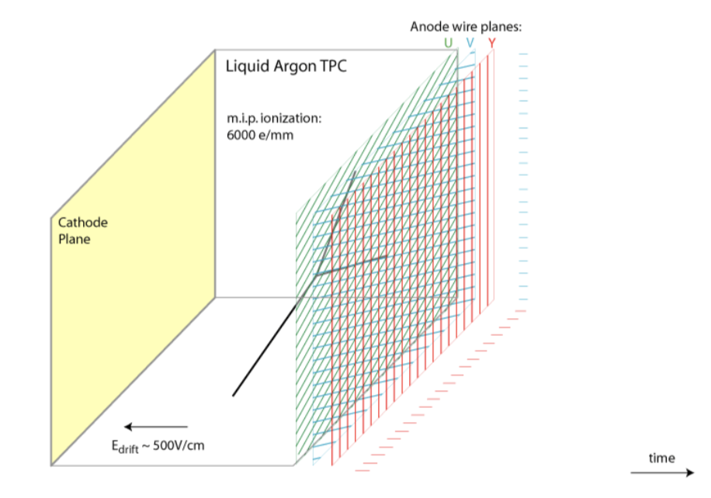
Liquid Argon Time Projection Chamber: Working Principles
Energy loss by charged particles:
Ionization and
Excitation of Ar
Prompt scintillation light emission by Ar₂⁺ starts clock: the light arrives to the light collection system in matter of ns

Slide 32
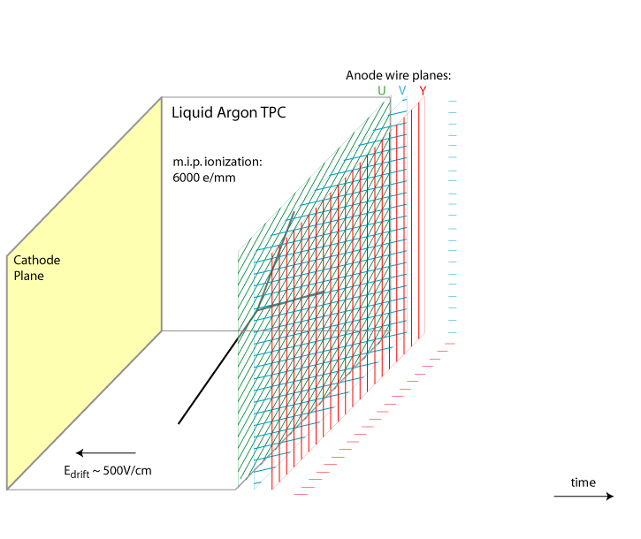
Liquid Argon Time Projection Chamber: Working Principles
Energy loss by charged particles:
Ionization and
Excitation of Ar
Prompt scintillation light emission by Ar₂⁺ starts clock: the light arrives to the light collection system in matter of ns
Electrons drift to anode: the charge arrives to the anode in matter of ms depending on detector size.
(Ar⁺ ions drift to cathode)
Moving electrons induce currents on wires
Tracks are reconstructed from wire signals

Slide 33
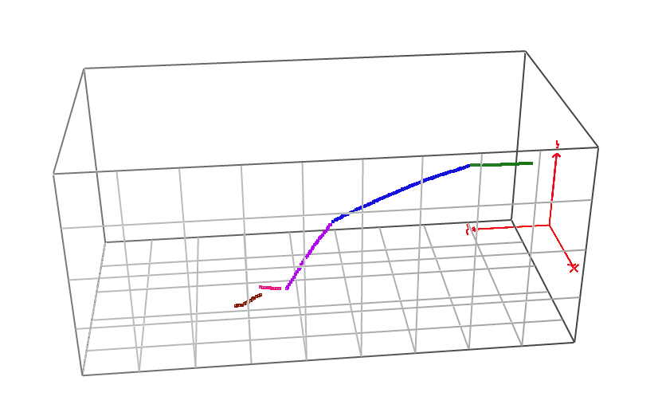
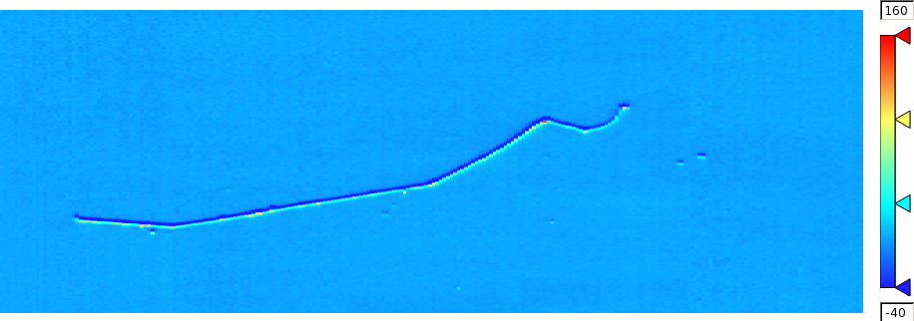
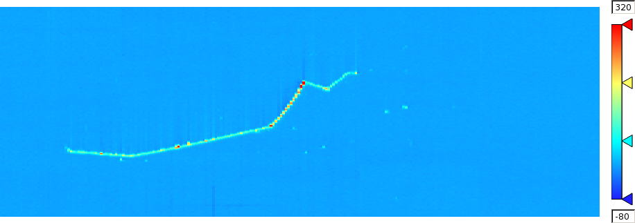
Let’s talk more about the wires a.k.a. y, z, time
⊕
⊕
Drift time =
Induction plane
Collection plane
LArIAT Data
LArIAT Data
Time Tick
Time Tick
K⁺ → μ⁺ → e⁺ Candidate
K⁺ → μ⁺ → e⁺ Candidate
Wire Number
Wire Number
ADC
Wire 74
ADC
Wire 74
Time (ticks)
Time (ticks)

Slide 34
Let’s talk more about the wires a.k.a. y, z, time
⊕
⊕
Drift time =
Induction plane
Collection plane
Bragg peak
LArIAT Data
LArIAT Data
Time Tick
Time Tick
K⁺ → μ⁺ → e⁺ Candidate
K⁺ → μ⁺ → e⁺ Candidate
Wire Number
Wire Number
3D imaging with mm space resolution (driven by wire spacing)
Calorimetry: the charge collected is proportional to energy deposited
PID capabilities

Slide 35
An example of event reconstruction workflow
Disclaimer: the rich data from the LArTPC are suitable for many different workflows and event reconstruction techniques. I’m presenting here an historical/traditional one, but here are more links to less traditional techniques of data processing. Wire-Cell event reconstruction: https://arxiv.org/abs/2011.01375 Convolutional Neural Nets: https://www.bnl.gov/isd/documents/94662.pdf Alright, let’s go “old school” on LArTPC event reconstruction...

Slide 36
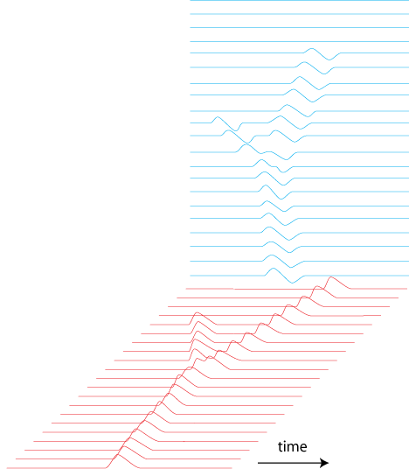
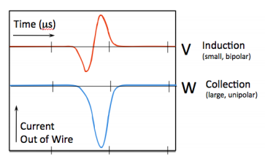
An example of event reconstruction workflow
Induction
Start with raw way forms on your wires and apply noise filter! Apply deconvolution (turn bipolar into unipolar)
Collection

Slide 37
An example of event reconstruction workflow
Induction
Start with raw way forms on your wires and apply noise filter! Apply deconvolution (turn bipolar into unipolar)
Hit reconstruction and identification
Q [ADC]
Threshold for hit definition
(Only collection shown for illustrative purpose)
Gaussian Fit of a hits which determines :
Wire number
Time tick
Hit Amplitude
Hit Width
Collection

Slide 38
An example of event reconstruction workflow
Induction
Start with raw way forms on your wires and apply noise filter! Apply deconvolution (turn bipolar into unipolar)
Hit reconstruction and identification
Clustering of proximal hits
A density-based Spatial Clustering algorithm clusters close and dense hits together
Collection

Slide 39
An example of event reconstruction workflow
Induction
Start with raw way forms on your wires and apply noise filter! Apply deconvolution (turn bipolar into unipolar)
Hit reconstruction and identification
Clustering of proximal hits
2D line reconstruction
3D line reconstruction
3D
2D lines in the 2 views are combined to
form a 3D track (plane to plane match in time). A hit-by-hit association from the 2 planes is then performed to ensure 3D fine granularity. Fundamental step for calorimetry
Collection

Slide 40
An example of event reconstruction workflow
Induction
Start with raw way forms on your wires and apply noise filter! Apply deconvolution (turn bipolar into unipolar)
Hit reconstruction and identification
Clustering of proximal hits
2D line reconstruction
3D line reconstruction
Calorimetry reconstruction of deposited energy
3D
The hits amplitude determines the measurement of the charge collected at the wire planes (proportional to the energy deposited in the TPC, dE ). The hit time and spacing between consecutive hits in the track determine the pitch dx. Together, they provide dE/dx: energy deposited per unit length. This is an important quantity!!
Collection

Slide 41
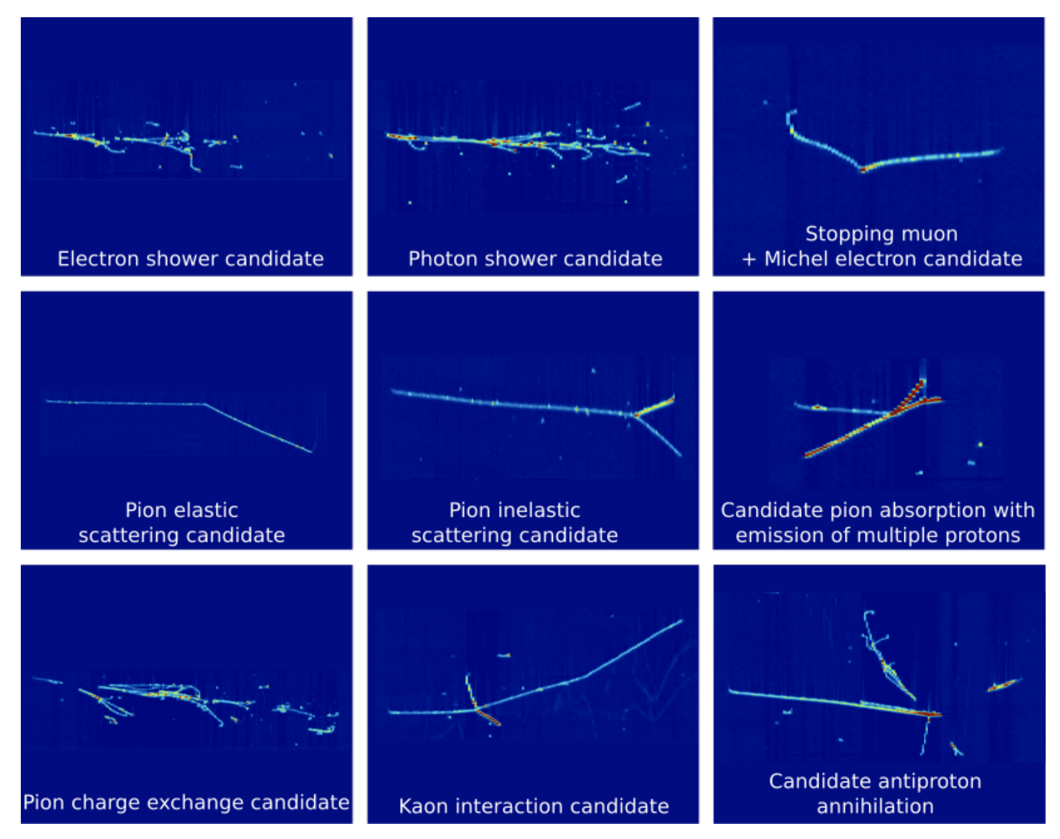
Particle identification (PID). Handle #1: topology
https://arxiv.org/pdf/1911.10379.pdf
LArIAT Data
Particles like pions, protons, kaons and muons leave track-like signatures in the LArTPC. Muons tend to be much longer and “cleaner” than other particles, since they don’t interact hadronically. Particles like electrons and photons (as well as neutral pions who immediately decay into 2 photons) leave shower-like signatures in the LArTPC.
LArIAT Data

Slide 42
Particle identification (PID). Handle #2: dE/dx for showers
How can we distinguish electrons from photons (very important when it comes to neutrino products)? Using the dE/dx at the beginning of the shower.
LArIAT Data
LArIAT Data

Slide 43
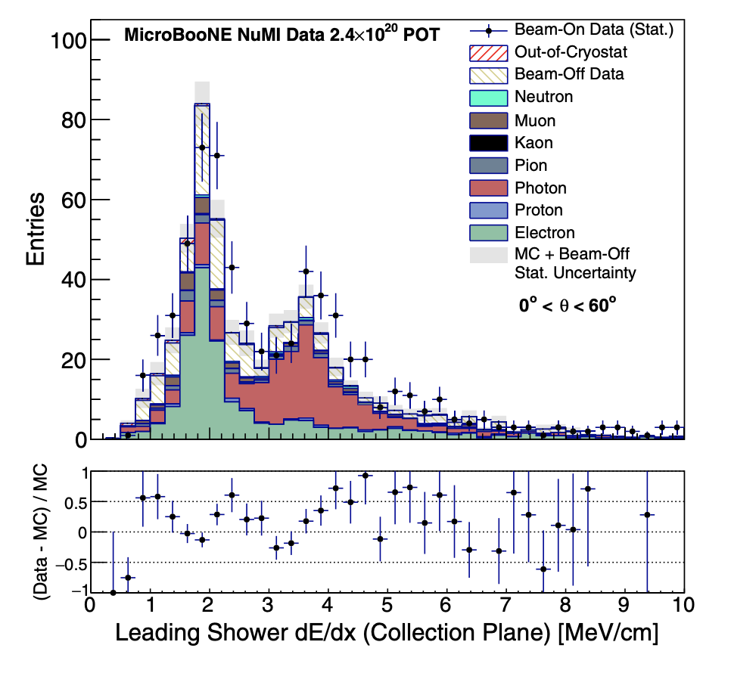
Particle identification (PID). Handle #2: dE/dx for showers
How can we distinguish electrons from photons (very important when it comes to neutrino products)? Using the dE/dx at the beginning of the shower.
LArIAT Data
LArIAT Data
Just like neutrinos, photons are neutral, which means that we can “see” them in the detector only if they interact. An interacting photon “pair converts”, which means it creates an electron-positron pair. This pair deposits double the amount of charge per unit length w.r.t the single electron.
PHYS. REV. D 104, 052002 (2021)

Slide 44
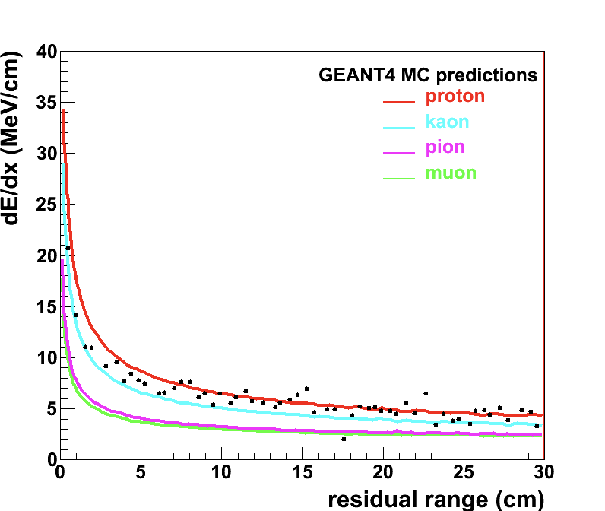
Particle identification (PID). Handle #2: dE/dx for tracks
https://arxiv.org/abs/1205.6747
Bragg peak
LArIAT Data
The amount of energy deposited by a particle while stopping in the detector depends on its mass, i.e. the Bragg peak can be used to differentiate particles species. So, we can use the energy deposited per unit length at each point of a stopping track and where the energy is deposited wrt to the track ending (residual range) to perform particle identification.

Slide 45
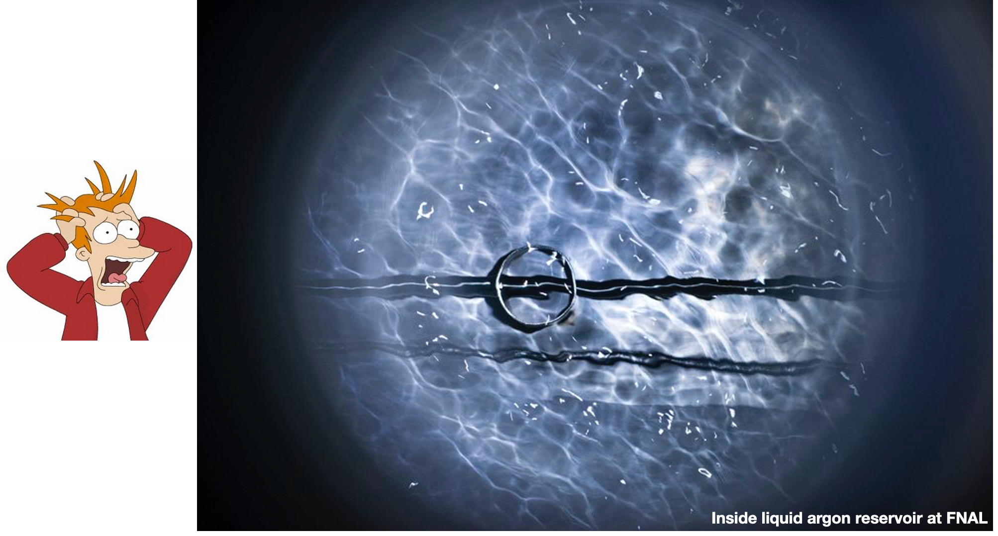
Complications… the microphysics gets in the way!

Slide 46
Complications… the microphysics gets in the way!
Most of the physics handles highlighted hinge on the proper assessment of the energy deposited by the particles in the TPC (dE/dx) via the measurement of the charge seen by the anode wires (dQ/dx). A number of detector effect complicate this relationship (and event reconstruction in general). We’ll treat: - Recombination effects → affects amount of charge produced by the particle - Electron Lifetime → affects amount of charge arriving at the wires - “Space charge” (i.e. local distortion of the electric field) → affects position reco - Diffusion → affects position reco These are important effects every (LAr)TPC need to assess and calibrate for.

Slide 47
Where did my charge go? Recombination
The passage of charged particles in the medium ionizes the Ar.
Example: Stopping proton
-
-
+
+
+
-
-
+
+
+
-
-
-
+
-
+
+
-
+
-
-
+
+
-
-
-
Bragg peak
+
+
-
+
+
-

Slide 48
Where did my charge go? Recombination
The passage of charged particles in the medium ionizes the Ar. What would happen to the charge in absence of electric field?
Example: Stopping proton
-
-
+
+
+
-
-
+
+
+
-
-
-
+
-
+
+
-
+
-
-
+
+
-
-
-
Bragg peak
+
+
-
+
+
-

Slide 49
Where did my charge go? Recombination
The passage of charged particles in the medium ionizes the Ar. What would happen to the charge in absence of electric field? Electrons and ions are termalized and feel each other’s electric field: they all live in the same space, with enough time they’ll find each others. All electrons and ions recombine → excited states
Example: Stopping proton

Slide 50
Where did my charge go? Recombination
The passage of charged particles in the medium ionizes the Ar. What would happen to the charge in absence of electric field? Electrons and ions are termalized and feel each other’s electric field: they all live in the same space, with enough time they’ll find each others. All electrons and ions recombine → excited states → scintillation light emission You get exactly zero charge on your wires… but a lot of light
Example: Stopping proton

Slide 51
Where did my charge go? Recombination
The passage of charged particles in the medium ionizes the Ar. Let’s add the electric field
Example: Stopping proton
-
-
+
+
+
E_{TPC}
-
-
+
+
+
-
-
-
+
-
+
+
-
+
-
-
+
+
-
-
-
+
+
-
+
+
-

Slide 52
Where did my charge go? Recombination
The passage of charged particles in the medium ionizes the Ar. The electric field in the TPC drifts positive ions and negative electrons in opposite directions. Some of the electron charge “gets eaten” by the Ar⁺.
Example: Stopping proton
-
-
+
+
+
E_{TPC}
-
-
+
+
+
-
-
-
+
-
+
+
-
+
-
-
+
+
-
-
-
+
+
-
+
+
-

Slide 53
Where did my charge go? Recombination
The passage of charged particles in the medium ionizes the Ar. The electric field in the TPC drifts positive ions and negative electrons in opposite directions. Some of the electron charge “gets eaten” by the Ar⁺. How much charge recombines determines how much our signal is attenuated.
Example: Stopping proton
-
-
+
+
+
E_{TPC}
-
+
-
+
+
-
+
-
+
+
-
+
-
+
+
Columnar model: electron + nearby ions [Dominant]
-
-
-
+
+
-
Geminate Theory: electron + its ion
+
+
-

Slide 54
Where did my charge go? Recombination
The passage of charged particles in the medium ionizes the Ar. The electric field in the TPC drifts positive ions and negative electrons in opposite directions. Some of the electron charge “gets eaten” by the Ar⁺. How much charge recombines determines how much our signal is attenuated. What does the recombination rate depend on?
Example: Stopping proton
-
-
+
+
+
E_{TPC}
-
+
-
+
+
-
+
-
+
+
-
+
-
+
+
Columnar model: electron + nearby ions [Dominant]
-
-
-
+
+
-
Geminate Theory: electron + its ion
+
+
-

Slide 55
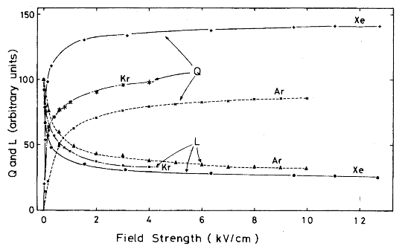
Recombination depends on: the TPC E field
The higher the field the smaller number of electron-ion pair which recombine. This conservation of charge & energy explains the inverse relationship between the light (L) and charge (Q) yield in noble elements.
Most LArTPCs live HERE!
500 V/cm
Phys. Rev. B, vol. 20, no. 8, p. 3486, 1979

Slide 56
Recombination depends on: the particles’ dE/dx
Collective effects are shown to be dominant for recombination: spatial distribution of the ions & electron plays a role → dQ/dx
Example: Stopping proton
-
-
+
+
+
E_{TPC}
-
+
-
+
+
-
+
-
+
+
-
+
-
+
+
Columnar model: electron + nearby ions [Dominant]
-
-
-
+
+
-
Geminate Theory: electron + its ion
+
+
-

Slide 57
Recombination depends on: the particles’ dE/dx
Collective effects are shown to be dominant for recombination: spatial distribution of the ions & electron plays a role → dQ/dx Recombination is then different for MIPs and Protons (HIPs)
Example: Stopping proton
-
-
+
+
+
E_{TPC}
-
+
-
+
+
-
+
-
+
+
-
+
-
+
+
Columnar model: electron + nearby ions [Dominant]
-
-
-
+
+
-
Geminate Theory: electron + its ion
+
+
-

Slide 58
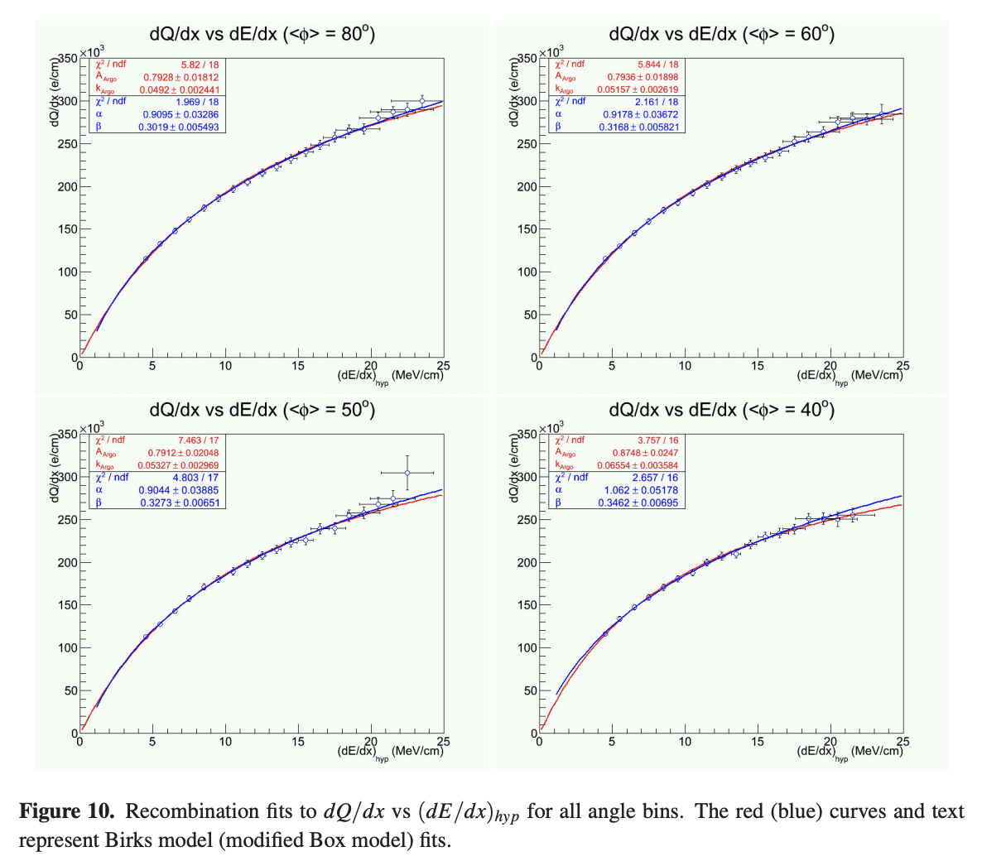
Recombination theoretical models: Birks and Box
https://arxiv.org/pdf/1306.1712.pdf
From the ArgoNeuT experiment
The Birks model → gaussian spatial distribution around the particle trajectory during the entire recombination phase and identical charge mobility for ions and electrons. It considers the charge diffusion coefficient.
The Box model → assumes that electron diffusion and ion mobility are negligible in liquid argon during recombination. These models are generally in accordance to data only in specific regimes: the Birks model for low dE/dx, the Box model for high dE/dX. LArTPC experiments tend to measure the recombination parameters as part of the detector calibration.

Slide 59
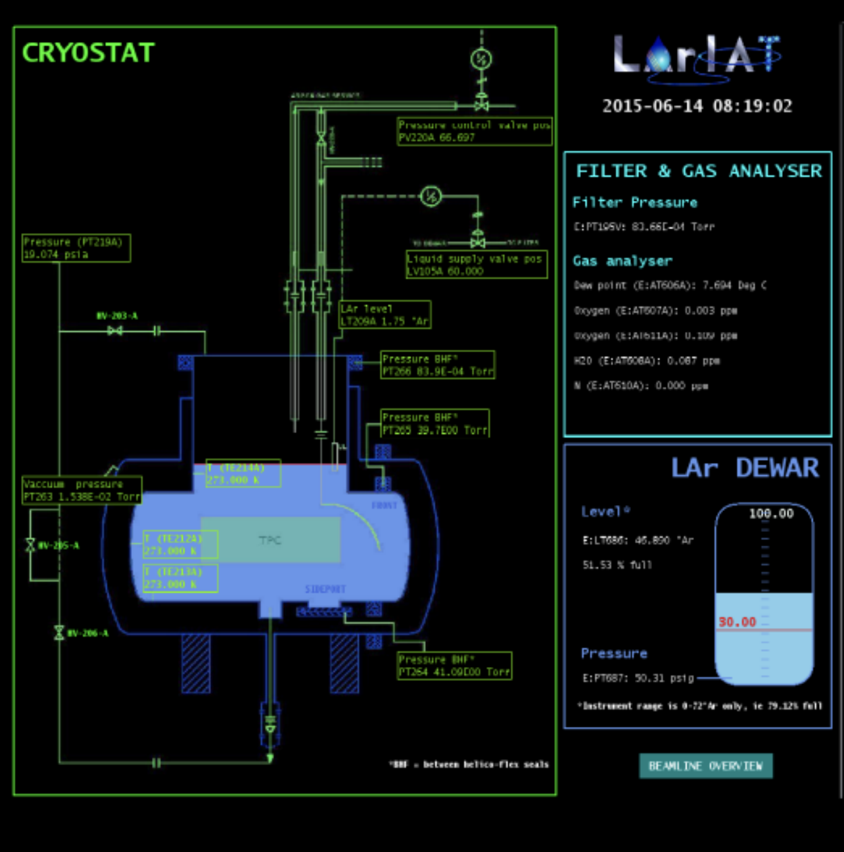
Where did my charge go? Electron lifetime
https://arxiv.org/pdf/1911.10379.pdf
Ionization electrons drift towards the anode, but electronegative contaminants in the argon can neutralize their charge → signal loss! Electronegative contaminant = Oxygen and Water vapor. Contaminants are controlled at the source: commercial Ar ~ graded for 1 ppm of O₂ and H₂O, but for LArTPC operation you need 1 part per trillion! Argon is filtered and analyzed for contaminants before it fills the cryostat. Outgassing (release of water-vapor/O₂ from plastic-like component) is constant → the Argon in the TPC is constantly purified, either from constant injection of new argon (small TPCs) or re-circulation and cleaning (big TPCs). The go-to choice for plastic components in the TPC is G10 because of low outgassing, particularly important at the ullage.

Slide 60
Where did my charge go? Electron lifetime
https://arxiv.org/pdf/1911.10379.pdf
Ionization electrons drift towards the anode, but electronegative contaminants in the argon can neutralize their charge → signal loss! Electronegative contaminant = Oxygen and Water vapor. W/ contaminants, the amount of charge collected at the anode depends on the distance the charge has to travels, or equivalently, the drift time. For a given charge deposited in argon, the charge collected decays exponentially with drift time. Why?

Slide 61
Where did my charge go? Electron lifetime
https://arxiv.org/pdf/1911.10379.pdf
Ionization electrons drift towards the anode, but electronegative contaminants in the argon can neutralize their charge → signal loss! Electronegative contaminant = Oxygen and Water vapor. W/ contaminants, the amount of charge collected at the anode depends on the distance the charge has to travels, or equivalently, the drift time. For a given charge deposited in argon, the charge collected decays exponentially with drift time. The contaminants are uniformly distributed in the Ar volume. My moving charge has the same constant probability of getting neutralized every moment along its journey: dQ = -λ dt Usually we express λ as 1/τ and we call τ electron lifetime. Solving the differential equation...

Slide 62
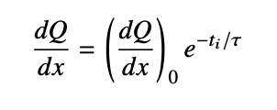
Where did my charge go? Electron lifetime
https://arxiv.org/pdf/1911.10379.pdf
… and remembering that we usually measure dQ/dx in the detector, we get
Lifetime
Drift time
Charge per unit length seen by my wires
Charge deposited when the charge started drifting
How do we measure and monitor this lifetime, (aka how do we calibrate) if potentially the amount of contaminants changes overtime? With a calibrated source of dQ/dx. Any guess at what that could be?

Slide 63
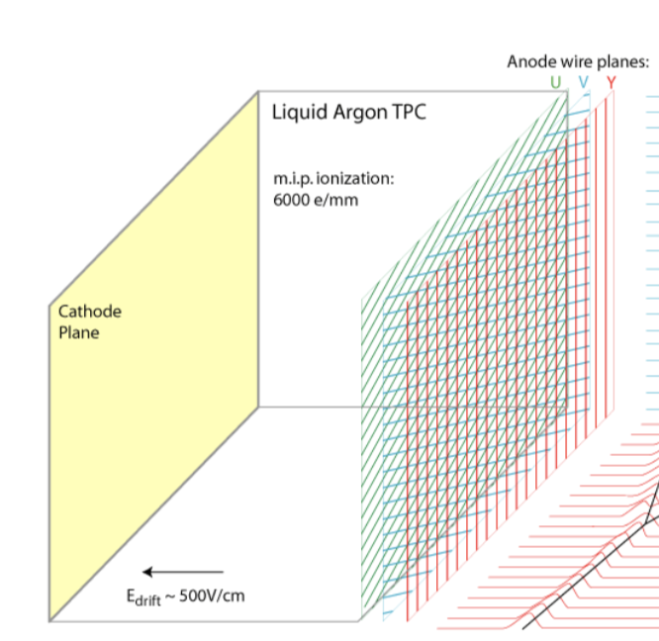
Where did my charge go? Electron lifetime
https://arxiv.org/pdf/1911.10379.pdf
Our calibration should be a source which deposits the same amount of charge everywhere along its path, so that I know this term, and I measure this and this!
High energy muons that cross both the anode and the cathode are the perfect calibration source: the always deposit about 2 MeV/cm along their path. So the difference in the charge collected from the portion of the muon close to the cathode and the portion of the muon close to the anode corresponds to how much charge is “eaten” by the contaminants. We can measure that!

Slide 64
Where did my charge go? Electron lifetime
https://arxiv.org/pdf/1911.10379.pdf
Our calibration should be a source which deposits the same amount of charge everywhere along its path, so that I know this term, and I measure this and this!
Step 1: select a bunch of crossing tracks There are several ways to do this, a common one is relying on external scintillator detectors placed outside TPC and requiring signal coincidence and track matching.

Slide 65
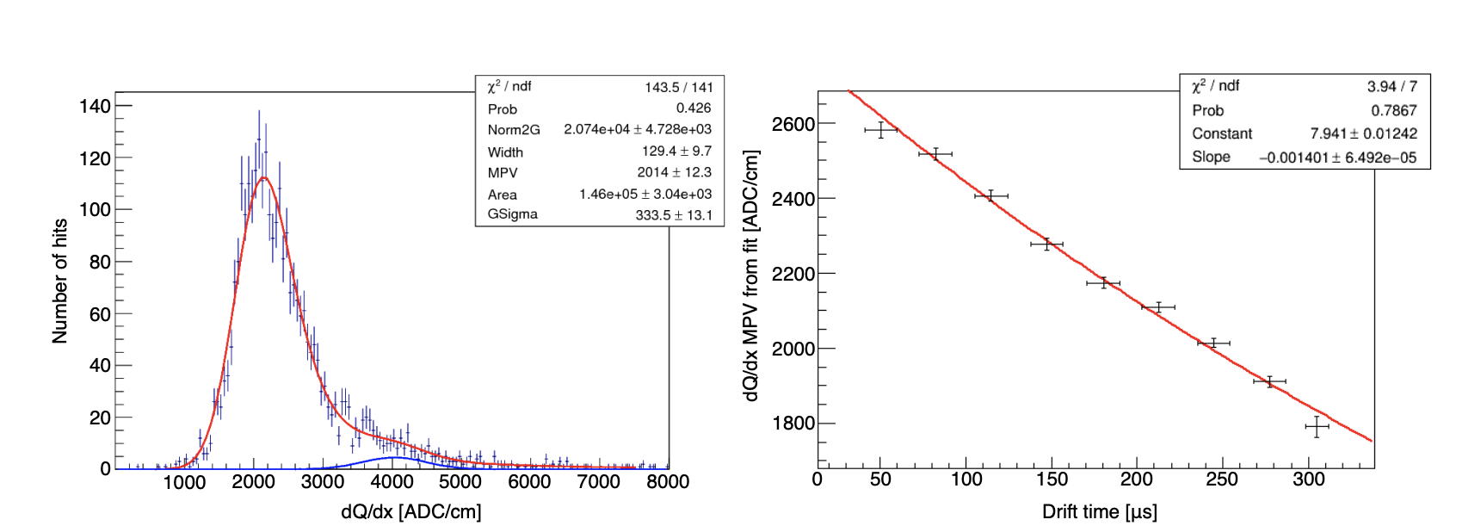
Where did my charge go? Electron lifetime
https://arxiv.org/pdf/1911.10379.pdf
Our calibration should be a source which deposits the same amount of charge everywhere along its path, so that I know this term, and I measure this and this!
Step 2: plot the measured dQ/dx in chunks of arrival time So, this, many many many times. Landau+Gaussians!

Slide 66
Where did my charge go? Electron lifetime
https://arxiv.org/pdf/1911.10379.pdf
Our calibration should be a source which deposits the same amount of charge everywhere along its path, so that I know this term, and I measure this and this!
Step 3: plot all the landaus’ MPV, as a function of time fit with exponential

Slide 67
Did my charge move? Diffusion
Diffusion is the spread of the electron cloud over time.
Example: Stopping proton at time t₀
-
-
+
+
+
E_{TPC}
-
-
+
+
+
-
-
-
+
-
+
+
-
+
-
-
+
+
-
-
-
+
+
-
+
+
-

Slide 68
Did my charge move? Diffusion
Diffusion is the spread of the electron cloud over time.
Example: Stopping proton at time t₁
+
+
+
E_{TPC}
-
-
+
+
+
-
+
-
+
+
+
-
-
-
+
+
-
-
-
-
-
+
-
+
-
+
+
-
-

Slide 69
Did my charge move? Diffusion
Diffusion is the spread of the electron cloud over time. The ions move too, but since their mobility is an order of magnitude less than the electrons, their drift velocity is much smaller.
Example: Stopping proton at time t₂
+
+
+
E_{TPC}
+
+
+
-
-
-
+
+
+
+
-
-
-
-
+
+
-
-
-
-
+
+
-
-
-
+
+
-
-

Slide 70
Did my charge move? Diffusion
Diffusion is the spread of the electron cloud over time. Even if there is a preferential direction of motion, the charge is still affected by thermal random motion → it will spread out!
Example: Stopping proton at time t₃
+
+
+
E_{TPC}
+
+
+
+
-
-
+
+
+
-
-
+
+
-
-
-
-
-
+
+
-
-
-
+
+
-
-
-
-

Slide 71
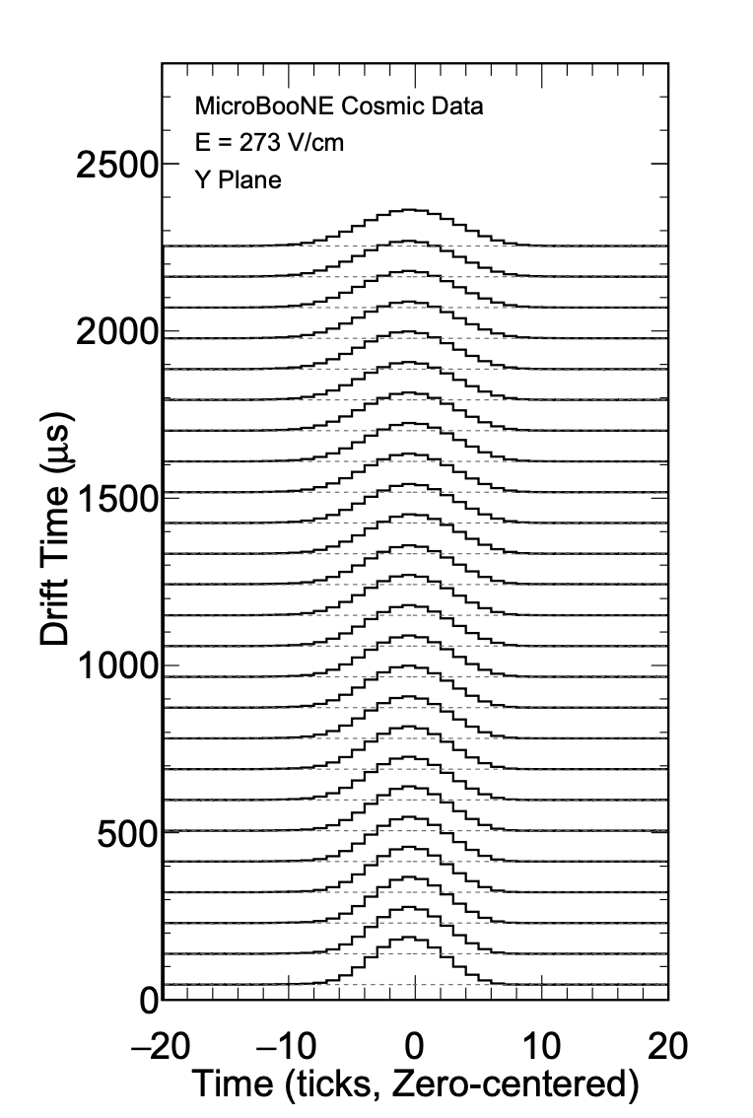
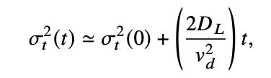
Did my charge move? Diffusion
https://arxiv.org/pdf/2104.06551.pdf
TPCs are anisotropic detectors by construction: not all directions in space “are created equal” because the electric field determines the direction of the electrons’ drift (X). Two separated direction for the spread of the ionization charge: the longitudinal diffusion D_{L} (along the drift direction) and the transverse diffusion D_{T} (perpendicular to the drift direction). The transverse diffusion determines how well you can know the position of the charge in the YZ plane. For meters long TPC, the spread if order of mm → pitches smaller than 3 or 4 mm are not advantageous For a measurement of D_{L} is obtained sampling a calibrated source like cosmic ray muons and using:

Slide 72
Did my charge move? Space charge effect
https://arxiv.org/pdf/2008.09765.pdf
Remember the Ar⁺ ions which are slowly moving towards the cathode? Where do they go?
Example: Stopping proton at time t₃
+
+
+
E_{TPC}
+
+
+
+
-
-
+
+
+
-
-
+
+
-
-
-
-
-
+
+
-
-
-
+
+
-
-
-
-

Slide 73
Did my charge move? Space charge effect
https://arxiv.org/pdf/2008.09765.pdf
Remember the Ar⁺ ions which are slowly moving towards the cathode? Where do they go? They are absorbed by the cathode, but if you have a constant production of ions which are moving slowly, as in the case of LArTPC on the surface which are exposed to a constant rate of cosmic rays, they build up. Why is this “bad”?
Example: Stopping proton at time t₃
+
+
+
+
+
+
-
+
+
-
+
+
-
-
+
+
-
-
-
-
-
+
+
-
-
-
+
+
-
-
-
-

Slide 74
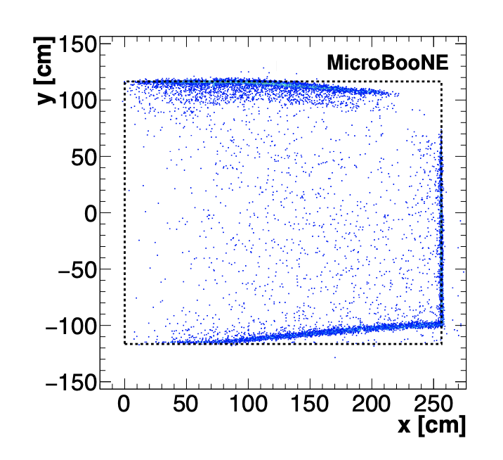
Did my charge move? Space charge effect
https://arxiv.org/pdf/2008.09765.pdf
Ions are positive charges, so they distort the electric field around them → your position reconstruction is affected, and so is recombination. E.g. Entry/exit points of reconstructed cosmic muon tracks coincident with a signal from a muon counter located outside of the cryostat.
The points are shown in the 𝑥−𝑦 plane. W/o SCE and its associated non-uniform electric field in the detector volume, the points should be located strictly along the TPC boundaries (dashed lines). The anode is located at 𝑥 = 0 cm while the cathode is at 𝑥 = 256 cm. Another effect to be calibrated out w/ muons!

Slide 75
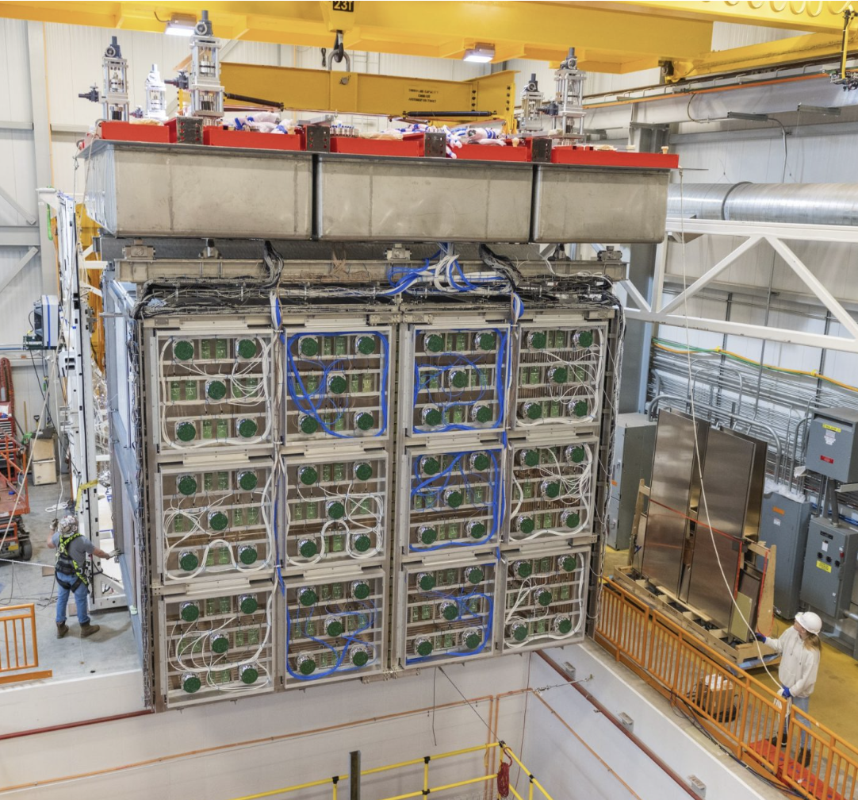
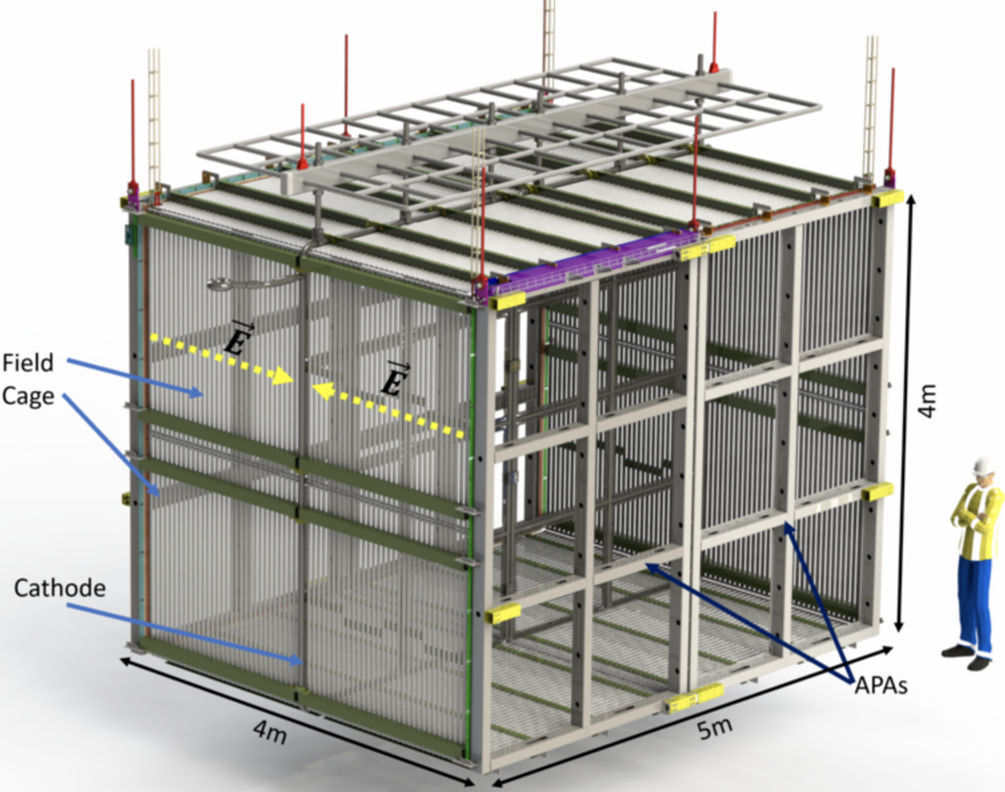
Time Projection Chambers for neutrino physics
SBND

Slide 76
Time Projection Chambers for neutrino physics
SBND

Slide 77
Noble element detectors for Dark Matter

Slide 78
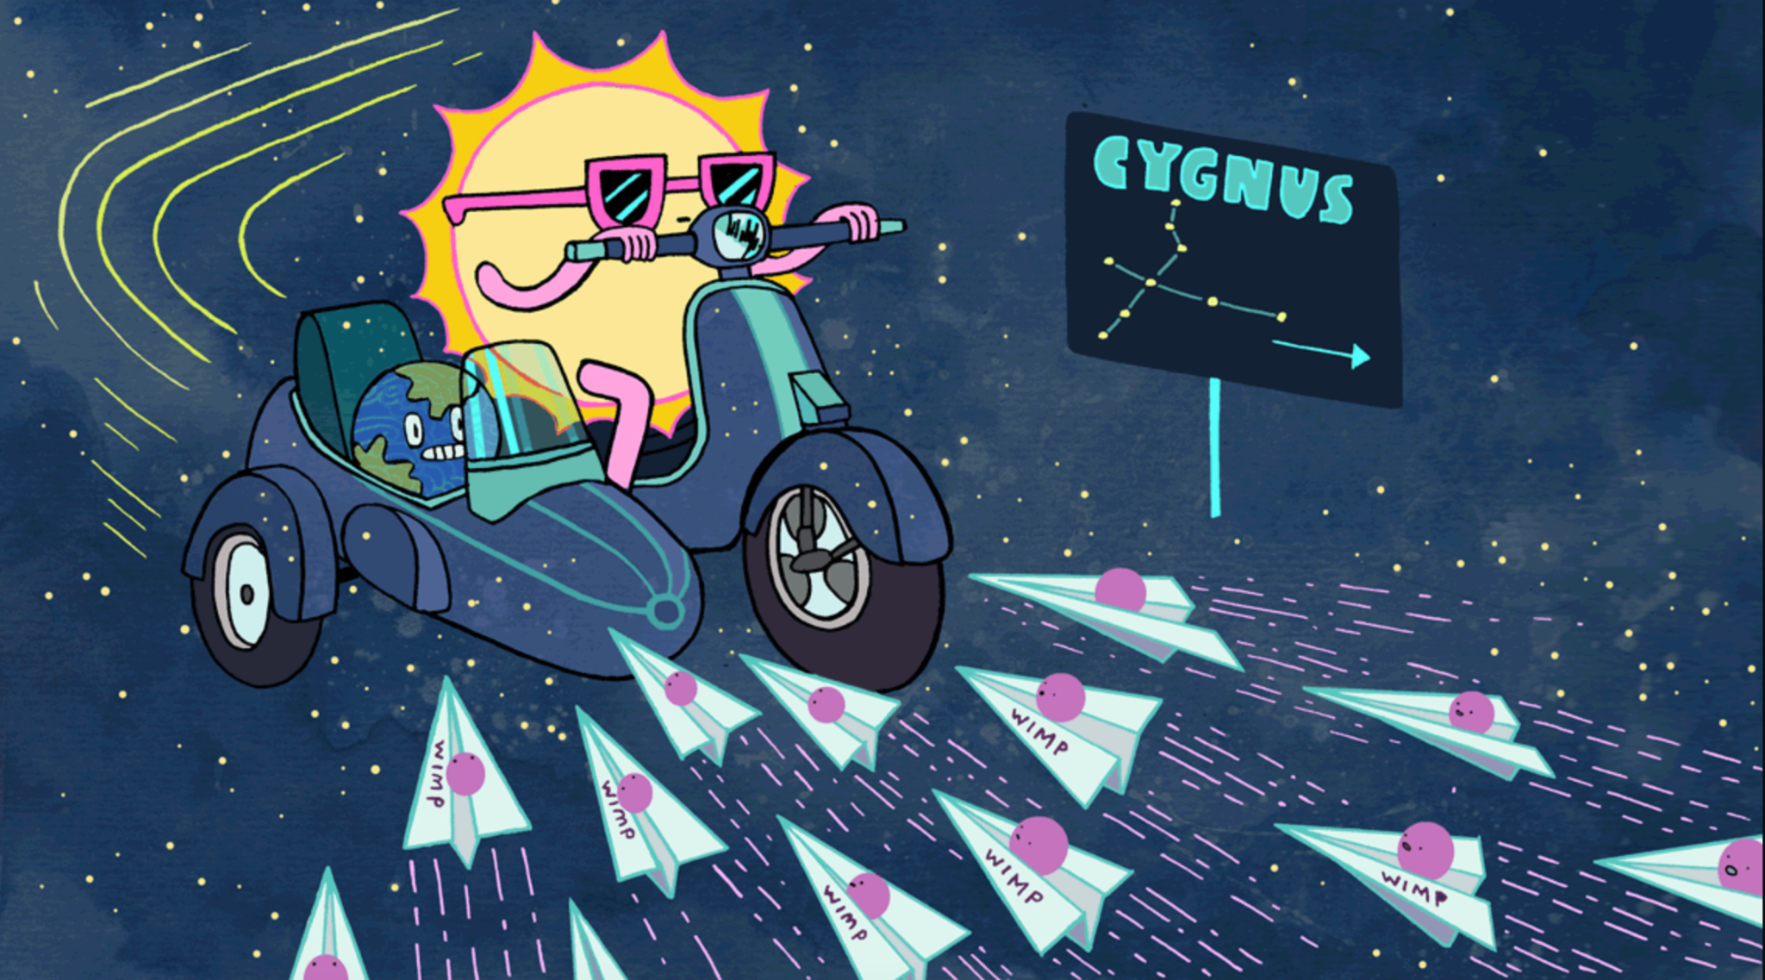
What do we detect in Dark Matter direct detection?
Weakly Interacting Massive Particles from the Milky way halo: “DM wind”
Artwork by Sandbox Studio, Chicago with Corinne Mucha

Slide 79
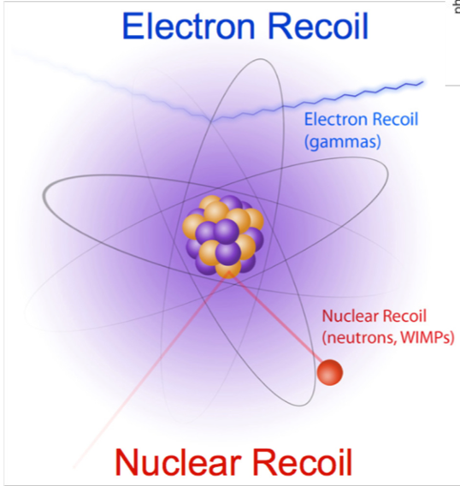
What do we detect in Dark Matter direct detection?
Background
Detect the nucleus recoiling from a weak Χ-N interaction
SIGNAL!

Slide 80
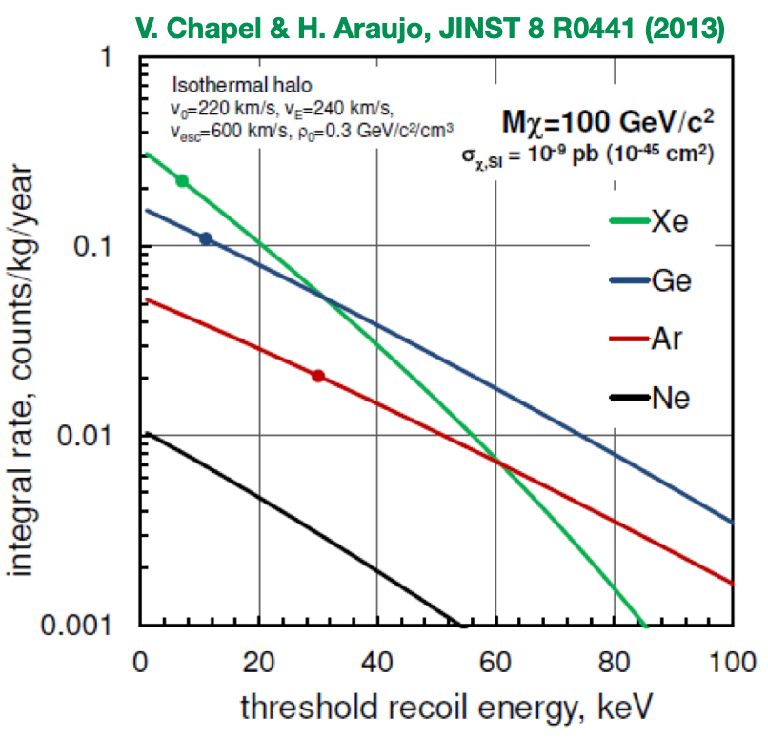
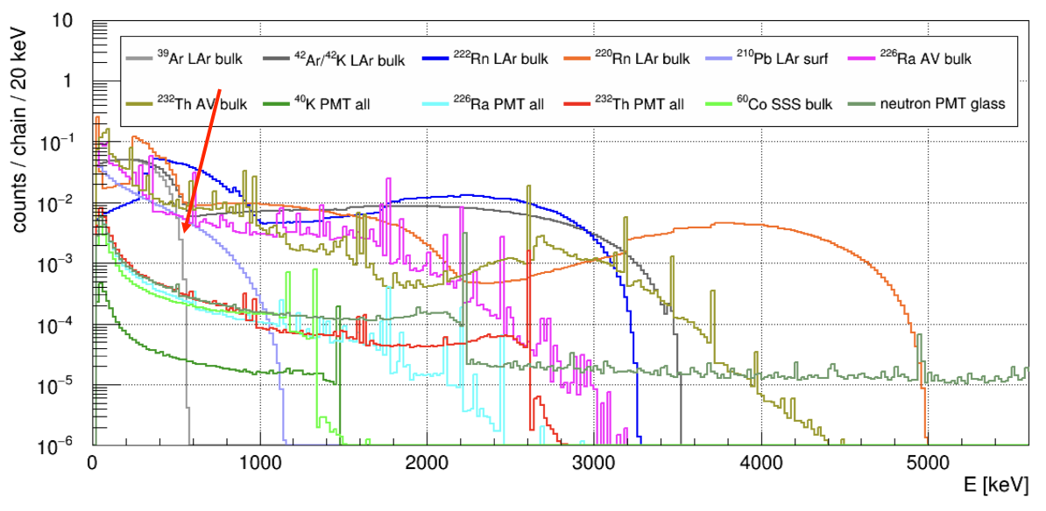
Requirements for Dark Matter noble elements detectors
- DM (WIMP) interaction probability is extremely small → very large detectors (ton-scale):
- Detect the nucleus recoiling from a weak Χ-N interaction → low-energy detection thresholds (keV)
- And distinguish that recoil from natural radioactivity → low background
Ar seems a good choice, but ³⁹Ar (≤565 keV) contamination
So Xe became the default (until we found underground Ar)
DEAP Collaboration, Phys. Rev. D 100, 072009 (2019)

Slide 81
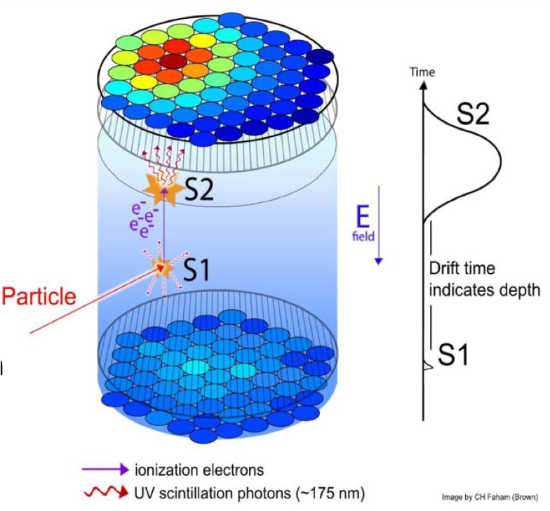
Liquid Xenon TPCs for Dark Matter
→ Dual-phase TPC: liquid & gas
→ Amplification (e.g.~30ph/e⁻) of charge with electroluminescence (S2) in vapor phase
→ Self-shielding: attenuation lengths of photons <10 cm for few MeV photons (additional shielding w/ outer detectors)
→ Position identification ~mm level (helps w/ bgk discrimination) → Calibration done w/ injection of sources

Slide 82
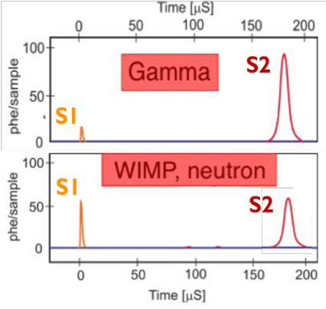
Liquid Xenon TPCs for Dark Matter
→ Combining S1 (scintillation) and S2 (amplified electroluminescence) allows for Pulse Shape Discrimination: differentiate signal and background

Slide 83
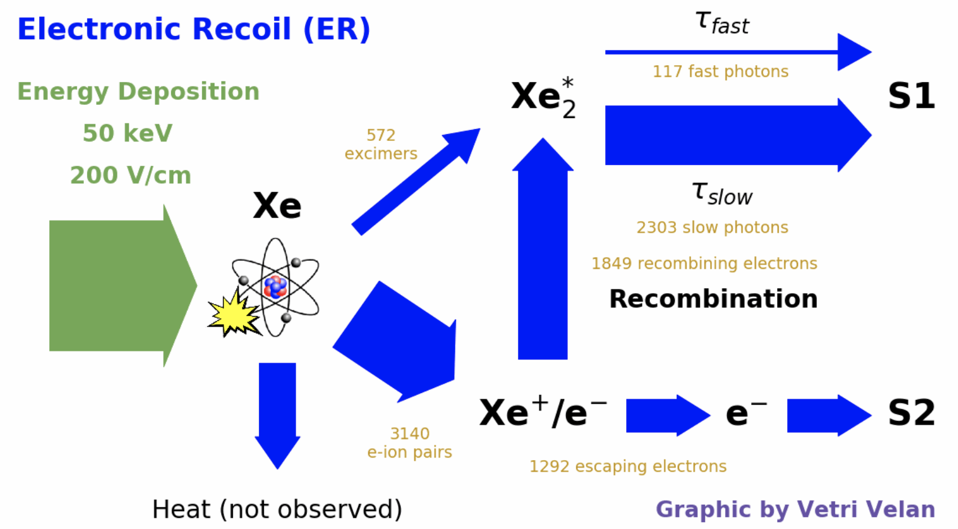
Liquid Xenon TPCs for Dark Matter

Slide 84
Liquid Xenon TPCs for Dark Matter

Slide 85
Liquid Xenon TPCs for Dark Matter
→ Combining S1 (scintillation) and S2 (amplified electroluminescence) allows for Pulse Shape Discrimination: differentiate signal and background

Slide 86
Liquid Argon TPCs for Dark Matter
LAr is also powerful for dark matter search, but ³⁹Ar is a big issue… until now!

Slide 87
Underground argon
³⁹Ar is produced by cosmic ray activation → “shielded” UAr shows a ³⁹Ar depletion of o(10³) Extraction of UAr in C CO₂ rich gas-wells (by-product of C0₂ extraction)
link

Slide 88
Liquid Argon for Dark Matter
DarkSide: Dual phase TPC
DEAP: single-phase detectors (not TPCs as they only use the scintillation light)

Slide 89
Liquid Argon for Dark Matter
DarkSide: Dual phase TPC
DEAP: single-phase detectors (not TPCs as they only use the scintillation light)
Notes:
DEAP uses only the fast/slow component of the light

Slide 90
Noble element detectors for Neutrinoless Double Beta Decay

Slide 91
0νββ in a nutshell
Neutrinoless double beta decay hypothetical type of radioactive decay in which a nucleus emits two electrons without the emission of any neutrinos. Only allowed for double β decaying nuclei (the ones for which single beta is forbidden). Half life > 10²⁵ years

Slide 92
0νββ in a nutshell
Here, there is no choice! The only noble element that can undergo double beta decay is ¹³⁶Xe

Slide 93
What do we detect in 0νββ? Requirements noble elements detectors
We measure the energy of the 2 outgoing electrons with as much precision as possible: → Very large detectors (ton-scale) → Excellent energy resolution → Very low background → Energy of interest: 2.5 MeV
Relative peak heights not to scale!!
Two choices of technology: Liquid Xe TPC or Gaseous Xe TPC

Slide 94
LXe TPC for 0νββ
Single-phase TPC (collects both charge and light directly)

Slide 95
LXe TPC for 0νββ
Single-phase TPC (collects both charge and light directly)

Slide 96
HPgXeTPC for 0νββ
High pressure gas TPC
NEXT schematics

Slide 97
Why gas HPgXeTPC?
Density is low → need high pressure
Better for low-energy (extended tracks)

Slide 98
0νββ: energy resolution & bkg rejection is the name of the game
For HPgXe TPC: topological separation power between signal and background

Slide 99
Why gas HPgXeTPC?
Density is low → need high pressure
Better for low-energy (extended tracks)
Great intrinsic energy resolution

Slide 100
0νββ: energy resolution & bkg rejection is the name of the game
For HPgXe TPC, energy resolution at the level of sub-percent

Slide 101
Why gas HPgXeTPC?
Density is low → need high pressure
Better for low-energy (extended tracks)
Great intrinsic energy resolution
Easy calibration
Krypton calibrations used to correct for the finite drift-electron lifetime & dependence on the event transverse position and edge effect
Notes:
which is caused by variations in solid angle coverage both for direct and reflected light and edge effects.

Slide 102
Why gas HPgXeTPC?
single fluorescent molecule
Density is low → need high pressure
Better for low-energy (extended tracks)
Great intrinsic energy resolution
Easy calibration “Easier” Barium Tagging
Bench-top experiments for developing Ba tagging (Ba ion beam source + high pressure microscope)
Identification of 0νββ via the observation of the daughter atom in the decay (cannot be generated by radioactive backgrounds). For ¹³⁶Xe → ¹³⁶Ba²⁺
Notes:
which is caused by variations in solid angle coverage both for direct and reflected light and edge effects.

Slide 103
Takeaways & Outlook

Slide 104
Takeaways!
Detectors see particles by the energy they leave behind → energy loss shows up mainly in the form of ionization, scintillation light. → using both handles gives improves energy resolution (crucial for 0νββ) We never see neutrinos or DM directly, only the products of their interactions
→ Charged particles are “easily” detectable → Neutral particles (e.g. γ/π⁰) need to produce charged particle to be seen → Electron vs nuclear recoil is tricky: needs exquisit understanding of light emission
The questions you can answer in neutrino, dark matter and 0νββ physics highly depend on the smart choices you make in your detector technology.

Slide 105
Takeaways!
Noble element detectors have played and are playing a huge role in many areas of particle physics
→ These detectors are versatile and scalable
→ But a lot of details are important require particular attention
→ A lot of R&D (and fun) remains to do to bring the full potential of these great detectors!

Slide 106
A lot of R&D for future detectors
→ 3D (pixel) readout for TPCs (LArPix, QPix,…)
→ Ultra-low noise charge detector
→ Signal amplification in liquid
→ Integrated readout solutions for light and charge
→ New and/or improved light detection devices
→ New wavelength shifting methods (thin films, fluorescent and scintillating material, quantum dots, …)
→ New highly reflective materials
→ Target mixture and medium doping
→ Scintillating bubble chambers (Xe, Ar)
→ Ion TPCs and ion tagging
→ Novel detector structures and layouts
→ Novel purity monitors
→ Phonons and rotons (direct or indirect) detection
→ Study of microphysics and calibration for charge, light and heat

Slide 107
One example to make the LArTPC better: pixels!
A fundamental issue with LArTPC w/ projective readouts (wires): highly anisotropic detectors... the readout affects the possibility of maintaining the intrinsic 3D quality of the events. In 2D projective readouts, the readout space DOES NOT coincide w/ the physical space: traditional LArTPCs use sets of wire planes at different angles to reconstruct the transverse position → automatic plane matching is difficult, especially for complex topologies. Constructing anode planes with pixels instead of wires can solve a number of shortcomings of 2D projective readouts.

Slide 108
One example to make the LArTPC better: pixels!
More resilient against single point failure and simpler to construct. Small pixels sizes (4x4 mm² ) provide comparable spatial resolution, but the readout space coincides w/ the physical projected space:
→ native 3D reconstruction
→ abated ambiguities (mm vs m projections)
Shortcoming: massive amounts of readout channels “Pixelizing”
A massive detector such as a 10kTon DUNE module requires O(130.0 million) pixels vs
O(1.5 million) wires.

Slide 109
One example to make the LArTPC better: pixels!
Creative solutions such as Q-Pix and LArPix are under development. Q-Pix: https://arxiv.org/abs/1809.10213 LArPix: https://arxiv.org/abs/1808.02969 But we need your ingenuity to make the next generation of noble element detectors!!!

Slide 110
Literature review
LArTPC intro: Chapter 2 https://lss.fnal.gov/archive/thesis/2000/fermilab-thesis-2018-24.pdf Recombination: https://arxiv.org/pdf/1306.1712.pdf Lifetime: https://arxiv.org/pdf/0910.5087.pdf Space charge: https://arxiv.org/pdf/2008.09765.pdf Signal processing: https://arxiv.org/pdf/1802.08709.pdf https://arxiv.org/pdf/1804.02583.pdf LArIAT Detector description: https://arxiv.org/pdf/1911.10379.pdf Scintillation Light: https://dspace.mit.edu/handle/1721.1/101327
Thank you!
Special thanks to the LArIAT, MicroBooNE & ArgoNeut Collaborations, Dr Asaadi, Dr Jones & Dr Soderberg, Dr. Raaf and Prof. Guenette for helping me gather the presented material

Slide 113
Did my charge move? Space charge effect
https://arxiv.org/pdf/2008.09765.pdf
Calibration relies again on “mapping” the electric field in the whole TPC volume. 1. You select muon events where you know where the charge was deposited either via external detectors or anode and cathode piercing tracks. Or, you map out the TPC by shining a laser w/ know direction (“perfect” muon). 2. you see what your event reconstruction tells you about the reconstructed muon position (position of each hit) 3. you calculate the difference in each x,y,z point in the detector
Blue: true muons path Purple: reconstructed position distorted by SCE (exaggerated )

Slide 114
Heavy charged particle (i.e. not electrons)
Mean Energy Loss per Unit Length (To get it in MeV/cm, you must multiply by density of material)
Particles in the range of 𝛽𝛾 ~ 0.1-1000 lose energy primarily by ionization: → Bethe-Bloch equation describes mean energy loss in that range → Most particles in accelerator-based neutrino experiments produce particles in this range

Slide 115
Heavy charged particle (i.e. not electrons)
Mean Energy Loss per Unit Length
Region just above minimum ionization is known as the “relativistic rise” where dE/dx roughly plateaus, but is very near minimum. Particles near the minimum are often called MIPs (minimum ionizing particles)

Slide 116
Mean energy loss <dE/dx>
Problem. Bethe-Bloch formula only gives the mean energy loss: → Single measurements have large fluctuations (Landau distribution) Mitigation strategies:
1) Neglect x% of measurements with highest dE/dx (typically 20-30%), restrict dE/dx (“truncated mean”)

Slide 117
Mean energy loss <dE/dx>
Problem. Bethe-Bloch formula only gives the mean energy loss: → Single measurements have large fluctuations (Landau distribution) Mitigation strategies: 2) Measure dE/dx many times along a track and fit a Landau distribution
Charged pions and muons traveling through the LArIAT TPC → measure particles every 3-4 mm

Slide 118
Mean energy loss <dE/dx>
Problem. Bethe-Bloch formula only gives the mean energy loss: → Single measurements have large fluctuations (Landau distribution) Mitigation strategies: 2) Measure dE/dx many times along a track and fit a Landau distribution
Charged pions and muons traveling through the LArIAT TPC → measure particles every 3-4 mm
What are these?

Slide 119
Mean energy loss <dE/dx>
Problem. Bethe-Bloch formula only gives the mean energy loss: → Single measurements have large fluctuations (Landau distribution) Mitigation strategies: 2) Measure dE/dx many times along a track and fit a Landau distribution
Charged pions and muons traveling through the LArIAT TPC → measure particles every 3-4 mm
δ-rays!

Slide 120
Heavy charged particle (i.e. not electrons)
Mean Energy Loss per Unit Length
Particles below the minimum ionization point start to lose more energy as they slow down
Can be used to identify which type of particle you have detected → Bragg Peak!

Slide 121
Particle identification with dE/dx
For a given momentum, dE/dx is different for particles with different masses Measure both momentum and dE/dx ⇒ particle ID (for a certain range of momenta)
Bragg peaks: stopping particles deposit more energy the slower it goes

Slide 122
LArTPCs… And how to measure momentum w/o B field
Momentum by range. If the detector is long enough to stop a particle: determine the momentum by measuring its range.
stopping
stopping
Not so much..

Slide 123
LArTPCs… And how to measure momentum w/o B field
Momentum by range. If the detector is long enough to stop a particle: determine the momentum by measuring its range. How far (on average) will a 1 GeV/c muon travel in iron (density = 7.86 g/cm3)?
stopping
stopping
Not so much..

Slide 124
LArTPCs… And how to measure momentum w/o B field
Momentum by range. If the detector is long enough to stop a particle: determine the momentum by measuring its range. How far (on average) will a 1 GeV/c muon travel in iron (density = 7.86 g/cm3)?
stopping
stopping
Not so much..

Slide 125
Heavy charged particle at high momenta
For particles with 𝛽𝛾 ≳1000, radiative energy losses dominate
Bethe-Bloch not valid here (dE/dx here is not simply a function of 𝛽).
Energy losses due to bremsstrahlung and knock-on electrons (delta rays)

Slide 126
Bremsstrahlung “braking radiation”
Emission of EM radiation (photons) due to a charged particle scattering in the electric field of a nucleus.
For heavy particles, this starts to dominate the energy loss when they are ultra-relativistic (above 𝛽𝛾~1000)
It is much more important for electrons, as it is the dominant energy loss mechanism above electron energies of ~10-100 MeV (depends on material)
Radiation length X⁰
Fractional energy loss per radiation length

Slide 127
Radiation length and EM showers
The radiation length, X₀, of a material is defined as the distance over which the electron energy is reduced by 1/e (~63%) via bremsstrahlung radiation: → Measured in cm or in g/cm² (trick: unit analysis for density) → Roughly, 1 electron emits 1 brem photon for every 1 X₀ of material traversed Radiation length also describes the distance over which photons pair produce (interact with a nucleus to convert to an electron-positron pair):
Shower continues until all electrons fall below the critical energy (i.e., no more brems).

Slide 128
Radiation length and EM showers
The radiation length, X₀, of a material is defined as the distance over which the electron energy is reduced by 1/e (~63%) via bremsstrahlung radiation: → Measured in cm or in g/cm² (trick: unit analysis for density) → Roughly, 1 electron emits 1 brem photon for every 1 X₀ of material traversed Radiation length also describes the distance over which photons pair produce (interact with a nucleus to convert to an electron-positron pair):

Slide 129
Radiation length and EM showers
The length of an EM shower is typically measured in units of X₀
The “width” (transverse to initial particle direction) is measured in units of Moliere radius (RM):
Roughly speaking, all EM showers look similar, independent of material and energy

Slide 130
Hadron showers
Hadrons (particles that interact via the strong force, like baryons and mesons) are likely to interact within one “interaction length” (𝜆_{I})
Can produce tracks and/or showers:
→ If the initial hadron only has enough energy to travel less < 1 interaction length (losing energy via ionization only) → track
→ If it has enough energy to travel longer > 1 interaction length, you’ll probably get a shower
→ Hadron showers are complicated, and can have some EM showers embedded within them! Cause: π⁰!
Hadron showers are typically “wider” than EM showers.

Slide 131
Electron vs hadron showers
Which is an EM shower?
Are these CC or NC neutrino interactions are these?

Slide 132
Electron vs hadron showers
Which is an EM shower?
Are these CC or NC neutrino interactions are these?

Slide 133
Neutrino interactions: in theory…
Neutrino-electron elastic scattering
Neutrino interactions with atomic electrons, nuclei and nucleons are mediated exclusively by the weak force. If W is exchanged: Charged Current! → corresponding charged lepton in the final state → need enough energy to produce the massive lepton If Z is exchanged: Neutral Current! → no charged lepton in the final state (no threshold)
Neutrino-nucleus scattering

Slide 134
Neutrino interactions: in theory…
Neutrino-electron elastic scattering
Neutrino interactions with atomic electrons, nuclei and nucleons are mediated exclusively by the weak force. If W is exchanged: Charged Current! → corresponding charged lepton in the final state → need enough energy to produce the massive lepton If Z is exchanged: Neutral Current! → no charged lepton in the final state (no threshold)
Neutrino-nucleus scattering

Slide 135
Neutrino interactions: in theory…
Neutrino-electron elastic scattering
Neutrino interactions with atomic electrons, nuclei and nucleons are mediated exclusively by the weak force. If W is exchanged: Charged Current! → corresponding charged lepton in the final state → need enough energy to produce the massive lepton If Z is exchanged: Neutral Current! → no charged lepton in the final state (no threshold)
Neutrino-nucleus scattering

Slide 136
Neutrino interactions: in theory…
At low energies, neutrinos interact with atomic electrons and nuclei as a whole (coherent) → At higher energies, they interact with nucleons (n or p) inside a nucleus (CCQE&RES) → At the highest energies, the neutrino transfers enough energy to break the nucleus (DIS)
Neutrino-nucleus CC Interactions

Slide 137
Neutrino interactions: … in the experiment!
At low energies, neutrinos interact with atomic electrons and nuclei as a whole (coherent) → At higher energies, they interact with nucleons (n or p) inside a nucleus (CCQE&RES) → At the highest energies, the neutrino transfers enough energy to break the nucleusc(DIS)
Neutrino-nucleus scattering
DIS candidate as seen by the ArgoNeut experiment
CC-QE like candidate as seen by the MicroBooNE experiment

Slide 138
The scale of the problem
Neutrinos are the most abundant massive particle in the universe, and one of the least understood. They are neutral: we can’t directly detect them.
We can study them only if they interact, but… Neutrino interaction probability is extremely small!!!
ν
7 ½ earths

Slide 139
Neutrino sources and their XS sections
Neutrinos are produced in any thermonuclear reaction occuring in the Universe… ~100 trillion go through your thumb every second. Most of them come from the sun. Their probability of interaction (cross section) with atomic electrons and nuclei tends to increase with energy.

Slide 140
Building our first neutrino experiment
Since the probability for interaction is very small (~10⁻³⁸ cm²) how would you increase your chances of seeing a neutrino event?

Slide 141
Building our first neutrino experiment
Since the probability for interaction is very small (~10⁻³⁸ cm²) how would you increase your chances of seeing a neutrino event? → Send a lot of neutrinos through it! → Large detector mass (and high detection efficiency) and a long exposure

Slide 142
An early days radiochemical experiment: Homestake
2002
Run from 1970 until 1994. Utilized 100000 gallons of dry-cleaning fluid to detect solar neutrinos.
Notes:
0.5-1 neutrinos per day 2,200

Slide 143
An early days radiochemical experiment: Homestake
2002
Run from 1970 until 1994. Utilized 100000 gallons of dry-cleaning fluid to detect solar neutrinos. Neutrino absorbed by nucleus, converting neutron to proton: → New nucleus (³⁷Ar) is unstable with long ½ life (35 days)
→ Every few weeks, the unstable radioactive isotope is extracted via helium bubbling from the huge tank and collected on a small counter and you wait for its decay: # of decays = # neutrino interactions Davis counted ~ ⅓ of Bahcall expected neutrinos from the sun.. birth of the SOLAR neutrino problem.

Slide 144
An early days radiochemical experiment: Homestake
2002
Run from 1970 until 1994. Utilized 100000 gallons of dry-cleaning fluid to detect solar neutrinos. Neutrino absorbed by nucleus, converting neutron to proton: → New nucleus (³⁷Ar) is unstable with long ½ life (35 days)
→ Every few weeks, the unstable radioactive isotope is extracted via helium bubbling from the huge tank and collected on a small counter and you wait for its decay: # of decays = # neutrino interactions Davis counted ~ ⅓ of Bahcall expected neutrinos from the sun.. birth of the SOLAR neutrino problem.
Ideas on how to experimentally fix this problem?

Slide 145
An early days experiment: Homestake
2002
Run from 1970 until 1994. Utilized 100000 gallons of dry-cleaning fluid to detect solar neutrinos. Neutrino absorbed by nucleus, converting neutron to proton: → New nucleus (³⁷Ar) is unstable with long ½ life (35 days)
→ Every few weeks, the unstable radioactive isotope is extracted via helium bubbling from the huge tank and collected on a small counter and you wait for its decay: # of decays = # neutrino interactions Davis counted ~ ⅓ of Bahcall expected neutrinos from the sun.. birth of the SOLAR neutrino problem.
Ideas on how to experimentally fix this problem? See ALL flavors (sort of)

Slide 146
Takeaways!
Noble detectors see particles by the energy they leave behind → Energy loss shows up mainly in the form of ionization, scintillation light. → something about energy resolution for 0nbb We never see neutrinos or DM directly, only the products of their interactions
→ Charged particles are “easily” detectable
→ Neutral particles (e.g. γ/π⁰) need to produce charged particles to be detected → something about electron/nuclear recoil
Something about liquid vs gas The questions you can answer in neutrino, dark matter and 0νββ physics highly depend on the smart choices you make in your detector technology.

Slide 147
Thanks!!
Special thanks to Jen Raaf and Roxanne Guenette for helping me gather the presented material

Slide 148
Reference: the bible of detectors in particle physics
William R. Leo Techniques for Nuclear and Particle Experiments

Slide 149
A Simplified view of ν interaction
(and of our jobs as experimentalists)
Outgoing lepton:
CC: charged lepton NC: neutral lepton Energy: measure
Incoming ν:
Flavor unknown
Energy unknown
N
P
P
P
N
Mesons:
Final State Interactions
Energy? Identity?
Z/W⁺⁻
N
P
N
P
N
From the products of the neutrino interactions, it is the experiment’s job to understand the neutrino type (ν_{e},ν_{μ},ν_{τ} ) and to measure the neutrino energy.
P
N
P
N
N
Outgoing nucleons:
Visible?
Energy?
‹#›

Slide 150
Experimentally neutrinos are difficult
They are neutral: we can’t directly detect them. We can study them only if they interact, but they don’t like to interact.
When they interact, the particles produced often have low energy (hundreds of MeV).
‹#›

Slide 151
Dear Funding Agencies, to “see” neutrinos, we would like:
Big and dense detectors exposed to high neutrino flux.
A detector technology able to measure the energy and identity of many particles (calorimetry&PID) even for low energy particles.
An excellent calibration of that technology… including the related nuclear model
Love, the International Neutrino Community
Neutrino Detectors Wish list
‹#›

Slide 152
Energy loss by atomic excitation (scintillation)
Some of the energy from the charged particle is transferred in the form of atomic excitation → Light output per unit length is proportional to the stopping power (dE/dx) → Rydgber dimers decay to ground state by emitting photons: scintillation light
The medium must be transparent to its own light over large enough distance for the light to be collected. Light can be collected in two ways:
Photosensors view scintillator volume directly. E.g. Borexino, KamLAND, Double Chooz, RENO, Daya Bay
Photosensor is coupled to wavelength shifting fiber embedded in scintillator
E.g. Minerva, NOνA, MINOS

Slide 153
Break: the event display game
Now that we are a bit more familiar with “single particle” events, let’s try to piece together what we know and see if we can identify some features of neutrino interactions.

Slide 155
1 long MIP (likely a muon) 2 short highly ionizing tracks (likely protons) Muon neutrino CC interaction.
Cosmic Ray muon
proton
proton
muon

Slide 157
1 long MIP (likely a muon) 1 short highly ionizing tracks (likely protons) 2 showers pointing at the vertex, one with a detached start (likely a neutral pion) Muon neutrino CC interaction with pi0 production
photon
muon
proton
photon?

Slide 159
Several short highly ionizing tracks (likely protons) 1 shower attached to the vertex (likely an electron) Electron neutrino CC interaction Note. As it will be clearer in a second, you are looking at the measured uncalibrated charge in these event displays: you cannot perform calorimetry by eye.
protons
electron

Slide 161
Several short highly ionizing tracks (likely protons or pions) 2 showers detached from the vertex (likely pi0) NC interaction

