Slide 1
A quantum computer as an axion dark matter detector
Aaron S. Chou
Fermilab
November 14, 2024

Slide 2
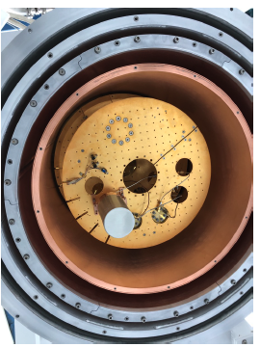
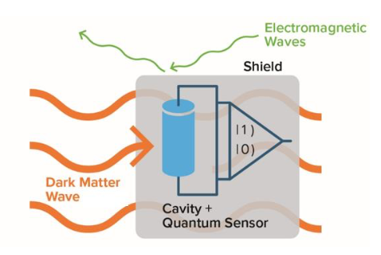
Hmmm… quantum computing platforms look just like dark matter searches:
DOE-OHEP Basic Research Needs white paper, 2018
(R. Harnik cartoon)
Sensitive single-quantum devices (10⁻⁴ eV excitation energy) are operated in a cryostat and/or vacuum system and well-shielded from external disturbances (heat, light, sound) in order to maximize their coherence time.
Cannot shield from the dark matter!
Backgrounds: ionizing radiation ~MeV/cm, mechanical stress release ~ eV
→ Google’s catastrophic events wipe out all info on their multi-qubit processor

Slide 3
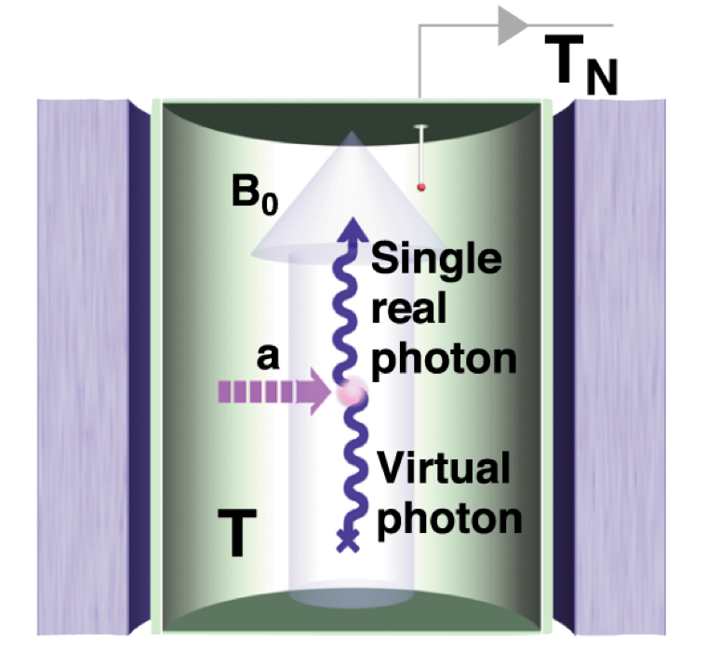
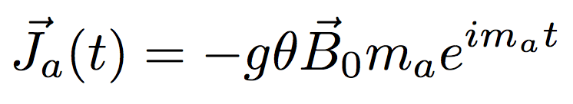
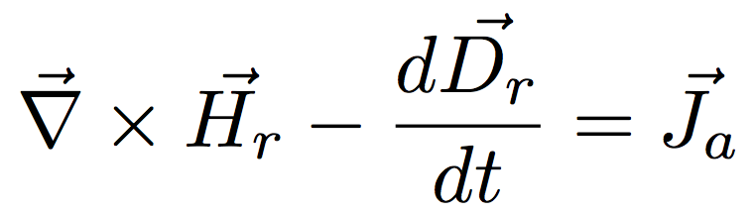
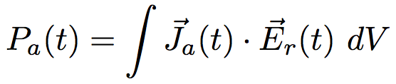
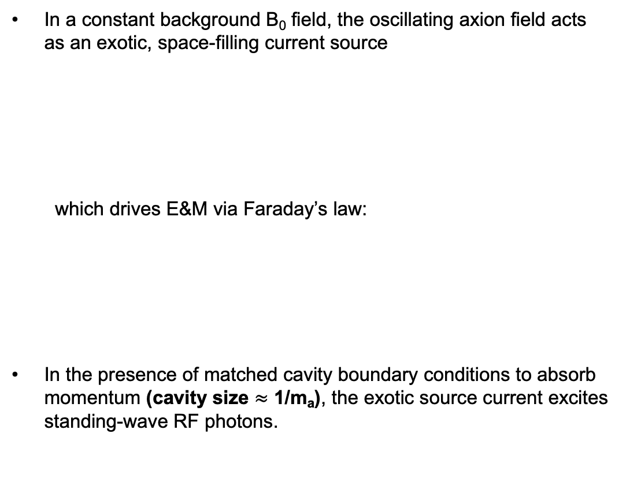
Example: Classical axion wave drives RF cavity mode
In a constant background B₀ field, the oscillating axion field acts as an exotic, space-filling current source
which drives E&M via Faraday’s law:
In the presence of matched cavity boundary conditions to absorb momentum (cavity size $≈$ 1/m_{a}), the exotic source current excites standing-wave RF photons.
Coupling g ~ 𝛼/𝜋
DM wave amplitude 𝜃 ~ 10⁻¹⁹
Power = Force times velocity

Slide 4
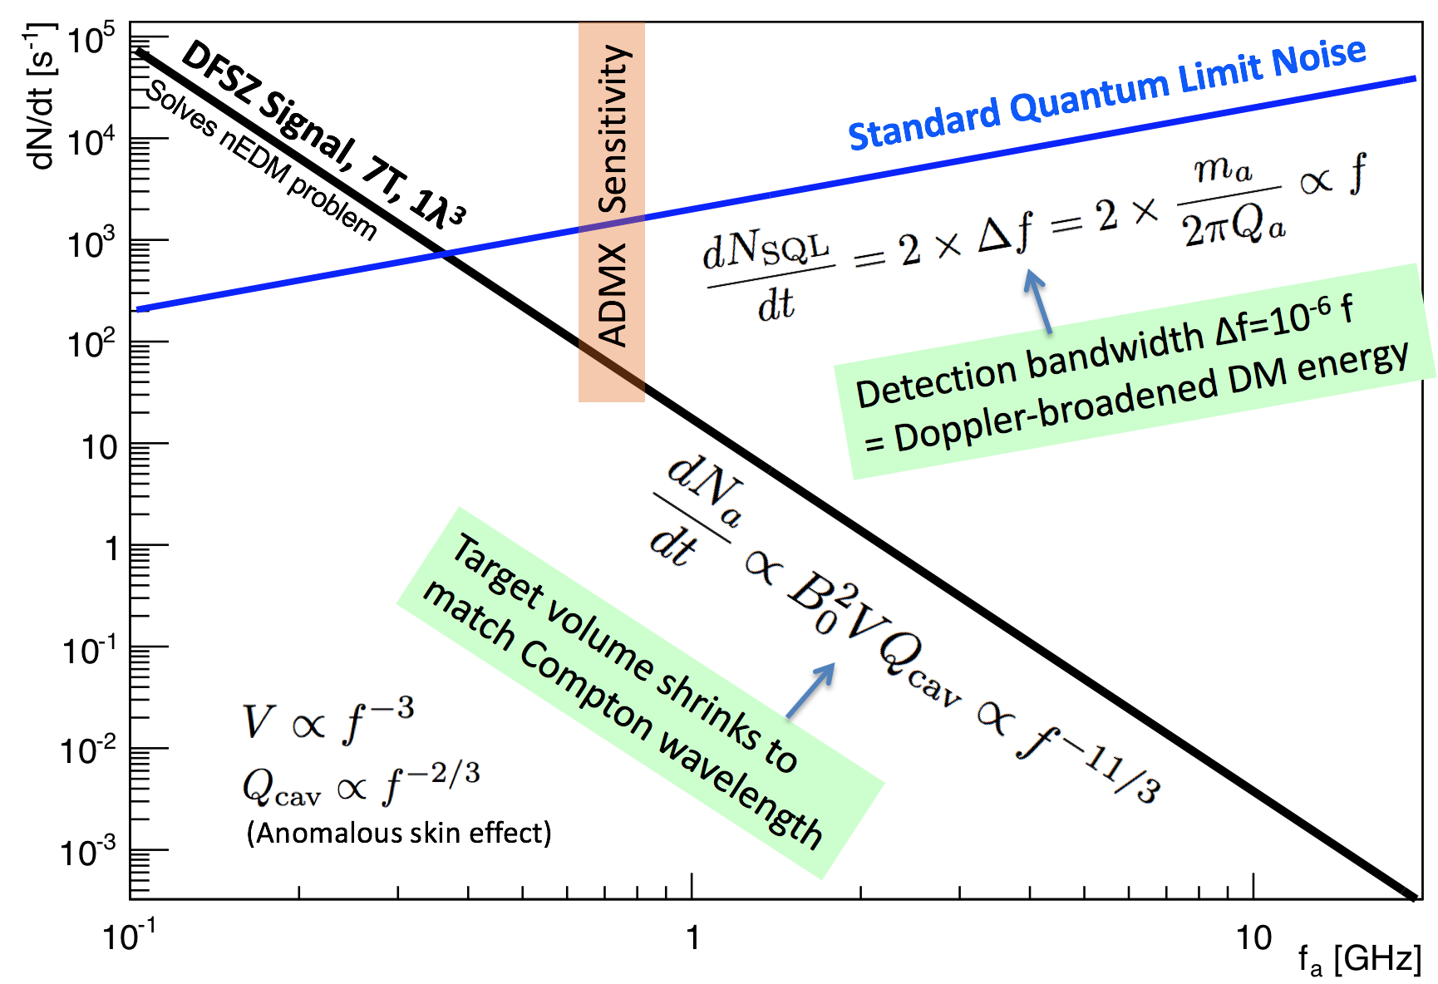
The predicted axion DM signal/noise ratio in cavity experiments plummets as the axion mass increases → SQL readout is not scalable.
Effective
DCR = 10⁴/s
Photon rate
SQL equivalent to DCR = 1 photon per resolved mode
= 1 / Δt
= 1 × Δf
Need
DCR < 10⁻²/s
Poisson noise
∝ sqrt(DCR)
Photon frequency

Slide 5
Need much larger signal/noise ratio in many searches for new physics.
Increase signal?
We do need more magnets, but these are expensive and have long lead time.
Reduce noise?
Many quantum tricks are possible, but must be tailored to the application.

Slide 6
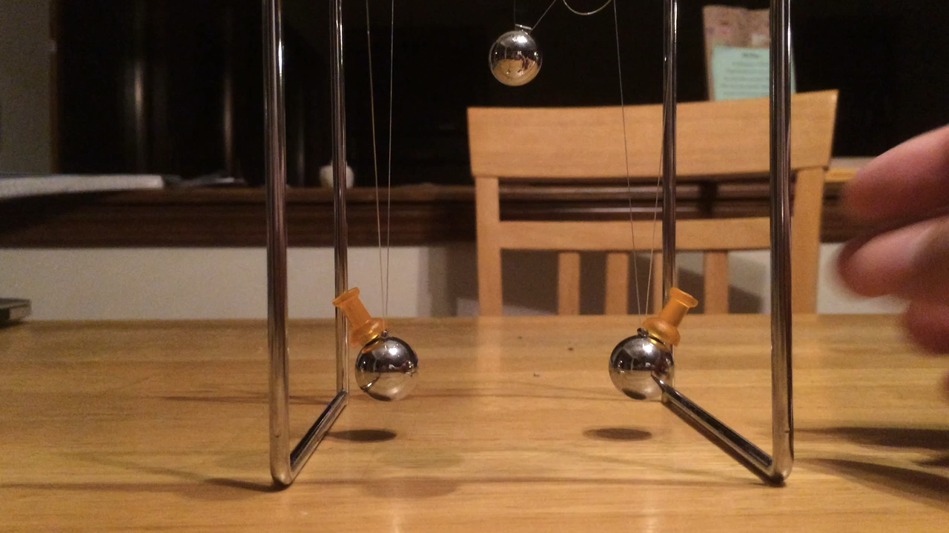
Energy transfer between two coupled oscillators
Laboratory oscillator
Dark matter wave
or Grav. wave
Weak coupling -- takes many swings to fully transfer the wave amplitude.
In real life, the number of swings is limited by coherence time and one only gets the transfer of an occasional single quantum of energy.

Slide 7
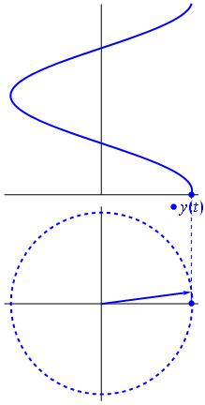
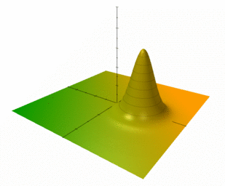
Harmonic oscillator sine waves are described by phasors
Quantum mechanics:
Endpoint of phasor in X, P phase space has uncertainty principle
∆X×∆P ≥ ½.
In polar coordinates this becomes:
∆N×∆𝜑 ≥ ½.
Glauber’s coherent state:
Quantum description of classical sine wave

Slide 8
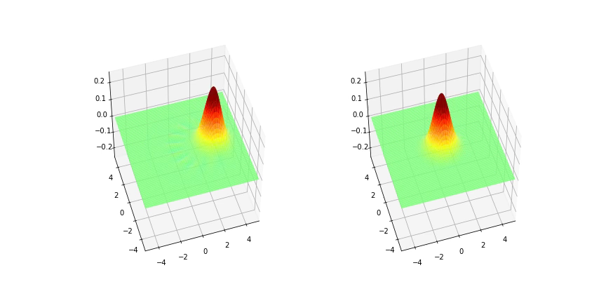
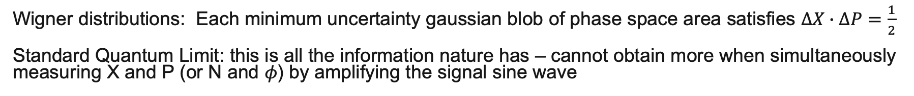
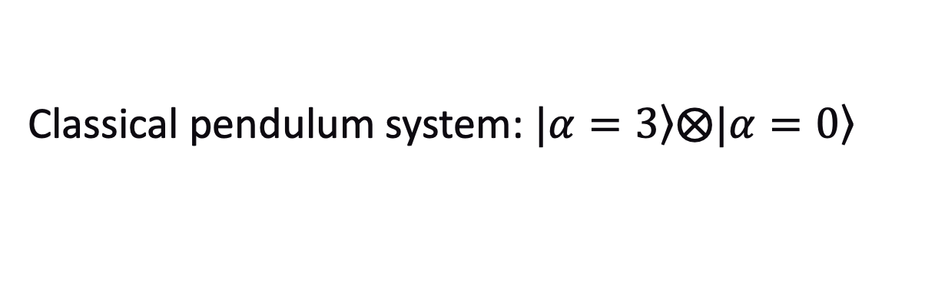
Classical pendulum system: $\left.|α=3\right\rangle ⨂\left.|α=0\right\rangle$
Wigner distributions: Each minimum uncertainty gaussian blob of phase space area satisfies $∆X∙∆P=\frac{1}{2}$
Standard Quantum Limit: this is all the information nature has – cannot obtain more when simultaneously measuring X and P (or N and 𝜙) by amplifying the signal sine wave
P
X
Simulated with QuTIP
Given enough time, the two pendula swap their coherent states.
Real experiments are limited by coherence time so only get the occasional single quantum of signal

Slide 9
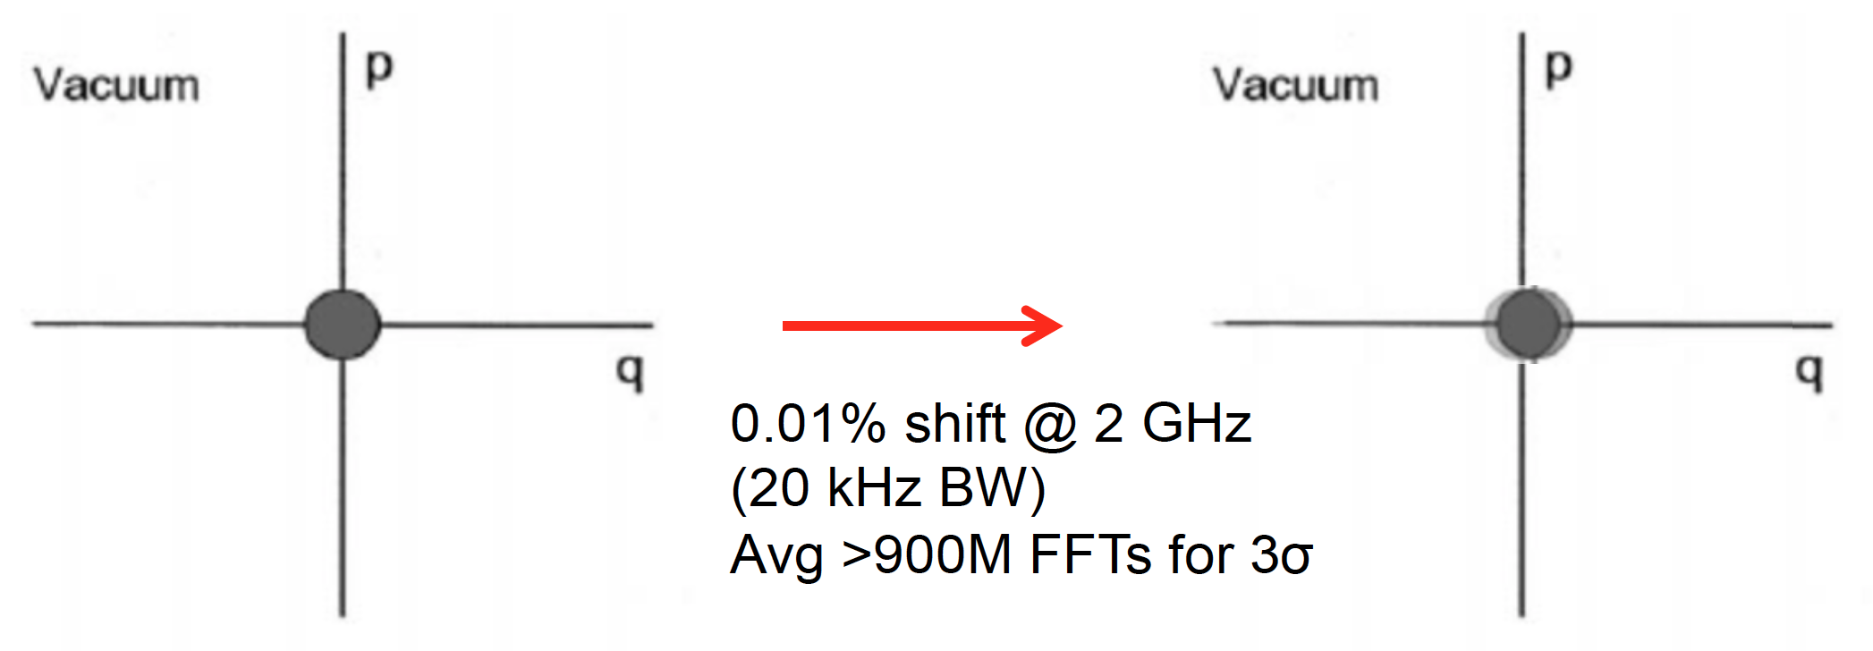
A tiny problem: Signal/Noise Ratio is tiny due to finite coherence time
p
Gaussian distribution of endpoint of phasor
p
Initial state:
x
Force over limited coherence time
x
Coherent state
phase space area = ½ħ
(Exaggerated) displacement <10⁻³ of zero-point noise
𝛼=10⁻²
The Gaussian blob is also effectively the probe resolution when using a linear amplifier to resolve the tiny signal sine wave. Simultaneous measurement of non-commuting observables N and 𝜑 incurs the Heisenberg uncertainty principle ∆N×∆𝜑 ≥ ½.
e.g. ADMX uses millions of standard-quantum-limit measurements to average away the zero-point noise to resolve the tiny displacement signal.

Slide 10

To reduce readout noise below SQL, use photon counting to measure displacement using the Fock basis, i.e. number eigenstates
Measure only displacement amplitude and not phase
no zero-point noise since we are not simultaneously measuring non-commuting observables
Measurement noise, e.g. from dark counts can be arbitrarily low
Blue rings give the probe resolution
1
2
3
Displaced vacuum state exponentially leaks into non-zero Fock number.
Detect displacement by counting the occasional single photon.

Slide 11
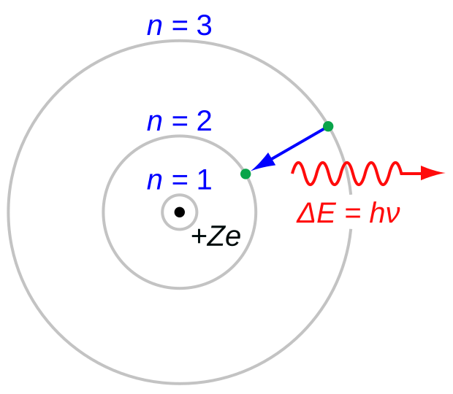
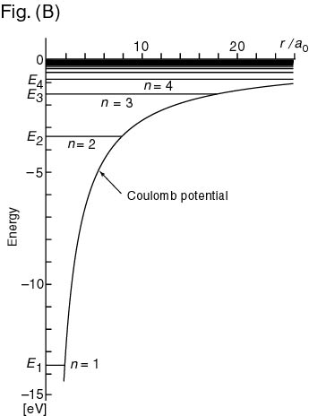
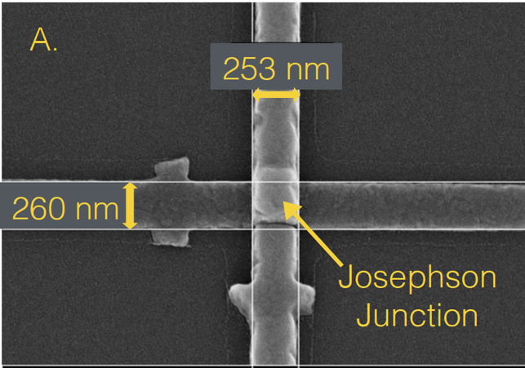
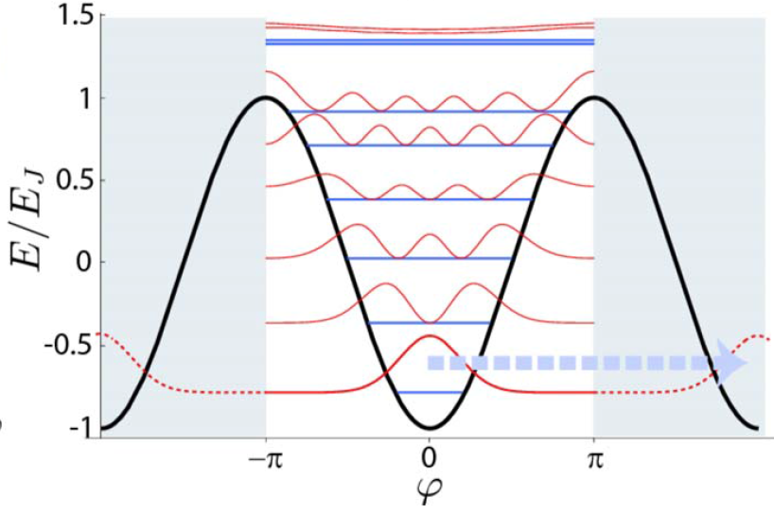
Atoms and other nonlinear oscillators can be used as single photon counters
Nonlinear
electrostatic potential
Nonlinear inductance
Real atom
Artificial atom (Josephson junction oscillator)
Both have non-degenerate energy level spacings due to the nonlinear potentials, and thus act as 2-level systems useful for quantum computing.
Jostling of the nonlinear oscillator due to background electromagnetic fields gives “atomic” frequency shifts
→ Lamb shift from zero-point fluctuations
→ quantized AC Stark shift from finite background photon occupation number

Slide 12
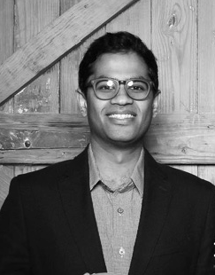
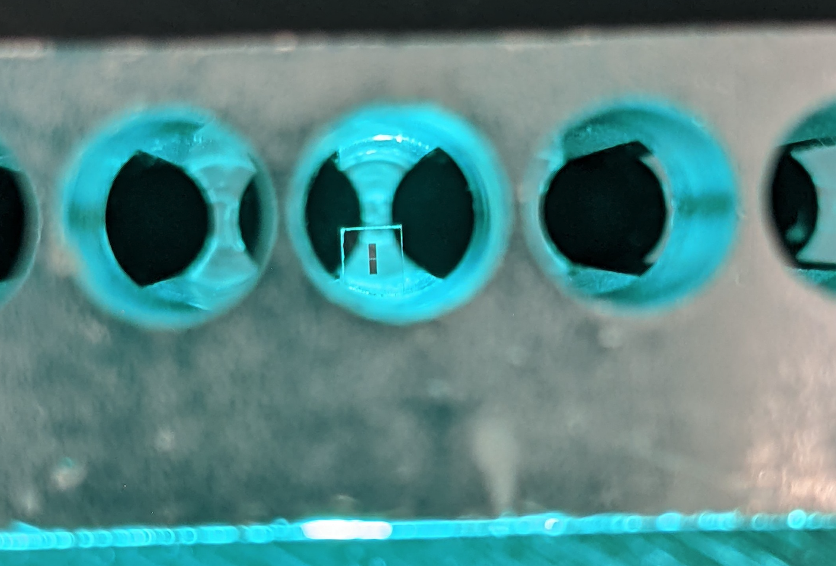
Transmon qubit in 6 GHz aluminum cavity
Panflute microwave cavity = QRAM storing information as single photon
Akash V. Dixit,
PhD 2021
Dark matter interaction causes a single quantum of information to mysteriously appear in your QRAM that was not part of your quantum computation
Quantized qubit frequency shift occurs because the photon electric field induces an oscillating Cooper pair current and drives the qubit into nonlinearity. (cf. matter effects in neutrino oscillations)

Slide 13
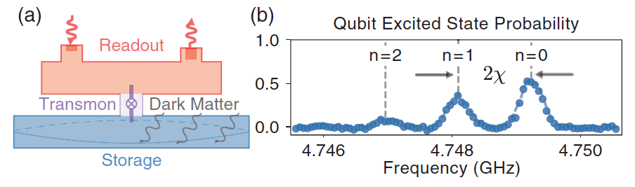
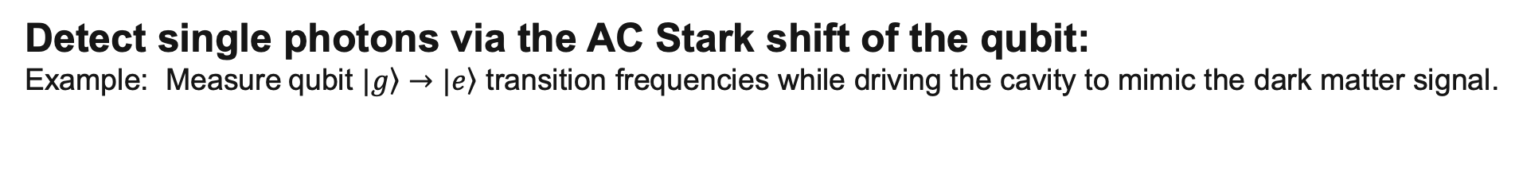
Detect single photons via the AC Stark shift of the qubit:
Example: Measure qubit $|\left.g\right\rangle →|\left.e\right\rangle$ transition frequencies while driving the cavity to mimic the dark matter signal.
Akash V. Dixit, et.al, Phys.Rev.Lett. 126, 141302 (2021)
The measured qubit excitation spectrum exhibits a distribution of resonances which are in 1-1 correspondence with the Poisson distribution of the “coherent state” of cavity photons.
Measure the dressed qubit Hamiltonian averaged over many photon oscillation cycles
  No information is gained on the photon phase and so there is no SQL noise!
  Demonstrated factor of 1300 reduction in DCR, equivalent to -36 dB of squeezing below SQL

Slide 14
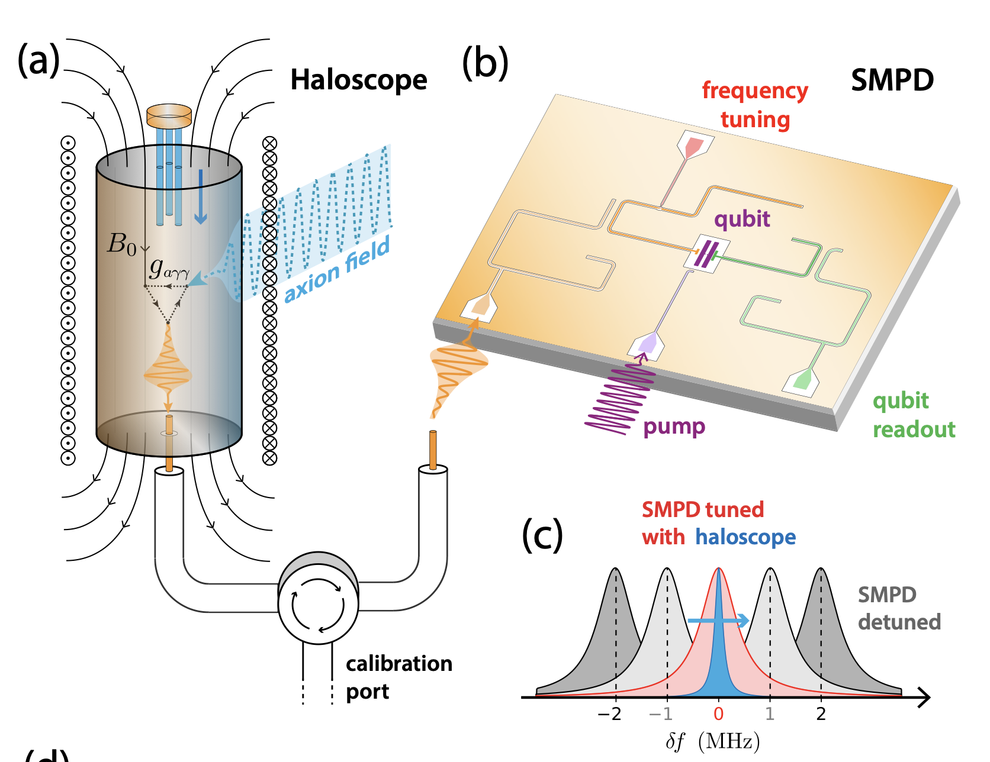
Saclay remote single microwave photon receiver deployed in axion search
Photon is detected via a controlled-X gate, exciting the qubit transition g→e only when a signal photon is present.
e.g. perform operations at the shifted qubit frequency corresponding to exactly 1 photon.
Superconducting electronics located safely outside of the magnetic field
C. Braggio et al., arXiv:2403.02321

Slide 15
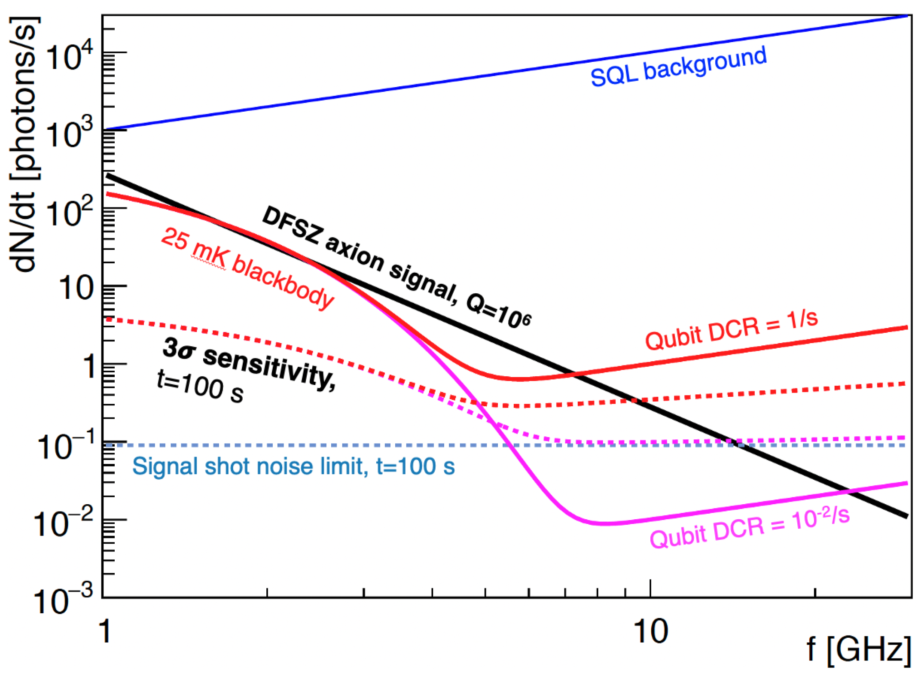
Signal rate sensitivity is determined by the integration time budget:
If budgeted t=100 s at each tuning, can do 10⁵ tunings in 1 year. 1 octave in mass is 10⁶ tunings, so do 10 concurrent experiments to cover the full octave.
For t = 100 s, the minimum observable signal rate is R_{s} ≳ 0.1 Hz
(Signal shot noise limit, need to count 9 ± 3 photons for 3𝜎 sensitivity)

Slide 16
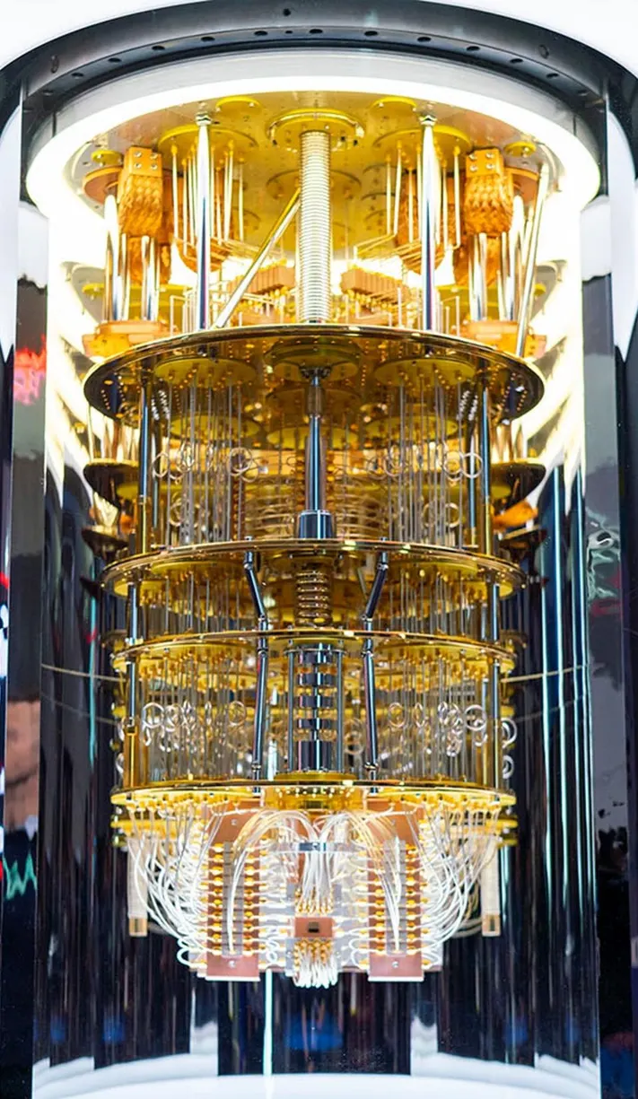
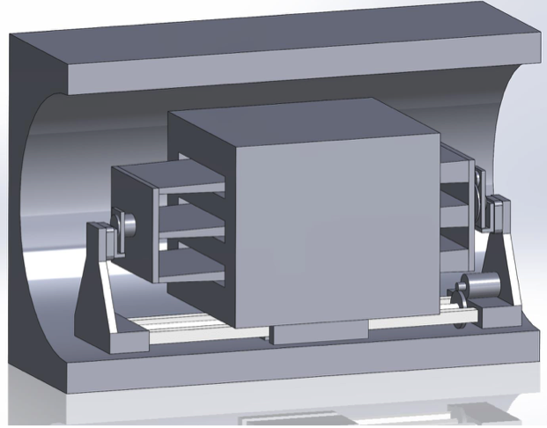
Use a quantum computer as the front-end readout for HEP experiments
Single photon frequency transduction (quantum networking tech)
Signal processing pipeline (made of qubits and qRAMs)
Analog signal integration (using qubits as quantum memory banks)
Noiseless readout (already factor 1/40 of zero-point noise)
Axion scattering target in high B field
connected to quantum computer outside of the B field
(A. Chou, D.I. Schuster, A. Vrajitoarea)

