Slide 1
DEVELOPING QUBIT BASED DARK MATTER SENSORS
Sara Sussman for the CosmiQ group @ Fermilab
EDIT workshop, 11/14/24

Slide 2
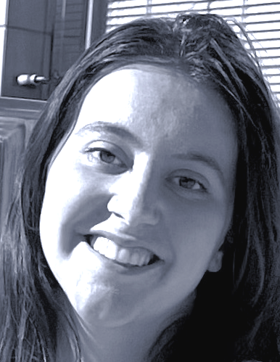
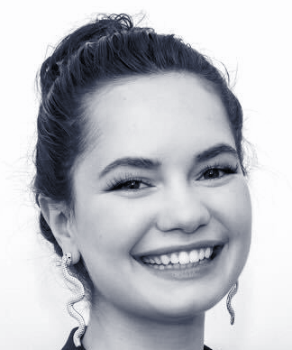
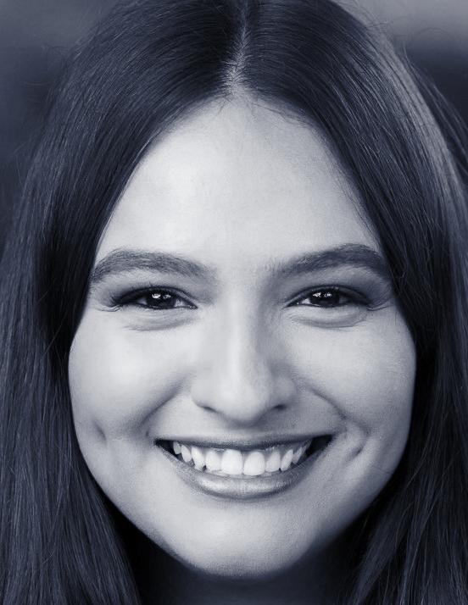
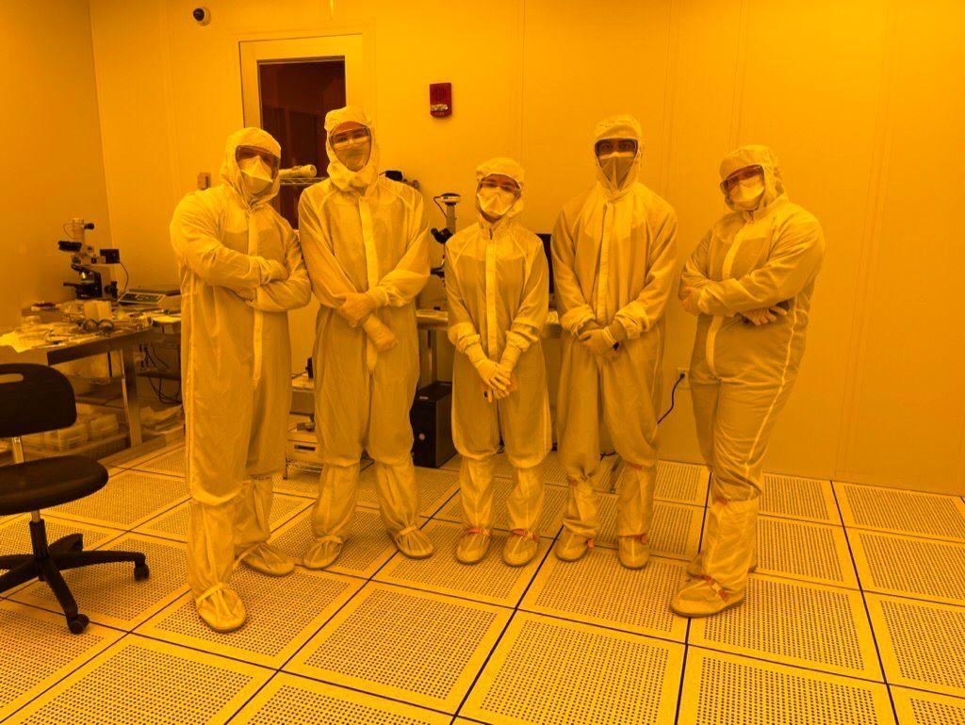
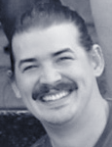
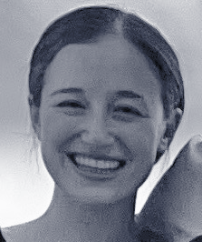
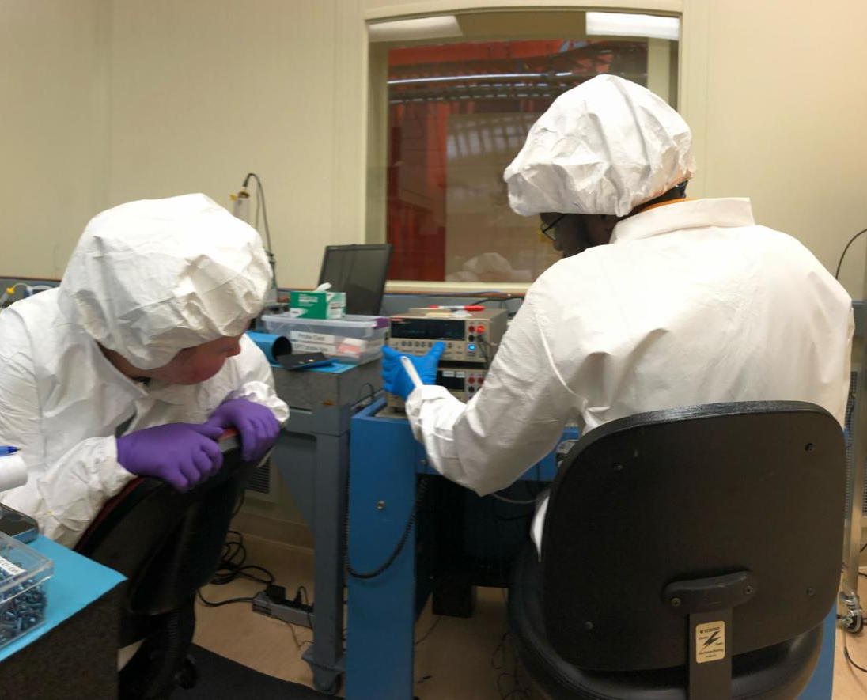
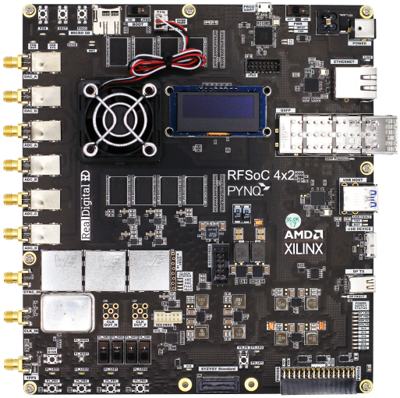
Our team will be your TA’s at the Quantum Sensors lab!
Design/fab
Measurement
ISRAEL HERNANDEZ (Fermilab/IIT)
ihernandez6@hawk.iit.edu
GRACE BRATRUD (Fermilab/Northwestern)
gracebratrud2027@
u.northwestern.edu
OLIVIA SEIDEL
(Fermilab/U. Texas)
olivias@fnal.gov
ARIANNA COLÓN CESANÍ (Fermilab/Northwestern)
AriannaColonCesani2028@u.northwestern.edu
DYLAN TEMPLES (Fermilab)
dtemples@fnal.gov
SARA SUSSMAN (Fermilab)
sarafs@fnal.gov

Slide 3
Outline
9:00-9:10 am Why today’s transmon qubits are already useful dark
matter sensors, and why we need to engineer
higher T1, broadly tunable, transmon qubit devices
9:10-9:20 am Our experimental progress
9:20-9:30 am Our open source design workflow

Slide 4
Introduction
Today's superconducting transmon qubit hardware is developing.

Slide 5
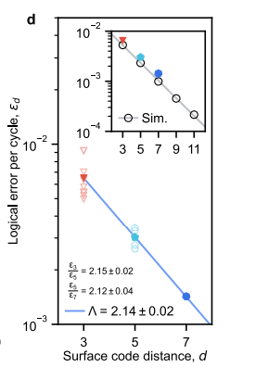
Introduction
Today's superconducting transmon qubit hardware is developing.
On the arXiv from Google in August, 101-qubit distance 7 surface code with Λ = 2

Slide 6
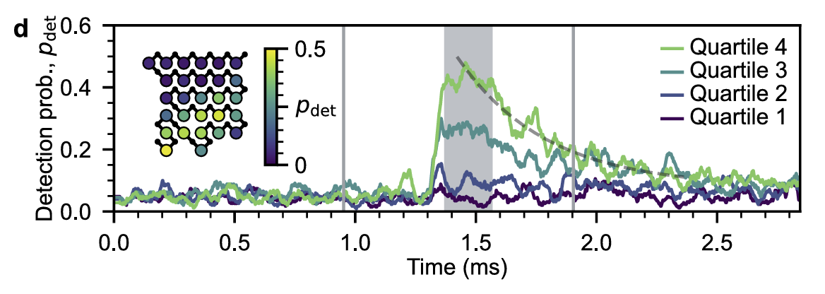
Introduction
Today's superconducting transmon qubit hardware is developing.
On the arXiv from Google in August, 101-qubit distance 7 surface code with Λ = 2
Also reported correlated error bursts in patches of ~30 qubits that disrupt the surface code
https://arxiv.org/html/2408.13687v1

Slide 7
Introduction
Today's superconducting transmon qubit hardware is developing.
→ We need devices that are generally more robust to decoherence
(longer T1 time, gap-engineered Josephson junctions)

Slide 8
Introduction
Today's superconducting transmon qubit hardware is developing.
Academic labs don't have the resources to do big error correction experiments. They can typically cool devices with ~10 qubits.

Slide 9
Introduction
Today's superconducting transmon qubit hardware is developing.
Academic labs don't have the resources to do big error correction experiments. They can typically cool devices with ~10 qubits.
What kind of science can be done on the scale of 10 qubits?

Slide 10
Introduction
Today's superconducting transmon qubit hardware is developing.
Academic labs don't have the resources to do big error correction experiments. They can typically cool devices with ~10 qubits.
What kind of science can be done on the scale of 10 qubits?
World-leading searches for dark matter.

Slide 11
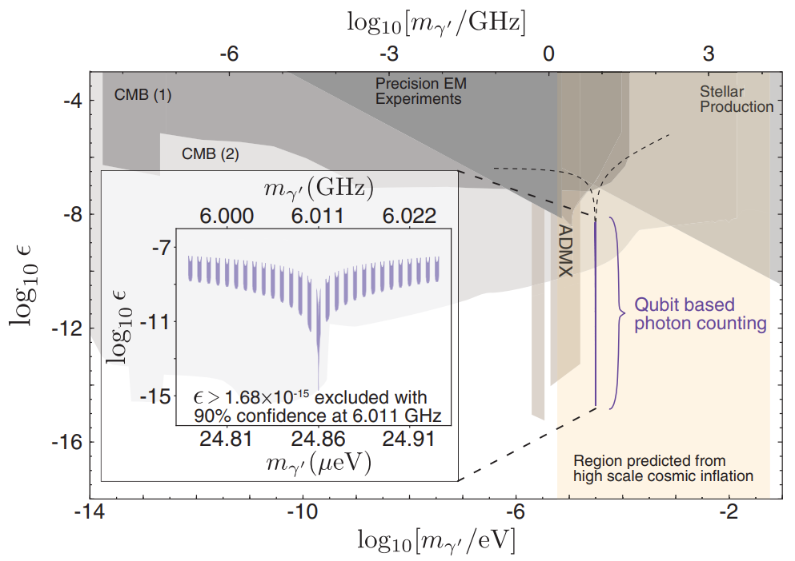
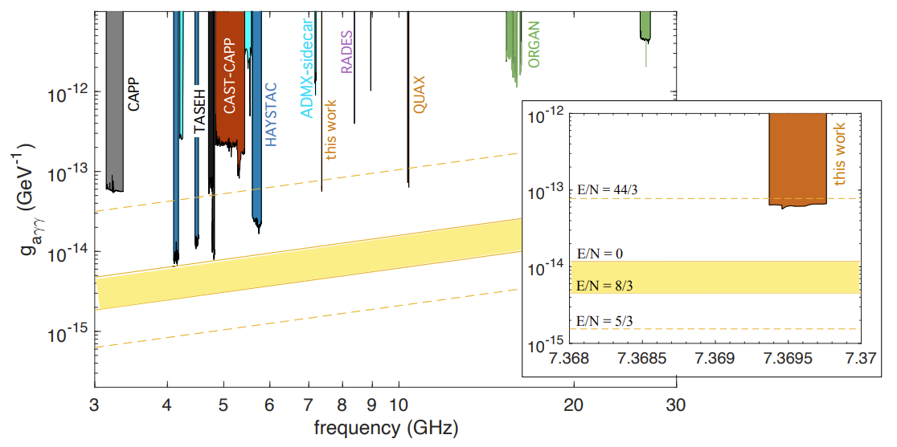
Introduction
Today's superconducting transmon qubit hardware is developing.
Academic labs don't have the resources to do big error correction experiments. They can typically cool devices with ~10 qubits.
What kind of science can be done on the scale of 10 qubits?
World-leading searches for dark matter.
A. Dixit et al., PRL 126, 141302 (2021)
C. Braggio et al., arXiv (2024)

Slide 12
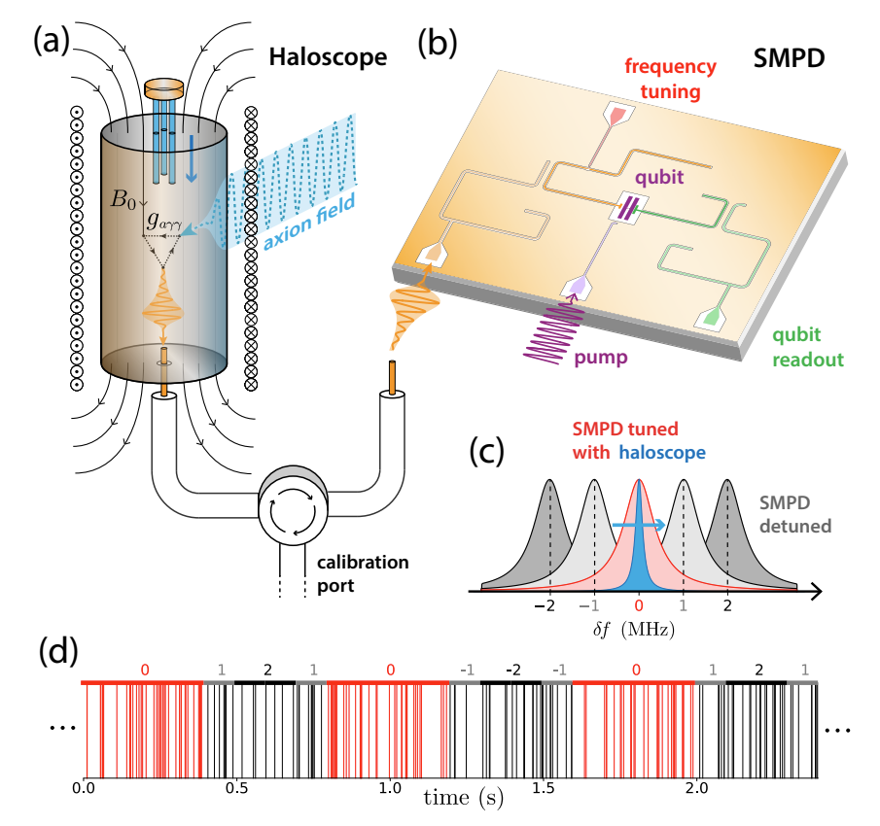
Introduction
Today's superconducting transmon qubit hardware is developing.
Academic labs don't have the resources to do big error correction experiments. They can typically cool devices with ~10 qubits.
What kind of science can be done on the scale of 10 qubits?
World-leading searches for dark matter.
Qubits used as single microwave photon counters like in Dixit et al and Braggio et al, are sensitive to signals from dark matter candidates such as “dark photons” or axions

Slide 13
Introduction
Today's superconducting transmon qubit hardware is developing.
Academic labs don't have the resources to do big error correction experiments. They can typically cool devices with ~10 qubits.
What kind of science can be done on the scale of 10 qubits?
World-leading searches for dark matter.
Braggio et al chip has relatively few components: a single counting qubit (purple) with a Purcell filter (yellow), a tunable receiving resonator (pink), and a readout resonator (green) ✅

Slide 14
Introduction
Today's superconducting transmon qubit hardware is developing.
Academic labs don't have the resources to do big error correction experiments. They can typically cool devices with ~10 qubits.
What kind of science can be done on the scale of 10 qubits?
World-leading searches for dark matter.
Even better, some detection protocols like in Dixit et al, are insensitive to qubit T1 time, because they detect on the qubit parity switching. You can still count the number of parity switches even if T1 happens (telegraph signal) ✅

Slide 15
Introduction
Today's superconducting transmon qubit hardware is developing.
Academic labs don't have the resources to do big error correction experiments. They can typically cool devices with ~10 qubits.
What kind of science can be done on the scale of 10 qubits?
World-leading searches for dark matter.
However, long T1 (high quality factor) is needed for an axion search chip, as the on-chip resonator receiving the signal (pink) must have a high quality factor close to that of the “axion cavity” in a B field (Q~1e6, rings up with axion signal)

Slide 16
Introduction
Today's superconducting transmon qubit hardware is developing.
Academic labs don't have the resources to do big error correction experiments. They can typically cool devices with ~10 qubits.
What kind of science can be done on the scale of 10 qubits?
World-leading searches for dark matter.
Furthermore, we want to tune across a wide band to search for the axion, it could be anywhere between 3-30 GHz…
Braggio et al searched in a 5 MHz band.

Slide 17
Introduction
Today's superconducting transmon qubit hardware is developing.
Academic labs don't have the resources to do big error correction experiments. They can typically cool devices with ~10 qubits.
What kind of science can be done on the scale of 10 qubits?
World-leading searches for dark matter.
Our major problem: The Purcell effect causes radiative T1 decay (Purcell decay) into the environment for high frequency signals (starts limiting T1 at ~6 GHz typically), preventing us from
Tuning to high frequencies in order to search for the axion in a wide band
Having a long-lived high-frequency qubit (high freq → less thermal “dark counts”)
where is the qubit capacitance, and is the frequency-dependent admittance from the qubit to the environment, at the qubit frequency.

Slide 18
Introduction
Today's superconducting transmon qubit hardware is developing.
Academic labs don't have the resources to do big error correction experiments. They can typically cool devices with ~10 qubits.
What kind of science can be done on the scale of 10 qubits?
World-leading searches for dark matter.
Problem summary: today’s transmon qubits T1 times are too low and the bandwidth that qubits have high T1, is too low. Purcell decay is one design issue causing these problems. In trying to make our qubits better dark matter sensors, we must improve the device quality (T1) exactly as we must for quantum computing applications. So, we’re all trying to solve the same problem, but for different applications.
Basic R&D for qubit coherence (T1) is still required!

Slide 19
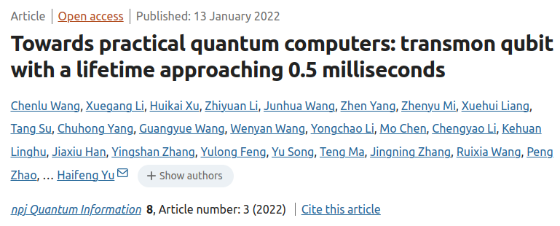
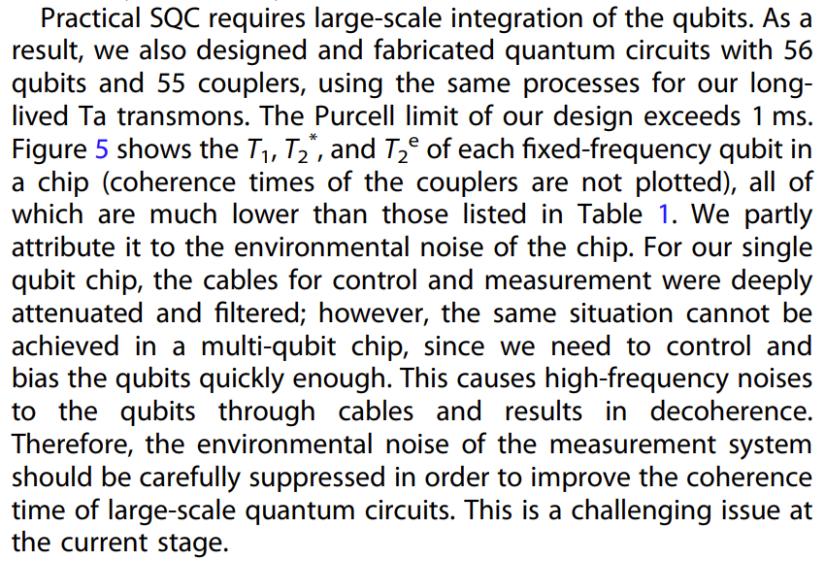
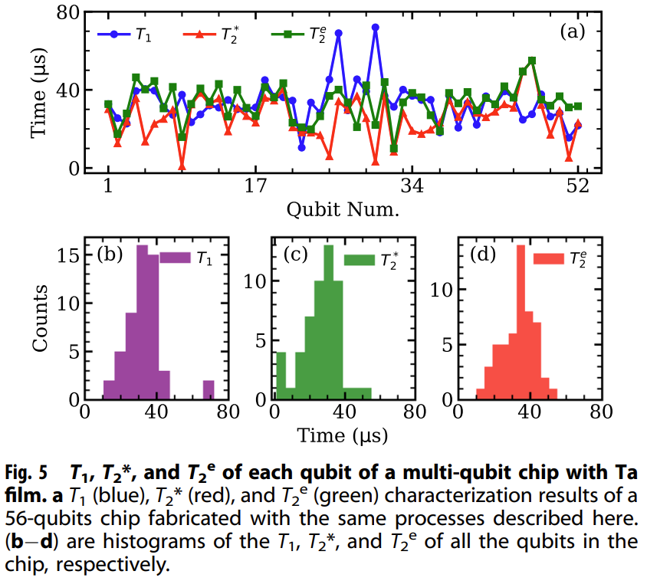
Very similar design challenge for quantum computing devices
Purcell/environmental noise sources add in parallel, making scaling difficult

Slide 20
Outline
9:00-9:10 am Why today’s transmon qubits are already useful dark
matter sensors, and why we need to engineer
higher T1, broadly tunable, transmon qubit devices
9:10-9:20 am Our experimental progress
9:20-9:30 am Our open source design workflow

Slide 21
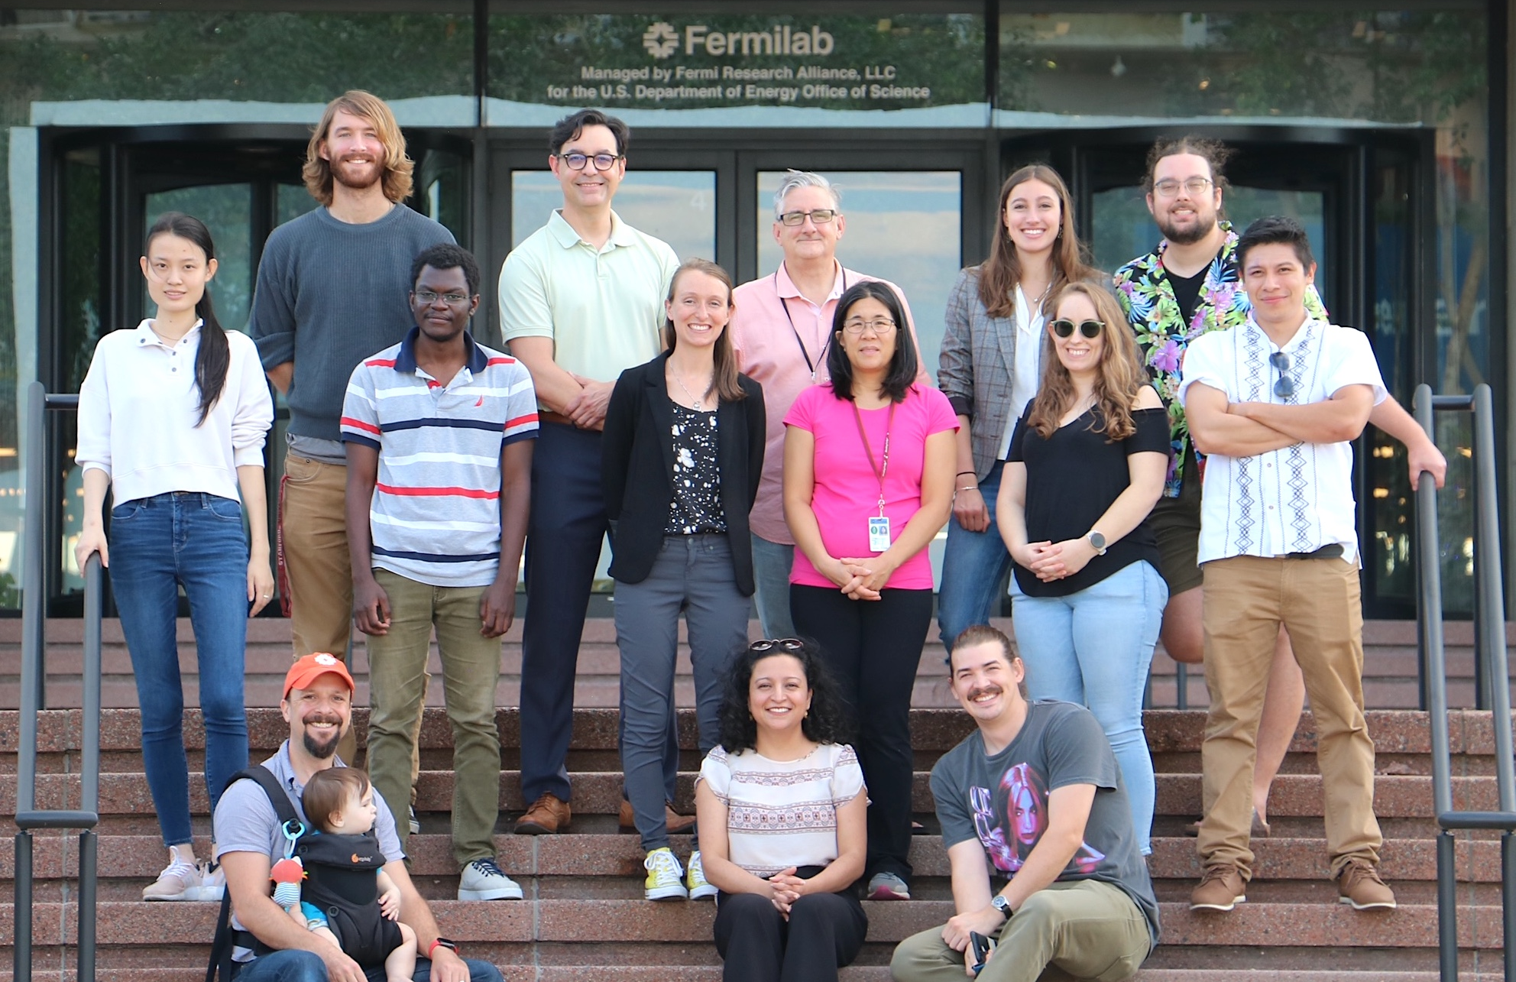
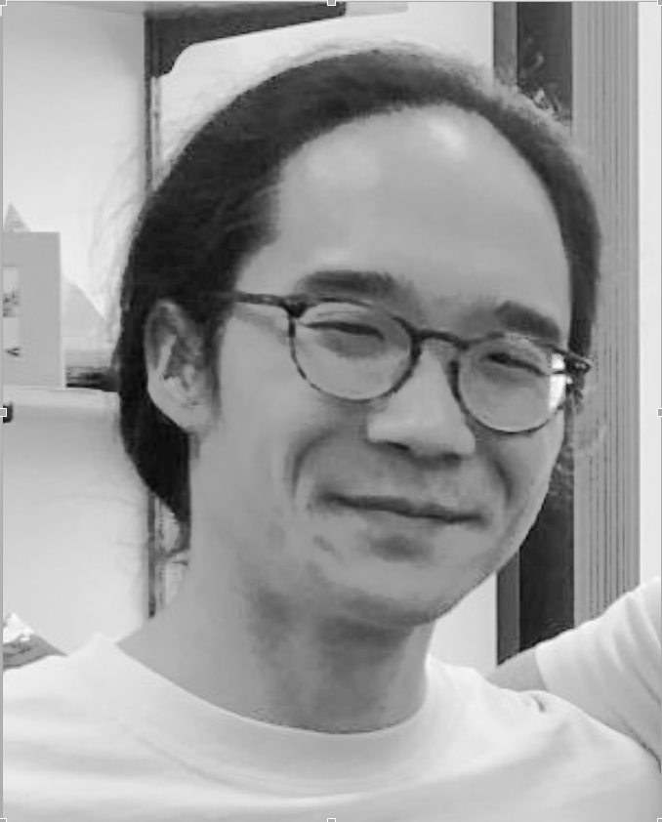
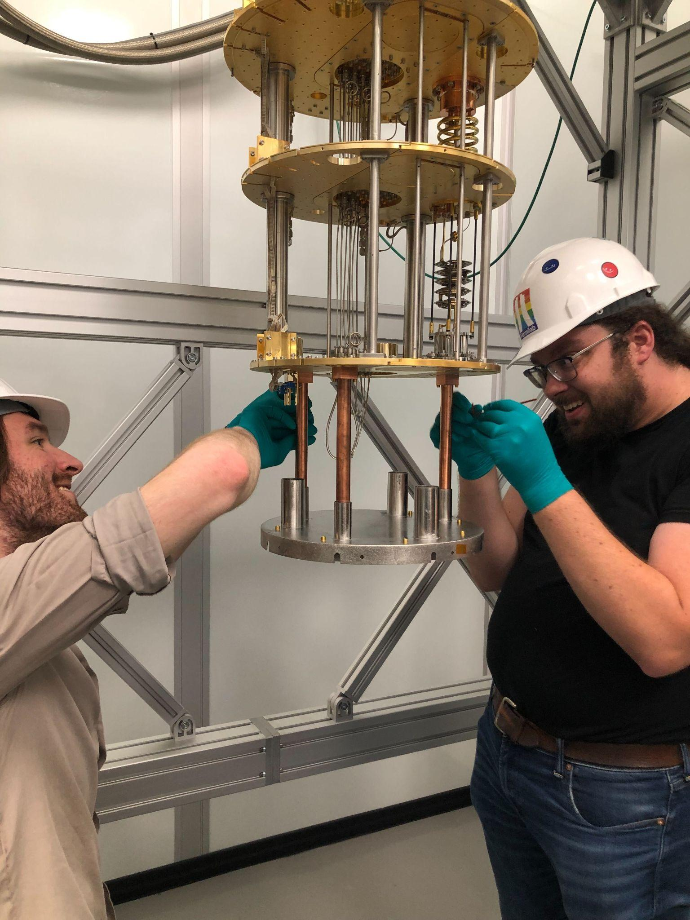
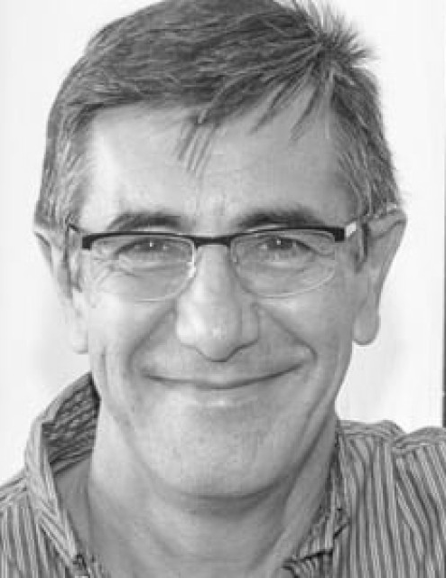
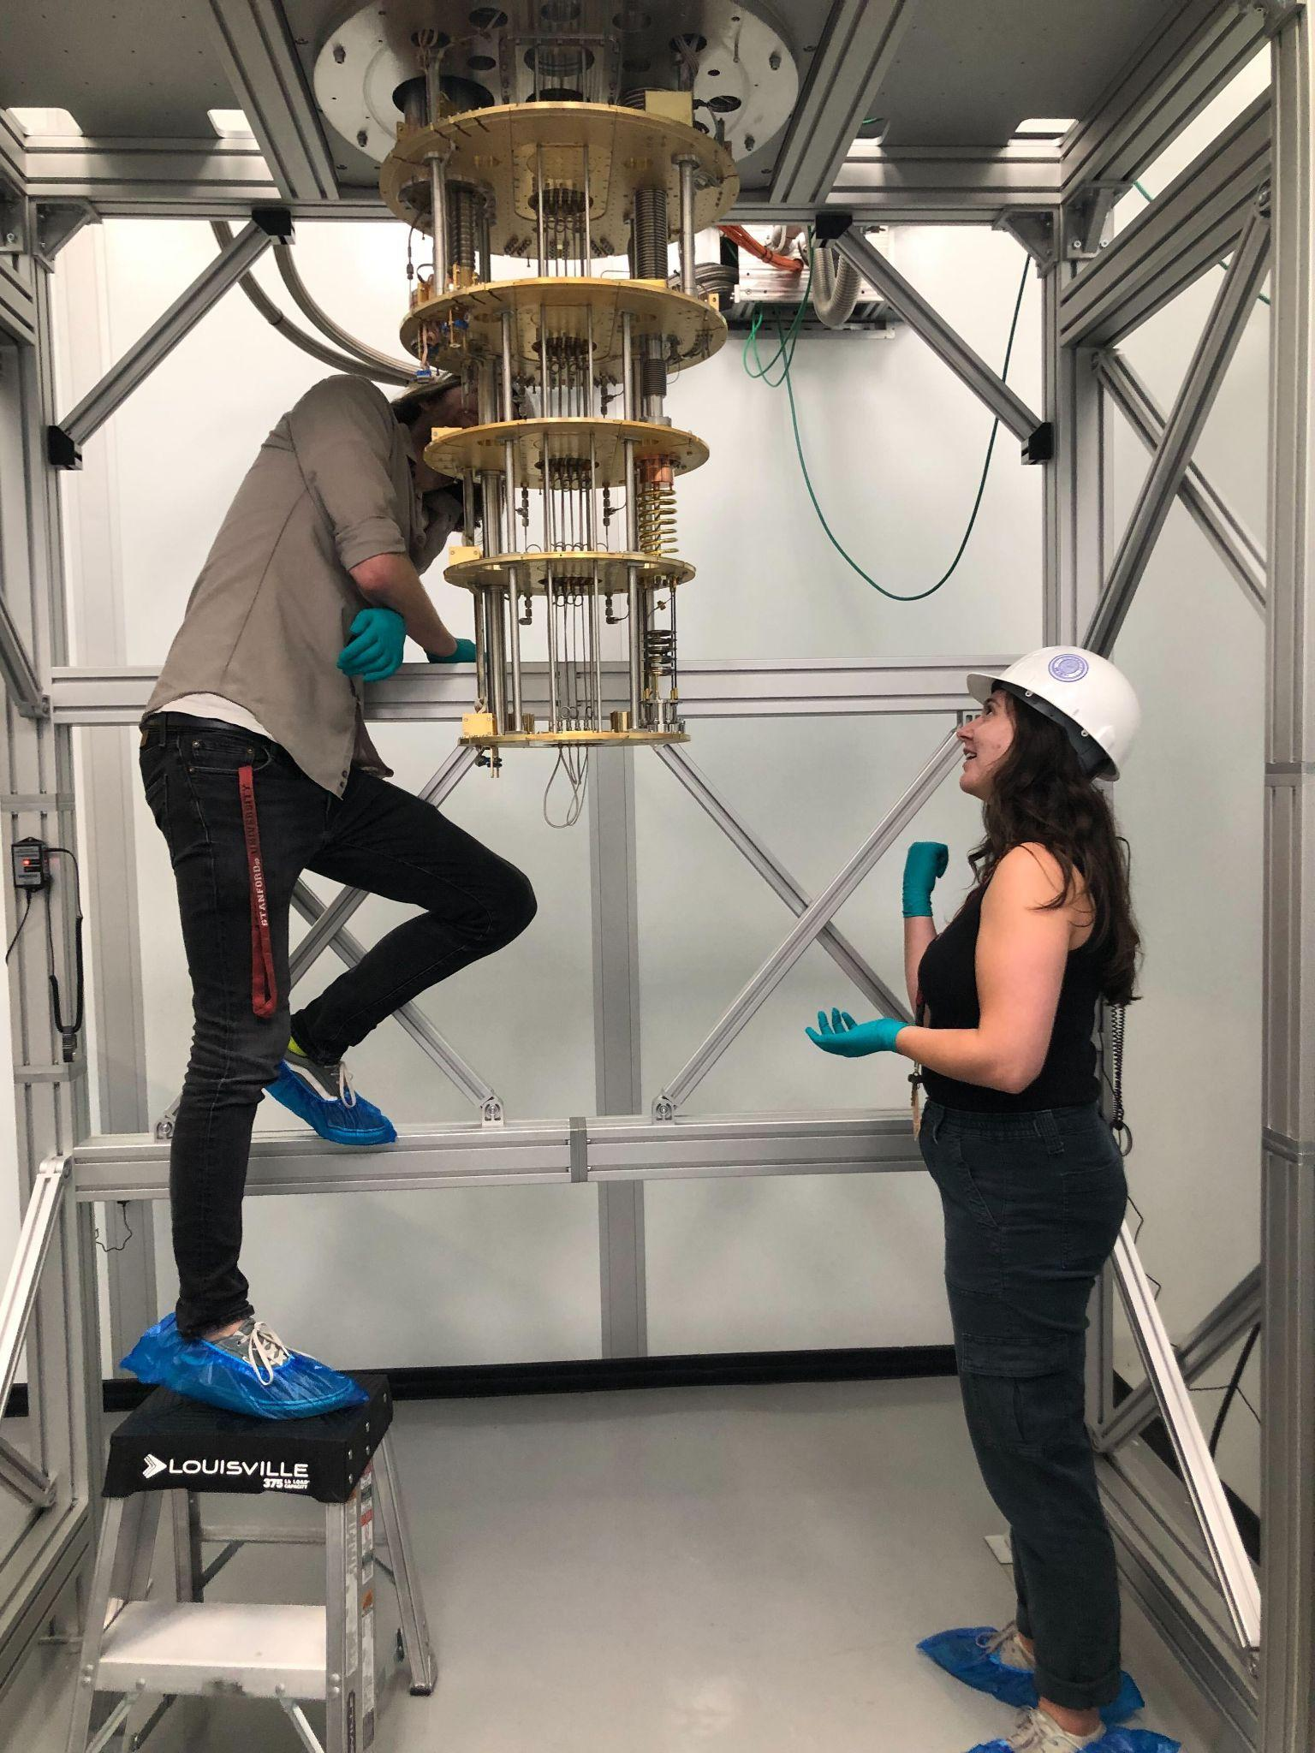
I’m presenting on behalf of the CosmiQ team at Fermilab
4 dilution fridges
(2 underground)
~5 PIs, ~5 postdocs, ~5 PhD students, from Fermilab, Northwestern, and Illinois Institute of Technology

Slide 22
Our team’s unique background/expertise
Dark matter searches with cryogenic detectors
A. Chou, D. Baxter, E. Figueroa, R. Khatiwada, L. Hsu, S. Uemura
Rocketry with TESes, cryogenics
E. Figueroa
Fab of superconducting RF cavities for accelerators
D. Bowring
RF electronics (developed QICK)
G. Cancelo, S. Uemura

Slide 23
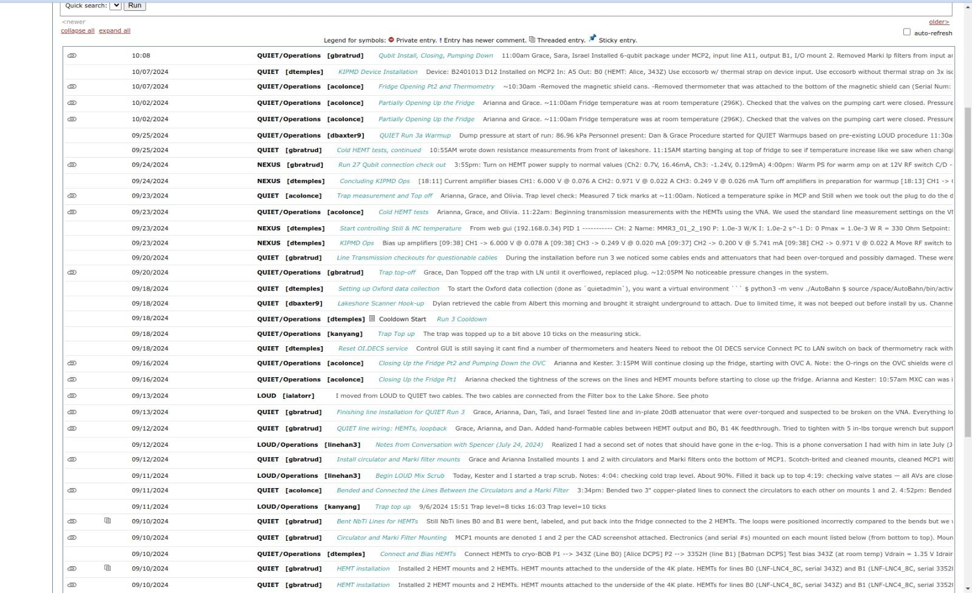
Our team’s unique background/expertise
Dark matter searches with cryogenic detectors
A. Chou, D. Baxter, E. Figueroa, R. Khatiwada, L. Hsu, S. Uemura
Rocketry with TESes, cryogenics
E. Figueroa
Fab of superconducting RF cavities for accelerators
D. Bowring
RF electronics (developed QICK)
G. Cancelo, S. Uemura
Systems engineering for running large remote particle physics detectors
All of the above! Detailed e-logs→

Slide 24
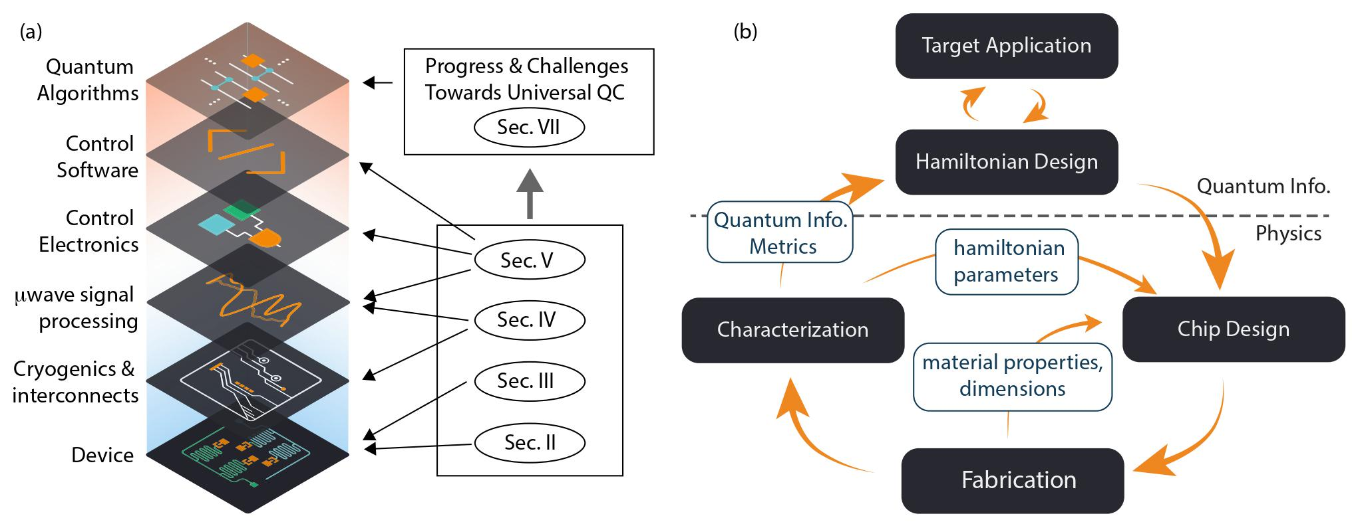
We have begun iterating our own devices this past year
The device iteration cycle is itself a balancing act between design, fabrication, and measurement
Y. Gao et al, PRX QUANTUM 2, 040202 (2021)

Slide 25
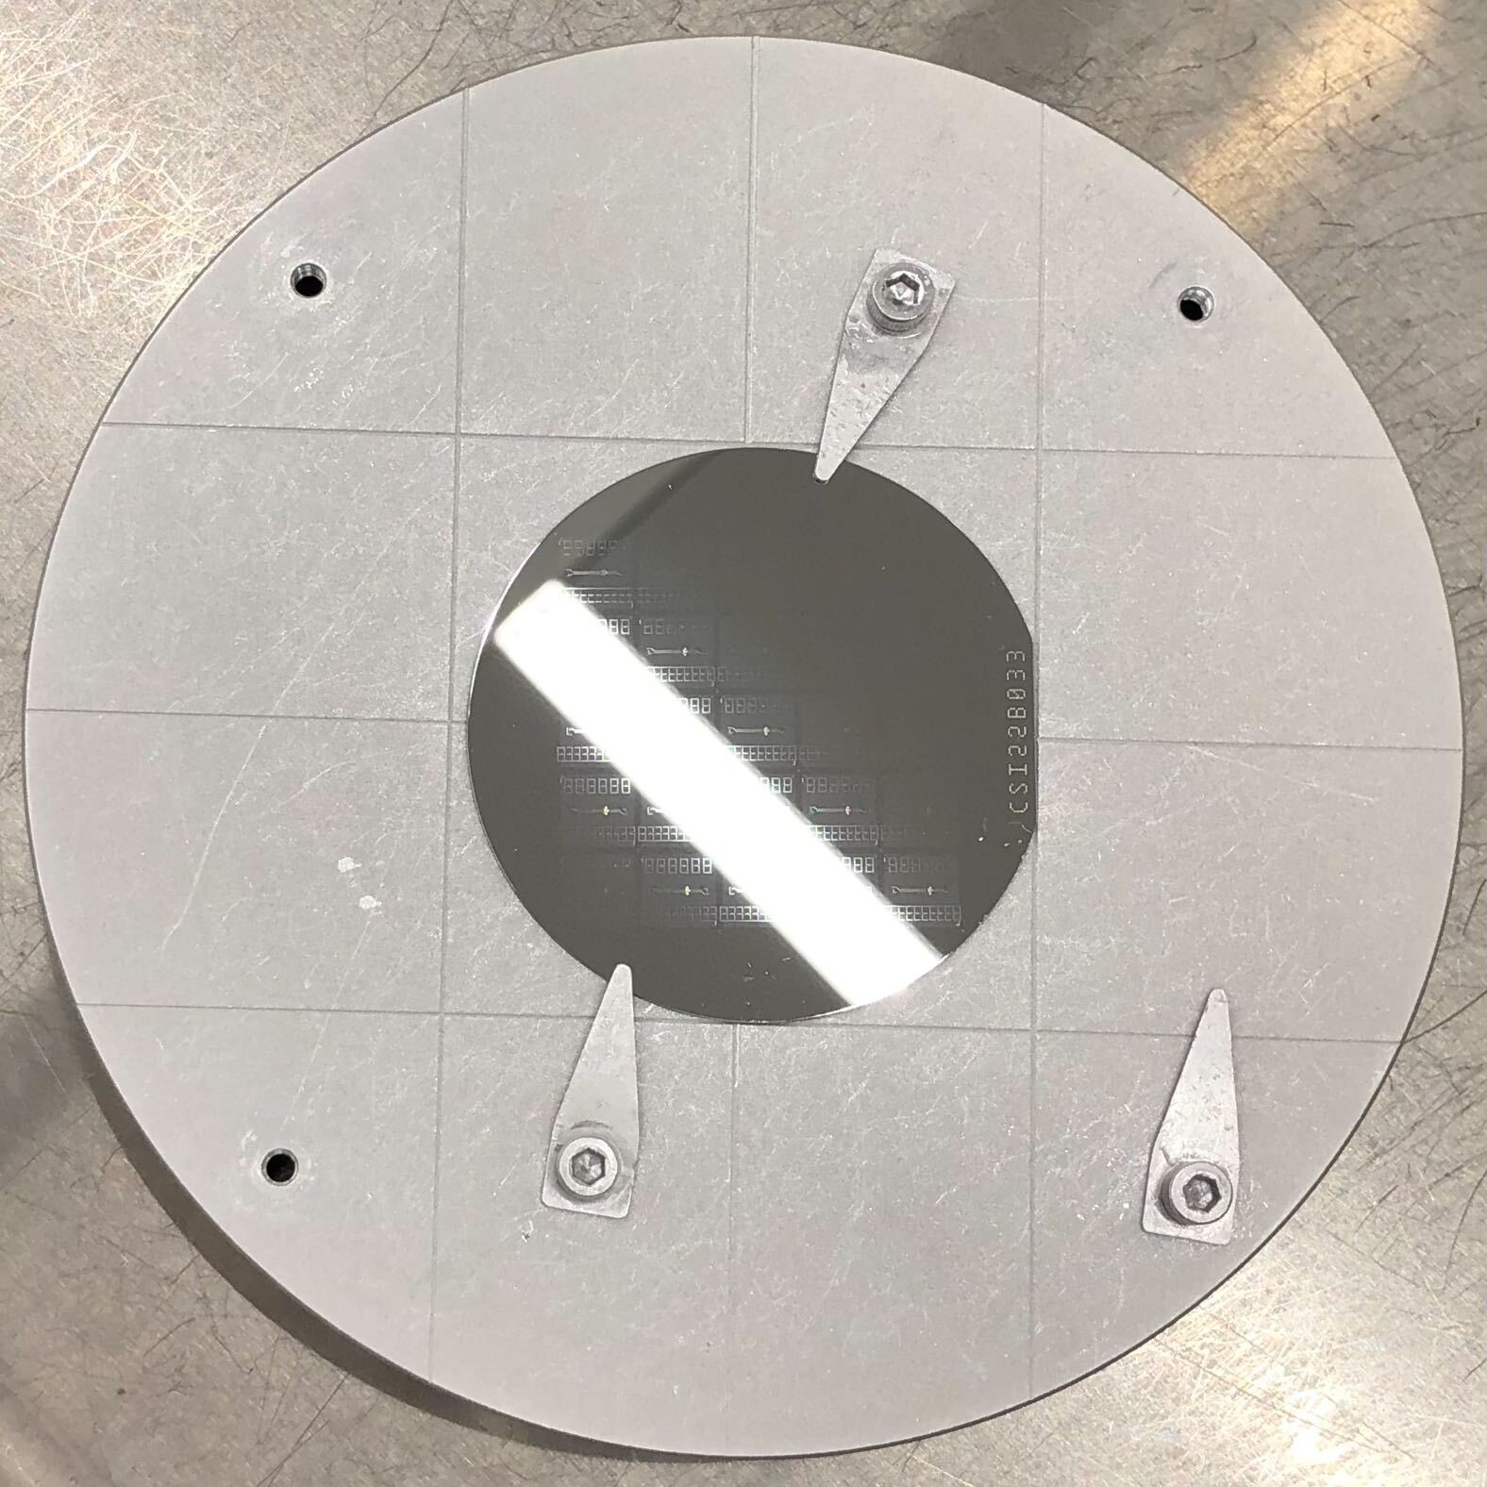
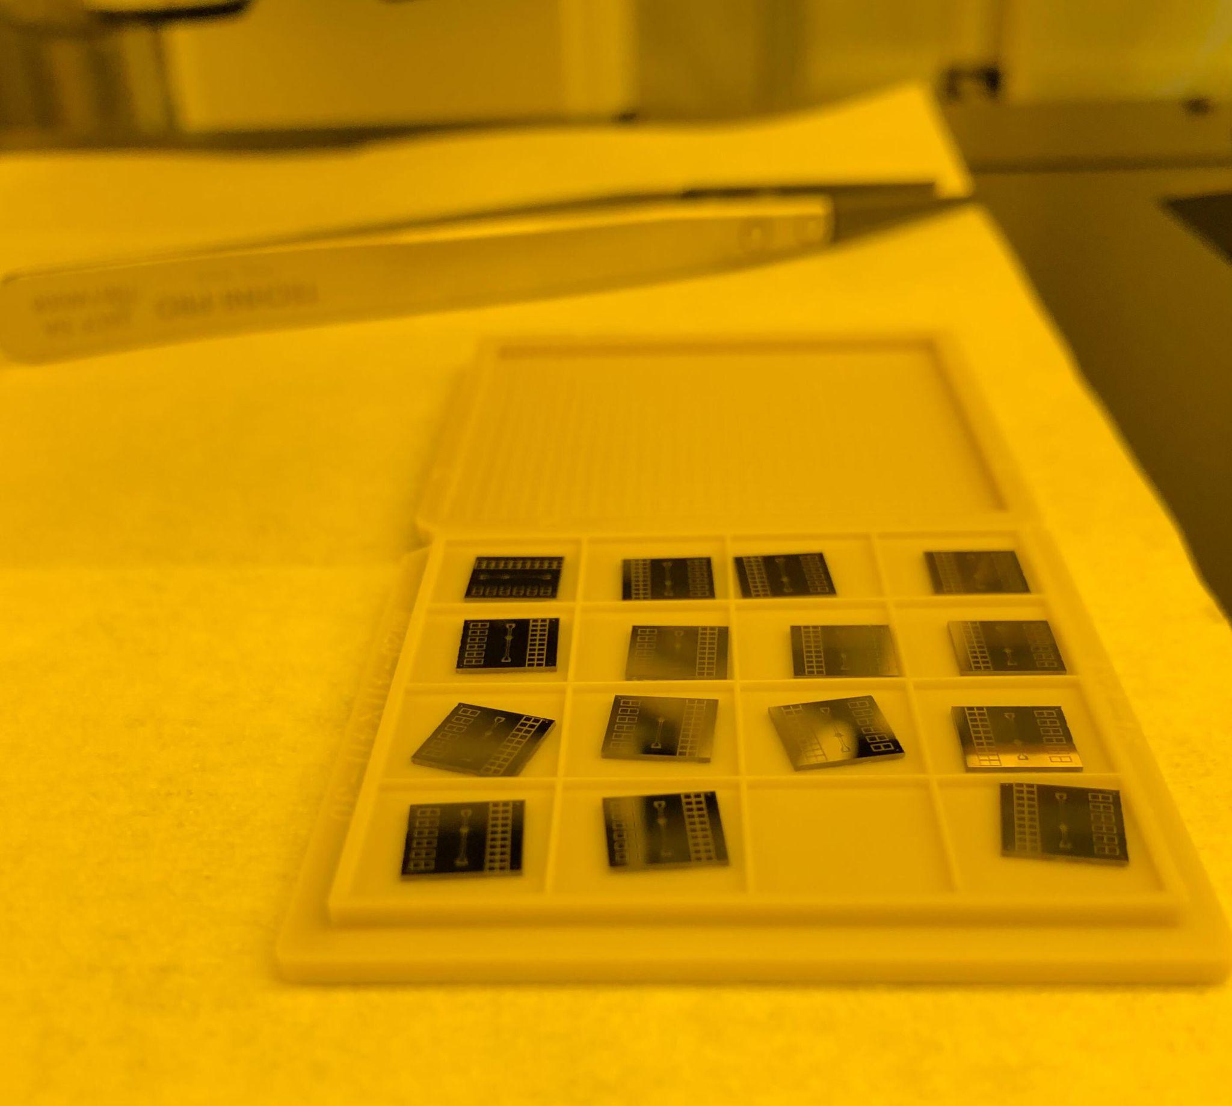
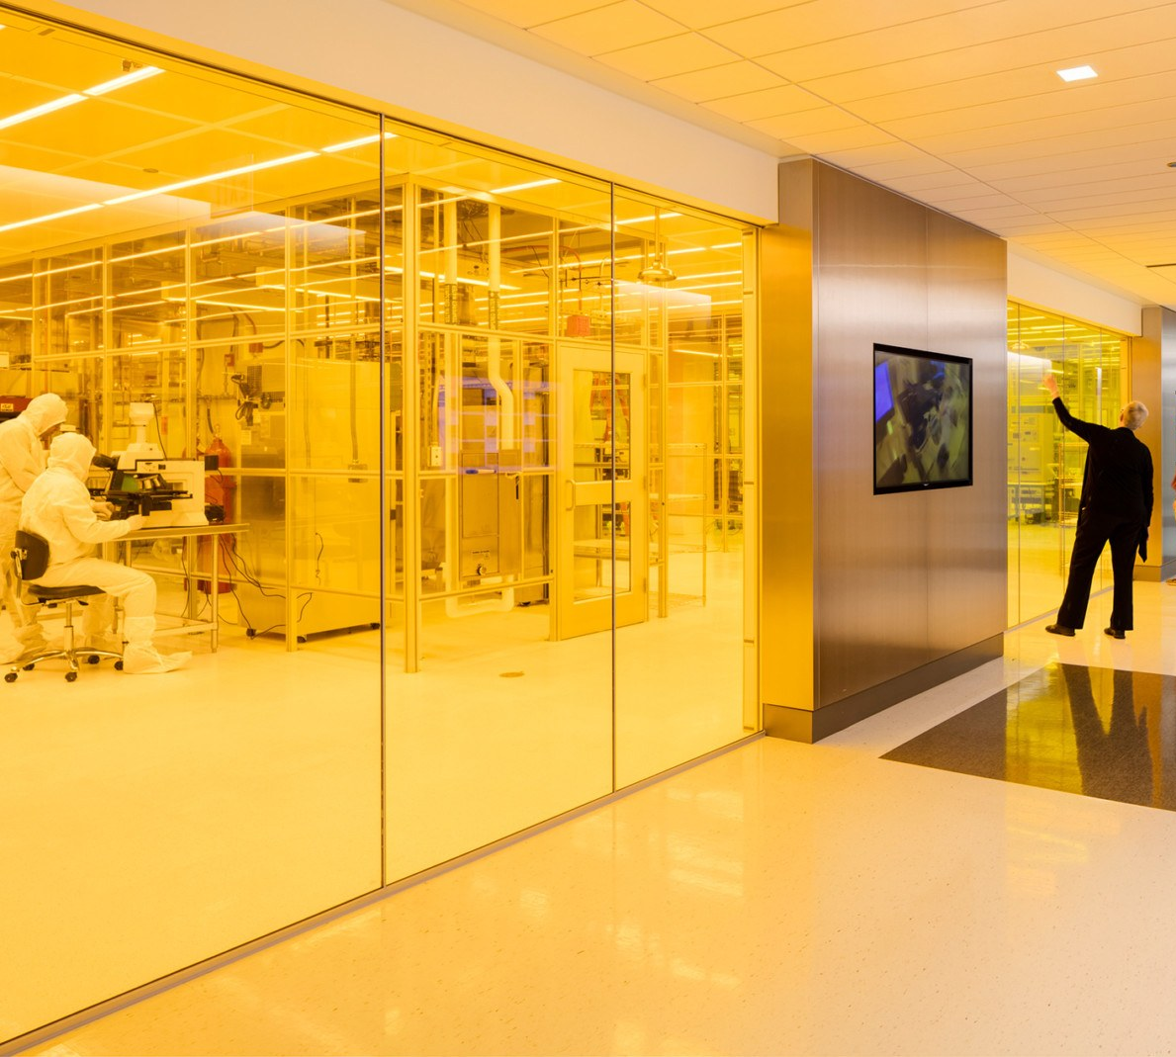
2 inch wafer scale fab at uChicago PNF cleanroom
2 inch wafer =
25 7x7mm chips
Recipe credit to Fang Zhao, Fermilab

Slide 26
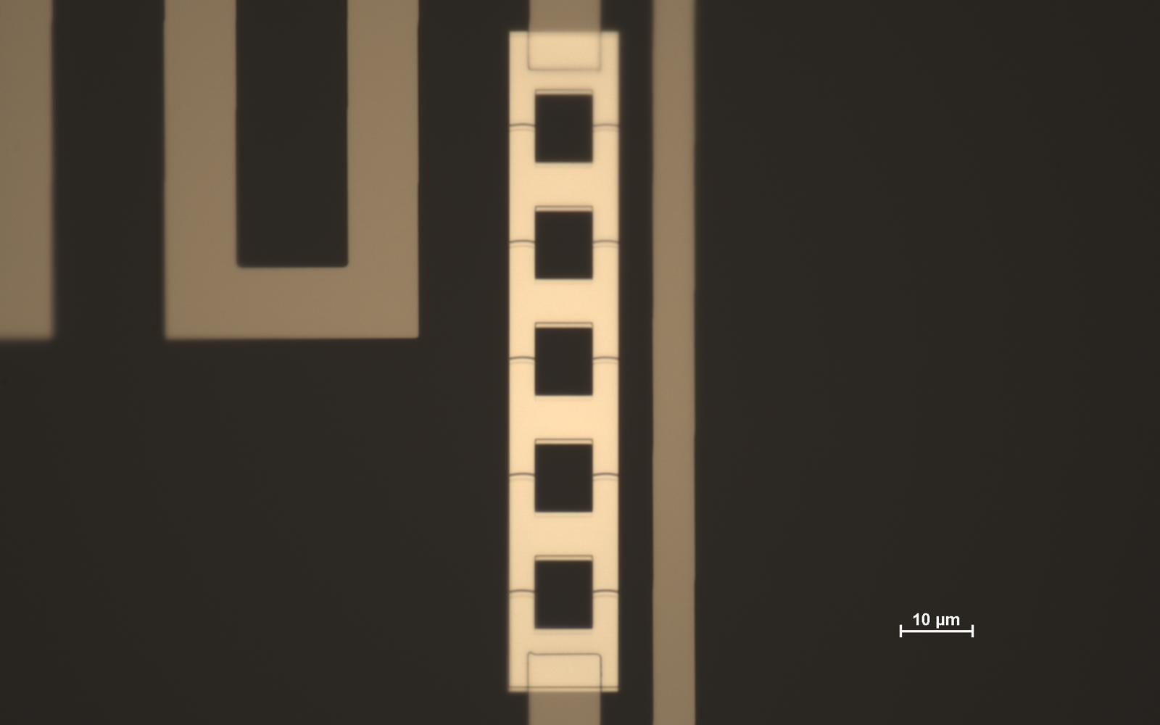
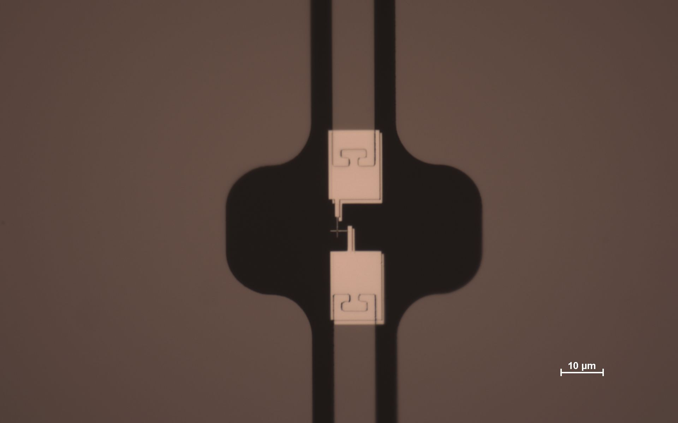
2 inch wafer scale fab at uChicago PNF cleanroom
JPA wafer
SQUID array
(Dolan JJs)
Nb on Sapphire
6 transmon wafer
Manhattan JJs
Ta on Sapphire

Slide 27
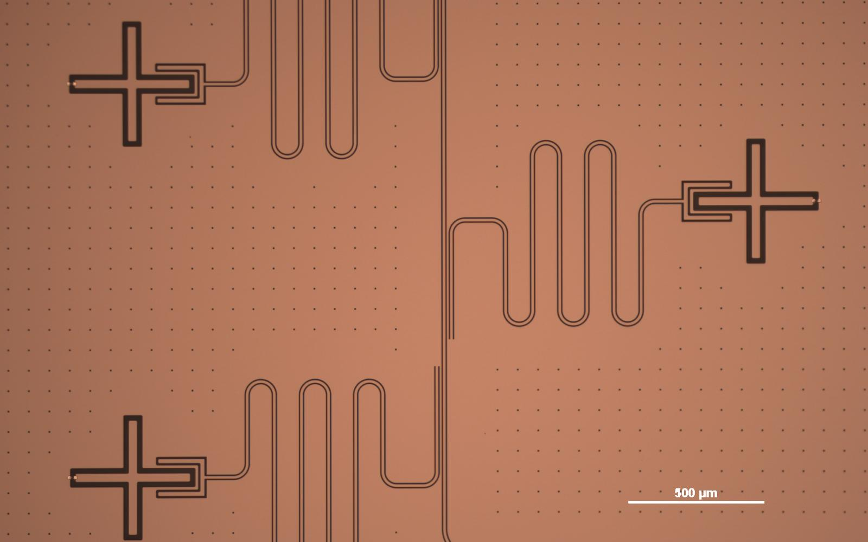
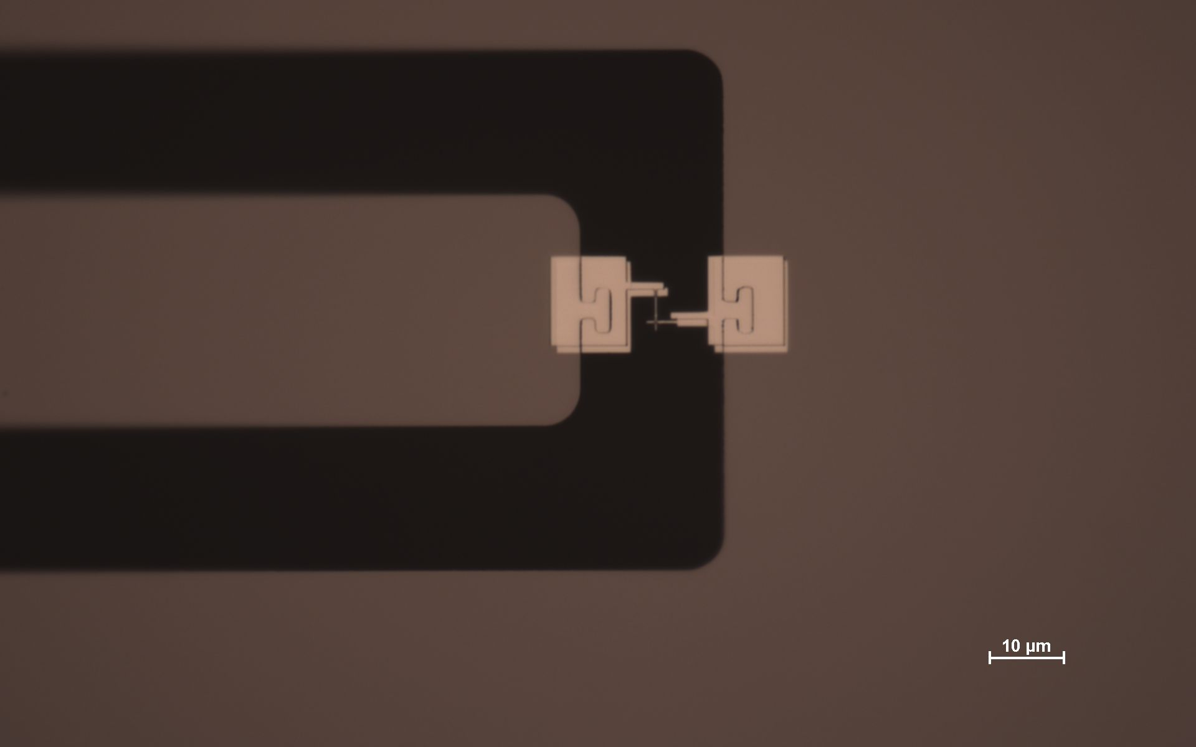
2 inch wafer scale fab at uChicago PNF cleanroom
6 transmon wafer
Manhattan JJs
Ta on Sapphire

Slide 28
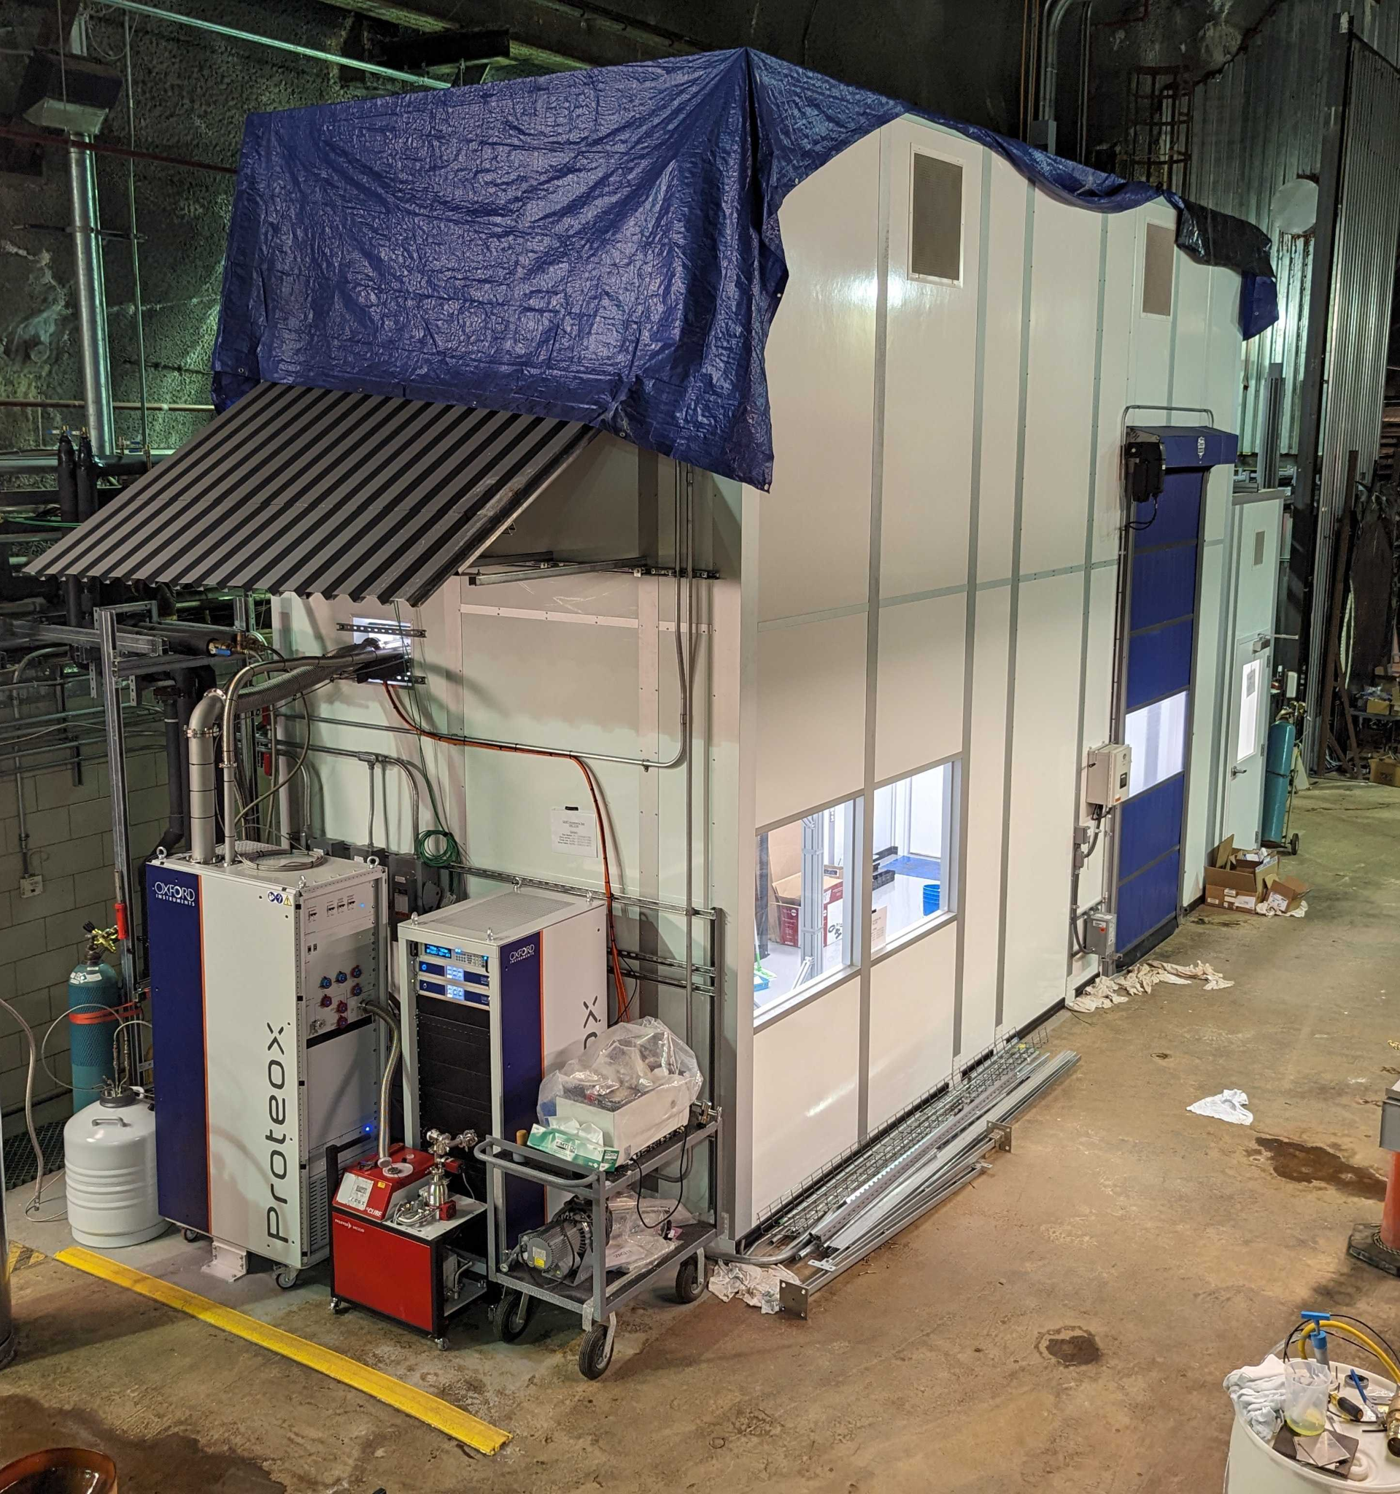
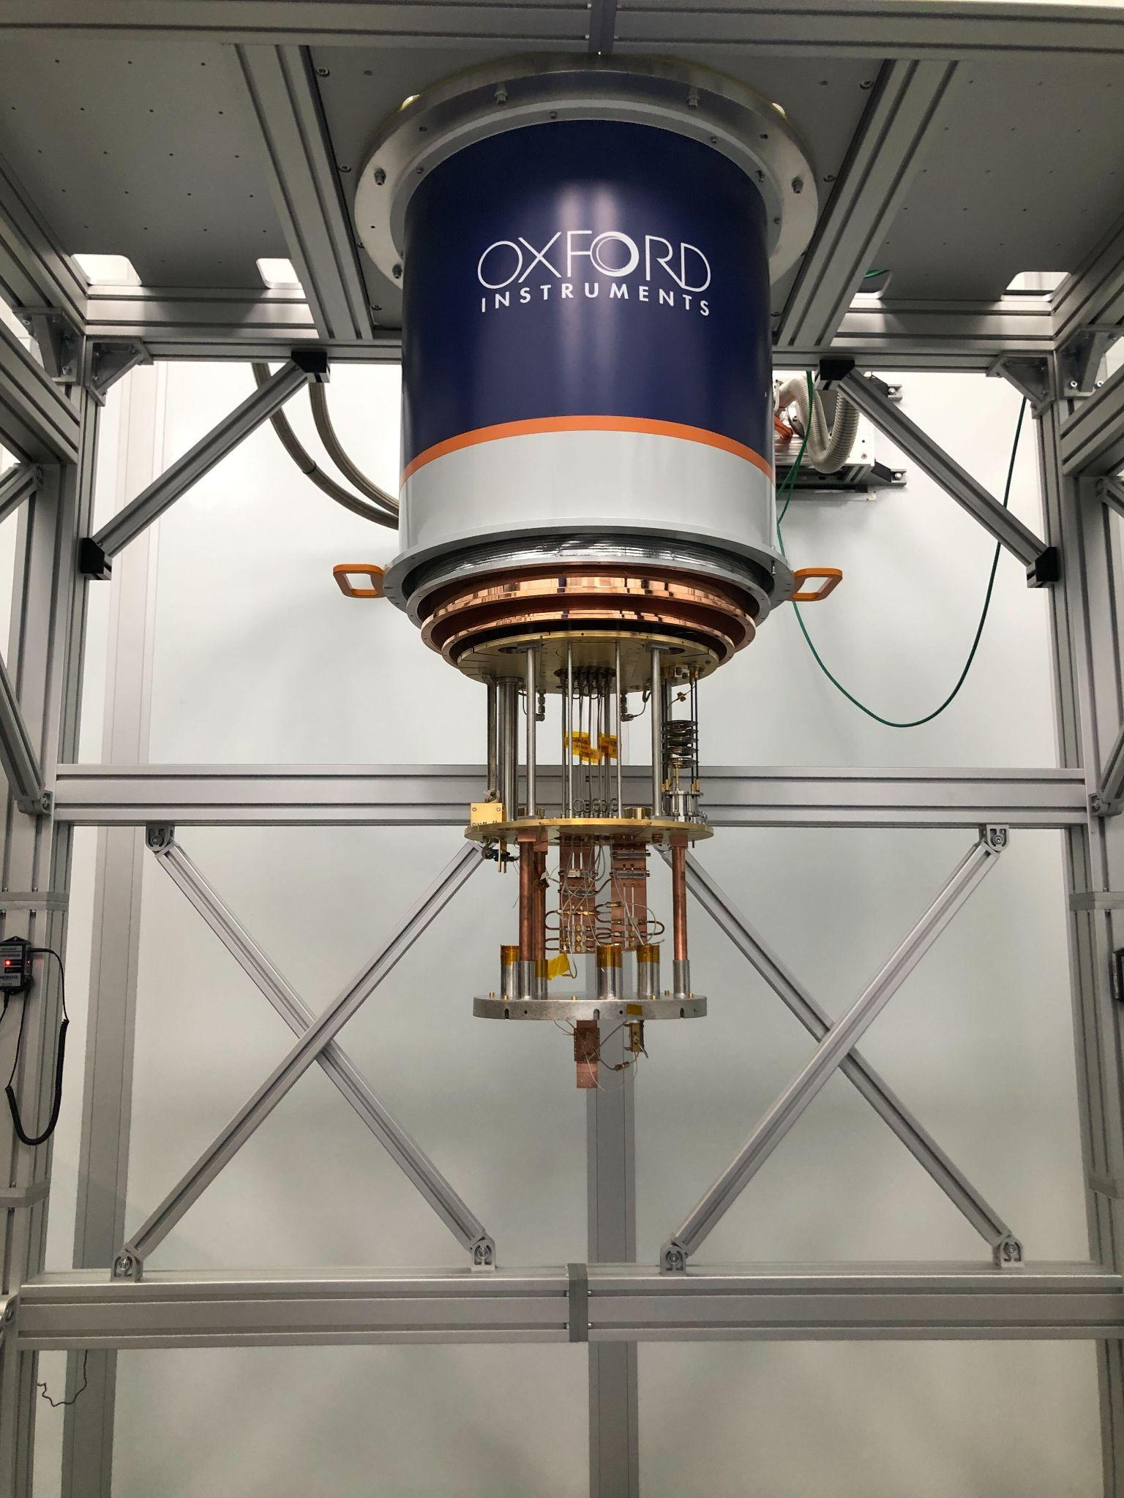
New fridge named “QUIET” ~300 ft underground

Slide 29
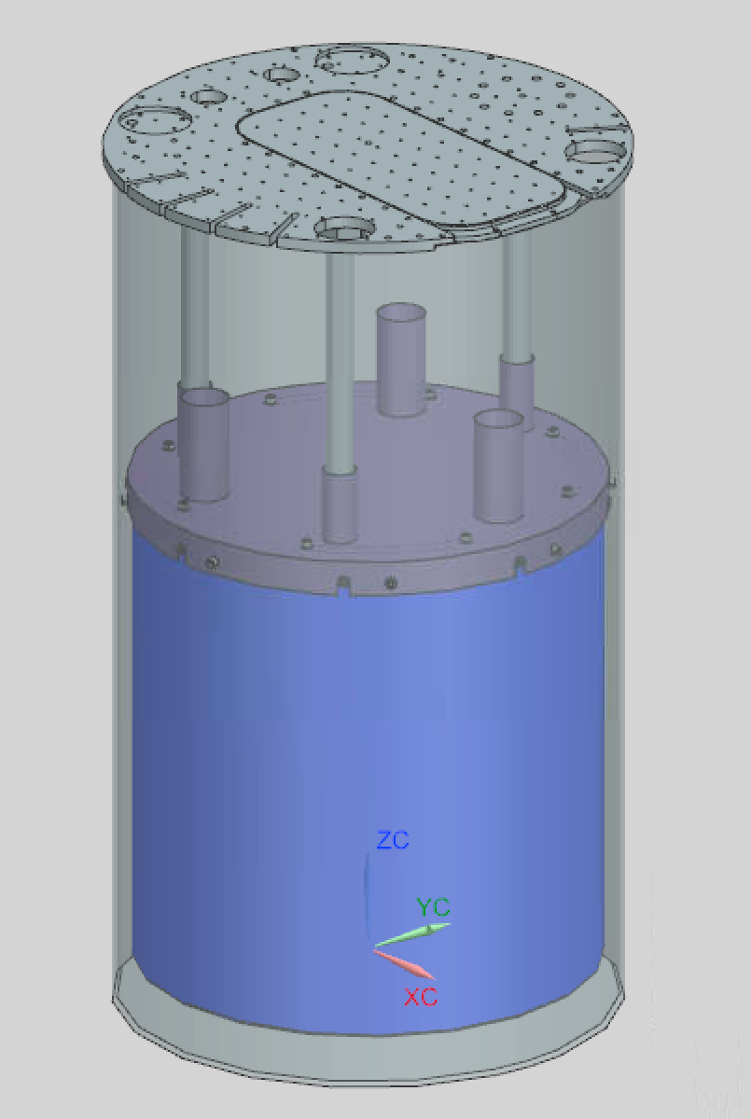
New fridge named “QUIET” ~300 ft underground, new “big mag shield” can
In simulation, reduction of B field expected is 3-4 orders of magnitude within the shield.
Magnetic shield

Slide 30
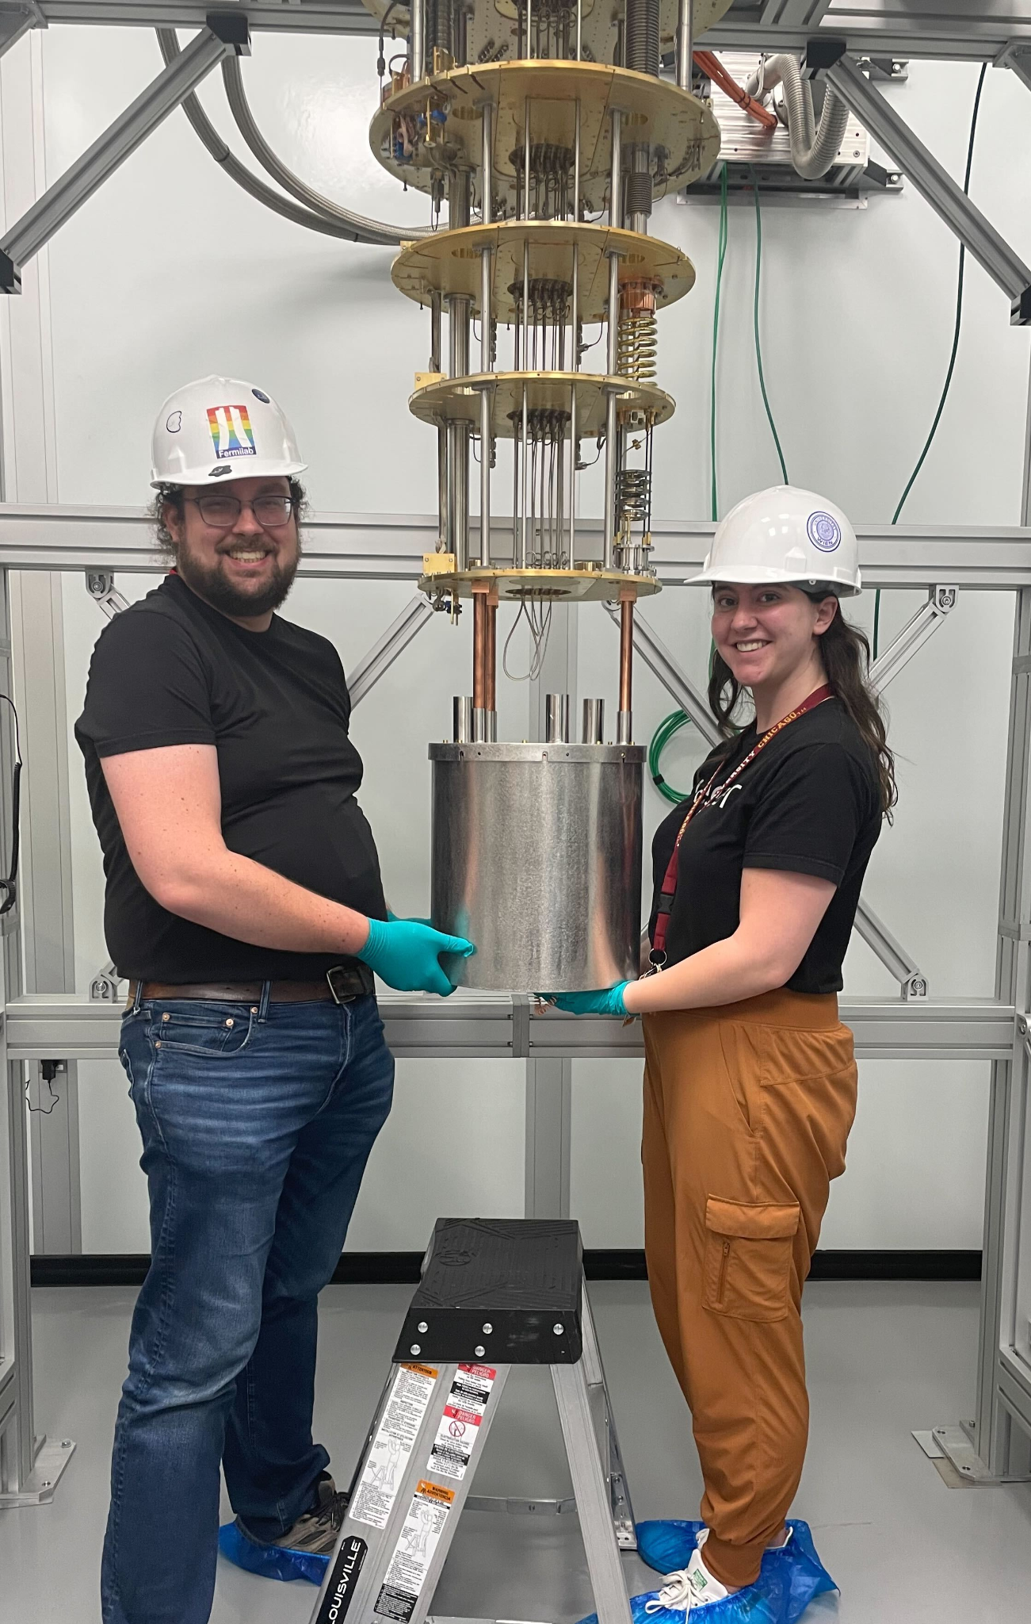
New fridge named “QUIET” ~300 ft underground, new “big mag shield” can
Magnetic shield

Slide 31
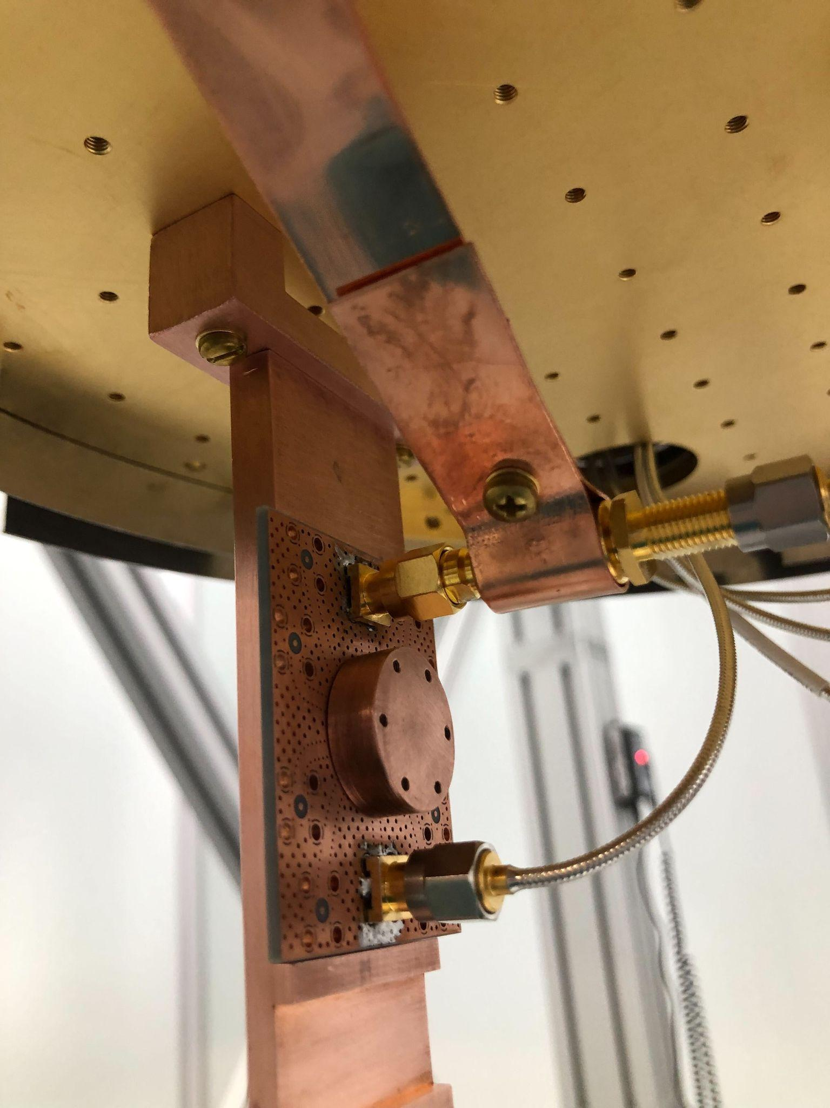
New fridge “QUIET”, + first devices
Magnetic shield

Slide 32
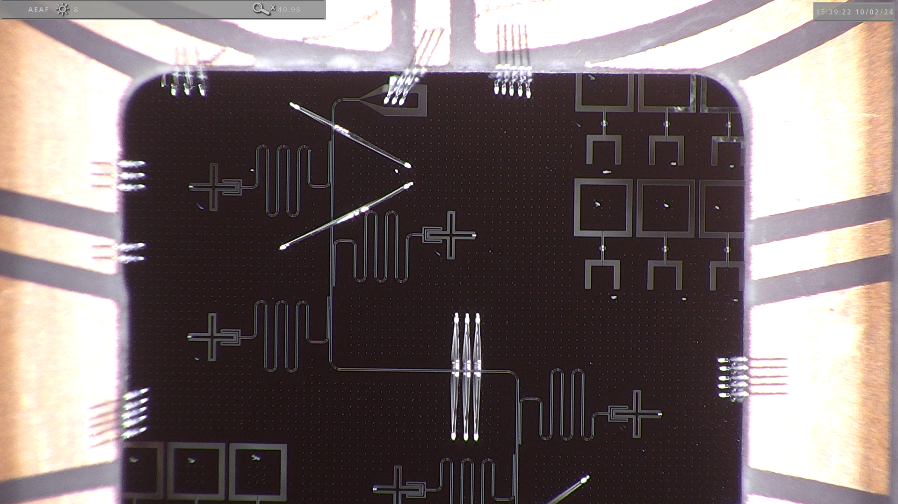
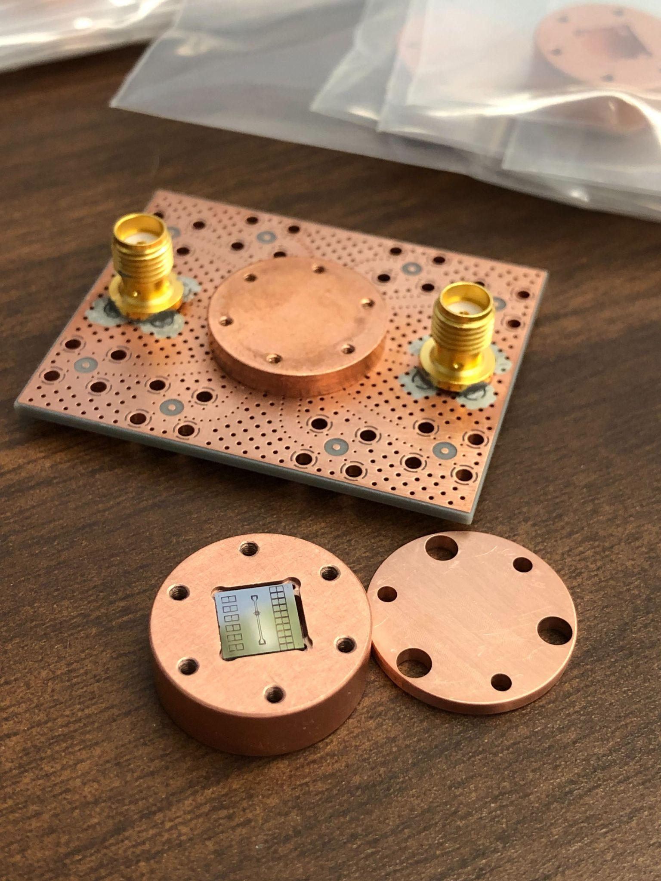
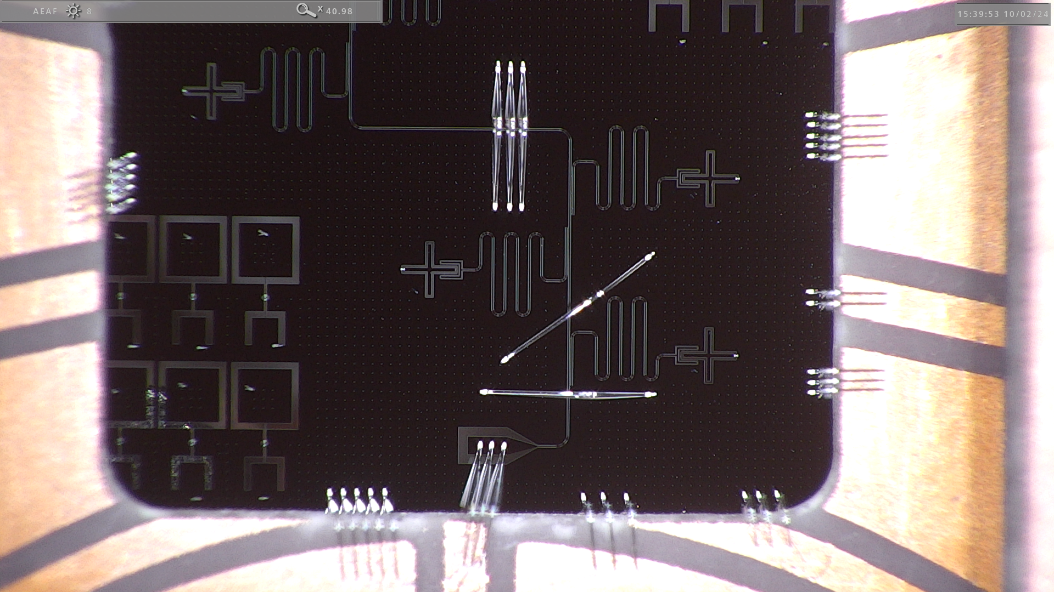
New fridge, new “big mag shield” can, + first devices, reached base temp ~2 wks ago
Typical chip package used by Houck, Schuster, Ma labs
Chip design credit to Ziqian Li, Schuster lab

Slide 33
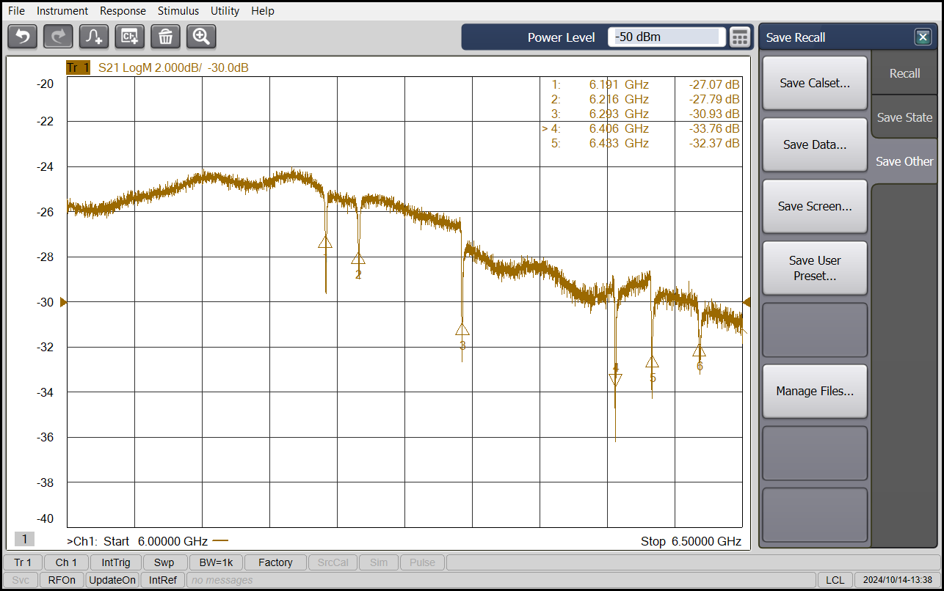
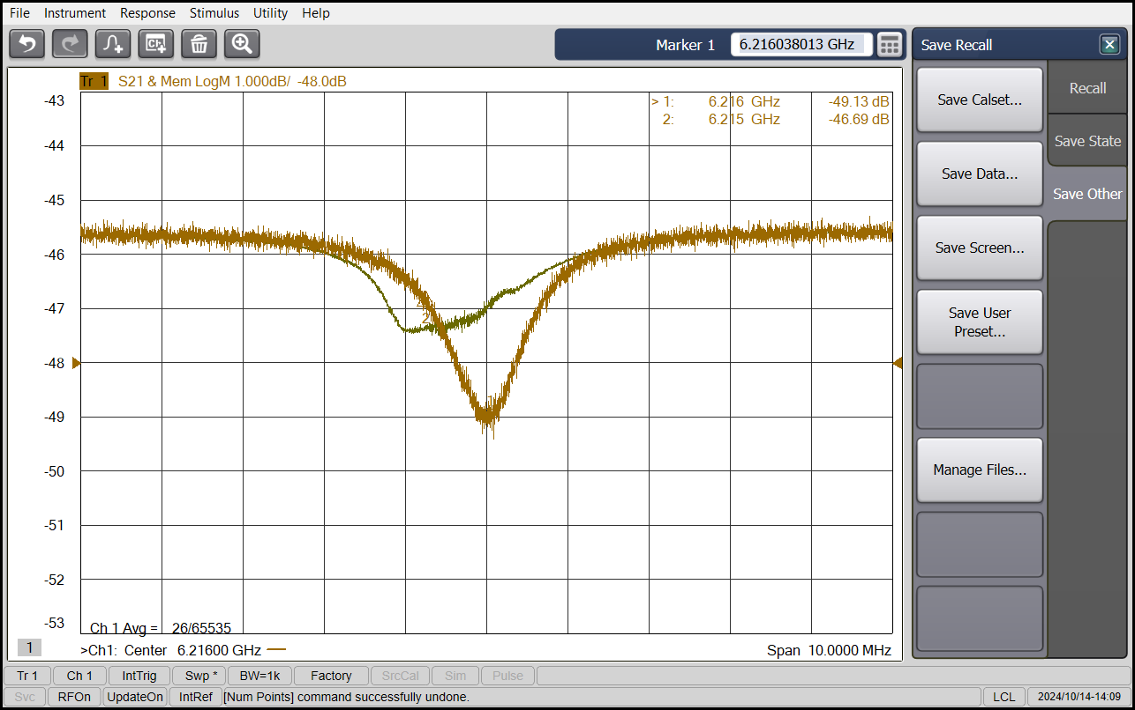
We see the 6 resonators & qubits where we expect with good initial SNR

Slide 34
We see the 6 resonators & qubits where we expect with good initial SNR
“Punch-out” resonator spectroscopy
Measure low and high power resonator frequency
Measure Lamb shift to extract g
Measure κ from low power trace
Same technique as “SQuADDS: A validated design database and simulation workflow for superconducting qubit design” S. Shanto et al., Quantum 2024-09-05

Slide 35
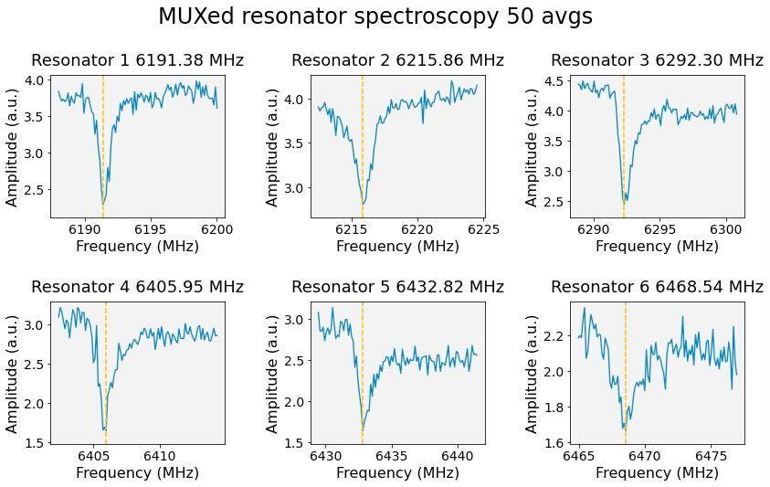
We see the 6 resonators & qubits where we expect with good initial SNR
Pulsed 6x MUX’d readout
Google also MUXes 6x, as per https://arxiv.org/abs/2402.00413
Resonator separation <30 MHz
QICK code for these and following measurements available with latest firmware https://github.com/sarafs1926/tprocv2_demos

Slide 36
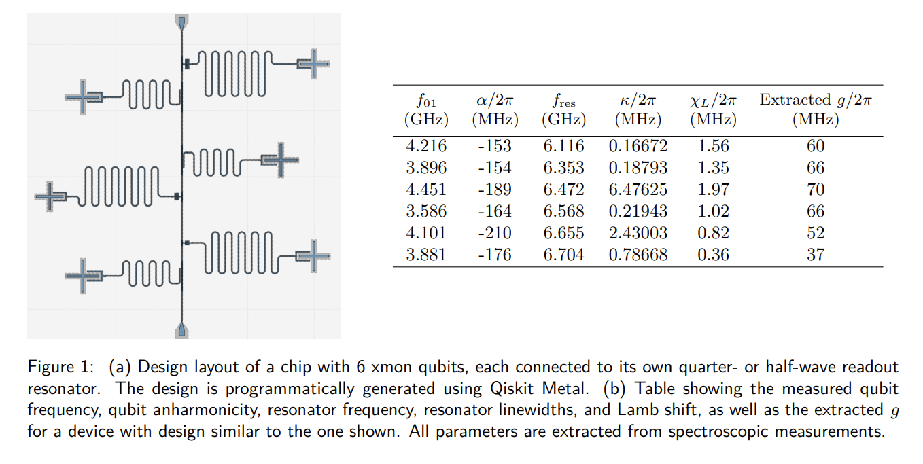
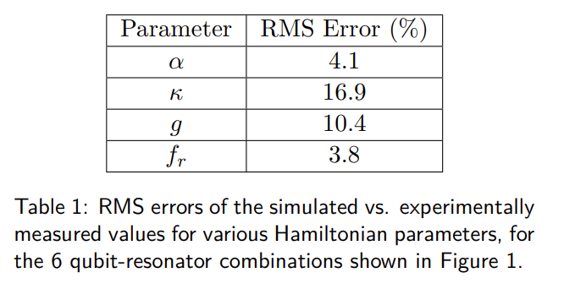
How close are we to our target params? Can compare to the literature
Parameters relevant to Purcell decay | RMS Error (%)
κ | 33-54
g | 56-69
f_{resonator} | 2.7-4.6
“SQuADDS: A validated design database and simulation workflow for superconducting qubit design” S. Shanto et al., Quantum 2024-09-05

Slide 37
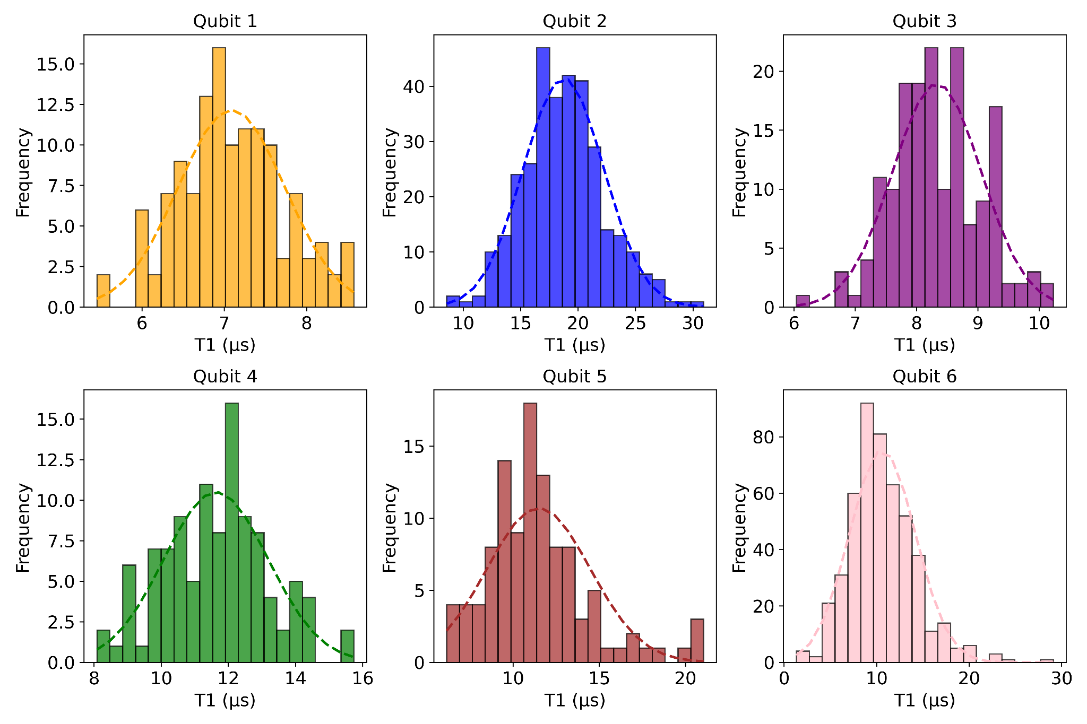
Initial T1 data for 6Q chip (haven’t validated mag shield), Gaussian distributions
Measurements by O. Seidel, A. Colón Cesaní

Slide 38
What’s limiting T1 for our qubits right now? It’s probably not Purcell…
Using:
From “Charge-insensitive qubit design derived from the Cooper pair box”
J. Koch et al., Phys. Rev. A 76, 042319 (2007)

Slide 39
Our next steps
Debug lower than expected T1 across the chip
Lack of magnetic shielding?
Measure T2 Ramsey, Echo
Re-cool with additional small magnetic shield (experimentally validated to shield by a factor of >100) around the device itself

Slide 40
Our next steps
Debug lower than expected T1 across the chip
Lack of magnetic shielding? (Can decisively check ✅)
Measure T2 Ramsey ✅, Echo 📈
Re-cool with additional small magnetic shield (experimentally validated to shield by a factor of >100) around the device itself

Slide 41
Our next steps
Debug lower than expected T1 across the chip
Lack of magnetic shielding? (Can decisively check ✅)
Measure T2 Ramsey ✅, Echo 📈
Re-cool with additional small magnetic shield (experimentally validated to shield by a factor of >100) around the device itself
Qubit is hot?
Measure qubit temperature by optimizing readout fidelity

Slide 42
Our next steps
Debug lower than expected T1 across the chip
Lack of magnetic shielding? (Can decisively check ✅)
Measure T2 Ramsey ✅, Echo 📈
Re-cool with additional small magnetic shield (experimentally validated to shield by a factor of >100) around the device itself
Qubit is hot? (Can decisively check ✅)
Measure qubit temperature by optimizing readout fidelity 📈

Slide 43
Our next steps
Debug lower than expected T1 across the chip
Lack of magnetic shielding? (Can decisively check ✅)
Measure T2 Ramsey ✅, Echo 📈
Re-cool with additional small magnetic shield (experimentally validated to shield by a factor of >100) around the device itself
Qubit is hot? (Can decisively check ✅)
Measure qubit temperature by optimizing readout fidelity 📈
Purcell?
Model Purcell of package + device, etc

Slide 44
Our next steps
Debug lower than expected T1 across the chip
Lack of magnetic shielding? (Can decisively check ✅)
Measure T2 Ramsey ✅, Echo 📈
Re-cool with additional small magnetic shield (experimentally validated to shield by a factor of >100) around the device itself
Qubit is hot? (Can decisively check ✅)
Measure qubit temperature by optimizing readout fidelity 📈
Purcell? (In general, we’d like to be more sure about this…)
Model Purcell of package + device, etc

Slide 45
Our next steps
Debug lower than expected T1 across the chip
Lack of magnetic shielding? (Can decisively check ✅)
Measure T2 Ramsey ✅, Echo 📈
Re-cool with additional small magnetic shield (experimentally validated to shield by a factor of >100) around the device itself
Qubit is hot? (Can decisively check ✅)
Measure qubit temperature by optimizing readout fidelity 📈
Purcell? (In general, we’d like to be more sure about this…)
Model Purcell of package + device, etc
→ Fab?
Keep on iterating with better/cleaner fab and packaging techniques

Slide 46
Longer term next steps
Doing A-B tests with the latest QICK RF board to see if qubit readout SNR improves as expected
Doing A-B tests with different shielding/filtering/device MUXing (cryoswitches) configurations.
Measuring correlated decoherence on short timescales under different radiation configurations (G Bratrud et al, arXiv 2024)
The next design/fab iteration
Designing/fabbing chips specific for axion (C Braggio et al, arXiv 2024) and particle dark matter (R Linehan, arXiv 2024) searches

Slide 47
Outline
9:00-9:10 am Why today’s transmon qubits are already useful dark
matter sensors, and why we need to engineer
higher T1, broadly tunable, transmon qubit devices
9:10-9:20 am Our experimental progress
9:20-9:30 am Our open source design workflow

Slide 48
An open source workflow helps us iterate devices 💪
The device iteration cycle is a balancing act between design, fabrication, and measurement
Y. Gao et al, PRX QUANTUM 2, 040202 (2021)

Slide 49
Our open source device iteration workflow
Measurement: QICK qubit controller
300+ users, 29 science papers published and counting

Slide 50
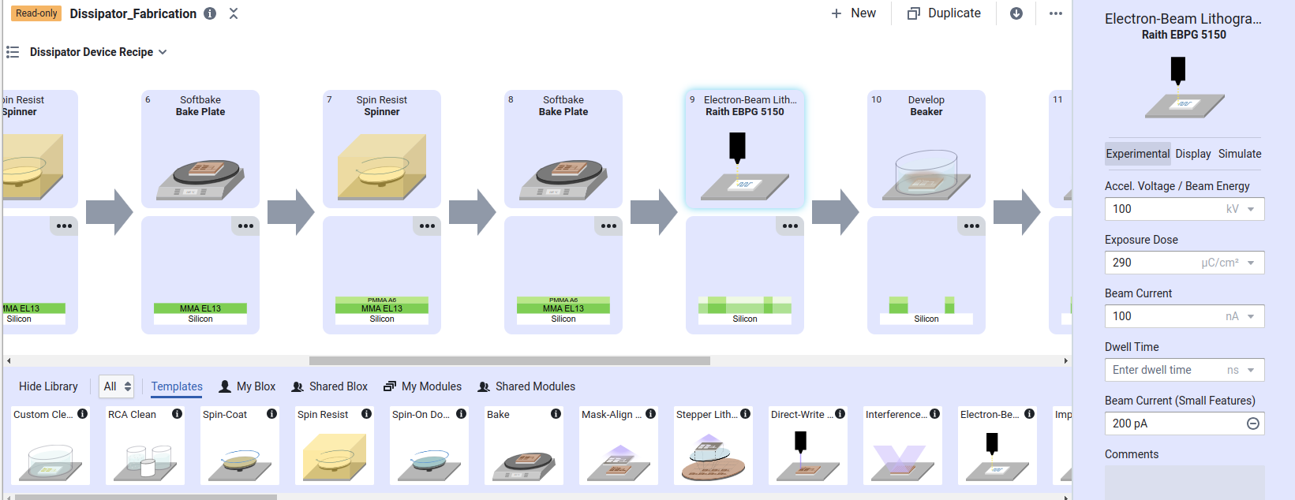
Our open source device iteration workflow
Measurement: QICK qubit controller
300+ users, 29 science papers published and counting
Fab: Fabublox
Open source fab recipe software
CosmiQ group is a beta tester
E.g. USC’s SC qubit lab has uploaded to Fabublox!

Slide 51
Our open source device iteration workflow
Measurement: QICK qubit controller
300+ users, 29 science papers published and counting
Fab: Fabublox
Open source fab recipe software
CosmiQ group is a beta tester
Design (we’ll focus here)

Slide 52
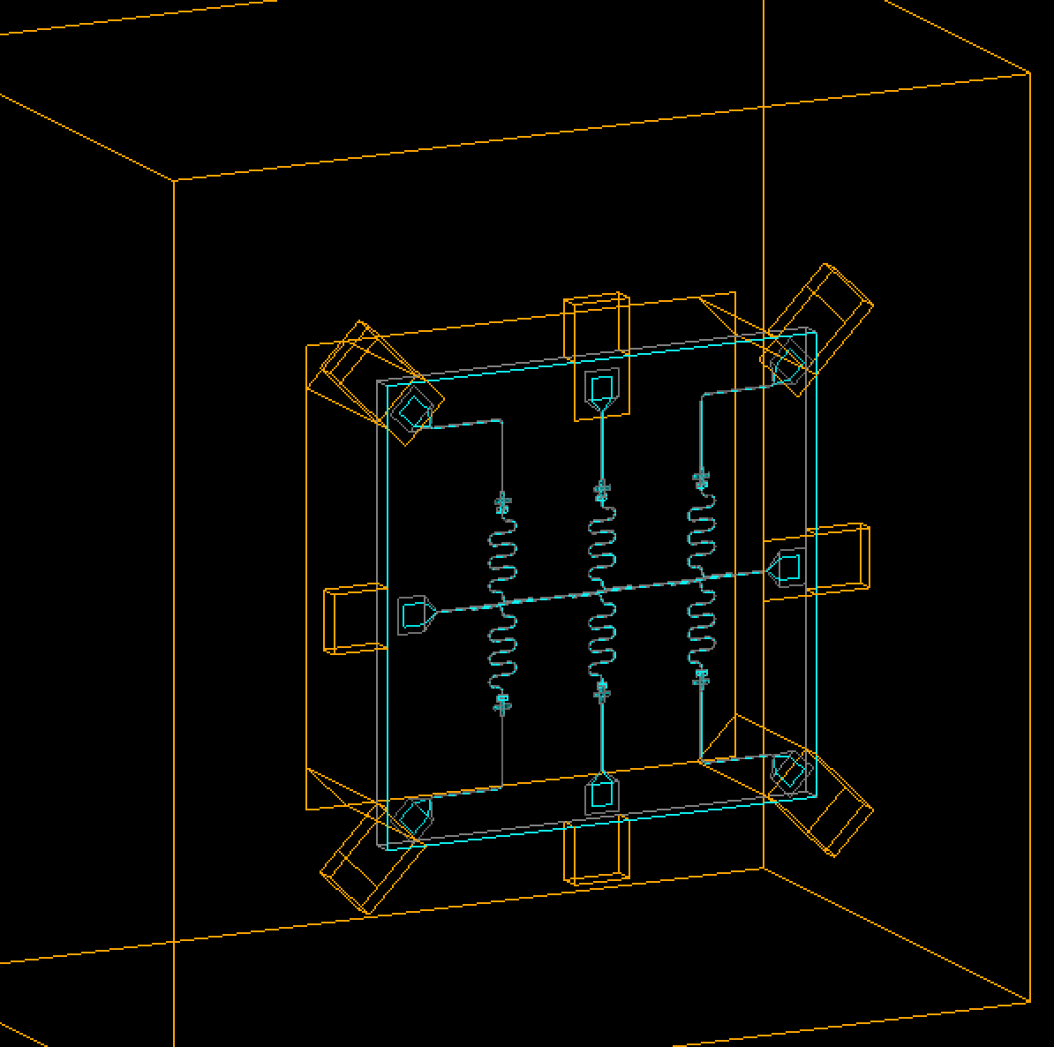
Our open source device iteration workflow
Measurement: QICK qubit controller
300+ users, 29 science papers published and counting
Fab: Fabublox
Open source fab recipe software
CosmiQ group is a beta tester
Design (we’ll focus here)
CosmiQ group has been a main developer for G4CMP, an open source tool developed by particle physicists for simulating particle scatters in materials/3D geometries

Slide 53
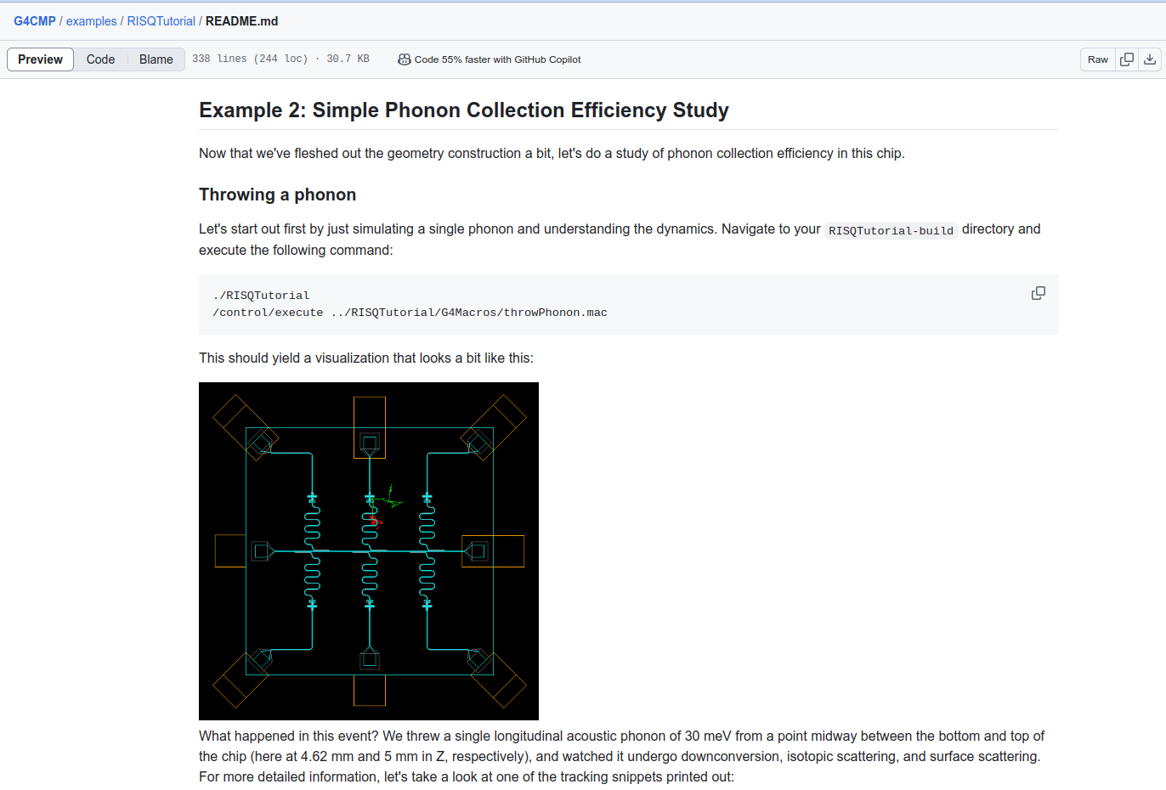
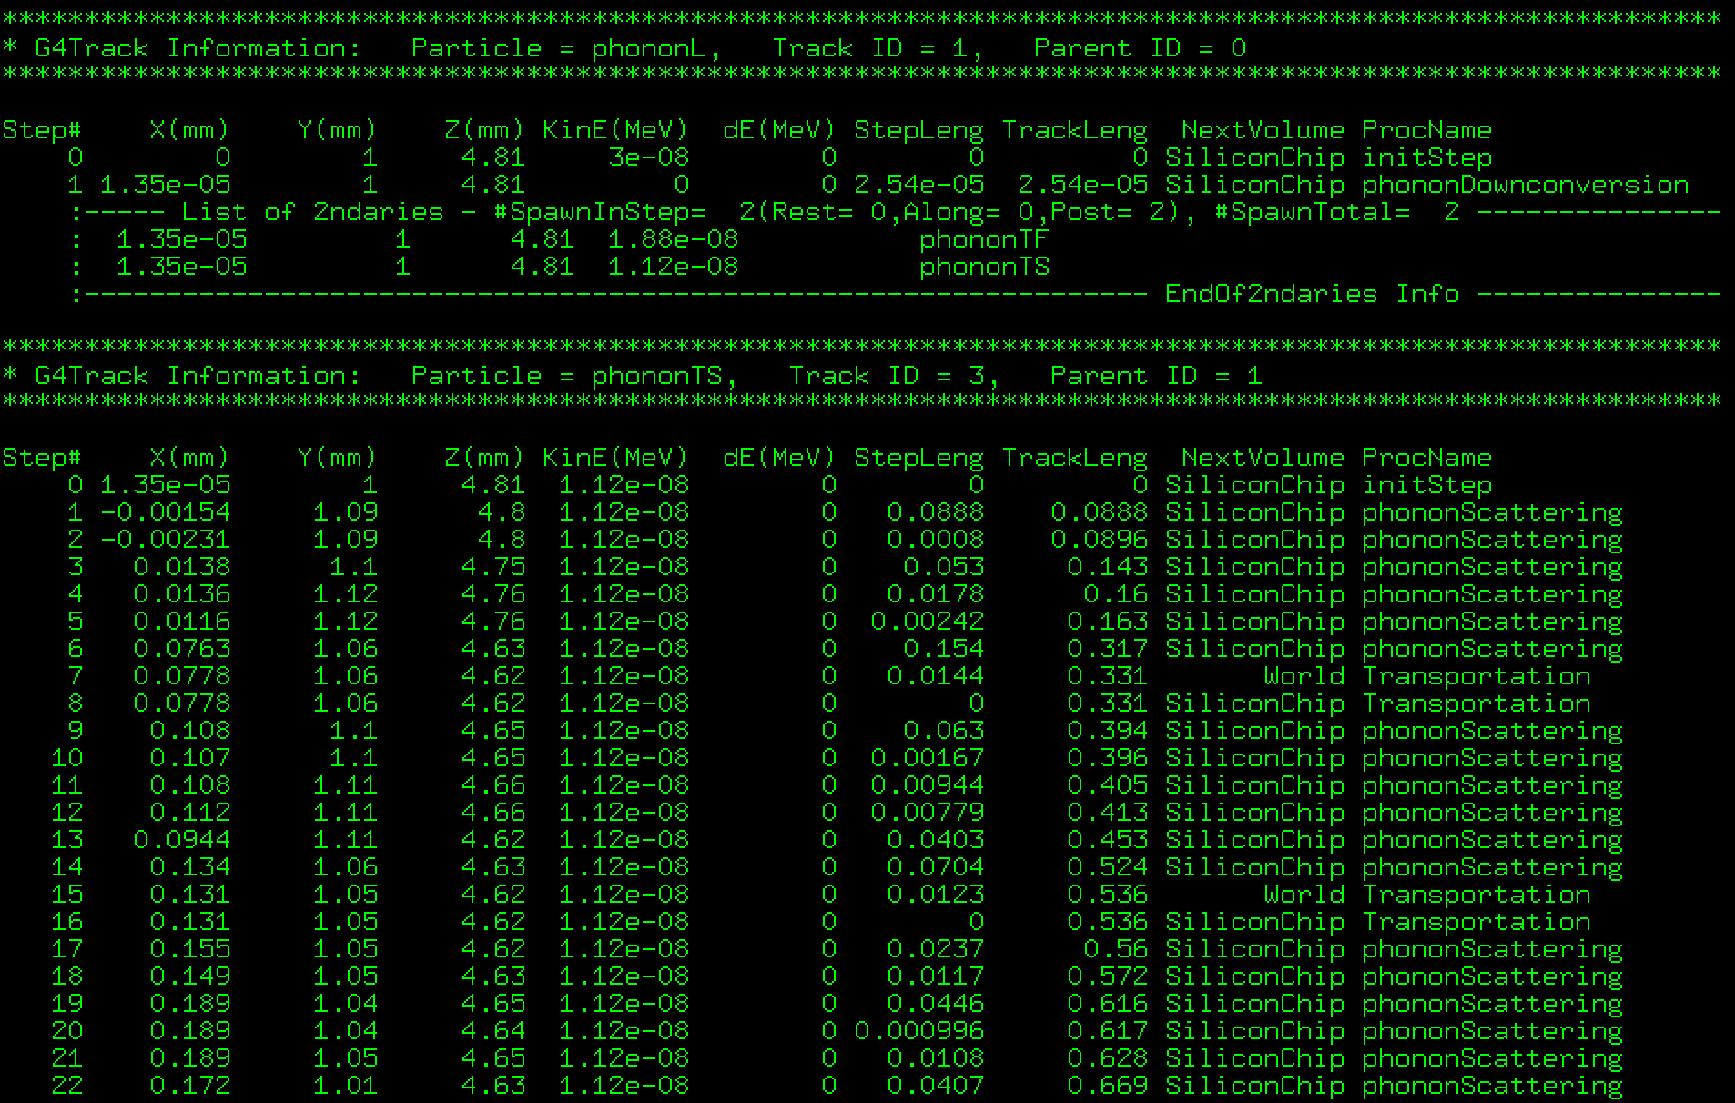
G4CMP: open source tool that simulates particle scatters in qubit chips

Slide 54
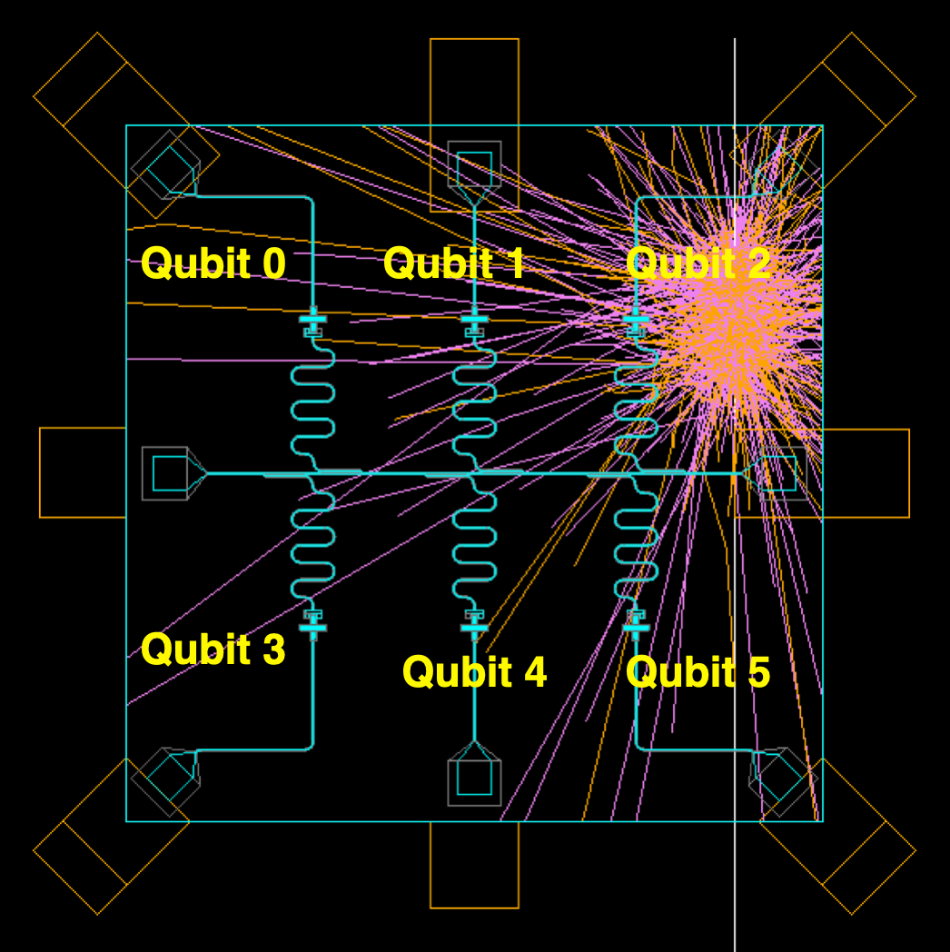
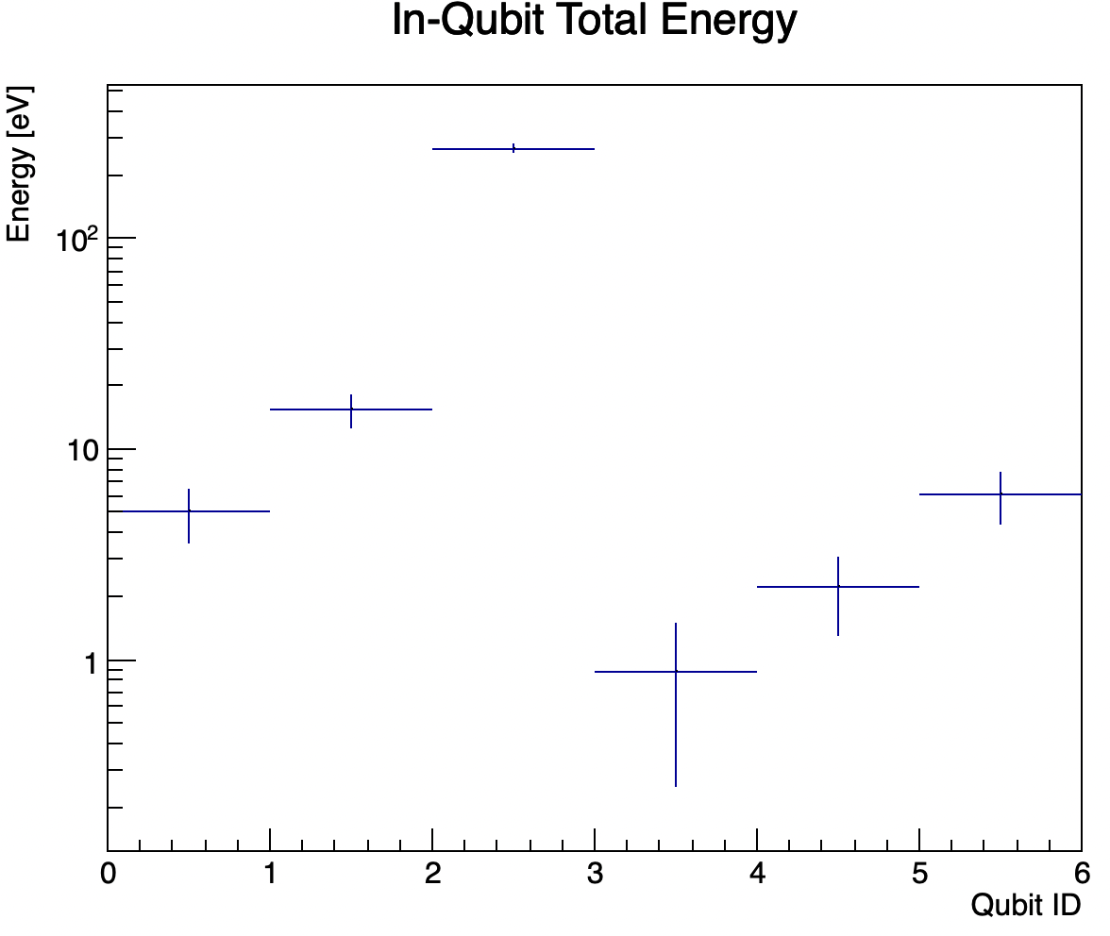
G4CMP: open source tool that simulates particle scatters in qubit chips
G4CMP simulates a muon hitting a qubit

Slide 55
G4CMP: open source tool that simulates particle scatters in qubit chips
G4CMP is used to estimate the sensitivity of different qubit device layouts to energy deposits

Slide 56
G4CMP: open source tool that simulates particle scatters in qubit chips
G4CMP is used to estimate the sensitivity of different qubit device layouts to energy deposits
→ Some chip layouts (limited ground plane) are more efficient at sensing the phonons that result from a simulated dark matter particle hitting the chip substrate. Longer T1 improves sensitivity.
Notes:
The ground plane absorbs phonons. In general it really helps to have high T1 so you can maintain a coherent many body state, increasing your “cross section” to the dark matter

Slide 57
The software stack of open source qubit design tools
Benchmark and Optimization
Circuit Simulator
Quantum application results and benchmark
Quantum algorithms and applications
Quantum circuits
QASM
QIR
NWQ-Sim
Gate pulse profiles
Pulse Simulator
Gate description
QuTip
Noise model
Qubit Simulator
Effective Hamiltonian model
scQubits
EM simulator
Lumped-element circuit model parameters
Ansys HFSS
AWS Palace
EDA tools
Chip and qubit layout GDS design
Qiskit-Metal
SQuADDS

Slide 58
The software stack of open source qubit design tools
Benchmark and Optimization
Circuit Simulator
Quantum application results and benchmark
Quantum algorithms and applications
Quantum circuits
QASM
QIR
NWQ-Sim
Gate pulse profiles
Pulse Simulator
Gate description
QuTip
Noise model
Qubit Simulator
Effective Hamiltonian model
scQubits
EM simulator
The SQuADDs library can bridge the gap by using the effective Hamiltonian model as well as the lumped model to optimize the chip layout design
Lumped-element circuit model parameters
Ansys HFSS
AWS Palace
EDA tools
Chip and qubit layout GDS design
Qiskit-Metal
SQuADDS

Slide 59
Thank you for listening!

Slide 60
Acknowledgements- the CosmiQ group @ Fermilab
Fermilab Group
Daniel Baxter
Daniel Bowring
Gustavo Cancelo
Aaron Chou
Lauren Hsu
Ryan Linehan
Sara Sussman
Dylan Temples
Sho Uemura
Chris James
Olivia Seidel
NU Group
Enectalí Figueroa-Feliciano
Riccardo Gualtieri
Emanuela Celi
Grace Bratrud
Arianna Colón Cesaní
Deeksha Sabhari
IIT Group
Rakshya Khatiwada
Kester Anyang
Israel Hernandez
Jialin Yu

Slide 61
Thank you for listening!
If you have any questions, please feel free to email at sarafs@fnal.gov

Slide 62
Backup slides

Slide 63
Initial T1 data for 6Q chip (haven’t validated mag shield), Gaussian tails

Slide 64
Initial T1 data for 6Q chip (haven’t validated mag shield), Gaussian distributions

Slide 65
Initial T1 data for 6Q chip (haven’t validated mag shield), Gaussian distributions

Slide 66
Initial T1 data for 6Q chip (haven’t validated mag shield), Gaussian distributions

