Slide 1
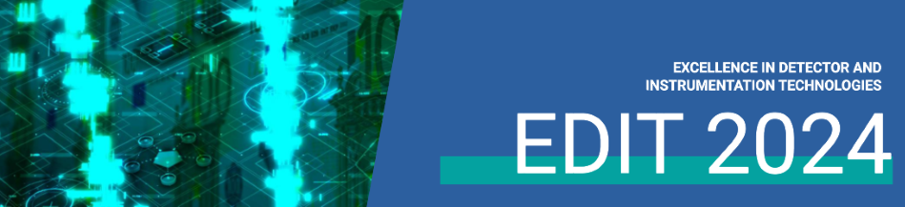


Application of Detector in Medicine
Hyejoo Kang, PhD
Associate Professor
Loyola University Chicago
Loyola Medical Center
11-21-2024, EDIT conference, fermilab

Slide 2
Introducing myself
Radiation therapy medical physicist
Formally, high energy experimental physicist
  Stanford linear accelerator center : SLD experiment working on QCD
  Fermi national laboratory: Neutrino oscillation experiment (MINOS)
Re-trained as a medical physicist at Memorial Sloan-Kettering Cancer Center (MSKCC) in NYC
Currently, faculty member at Loyola University of Chicago
Associate director of medical physics at radiation oncology department
Clinical work, teaching/mentoring, research and outreach

Slide 3
OUTLINE
INTRODUCTION OF MEDICAL PHYSICS
INTRODUCTION OF RADIATION THERAPY
DETECTORS & APPLICATIONS IN RADIATION THERAPY
DETECTORS & APPLICATIONS IN MEDICAL IMAGING
CUTTING-EDGE DEVELOPMENT IN MEDICAL PHYSICS

Slide 4
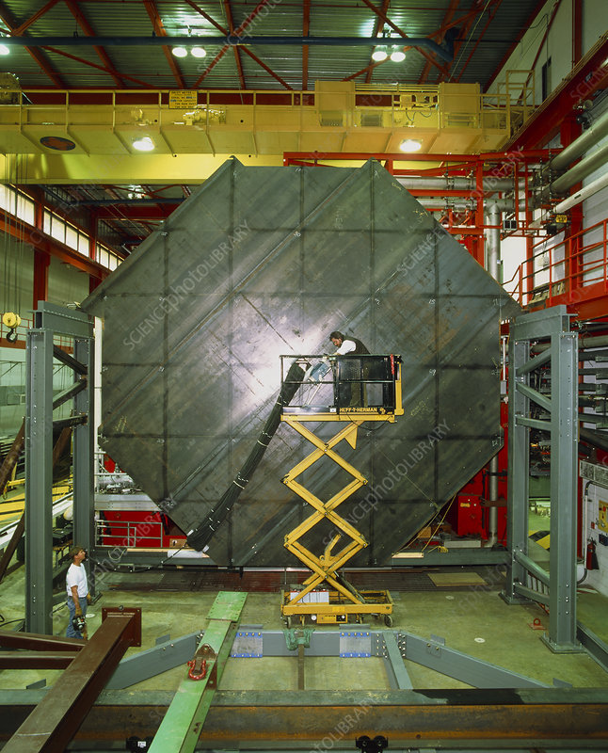
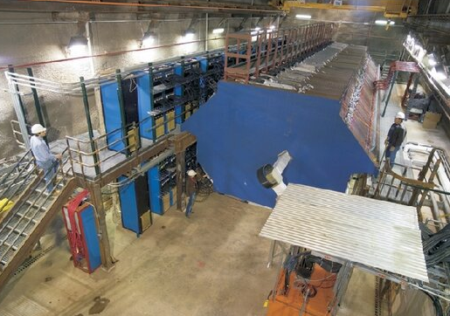
The bigger, the better
Minos (Main injector neutrino oscillation search) (2005-2016)
457 mi
Near detector @ Fermilab: 3 meter fiducial region steel & solid scintillator & Photomultiplier tube (PMT) detectors
Far detector @ Soudan: 8 meter diameter, 30 meter length; steel & scintillator & PMT

Slide 5
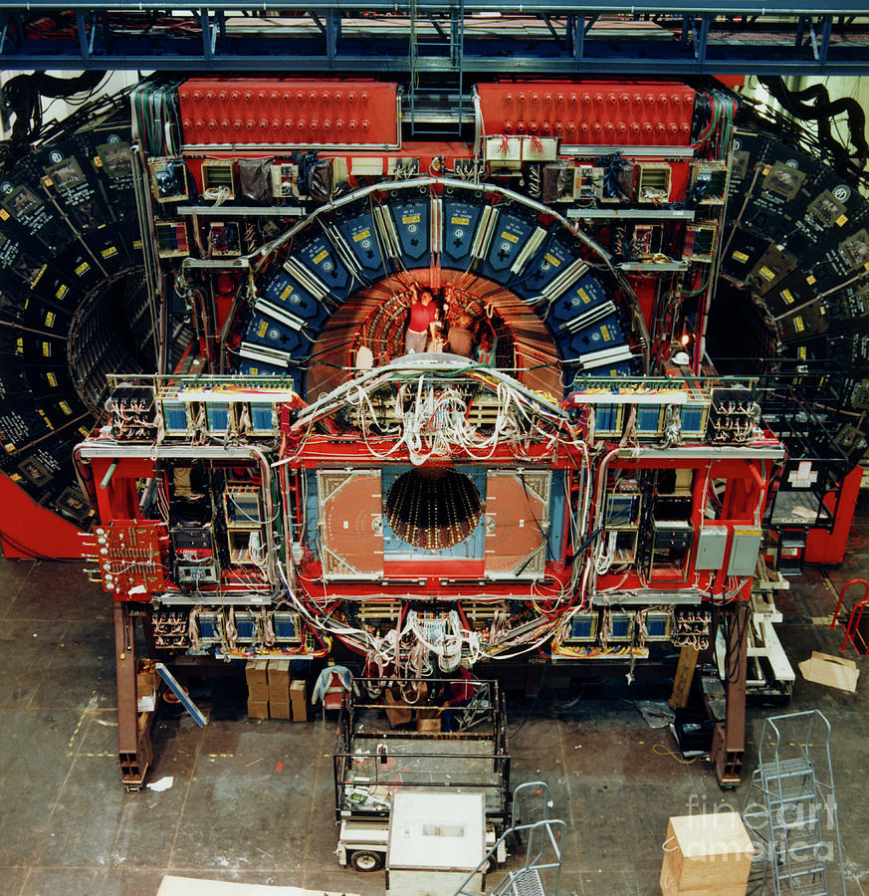
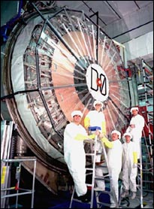
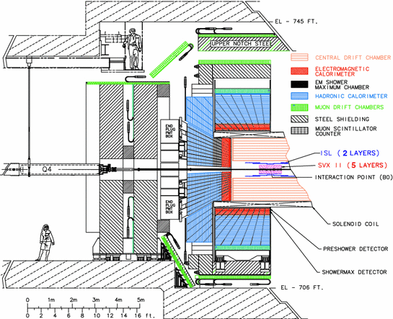
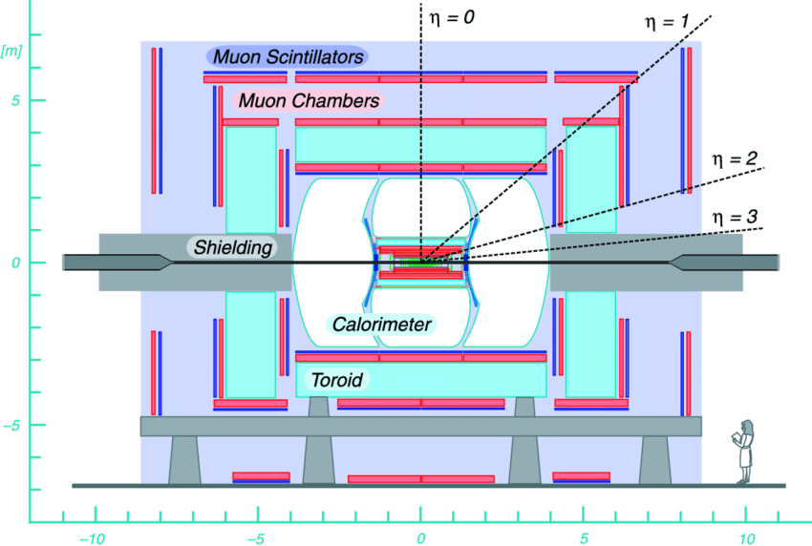
Large complex hadron detectors: Fermilab Tevatron
CDF
D0
(1983-2011)
8 meters
High energy experiments looking for new particles, discovered top quark & searched for Higgs boson
The state-of-the art accelerator & detectors

Slide 6
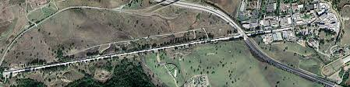
The longer, the better
Stanford linear accelerator center (slac)
2 mi (3219 meters)
The Stanford Linear Detector (SLD) experiment to study Z-boson, quark and lepton, Quantum Chromodynamics (QCD) through e- & e+ collision at Z0-pole (1992-1998)

Slide 7
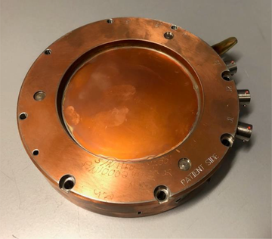
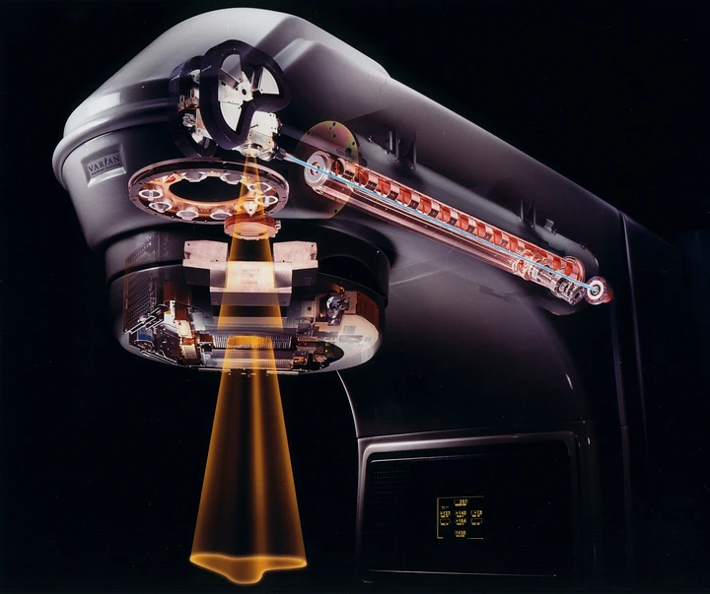
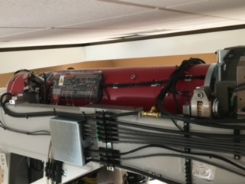
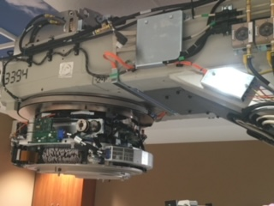
The shorter, the better (medical linear accelerator)
1m long linear accelerator
Chamber detector
Medical linear accelerator is 1 m
Unit of shaping radiation

Slide 8
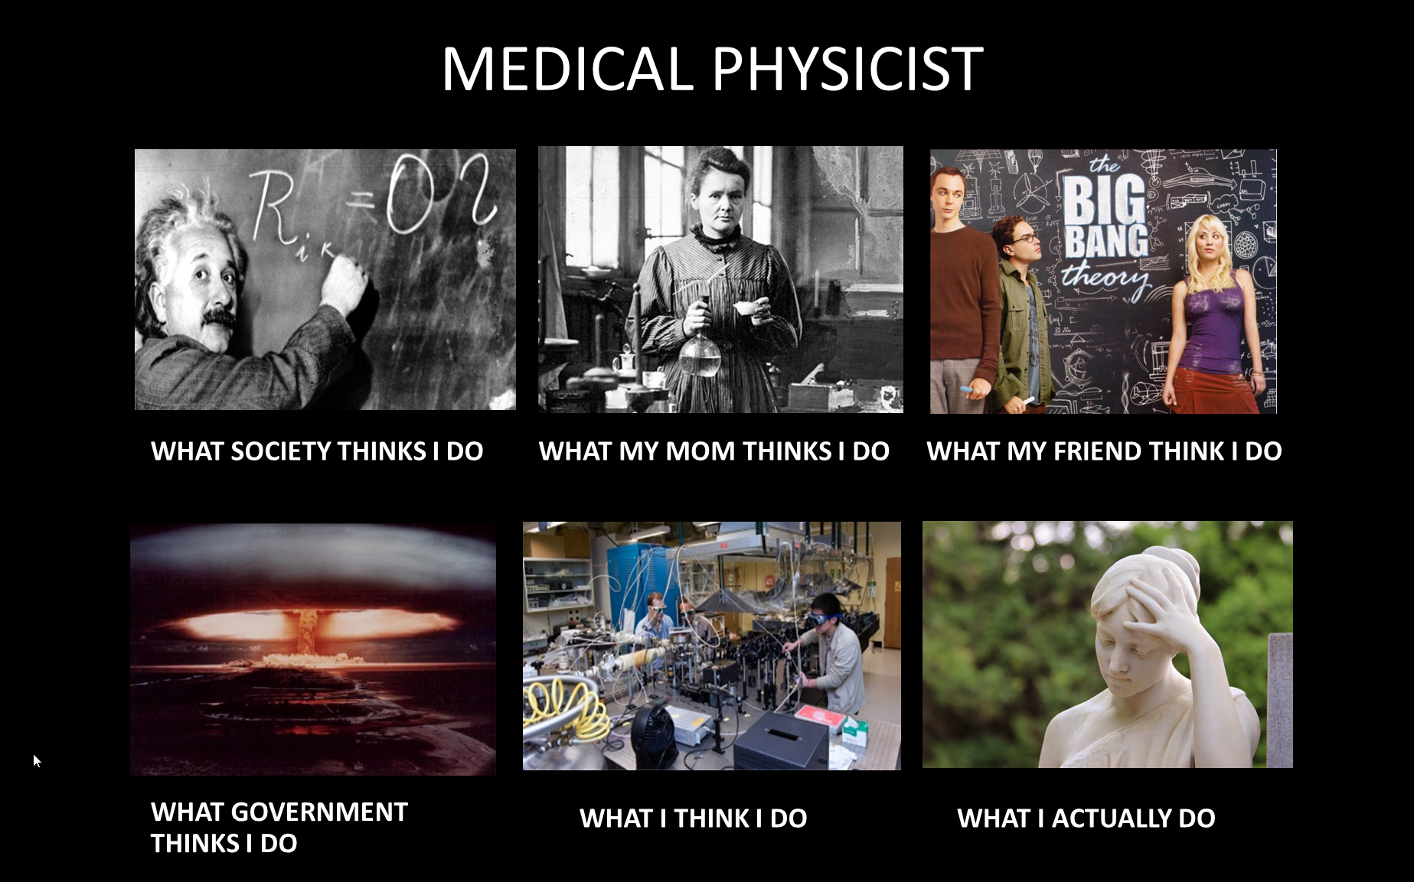
What is medical physics anyway?

Slide 9

Medical physicists: Scientists in patient care
Medical physics: modern branch of physics concerned with the application of the concepts and methods of physics to the diagnosis and treatment of human disease and is allied with health physics (Newhauser et al, JACMP, 2023)
Radiation therapy, imaging, nuclear medicine, radiation protection (health physics)
The mission of a professional organization:
  Advancing medicine through excellence in the science, education and professional practice of medical physics.
Critical thinking scientist
Educator/teacher/mentor
New technology expert
Problem solving champion

Slide 10

Introduction of Radiation Therapy/Treatment
Radiation treatment uses various forms of radiation to treat cancer and other diseases
  External beam radiation therapy: using photons, electrons, protons, carbons from accelerator to treat diseases
  Internal radiation therapy: using radioactive materials to treat diseases
Often in conjunction with other treatment types
Approximately, two-third of cancer patients receive radiation as part of treatment
Need medical imaging within the department and from radiology department

Slide 11
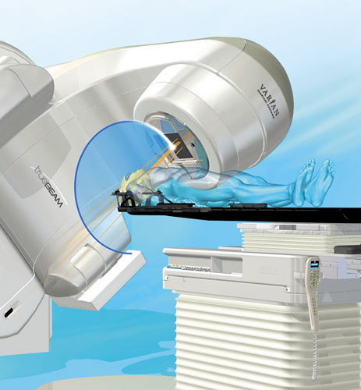
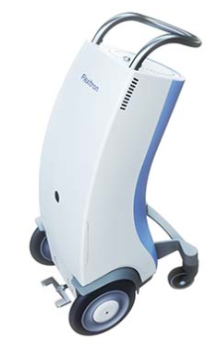
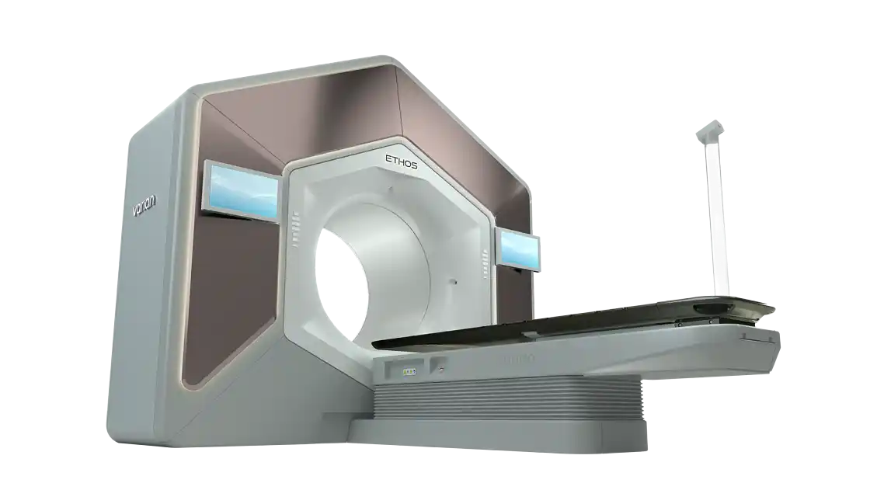
Radiation treatment machines @Loyola Medical Center
Linear accelerator with X-ray imaging: External beam treatment
High dose rate radioactive material internal beam treatment machine
Linear accelerator with advanced imaging and delivery

Slide 12
When patient comes for Radiation Treatment
Doctor consultation
Learn about radiation treatment. Give permission for treatment
Simulation Imaging
Imaging scans to determine exact area to treat. Crucial step of treatment design
Treatment planning
Design treatment to achieve the treatment goals. Perform highly technical calculation
Quality Assurance (QA)
Treatment Delivery
Physicist assess the quality of plan via verifying & measuring prior to treatment
Make sure each treatment is accurately & safely delivered

Slide 13
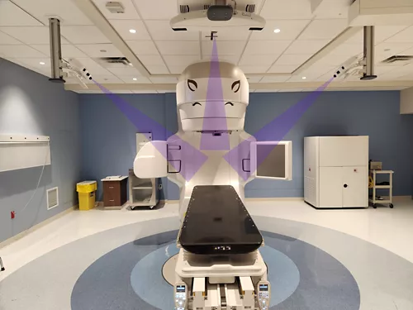
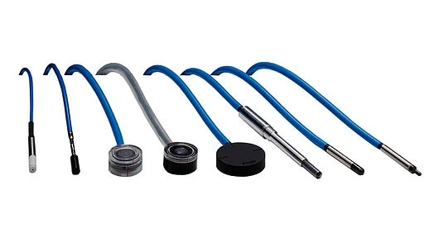
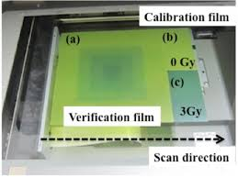
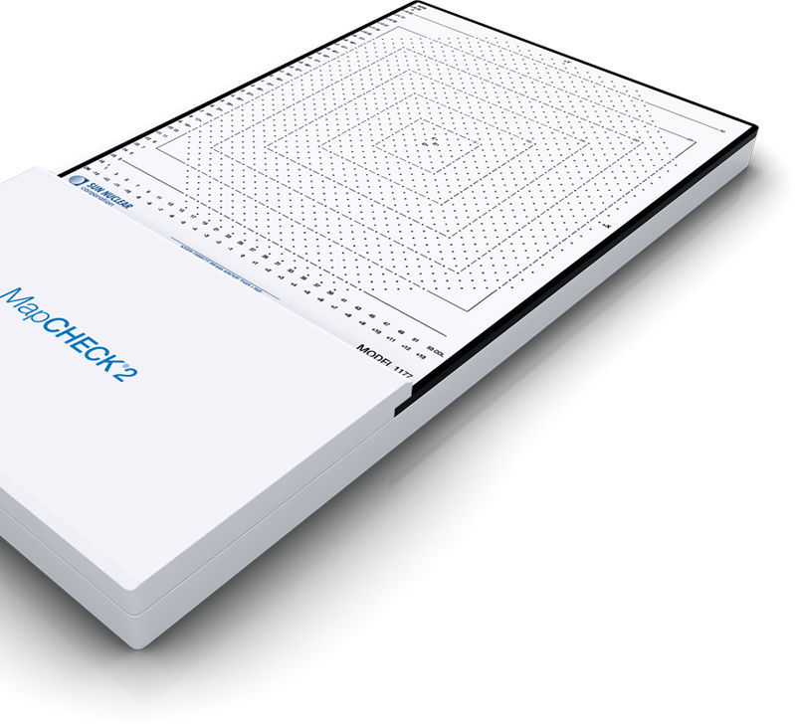
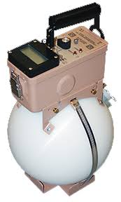
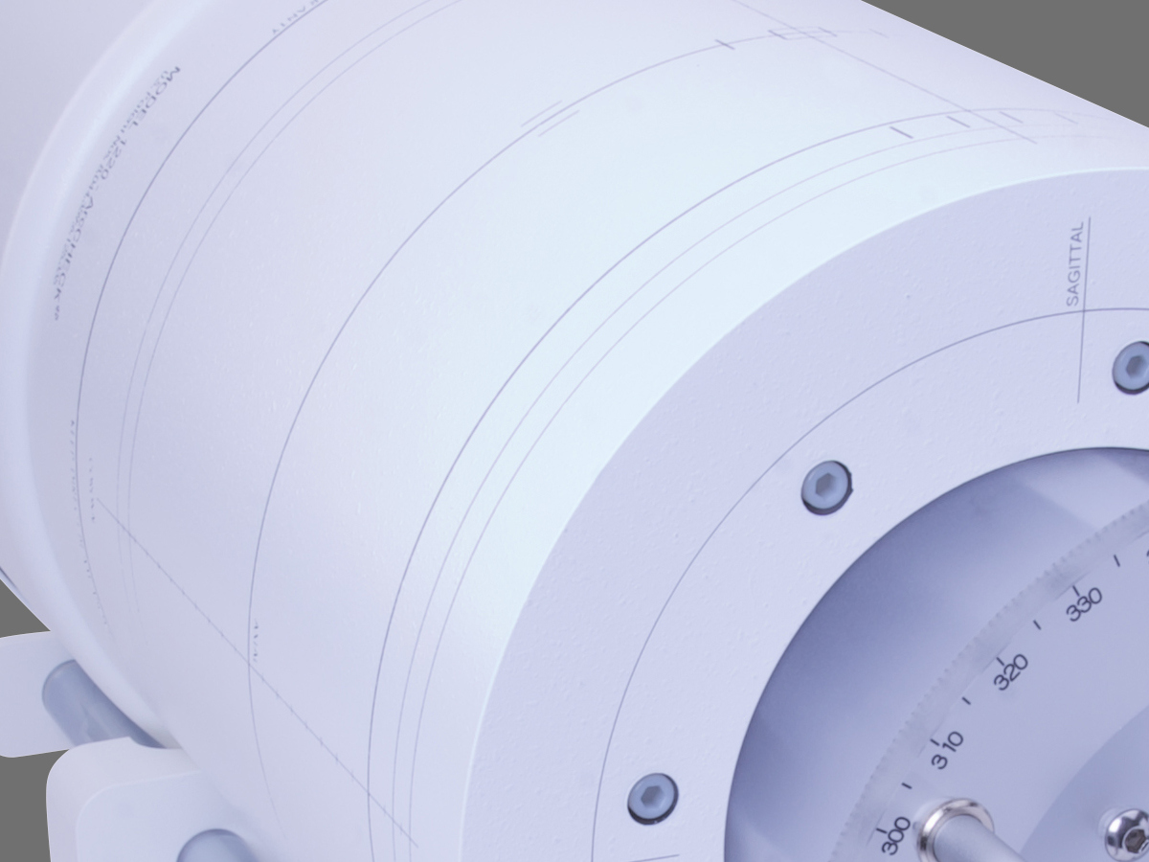
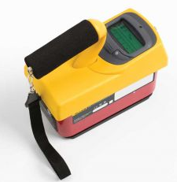
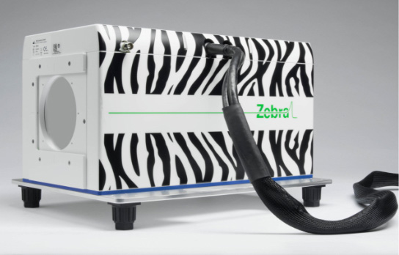
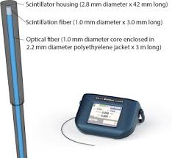
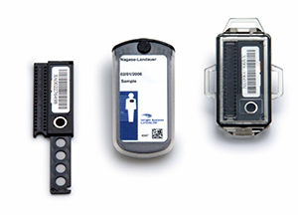
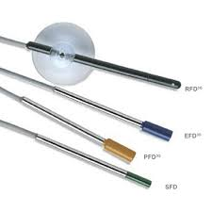
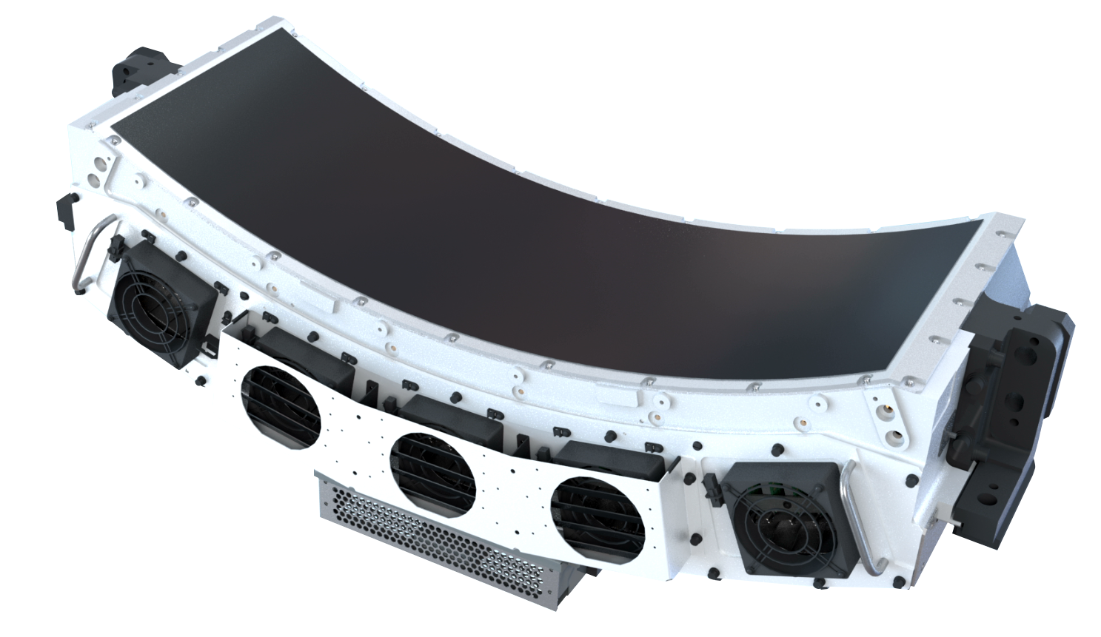
Detectors for medical physics application

Slide 14
Radiation therapy (RT) detectors
The smaller, the better. The simpler, the better
Use to measure radiation amount, a.k.a dose, energy per mass (J/kg)
  Radiation dose in experiment settings & patient (In-vivo) dosimetry
  RT machine calibration and Quality Assurance
  Ensure that machine delivers the correct radiation dose within specifications
  Monitor the characters and properties of radiation beam
  Help maintain the accurate treatment delivery
Imaging detectors
  Flat panel detectors to capture patient image to make sure radiation is delivered to cancer tumors
Radiation protection & safety
  Area monitors: detectors measure the radiation levels in the environment
  Personal badge: monitor radiation levels for radiation works or patient

Slide 15
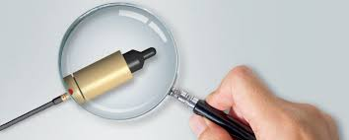
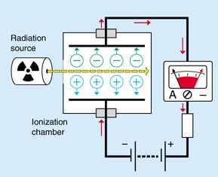
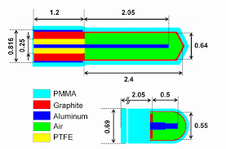
Gas- or air-filled ionization chambers
Collected charges is proportional to the radiation dose
Simple and durable; bread&butter detector
Versatile: measure both low & high radiation levels and wide range of radiation types & energy
Real time measurement, but relatively large volume
Cables and other auxiliary devices are needed
Cathode & anode (electrodes) to collect charges or current from electron generated from radiation ionization. Signals are measured using electrometer
Thimble type ion chamber

Slide 16
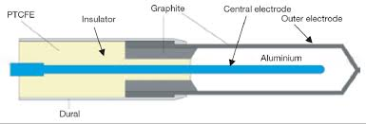
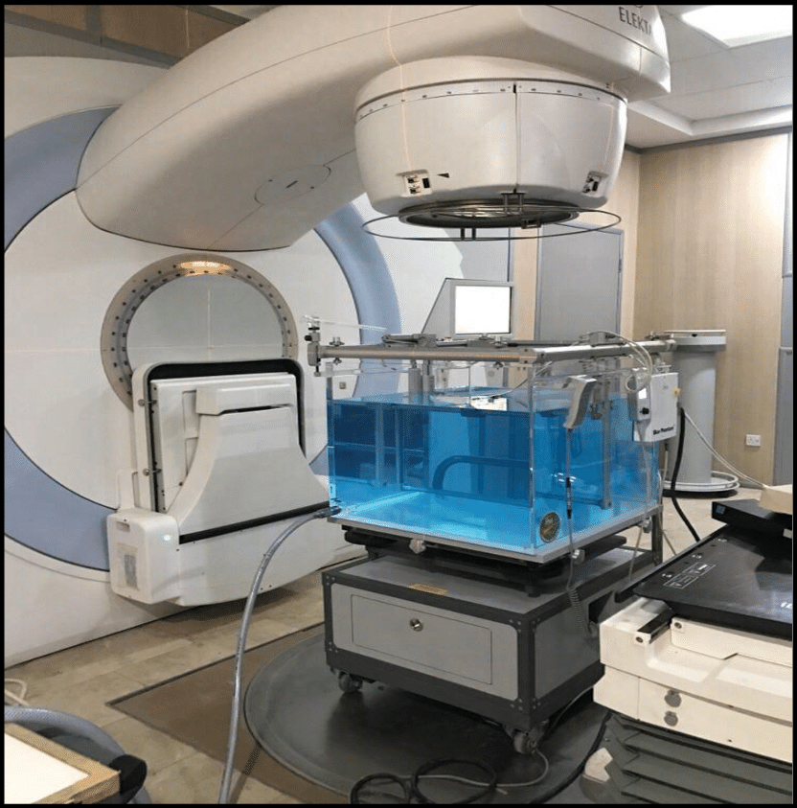
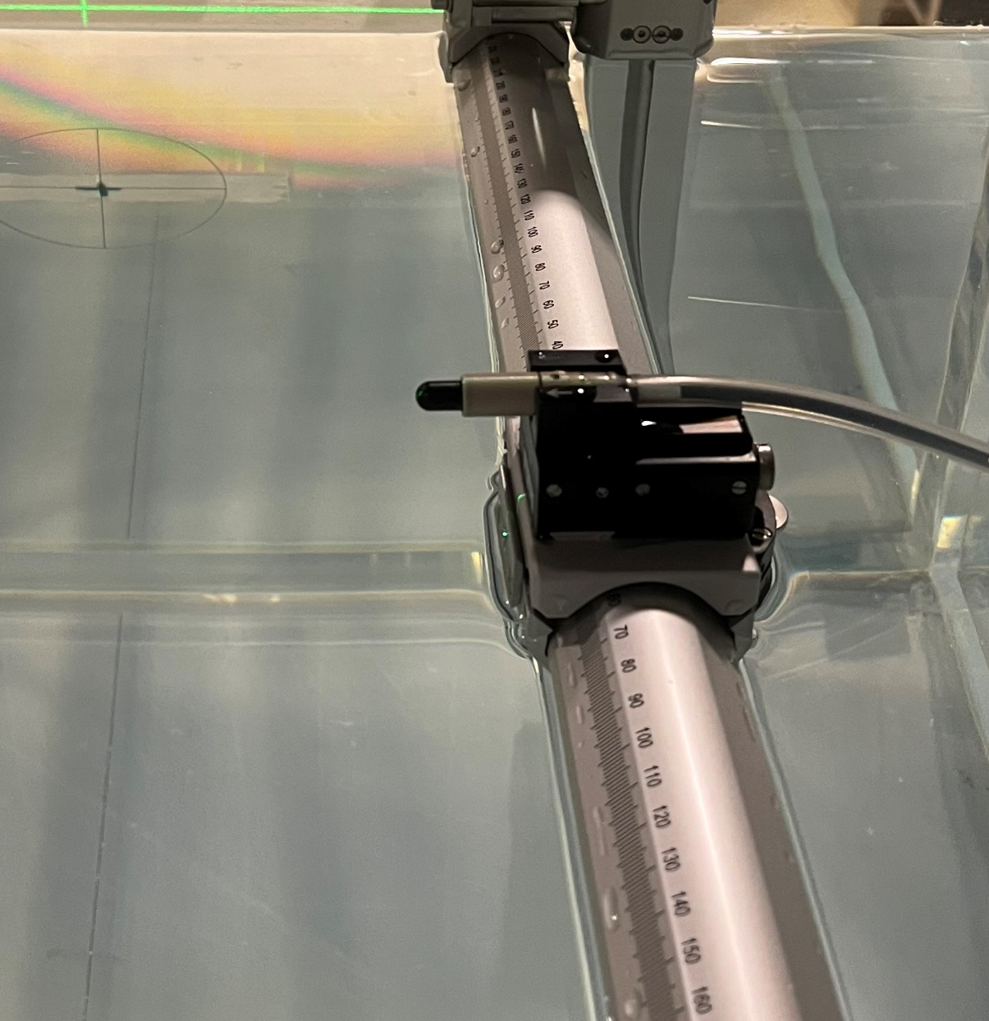
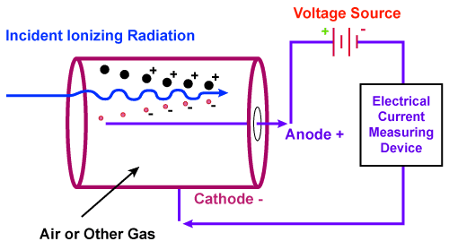
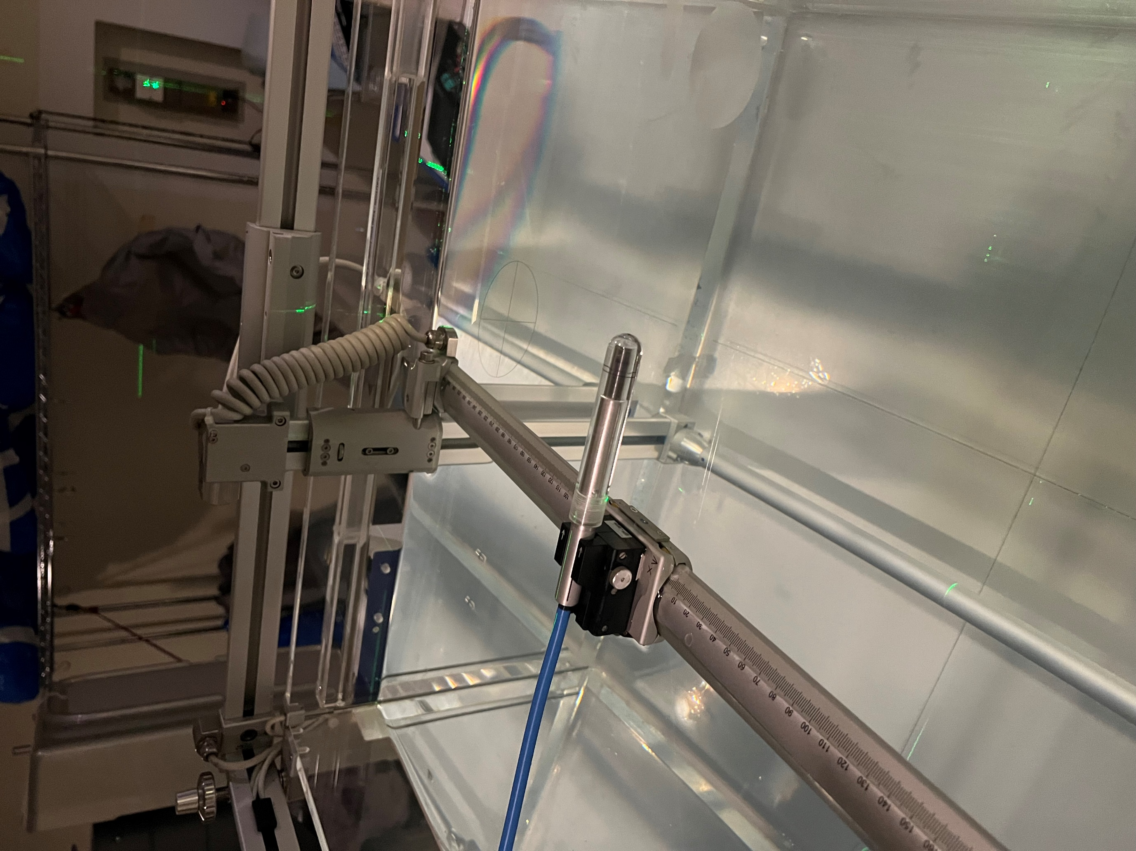
What do we do with them?
Dump the detector into a big tub of water to measure radiation from the machine and scattering radiation from water
Why? We approximate human to a tub of water and it works for most of the times
Luke Laymen, MS

Slide 17
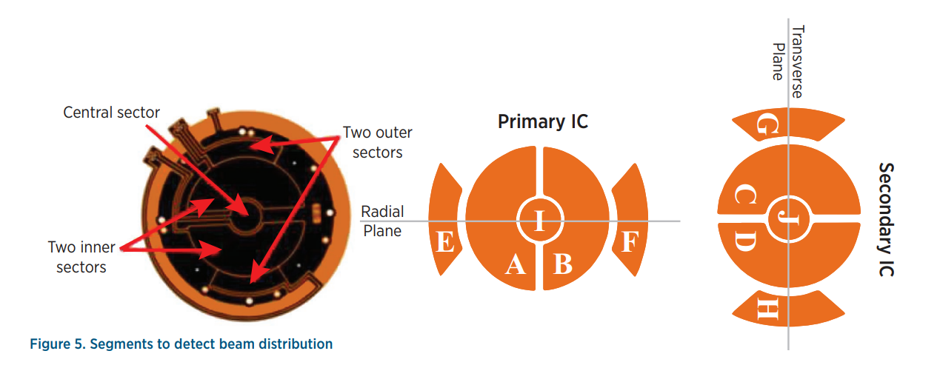
Monitor radiation dose and characteristics
Medical linear accelerator is 1 m
Chamber detector
Dose, symmetry, flatness….

Slide 18
Solid State Detectors
Types:
  Thermoluminescent dosimeter (TLD): LiF:Mg,Ti
  Optically stimulated luminescent dosimeter (OSLD): Al₂O₃:C
    TLD & OSLD: Photomultiplier tube (PMT) to collect luminescent signals
  Diode: Semiconductor detectors (Silicon or Germanium)
  Diamond detectors (insulator)
  Scintillator detectors
Small size, high sensitivity, fast response time, no cables or electrometer
Wait time for radiation reading, not real-time
Notes:
LiF:Mg, Ti: Lithium Fluoride doped with Magnesium (Mg) and Titanium (Ti)
AlxO3:C: Carbon-doped aluminum oxide

Slide 19
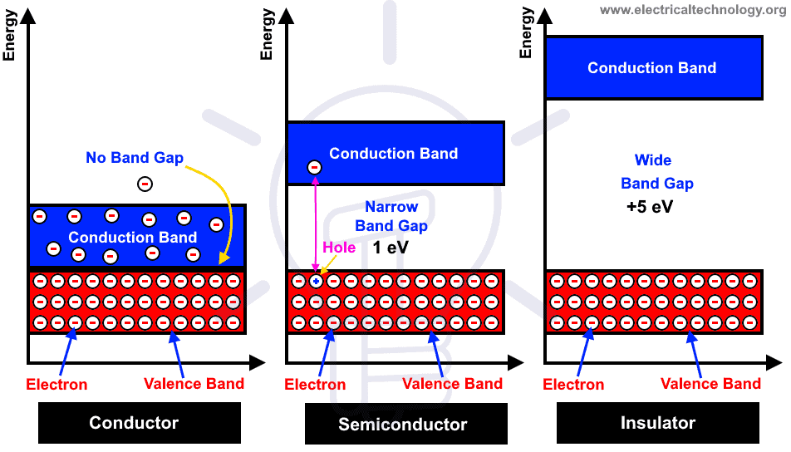
Solid state detector principle (conductor, semi-conductor & insulator)
Solid state physics:
  Conduction band
  Valence band
  Band gap
Electrons & holes; electron can gain energy to move up to conduction band
Silicon, Germanium
Diamond, Glass.…

Slide 20
Semiconductor to emit luminescence light (TLD & OSLD)
Energy
Energy level diagram of LD
  Radiation ionization creates electron-hole pairs
  Electrons move to conduction band and gets trapped in band gap (defects) and holes get trapped in defects
  Heat/light stimulation: When stimulated by heat/light, trapped electrons gain sufficient energy to move back to the conduction band, then they can recombine with trapped holes.
  This recombination process emits light, a phenomenon known as luminescence.
  The intensity of the emitted luminescence is proportional to the amount of radiation absorbed by the detector

Slide 21
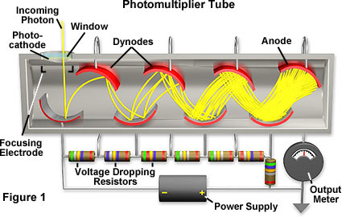
Photomultiplier Tube (PMT)
Useful for light detection of very weak signals, is a photoemissive device in which the absorption of a photon results in the emission of an electron. These detectors work by amplifying the electrons generated by a photocathode exposed to a photon flux.
PMTs acquire light through a glass or quartz window that covers a photosensitive surface, called a photocathode, which then releases electrons that are multiplied by electrodes known as metal channel dynodes. At the end of the dynode chain is an anode or collection electrode. Over a very large range, the current flowing from the anode to ground is directly proportional to the photoelectron flux generated by the photocathode.

Slide 22
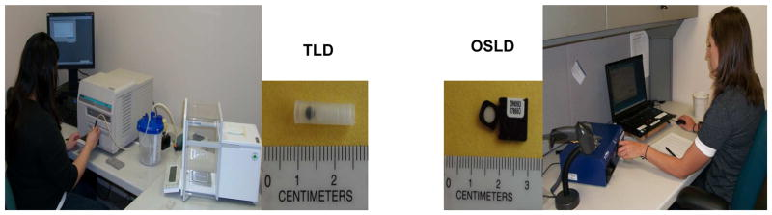
TLD/OSLD: readers receive signals using PMT
HEATING
LIGHT

Slide 23
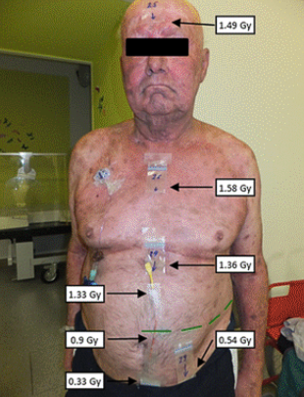
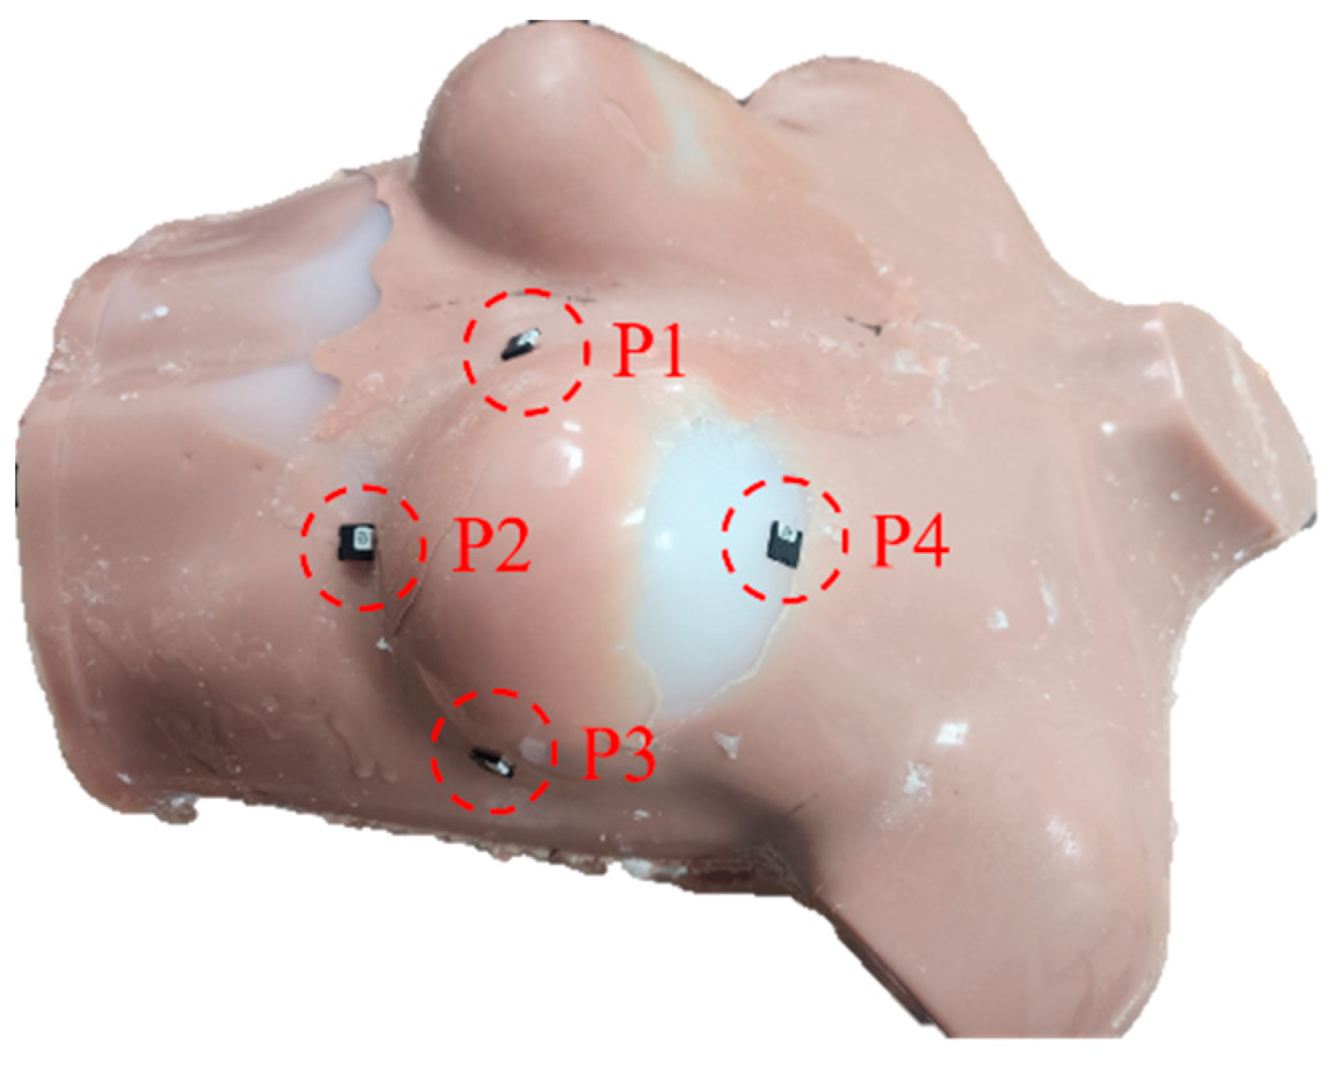
Why TLD & OSLD?
Convenient: no cable or electrometer
Small to measure radiation on localized areas
Used to measure entering radiation dose on patient (in-vivo dosimetry)
Characterize radiation treatment beams
Larger measurement uncertainty
Need reading devices
Skin radiation dose for breast cancer patients
Total skin electron beam therapy for cutaneous T-cell lymphoma
T

Slide 24
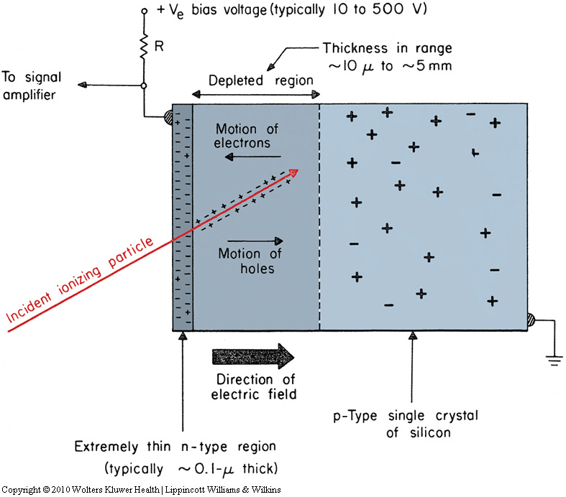
Basic physics of diode detectors
Built-in potential 0.3 ~ 1V
A p-n junction diode is formed when a p-type semiconductor is fused to an n-type semiconductor creating a potential barrier voltage across the diode junction
Schematic of a silicon p-n junction diode as a radiation detector:
The excess minority carriers • electron and ○ hole generated by radiation within one diffusion length, L_{p} & L_{n} are able to diffuse to the depleted region
They are swept across the junction by the built-in potential ψ₀ and are collected by the electrometer.

Slide 25

Why diode detectors?
Versatile detectors:
  Can be used to measure radiation dose and characteristics
  Smaller sized detector makes it useful in radiation therapy
Need to consider many dependence factors for radiation dose measurement
Bigger uncertainties compared to ion chamber detector

Slide 26
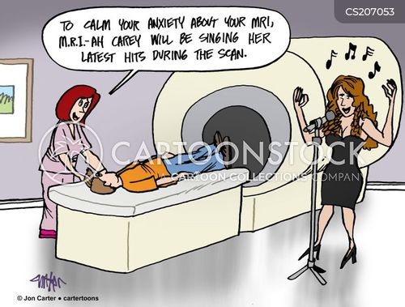
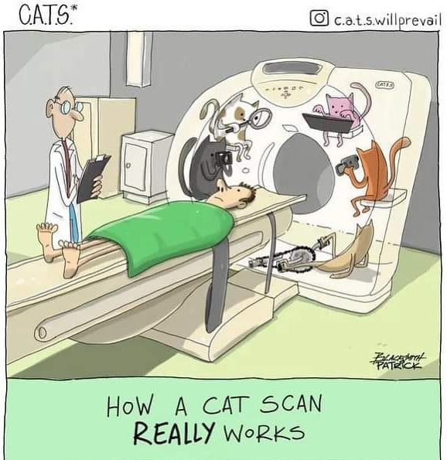

Medical imaging detectors
RT application: flat panel x-ray detector
  Advanced development: non x-ray images
Radiology & diagnostic imaging
  Computer Tomography (CT)
  Positron Emission Tomography (PET)
  Magnetic Resonance Image (MRI)
  Ultrasound (US)

Slide 27
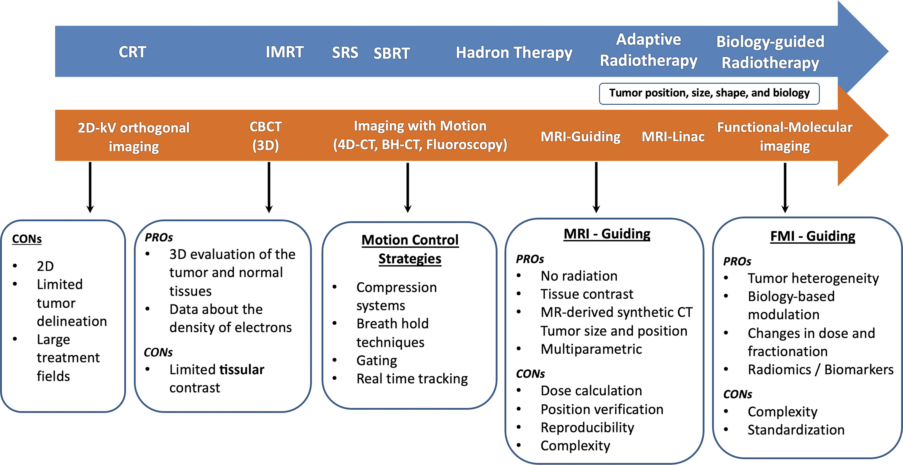

Advances in RT techniques and the use of imaging over time
García-Figueiras R. Published Online: January 11, 2024
https://doi.org/10.1148/rg.230152
G

Slide 28
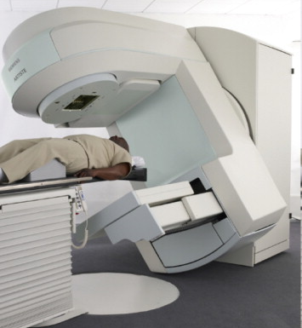
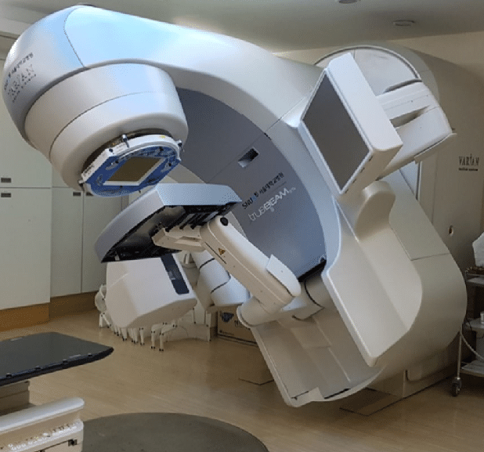
Electronic Portal Imaging Detector (EPID):flat-panel detector
EPID
EPID
Measure the x-ray intensity transmitted through a patient from a radiation source
Radiation signal is converted electronically into a 2D digital radiographic image to verify the correct beam placement w.r.t the patient’s anatomy

Slide 29
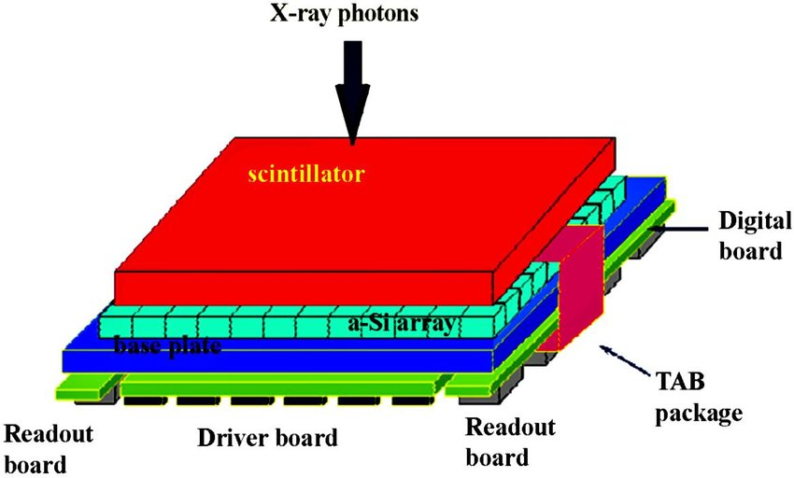
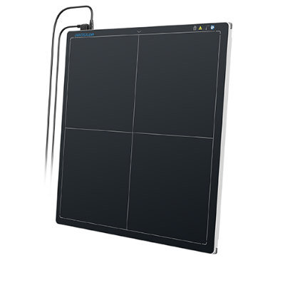


EPID (flat panel detector): patient positioning & dose distribution model
> 1 MeV photons
Cesium iodide (CsI) or Gadolinium Oxysulfide (GOS)
amorphous silicon photodiodes
Photodiodes (a-Si) attached to TFT as switch
2 or 3cm thickness
Notes:
X-ray photons enter the EPID and interact with the scintillator layer (e.g., cesium iodide or gadolinium oxysulfide). The scintillator converts X-rays into visible light photons. These visible light photons then interact with the amorphous silicon (a-Si) photodiode array, generating electron-hole pairs in the silicon. The liberated electrons are collected in the pixelized detector array, with each pixel accumulating charge proportional to the intensity of the light received. The collected charge is read out one row at a time using thin-film transistor (TFT) switches integrated into the detector. The output signal is amplified, digitized, and sent to the processing unit for image reconstruction.

Slide 30


EPID images
Breast cancer patients: showing both soft-tissues and bony anatomy
Blurry bony anatomy
Low metal imaging artifacts
Can be real-time using treatment beams
Poor soft tissue contrast
Increased imaging dose
Breast tissues
MeV EPID image
KeV image

Slide 31



Computer tomography (CT) imaging: gold-standard imaging for RT
Fan beam
Siemens SOMATOM Force
:Dual x-ray sources, AI
See through internal anatomy by detecting x-rays passing through the body
Create detailed cross-sectional images by reconstructing x-ray maps from multiple angles
Notes:
CT scans work by detecting X-rays that pass through the body from multiple angles. The X-ray source and detectors are positioned on opposite sides of the patient, and the system rotates around the patient while they move through the scanner. These X-rays create detailed cross-sectional images of the body, allowing doctors to see the internal structures of organs and tissues in 3D.

Slide 32
CT imaging
Radiation Therapy (RT):
  Treatment designing/planning
  Tumor localization
  Patient positioning verification
  Adaptive radiation therapy
  Monitoring tumor response to RT
Diagnostic Imaging:
  Diagnosing conditions like tumors, trauma, and internal bleeding, especially in the brain, chest, and abdomen
  CT angiography for vascular imaging, virtual colonoscopy for cancer screening, and cardiac and spinal imaging for disease assessment.
Essentially, almost everything we do!
Notes:
Diagnostic imaging is a medical technique used to look inside the body without surgery, helping doctors see what’s going on with organs, bones, and tissues.
Additionally, special CT scans, such as CT angiography can be used for vascular imaging, which visualize and evaluate blood vessels and their functionality

Slide 33


Detectors for CT imaging
< 120 kev photons
Maintaining detector alignment, absorbing heats and ensuring electrical isolation
The detector is responsible for capturing the X-rays produced by the CT tube and converting them into an electrical signal

Slide 34


CT scanner detector
Solid-state crystal detectors, consists of photodiodes that detect gamma rays and convert them into digital signal. Image data is then sent to Data Acquisition Subsystem (DAS) for collection and processing

Slide 35




CT images
Data stored as raw detector signal output, sinograms, angle specific histrograms of detected events.
Images can be reconstructed using analytic or iterative reconstruction (e.g. back projection)
Reconstructed 3D images can be rendered and displayed in many useful ways including locating cancerous cells
CT scans are used for treatment designing for radiation treatment
https://humanhealth.iaea.org/HHW/MedicalPhysics/NuclearMedicine/ImageAnalysis/3Dimagereconstruction/index.html

Slide 36


CT image examples
Radiology CT scans: diagnosing & locating disease
Radiation therapy CT scans: defining disease and designing RT
eye
optical nerves
brainstem
Diagnostic cerebral CT-angiogram (A) showing a large tangle of abnormal vessels (B) 3D volumetric CT scan of the vessel location
Example of (A) cancerous cell volumes and (B) treatment design/plan with radiation dose levels for a patient treated with post-operative cavity RT

Slide 37


Energy integrated vs. photon counting detector
Energy integrating detector (EID): Xray photons are absorbed in a scintillator ceramic (GOS) & generate light which is then collected by photodiodes. The collected signal is proportional to the incoming X-ray intensity
Photon counting detector (PCD): X-ray photons are absorbed in a semiconductor crystal, generating electron charge clouds directly, inducing electrical pulses at the pixel electrodes. These electrical pulses are analyzed to detect individual photon interactions.
Notes:
For example, Cadmium Telluride (CdTe) or Cadmium Zinc Telluride (CZT)

Slide 38


Why photon counting detector (PCD)?
Adding “color” information to provide more details of images
With “color” information, can have better visualization between bone/soft tissues/calcium..

Slide 39

PCD images
Photon counting detector (PCD)
Energy integrated detector (EID)
PCD and EID CT of vascular reconstruction kernels in photon-counting CT angiographies of the leg
  More detailed substructures are shown
More applications
Notes:
These are CT angiographic images of the leg, obtained using different thresholds in blood volume (BV) measurement.

Slide 40
Functional and molecular imaging
Shows location/strength of metabolism vs. anatomy
  Disorders or cancer cells with high metabolic activity have elevated glucose metabolism and increased uptake of radioactivity from the glucose analogue
  Improve disease detection: brain disorders, heart or cancer
  Provides metabolic or biochemical function information
  Positron Emission Tomography (PET) & Single-photon Emission Computed Tomography (SPECT)
Positron Emission Tomography (PET)
  ¹⁸F-FDG used for glucose metabolism detection
Notes:
F-FDG: Fluorine-18 Fluorodeoxyglucose

Slide 41


Positron Emission Tomography (PET)
Full ring of scintillating detector surrounding patient
Notes:
A Positron Emission Tomography (PET) scan works by detecting a process called positron-electron annihilation. In this process, radioactive atoms attached to a glucose molecule are injected into the body. When the radioactive atoms decay, they emit positrons, which interact with electrons in the body, resulting in the release of two photons traveling in opposite directions. These photons, each with an energy of 511 keV, are detected by the PET scanner. By measuring the coincident detection of these photons, PET scans can pinpoint the location where the annihilation took place, allowing doctors to visualize areas of high radioactivity, such as tumors or abnormal tissue

Slide 42


Positron Emission Tomography (PET)
Tomographic techniques that uses radiotracers administered to the patient: emission imaging
Basic physics
  Radiotracers undergo β⁺ decay, emitting e⁺ (positron) for neutron-deficient or proton-rich
  e⁺ travels in tissues and loses energy & comes to rest
  e⁺ annihilates with atomic e⁻
  Emits two back-to-back photons (γ-rays)
  Detect the photons utilizing time coincidence
$${}_{1}^{1}p→{}_{0}^{1}n+{{}_{+1}^{0}e}^{+}+{{}_{0}^{0}ν}_{e}$$

Slide 43

Annihilation Coincidence Detection
Annihilation coincidence: two photons detected by opposite detectors within coincidence window of 5-10 ns along the line of the two detectors
γ
Yes
Coincidence ?
Register
Event
γ
5-10 ns

Slide 44




Positron Emission Tomography (PET) images
For a PET acquisition, a patient is placed within a ring of detectors and sinograms are created.
Emission profiles per angle can be generated by mapping and sorting the detector pair events

Slide 45

PET Image
Hounsfield Unit/CT number (HU)
Standardized Uptake Values (SUV)

Slide 46


PET detectors
Thermal barrier
Gamma ray detector blocks

Slide 47

Scintillation detectors for PET
PET scintillator:
Sodium Iodide (NaI)
Lutetium oxyorthosilicate (LSO)
Lutetium Yttrium Orthosilicate (LYSO)
Bismuth Germanate Oxide (BGO)
Gadolinium Gallium Garnet (GaGG)
Cerium-doped Bromide (CeBr)
A 511 keV photons enters scintillator to interact with a dense scintillator material (e.g.BGO) generated optical photons (around 1 eV)
Optical photons are detected by an array of photomultiplier tubes (PMTs). PMTs amplify the signal significantly
Measure current pulse for each detected photon

Slide 48


PET photodetectors
SiPM
Array of photosensitive single-photon avalanche photodiodes (SPAD)
SPAD: operated in Geiger mode. Single photon causes charge avalanche
Siemens PET (Biograph Vision PET/CT) with SiPM and a TimeOfFlight: 214 ps
LSO crystal
SiPM
Silicon photomultiplier (SiPM)
Detector mini-block
Block
PET detector block (Siemens, Optiso UDR): 3.2mm LSO crystal arrays with SiPM sensors in a detector mini-block
Photomultiplier tube (PMT)
https://www.siemens-healthineers.com/en-us/molecular-imaging/pet-ct/biograph-vision-quadra/udr-detector

Slide 49

CT+PET
Two gantries combined in same housing
Multislice CT scanner mated to a PET scanner
Improved attenuation correction for PET
Measure anatomy+functionality at once
Possibly three scans acquired
  Attenuation correction CT
  PET
  Treatment planning CT, with contrast if necessary

Slide 50


Magnetic Resonance Image (MRI)
Superior soft tissue distinguishability
Non-invasive and painless
Functional Imaging: Provide both anatomy and metabolism information
Can be long scan time
CT
T1 MRI
T2 MRI

Slide 51


MRI RF detector
Signals are detected by the MRI receiver coils
The frequency and timing of the signals depend on the tissues
https://mriquestions.com/receive-only-coils.html
https://www.nature.com/articles/s41598-019-54200-3

Slide 52

Ultrasound: piezoelectric crystal transducer
Estimate blood flow

Slide 53


We need multiple imaging to identify disease more accurately
Multi-modality brain imaging includes different MRI and PET types
Diagnosing FIGO Stage IVB high-grade serous carcinoma of the ovary using multiple image types

Slide 54


State of the art in radiation therapy
Radiation therapy machine + non x-ray imaging unit
Monitoring cancer target during the treatment
Fine-tune radiation treatment plan to daily changes
Goal: Increase therapeutic outcome
Machine+PET
Machine+MRI

Slide 55




Reflexion: RT machine + PET detector
Biologically Guided RT: PET signal, metabolic response or tumor guides RT, “functional imaging based RT”
Tumor-adaptive RT planning
Real-time tumor tracking

Slide 56

Signals for PET imaging
BTZ: biology-tracking zone.
Limited-time-sample (LTS) PET image to track tumor: 100ms per image
FULL: Sum of the derived partial sample of each LTS, ~ 500 ms in 60 RPM (half rotation)
Shirvani et al, 2021, BJR

Slide 57


MRI image guided RT
Accelerator is mounted on a ring gantry
Superconduction coils are repositioned to create a low field toroid and to create a beam portal
Gradient coil is split to allow beam passage
Accelerator is mounted on a ring gantry.
It is sandwiched between two separate MRI units

Slide 58


RT machine with MRI attached
ViewRay MRIdian: MRI scanner + Treatment machine
3D CT
MRI

Slide 59

MRI real-time tracking of tumors in the abdomen
Blue: tumor
Orange: range of tumor excursion
Automatically Radiation beam on/off
Showing tumor motions
Loyola University chicago

Slide 60
Summary
Detectors are essential in medical field
  Radiation dose measurement
  Quality assurance & safety
  Radiation dose monitoring
  Essential components in medical images
  Radiation protection & safety
Many of these detectors had been developed in other physics fields, high-energy particle physics
Simple & robust
Adopt newest and latest detector technologies
Clinical validation is must

Slide 61





Acknowledgement
Loyola
Alexander R. Podgorsak, PhD (University of Rochester)
Andrew Godley (UT Southwestern)
Luke Layman, MS
Yussuf Abdelal, MS
Sebastien Gros, PhD

Slide 62

THANK you

Slide 63
Backup slides

Slide 64
TLD and OSLD

Slide 65



Diode Principle
Zero bias
A PN-junction diode is formed when a p-type semiconductor is fused to an n-type semiconductor creating a potential barrier voltage across the diode junction

Slide 66
Diodes in RT
A PN-junction diode is formed when a p-type semiconductor is fused to an n-type semiconductor creating a potential barrier voltage across the diode junction

Slide 67

Photon counting detector (PCD)
Energy-integrating detectors
  convert incoming photons to visible light, directly followed by a conversion to an electrical signal by photodiodes
  all measured photons in one projection are integrated to create the signal
  detector’s spatial resolution depends on the use of reflecting septa to prevent cross-talk
Photon-counting detectors
  create an electron-hole pair when a photon strikes the semiconductor material of the detector
  the anode attracts the electrons from the electron-hole-pair
  electric pulse signal is proportional to the photon’s energy
Energy-integrating detectors: commonly used
Photon-counting detectors: advanced
Basic comparison of energy-integrated detector (EID) (a) and photon-counting detector computed tomography (PCT) (b). EID systems use solid-state scintillation detectors where X-rays are first converted to light, then to an electrical signal, but this method is limited by electronic noise and has a finite spatial resolution. PCT systems, in contrast, directly convert X-rays into electrical signals in a semiconductor, offering improved dose efficiency and spatial resolution by eliminating the need for septa between pixels and allowing for sub-pixel readouts [30]

Slide 68

Photon counting detector (PCD)
PCCT-scan of a Patient with endovascular aortic repair. A/B. Virtual-mono-energetic images (VMIs) can be created without additional scanning from the spectral dataset to generate images for virtual photons at a single kiloelectronvolt (keV) energy level. This can be helpful to improve differentiation between tissues, visualization of contrast-enhanced tissues, or reducing artifacts. C. Virtual-non-contrast (VNC) reconstructions remove the signal of iodinated contrast agents from contrast-enhanced scans, with the idea to potentially make non-enhanced scans obsolete. D. Iodine maps are useful to measure perfusion but hinge on their quantification accuracy [2]. E. It is possible to fuse VNC and iodine maps for additional information.

Slide 69

Figure 1: Diagrams show detector types. A, In conventional energy-integrating detector, an incident x-ray photon is converted into a shower of visible light photons in a scintillator. Visible light hits an underlying light sensor, where it generates positive and negative electrical charges. B, In photon-counting detector, the x-ray photon is absorbed in a semiconductor material, where it generates positive and negative charges. Under the influence of a strong electric field, the positive and negative charges are pulled in opposite directions, generating an electrical signal.

Slide 70



PET/CT GE Omni Legend
Optiso UDR detector: LSO crystal arrays with SiPM
Siemens Biograph Vision

Slide 71
Typical PET scanner detector ring

Slide 72


Slide 73

PET detector design

Slide 74


Slide 75

Time of Flight

Slide 76


Transaxial slices of an image quality phantom, reconstructed with high-resolution iterative reconstruction with resolution recovery. The scans were performed on a Siemens Biograph mCT PET/CT scanner (527 ps intrinsic time resolution) and the new Siemens Biograph Vision (210 ps intrinsic time resolution). From left to right: a non TOF image from mCT, b TOF image from Biograph mCT, and c TOF image from Biograph Vision. The phantom had six hot spheres (5, 8, 10, 13, 17, 22 mm diameter) with a contrast of about 4:1, and a total activity in the background of about 50 MBq of 18F → reference: Conti 2019, the new op

Slide 77

1st TOF PET in 2006
Time resolution for LSO: 300 ps

Slide 78


Slide 79


PET/CT Scanner: combined unit
Two gantries combined in same housing
Multislice CT scanner mated to a PET scanner
Improved attenuation correction
Possibly three scans acquired during procedure
  Attenuation correction CT
  PET
  Treatment planning CT, with contrast if necessary
Phillips Veros Digital PET/CT
GE Omni Legend

Slide 80




MRI images
Principle:
  MRI utilizes a powerful magnetic field (typically 1.5 to 3 Tesla) to align the protons in the hydrogen atoms
  Send a short radiofrequncy (RF) pulse to temporarily disturb the alignment of the protons to excites them and move out of alignment with the magnetic field.
  When the RF pulse is turned off, the protons relax back to their original alignment with the magnetic field. During this relaxation process, protons release energy in the form of RF signals.
  Signals are detected by the MRI receiver coils. The frequency and timing of the signals depend on the tissue type and water content, etc
  Small magnetic field gradients are applied in different directions (x, y, z axes) to spatially encode the signals. This allows the MRI system to determine the origin of the signals in 3D space.
Different tissues (e.g., muscle, fat, water) have different relaxation properties, leading to distinct signal intensities.
T1 relaxation time
T2 relaxation time

Slide 81


Ultrasound
transverse
longitudinal
Gallstones causing “acoustic shadowing” for US imaging

Slide 82


Slide 83


Slide 84

Toward a planning scheme for emission guided radiation therapy (EGRT): FDG based tumor tracking in a metastatic breast cancer patient
EGRT treatment scheme consisting of three major components: simulation, pretreatment, and treatment.

Slide 85

MRI image guided RT

Slide 86

Biologically guided RT (BgRT)

Slide 87


Slide 88

Fig. 1. Schematic design of the MR-linac concept. The accelerator is mounted on a ring gantry. The superconduction coils (in orange) are repositioned in order to create a low field toroid (light blue) as well as to create a beam portal. Also the gradient coil (in yellow) is split to allow beam passage

