Slide 1
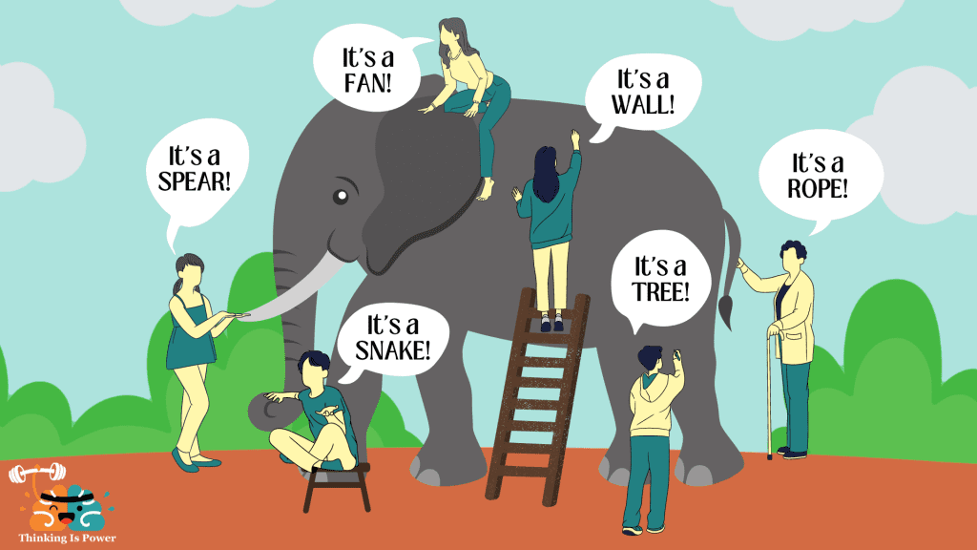
Putting it all together
S. Nahn
EDIT 2024
November 22, 2024

Slide 2
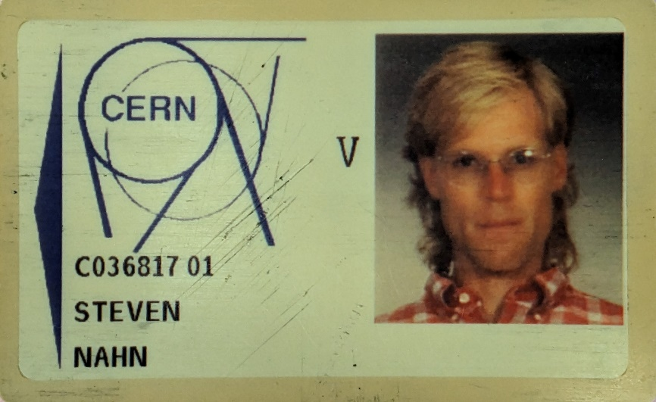
Who am I?
30 years ago, I was you
Inadvertent career in building things
      BS ‘91: UW Madison – X-Ray Quantum Calorimeter
      “small” experiment, non-HEP, but lots of fun
  PhD @ MIT – L3 F/B Muon Chamber Upgrade, Muon Chamber Operations
  Postdoc @ Yale – CDF Run II Silicon Detector Upgrade, Silicon Detector Operations
  Faculty @ MIT – CMS Silicon Tracker Construction/Operations
    Also made 5 PhDs on early LHC data
  Scientist @ FNAL
    Project Manager for U.S. Phase 1 CMS Upgrades 2013-2019
    Project Manager for U.S. HL LHC CMS Upgrades 2019-forever…

Slide 3
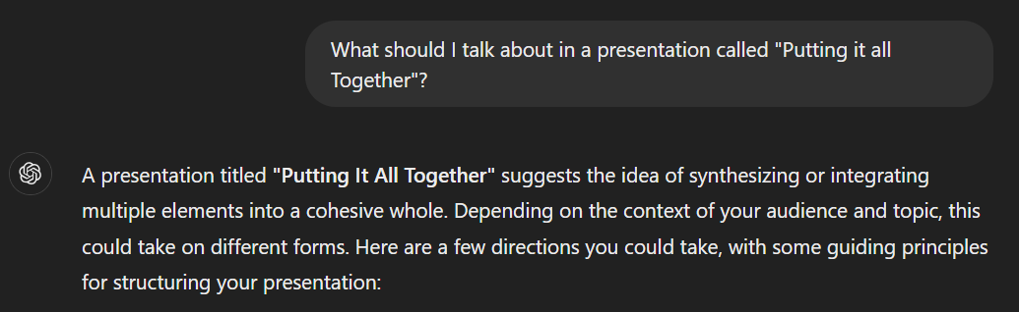
“Putting it all together”
WTF kind of title is that?
Will try to explore what it takes to go from a technology to a detector
  With a lot of short cuts and hand waving to meet time constraints
  and if time allows, some examples where things can go wrong

Slide 4
So you have a detector technology, now what?
Several things have to happen to turn a technology into a measurement
  Embed the technology into a subdetector
    Provide appropriate substructure, power, cooling, slow and fast controls, readout
    Prototype, review, prototype, review, prototype, review…
    Mass produce in a layout that balances performance vs cost, with industrialized production and quality control
  Attach or otherwise marry your subdetector to other subdetectors of your experiment, in the appropriate environment
    Get all the interfaces and protocols correct
  Commission the detector
    Figure out timing, calibration, alignment that maximizes the performance
  Operate the detector
    24/7 while the beam is on, take “physics quality” data, put out any fires that jeopardize that goal

Slide 5










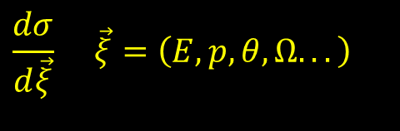

Detector Mission Statement
Theory |  | Experiment
e±,μ±,γ | → | e±,μ±,γ
τ± | →W±ν_{τ} W±→lν_{l},qq | e±,μ±,ν,jets
u,d,s,c b | “Hadronize” | Tracks+jets, ID: p,π,K “ “ + displaced vtx
t | →W⁺b | above, + W±→lν_{l},qq
ν | → | ∅: Missing E,p
Goal: Measure observables, compare with theory
  Cross sections
  Particle Properties
    m, Γ, Branching Ratios, Spin, Parity …
  Interactions and Couplings
    ZWW (“Trilinear gauge”) coupling, quark mixing matrix, …
  Violations of the Standard Model
    Parity or other symmetry violation, proton decay…
Mandate for the Detector
  Collect as precise data as possible
    Resolution on
  Collect as much relevant data as possible
    Cover all of 4π
    Filter (“trigger”) in face of limited bandwidth
    Robustness in design and operation
$$\frac{dσ}{d\vec{ξ}} \vec{ξ}=\left(E,p,θ,Ω...\right)$$
$$e^{+}$$
$$W^{+}$$
$$ν_{e}→\text{Missing} \text{Energy}$$
$$s$$
K⁻→jet
$$γ$$
Displaced Vertex
$$c$$
π⁰
$$\left(E,\vec{p}\right) \text{and} \left(ct,\vec{x}\right)$$
$$u$$
$$\bar{u}$$
$$γ$$
$$u$$
$$d$$
$$d$$
$$W^{−}$$
π⁻→jet
$$g$$
$$\bar{t}$$
$$b$$
B⁻
$$\bar{u}$$
$$t$$
$$H$$
$$g$$
$$t$$
$$\bar{b}$$
B⁺
$$W^{+}$$
$$u$$
K⁺→jet
$$u$$
$$\bar{c}$$
$$c$$
$$\bar{s}$$
$$μ^{+}$$
$$u$$
Displaced Vertex
^{J/Ψ}
$$γ$$
$$d$$
$$μ^{−}$$

Slide 6
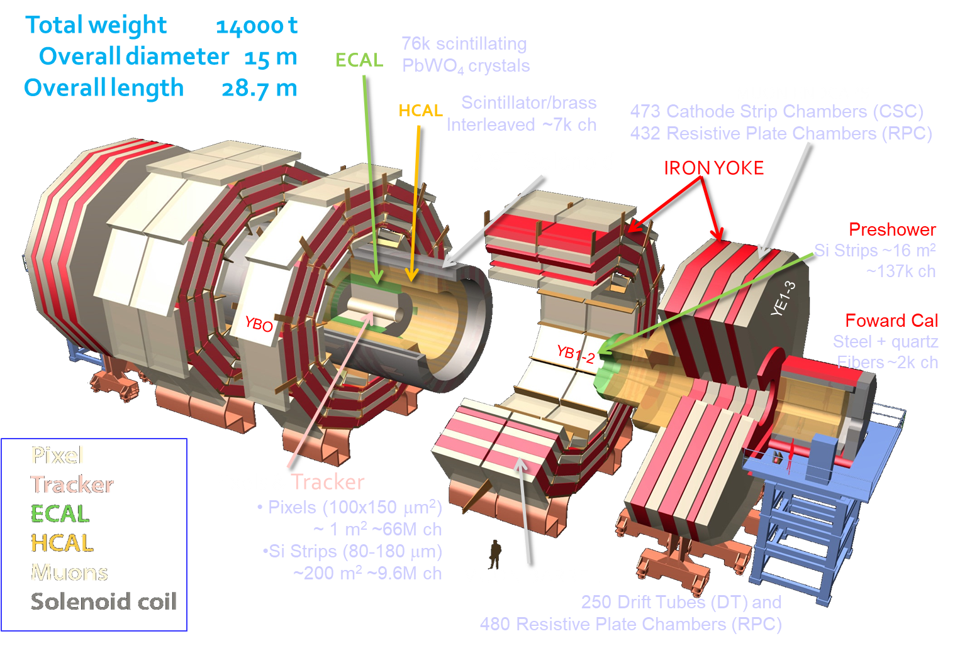
And you get something like this

Slide 7
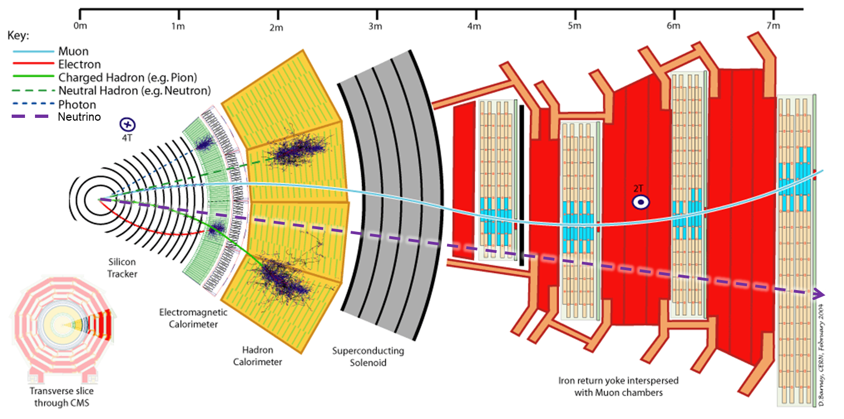
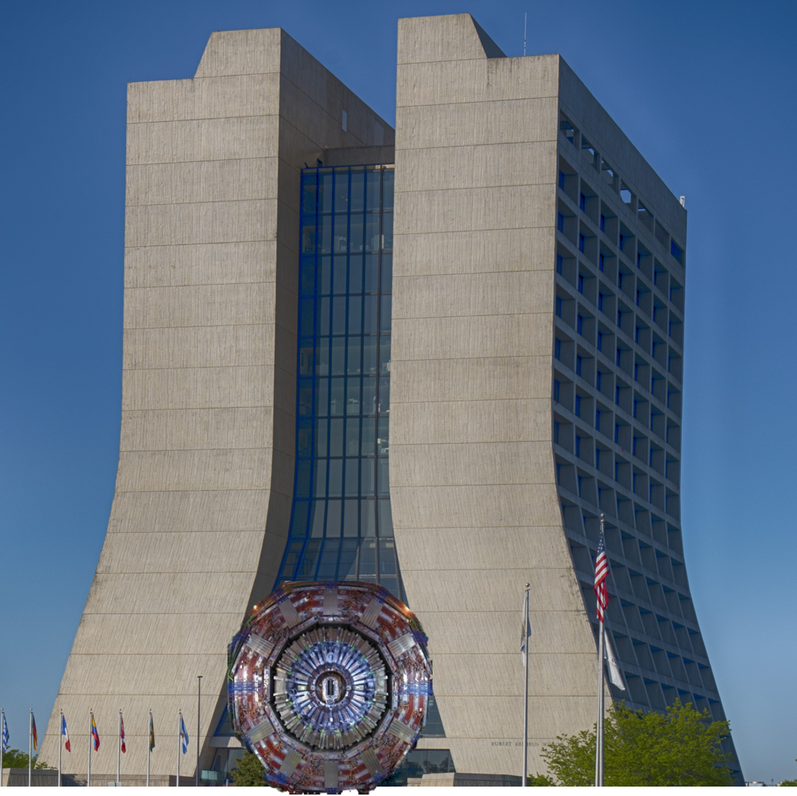

Measurements
Position: Follow trail left by ionization/Energy deposition
  Intersections = Interaction vertices, decay vertices
Energy/Momentum: Bend in , measure E via calorimeter
Particle ID
  m via β: Čerenkov effect, dE/dx, Time of Flight
  Q from curvature, particle species from range
Figures of Merit
Resolution
Response Time
  Time needed to make signal after particle passage
Dead Time
  Minimum interval between successive detections
Efficiency: Capability to see events
  Acceptance (Geometrical) – how many events fall in fiducial volume
  Intrinsic – how many in fiducial are triggered/reconstructed/recognized
$$\vec{B}$$

Slide 8
Common Elements everyone should know
Prototyping and Quality Control
  Typically where early career scientists get involved
  Two Phases
    Validation of design – before production, will the design meet the specifications
      Always a balance between time/money and how much of the full “system” is included
      Usually involves building early prototypes, testing on bench, testing in testbeam, before/after irradiation
    Quality Control – during production, does what we are building perform per design
      Usually more industrialized, standardized “button-click” testing regime, possibly with thermal cycling component
PSA on Safety
  The fastest way to get a project cancelled is not paying proper attention to safety aspects
    You should be properly trained, and follow appropriate procedures wrt Safety
      Even if there doesn’t seem to be a large risk to you
    You do not want to be the cause of a cancellation

Slide 9
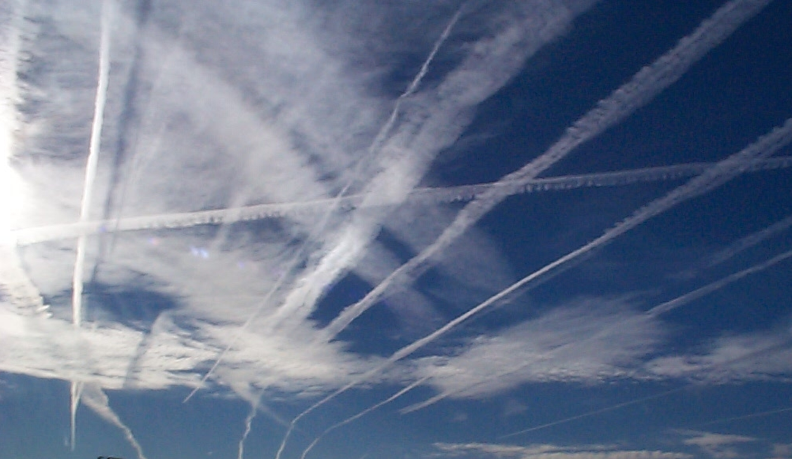
Tracking

Slide 10
Tracking
x₂
Measure trajectory in B field, reconstruct p_{T}
  curvature also gives sign
Typical techniques
  Photography: Emulsions, Bubble chambers
  Multiwire Proportional Chamber: 1-2 mm
  Drift Chamber: 50-250 μm
  Solid State (Si) Detector: 5-50 μm
The trick – minimize mass in tracking volume
  Keeps degradation from multiple scattering small
B
x₁
s
x₃
L
x
R
R

Slide 11
Building a (sub)detector: CMS Tracker
Key: – excellent spatial resolution, minimal mass, high radiation tolerance
Fundamental unit is Module
  Silicon wirebonded/bumpbonded to Readout Chips, which are connected to Readout
  Power – High Voltage for biasing Silicon, Low Voltage for electronics
    DC DC converters in power chain to reduce resistive losses, fan-out distribution
  Cooling - minimize mass (multiple scattering) but provide adequate cooling:
    Control leakage current which has a positive feedback loop with Temperature -> Thermal Runaway!
      Temperatures kept at -30 C
    Cool onboard electronics
  Support structure – minimize mass but provide adequate precision alignment
  Ensure all elements work at Cold Temp, high radiation environment, inside B field
Tile Modules around interaction point
  Superstructure with small clearances, low mass

Slide 12
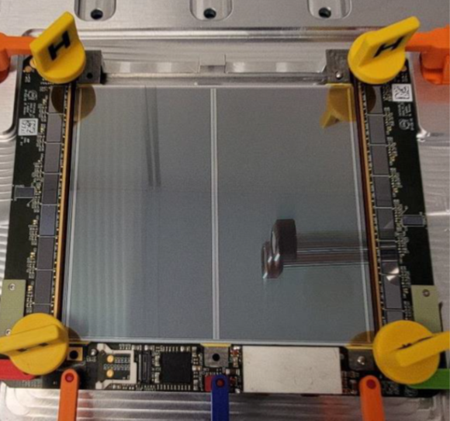
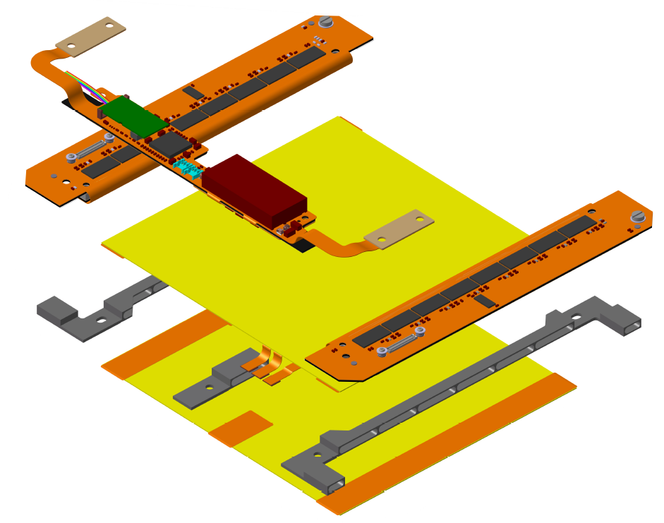
CMS Module (2S variant)

Slide 13
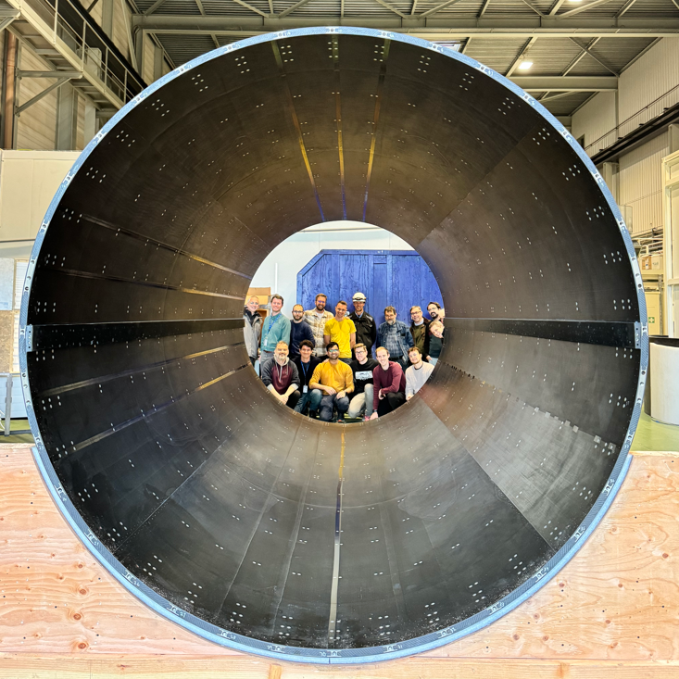
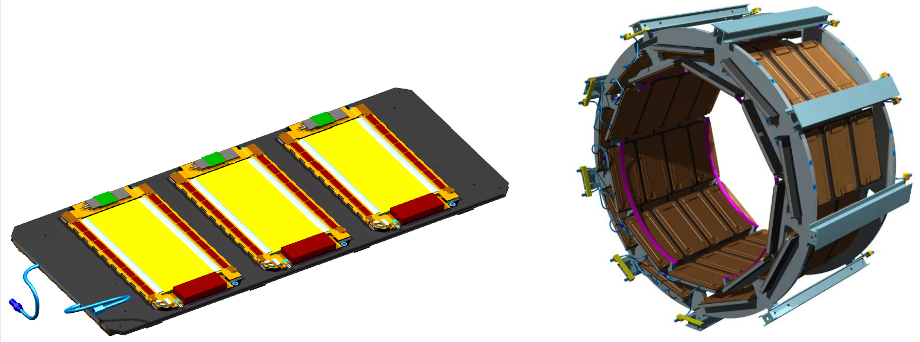
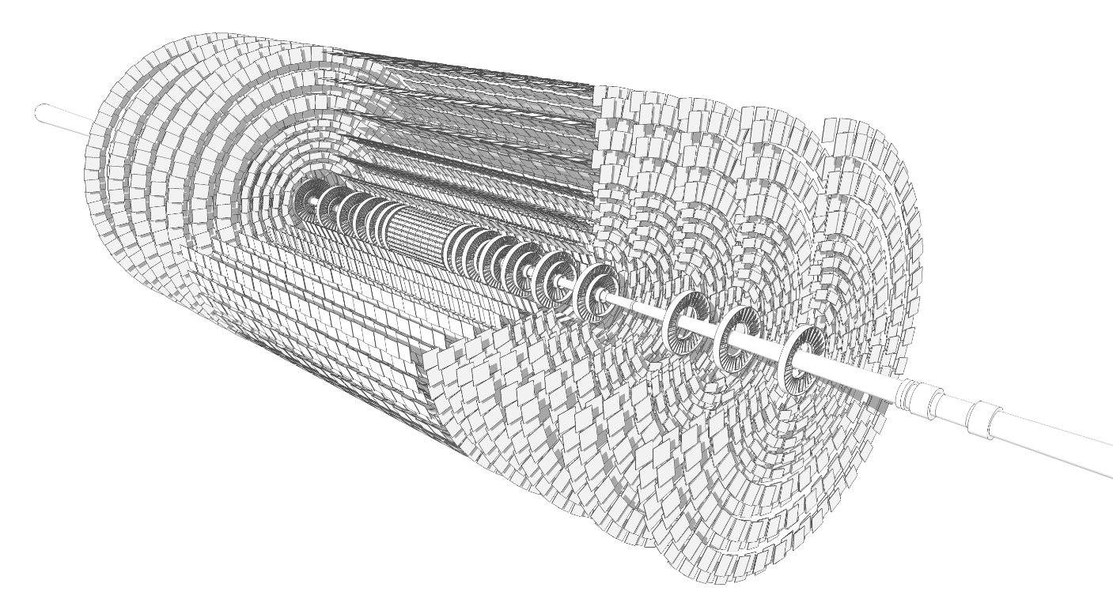
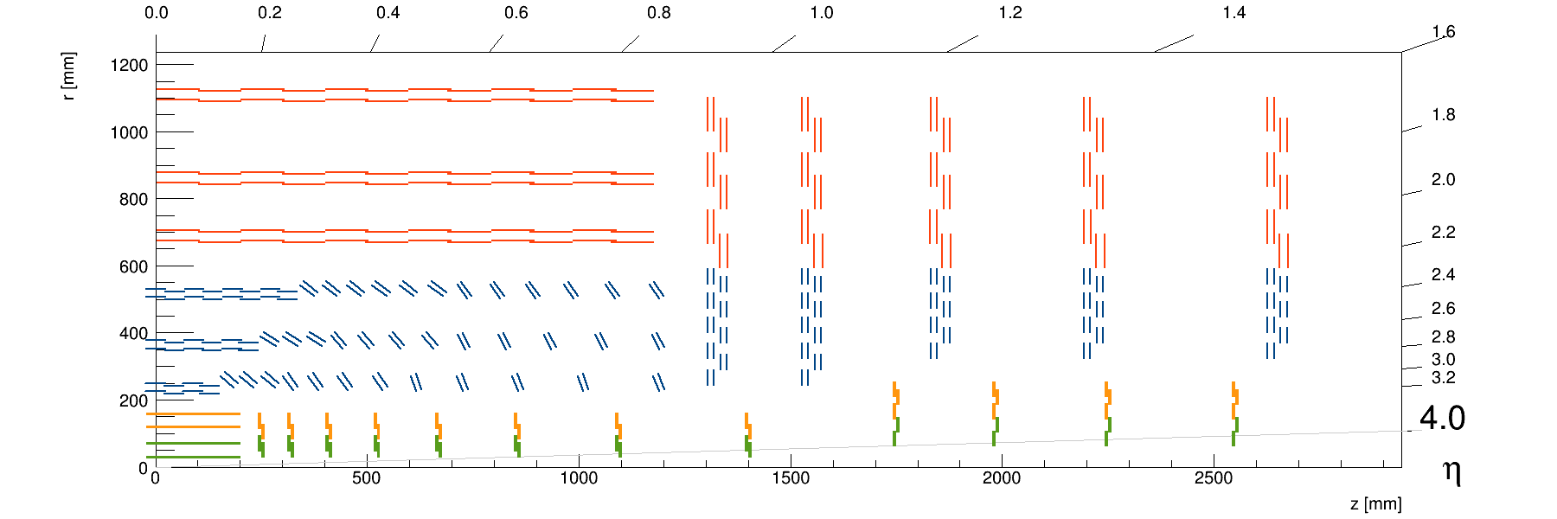
HL LHC Upgrade Tracker
5.3m
Outer Tracker
Inner Tracker
TB2S
TFPX
1.2 m
TBPX
Endcap Disks (TEDD)
TFPX
TEDD
TEPX
Barrel TBPS
Tilted TBPS
Barrel Cylinders
Inner TBPS
Outer TB2S
TBPX
TFPX
TEPX
Endcap Disks (TEDD)

Slide 14
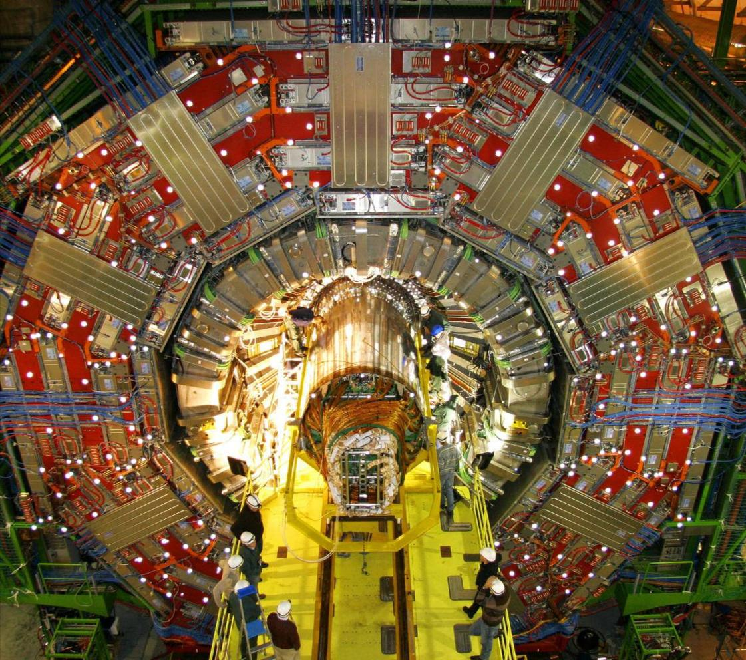
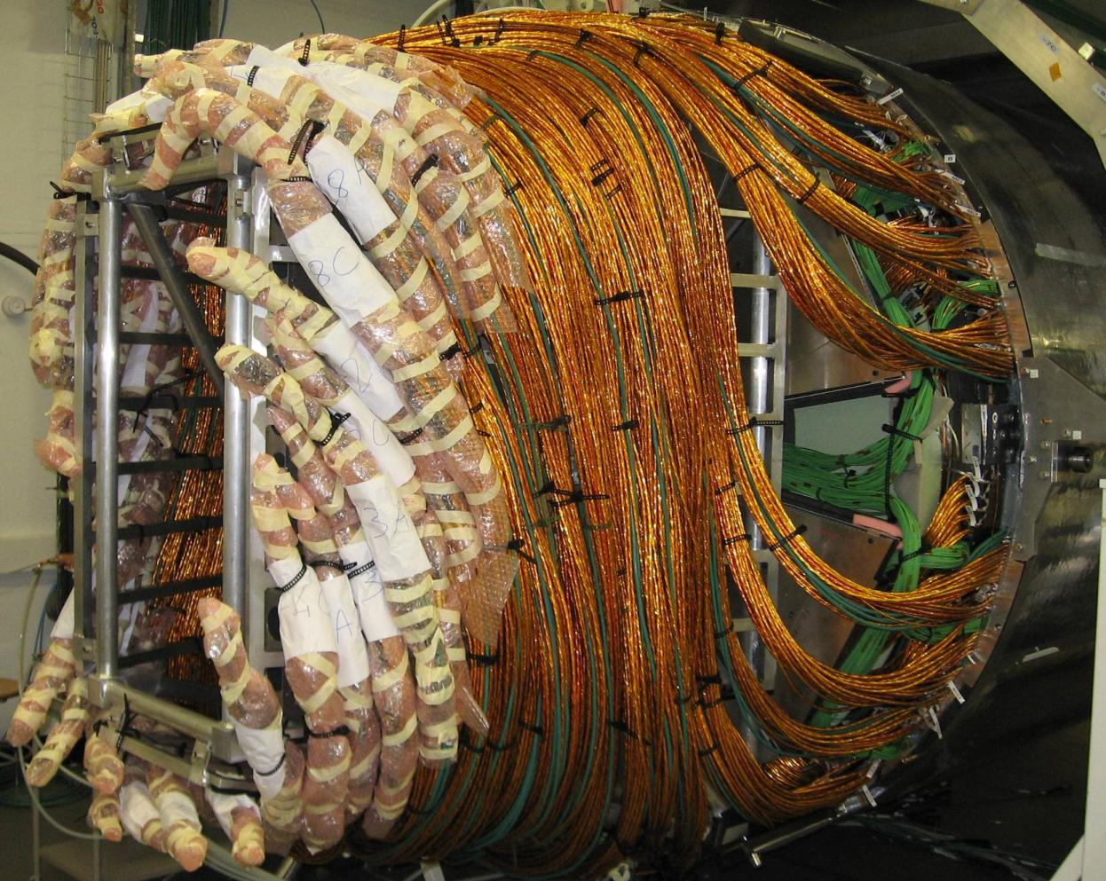
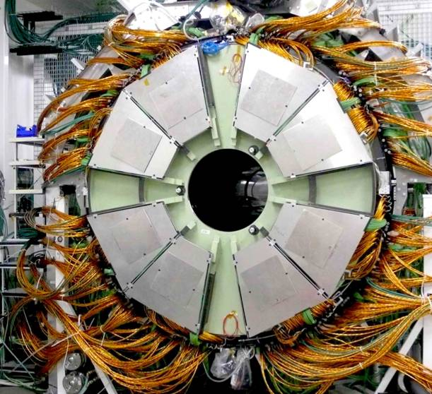
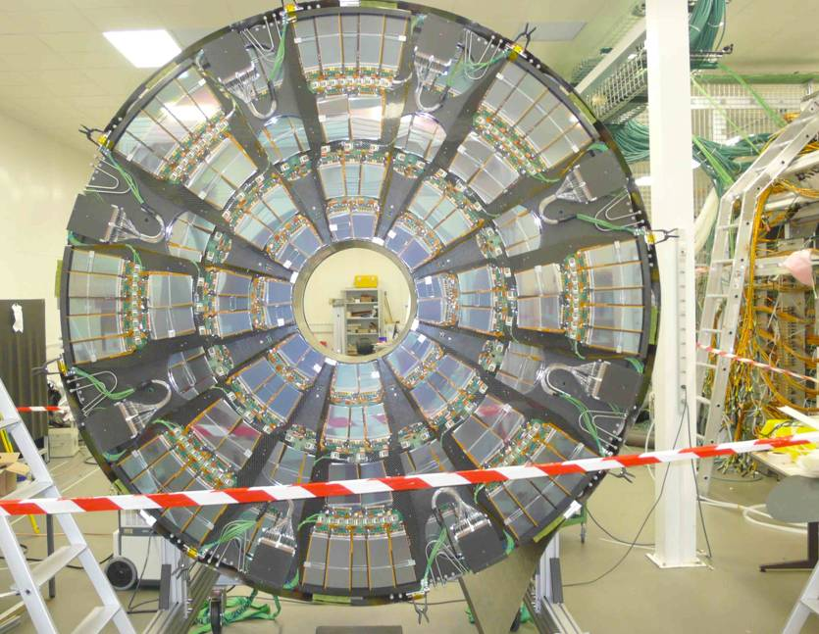
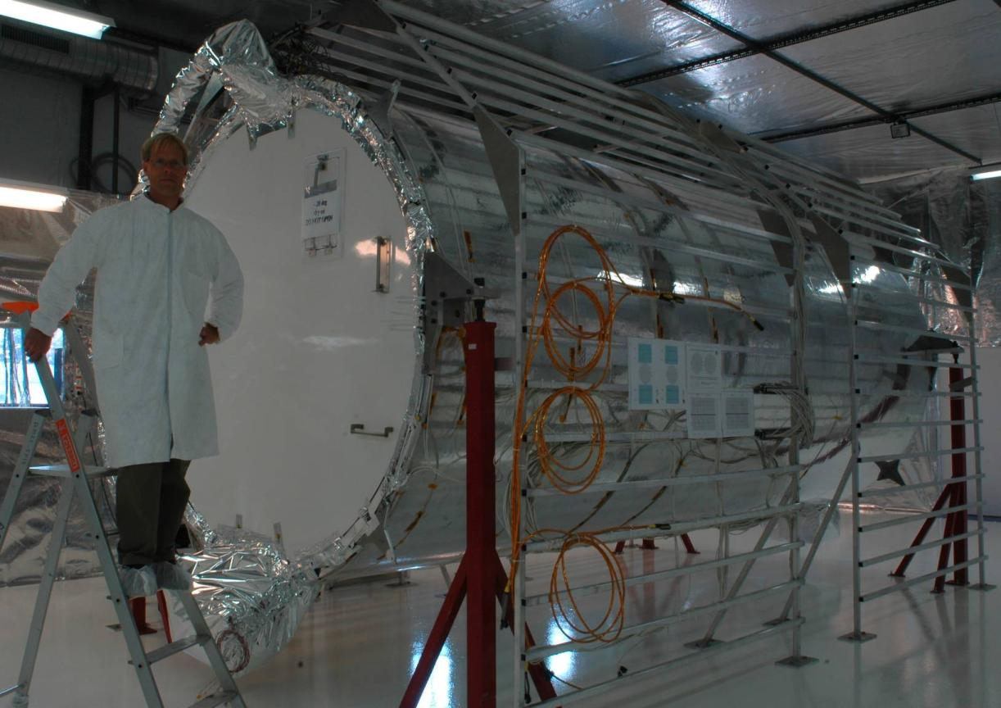
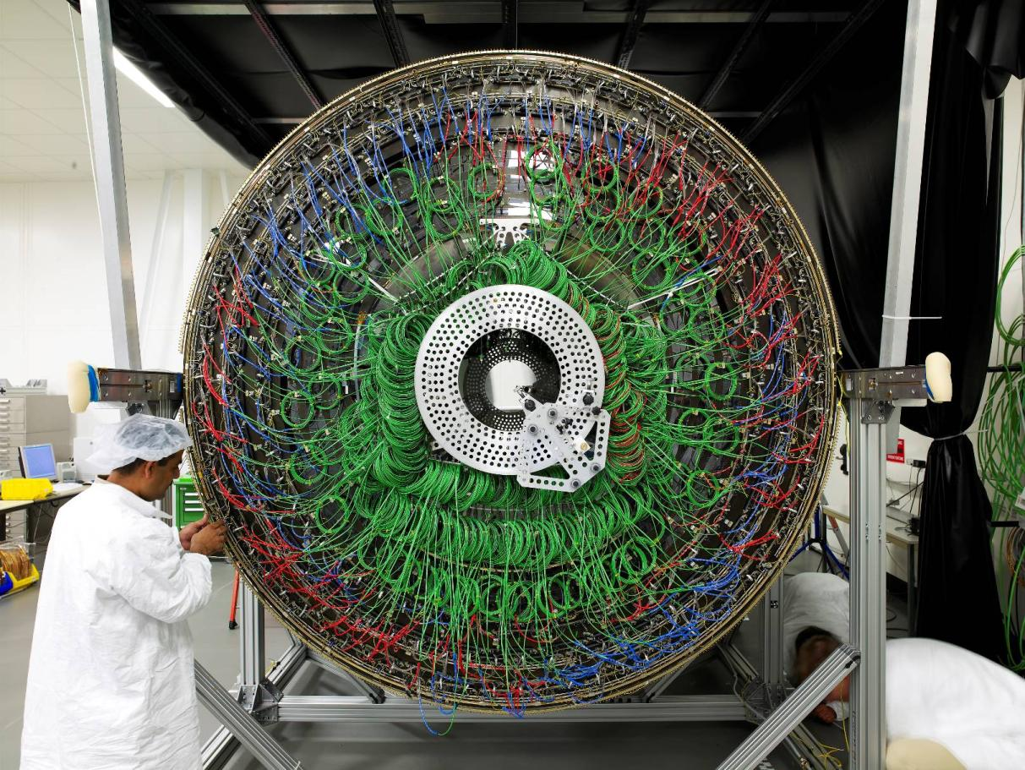
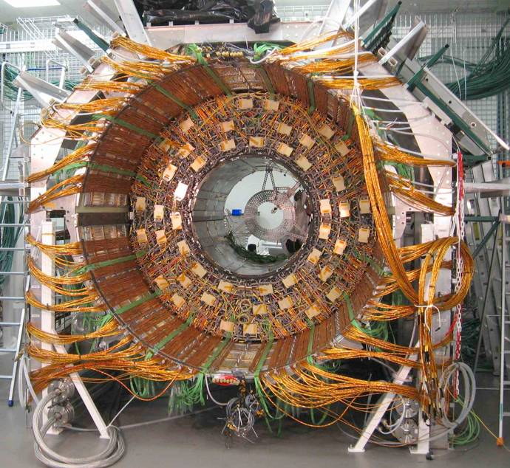
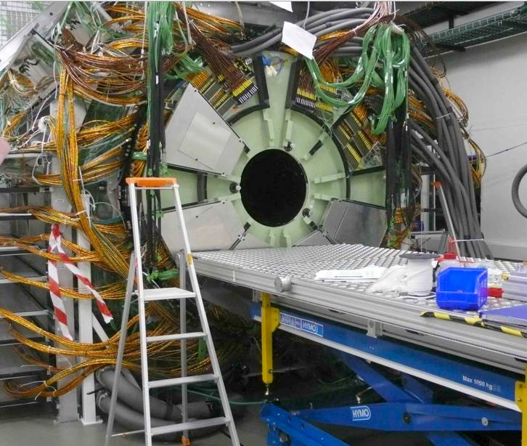
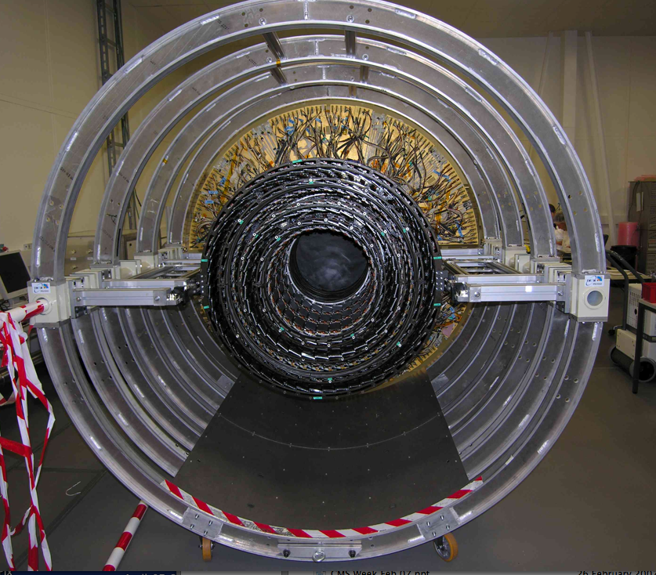
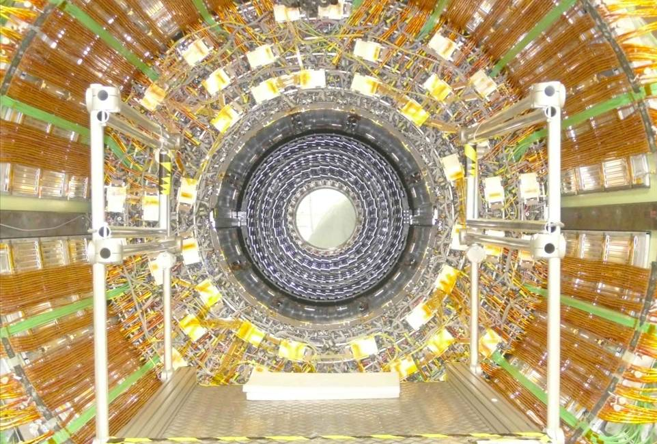
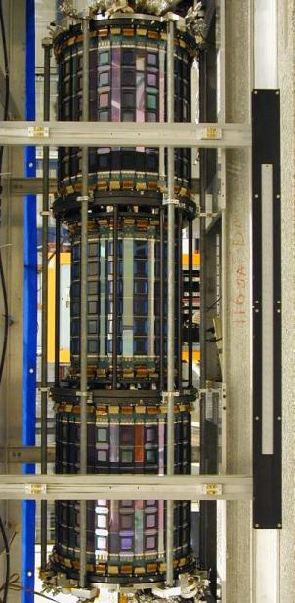
Legacy Tracker Evolution in Pictures
June 2005 – Support Structure
ISL of CDF
Aug 2006 – TOB integration
Oct 2006 – TIB integration
– TOB insertion
S Nahn
CMS TOB support
Dec 2006 – TIB Insertion
– TEC+ Arrival
Feb 2007 – TEC+ Insertion
March 21 2007 – Tracker Done
TIF Cosmics Slice Test
TK Packing – August 2007
TK Delivery – Dec 2007
Notes:
Here’s a timeline of the CMS tracker In Sept 2005 when I joined, they were still building the device…

Slide 15
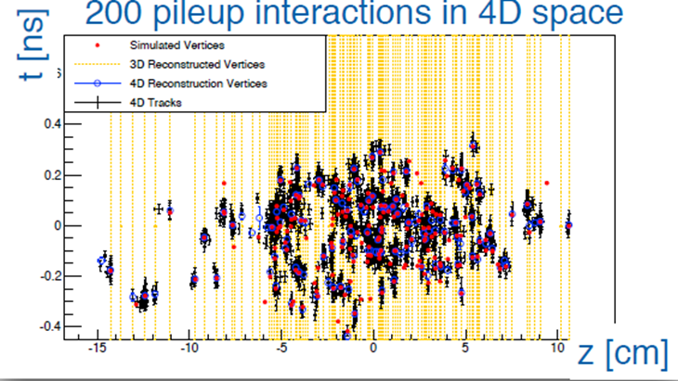
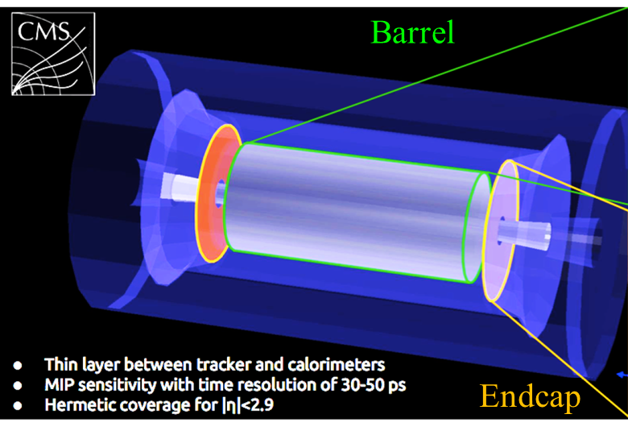
Latest wrinkle – the Quantum Worldline Detector©
Add Timing!
  Past – dedicated Time Of Flight detectors, mostly used as Particle ID if β < 1
    ~Uncorrelated with track measurements
  The future: “Exploiting the 4th dimension”
    Tracks that overlap in space are separable in time – can reduce confusion in event reconstruction (LHC – “pileup”)
      Also useful in traditional particle ID
    LHC
      One or two layers, Large coverage with ~ 30 ps timing resolution, ~mm scale position resolution
    QWD© : every track hit will include timing information

Slide 16
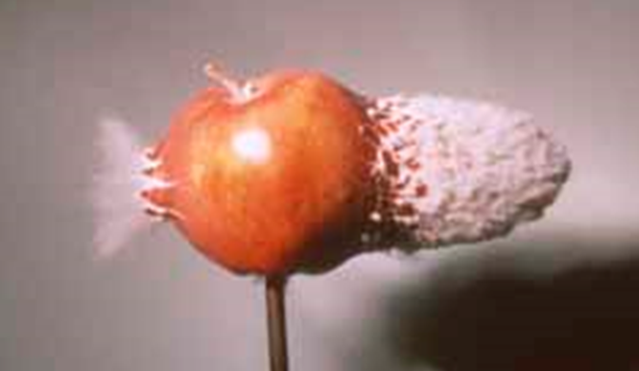
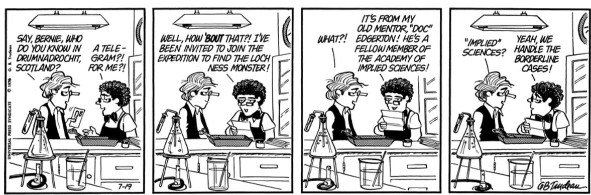
Calorimetry
Thanks, Doc Edgerton

Slide 17
Calorimetry
Basic Idea:
Interactions create shower of lower E particles
  Longitudinal and Transverse Containment of shower necessary
    Penetration depth depends logarithmically on incoming Energy
      At some point (“Shower max”) particle production no longer possible, shower stops propagating
  Response depends on absorber material properties for electromagnetic/hadronic interactions – which have distinct length scales
    X₀ – Brehmsstrahlung, λ_{pair} – pair production, λ_{I} – nuclear interaction
      Hadronic vs EM Calorimeters: Discriminate hadrons vs e,γ: X₀, λ_{pair} vs. λ_{I}
  Shower measured by scintillation light, Čerenkov radiation, or ionization
  ~ Counting # of secondaries: Poisson statistics
    Calibration in test beam and in situ is crucial for understanding resolutions
  Use in trigger requires fast response
Two types
  Homogeneous Calorimeters: Crystals, Noble Fluids - absorber = detector, typically better resolution, $$$
  Sampling Calorimeters: Sandwich of absorber and detector

Slide 18
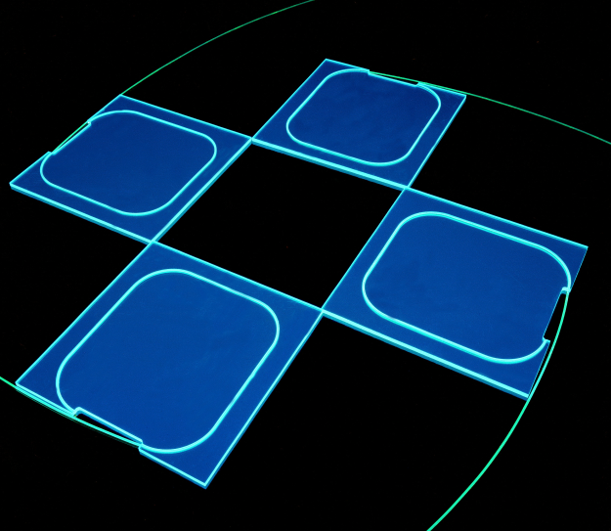
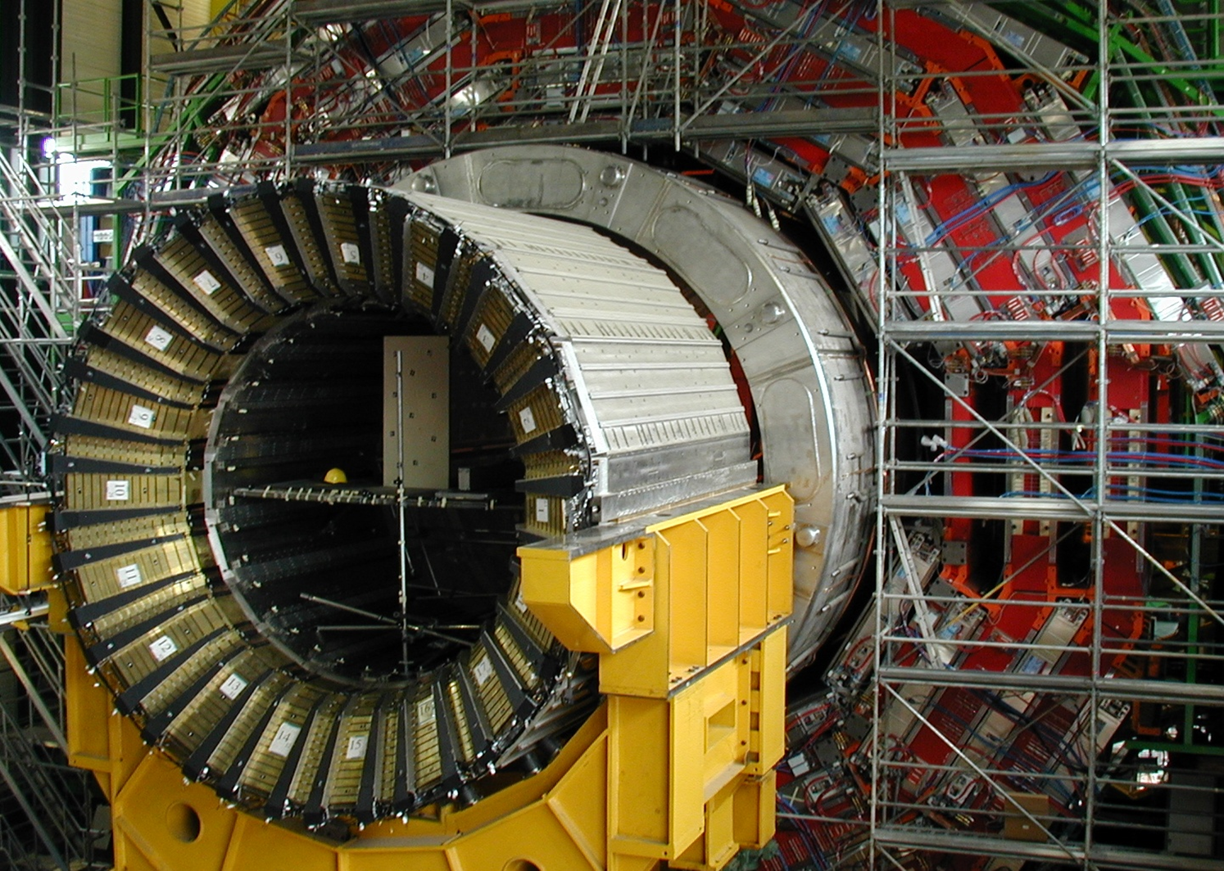
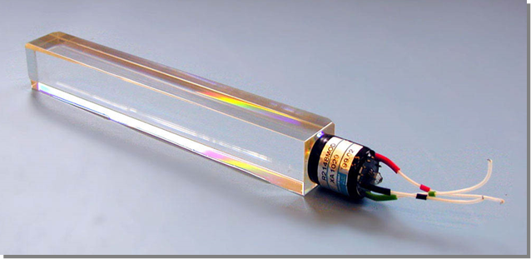
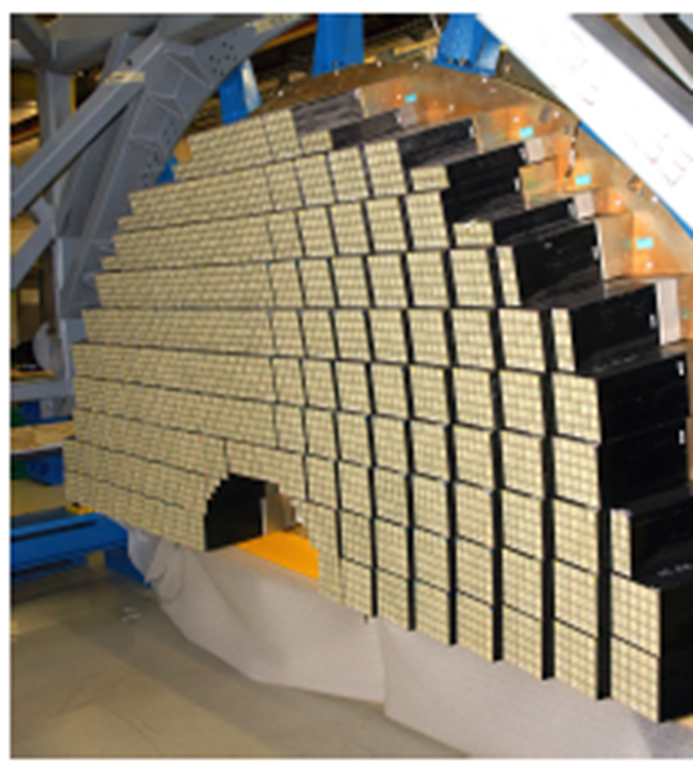
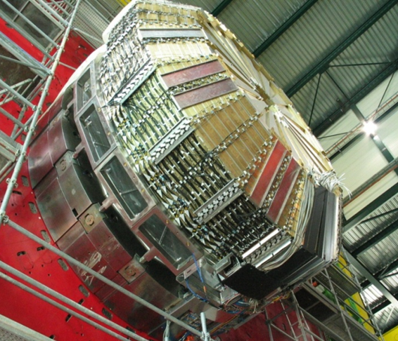
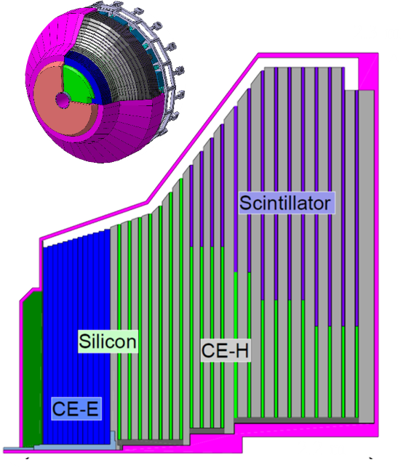
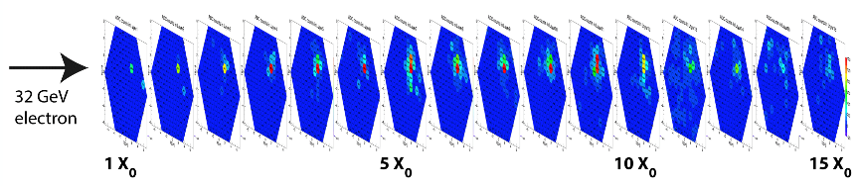
Some Calorimeters
Tile Scintillator with wavelength shifting fibers
Sandwiched between Brass Absorber recycled from 70mm artillery cartridges
PbW0₄ 2.3x2.3.23 cm³, 3 lbs
76k of these in CMS
Upgraded CMS Endcap
Imaging Calorimeter
EM and Had combined
Much higher granularity
All at -30° C

Slide 19
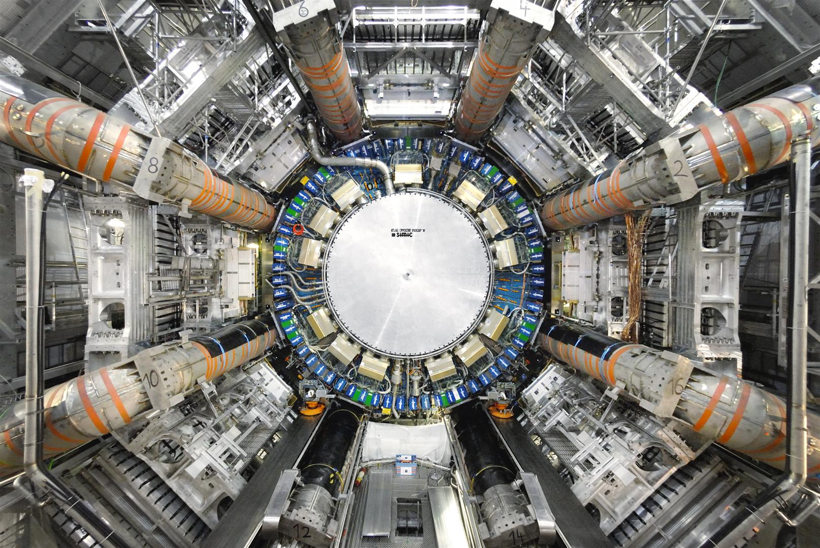
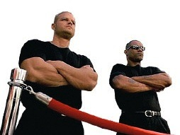
Muon Chambers
Information on the ATLAS Muons Spectrometer

Slide 20
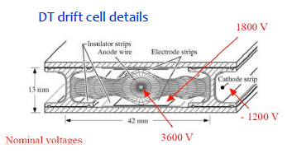
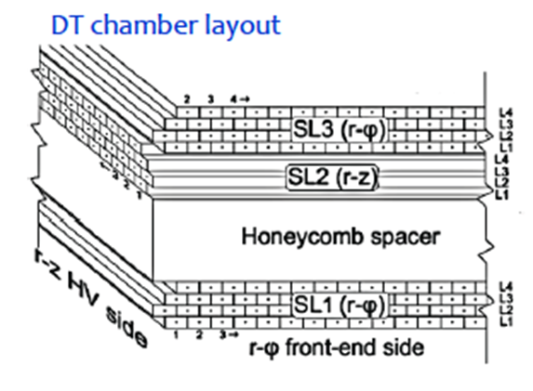
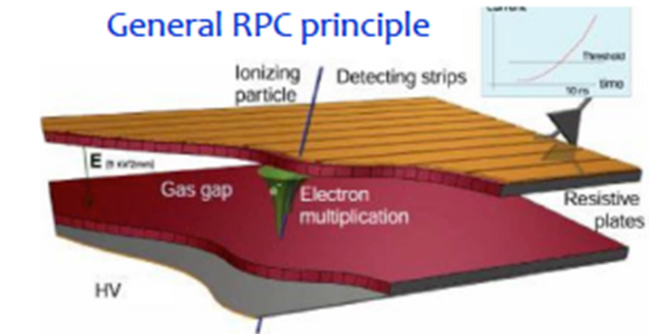
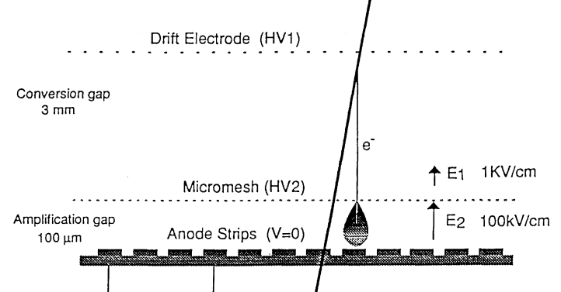
Muon Chamber Cornucopia
Essentially Tracking Detectors but cover large areas, outside of absorbers which catch “everything else”
  Mu2e - uses magnetic chicane to separate muons from other stuff
Many variants depending on gas amplification range – how much drifting before amplification
  Drift Chambers or Drift Tubes
    Time of signal + known drift velocity gives position
  Cathode Strip Chambers
  Resistive Plate Chambers
    High amplification produces spark – very fast
  Gas Electron Multipliers
  MicroMegas

Slide 21
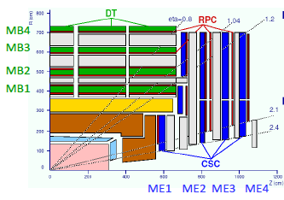
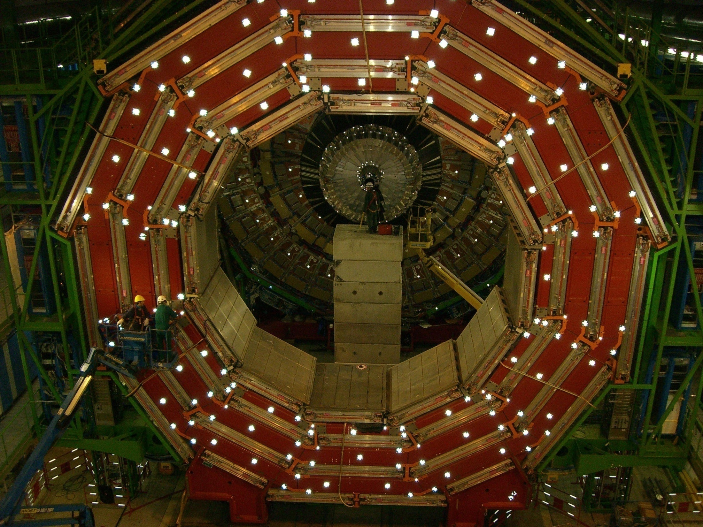
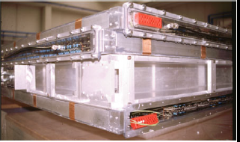
CMS Muon Chambers
8
4
0
0 2 4 6 8 10 12

Slide 22
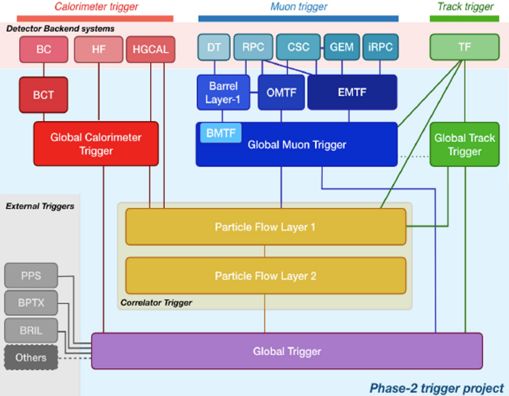
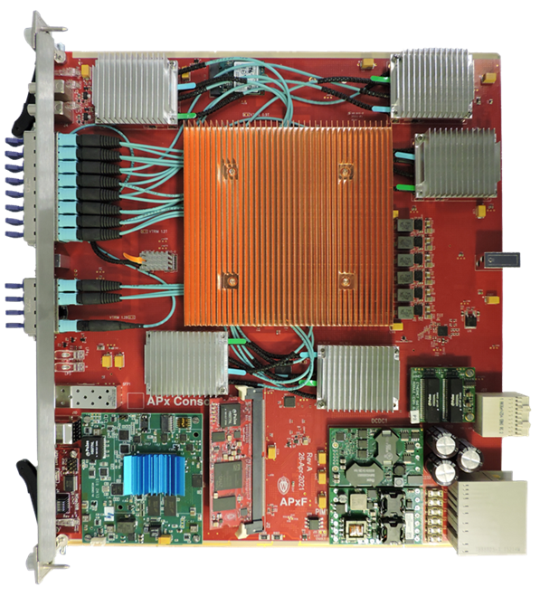
Triggering and data acquisition
The Problem
  40 MHz beam crossings × ~25 interactions/crossing = 10⁹ events/s
  Beam crossings generate ~1 MB of data or 40 Terabytes/s
  Can Record ~1 kHz → 1 GB/s ⇒ tens of Petabyte/year
  Need to reject 99.9998% of events in quasi real time
The Solution
  Level 1 (L1) Hardware trigger finds jets, electrons, muons, and missing E_{T} using only calorimeters and muon detectors and rejects 99.8% of events in 3.2 μs
    HL LHC - including tracking, correlator, 12 μs latency, 28 Gbps throughputs, much larger processors
    “High Level Synthesis” → Physicists write Firmware!
      AI/ML techniques infiltrating L1T algorithms
  High Level Trigger (HLT): Surviving 100 K Crossings/s of events fed into several thousand CPU core farm where events are reconstructed using full detector including tracking and <1% kept
    Latest rage: CPU/GPU/FPGA mixing to increase throughput
Massively parallel high throughput DAQ system

Slide 23
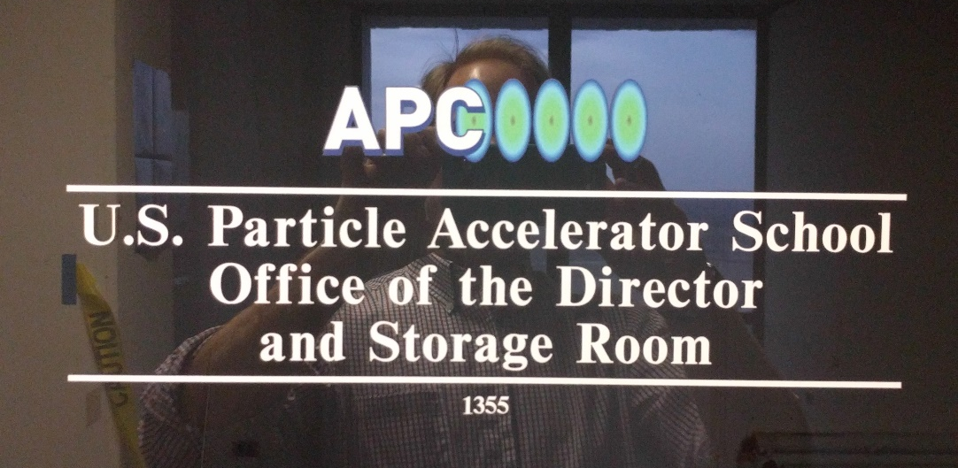
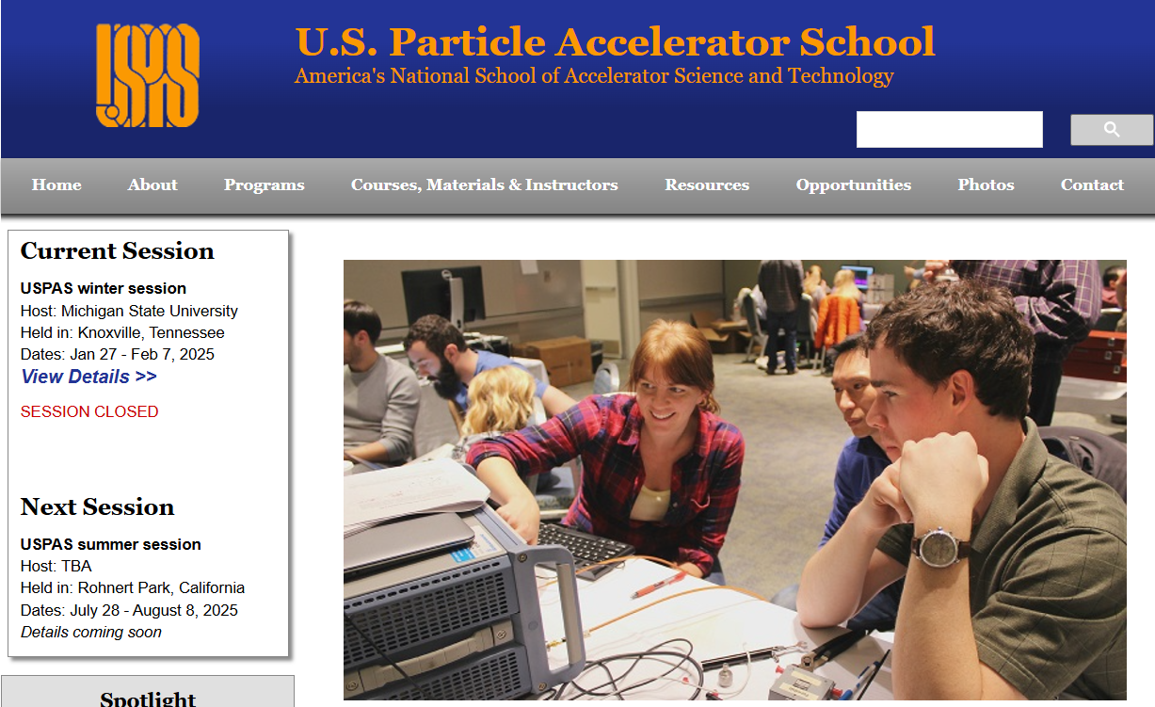
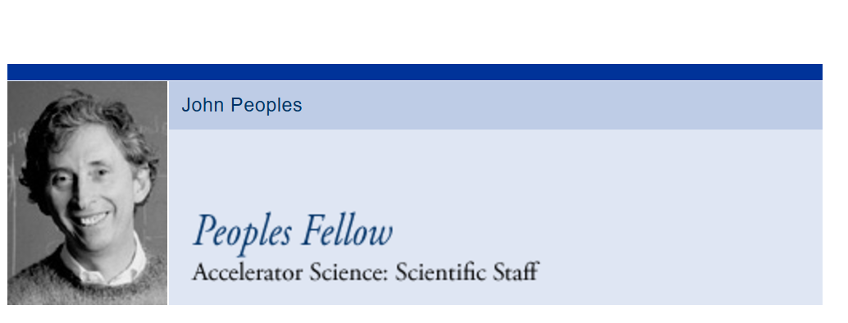
The unmentioned
A source of particles, often an Accelerator system
  See uspas.fnal.gov
Infrastructure and Environmental Controls
  Power supplies, Cooling infrastructure, Temperature and Humidity monitoring, Interlock Safety System
  Detector Magnets
    NB – taking these “mundane” topics for granted is by far where much of the problems come from
Software
  Control/Configuration/Montoring of Detector elements
  Offline Reconstruction and Analysis
Operations
  Everything the builders forgot! This is another fertile field for gaining experience
    But it is getting it “the hard way”

Slide 24

What could go wrong?
Did you ever read “Choose your own Adventure” books?
  Lorentz Forces in your tracker
  Quench protection issues in your accelerator
  It’s always the plumbing
  Current pulses from your ASIC
  Stories in the making (no slides)
    Detector decay 6 months after installation
    Ripples and fissures in your silicon
    Extensive testing backfires
  Just conclude

Slide 25
Instrumentation is Crucial
The quality of detector you produce dictates more than anything else the quality of the measurements you can make
  Often a clear link between ground-breaking measurements and new technologies
The extraordinary measurements we make result from blood sweat and tears over the details of the apparatus we build and then use
  This is every bit as much a part of “Physics” as writing the code to make the final analysis fit
    But is not treated that way, to the detriment of our field
The art of experimentation is endangered, and (though I tried) is not really accessible via a talk
  it is something that must be done first hand
    Two week school is a good start, but just the beginning
  Opportunities are rare – seize them!

Slide 26
Go Build It

Slide 27



The b Physicist’s tool: Silicon detectors
11 cm
1 m
SVXII: 5 double-sided layers
  3d hits, added z coverage, trigger
ISL: 2 outer layers
  Forward tracking, Link to COT
¾ million channels of Silicon
  Data Volume = 1.5 MB * Occupancy

Slide 28




Boink! Blocked Cooling lines
2001 Blockage of 12 Al lines stopped operation of CDF ISL
  Boroscope shows epoxy seal beyond elbows
  Some both inlet and outlet
  Noticed well after installation

Slide 29


ISL Laser Roto-rooting
40W Nd/YAg Laser opens 11 of 12 lines
  Prisms used to fire laser around corner
  Targeting technique
    PMT on fiber measures reflections after pulsing laser
    Epoxy burn signal distinguishable from that sidewall reflection
Moral: Boring Infrastructure Matters
  (Same for power systems)

Slide 30


Boink! Pickup on L00 signal cables
Noise on analog signal cables
  Largest pickup at edges of cables
  Coherent and incoherent sources
    Noise shapes
    Pedestal shifts
Solution: Offline Pedestal Fit
⇒ L00 in READALL mode
Cable 2
Cable 1
Hybrids
Radio CDF.
Wide Sensors
Signal Cables
Narrow Sensors
Notes:
One of the first issues that came up

Slide 31

Consequence of L00 Noise
L00 in READALL mode forces rest of Silicon to run at its speed
  It is always done last
Readout duration no longer subject to fluctuation
L2 trigger waiting on data it doesn’t use
L00 (read all)
SVXII
All
ISL
Readout time
(last done)
L1A
DIG
φ
SVXII z
ISL z
RO
L00
L2D
Long Wait!

Slide 32
The Fancy Trigger System
Information Available
Tracks (pt,φ)
Calorimeter energy
Muon stubs
Silicon displaced vertex
Cal Energy-track match
E/P, EM shower max
Multi object triggers
“Deadtimeless” ⇒ simultaneous acquisition and readout
  Optimal use is to always have an event pending

Slide 33


Find Bs with Displaced Track Trigger
Distinguish hadronic B decays from generic hadron decays by lifetime
  Avoids neutrino penalty ⇒ Better proper lifetime resolution (boost)
How: Secondary Vertex Trigger (SVT) in the L2 decision
  SVXII rφ ⊕ L1 Track information, fits tracks at 20 kHz
  L2 Processor combines tracks, looks for displaced vertices
Requires SVXII information at L1A rates
Β
y
x
Notes:
Add cute picture for impact parameter explanation

Slide 34


BOINK! Resonant Readout
2003: Certain DAQ components fail
  Jumpers: carry power, signals to/from r-ϕ and r-z chips
  DOIMs: laser diodes send data off detector
Both consistent with power line failure
  Aging vias?
    Accelerated aging shows no problem
  Fusing Bonds?
    Not enough energy in capacitors
  Lorentz Forces
    Huh?

Slide 35




Lorentz Forces on Wirebonds
Incident: correlates failure with synchronous high rate readout conditions
Ansatz: Lorentz force driven oscillation
  I(Occupancy) x B ~ 100 mA x 1.4 T ⇒ 25 mg
  ⇒ ~4 μm on a 25 μm AlSi wire
  Can be driven into resonance at ~ 15 kHz
  Bond heal breaks in characteristic fashion
    Matches IEEE literature: ultrasound induced damage
B
I_{pp} ~ 160 mA
φ
B
z

Slide 36




Task Force on Resonating Wirebonds
Create Abnormal operating point
⇒ fixed interval + high current
  Resonances prevalent
High Q, few kicks induce oscillation
Ladder damage reproduced
Free decay of the motion
  Amplitude [A.U.]
40 pulses in a row
Notes:
Mention effort involved

Slide 37


The insidious conspiracy
L00 in READALL dangerous to the detector
  Separate readout control for L00/ISL from SVXII
    SVXII driven by varying occupancy
    L00/ISL → After L2A so 300 Hz - no resonance danger
Also benefits the trigger
  Occupancy and various improvements available only to SVXII
L1A
DIG
RO
φ
SVXII z
DIG
RO
φ
L00
ISL z
Big Gain!

Slide 38
Other Mitigation
Preliminary reaction
  Administrative limit on L1A rate (gut reaction) and testing
    First incident due to unforeseen race condition exposed by new configuration
  Reduction of current though wire bonds
Implementation of hardware resonance protection
  Count consecutive equal time intervals, pull brake if count > n
  ⇒ No failures since implementation
  Adopted by both ATLAS and CMS (more detectors in B field)
Morals
  Test at expected operating points in the expected environment
  In the end, detector does not factorize into individual subdetectors – complex yet subtle correlations abound

Slide 39


The Large Hadron Collider
Proton - Proton Collisions
Initially: 10⁶ events/s, 7 TeV
Eventually: 10⁹ events/s, 14 TeV
(Heavy Ions
5.5 TeV/nucleon)
`
Notes:
Instead of a new collider, we’ve focused our attention on a recycled 27 km ring at a lab called CERN in Geneve Switzerland, possibly because of the proximity of the Alps.
This is the location of the Large Hadron Collider, where they will collide protons at 14 TeV, the largest Energy collider ever, starting at one million collisions per second, hopefully reaching one billion collisions per second.
In addition, the same sort of Heavy Ion Collisions at the RHIC will take place here, albeit at energies 50 times higher

Slide 40



Slide 41


Slide 42




September 11 2008 things look good…
21:20
Debunching in ~ 25ns x 10 turns w/o RF
21:26
First RF at wrong injection phase
21:38
RF at corrected phase
21:43
RF at optimal phase

Slide 43

Sept 19, 2008: Catastrophe!
Splice in one of 10000 interconnections between two magnets failed

Slide 44
Disaster waiting to happen…
Several factors collude in catastrophe
  300 × (0.3 nΩ)
    Reproducible ONLY with no solder or no induction braze
    Splice not monitored for ΔV
  Cooling circuit in “closed loop”
    Continuous demand for more cooling power during incident went unnoticed
  Superfluid ⁴He high K_{T}: little temperature change, then huge
Connection broken
  Magnetic circuit carrying ~ 100 MJ interrupted

Slide 45

Breaking an Inductive Circuit
Above: 12 H solenoid at 30 A ⇒ 3.6 kJ
LHC Dipoles: 154 × 0.11 H at 9 kA ⇒ 680 MJ

Slide 46


A Series of Unfortunate Events
Arc: He at 1.9K ⇒ Insulation vacuum (Room T)
Relief Valves overwhelmed - 30 tons on Vacuum Barriers

Slide 47

1 Year Repair campaign
54 Interconnects
repaired, 150
reworked
4 km of
beampipe
cleaned
14 Quads
replaced
39 Dipoles
replaced
New restraint
for 50 Quads
~900 new pressure
release ports
~6500 new detectors +
250 km cables for MPS

Slide 48
Silent Killers
Magnet
Magnet
Further Analysis ⇒ problems with bus bar connectivity
Resistance and decay time limit safe current and therefore Beam Energy
2013-14 Shutdown to go higher in E
Splice
Bus bar
Bus bar
Superconductor
Maximum Safe Current (A)
5 TeV
4 TeV
Residual Resistance (μΩ)

Slide 49


High Rate Validation at TIF
Goal: Verify performance near realistic operation point
Means: cobble together slice of CMS DAQ system
to RUBUFU
Myrinet Switch crate
Myrinet data flow
Transition cards in back of FED crate
S-LINK data flow
FRL/FMM CPCI crate
FMM control flow
Notes:
Pretty pictures of hardware. Point is that in contrast to the current operation, data flows out of the back of the FED crate on left, then into the FRLs and through the Myrinet switch to the proxy HLT. In addition, there is real Flow control via the FMMs which is not present in the VME system.

Slide 50

Event Data Flow - Normal
BTW – work of K. Hahn,
Wednesday’s lecturer,
when he was a postdoc
Now he’s the head of the CMS tracker

Slide 51

Event Data Flow - Prescaled
BTW – work of K. Hahn,
Wednesday’s lecturer,
when he was a postdoc
Now he’s the head of the CMS tracker

Slide 52


TIF High Rate testing
Noise data at up to 100 kHz
  Spikes in occupancy, growth cluster size at > 20 kHz
  On all APV25 chips simultaneously
    Absent during single component tests
    Makes pattern reconstruction unfeasible

Slide 53



Diagnosing high rate noise
Read – all mode, prescaled
  ⇒Strong anticorrelation between edge channels
Pronounced dependence on trigger spacing
0.3
Chip 1
Chip 2
2nd Acquisition position
Occupancy
1st Acquisition:Header Data
Strip

Slide 54



Underlying Cause
Symptoms confirmed on bench
  Signal processing sequence includes switches in APV25 during readout

Slide 55

Resolution, Consequences
High Rate noise source from APV25 readout cycle
  Switch operation in readout cause current pulses
  Pulses magnetically coupled via power lines
    Tracked down via geometry plus selective destruction
Effect on Tracking
  Infrequent: Data Volume not the problem
  Pattern recognition in Trigger chokes
    Processing time → minutes

Slide 56



Mitigation
Mitigation via Chip Emulator
  Trigger veto on susceptible timing configuration
    Non-trivial thinking in multiple time zones
Minimize Deadtime
  n_{mask} = 2 ⇒ 0.5% at 100 kHz
Moral: We learn from the past!
  Too late to fix it, but running at high rate very valuable

