Slide 1
MQXFA test analysis for decision about testing all magnets vertically with only one Thermal Cycle Giorgio Ambrosio
AUP Mtg
September 25, 2024

Slide 2
Magnet | NC found in TC1 | NC found in TC2
MQXFA03 | 0 | 0
MQXFA04 | 0 | 0
MQXFA05 | 0 | 0
MQXFA06 | 0 | 0
MQXFA07 | 1 | N/A
MQXFA07b | 0 | 0
MQXFA08 | 1 | 1
MQXFA08b | 0 | 0
MQXFA10 | 0 | 0
MQXFA11 | 0 | 0
MQXFA13 | 1 | N/A
MQXFA13b | 0 | 0
MQXFA14b | 0 | 0
MQXFA15 | 0 | 0
MQXFA17 | 1 | N/A
TOTAL | 4 | 1
Detection rate | 100% | N/A
Legend:
NC = Non conformity
Black: Magnet met requirements
Red: Magnet did not meet requirements
1 = NC detected
0 = No detection of NC
N/A = TC2 was not done
Conclusion:
All magnets that showed limited test performance during vertical test were identified during the first thermal cycle (TC1)

Slide 3
Magnet | Number of quenches in TC1 | Number of quenches in TC2 | Number of quenches in TC2 | Comments
MQXFA03 | 10 | 0 | 0
MQXFA04 | 6 | 0 | 0
MQXFA05 | 8 | 0 | 0
MQXFA06 | 20 | 0 | 0 | Training at 4.5 K up to quench#12
MQXFA07 | 14 | N/A | N/A
MQXFA07b | 0 | 1 | 1 | 4 trips and 1 quench at 4.5 K in TC2
MQXFA08 | 18 | 5 | 5 | 2 quenches in superconducting leads during TC1; issue with splice to top-head fixed before TC3
MQXFA08b | 6 | 2 | 2
MQXFA10 | 19 | 0 | 0
MQXFA11 | 14 | 0 | 0
MQXFA13 | 32 | N/A | N/A
MQXFA13b | 16 | 0 | 0 | 1 trip
MQXFA14b | 5 | 1 | 1
MQXFA15 | 2 | 1 | 1 | 3 trips
MQXFA17 | 21 | N/A | N/A | 2 trips
Summary w/o re-assemblies:
TOTAL # of quenches | 169 | 7
Average # of quenches/test | 14 | 0.8
Max | 32
Min | 2
Conclusion:
Average number of quenches for new magnet training: 15

Slide 4
By Anis Ben Yahia

Slide 5
By Anis Ben Yahia

Slide 6
By Anis Ben Yahia

Slide 7
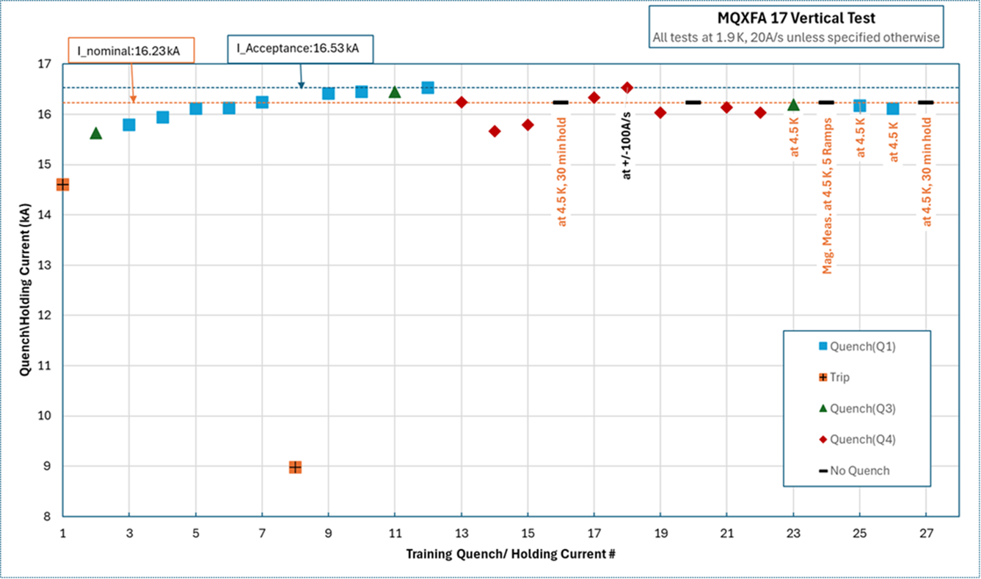
By Febin Kurian

